Slide 1
Police and Crime Plan 2021-2024
Monthly Performance Update
July 2023
National and MSG positions are to 31 May 2023 (Essex Police data are to 31 July 2023).
Version 1.3
Produced August 2023
Performance Analysis Unit, Research & Analysis Department, Essex Police
Sensitivity: Official

Slide 2
Executive Summary
The Police and Crime Plan 2021-2024 was introduced in April 2021, with new measures that reflect the Essex Police, Fire and Crime Commissioner’s (PFCC) strategic commitment to targeted prevention and early intervention. In December 2022, the Chief Constable of Essex Police and the Police, Fire & Crime Commissioner for Essex agreed that more measures should be included so a more holistic and rounded view of the Force’s performance against the Police and Crime Plan could be provided.
Five of the twelve PFCC Priorities have been given a recommended grade of ‘Good’: 2 (Reducing drug driven violence), 3 (Protecting vulnerable people and breaking the cycle of domestic abuse), 4 (Reducing violence against women and girls), 6 (Protecting rural and isolated areas) and 7 (Dog Theft). Five have been given a recommended grade of ‘Adequate’ and two have been given a recommended grade of ‘Requires Improvement’: 5 (Improving support for victims of crime) and 9 (Improving safety on our roads).
There have been no changes in the recommended grades since the previous month’s report.
Confidence (from the independent survey commissioned by Essex Police) was at 72.4% for the 12 months to June 2023. Although confidence decreased by 5.5 percentage points compared to the 12 months to June 2022 (77.9%), confidence is 7.7% points higher than it was in the 12 months to December 2019 (64.7%). The 12 months to December 2019 was the last full year (and last full financial quarter) in which society, crime and policing was not affected by the pandemic. Although confidence in the local police has deteriorated significantly compared to year ending June 2022, forces contacted by Essex Police reported patterns similar to Essex Police: confidence was high during COVID, but has been in general decline ever since (the last two quarters especially have seen significant decreases).
There was a decrease in All Crime (5.1%) and Rural Crime (5.5%). When compared to the 12 months to December 2019, All Crime decreased by 5.7%; this equates to 9,621 fewer offences. For the three months to July 2023, All Crime fell by 10.1% whilst the solved outcomes fell by 8.2% and the solved rate increased by 0.3% percentage points compared to the three months to July 2022.
Business Crime increased by 8.3% for the 12 months to July 2023 compared to the 12 months to July 2022. This is due to an increase in Shoplifting offences; whilst the volume of Shoplifting is lower than the year prior to COVID, offence levels are rising year-on-year.
In the 12 months to July 2023, all Theft offences rose by 9.8% (4,209 more), compared to the 12 months to July 2022. This has primarily been driven by increases in Shoplifting (1,563 more), Theft of a Vehicle (981 more) and Theft from a Vehicle (690 more).

Slide 3
Executive Summary - continued
Essex experienced a 12.3% decrease (5,850 fewer) in the number of offences with a repeat victim for the 12 months to July 2023 (41,803 offences) compared to the 12 months to July 2022 (47,653 offences). Except for August 2022, the year on year increase in repeat victimisation has been reducing each month since March 2022.* The number of individual repeat victims decreased by 6.3% (1,442 fewer) for the 12 months to July 2023 (21,312 individual victims) compared to the 12 months to July 2022 (22,754 individual victims). It is of note that any over-recording of Stalking & Harassment offences (discussed on the next slide) will impact both the number of repeat victims and the number of offences with a repeat victim.
In June, HMIC released their annual State of Policing annual assessment of Policing in England and Wales**. Of the eight measures for which Essex Police were graded, three were graded at Good (Treatment of the public, Good use of resources and Developing a positive workplace), four as Adequate and one as Requires Improvement (Responding to the public). Essex also received a good grading on the effectiveness of Vetting and Counter-corruption in the force***.
Essex Police prides itself on having excellent Crime Data Accuracy (CDA). In its most recent inspection by HMICFRS, Essex Police was graded as Outstanding in relation to its CDA. Maintaining excellent CDA, however, requires the Force to neither under-record nor over-record offences. To this end, Essex Police is auditing and – where appropriate – cancelling Stalking & Harassment (S&H) offences to ensure additional crimes have not been unnecessarily recorded. Essex Police have also been educating those working within the Resolution Centre to ensure they fully research the individuals involved in these types of offences before they create new crimes; where previous records exist, these additional incidents are instead referred to the relevant officer(s) in order that they can be investigated together. This activity has therefore not only resulted in a decrease in offences since the start of the review (August 2022) but has enabled the Force to better coordinate these types of investigations. From 1 April 2023, a further 416 records have been reviewed as potential duplicate crimes and 118 identified for cancellation; of these, 69 records (58.5%) have now been cancelled.
In May 2023, national Home Office Counting Rules (HOCR) changed as regards Stalking & Harassment (S&H) offences. The “principle crime rule” now applies, meaning that only the most serious crime is recorded (previously, Stalking & Harassment offences were recorded as well as the more serious offence). This has resulted in fewer Stalking & Harassment offences being recorded. It is of note that Stalking & Harassment offences comprise the largest volume of Violence Against Women & Girls offences (VAWG) and account for 19.6% of all Domestic Abuse investigations. There were, for example, 3,230 fewer Stalking & Harassment crimes committed against females in the 12 months to July 2023 (13,686 crimes) compared to the 12 months to July 2022 (16,916 crimes).

Slide 4
Executive Summary - continued
Violence Against the Person (VAP) offences committed against females decreased by 11.7% (4,620 fewer) in the 12 months to July 2023 compared to the 12 months to July 2022. There was also a 7.8% decrease (383 fewer) in the number of sexual offences committed against females in these time periods. Essex Police additionally solved 34 more (12.7%) sexual offences committed against females in the 12 months to July 2023 compared to the 12 months to July 2022.
Comparing High Harm* offences to its Most Similar Group (MSG) by crimes per 1,000 population, Essex recorded the third lowest number of offences (out of eight police forces) for Other Sexual Offences and Violence with Injury, third highest for Burglary Residential and highest for Robbery of Personal Property and Rape.
There was a 5.0% decrease (45 fewer) in the number of those Killed or Seriously Injured (KSI) in Essex for the 12 months to July 2023 compared to the 12 months to July 2022. It is of note that road traffic safety is the responsibility of the Safer Essex Roads Partnership (SERP) which includes Essex Police, Essex County Fire & Rescue Service, Essex County Council, Southend on Sea Borough Council, Thurrock Council, National Highways, East of England Ambulance Service Trust, Essex and Herts Air Ambulance Service Trust, and The Safer Roads Foundation (Registered Charity).
Essex Police conducted 53 more OCG disruptions in the 12 months to June 2023 compared to the 12 months to June 2022***.
There were no statistically significant changes in the number of offences in July 2023.
Officer numbers were at 3,771 in July 2023, an increase of 133 from 3,638 in July 2022, but a slight decrease on the peak reached in March 2023**. Almost half of all Essex Police employees were female (48.1%) with female officers accounting for over a third of all officers (37.1%). However, Ethnic Minorities as a percentage of the workforce continues to fall, with a decrease in overall numbers in July 2023 compared to 12 months ago.

Slide 5
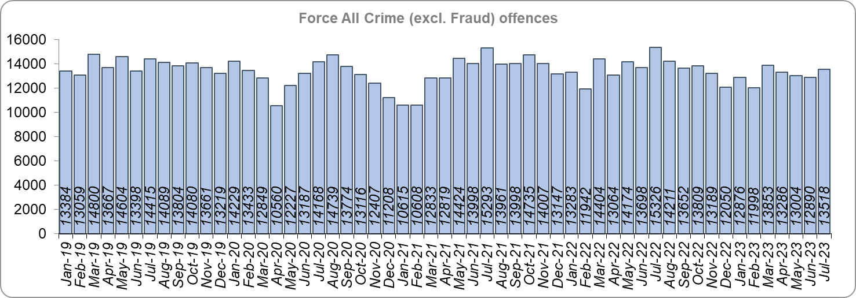
Priority 1 – Further investment in crime prevention
Grade: Adequate
There was a 5.1% decrease in All Crime in the 12 months to July 2023 compared to the 12 months to July 2022; this equates to 8,585 fewer offences. There was also a 5.7% decrease in All Crime (9,621 fewer offences) for the 12 months to July 2023 compared to the 12 months to December 2019. Essex recorded the sixth lowest volume of offences per 1,000 population out of the eight forces in it’s MSG at 87.4, which is above the MSG average.
Out of the eight forces in it’s MSG, Essex Police had the sixth highest number of Rape offences solved per 1,000 population and came 32nd nationally (out of 42 forces). For Rape offences recorded, Essex had the highest number per 1,000 population in its MSG and was 5th highest nationally.
13,518 offences were recorded in the month of July 2023, a decrease of 11.8% (1,808 fewer offences) compared to the month of July 2022 (15,326 offences).

Slide 6
Priority 1 – Further investment in crime prevention - continued
Grade: Adequate
The All Crime Harm (Crime Severity) Score* (14.1) decreased by 0.8 in the 12 months to May 2023. Essex has the seventh lowest Harm Score (out of eight forces) in its MSG and remains above the MSG average.
Please note:
* Crime Severity Scores (as calculated by the Office for National Statistics) measure the ‘relative harm’ of crimes by taking into account both their volume and their severity. As national data are only available to May 2023, the score for the 12 months to May for the preceding year has been included.

Slide 7
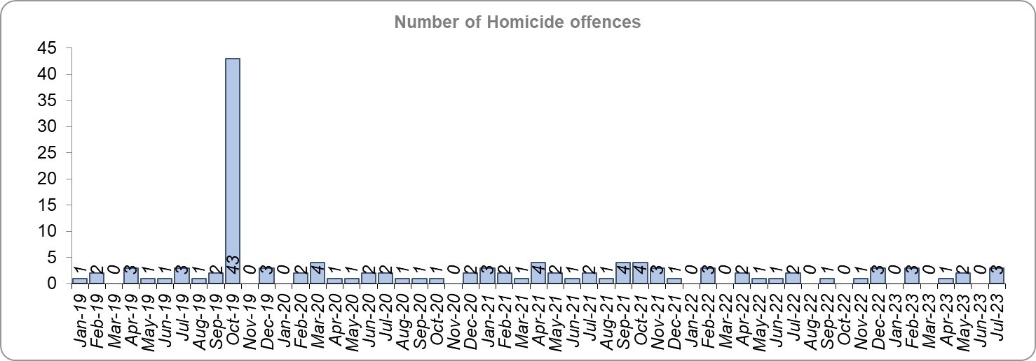
Priority 1 - Further investment in crime prevention - continued
Grade: Adequate
Ten fewer Homicides were recorded for the 12 months to July 2023 compared to the 12 months to July 2022, a 41.7% decrease.
The number of Homicides decreased by 77.0% (47 fewer offences) in the 12 months to July 2023 compared to the 12 months to December 2019.*
Please note:
* In October 2019 the bodies of 39 Vietnamese nationals were discovered in a lorry trailer in Grays. This tragic incident is reflected in the Homicide numbers for the 12 months to December 2019.

Slide 8
Priority 1 - Further investment in crime prevention - continued
Grade: Adequate
In March 2023, the government launched their National ASB Action Plan. Essex experienced a 31.5% decrease (7,888 fewer) in Anti-Social Behaviour (ASB) incidents for the 12 months to July 2023 compared to the 12 months to July 2022.** There was a decrease of 59.1% ASB reports in the 12 months to July 2023 compared to the 12 months to December 2019 (24,799 fewer incidents).
Please note:
** October 2021 saw the implementation of Operation SOMERTON, which aims to both improve the service given to victims of ASB and ensure crimes are correctly recorded.

Slide 9
Priority 1 - Further investment in crime prevention - continued
Grade: Adequate
Essex Police received 52,298 fewer 101 calls to the Force Control Room (FCR) in the 12 months to July 2023 (203,949 calls) compared to the 12 months to July 2022 (256,247); this equates to a decrease of 20.4%. There was also a 30.4% decrease compared to the 12 months to December 2019 (293,049 calls).
The Resolution Centre received 7,446 fewer calls in the 12 months to July 2023 (80,861 calls) compared to the 12 months to July 2022 (88,307 calls). There was a 24.7% decrease compared to the 12 months to December 2019 (107,347 calls).
The number of online reports increased by 21.3% (6,631 more) in the 12 months to July 2023 compared to the 12 months to July 2022. The number of reports also increased by 54.1% (13,248 more) compared to the 12 months to December 2019.
The average FCR wait time in July 2023 increased by more than three minutes when compared to July 2022, and increased by almost two minutes when compared to the December 2019.
The average Resolution Centre wait time in July 2023 decreased by almost ten minutes when compared to July 2022 but increased by four minutes compared to December 2019.

Slide 10
Priority 1 - Further investment in crime prevention - continued
Grade: Adequate
36.4% of FCR 101 calls were abandoned in the month of July 2023, an increase of 12.4 percentage points compared to July 2022 (24.0%). There was also an increase of 2.4 percentage points compared to December 2019 (34.0%).
21.3% of Resolution Centre (RC) calls were abandoned in the month of July 2023, a decrease of 15.0 percentage points when compared to the month of July 2022 (36.3%). There was a decrease of 2.2 percentage points when compared to December 2019 (23.5%).
Due to concerns as regards 101 FCR performance, Contact Management is subject to one of the Force’s major change programmes, which aims to optimise and improve its processes. Although year-on-year deteriorations have been reported, performance has improved compared to last month’s report.

Slide 11
Priority 1 - Further investment in crime prevention - continued
Grade: Adequate
Confidence experienced a statistically significant decline to 72.4% in the 12 months to June 2023 compared to the 12 months to June 2022 (by -5.5 percentage points from 77.9% for the 12 months to June 2022). Forces contacted by Essex Police reported similar patterns: confidence was high during COVID, but has since been in general decline. However, confidence remains 7.7 percentage points higher compared to the 12 months to December 2019 (64.7%).
Nine of the twelve measures for this priority are improving, whilst three are deteriorating. Due to the deterioration in the call handling measures compared to last year and 2019, this area is currently subject to a major change programme to improve performance. However, due to the significant decline in confidence, a grade of Adequate is recommended.

Slide 12
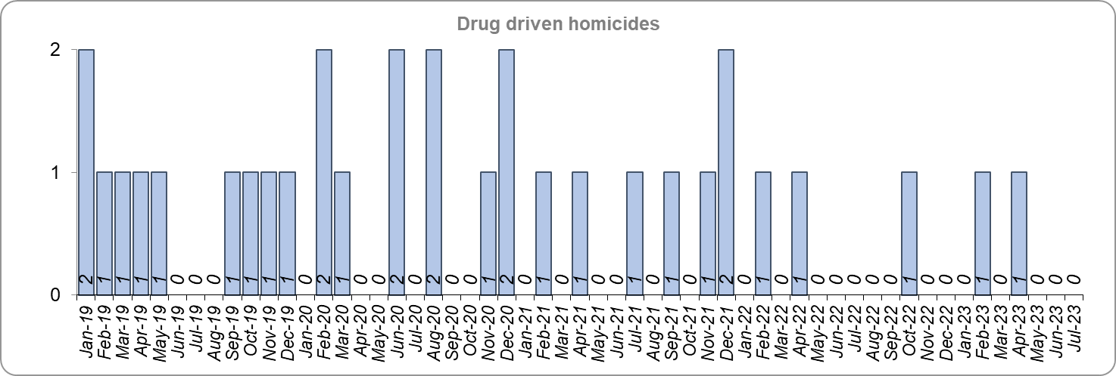
Priority 2 – Reducing drug driven violence
Grade: Good
Essex experienced three fewer drug related homicides (3) for the 12 months to July 2023 compared to the 12 months to July 2022 (6) and seven fewer compared to the 12 months to December 2019.
Please note:
* The methodology used for identifying investigations as being drug-related is subjective (qualitative data) and based on the circumstances presented. These figures include investigations where the victim and/or suspect are suspected of being involved in Drug Use, Possession or Selling. Data has been re-run to reflect the current position. This will be run on a annual basis due to the complexity of the process.

Slide 13
Priority 2 – Reducing drug driven violence
Grade: Good
There was a 7.6% decrease (1,228 fewer offences) in Violence with Injury (VWI) offences for the 12 months to July 2023 compared to the 12 months to July 2022. There was a 2.2% decrease (337 fewer) in offences compared to the 12 months to December 2019.

Slide 14
Priority 2 – Reducing drug driven violence – continued
Grade: Good
There was a 11.9% decrease (204 fewer) in the number of knife-enabled crime offences in the 12 months to July 2023 compared to the 12 months to July 2022. The number of knife-enabled crime offences also decreased by 7.8% (128 fewer) in the 12 months to July 2023 compared to the 12 months to December 2019. Essex conducted 14.4% more Organised Crime Group (OCG) disruptions (53 more) for the 12 months to June 2023 compared to the 12 months to June 2022. Although there was a 325.3% increase compared with the 12 months to December 2019 (322 more), this is due to a breakdown in the communication between the data from the operation activity to the figures which were produced by the Eastern Region Special Operations Unit (ERSOU)**. Confidence that Essex Police and partners are dealing with drug crime (from the independent survey commissioned by Essex Police) is at 56.1% for the 12 months to June 2023. The results for this question have been stable since it was first asked in September 2021.
Drug related homicides, Violence with Injury offences and Knife enabled crimes have fallen, whilst confidence is relatively high and OCG disruptions have increased. Therefore, a grade of Good is recommended.

Slide 15
Priority 2 – Reducing drug driven violence – continued
Grade: Good
Please note:
* The number of knife crime offences is an indicator of how effective Essex Police is at identifying knife-enabled offences, and is not necessarily reflective of the number of these offences that have been committed in the county. This is because the identification of these offences is reliant on the appropriate indicator being manually added to the crime record. A new data quality process was introduced in June 2020 and Essex Police is currently working with the National Data Quality Improvement Service (NDQIS) to revise knife crime flags. In September 2021, data from April 2019 was revised; this resulted in an increase in the number of offences recorded. This has enabled Essex Police to better understand knife crime in Essex.
** In the fiscal year 2019/20 the disruption returns to the Eastern Region Special Operations Unit (ERSOU) averaged 25 a quarter. A process review identified a breakdown in the communication of the data from the operation activity to the figures produced by ERSOU. A project of improvement was implemented; this focussed on improving the communication between teams internally, and, more importantly, with ERSOU, to understand the parameters of what a disruption is and share this information with all teams within Essex Police. Over a two year period a continual improvement of disruption figures has come from a refinement of the communication and claiming process. This has been focussed on ensuring that we are claiming all possible disruptions of OCGs, tracking all activity from inception to closure, being innovative in our activity led by the Organised Crime Group Management Unit (OCGMU) and highlighting and educating new teams on how they can impact OCGs in their daily work. The moderation process has also been refined to ensure consistency with ERSOU. OCG disruption data are provided quarterly, data is to June 2023.
*** The confidence question was added to the external independent survey in September 2021. A year on year comparison is therefore not available.

Slide 16
Priority 3 - Protecting vulnerable people and breaking the cycle of domestic abuse
Grade: Good
Essex experienced an 15.0% decrease (4,603 fewer) in the number of recorded Domestic Abuse (DA) offences for the 12 months to July 2023 compared to the 12 months to July 2022**. The Force recorded 1,703 fewer offences in the three months to July 2023 compared to the three months to July 2022 (6,018 v. 7,721). It is of note that Stalking & Harassment offences account for about a fifth (19.6%) of all Domestic Abuse investigations and that Essex Police are currently auditing and – where appropriate – cancelling Stalking & Harassment offences to ensure additional crimes have not been unnecessarily recorded.
Essex Police solved 10.1% (335) fewer DA offences for the 12 months to July 2023 compared to the 12 months to July 2022. The Force also solved 223 fewer offences in the three months to July 2023 compared to the three months to July 2022 (637 v. 860). However, these volumes have been affected by the changes to the HOCR rules, as detailed on slide 21.

Slide 17
Priority 3 - Protecting vulnerable people and breaking the cycle of domestic abuse
Grade: Good
There was a 12.5% decrease (3,711 fewer) in DA offences and a 1.3% decrease (39 fewer) in the number of DA offences solved for the 12 months to July 2023 compared to the 12 months to December 2019.
There were 4,505 fewer repeat victims of DA in the 12 months to July 2023 compared to the 12 months to July 2022 (21.4% less). There was also a decrease of 19.6% (4,037 fewer) compared to the 12 months to December 2019.
Please note:
* A repeat victim is someone who has been named as a victim for more than one crime within a 12-month period; to mitigate the fact that multiple crimes can be associated with the same incident, additional crimes with the same victim on the same date are not counted.
** Data may differ to the tables in the appendices depending on the date of data collection as corrections are often made to Domestic Abuse incidents.

Slide 18
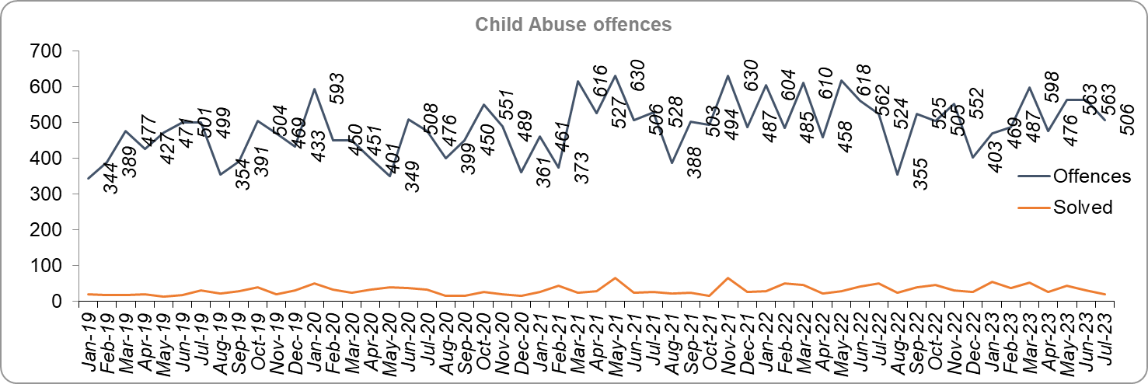
Priority 3 - Protecting vulnerable people and breaking the cycle of domestic abuse - continued
Grade: Good
Essex Police solved 11 more (2.6%) child abuse offences for the 12 months to July 2023 compared to the 12 months to July 2022, whilst there was a 5.7% decrease (361 fewer) in offences for the same comparison periods.
Essex Police solved 155 more (56.4%) offences for the 12 months to July 2023 compared to the 12 months to December 2019. There was also a 14.1% increase (743 more) in Child Abuse offences for the same comparison period.

Slide 19
Priority 3 - Protecting vulnerable people and breaking the cycle of domestic abuse - continued
Grade: Good
254 Modern Slavery referrals were made in the 12 months to July 2023 compared with 181 in the 12 months to July 2022 (73 more).
The number of Domestic Violence Protection Notices (DVPN) issued decreased by 43.4% (96 fewer notices) in the 12 months to July 2023 compared to the 12 months to July 2022. 92 fewer (45.5%) Domestic Violence Protection Orders (DVPO) were issued in the 12 months to July 2023 compared to the 12 months to July 2022.
Confidence that the policing response to protect children and vulnerable people (from the independent survey commissioned by Essex Police) is at 77.9% (results to the 12 months to June 2023). Compared to year ending June 2022, confidence has decreased by 3.8 percentage points.
As a result of Operation Puffin***, the Force has implemented a number of changes to how it approaches the issue of Domestic Abuse. This includes implementing improvements to the risk assessment and victim safeguarding processes.
Four of the nine metrics for this Priority improved in the 12 months to July 2023 compared to the 12 months to July 2022 (DA offences, Repeat victims of DA, CA offences and CA solved); five deteriorated (DA offences solved, NRM referrals, DVPNs, DVPOs and confidence). Three metrics improved when compared with the 12 months to December 2019. Changes in the Home Office Counting Rules relating to Stalking and Harassment contributed to a decline; there are also indications that there has been a reduction in the number of offences reported to Essex Police. A grade of Good is therefore recommended.

Slide 20
Priority 3 - Protecting vulnerable people and breaking the cycle of domestic abuse - continued
Grade: Good
Please note:
* The number of Modern Slavery referrals made to the National Referral Model are only available from April 2019 due to a change in the method of recording. A year on year comparison for the 12 months to December 2019 is therefore not possible.
** DVPN’s are the first stage of the process, and DVPO the second. An officer issues a DVPN which has to go to court to become a DVPO. There are always fewer orders than notices as a result, as on some occasions the notices are not approved.
*** Operation Puffin was an investigation into the horrific murder of Ashley Wadsworth by a young man with a history of domestic violence in Chelmsford in 2022.

Slide 21
Priority 4 – Reducing violence against women and girls
Grade: Good
Essex experienced a 11.7% decrease (4,620 fewer) in the number of VAP offences committed against females in the 12 months to July 2023 compared to the 12 months to July 2022. There was a 1.8% decrease (637 fewer) in the number of VAP offences committed against females in the 12 months to July 2023 compared to the 12 months to December 2019. Where gender is detailed, over half of victims of Violence Against the Person (VAP) offences are identified as female* (55.9%). 3.3% of offences (2,143 offences) had no gender recorded**.
Essex Police prides itself on having excellent Crime Data Accuracy (CDA). In its most recent inspection by HMICFRS, Essex Police was graded as Outstanding in relation to its CDA. Maintaining excellent CDA, however, requires the Force to neither under-record nor over-record offences. To this end, Essex Police is auditing and – where appropriate – cancelling Stalking & Harassment offences to ensure additional crimes have not been unnecessarily recorded. Essex Police have also been educating those working within the Resolution Centre to ensure they fully research the individuals involved in these types of offences before they create new crimes; where previous records exist, these additional incidents are instead referred to the relevant officer(s) in order that they can be investigated together. As of 16 July 2023, for the fiscal year to date, 416 records have been reviewed as potential duplicate crimes and 118 identified for cancellation; of these, 69 records (58.5%) have now been cancelled. It is of note that Stalking & Harassment offences comprise the largest volume of VAP offences at 39.3% in the 12 months to July 2023. There were 3,230 fewer Stalking & Harassment crimes committed against females in the 12 months to July 2023 (13,686 crimes) compared to the 12 months to July 2022 (16,916 crimes).
In May 2023, national Home Office Counting Rules (HOCR) changed as regards Stalking & Harassment (S&H) offences. The “principle crime rule” now applies, meaning that only the most serious crime is recorded (previously, Stalking & Harassment offences were recorded as well as the more serious offence). This has resulted in fewer Stalking & Harassment offences being recorded. The HOCRs in relation to Malicious Communications have also changed; only isolated offences will now be recorded as Malicious Communications (repeat offences with the same victim and suspect will be recorded as Stalking & Harassment).

Slide 22
Priority 4 – Reducing violence against women and girls
Grade: Good
There was a 7.8% decrease (383 fewer) in the number of Sexual Offences committed against females in the 12 months to July 2023 compared to the 12 months to July 2022, and a 19.5% increase (742 more) compared to the 12 months to December 2019. Essex Police solved 34 more of these offences in the 12 months to July 2023 compared to the 12 months to July 2022 and solved 98 more compared to the 12 months to December 2019.
Please note:
* Officer defined gender.
** Not Recorded also includes records where gender is unknown or unspecified.
*** Please see the appendices for tables detailing Offences, Solved Outcomes and Solved Rates% for Violence against the Person and Sexual offences (by crime type) split by gender.

Slide 23
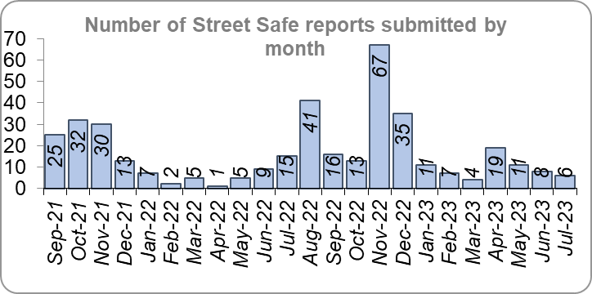
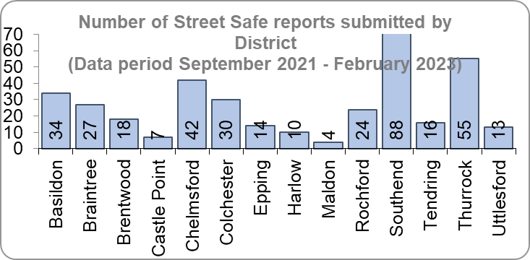
Priority 4 – Reducing violence against women and girls - continued
Grade: Good
StreetSafe reports enable people, particularly women and girls, to pin-point locations where they feel unsafe or have felt unsafe and identify why that location made them feel unsafe. StreetSafe was developed by the Digital Public Contact (DPC) Programme in cooperation with the Home Office and the National Police Chiefs’ Council (NPCC) and was introduced into Essex as part of the government’s strategy to tackle Violence against Women and Girls (VAWG). In July 2023, 6 reports were submitted in Essex. In total, 382 reports have been submitted for the county.
43.8% of females feel safe walking alone in their area after dark (from the independent survey commissioned by Essex Police) for the 12 months to June 2023 compared to 76.4% of males.
Essex Police is regularly reporting to the national VAWG Taskforce and HMICFRS in respect of its performance, its action plan to tackle VAWG, and its internal conduct and behaviour. This contact also shares best practice and innovation. The national VAWG Taskforce categorise work in three distinct areas: improving trust and confidence in policing; relentless pursuit of offenders; and creating safer spaces. Partnership engagement is key in tackling VAWG, as there are many strands which policing cannot tackle alone; these include education and the prevalence of VAWG and the anonymity of the internet. In March, the NPCC released national findings on VAWG performance.

Slide 24
Priority 4 – Reducing violence against women and girls - continued
Grade: Good
Essex Police encourage reporting and are working to gain a better understanding of this type of offence. There has been a decrease in Violence Against the Person offences and Sexual Offences against females compared to last year. Conversely, there has been an increase in the number of sexual offences solved. As such a grade of Good is recommended.
Please note:
* The confidence question was added to the internal survey in September 2021 so year on year comparison is not available.

Slide 25
Priority 5 – Improving support for victims of crime
Grade:
Requires Improvement
Essex experienced a 12.3% decrease (5,850 fewer) in the number of offences with a repeat victim for the 12 months to July 2023 (41,803 offences) compared to the 12 months to July 2022 (47,653 offences) and a 2.1% decrease (901 fewer) compared to the 12 months to December 2019 (42,704 offences).* Except for August 2022, the year on year change for repeat victimisation has decreased each month since March 2022.
The average number of days taken to investigate High Harm offences increased to 51.0 for the month of July 2023 compared to 46.4 for the month of July 2022 (4.6 days more). There was an increase of 6.9 days compared to the month of December 2019 (44.2 days).

Slide 26
Priority 5 – Improving support for victims of crime
Grade:
Requires Improvement
The number of individual repeat victims decreased by 6.3% (1,442 fewer) for the 12 months to July 2023 (21,312 individual victims) compared to the 12 months to July 2022 (22,754 individual victims). There was an increase of five individual victims compared to the 12 months to December 2019 (21,307 individual victims).
There was a 2.1% decrease in the number of referrals to Victim Support in the 12 months to July 2023 compared to the 12 months to July 2022; this equates to 597 fewer referrals. It should be noted that this is likely due to the decrease in overall offence numbers. There was, however, also a 32.6% decrease (13,396 fewer referrals) for the 12 months to July 2023 compared to the 12 months to December 2019.*** The proportion of victims who received a referral to victim support was 25.1% in the 12 months to July 2023, an increase of 1.0 percentage points on 24.1% in the 12 months to July 2022.
Please note:
* This metric details how many crimes had a repeat victim rather than the number of individual people who are repeat victims of crime. A repeat victim is someone who has been named as a victim for more than one crime within a 12-month period; to mitigate the fact that multiple crimes can be associated with the same incident, additional crimes with the same victim on the same date are not counted.
** Data is the average for July only for the last two years.
*** Please see the appendices for tables detailing Offence details.

Slide 27
Priority 5 – Improving support for victims of crime - continued
Grade:
Requires Improvement
Confidence among victims (from the independent survey commissioned by Essex Police) is at 59.7% (results to the 12 months to June 2023). Although this is 14.8 percentage points lower than confidence of non-victims for the same period (74.5%), the gap has narrowed from 17.0 percentage points over the same period last year. However, the disparity has increased by 1.4 percentage points compared to the 12 months to December 2019 (13.4%).
Compared to year ending June 2022 confidence in the local police amongst victims is stable, in contrast to confidence amongst non-victims for whom there was a statistically significantly reduction of 5.2 percentage points.

Slide 28
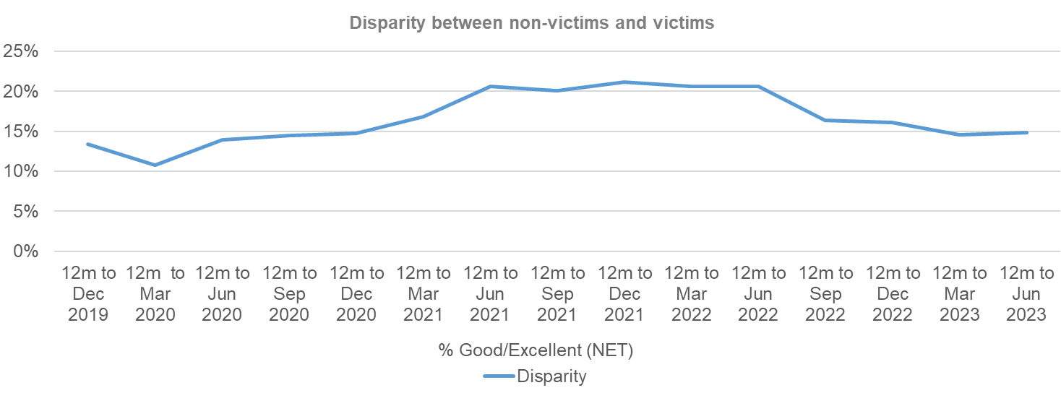
Priority 5 – Improving support for victims of crime - continued
Grade:
Requires Improvement
Whilst the number of repeat victims has decreased in the 12 months to July 2023 compared to last year, the average number of days taken to investigate high harm offences has increased substantially when compared to July 2022 and December 2019. With three of the six measures deteriorating, a grade of Requires Improvement is recommended.

Slide 29
Priority 6 – Protecting rural and isolated areas
Grade: Good
Rural Crime decreased by 5.5% (1,333 fewer offences) in the 12 months to July 2023 compared to the 12 months to July 2022. During this period All crime decreased by 5.1%. However, Rural Crime decreased by 12.6% (3,338 fewer offences) compared to the 12 months to December 2019. All Crime in Essex decreased by 5.7% in the same period.
Essex Police solved 0.1% (-3) fewer Rural Crime offences for the 12 months to July 2023 compared to the 12 months to July 2022, and 18.0% fewer (a decrease of 548) compared to the 12 months to December 2019.
The Rural Crime Harm (Crime Severity) Score* was 8.2 for the 12 months to July 2023, which is a decrease of 0.7 when compared to the 12 months to July 2022 and lower than the All Crime Harm Score in Essex (14.1) which decreased by 0.8.

Slide 30
Priority 6 – Protecting rural and isolated areas
Grade: Good
Please note:
* Crime Severity Scores (as calculated by the Office for National Statistics) measure the ‘relative harm’ of crimes by taking into account both their volume and their severity. National data are not available for crimes committed in rural areas, so it is not possible to measure against an MSG average; due to this, Essex Police data (to July 2023) have been used rather than national data (which are to May 2023).

Slide 31
Priority 6 – Protecting rural and isolated areas - continued
Grade: Good
Confidence in rural policing (from the independent survey commissioned by Essex Police) is at 73.3% (results to the 12 months to June 2023). Compared to year ending June 2022 (80.1%), confidence in rural policing has deteriorated significantly (by 6.8% points), although it remains slightly higher than the current overall Essex average (rural and urban combined) of 72.4%. Since 2019, confidence in Essex Police has increased significantly in every area across Essex.
Essex Police is one of only 15 forces who have dedicated Rural Policing Teams. Essex Police are also continuing their commitment to prevent rural and heritage crime with the innovative launch of a horseback volunteer scheme in Uttlesford. The idea behind the scheme is that horse riders are in a unique position to spot signs of suspicious activity related to offences such as hare coursing, stolen agricultural vehicles, unlawful metal detecting or theft of lead from protected heritage buildings. The horseback volunteers will be trained in what to look out for and will be able to report any concerns or suspicious activity, helping the Force target those committing offences and stop criminality before it happens.
In March 2023, a new Rural Crime Strategy was launched in collaboration with the Essex Rural Partnership (ERP) and the Police, Fire and Crime Commissioner (PFCC).
Confidence in the local police in rural areas is in line with the rest of the county, and offence levels in the 12 months to July 2023 are lower compared to the 12 months to December 2019 (pre-COVID). With only a slight decrease in solved numbers and a comparatively large decrease in the overall number of Rural Crime offences and the Severity Score, a grade of Good is recommended.
Please note:
* Rural districts: Braintree, Maldon, Tendring and Uttlesford

Slide 32
Priority 7 – Preventing dog theft
Grade: Good
21 fewer dog thefts were reported in Essex for the 12 months to July 2023 compared to the 12 months to July 2022 (49 v. 70). There were eight fewer dog thefts in the 12 months to July 2023 compared to the 12 months to December 2019.
The number of dog thefts solved for the 12 months to July 2023 (3) is stable compared to the 12 months to July 2022 (3). There was an increase of one compared to the 12 months to December 2019 (2).

Slide 33
Priority 7 – Preventing dog theft
Grade: Good
Confidence in how Essex Police and the organisations they work with are dealing with dog theft (from the independent survey commissioned by Essex Police) is at 60.8% for the 12 months to June 2023.
Due to the low and reducing number of thefts across the county (given the comparatively large population of Essex), along with relatively high confidence levels, a grade of Good is recommended.
Please note:
* This is number of thefts in which dogs were stolen, and not quantity of dogs stolen in each theft. Data are based on theft offence crimes and robbery offence crimes where the ‘property code’ is ‘pet animal – dog’ and the ‘property status’ is ‘stolen’ and/or ‘stolen/recovered’.
** The confidence question was added to the internal survey in September 2021 so year on year comparison is not available.

Slide 34
Priority 8 – Reducing business crime, fraud and cyber crime
Grade: Adequate
Business Crime offences include any notifiable crimes recorded with a victim which is an organisation; it does not include Fraud offences. All reports of Fraud are recorded by the National Fraud Intelligence Bureau (NFIB) rather than Essex Police. In the 12 months to July 2023, a total of 1,946 Fraud investigations were allocated to Essex Police by NFIB for investigation. For data on the number and type of Fraud investigations reported as being committed within the Essex Police area, please visit the NFIB Fraud and Cyber Crime Dashboard.
Essex experienced a 8.3% increase (1,646 more) in the number of Business Crime offences and a 5.6% increase (180 more) in the number of these offences which were solved in the 12 months to July 2023 compared to the 12 months to July 2022. Shoplifting accounts for approximately 49.4% of business crime. Essex Police have been working with businesses to encourage them to record more offences.

Slide 35
Priority 8 – Reducing business crime, fraud and cyber crime - continued
Grade: Adequate
There was a 10.5% decrease (2,519 fewer) in the number of Business Crime offences and a 31.0% decrease (1,514 fewer) in the number of Business Crimes solved in the 12 months to July 2023 compared to the 12 months to December 2019.
There was a 6.1% decrease in the number of fraud offences related to Business Crime in the 12 months to July 2023 compared to the 12 months to July 2022; this equates to 22 fewer offences. There was also a 30.1% decrease in the 12 months to July 2023 compared to the 12 months to December 2019; this equates to 146 fewer offences.
Confidence that Essex Police are dealing with cyber crime (from the independent survey commissioned by Essex Police) is at 46.1% for the 12 months to June 2023.
Two of the five metrics deteriorated when compared to the 12 months to July 2022 (Business Crime offences and the total number of fraud offences). However, despite the increase in Business Crime Offences, the number solved has also increased and business related fraud has decreased. Due to the fact that these measures are also improving when compared to the 12 months to December 2019, a grade of Adequate is recommended.
Please note:
* Fraud offences recorded on Athena where the victim is either an organisation or a person with the Business Victim flag.
** The confidence question was added to the internal survey in September 2021 so year on year comparison is not yet available.

Slide 36
Priority 9 - Improving safety on our roads
Grade:
Requires Improvement
Road traffic safety is the responsibility of the Safer Essex Roads Partnership (SERP). SERP comprises representatives from Essex Police, Essex County Fire & Rescue Service, Essex County Council, Southend on Sea Borough Council, Thurrock Council, National Highways, East of England Ambulance Service Trust, Essex and Herts Air Ambulance Service Trust and The Safer Roads Foundation (Registered Charity). The aspiration of Essex Police and partners is ‘Vision Zero’, namely to have no road deaths or serious injuries by 2040. The SERP Safety delivery plan sets out a structured programme of educational and engagement activity to address this and support behavioural changes.
There was a 5.0% decrease (45 fewer) in the number of those Killed or Seriously Injured (KSI) in Essex for the 12 months to July 2023 compared to the 12 months to July 2022. However, the number of KSIs increased by 38 (4.6%) in the 12 months to July 2023 compared to the 12 months to December 2019.

Slide 37
Priority 9 - Improving safety on our roads - continued
Grade:
Requires Improvement
Essex recorded the third highest number of casualties per 100 million vehicle kilometres (results to June 2021) in its Most Similar Group (MSG) of eight forces; Essex are above the MSG average also. However, due to the fact that more recent national figures have not been released, the current position cannot be determined (the date of the next national release has not yet been confirmed).
Please note that not all KSIs will result in a criminal offence, for instance where a fatal collision has been caused by bad weather or because of a medical episode suffered by the driver.

Slide 38
Priority 9 - Improving safety on our roads - continued
Grade:
Requires Improvement
There was a 7.2% decrease (173 fewer offences) in drink/drug driving offences for the 12 months to July 2023 compared to the 12 months to July 2022. There was a 15.7% decrease (235 fewer offences) in drink driving and a 6.8% increase (62 more offences) in drug driving. There was also a 32.8% decrease (1,085 fewer offences) in drink/drug driving offences for the 12 months to July 2023 compared to the 12 months to December 2019; of these offences, there was a 14.2% decrease (209 fewer offences) in drink driving and a 47.5% decrease (876 fewer offences) in drug driving. All of these offence types are primarily driven by police proactivity in relation to road safety.
The number of Failure to Provide samples decreased by 10.0% (35 fewer) in the 12 months to July 2023 compared to the same period last year, and by 20.8% compared to the 12 months to December 2019.
There was a 183.2% increase (1,405 more offences) in the number of driving related mobile phone offences recorded for the 12 months to July 2023 compared to the 12 months to July 2022.*
Confidence in Essex Police and organisations with whom they police the roads (from the independent survey commissioned by Essex Police) is at 66.4% (results to the 12 months to June 2023). Confidence in the local police and organisations they work is improving when compared to year ending June 2022 (64.1%).

Slide 39
Priority 9 - Improving safety on our roads - continued
Grade:
Requires Improvement
Due to the increase in KSIs compared to the 12 months to December 2019 and the decrease in the number of driving under the influence of drink drug driving in the past 12 months compared to the previous 12 months and the 12 months to December 2019 a grade of Requires Improvement is recommended.
Please note:
* In 2019, the definition as to what constituted “use” of a mobile phone in relation to driver-related mobile phone offences was subject to a legal challenge. This resulted in a ruling, which held that while “use” included accessing the interactive functions of the mobile phone (such as making calls, sending messages or using the internet), it did not extend to solely accessing the device’s internal functions (such as making use of the camera). Fewer mobile phone offences were subsequently prosecuted from this point. In 2021 the government announced that the law was to be changed making it illegal to “hold” a phone or sat nav when driving or riding a motorcycle. This law was finally passed on 25th March 2022.

Slide 40
Priority 10 – Encouraging volunteers and community support
Grade: Adequate
Essex Watch Liaison Officers continue to work with Neighbourhood Watch (NHW) to offer crime and fraud prevention advice.* There are currently 2,343 NHW Co-ordinators and 79,449 NHW members.
Citizens in Policing and the Special Constabulary play an integral part in supporting Essex Police. In January 2022, the Local Policing Support Unit (LPSU) introduced a Strategic Co-ordination Group which proactively supports, throughout the county, the mobilisation of all Special Constables, Police Support Volunteers, Active Citizens, Accredited Persons and, where appropriate our Volunteer Police Cadets, with local operations and initiatives under the Chief Constable’s Plan on a Page and the Police, Fire Crime Commissioner’s Police and Fire Plan.
Since last month’s report, there are now: 66 more dog group members, two more farm and rural group members, two more marine group members, two more heritage group members and one more caravan group member.
Please note:
* Neighbourhood Watch data were first produced in March 2022 so year on year comparison is not available.

Slide 41
Priority 10 – Encouraging volunteers and community support - continued
Grade: Adequate
The Special Constabulary headcount is currently 289 (as of 31 July 2023). This is down 29.7% (122 fewer) compared to July 2022. Compared to the 12 months to December 2019 this is down 44.3% (230 fewer).
There are 168 Volunteer Police Cadets (VPCs) and 74 Volunteer Cadet Leaders across 13 Cadet Units. In addition, there are 97 Police Support Volunteers and 52 Active Citizens within Essex Police across the county, a total of 149 Volunteers. These volunteers also are part of the Strategic Co-ordination Group and support their Local Community Policing Teams with local events.
Confidence that there are good opportunities for volunteers to assist policing and reduce crime in Essex (from the independent survey commissioned by Essex Police) is at 54.3% for the 12 months to June 2023. Confidence has increased each quarter since Q4 2021/22 (45.1%).
The Special Constabulary headcount has decreased significantly compared to 12 months ago and December 2019. However, due to the fact that Essex has the second largest Special Constabulary in the country***, the Force’s use of Ethics Boards to inform its work and the uptick in watch group membership, a grade of Adequate is recommended.

Slide 42
Priority 10 – Encouraging volunteers and community support - continued
Grade: Adequate
Please note:
* Monthly data only collected from December 2022 so year on year comparisons not available. Of the 13 Cadet Units 9 are active and 4 are temporarily suspended due to not enough leader coverage in that area. Recruitment is ongoing to get the units up and running again.
** The confidence question was added to the internal survey in September 2021 so year on year comparison is not available.
*** As of September 2022. The latest National Police Workforce Statistics were published in January 2023 and are updated bi-annually.

Slide 43
Priority 11 – Supporting our officers and staff
Grade: Adequate
There has been a slight decrease (0.11% points) in the proportion of ethnic minority employees in July 2023 (262) compared to July 2022 (268); this equates to six fewer employees. However, in contrast, there has been an increase of 45 compared to December 2019 (217).
In the 12 months to July 2023, 394 new officers took their oaths to the King and started their Essex Police careers. The new officers pledged their commitment to police with the consent of every community at a time when the Force is welcoming more new colleagues from a range of different backgrounds. Over the same period, 261 officers left their positions, leading to an overall increase of 133 officers over the last year.
Please note:
* Ethnic minority employees as a percentage of the total workforce.
** Ethnic minority employees as a percentage of type of employee.

Slide 44
Priority 11 – Supporting our officers and staff - continued
Grade: Adequate
The average days lost per person for sickness decreased for all employee types in the 12 months to July 2023 compared to the 12 months to July 2022. Full Time Employee vacancies decreased for all staff groups over the 12 months to July 2023 compared to the 12 months to July 2022. For these reasons a grade of Adequate is recommended.

Slide 45
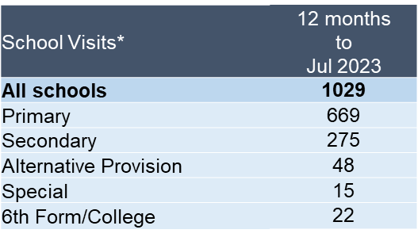
Priority 12 – Increasing collaboration
Grade: Adequate
The data is this section is provided by Essex County Fire and Rescue Service as part of the Joint Essex Fire and Police Education in Schools Programme (2022). Except for the types of programmes delivered, school visit data has been provided up to July 2023.
There has been a 23.3% decrease (35,087 fewer) in audience numbers in the 12 months to July 2023 (115,269) compared to the 12 months to July 2022 (150,356).
1,029 school visits at 629 unique schools were conducted in the 12 months to July 2023. 65.0% of these were at primary schools. Over the last 6 months the number of visits to unique schools and programmes delivered has increased compared to the same period last year.
Over the 12 months to July 2023 audience numbers have decreased compared to the 12 months to July 2022. Due to a lack of further qualitative information in relation to this priority, a grade of Adequate is recommended.
Please note:
* Due to changes to the way data is recorded, data is only available from January 2022. As such, 12 month year on year comparisons are not possible. A sixth month year on year comparison has been included instead.

Slide 46
Monthly Performance Overview: Exceptions
Exceptions Overview
There were no statistically significant changes in offences in July 2023.

