Slide 1
Police and Crime Plan 2021-2024
Monthly Performance Update
May 2023
National and MSG positions are to 31 March 2023 (Essex Police data are to 31 May 2023).
Version 1.2
Produced June 2023
Performance Analysis Unit, Research & Analysis Department, Essex Police
Sensitivity: Official

Slide 2
Executive Summary
The Police and Crime Plan 2021-2024 was introduced in April 2021, with new measures that reflect the Essex Police, Fire and Crime Commissioner’s (PFCC) strategic commitment to targeted prevention and early intervention. On 13 December 2022, the Chief Constable of Essex Police and the Police, Fire & Crime Commissioner for Essex agreed that more measures should be included so a more holistic and rounded view of the Force’s performance against the Police and Crime Plan could be provided.
Five of the twelve PFCC Priorities have been given a recommended grade of ‘Good’: 2 (Reducing drug driven violence), 3 (Protecting vulnerable people and breaking the cycle of domestic abuse), 4 (Reducing violence against women and girls), 6 (Protecting rural and isolated areas) and 7 (Dog Theft). Five have been given a recommended grade of ‘Adequate’ and two have been given a recommended grade of ‘Requires Improvement’: 5 (Improving support for victims of crime) and 9 (Improving safety on our roads).
There have been no changes in grading compared to the previous month’s report.
Confidence (from the independent survey commissioned by Essex Police) was at 73.5% for the 12 months to March 2023. Although confidence decreased by 5.5 percentage points compared to the 12 months to March 2022 (79.0%), confidence is 8.8 percentage points higher than it was in the 12 months to December 2019 (64.7%). The 12 months to December 2019 was the last full year (and last full financial quarter) in which society, crime and policing was not affected by the pandemic. Although confidence in the local police has deteriorated significantly compared to year ending December 2021, Forces contacted by Essex Police reported patterns similar to Essex Police: confidence was high during COVID, but has been in general decline ever since (the last two quarters especially have seen significant decreases).
There was a decrease in All Crime (2.9%) and Rural Crime (2.7%), but an increase in Business Crime (9.5%) for the 12 months to May 2023 compared to the 12 months to May 2022; acquisitive crime has generally been at higher levels in the last 12 months than in the same 12 months the preceding year. When compared to the 12 months to December 2019, All Crime decreased by 4.0%; this equates to 6,797 fewer offences. For the three months to May 2023, All Crime fell by 5.5% whilst the solved rate increased by 0.5 percentage points compared to the three months to May 2022.
In the 12 months to May 2023 all Theft offences rose by 11.2% (4,714 more), compared to the 12 months to May 2022. This has primarily been driven by increases in shoplifting (1,355 more), Theft of a Vehicle (956 more) and Theft from a Vehicle (810 more).
Essex experienced a 9.4% decrease (4,536 fewer) in the number of offences with a repeat victim for the 12 months to May 2023 (43,481 offences) compared to the 12 months to May 2022 (48,017 offences). Except for August 2022, the year on year increase in repeat victimisation has been reducing each month since March 2022.* The number of individual repeat victims decreased by 3.6% (810 fewer) for the 12 months to May 2023 (21,800 individual victims) compared to the 12 months to May 2022 (22,610 individual victims). It is of note that any over-recording of Stalking & Harassment offences (discussed on the next slide) will impact both the number of repeat victims and the number of offences with a repeat victim.

Slide 3
Executive Summary - continued
Essex Police prides itself on having excellent Crime Data Accuracy (CDA). In its most recent inspection by HMICFRS, Essex Police was graded as Outstanding in relation to its CDA. Maintaining excellent CDA, however, requires the Force to neither under-record nor over-record offences. To this end, Essex Police is auditing and – where appropriate – cancelling Stalking & Harassment (S&H) offences to ensure additional crimes have not been unnecessarily recorded. Essex Police have also been educating those working within the Resolution Centre to ensure they fully research the individuals involved in these types of offences before they create new crimes; where previous records exist, these additional incidents are instead referred to the relevant officer(s) in order that they can be investigated together. This activity has therefore not only resulted in a decrease in offences since the start of the review (August 2022) but has enabled the Force to better coordinate these types of investigations. For the fiscal year to date, starting 01 April 2023, a further 261 records have been reviewed as potential duplicate crimes and 78 identified for cancellation; of these, 46 records (59%) have now been cancelled.
In May 2023 national Home Office Counting Rules (HOCR) changed as regards Stalking & Harassment (S&H) offences. The “principle crime rule” now applies, meaning that only the most serious crime is recorded (previously, Stalking & Harassment offences were recorded as well as the more serious offence). This has resulted in fewer Stalking & Harassment offences being recorded. It is of note that Stalking & Harassment offences comprise the largest volume of Violence Against Women & Girls offences (VAWG) and account for 19.7% of all Domestic Abuse investigations. There were, for example, 2,991 fewer Stalking & Harassment crimes committed against females in the 12 months to May 2023 (14,385 crimes) compared to the 12 months to May 2022 (17,376 crimes).
Violence Against the Person (VAP) offences committed against females decreased by 9.2% (3,650 fewer) in the 12 months to May 2023 compared to the 12 months to May 2022. There was also a 6.1% decrease (300 fewer) in the number of sexual offences committed against females in these time periods. Essex Police additionally solved 32 more (11.7%) sexual offences committed against females in the 12 months to May 2023 compared to the 12 months to May 2022.
When comparing High Harm* offences to its Most Similar Group (MSG) by crimes per 1,000 population, Essex recorded the sixth highest number of offences (out of eight police forces) for Other Sexual Offences, fourth for Violence with Injury, third for Burglary Residential, second for Robbery of Personal Property and first for Rape.
There was a 1.8% decrease (16 fewer) in the number of those Killed or Seriously Injured (KSI) in Essex for the 12 months to May 2023 compared to the 12 months to May 2022. It is of note that road traffic safety is the responsibility of the Safer Essex Roads Partnership (SERP) which includes Essex Police, Essex County Fire & Rescue Service, Essex County Council, Southend on Sea Borough Council, Thurrock Council, National Highways, East of England Ambulance Service Trust, Essex and Herts Air Ambulance Service Trust, and The Safer Roads Foundation (Registered Charity).
Essex Police conducted 85 more OCG disruptions in the 12 months to March 2023 compared to the 12 months to March 2022***.
Stalking & Harassment experienced a statistically significant decrease in May 2023, most likely linked to the review of these offences and changes in Home Office counting rules (discussed above). Theft of a Vehicle experienced a statistically significant increase in offences in May 2023.
In May 2023, almost half of all Essex Police employees were female (48.1%) with female officers accounting for over a third of all officers (37.1%). However Ethnic Minorities as a percentage of the workforce continues to fall, with a decrease in overall numbers in May 2023 compared to 12 months ago.
Officer numbers stand at 3,770 in May 2023, an increase of 172 from 3,598 in May 2022, but a slight decrease on the peak reached in February 2023**.

Slide 4
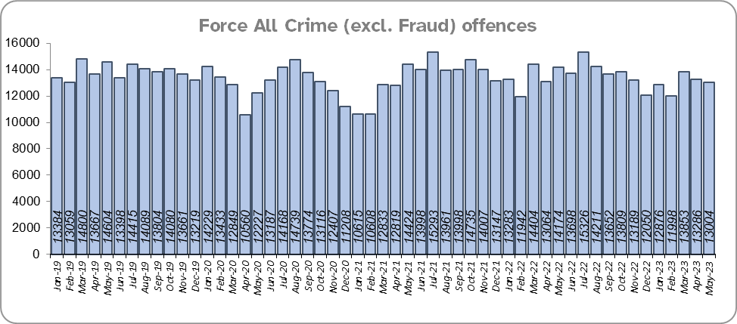
Priority 1 – Further investment in crime prevention
Grade: Adequate
There was a 2.9% decrease in All Crime in the 12 months to May 2023 compared to the 12 months to May 2022; this equates to 4,736 fewer offences. There was also a 4.0% decrease in All Crime (6,797 fewer offences) for the 12 months to May 2023 compared to the 12 months to December 2019. Essex recorded the second highest volume of offences per 1,000 population in its Most Similar Group of forces (MSG); there are seven other forces in Essex’s MSG.
Essex Police solved the 6th highest number of Rape offences per 1,000 population in it’s MSG (out of eight forces) and 32nd highest nationally (out of 42 forces). For offences committed, Essex had the highest number of offences per 1,000 population in it’s MSG and was 5th highest nationally.
13,004 offences were recorded in the month of May 2023, a decrease of 8.3% (1,170 fewer offences) compared to the month of May 2022 (14,174 offences).
The All Crime Harm (Crime Severity) Score* (14.3) has decreased by 0.5 in the 12 months to March 2023 with Essex the second highest out of eight in its MSG.
Please note:
* Crime Severity Scores (as calculated by the Office for National Statistics) measure the ‘relative harm’ of crimes by taking into account both their volume and their severity. As national data are only available to March 2023, the score for the 12 months to March for the preceding year has been included.

Slide 5
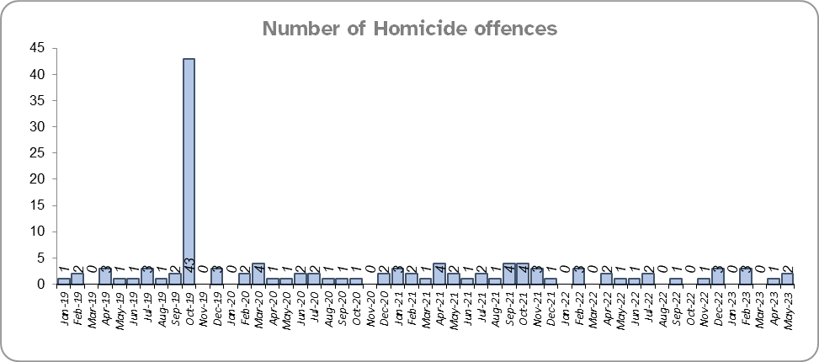
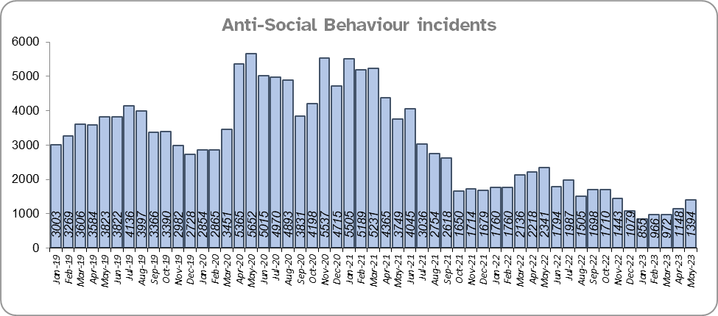
Priority 1 - Further investment in crime prevention - continued
Grade: Adequate
Ten fewer Homicides were recorded for the 12 months to May 2023 compared to the 12 months to May 2022, a 40% decrease.
The number of Homicides decreased by 75.4% (46 fewer offences) in the 12 months to May 2023 compared to the 12 months to December 2019.*
In March 2023, the government launched their National ASB Action Plan. Essex experienced a 31.3% decrease (8,562 fewer) in Anti-Social Behaviour (ASB) incidents for the 12 months to May 2023 compared to the 12 months to May 2022.** There was a decrease of 55.3% ASB reports in the 12 months to May 2023 compared to the 12 months to December 2019 (23,204 fewer incidents).
Please note:
* In October 2019 the bodies of 39 Vietnamese nationals were discovered in a lorry trailer in Grays. This tragic incident is reflected in the Homicide numbers for the 12 months to December 2019.
** October 2021 saw the implementation of Operation SOMERTON, which aims to both improve the service given to victims of ASB and ensure crimes are correctly recorded.

Slide 6
Priority 1 - Further investment in crime prevention - continued
Grade: Adequate
Essex Police received 43,662 fewer 101 calls to the Force Control Room (FCR), a decrease of 16.9% in the 12 months to May 2023 (214,911 calls) compared to the 12 months to May 2022 (258,573). There was a 26.7% decrease compared to the 12 months to December 2019 (293,049 calls).
35.7% of FCR 101 calls were abandoned in the month of May 2023, an increase of 20.3 percentage points compared to May 2022 (15.5%). There was also a decrease of 1.8 percentage points compared to December 2019 (35.7%). The average wait time as of 31 May 2023 increased by almost seven minutes when compared to 31 May 2022, and increased by over three minutes when compared to the 31st December 2019.
The Resolution Centre received 6,194 fewer calls in the 12 months to May 2023 (82,001 calls) compared to the 12 months to May 2022 (88,195 calls). There was a 23.6% decrease compared to the 12 months to December 2019 (107,347 calls).
19.9% of Resolution Centre (RC) calls were abandoned in the month of May 2023, a decrease of 6.4 percentage points when compared to the month of May 2022 (26.3%). There was a decrease of 3.6 percentage points when compared to December 2019 (23.5%). The average wait time on 31 May 2023 decreased by over two minutes when compared to the 31 May 2022 and by over three minutes compared to 31 December 2019.
Due to concerns in this area, Contact Management is subject to one of the Force’s major change programmes, which aims to optimise and improve its processes. Although this is a decrease year on year, performance has improved compared to last month’s report.
The number of online reports increased by 25.3% (7,472 more) in the 12 months to May 2023 compared to the 12 months to May 2022. The number of reports also increased by 51.2% (12,533 more) compared to the 12 months to December 2019.

Slide 7
Priority 1 - Further investment in crime prevention - continued
Grade: Adequate
Confidence experienced a statistically significant decline to 73.5% in the 12 months to March 2023 compared to the 12 months to March 2022 (by 5.5% percentage points from 79.0% for the 12 months to March 2022). It was during the height of the pandemic that confidence reached its highest levels. Forces contacted by Essex Police reported similar patterns: confidence was high during COVID, but has been in general decline ever since. Confidence remains 8.8 percentage points higher compared to the 12 months to December 2019 (64.7%).
Nine of the twelve measures for this priority are improving, whilst three are deteriorating. Due to the deterioration in the call handling measures compared to last year and 2019, this area is currently subject to a major change programme to improve performance. However, due to the significant decline in confidence, a grade of Adequate is recommended.

Slide 8
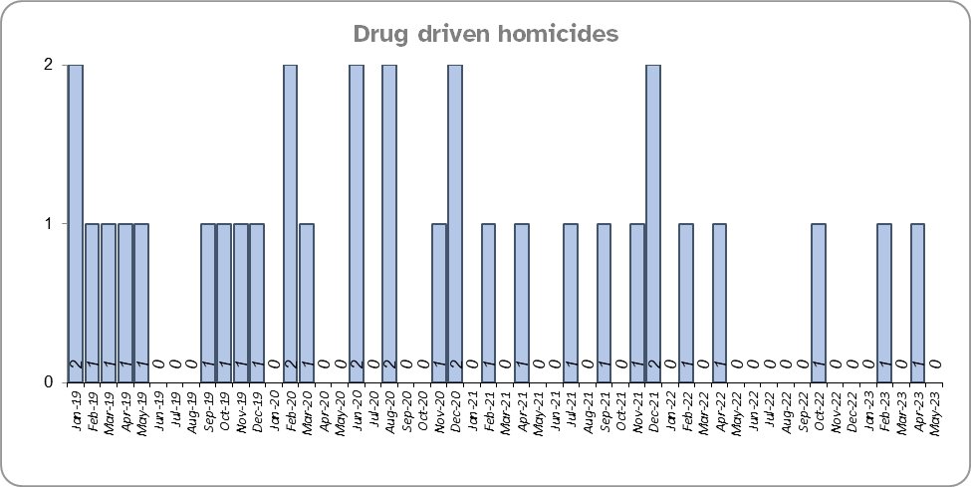
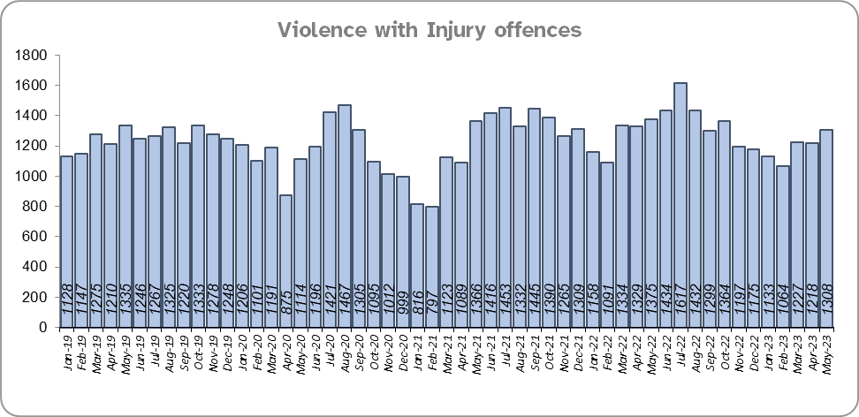
Priority 2 – Reducing drug driven violence
Grade: Good
Essex experienced four fewer drug related homicides (3) for the 12 months to May 2023 compared to the 12 months to May 2022 (7) and seven fewer compared to the 12 months to December 2019.
There was a 2.6% decrease (412 fewer offences) in Violence with Injury (VWI) offences for the 12 months to May 2023 compared to the 12 months to May 2022. There was a 1.4% increase compared to the 12 months to December 2019 (212 more offences).
Please note:
* The methodology used for identifying investigations as being drug-related is subjective (qualitative data) and based on the circumstances presented. These figures include investigations where the victim and/or suspect are suspected of being involved in Drug Use, Possession or Selling. Data has been re-run to reflect the current position. This will be run on a annual basis due to the complexity of the process.

Slide 9
Priority 2 – Reducing drug driven violence – continued
Grade: Good
There was a 5.2% decrease (87 fewer) in the number of knife-enabled crime offences in the 12 months to May 2023 compared to the 12 months to May 2022. The number of knife-enabled crime offences also decreased by 2.9% (48 fewer) in the 12 months to May 2023 compared to the 12 months to December 2019.
Essex conducted 25.3% more Organised Crime Group (OCG) disruptions (85 more) for the 12 months to March 2023 compared to the 12 months to March 2022. Although there was a 325.3% increase compared with the 12 months to December 2019 (322 more), this is due to a breakdown in the communication between the data from the operation activity to the figures which were produced by the Eastern Region Special Operations Unit (ERSOU)**.
Confidence that Essex Police and partners are dealing with drug crime (from the independent survey commissioned by Essex Police) is at 57.6% for the 12 months to March 2023. The results for this question have been stable since it was first asked in September 2021.
Drug related homicides, Violence with Injury offences and Knife enabled crimes have fallen, whilst confidence is relatively high and OCG disruptions are higher. Therefore, a grade of Good is recommended.
Please note:
* The number of knife crime offences is an indicator of how effective Essex Police is at identifying knife-enabled offences, and is not necessarily reflective of the number of these offences that have been committed in the county. This is because the identification of these offences is reliant on the appropriate indicator being manually added to the crime record. A new data quality process was introduced in June 2020 and Essex Police is currently working with the National Data Quality Improvement Service (NDQIS) to revise knife crime flags. In September 2021, data from April 2019 was revised; this resulted in an increase in the number of offences recorded. This has enabled Essex Police to better understand knife crime in Essex.
** In the fiscal year 2019/20 the disruption returns to the Eastern Region Special Operations Unit (ERSOU) averaged 25 a quarter. A process review identified a breakdown in the communication of the data from the operation activity to the figures produced by ERSOU. A project of improvement was implemented which focussed on improving the communication between teams internally, and more importantly with ERSOU, to understand the parameters of what a disruption is and share this information with all teams within Essex Police. Over a two year period a continual improvement of disruption figures has come from a refinement of the communication and claiming process. This has been focussed on ensuring that we are claiming all possible disruptions of OCGs, tracking all activity from inception to closure, being innovative in our activity led by the Organised Crime Group Management Unit (OCGMU) and highlighting and educating new teams on how they can impact OCGs in their daily work. The moderation process has also been refined to ensure consistency with ERSOU. OCG disruption data are provided quarterly, data is to March 2023.
*** The confidence question was added to the external independent survey in September 2021. A year on year comparison is therefore not available.

Slide 10
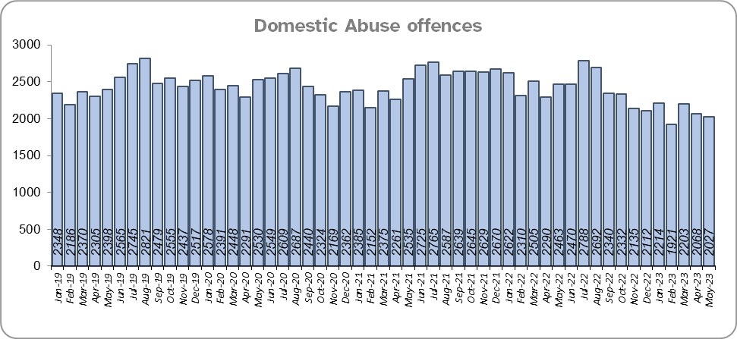
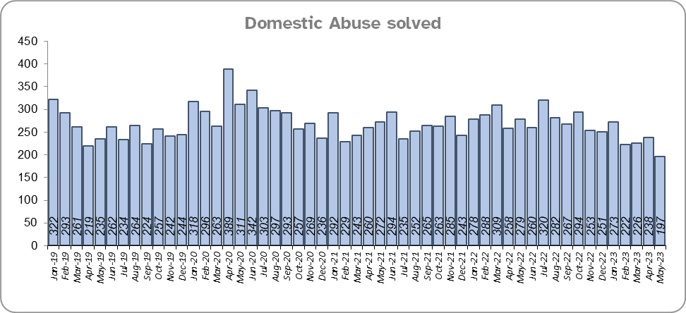
Priority 3 - Protecting vulnerable people and breaking the cycle of domestic abuse
Grade: Good
Essex experienced an 11.5% decrease (3,548 fewer) in the number of recorded Domestic Abuse (DA) offences for the 12 months to May 2023 compared to the 12 months to May 2022. The Force recorded 1,012 fewer offences in the three months to May 2023 compared to the three months to May 2022 (6,281 v. 7,293). It is of note that Stalking & Harassment offences account for about a fifth (19.7%) of all Domestic Abuse investigations and that Essex Police are currently auditing and – where appropriate – cancelling Stalking & Harassment offences to ensure additional crimes have not been unnecessarily recorded.
Essex Police solved 5.1% (166) fewer DA offences for the 12 months to May 2023 compared to the 12 months to May 2022. The Force solved 130 fewer offences in the three months to May 2023 compared to the three months to May 2022 (658 v. 788).
There was a 8.2% decrease (2,424 fewer) in DA offences and a 2.6% increase (78 more) in the number of DA offences solved for the 12 months to May 2023 compared to the 12 months to December 2019.
There were 3,602 fewer repeat victims of DA in the 12 months to May 2023 compared to the 12 months to May 2022 (17.0% less). There was also a decrease of 14.5% (2,987 fewer) compared to the 12 months to December 2019.
Please note:
A repeat victim is someone who has been named as a victim for more than one crime within a 12-month period; to mitigate the fact that multiple crimes can be associated with the same incident, additional crimes with the same victim on the same date are not counted.

Slide 11
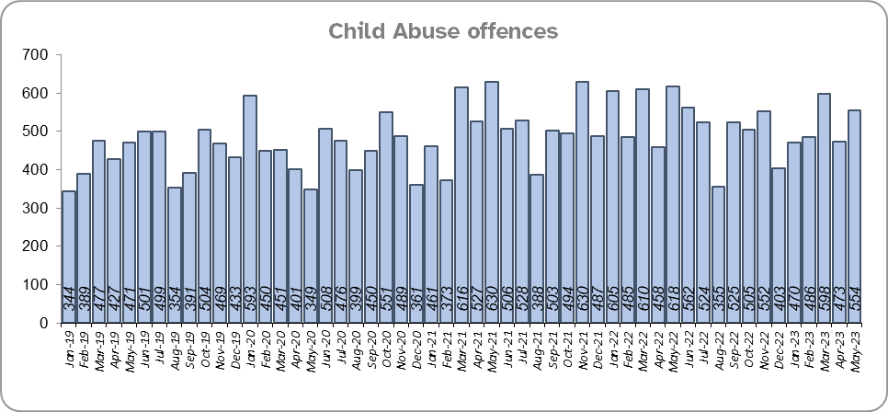
Priority 3 - Protecting vulnerable people and breaking the cycle of domestic abuse - continued
Grade: Good
Essex Police solved 95 more (25.3%) child abuse offences for the 12 months to May 2023 compared to the 12 months to May 2022, whilst there was a 4.8% decrease (305 fewer) in offences for the same comparison periods.
Essex Police also solved 196 more (71.3%) offences for the 12 months to May 2023 compared to the 12 months to December 2019. There was also a 14.2% increase (748 more) in Child Abuse offences for the same comparison periods.

Slide 12
Priority 3 - Protecting vulnerable people and breaking the cycle of domestic abuse - continued
Grade: Good
245 Modern Slavery referrals were made in the 12 months to May 2023 compared with 178 in the 12 months to May 2022 (67 more).
The number of Domestic Violence Protection Notices (DVPN) decreased by 38.6% (91 fewer notices) in the 12 months to May 2023 compared to the 12 months to May 2022. 96 fewer (43.0%) Domestic Violence Protection Orders (DVPO) were issued in the 12 months to May 2023 compared to the 12 months to May 2022.
Confidence that the policing response to protect children and vulnerable people (from the independent survey commissioned by Essex Police) is at 78.6% (results to the 12 months to March 2023). Compared to year ending March 2022, confidence has decreased by 5.2 percentage points but nevertheless remains at a high level.
As a result of Operation Puffin***, the Force has implemented a number of changes to how it approaches the issue of Domestic Abuse. This includes implementing improvements to the risk assessment and victim safeguarding processes.
Four of the nine metrics for this Priority improved in the 12 months to May 2023 compared to the 12 months to May 2022 (DA offences, Repeat victims of DA, CA offences and CA solved); five deteriorated (DA offences solved, NRM referrals, DVPNs, DVPOs and confidence). Four metrics improved when compared with the 12 months to December 2019. Due to changes efforts to improve recording and cancel duplicate Stalking & Harassment incidents, reductions repeats are hard to assess. As a result a grade of Good is recommended.
Please note:
* The number of Modern Slavery referrals made to the National Referral Model are only available from April 2019 due to a change in the method of recording. A year on year comparison for the 12 months to December 2019 is therefore not possible.
** DVPN’s are the first stage of the process, and DVPO the second. An officer issues a DVPN which has to go to court to become a DVPO, there are always less orders than notices as a result, as not all are approved or process hasn’t been followed.
*** Operation Puffin was an investigation into the horrific murder of Ashley Wadsworth by a young man with a history of domestic violence in Chelmsford last year.

Slide 13
Priority 4 – Reducing violence against women and girls
Grade: Good
Essex experienced a 9.2% decrease (3,650 fewer) in the number of VAP offences committed against females in the 12 months to May 2023 compared to the 12 months to May 2022. There was a 1.7% increase (617 more) in the number of VAP offences committed against females in the 12 months to May 2023 compared to the 12 months to December 2019. Where gender is detailed, over half of victims of Violence Against the Person (VAP) offences identified as female* (56.1%). 3.2% of offences (2,174 offences) had no gender recorded**.
Essex Police prides itself on having excellent Crime Data Accuracy (CDA). In its most recent inspection by HMICFRS, Essex Police was graded as Outstanding in relation to its CDA. Maintaining excellent CDA, however, requires the Force to neither under-record nor over-record offences. To this end, Essex Police is auditing and – where appropriate – cancelling Stalking & Harassment offences to ensure additional crimes have not been unnecessarily recorded. Essex Police have also been educating those working within the Resolution Centre to ensure they fully research the individuals involved in these types of offences before they create new crimes; where previous records exist, these additional incidents are instead referred to the relevant officer(s) in order that they can be investigated together. As of 28 May 2023, for the fiscal year to date, 261 records have been reviewed as potential duplicate crimes and 78 identified for cancellation; of these, 46 records (78%) have now been cancelled. It is of note that Stalking & Harassment offences comprise the largest volume of VAP offences at 39.9% in the 12 months to May 2023. There were 2,991 fewer Stalking & Harassment crimes committed against females in the 12 months to May 2023 (14,385 crimes) compared to the 12 months to May 2022 (17,376 crimes).
In May 2023, national Home Office Counting Rules (HOCR) changed as regards Stalking & Harassment (S&H) offences. The “principle crime rule” now applies, meaning that only the most serious crime is recorded (previously, Stalking & Harassment offences were recorded as well as the more serious offence). This has resulted in fewer Stalking & Harassment offences being recorded. The HOCRs in relation to Malicious Communications have also changed; only isolated offences will now be recorded as Malicious Communications (repeat offences with the same victim and suspect will be recorded as Stalking & Harassment).
There was a 6.1% decrease (300 fewer) in the number of Sexual Offences committed against females in the 12 months to May 2023 compared to the 12 months to May 2022, and a 22.1% increase (843 more) compared to the 12 months to December 2019. Essex Police solved 32 more of these offences in the 12 months to May 2023 compared to the 12 months to May 2022 and solved 103 more compared to the 12 months to December 2019.
Please note:
* Officer defined gender.
** Not Recorded also includes records where gender is unknown or unspecified.
*** Please see slide 36 for tables detailing Offences, Solved Outcomes and Solved Rates% for Violence against the Person and Sexual offences (by crime type) split by gender.

Slide 14
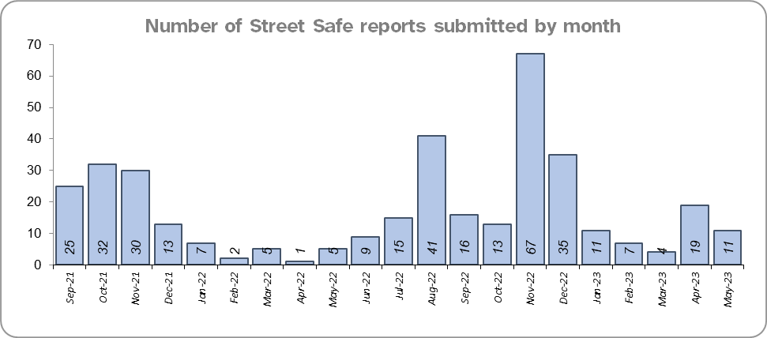
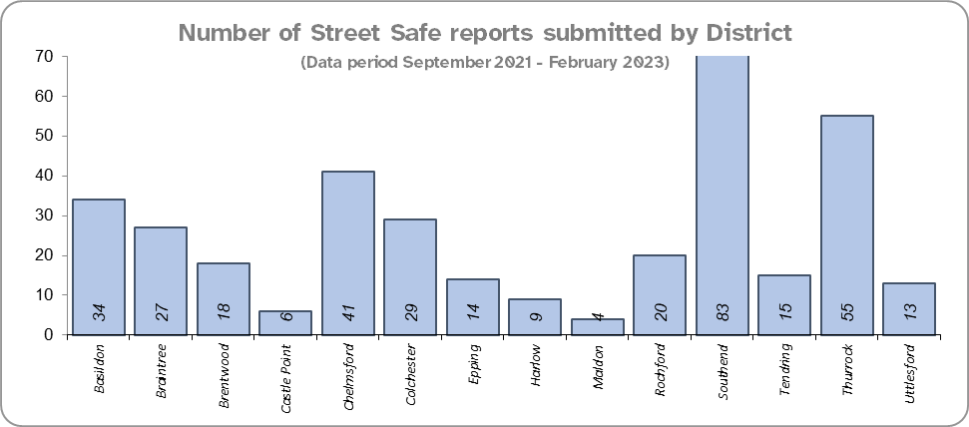
Priority 4 – Reducing violence against women and girls - continued
Grade: Good
The Home Office is trialling a new online tool called StreetSafe on police.uk to enable people, particularly women and girls, to pin-point locations where they feel unsafe or have felt unsafe and identify why that location made them feel unsafe. StreetSafe was developed by the Digital Public Contact (DPC) Programme in cooperation with the Home Office and the National Police Chiefs’ Council (NPCC) and was launched on 2 September 2021 as a national pilot for three months. StreetSafe was introduced into Essex as part of the government’s strategy to tackle Violence against Women and Girls (VAWG). In April 2023, 11 reports were submitted in Essex. In total 368 reports have been submitted for the county.
44.5% of females feel safe walking alone in their area after dark (from the independent survey commissioned by Essex Police) for the 12 months to March 2023 compared to 73.2% of males.
Essex Police is regularly reporting to the national VAWG Taskforce and HMICFRS in respect of its performance, its action plan to tackle VAWG, and its internal conduct and behaviour. This contact also shares best practice and innovation. The national VAWG Taskforce categorise work in three distinct areas: improving trust and confidence in policing; relentless pursuit of offenders; and creating safer spaces. Partnership engagement is key in tackling VAWG, as there are many strands which policing cannot tackle alone; these include education and the prevalence of VAWG and the anonymity of the internet. In March 2023, the NPCC released national findings on VAWG performance.
Essex Police encourage reporting and are working to gain a better understand this type of offence. There has been a decrease in Violence Against the Person offences and Sexual Offences against females compared to last year. Conversely, there has been an increase in the number of sexual offences solved. As such a grade of Good is recommended.
Please note:
* The confidence question was added to the internal survey in September 2021 so year on year comparison is not available.

Slide 15
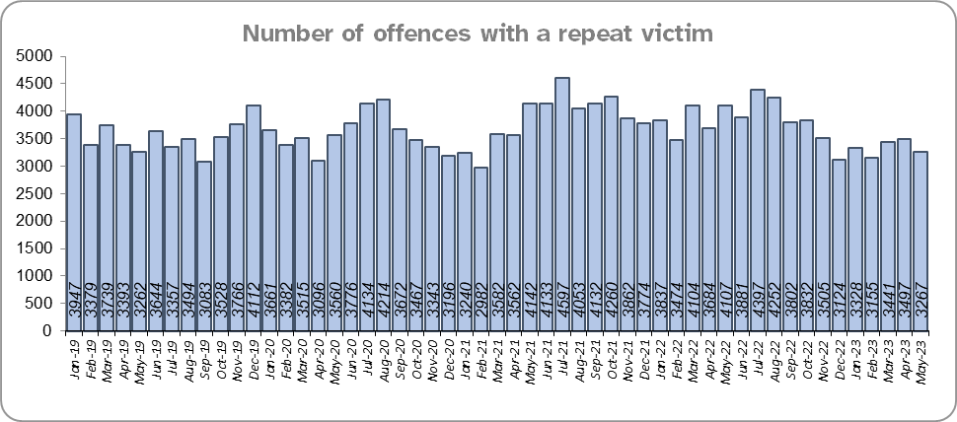
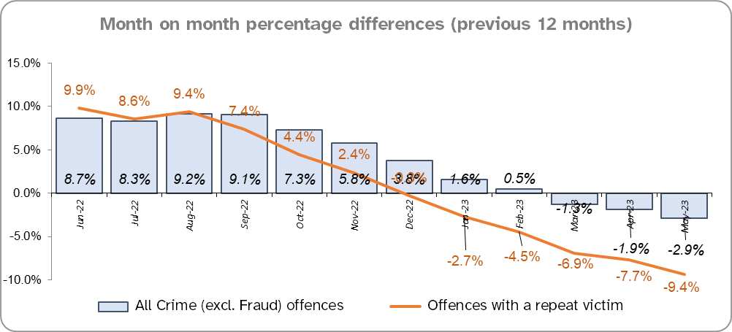
Priority 5 – Improving support for victims of crime
Grade:
Requires Improvement
Essex experienced a 9.4% decrease (4,536 fewer) in the number of offences with a repeat victim for the 12 months to May 2023 (43,481 offences) compared to the 12 months to May 2022 (48,017 offences) and a 1.8% increase (777 more) compared to the 12 months to December 2019 (42,704 offences).* Except for August 2022, the year on year change for repeat victimisation has decreased each month since March 2022.
The number of individual repeat victims decreased by 3.6% (810 fewer) for the 12 months to May 2023 (21,800 individual victims) compared to the 12 months to May 2022 (22,610 individual victims). There was an increase of 2.3% (493 more) compared to the 12 months to December 2019 (21,307 individual victims).
The average number of days taken to investigate High Harm offences increased to 51.6 in May 2023 compared to 43.7 in May 2022 (7.9 days more). There was an increase of 17.5 days compared to December 2019 (44.2 days).
There was a 0.4% decrease in the number of referrals to Victim Support in the 12 months to May 2023 compared to the 12 months to May 2022; this equates to 116 fewer referrals. There was, however, a 31.4% decrease (12,893 fewer referrals) for the 12 months to May 2023 compared to the 12 months to December 2019.***
Please note:
* This metric details how many crimes had a repeat victim rather than the number of individual people who are repeat victims of crime. A repeat victim is someone who has been named as a victim for more than one crime within a 12-month period; to mitigate the fact that multiple crimes can be associated with the same incident, additional crimes with the same victim on the same date are not counted.
** Data are for May only for the last two years.
*** Please see slide 37 for tables detailing Offence details.

Slide 16
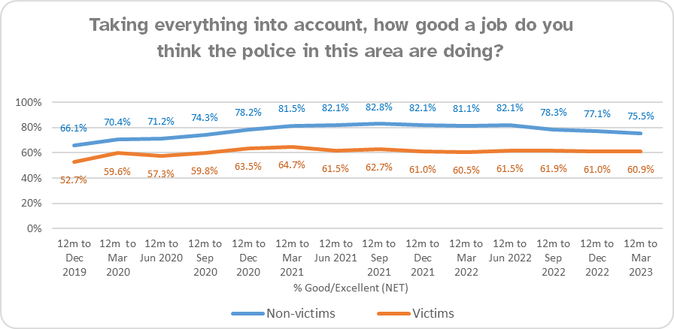
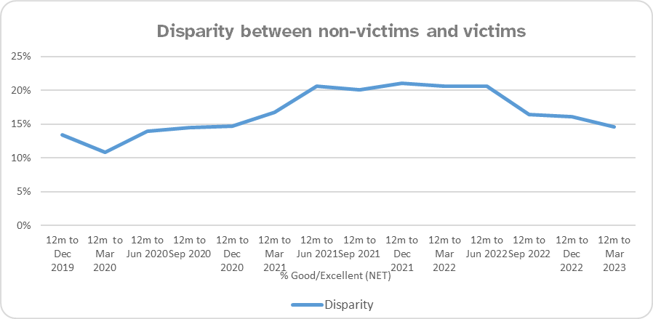
Priority 5 – Improving support for victims of crime - continued
Grade:
Requires Improvement
Confidence among victims (from the independent survey commissioned by Essex Police) is at 60.9% (results to the 12 months to March 2023). Although this is 14.6 percentage points lower than confidence of non-victims for the same period (75.5%), the gap has narrowed from 20.5 percentage points over the same period last year. However, the disparity has increased by 1.2 percentage points compared to the 12 months to December 2019 (13.4%).
Compared to year ending March 2023, confidence in the local police amongst victims is stable, in contrast to confidence amongst non-victims for whom there was a statistically significantly reduction of 5.6 percentage points.
Whilst the number of repeat victims has decreased in the 12 months to April 2023 compared to last year, the average number of days taken to investigate high harm offences has increased substantially when compared to April 2022 and December 2019. Therefore, a grade of Requires Improvement is recommended.

Slide 17
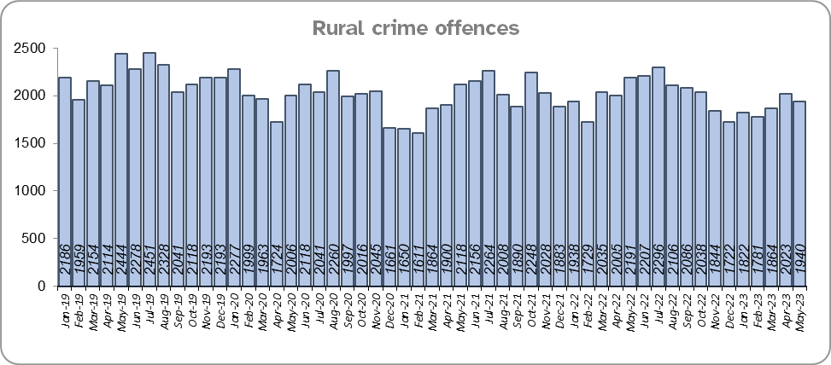
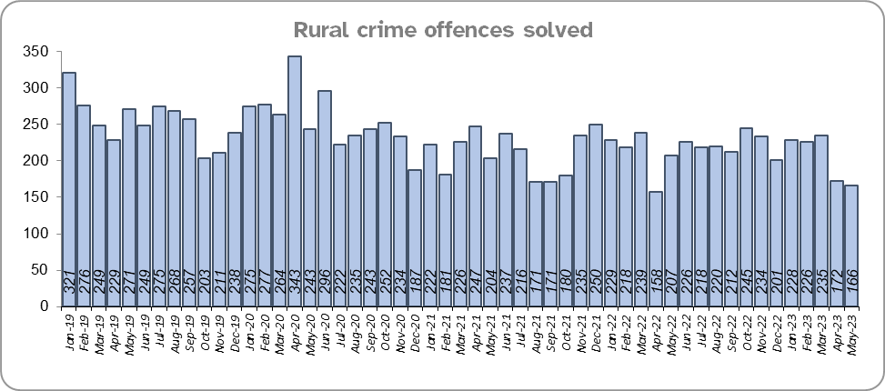
Priority 6 – Protecting rural and isolated areas
Grade: Good
Rural Crime decreased by 2.7% (646 fewer offences) in the 12 months to May 2023 compared to the 12 months to May 2022. During this period All crime decreased by 2.9%. However, Rural Crime decreased by 10.3% (2,730 fewer offences) compared to the 12 months to December 2019. All Crime in Essex decreased by 3.0% in the same period.
Essex Police solved 2.9% (72) more Rural Crime offences for the 12 months to May 2023 compared to the 12 months to May 2022, and 15.2% fewer (a decrease of 464) compared to the 12 months to December 2019.
The Rural Crime Harm (Crime Severity) Score* was 8.6 for the 12 months to May 2023, which is a decrease of 0.3 when compared to the 12 months to May 2022 and lower than the All Crime Harm Score in Essex (14.3) which decreased by 0.5.
Please note:
* Crime Severity Scores (as calculated by the Office for National Statistics) measure the ‘relative harm’ of crimes by taking into account both their volume and their severity. National data are not available for crimes committed in rural areas, so it is not possible to measure against an MSG average; due to this, Essex Police data (to May 2023) have been used rather than national data (which are to March 2023).

Slide 18
Priority 6 – Protecting rural and isolated areas - continued
Grade: Good
Confidence in rural policing (from the independent survey commissioned by Essex Police) is at 74.0% (results to the 12 months to March 2023). Compared to year ending March 2022 (81.5%), confidence in rural policing has deteriorated significantly (by 7.6%), although it remains slightly higher than the current overall Essex average (rural and urban combined) of 73.5%. Since 2019, confidence in Essex Police has increased significantly in every area across Essex.
Essex Police is one of only 15 forces who have dedicated Rural Policing Teams. Essex Police are also continuing their commitment to prevent rural and heritage crime with the innovative launch of a horseback volunteer scheme in Uttlesford. The idea behind the scheme is that horse riders are in a unique position to spot signs of suspicious activity related to offences such as hare coursing, stolen agricultural vehicles, unlawful metal detecting or theft of lead from protected heritage buildings. The horseback volunteers will be trained in what to look out for and will be able to report any concerns or suspicious activity, helping the Force target those committing offences and stop criminality before it happens.
In March 2023, a new Rural Crime Strategy was launched in collaboration with the Essex Rural Partnership (ERP) and the Police, Fire and Crime Commissioner (PFCC).
Confidence in the local police in rural areas is in line with the rest of the county, and offence levels in the 12 months to May 2023 are lower compared to the 12 months to December 2019 (pre-COVID). With an increase in the number of rural offences solved and a decrease in the overall number of Rural Crime offences and the Severity Score, a grade of Good is recommended.
Please note:
* Rural districts: Braintree, Maldon, Tendring and Uttlesford

Slide 19
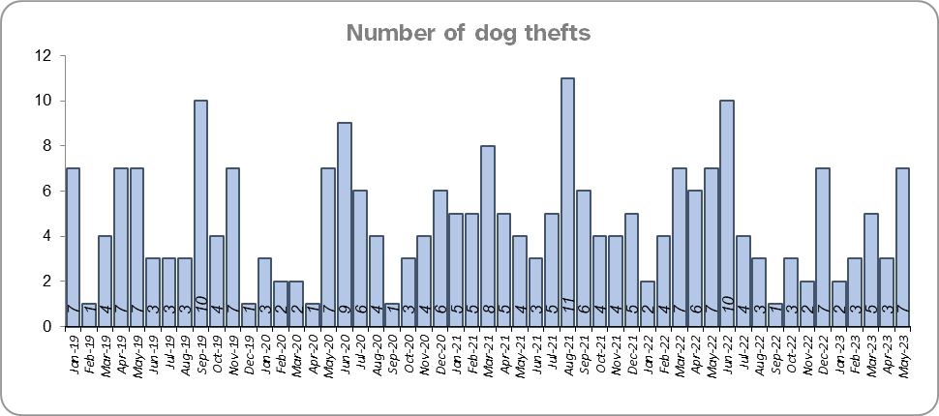
Priority 7 – Preventing dog theft
Grade: Good
There were fourteen fewer dog thefts in Essex for the 12 months to May 2023 compared to the 12 months to May 2022 (50 v. 64). There were seven fewer dog thefts in the 12 months to May 2023 compared to the 12 months to December 2019.
The number of dog thefts solved for the 12 months to May 2023 (1) fell by two compared to the 12 months to May 2022 (3) and by 1 compared to the 12 months to December 2019 (2).
Confidence in how Essex Police and the organisations they work with are dealing with dog theft (from the independent survey commissioned by Essex Police) is at 61.6% for the 12 months to March 2023.
Due to the low and reducing number of thefts across the county (given the comparatively large population of Essex), along with relatively high confidence levels, a grade of Good is recommended.
Please note:
* This is number of thefts in which dogs were stolen, and not quantity of dogs stolen in each theft. Data are based on theft offence crimes and robbery offence crimes where the ‘property code’ is ‘pet animal – dog’ and the ‘property status’ is ‘stolen’ and/or ‘stolen/recovered’.
** The confidence question was added to the internal survey in September 2021 so year on year comparison is not available.

Slide 20
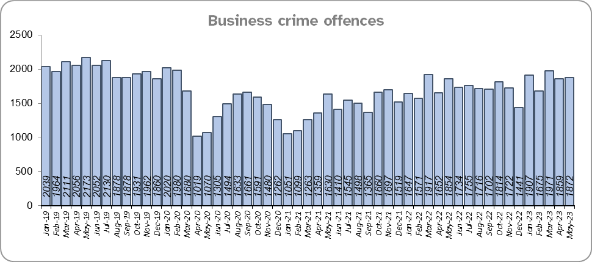
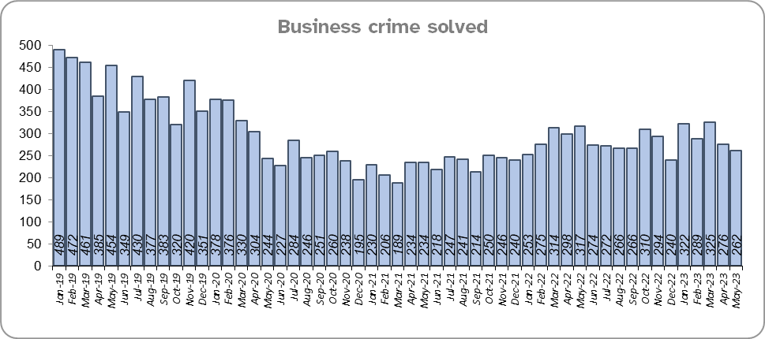
Priority 8 – Reducing business crime, fraud and cyber crime
Grade: Adequate
Business Crime offences include any notifiable crimes recorded with a victim which is an organisation; it does not include Fraud offences. All reports of Fraud are recorded by the National Fraud Intelligence Bureau (NFIB) rather than Essex Police. In the 12 months to May 2023, a total of 1,872 Fraud investigations were allocated to Essex Police by NFIB for investigation. For data on the number and type of Fraud investigations reported as being committed within the Essex Police area, please visit the NFIB Fraud and Cyber Crime Dashboard.
Essex experienced a 9.5% increase (1,833 more) in the number of Business Crime offences and a 9.1% increase (283 more) in the number of these offences which were solved in the 12 months to May 2023 compared to the 12 months to May 2022. Shoplifting accounts for approximately 48.4% of business crime. Essex Police have been working with businesses to encourage them to record more offences.
There was a 11.9% decrease (2,866 fewer) in the number of Business Crime offences and a 30.6% decrease (1,495 fewer) in the number of Business Crimes solved in the 12 months to May 2023 compared to the 12 months to December 2019.

Slide 21
Priority 8 – Reducing business crime, fraud and cyber crime - continued
Grade: Adequate
There was a 10.2% decrease in the number of fraud offences related to business crime in the 12 months to May 2023 compared to the 12 months to May 2022; this equates to 38 fewer offences. There was also a 30.9% decrease in the 12 months to May 2023 compared to the 12 months to December 2019; this equates to 150 fewer offences.
Confidence that Essex Police are dealing with cyber crime (from the independent survey commissioned by Essex Police) is at 48.8% for the 12 months to March 2023.
Two of the five metrics deteriorated when compared to the 12 months to May 2022 (Business Crime offences and the total number of fraud offences). However, despite the increase in Business Crime Offences, the number solved has increased in proportion to this and business related fraud has decreased. Due to the fact that these measures are also improving when compared to the 12 months to December 2019, a grade of Adequate is recommended.
Please note:
* Fraud offences recorded on Athena where the victim is either an organisation or a person with the Business Victim flag.
** The confidence question was added to the internal survey in September 2021 so year on year comparison is not yet available.

Slide 22
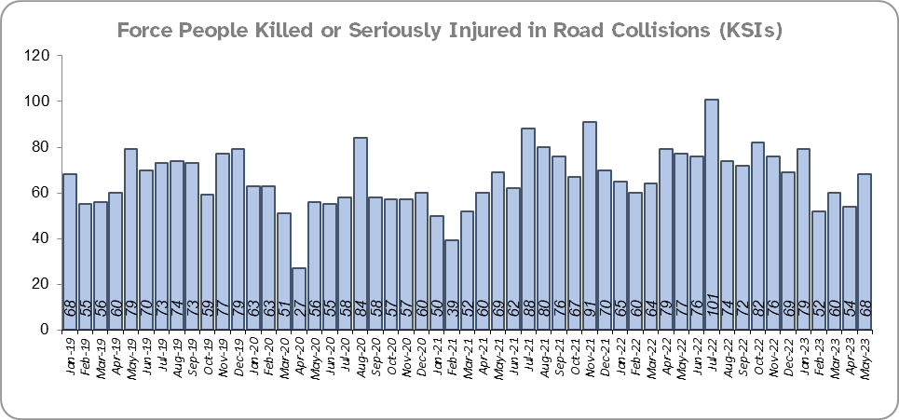
Priority 9 - Improving safety on our roads
Grade:
Requires Improvement
Road traffic safety is the responsibility of the Safer Essex Roads Partnership (SERP). SERP comprises representatives from Essex Police, Essex County Fire & Rescue Service, Essex County Council, Southend on Sea Borough Council, Thurrock Council, National Highways, East of England Ambulance Service Trust, Essex and Herts Air Ambulance Service Trust and The Safer Roads Foundation (Registered Charity). The aspiration of Essex Police and partners is ‘Vision Zero’, namely to have no road deaths or serious injuries by 2040. The SERP Safety delivery plan sets out a structured programme of educational and engagement activity to address this and support behavioural changes.
There was a 1.8% decrease (16 fewer) in the number of those Killed or Seriously Injured (KSI) in Essex for the 12 months to May 2023 compared to the 12 months to May 2022. The number of KSIs increased by 40 in the 12 months to May 2023 compared to the 12 months to December 2019, however.
Essex recorded the third highest number of casualties per 100 million vehicle kilometres (results to June 2021) in its Most Similar Group (MSG) of eight forces; Essex are above the MSG average also. However, due to the fact that more recent national figures have not been released, the current position cannot be determined (the date of the next national release has not yet been confirmed).
Please note that not all KSIs will result in a criminal offence, for instance where a fatal collision has been caused by bad weather or because of a medical episode suffered by the driver.

Slide 23
Priority 9 - Improving safety on our roads - continued
Grade:
Requires Improvement
There was a 9.3% decrease (227 fewer offences) in drink/drug driving offences for the 12 months to May 2023 compared to the 12 months to May 2022. There was a 15.1% decrease (229 fewer offences) in drink driving and a 0.2% increase (2 more offences) in drug driving. There was also a 32.9% decrease (1,090 fewer offences) in drink/drug driving offences for the 12 months to May 2023 compared to the 12 months to December 2019; of these offences, there was a 12.5% decrease (184 fewer offences) in drink driving and a 49.1% decrease (906 fewer offences) in drug driving. All of these offence types are primarily driven by police proactivity in relation to road safety.
The number of Failure to Provide samples decreased by 8.4% (30 fewer) in the 12 months to May 2023 compared to the same period last year, and by 18.3% compared to the 12 months to December 2019.
There was a 202.3% increase (1,236 more offences) in the number of driving related mobile phone offences recorded for the 12 months to May 2023 compared to the 12 months to May 2022.*
Confidence in Essex Police and organisations with whom they police the roads (from the independent survey commissioned by Essex Police) is at 66.0% (results to the 12 months to March 2023). Confidence in the local police and organisations they work is stable when compared to year ending March 2022 (64.0%).
Due to the increase in KSIs compared to the 12 months to December 2019 and the decrease in the number of driving under the influence of drink drug driving in the past 12 months compared to the previous 12 months and the 12 months to December 2019 a grade of Requires Improvement is recommended.
Please note:
* In 2019, the definition as to what constituted “use” of a mobile phone in relation to driver-related mobile phone offences was subject to a legal challenge. This resulted in a ruling, which held that while “use” included accessing the interactive functions of the mobile phone (such as making calls, sending messages or using the internet), it did not extend to solely accessing the device’s internal functions (such as making use of the camera). Fewer mobile phone offences were subsequently prosecuted from this point. In 2021 the government announced that the law was to be changed making it illegal to “hold” a phone or sat nav when driving or riding a motorcycle. This law was finally passed on 25th March 2022.

Slide 24
Priority 10 – Encouraging volunteers and community support
Grade: Adequate
Essex Watch Liaison Officers continue to work with Neighbourhood Watch (NHW) to offer crime and fraud prevention advice.*
Citizens in Policing and the Special Constabulary play an integral part in supporting Essex Police. In January 2022, the Local Policing Support Unit (LPSU) introduced a Strategic Co-ordination Group which proactively supports, throughout the county, the mobilisation of all Special Constables, Police Support Volunteers, Active Citizens, Accredited Persons and, where appropriate our Volunteer Police Cadets, with local operations and initiatives under the Chief Constable’s Plan on a Page and the Police, Fire Crime Commissioner’s Police and Fire Plan.
Since last month’s report, there are now: 33 more dog group members, four more farm and rural group members, one more caravan group member, one more horse group member, one less allotment group member and one less heritage group member.
There are currently 2,343 NHW Co-ordinators and 79,449 NHW members.
Please note:
* Neighbourhood Watch data were first produced in March 2022 so year on year comparison is not available.

Slide 25
Priority 10 – Encouraging volunteers and community support
Grade: Adequate
The Special Constabulary headcount is currently 300 (as of 31 May 2023). This is down 32.1% (142 fewer) compared to May 2022. Compared to the 12 months to December 2019 this is down 42.2% (219 fewer).
There are 220 Volunteer Police Cadets (VPCs) and 86 Volunteer Cadet Leaders across 13 Cadet Units. In addition, there are 98 Police Support Volunteers and 54 Active Citizens within Essex Police across the county, a total of 152 Volunteers. These volunteers also are part of the Strategic Co-ordination Group and support their Local Community Policing Teams with local events.
Confidence that there are good opportunities for volunteers to assist policing and reduce crime in Essex (from the independent survey commissioned by Essex Police) is at 54.0% for the 12 months to March 2023. Confidence has increased each quarter since Q4 2021/22 (45.1%).
The Special Constabulary headcount has decreased significantly compared to 12 months ago and December 2019. However, due to the fact that Essex has the second largest Special Constabulary in the country***, the Force’s use of Ethics Boards to inform its work and the uptick in watch group membership, a grade of Adequate is recommended.
Please note:
* Monthly data only collected from December 2022 so year on year comparisons not available. Of the 13 Cadet Units 10 are active and 3 are temporarily suspended due to not enough leader coverage in that area. Recruitment is ongoing to get the units up and running again. They are Southend, Chelmsford & Braintree.
** The confidence question was added to the internal survey in September 2021 so year on year comparison is not available.
*** As of September 2022. The latest National Police Workforce Statistics were published in January 2023 and are updated bi-annually.

Slide 26
Priority 11 – Supporting our officers and staff
Grade: Adequate
There has been a slight decrease (0.18%) in the proportion of ethnic minority employees in May 2023 (266) compared to May 2022 (277); this equates to 11 fewer employees. However, in contrast, there has been an increase of 49 compared to December 2019 (217).
In the 12 months to May 2023, 431 new officers took their oaths to the King and started their Essex Police careers. The new officers pledged their commitment to police with the consent of every community at a time when the Force is welcoming more new colleagues from a range of different backgrounds. Over the same period, 259 officers left their positions, leading to an overall increase of 172 officers over the last year.
The average days lost per person for sickness decreased for all employee types in the 12 months to May 2023 compared to the 12 months to May 2022. Full Time Employee vacancies deteriorated for all employee types except PCSOs over the same period. For these reasons a grade of Adequate is recommended.
Please note:
* Ethnic minority employees as a percentage of the total workforce.
** Ethnic minority employees as a percentage of type of employee.

Slide 27
Priority 12 – Increasing collaboration
Grade: Adequate
The data in this section is provided by Essex County Fire and Rescue Service as part of the Joint Essex Fire and Police Education in Schools Programme (2022). Except for audience numbers, school visit data has been provided up to March 2023 as data to the end of May is not yet available.
There has been a 12.3% decrease (17,595 fewer) in audience numbers in the 12 months to May 2023 (125,733) compared to the 12 months to May 2022 (143,328).
1,028 school visits at 361 unique schools were conducted in the 12 months to March 2023. 67.7% of these were at primary schools.
Over the 12 months to May 2023 audience numbers have decreased compared to the 12 months to May 2022, however, due to a lack of further qualitative information, a grade of Adequate is recommended.
Please note:
* Data is to March 2023. Due to changes to the way data is recorded, data is only available from January 2022. As such, year on year comparisons are not possible.
** Data only available to September 2022.
*** Data only available to March 2023

Slide 28
Monthly Performance Overview: Exceptions
Exceptions Overview
The force saw a statistically significant decrease in Stalking & Harassment offences in May 2023 and a statistically significant increase in Theft of a Vehicle offences in May 2023.
Stalking & Harassment– Decrease
19.3% decrease (5,368 fewer crimes) for the 12 months to May 2023 compared to the 12 months to May 2022. There were statistically exceptional decreases in three Districts in May 2023: Colchester, Southend and Castle Point. This has been driven by both a Force-wide effort to review and cancel duplicate offences and changes to Home Office counting rules, which came into effect on 1 May 2023.
Theft of a Vehicle – Increase
21.4% increase (956 more crimes) for the 12 months to May 2023 compared to the 12 months to May 2022. There were statistically exceptional increases in two Districts in May 2023: Rochford and Brentwood.

Slide 29
2021-2024 Police and Crime Plan Performance Indicators
Table 1
Please view above table with the explanations and caveats detailed on slides 32 and 33.

Slide 30
2021-2024 Police and Crime Plan Performance Indicators - continued
Table 2
Please view above table with the explanations and caveats detailed on slides 32 and 33.

Slide 31
2021-2024 Police and Crime Plan Performance Indicators - continued
Table 3
Please view above table with the explanations and caveats detailed on slides 32 and 33.

Slide 32
End Notes
¹ Crime Severity Score measures ‘relative harm’ of crimes by taking into account both the volume and the severity of offences, and by weighting offences differently. National data for the 12 months to March 2023 have been used in order that comparisons can be made to Essex’s Most Similar Group of Forces (MSG).
² Please note that on Wednesday 23 October 2019 the bodies of 39 Vietnamese nationals were discovered in a lorry trailer in Grays. This tragic incident is reflected in the Homicide numbers.
³ October 2021 saw the implementation of Operation SOMERTON, which aims to both improve the service given to victims of ASB and ensure crimes are correctly recorded.
⁴ Question from the independent survey commissioned by Essex Police. Results are for the period 12 months March 2023 versus the 12 months to March 2022.
⁵ The confidence interval is the range +/- within which the survey result will lie. This is mainly influenced by the number of people answering the survey. The more people that answer the survey, the smaller the interval range.
⁶ The methodology used for identifying these investigations as drug related is subjective and based on the circumstances presented. These figures will include investigations where the victim or the suspect are involved Drug Use, Possession or Selling.
⁷ The number of knife crime offences is an indicator of how effective Essex Police is at identifying knife-enabled offences, and is not necessarily reflective of the number of these offences that have been committed in the county. This is because the identification of these offences is reliant on the appropriate indicator being manually added to the crime record. A manual review of knife flags was conducted and missing flags were added retrospectively. Additionally a new data quality process was introduced in June 2020. Whilst this has enabled us to better understand knife crime in Essex, the process has consequently inflated the figures. As such, no inferences can be drawn as to the current trend.
⁸ OCG disruptions are reported quarterly. Data are to March 2023.
⁹ Solved outcomes are crimes that result in: charge or summons, caution, crimes taken into consideration, fixed penalty notice, cannabis warning or community resolution.
¹⁰ NRM data only available from April 2019 due to recording change at that time.
¹¹ High Harm offences: Violence with Injury, Rape, Other Sexual Offences, Robbery of Personal Property and Residential Burglary. Average number of days are for the previous month in all three periods.
¹² This is the number of theft offences in which dogs were stolen, and not necessarily the number of dogs which were stolen.

Slide 33
End Notes - continued
¹³ ‘Killed or Seriously Injured’ (KSI) refers to all people killed or seriously injured on Essex’s roads, regardless of whether any criminal offences were committed. ‘Causing Death/Serious Injury by Dangerous/Inconsiderate Driving’ offences (detailed on slide 22) refers to the number of crimes of this type.
¹⁴ In 2019, the definition as to what constituted “use” of a mobile phone in relation to driver-related mobile phone offences was subject to a legal challenge. This resulted in a ruling, which held that while “use” included accessing the interactive functions of the mobile phone (such as making calls, sending messages or using the internet), it did not extend to solely accessing the device’s internal functions (such as making use of the camera). Fewer mobile phone offences were subsequently prosecuted from this point. In 2021 the government announced that the law was to be changed making it illegal to “hold” a phone or sat nav when driving or riding a motorcycle. This law was finally passed on 25th March 2022.
¹⁵ Monthly data only collected from December 2022 so year on year comparisons not available.
¹⁶ Neighbourhood Watch data are reported quarterly. Data as at 31st March 2023.
¹⁷ Ethnic minority employees as a percentage of the total workforce.
¹⁸ Absence data: Rolling from 1st April each year.
¹⁹ Data provided by the Fire Service. Comparison data provided to the 12 months to December 2022 only. Data for School Visits and Programmes are to March 2023. Data for Audience numbers are to May 2023.
²⁰ Number of offences with repeat victim including month on month percentage change.

Slide 34
Crime Tree Data – Rolling 12 Months to May
Table 4

Slide 35
Crime Tree Data – Rolling 12 Months to May - continued
Table 5

Slide 36
Crime Tree Data - Rolling 12 months to May Violence against the Person and Sexual offences and outcomes (by crime type) split by gender
Table 6
Please note: the breakdown of data for the previous 12 months within these tables may not tally with the totals on slide 13 as gender data is rerun on a monthly basis.

Slide 37
Victim Referrals by Crime offence - Rolling 12 months to May 2023
Table 7
Please note: data updated quarterly.

