Slide 1


Police and Crime Plan 2021-2024
Monthly Performance Update
DRAFT
January 2023
National and MSG positions are to 30 November 2022 (Essex Police data are to 31 January 2023).
Version 1.7
Produced February 2023
Performance Analysis Unit, Research & Analysis Department, Essex Police
Sensitivity: Official

Slide 2
Executive Summary
The Police and Crime Plan 2021-2024 was introduced in April 2021, with new measures that reflect the Essex Police, Fire and Crime Commissioner’s (PFCC) strategic commitment to targeted prevention and early intervention. On 13 December 2022, the Chief Constable of Essex Police and the Police, Fire & Crime Commissioner for Essex agreed that more measures should be included so a more holistic and rounded view of the Force’s performance against the Police and Crime Plan could be provided.
Three of the twelve PFCC Priorities have been given a recommended grade of ‘Good’: 2 (Reducing drug driven violence), 3 (Protecting vulnerable people and breaking the cycle of domestic abuse) and 7 (Dog Theft). Seven have been given a recommended grade of ‘Adequate’ and two have been given a recommended grade of ‘Requires Improvement’: 5 (Improving support for victims of crime) and 9 (Improving safety on our roads).
Priorities 2, 4 and 12 (Drug driven violence, VAWG and Collaboration) have improved their grading this month, whilst priority 6 (Rural and isolated areas) have deteriorated. The gradings for the remaining eight priorities have remained stable compared to last month.
Priority 2 (Reducing Drug Driven Violence) has been upgraded from ‘Adequate’ to ‘Good’ since the last report. This is due to the fact that two of the four metrics – namely drug related homicides and knife-enabled crimes – have improved when compared to the 12 months to January 2022, whilst only one has deteriorated. Priority 4 (Reducing Violence Against Women and Girls) has been upgraded from ‘Requires Improvement’ to ‘Adequate’. This is because there has been a reduction in the number of Sexual offences against females; although there was also a reduction in the number solved, this was in proportion to the reduction of the number of offences which were recorded in the same period. Priority 12 (Collaboration) has been upgraded from ‘Requires Improvement’ to ‘Adequate’. This is because this priority requires additional context so that a more accurate grading can be given.
Priority 6 (Protecting Rural and Isolated Areas) has been downgraded from ‘Good’ to ‘Adequate’. This is due to a deterioration in three of the four measures; Rural Crime Offences, Harm (Crime Severity) Score and Confidence in Rural Policing. It is of note that the number of solved offences increased, albeit in proportion to the number of offences which were recorded in the same period.
Confidence (from the independent survey commissioned by Essex Police) was at 76.3% for the 12 months to September 2022. Confidence increased by 11.6 percentage points compared to the 12 months to December 2019 (64.7%); the 12 months to December 2019 has been used as a comparative period as it was the last full year (and last full financial quarter) in which society, crime and policing was not affected by the pandemic. Although confidence in the local police has deteriorated significantly compared to year ending September 2021 (80.9%), falls in confidence are reflected in publicly available trackers; in the past year, YouGov reported a fall of 10% in the number of people who say the Police are doing a ‘Good Job’. Forces contacted separately by Essex Police similarly reported patterns similar to Essex Police: confidence was high during COVID, but has been in general decline ever since (the last two quarters especially have seen significant decreases).
There was a decrease in All Crime (2.3%), Rural Crime (8.8%) and Business Crime (13.8%) for the 12 months to January 2023 compared to the 12 months to December 2019. However, compared to the 12 months to January 2022, All Crime increased by 1.6%; this equates to 2,580 more offences. When looking at one month, All Crime is down 3.1%, whilst the volume of solved crimes increased by 245 in January 2023 compared to January 2022. Similarly, the three month trend saw All Crime fall by 5.8% whilst the volume of solved crimes increased by 327 in the three months to January 2023 compared to the three months to January 2022.
Essex experienced a 2.8% decrease (1,317 fewer) in the number of offences with a repeat victim for the 12 months to January 2023 (45,547 offences) compared to the 12 months to January 2022 (46,864 offences). Except for August 2022, the year on year increase in repeat victimisation has been reducing each month since March 2022.¹ However, the number of individual repeat victims increased by 1.6% (346 more) for the 12 months to January 2023 (22,331 individual victims) compared to the 12 months to January 2022 (21,985 individual victims). It is of note that any over-recording of Stalking and Harassment offences (discussed on the next slide) will impact both the number of repeat victims and the number of offences with a repeat victim.

Slide 3
Executive Summary - continued
Essex Police prides itself on having excellent Crime Data Accuracy (CDA). In its most recent inspection by HMICFRS, Essex Police was graded as Outstanding in relation to its CDA. Maintaining excellent CDA, however, requires the Force to neither under-record nor over-record offences. To this end, Essex Police is auditing and – where appropriate – cancelling Stalking & Harassment (S&H) offences to ensure additional crimes have not been unnecessarily recorded. Essex Police have also been educating those working within the Resolution Centre to ensure they fully research the individuals involved in these types of offences before they create new crimes; where previous records exist, these additional incidents are instead referred to the relevant officer(s) in order that they can be investigated together. This activity has therefore not only resulted in a decrease in offences since the start of the review (August 2022) but has enabled the Force to better coordinate these types of investigations. As of 31 January 2023, 904 records have been reviewed as potential duplicate crimes and 320 sent for cancellation; of these, 233 records (72.8%) have now been cancelled. It is of note that Stalking and Harassment offences comprise the largest volume of Violence Against Women & Girls offences (VAWG) and accounts for 20.5% of all Domestic Abuse investigations. There were, for example, 2,423 fewer Stalking and Harassment crimes committed against females in the 12 months to January 2023 (15,562 crimes) compared to the 12 months to January 2022 (17,985 crimes).
Violence Against the Person (VAP) offences committed against females decreased by 3.9% (1,514 fewer) in the 12 months to January 2023 compared to the 12 months to January 2022. There was also a 1.3% decrease (61 fewer) in the number of sexual offences against females in the 12 months to January 2023 compared to the 12 months to January 2022. However, Essex Police solved four fewer (-1.4%) sexual offences committed against females in the 12 months to January 2023 compared to the 12 months to January 2022.
When comparing High Harm² offences to its Most Similar Group (MSG) by crimes per 1,000 population, Essex is placed fourth (out of eight police forces) for Other Sexual Offences, fifth for Violence with Injury, sixth for Burglary Residential, and eighth for Rape and Robbery of Personal Property (first is considered to be the “best” performing force, and eighth the “worst”).
There was a 8.5% increase (70 more) in the number of those Killed or Seriously Injured (KSI) in Essex for the 12 months to January 2023 compared to the 12 months to January 2022. Since August, the number of incidents reported each month has been slightly below those experienced in 2021 (although there were 14 more incidents in October 2022 compared to October 2021: 81 v. 67). It is of note that road traffic safety is the responsibility of the Safer Essex Roads Partnership (SERP) which includes Essex Police, Essex County Fire & Rescue Service, Essex County Council, Southend on Sea Borough Council, Thurrock Council, National Highways, East of England Ambulance Service Trust, Essex and Herts Air Ambulance Service Trust, and The Safer Roads Foundation (Registered Charity).
Essex Police conducted 37 more OCG disruptions in the 12 months to December 2022 compared to the 12 months to December 2021.
Theft from a Vehicle, Theft of a Vehicle, Shoplifting and Trafficking of Drugs experienced a statistically significant increase in offences in January 2023. It is of note that Drug Trafficking offences are an indication of police proactivity and not necessarily of drug dealing activity levels in the county.
In spite of the fact that an article published in The Guardian in December³ indicated that more than 1,800 police officers recruited under the Government’s pledge to increase numbers have already resigned, Essex Police now has the highest numbers of officers in its 182-year history. The Force is also on track to have a total of 3,755 officers by March 2023. It is also of note that there has been a steady and continual increase in the numbers and proportion of employed female colleagues.

Slide 4
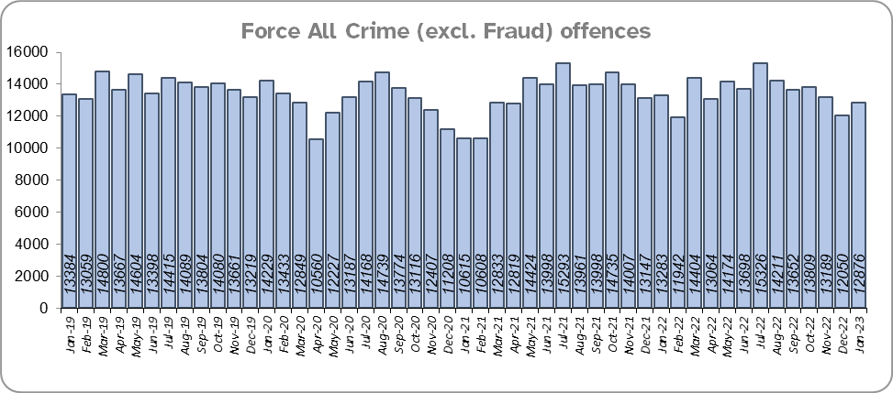
Priority 1 – Further investment in crime prevention
Grade:
Adequate
There was a 2.3% decrease in All Crime in the 12 months to January 2023 compared to the 12 months to December 2019; this equates to 3,941 fewer offences. There was, however, a 1.6% increase in All Crime (2,580 more offences) for the 12 months to January 2023 compared to the 12 months to January 2022. Essex is seventh in its Most Similar Group of forces (MSG) for all crime per 1,000 population.
Essex Police recorded a daily average of 415 crimes in January 2023, compared to an average of 389 crimes recorded in December 2022. This equates to an increase of 6.9%, or an average of 27 more crimes recorded per day.
12,876 offences were recorded in the month of January 2023, a decrease of 3.1% (407 fewer offences) compared to the month of January 2022 (13,283 offences), and a decrease of 3.8% (508 fewer offences) compared to the month of December 2019.
The All Crime Harm (Crime Severity) Score* (14.6) places Essex seventh in its MSG.
Please note:
* Crime Severity Scores (as calculated by the Office for National Statistics) measure the ‘relative harm’ of crimes by taking into account both their volume and their severity. As national data are only available to November 2022, the score for the 12 months to November for the preceding year has been included.

Slide 5
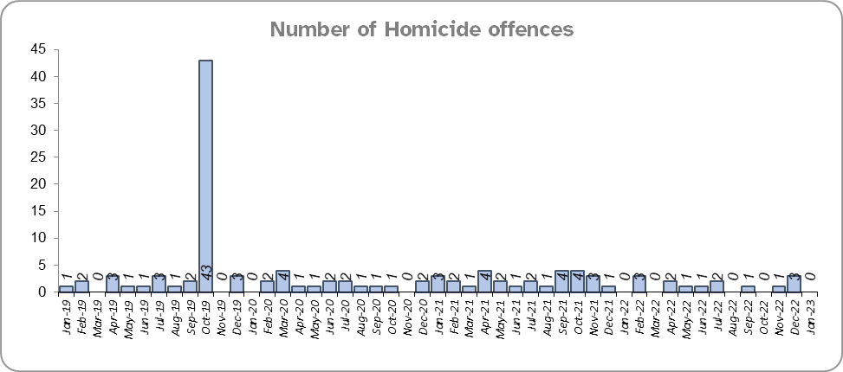
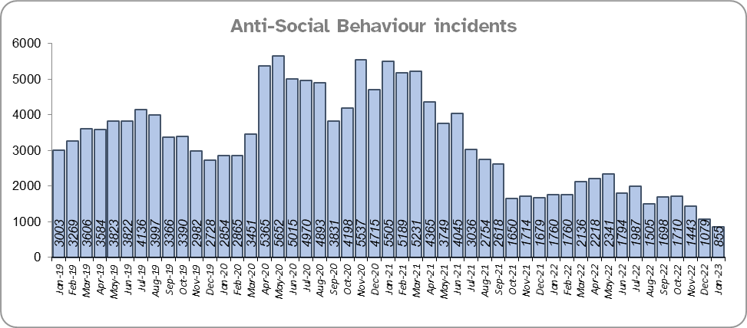
Priority 1 - Further investment in crime prevention - continued
Grade:
Adequate
Seven fewer Homicides (to 15 offences) were recorded for the 12 months to January 2023 compared to the 12 months to January 2022.
The number of Homicides decreased by 75.4% (46 fewer offences) in the 12 months to January 2023 compared to the 12 months to December 2019.*
Essex experienced a 34.3% decrease (12,779 fewer) in Anti-Social Behaviour (ASB) incidents for the 12 months to January 2023 compared to the 12 months to January 2022.** There was a decrease of 41.8% ASB reports in the 12 months to January 2023 compared to the 12 months to December 2019 (17,549 fewer incidents). The average daily number of ASB incidents decreased by 20.8% in January 2023 (28 incidents) compared to December 2022 (35 incidents).
Please note:
* In October 2019 the bodies of 39 Vietnamese nationals were discovered in a lorry trailer in Grays. This tragic incident is reflected in the Homicide numbers for the 12 months to December 2019.
** October 2021 saw the implementation of Operation SOMERTON, which aims to both improve the service given to victims of ASB and ensure crimes are correctly recorded.

Slide 6
Priority 1 - Further investment in crime prevention - continued
Grade:
Adequate
Essex Police received 13,254 fewer 101 calls to the Force Control Room (FCR), a decrease of 5.2% in the 12 months to January 2023 (243,197 calls) compared to the 12 months to January 2022 (256,451). There was a 17.0% decrease compared to the 12 months to December 2019 (293,049 calls).
33.2% of FCR 101 calls were abandoned in January 2023, an increase of 20.4 percentage points. when compared to the same period last year, (12.8%). There was a small decrease of 0.8 percentage points when compared to December 2019 (34.0%). The average wait time increased by over seven minutes in January 2023 when compared to January 2022, and an increase of almost three minutes when compared to December 2019.
The Resolution Centre received 3,307 more calls (an increase of 3.9%) in the 12 months to January 2023 (88,192 calls) compared to the 12 months to January 2022 (84,885). There was a 17.8% decrease compared to the 12 months to December 2019 (107,347 calls).
22.8% of Resolution Centre (RC) calls were abandoned in January 2023, an increase of 16.1 percentage points. when compared to the same period last year, (6.8%). There was a small decrease of 0.7 percentage points when compared to December 2019 (23.5%). The average wait time increased by almost eighteen minutes in January 2023 when compared to January 2022, and an increase of over six minutes when compared to December 2019.
Due to concerns in this area, Contact Management is one of the Force’s major change programmes, aiming to optimise and improve processes.
The number of online reports increased by 23.4% (6,548 more) in the 12 months to January 2023 compared to the 12 months to January 2022. The number of reports also increased by 40.9% (10,014 more) compared to the 12 months to December 2019.

Slide 7
Priority 1 - Further investment in crime prevention - continued
Grade:
Adequate
Confidence has experienced a statistically significant improvement compared to levels reported prior to the pandemic (by 11.6 percentage points from 64.7% for the 12 months to December 2019). It was during the height of the pandemic that confidence reached its highest levels. Although there was a statistically significant decrease in confidence of 4.5 percentage points (from the independent survey commissioned by Essex Police) in the 12 months to September 2022 (76.3%) compared to the 12 months to September 2021 (80.9%), falls in confidence are reflected in publicly available trackers; in the past year, YouGov reported fall of 10% in the number of people who say the Police are doing a ‘Good Job’. Forces contacted separately by Essex Police similarly reported patterns similar to Essex Police: confidence was high during COVID, but has been in general decline ever since (the last two quarters especially have seen significant decreases).
Four of the twelve metrics in this Priority have improved when compared to the 12 months to January 2022 (homicides, ASB incidents, 101 calls received and online reports), eight have deteriorated (all crime offences, Crime Severity Score, RC calls received, percentage of FCR and RC 101 calls abandoned, FCR and RC average wait times and confidence). When compared to the pre-COVID period, there has been a reduction in crime and an increase in confidence. Furthermore when looking at recent performance, month on month performance and the last 3 month trend and comparison, a reduction in crime is seen along with an increase in volume of crimes solved . As such, a grade of Adequate is recommended.

Slide 8
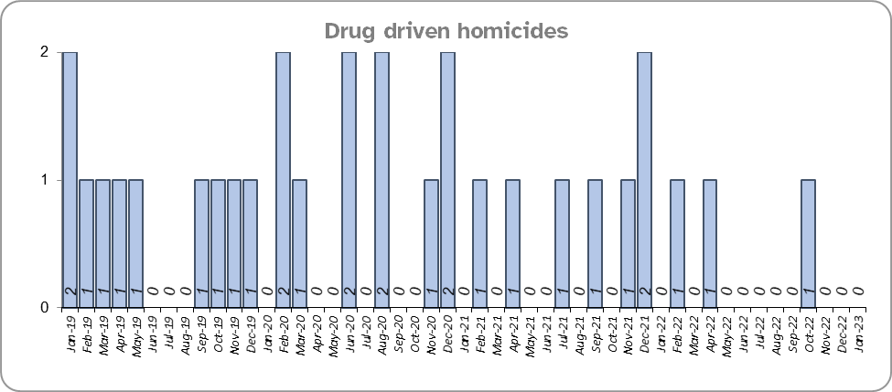
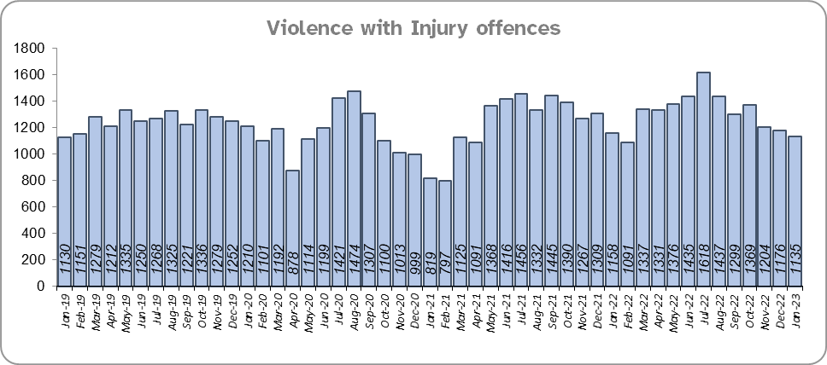
Priority 2 – Reducing drug driven violence
Grade: Good
Essex experienced four fewer drug related homicides (3) for the 12 months to January 2023 compared to the 12 months to January 2022 (7) and seven fewer compared to the 12 months to December 2019.
There was an 5.9% increase (887 more offences) in Violence with Injury (VWI) offences for the 12 months to January 2023 compared to the 12 months to January 2022. There was a 4.2% increase compared to the 12 months to December 2019 (644 more offences).
Please note:
* The methodology used for identifying investigations as being drug-related is subjective (qualitative data) and based on the circumstances presented. These figures include investigations where the victim and/or suspect are suspected of being involved in Drug Use, Possession or Selling. Data has been re-run to reflect the current position. This will be run on a annual basis due to the complexity of the process.

Slide 9
Priority 2 – Reducing drug driven violence – continued
Grade: Good
There was a 0.6% increase (10 more) in the number of knife-enabled crime offences in the 12 months to January 2023 compared to the 12 months to January 2022. The number of knife-enabled crime offences also increased by 0.6% (10 more) in the 12 months to January 2023 compared to the 12 months to December 2019.
Essex conducted 11.4% more Organised Crime Group (OCG) disruptions (37 more) for the 12 months to December 2022 compared to the 12 months to December 2021. Although there was a 265.7% increase compared with the 12 months to December 2019 (263 more), this is due to a breakdown in the communication between the data from the operation activity to the figures which were produced by the Eastern Region Special Operations Unit (ERSOU)***.
Confidence that Essex Police and partners are dealing with drug crime (from the independent survey commissioned by Essex Police) is at 61.0% for the 12 months to September 2022. The results for this question have been stable since it was first asked in September 2021.
Drug related homicides have fallen, whilst confidence is relatively high. Knife-enabled crime is stable and OCG disruptions are higher. However, there has been an increase in the number of VWI offences when compared to the same period. Overall, with two measures improving, one stable and one deteriorating, a grade of Good is recommended.
Please note:
* The number of knife crime offences is an indicator of how effective Essex Police is at identifying knife-enabled offences, and is not necessarily reflective of the number of these offences that have been committed in the county. This is because the identification of these offences is reliant on the appropriate indicator being manually added to the crime record. A new data quality process was introduced in June 2020 and Essex Police is currently working with the National Data Quality Improvement Service (NDQIS) to revise knife crime flags. In September 2021, data from April 2019 was revised; this resulted in an increase in the number of offences recorded. This has enabled Essex Police to better understand knife crime in Essex.
**The confidence question was added to the external independent survey in September 2021. A year on year comparison is therefore not available.
*** In the fiscal year 2019/20 the disruption returns to the Eastern Region Special Operations Unit (ERSOU) averaged 25 a quarter. A process review identified a breakdown in the communication of the data from the operation activity to the figures produced by ERSOU. A project of improvement was implemented which focussed on improving the communication between teams internally, and more importantly with ERSOU, to understand the parameters of what a disruption is and share this information with all teams within Essex Police. Over a two year period a continual improvement of disruption figures has come from a refinement of the communication and claiming process. This has been focussed on ensuring that we are claiming all possible disruptions of OCGs, tracking all activity from inception to closure, being innovative in our activity led by the Organised Crime Group Management Unit (OCGMU) and highlighting and educating new teams on how they can impact OCGs in their daily work. The moderation process has also been refined to ensure consistency with ERSOU. OCG disruption data are provided quarterly, data is to December 2022.

Slide 10
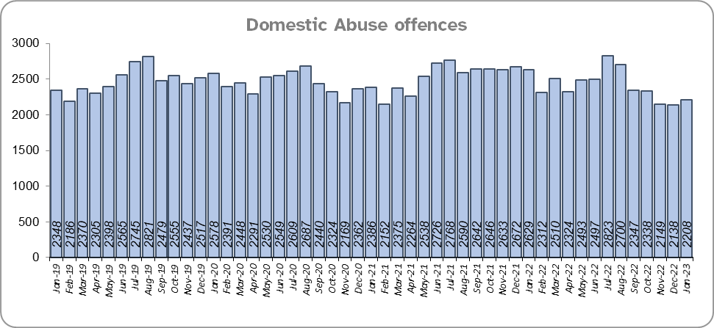
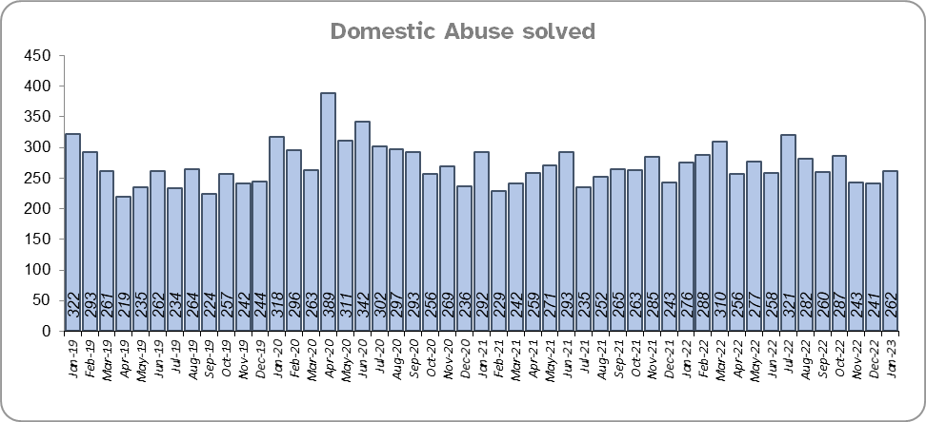
Priority 3 - Protecting vulnerable people and breaking the cycle of domestic abuse
Grade: Good
Essex experienced a 5.9% decrease (1,796 fewer) in the number of recorded Domestic Abuse (DA) offences for the 12 months to January 2023 compared to the 12 months to January 2022. The Force recorded 1,439 fewer offences in the three months to January 2023 compared to the three months to January 2022 (6,495 v. 7,934). It is of note that Stalking & Harassment offences account for more than a fifth (20.5%) of all Domestic Abuse investigations and that Essex Police are currently auditing and – where appropriate – cancelling Stalking & Harassment offences to ensure additional crimes have not been unnecessarily recorded.
Essex Police solved 5.5% (172) more DA offences for the 12 months to January 2023 compared to the 12 months to January 2022. The Force solved 58 fewer offences in the three months to January 2023 compared to the three months to January 2022 (804 v 746).
There was a 3.0% decrease (887 fewer) in DA offences and a 9.3% increase (280 more) in the number of DA offences solved for the 12 months to January 2023 compared to the 12 months to December 2019.
There were 1,939 fewer repeat victims of DA in the 12 months to January 2023 compared to the 12 months to January 2022 (9.2% less). There was also a decrease of 6.9% (1,426 fewer) compared to the 12 months to December 2019.
Please note:
* A repeat victim is someone who has been named as a victim for more than one crime within a 12-month period; to mitigate the fact that multiple crimes can be associated with the same incident, additional crimes with the same victim on the same date are not counted.

Slide 11
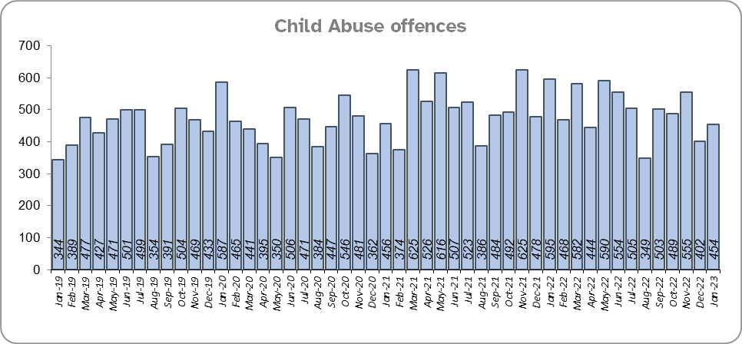
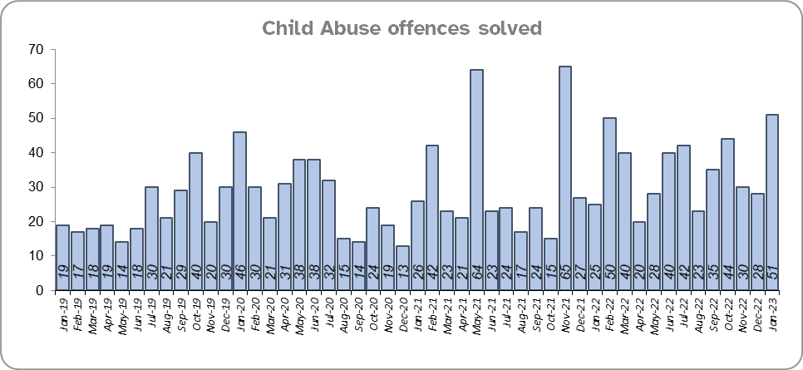
Priority 3 - Protecting vulnerable people and breaking the cycle of domestic abuse - continued
Grade: Good
Essex Police solved 61 more (16.5%) child abuse offences for the 12 months to January 2023 compared to the 12 months to January 2022; there was a 5.4% decrease (336 fewer) in offences for the same comparison periods.
Essex Police also solved 72 more (35.5%) offences for the 12 months to January 2023 compared to the 12 months to December 2019. There was also a 24.3% increase (927 more) in Child Abuse offences for the same comparison periods.

Slide 12
Priority 3 - Protecting vulnerable people and breaking the cycle of domestic abuse - continued
Grade: Good
219 Modern Slavery referrals were made in the 12 months to January 2023 compared with 167 in the 12 months to January 2021 (52 more).
The number of Domestic Violence Protection Notices (DVPN) decreased by 36.1% (101 fewer notices) in the 12 months to January 2023 compared to the 12 months to January 2022. There was an decrease of 26.9% (66 fewer notices) compared to the 12 months to December 2019.
There were 100 fewer Domestic Violence Protection Orders (DVPO), a decrease of 38.6% in the 12 months to January 2023 compared to the 12 months to January 2022. A 35.1% decrease was recorded compared to the 12 months to December 2019, (159 v. 245 DVPOs).
Confidence that the policing response to protect children and vulnerable people (from the independent survey commissioned by Essex Police) is at 79.2% (results to the 12 months to September 2022). Compared to year ending September 2021, confidence has decreased by 10.1 percentage points but nevertheless remains at a high level.
Six of the nine metrics for this Priority improved in the 12 months to January 2023 compared to the 12 months to January 2022 (DA offences, DA solved, repeat victims of DA, CA offences, NRM referrals and CA solved); three deteriorated (NRM referrals, DVPNs, DVPOs and confidence). Six metrics also improved when compared with the 12 months to December 2019. As such, a grade of Good is recommended.
Please note:
* The number of Modern Slavery referrals made to the National Referral Model are only available from April 2019 due to a change in the method of recording. A year on year comparison for the 12 months to December 2019 is therefore not possible.
** DVPN’s are the first stage of the process, and DVPO the second. An officer issues a DVPN which has to go to court to become a DVPO, there are always less orders than notices as a result, as not all are approved or process hasn’t been followed.

Slide 13
Priority 4 – Reducing violence against women and girls
Grade: Adequate
Where gender is detailed, over half of victims of Violence Against the Person (VAP) offences identified as female* (56.4%). 3.0% of offences (2,082 offences) had no gender recorded**.
Essex experienced a 3.9% decrease (1,514 fewer) in the number of VAP offences committed against females in the 12 months to January 2023 compared to the 12 months to January 2022. There was an 6.6% increase (2,328 more) in the number of VAP offences committed against females in the 12 months to January 2023 compared to the 12 months to December 2019. A rise in these types of offences, however, is often driven by an increased confidence in reporting. This not only raises more awareness of VAWG-related issues but better enables the Force to understand the problem and thereby meet victims' needs.
Essex Police prides itself on having excellent Crime Data Accuracy (CDA). In its most recent inspection by HMICFRS, Essex Police was graded as Outstanding in relation to its CDA. Maintaining excellent CDA, however, requires the Force to neither under-record nor over-record offences. To this end, Essex Police is auditing and – where appropriate – cancelling Stalking & Harassment offences to ensure additional crimes have not been unnecessarily recorded. Essex Police have also been educating those working within the Resolution Centre to ensure they fully research the individuals involved in these types of offences before they create new crimes; where previous records exist, these additional incidents are instead referred to the relevant officer(s) in order that they can be investigated together. As of 31 January 2023, 904 records have been reviewed as potential duplicate crimes and 320 sent for cancellation; of these, 233 records (72.8%) have now been cancelled. It is of note that Stalking and Harassment offences comprise the largest volume of VAWG offences; there were, for example, 2,423 fewer Stalking and Harassment crimes committed against females in the 12 months to January 2023 (15,562 crimes) compared to the 12 months to January 2022 (17,985 crimes).
There was a 1.3% decrease (61 fewer) in the number of Sexual Offences committed against females in the 12 months to January 2023 compared to the 12 months to January 2022, and a 24.3% increase (927 more) compared to the 12 months to December 2019. Although Essex Police solved four fewer of these offences in the 12 months to January 2023 compared to the 12 months to January 2022, it solved 72 more compared to the 12 months to December 2019.
Please note:
***iOfficer defined gender.
***iNot Recorded also includes records where gender is unknown or unspecified.
*** Please see slide 36 for tables detailing Offences, Solved Outcomes and Solved Rates% for Violence against the Person and Sexual offences (by crime type) split by gender.

Slide 14
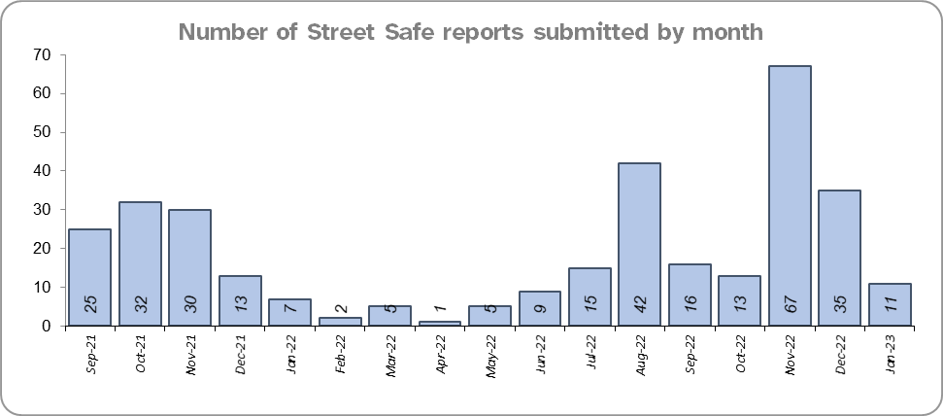
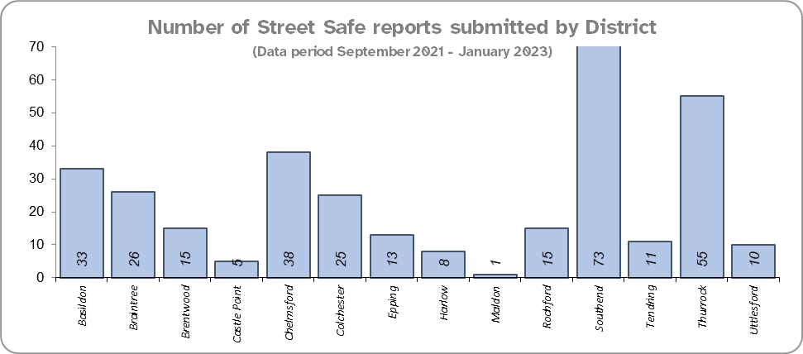
Priority 4 – Reducing violence against women and girls - continued
Grade: Adequate
The Home Office is trialling a new online tool called StreetSafe on police.uk to enable people, particularly women and girls, to pin-point locations where they feel unsafe or have felt unsafe and identify why that location made them feel unsafe. StreetSafe was developed by the Digital Public Contact (DPC) Programme in cooperation with the Home Office and the National Police Chiefs’ Council (NPCC) and was launched on 2 September 2021 as a national pilot for three months. StreetSafe was introduced into Essex as part of the government’s strategy to tackle Violence against Women and Girls (VAWG). In January 2023, 11 reports were submitted in Essex. In total 328 reports have been submitted for the county.
44.5% of females feel safe walking alone in their area after dark (from the independent survey commissioned by Essex Police) for the 12 months to September 2022 compared to 76.2% of males.
Essex Police is regularly reporting to the national VAWG Taskforce and HMICFRS in respect of its performance, its action plan to tackle VAWG, and its internal conduct and behaviour. This contact also shares best practice and innovation. The national VAWG Taskforce categorise work in three distinct areas: improving trust and confidence in policing; relentless pursuit of offenders; and creating safer spaces. Partnership engagement is key in tackling VAWG, as there are many strands which policing cannot tackle alone; these include education and the prevalence of VAWG and the anonymity of the internet.
Essex Police encourage reporting and are working to gain a better understand this type of offence. There has been a decrease in Violence Against the Person offences against females compared to last year. Whilst the number of solved sexual offences has fallen compared to last year, the number of sexual offences reported has also fallen proportionately. As such a grade of Adequate is recommended.
Please note:
The confidence question was added to the internal survey in September 2021 so year on year comparison is not available.

Slide 15
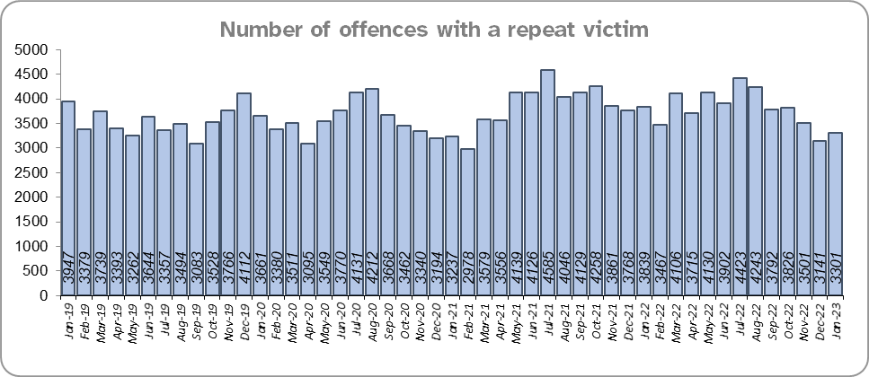
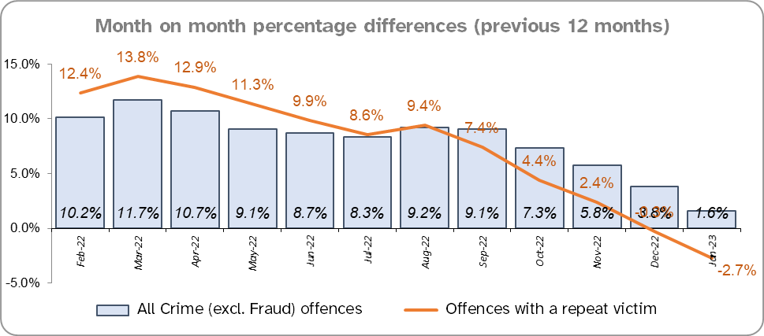
Priority 5 – Improving support for victims of crime
Grade:
Requires Improvement
Essex experienced a 2.8% decrease (1,317 fewer) in the number of offences with a repeat victim for the 12 months to January 2023 (45,547 offences) compared to the 12 months to January 2022 (46,864 offences) and a 6.7% increase (2,843 more) compared to the 12 months to December 2019 (42,704 offences).* Except for August 2022, the year on year change for repeat victimisation has decreased each month since March 2022.
The number of individual repeat victims increased by 1.6% (346 more) for the 12 months to January 2023 (22,331 individual victims) compared to the 12 months to January 2022 (21,985 individual victims). There was a slightly larger overall rise of 4.8% (1,024 more) compared to the 12 months to December 2019 (21,307 individual victims).
The average number of days taken to investigate High Harm offences increased to 59.1 in January 2023 compared to 48.3 in January 2022 (10.8 days more); it was 44.2 days in December 2019 (14.9 days more).
There was a 0.3% decrease in the number of referrals to Victim Support in the 12 months to January 2023 compared to the 12 months to January 2022; this equates to 97 fewer referrals. There was, however, a 32.0% decrease (13,140 fewer referrals) for the 12 months to January 2022 compared to the 12 months to December 2019.***
Please note:
* This metric details how many crimes had a repeat victim rather than the number of individual people who are repeat victims of crime. A repeat victim is someone who has been named as a victim for more than one crime within a 12-month period; to mitigate the fact that multiple crimes can be associated with the same incident, additional crimes with the same victim on the same date are not counted.
** Data are for January only for all three years.
*** Please see slide 37 for tables detailing Offence details.

Slide 16
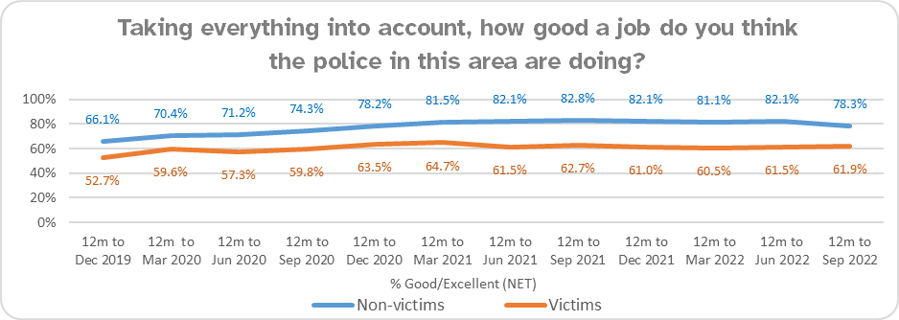
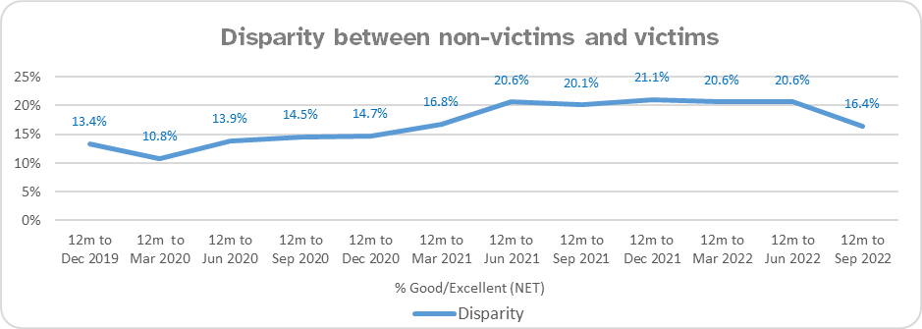
Priority 5 – Improving support for victims of crime - continued
Grade:
Requires Improvement
Confidence among victims (from the independent survey commissioned by Essex Police) is at 61.9% (results to the 12 months to September 2022). Although this is 16.4 percentage points lower than confidence of non-victims for the same period (78.3%), the gap has narrowed from 20.1 percentage points. compared to the same period last year. However, the disparity has increased by 3.0 percentage points compared to the 12 months to December 2019 (13.4%).
Compared to year ending September 2021, confidence in the local police among victims is stable, in contrast to confidence amongst non-victims for whom there was a statistically significantly reduction of 4.5 percentage points.
Due to the fact that the number of repeat victims has increased in the 12 months to January 2023 compared to last year and the 12 months to December 2019 and the average number of days taken to investigate high harm offences has increased when compared to the 12 months to January 2021 and December 2019, a grade of Requires Improvement is recommended.

Slide 17
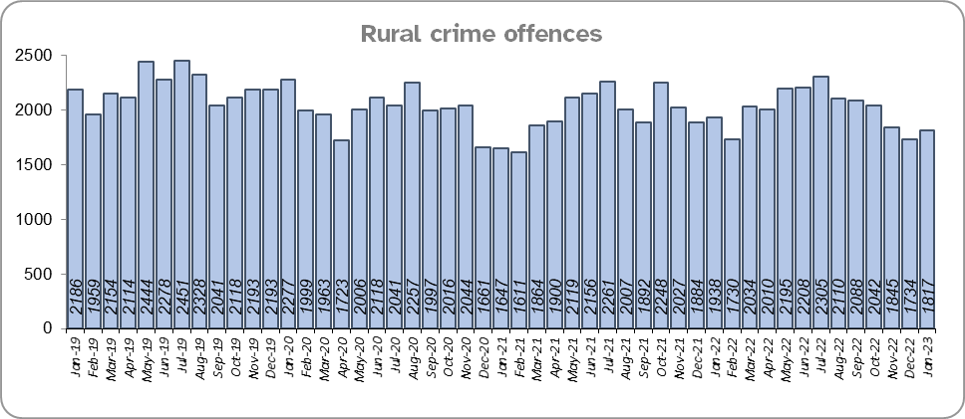
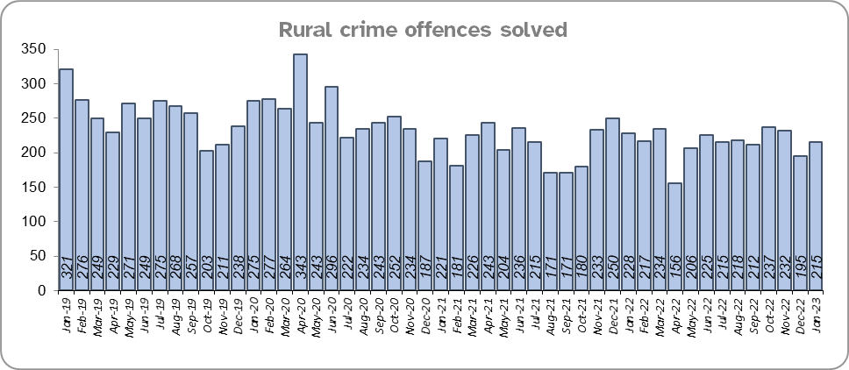
Priority 6 – Protecting rural and isolated areas
Grade: Adequate
Rural Crime increased by 0.9% (211 more offences) in the 12 months to January 2023 compared to the 12 months to January 2022. During this period All crime increased by 1.6%. However, Rural crime decreased by 8.8% (2,341 fewer offences) compared to the 12 months to December 2019. All Crime in Essex decreased by 2.3% in the same period.
Essex Police solved 0.9% (24) more rural crime offences for the 12 months to January 2023 compared to the 12 months to January 2022, but 15.9% fewer (a decrease of 485) compared to the 12 months to December 2019.
The rural crime Harm (Crime Severity) Score* was 8.8 for the 12 months to January 2023. Although equates to, a rise of 0.3 when compared to the 12 months to January 2022, it is lower than the All Crime Harm Score in Essex (14.6) which increased by 0.9 over the same period.
Please note:
* Crime Severity Scores (as calculated by the Office for National Statistics) measure the ‘relative harm’ of crimes by taking into account both their volume and their severity. National data are not available for crimes committed in rural areas, so it is not possible to measure against an MSG average; due to this, Essex Police data (to January 2023) have been used rather than national data (which are to November 2022).

Slide 18
Priority 6 – Protecting rural and isolated areas - continued
Grade: Adequate
Confidence in rural policing (from the independent survey commissioned by Essex Police) is at 77.4% (results to the 12 months to September 2022). Compared to year ending September 2021, confidence in rural policing has deteriorated, although it remains higher than the current overall Essex average (rural and urban combined) of 76.3%. In all four of the more rural districts in Essex, more than 75% of people believe Essex are doing a good or excellent job. Since 2019, confidence in Essex Police has increased significantly in every area across Essex. The four districts with the lowest levels of confidence (between 69%-75%) are urban.
Essex Police is one of only 15 forces who have dedicated Rural Policing Teams. Essex Police are also continuing their commitment to prevent rural and heritage crime with the innovative launch of a horseback volunteer scheme in Uttlesford. The idea behind the scheme is that horse riders are in a unique position to spot signs of suspicious activity related to offences such as hare coursing, stolen agricultural vehicles, unlawful metal detecting or theft of lead from protected heritage buildings. The horseback volunteers will be trained in what to look out for and will be able to report any concerns or suspicious activity, helping the Force target those committing offences and stop criminality before it happens.
Confidence in the local police in rural areas remains higher than in Essex as a whole, and offence levels in the 12 months to January 2023 are lower compared to the 12 months to December 2019 (pre-COVID). However, over the last 12 months there has been a slight increase in the number of rural offences, but a proportional increase in the number solved. Therefore, a grade of adequate is recommended.
Please note:
* Rural districts: Braintree, Maldon, Tendring and Uttlesford

Slide 19
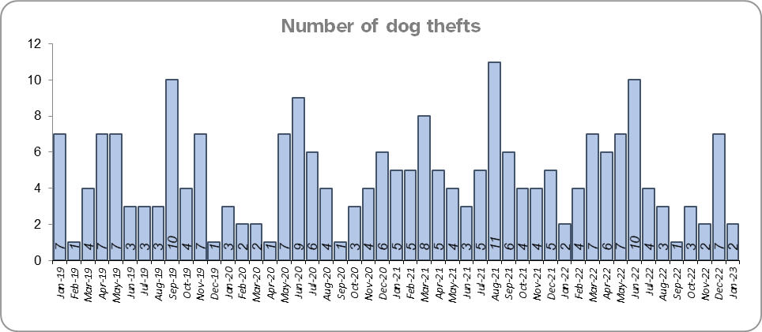
Priority 7 – Preventing dog theft
Grade: Good
There were five fewer dog thefts in Essex for the 12 months to January 2023 compared to the 12 months to January 2022 (57 v. 62). There were the same number of dog thefts in the 12 months to January 2023 compared to the 12 months to December 2019.
Essex Police solved one fewer dog theft offence for the 12 months to January 2023 compared to the 12 months to January 2022 and the 12 months to December 2019.
Confidence in how Essex Police and the organisations they work with are dealing with dog theft (from the independent survey commissioned by Essex Police) is at 63.4% for the 12 months to September 2022.
Due to the low and reducing number of thefts across the county (given the comparatively large population of Essex), along with relatively high confidence levels, a grade of Good is recommended.
Please note:
* This is number of thefts in which dogs were stolen, and not quantity of dogs stolen in each theft. Data are based on theft offence crimes and robbery offence crimes where the ‘property code’ is ‘pet animal – dog’ and the ‘property status’ is ‘stolen’ and/or ‘stolen/recovered’.
** The confidence question was added to the internal survey in September 2021 so year on year comparison is not available.

Slide 20
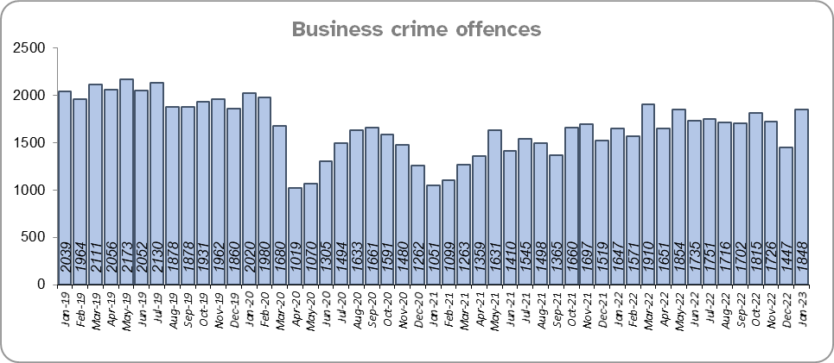
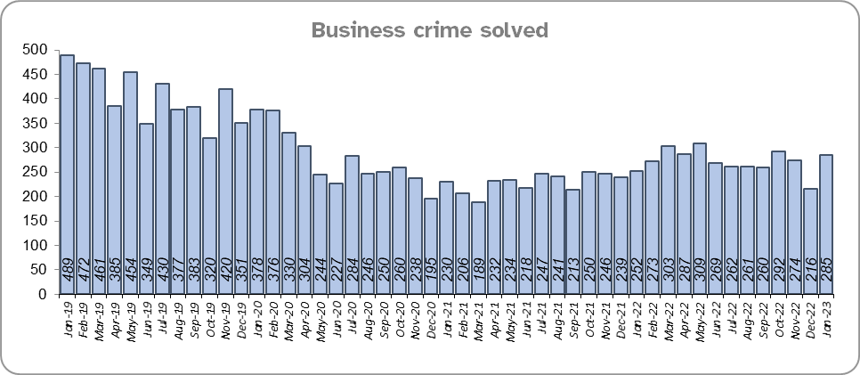
Priority 8 – Reducing business crime, fraud and cyber crime
Grade: Adequate
Business Crime offences include any notifiable crimes recorded with a victim which is an organisation; it does not include Fraud offences. All reports of Fraud are recorded by the National Fraud Intelligence Bureau (NFIB) rather than Essex Police. In the 12 months to January 2023, a total of 1,864 Fraud investigations were allocated to Essex Police by NFIB for investigation. For data on the number and type of Fraud investigations reported as being committed within the Essex Police area, please visit the NFIB Fraud and Cyber Crime Dashboard.
Essex experienced a 17.1% increase (3,034 more) in the number of Business Crime offences and a 14.4% increase (398 more) in the number of these offences which were solved in the 12 months to January 2023 compared to the 12 months to January 2022. Shoplifting accounts for approximately 46% of business crime. Essex Police have been working with businesses to encourage them to record more offences.
There was a 13.8% decrease (3,307 fewer) in the number of Business Crime offences and a 35.5% decrease (1,737 fewer) in the number of Business Crimes solved in the 12 months to January 2023 compared to the 12 months to December 2019.

Slide 21
Priority 8 – Reducing business crime, fraud and cyber crime - continued
Grade: Adequate
There was a 4.3% increase in the number of fraud offences related to business crime in the 12 months to January 2023 compared to the 12 months to January 2022; this equates to 15 more offences. There was also a 25.6% decrease in the 12 months to January 2023 compared to the 12 months to December 2019; this equates to 124 fewer offences.
Confidence that Essex Police are dealing with cyber crime (from the independent survey commissioned by Essex Police) is at 51.1% for the 12 months to September 2022. Confidence has significantly increased from the previous quarter when it was at 25.2%.
Three of the five metrics deteriorating when compared to the 12 months to January 2022 (Business Crime offences, fraud offences related to Business Crime and the total number of fraud offences). However, due to the fact that these measures are improving when compared to the 12 months to December 2019, a grade of Adequate is recommended.
Please note:
* Fraud offences recorded on Athena where the victim is either an organisation or a person with the Business Victim flag.
** The confidence question was added to the internal survey in September 2021 so year on year comparison is not yet available.

Slide 22
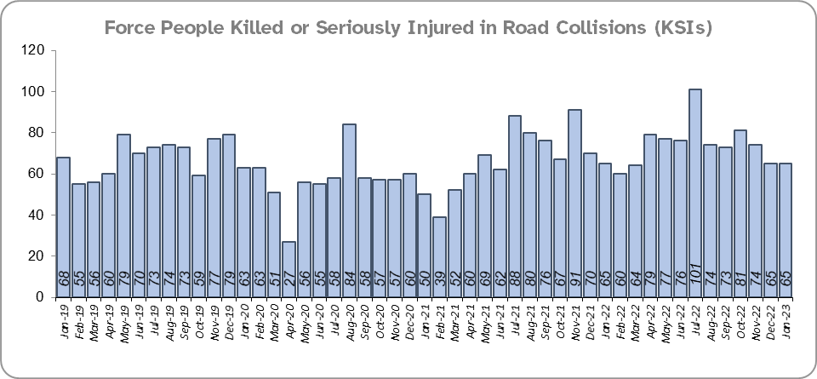
Priority 9 - Improving safety on our roads
Grade: Requires Improvement
Road traffic safety is the responsibility of the Safer Essex Roads Partnership (SERP). SERP comprises reprentatives from Essex Police, Essex County Fire & Rescue Service, Essex County Council, Southend on Sea Borough Council, Thurrock Council, National Highways, East of England Ambulance Service Trust, Essex and Herts Air Ambulance Service Trust and The Safer Roads Foundation (Registered Charity). The aspiration of Essex Police and partners is ‘Vision Zero’, namely to have no road deaths or serious injuries by 2040. The SERP Safety delivery plan sets out a structured programme of educational and engagement activity to address this and support behavioural changes.
There was a 8.5% increase (70 more) in the number of those Killed or Seriously Injured (KSI) in Essex for the 12 months to January 2023 compared to the 12 months to January 2022 with the rate of increase slowing more recently. The number of KSIs also increased by 66 in the 12 months to January 2023 compared to the 12 months to December 2019.
Essex is sixth in its Most Similar Group (MSG) of forces for casualties per 100 million vehicle kilometres (results to June 2021) and is slightly higher than the MSG average. However, due to the fact that more recent national figures have not been released, the current position cannot be determined (the date of the next national release has not yet been confirmed).
Please note that most KSIs do not necessarily result in criminal offences (such as death or serious injury caused by dangerous driving) being recorded.

Slide 23
Priority 9 - Improving safety on our roads - continued
Grade: Requires Improvement
There was a 8.9% decrease (222 fewer offences) in drink/drug driving offences for the 12 months to January 2023 compared to the 12 months to January 2022. There was a 5.6% decrease (81 fewer offences) in drink driving and a 13.3% decrease (141 fewer offences) in drug driving. There was also a 31.5% decrease (1,042 fewer offences) in drink/drug driving offences for the 12 months to January 2023 compared to the 12 months to December 2019; of these offences, there was a 7.7% decrease (113 fewer offences) in drink driving and a 50.4% decrease (929 fewer offences) in drug driving. All of these offence types are primarily driven by police proactivity in relation to road safety.
The number of Failure to Provide samples decreased by 8.5% (30 fewer) in the 12 months to January 2023 compared to the same period last year, and by 19.5% compared to the 12 months to December 2019.
There was a 192.1% increase (874 more offences) in the number of driving related mobile phone offences recorded for the 12 months to January 2023 compared to the 12 months to January 2022.*
Confidence in Essex Police and organisations with whom they police the roads (from the independent survey commissioned by Essex Police) is at 65.8% (results to the 12 months to September 2022). Confidence in the local police and organisations they work with has remained stable when compared to year ending September 2021 (66.0%).
Due to the increase in KSIs and the decrease in the number of driving under the influence of drink drug driving in the past 12 months compared to the previous 12 months and the 12 months to December 2019 a grade of Requires Improvement is recommended.
Please note:
* In 2019, the definition as to what constituted “use” of a mobile phone in relation to driver-related mobile phone offences was subject to a legal challenge. This resulted in a ruling, which held that while “use” included accessing the interactive functions of the mobile phone (such as making calls, sending messages or using the internet), it did not extend to solely accessing the device’s internal functions (such as making use of the camera). Fewer mobile phone offences were subsequently prosecuted from this point. In 2021 the government announced that the law was to be changed making it illegal to “hold” a phone or sat nav when driving or riding a motorcycle. This law was finally passed on 25th March 2022.

Slide 24
Priority 10 – Encouraging volunteers and community support
Grade: Adequate
Essex Watch Liaison Officers continue to work with Neighbourhood Watch (NHW) to offer crime and fraud prevention advice.*
Citizens in Policing and the Special Constabulary play an integral part in supporting Essex Police. In January 2022, the Local Policing Support Unit (LPSU) introduced a Strategic Co-ordination Group which proactively supports, throughout the county, the mobilisation of all Special Constables, Police Support Volunteers, Active Citizens, Accredited Persons and, where appropriate our Volunteer Police Cadets, with local operations and initiatives under the Chief Constable’s Plan on a Page and the Police, Fire Crime Commissioner’s Police and Fire Plan.
Since last month’s report, there are now: one fewer business group member, one more caravan group member, four fewer dog group members, four more farm and rural group members and two fewer heritage group members.
There are currently 2,366 NHW Co-ordinators and 92,500 NHW members.
Please note:
* Neighbourhood Watch data were first produced in March 2022 so year on year comparison is not available.

Slide 25
Priority 10 – Encouraging volunteers and community support
Grade: Adequate
The Special Constabulary headcount is currently 339 (as of 31 January 2023). This is down 28.9% (138 fewer) compared to January 2022. Compared to the 12 months to December 2019 this is down 34.7% (180 fewer).
There are 221 Volunteer Police Cadets (VPCs) and 88 Volunteer Cadet Leaders across 13 Cadet Units. In addition, there are 101 Police Support Volunteers and 56 Active Citizens within Essex Police across the county, a total of 157 Volunteers. This is a decrease of 7 compared to last month. These volunteers also are part of the Strategic Co-ordination Group and support their Locally Community Policing Teams with local events.
Confidence that there are good opportunities for volunteers to assist policing and reduce crime in Essex (from the independent survey commissioned by Essex Police) is at 49.4% for 12 months to September 2022. Confidence has increased each quarter since Q4 2021/22 (2021/22 Q4 45.1%; 2022/23 Q1 48.6%).
The total number of volunteers decreased slightly compared to last month. The Special Constabulary headcount has also decreased significantly compared to 12 months ago and December 2019. However, due to the fact that Essex has the second largest Special Constabulary in the country, and that the Essex Police makes use of Ethics Boards to inform its work, a grade of Adequate is recommended.
Please note:
Monthly data only collected from December 2022 so year on year comparisons not available.
VPC data are taken from the cadet census and are for the 31st January each year.
Of the 13 Cadet Units 10 are active and 3 are temporarily suspended due to not enough leader coverage in that area. Recruitment is ongoing to get the units up and iiiiirunning again. They are Southend, Chelmsford & Braintree.
** The confidence question was added to the internal survey in September 2021 so year on year comparison is not available.

Slide 26
Priority 11 – Supporting our officers and staff
Grade: Adequate
There has been a slight decrease (0.3%) in the proportion of ethnic minority employees in January 2023 (270) compared to January 2022 (291); this equates to 21 fewer employees. However, in contrast, there has been a 24.4% increase compared to December 2019 (217); this equates to 53 additional employees.
Essex Police reached record strength in its 182-year history. In the 12 months to January 2023, 415 new officers took their oaths to the King and started their Essex Police careers as the Force now has more officers than ever before. The new officers pledged their commitment to police with the consent of every community at a time when the Force is welcoming more new colleagues from a range of different backgrounds. Over the same period, 268 officers left their positions, leading to an overall increase of 147 officers over the last year.
The average days lost per person for sickness improved for all groups in the 12 months to January 2023 compared to the 12 months to January 2023. Full Time Employee vacancies deteriorated for all employee types except PCSOs over the same period. For these reasons a grade of Adequate is recommended.
Please note:
* Ethnic minority employees as a percentage of the total workforce.
** Ethnic minority employees as a percentage of type of employee.

Slide 27
Priority 12 – Increasing collaboration
Grade: Adequate
330 school visits were conducted in the 12 months to December 2022. This is an increase of 17% compared to the 12 months to December 2021.*
There was a 52.0% decrease (1,397 fewer) in the number of programmes delivered in the 12 months to December 2022 compared to the 12 months to December 2019.**
A decrease of 42.5% (88,963 fewer) was recorded for Audience Numbers in the 12 months to December 2022 compared to the 12 months to December 2019.**
This section is due to be reviewed for the next report to include additional context. Whilst there has been a decrease in programmes delivered and audience numbers in the 12 months to December 2022 compared to the 12 months to December 2019, due to a lack of contextual information a grade of Adequate is recommended.
Please note:
All data from the Joint Essex Fire and Police Education in Schools Programme (2022) have been provided by the Fire Service.
* Data is to December 2022. Only data for the last two years has been provided, so comparisons to the Pre-Covid period are not possible.
** Schools and colleges reopened in September 2020 due to the pandemic, but were closed again from January to March 2021. In addition, throughout most of the September 2020 to July 2021 period there were still government restrictions on gathering and movement, especially for non-essential mixing.
*** Data is only available to September 2022.

Slide 28
Monthly Performance Overview: Exceptions
Exceptions Overview
The force saw statistically exceptional increases in Thefts from a Vehicle, Thefts of a Vehicle, Shoplifting and Trafficking of Drugs in January 2023.
Theft from a Vehicle– Increase
13.3% increase (746 more crimes) for the 12 months to January 2023 compared to the 12 months to January 2022. There were statistically exceptional increases in three Districts in January 2023: Colchester, Thurrock and Harlow.
Theft of a Vehicle– Increase
29.3% increase (1,173 more crimes) for the 12 months to January 2023 compared to the 12 months to January 2022. There were statistically exceptional increases in four Districts in January 2023: Maldon, Tendring, Thurrock and Harlow.
Shoplifting– Increase
17.4% increase (1,420 more crimes) for the 12 months to January 2023 compared to the 12 months to January 2022. Chelmsford, Colchester and Thurrock districts experienced statistically exceptional increases in January 2023.
Trafficking of Drugs – Increase
11.1% increase (138 more crimes) for the 12 months to January 2023 compared to the 12 months to January 2022. The Force experienced a statistically exceptional increase in January 2023. It is of note that these offences are an indication of police proactivity rather than of the level of drug dealing activity in the county.

Slide 29
2021-2024 Police and Crime Plan Performance Indicators
Table 1
Please view above table with the explanations and caveats detailed on slides 32 and 33.

Slide 30
2021-2024 Police and Crime Plan Performance Indicators - continued
Table 2
Please view above table with the explanations and caveats detailed on slides 32 and 33.

Slide 31
2021-2024 Police and Crime Plan Performance Indicators - continued
Table 3
Please view above table with the explanations and caveats detailed on slides 32 and 33.

Slide 32
End Notes
¹ Crime Severity Score measures ‘relative harm’ of crimes by taking into account both the volume and the severity of offences, and by weighting offences differently. National data for the 12 months to November 2022 have been used in order that comparisons can be made to Essex’s Most Similar Group of Forces (MSG).
² Please note that on Wednesday 23 October 2019 the bodies of 39 Vietnamese nationals were discovered in a lorry trailer in Grays. This tragic incident is reflected in the Homicide numbers.
³ October 2021 saw the implementation of Operation SOMERTON, which aims to both improve the service given to victims of ASB and ensure crimes are correctly recorded.
⁴ Question from the independent survey commissioned by Essex Police. Results are for the period 12 months September 2022 versus the 12 months to September 2021.
⁵ The confidence interval is the range +/- within which the survey result will lie. This is mainly influenced by the number of people answering the survey. The more people that answer the survey, the smaller the interval range.
⁶ The methodology used for identifying these investigations as drug related is subjective and based on the circumstances presented. These figures will include investigations where the victim or the suspect are involved Drug Use, Possession or Selling.
⁷ The number of knife crime offences is an indicator of how effective Essex Police is at identifying knife-enabled offences, and is not necessarily reflective of the number of these offences that have been committed in the county. This is because the identification of these offences is reliant on the appropriate indicator being manually added to the crime record. A manual review of knife flags was conducted and missing flags were added retrospectively. Additionally a new data quality process was introduced in June 2020. Whilst this has enabled us to better understand knife crime in Essex, the process has consequently inflated the figures. As such, no inferences can be drawn as to the current trend.
⁸ OCG disruptions are reported quarterly. Data are to December 2022.
⁹ Solved outcomes are crimes that result in: charge or summons, caution, crimes taken into consideration, fixed penalty notice, cannabis warning or community resolution.
¹⁰ NRM data only available from April 2019 due to recording change at that time.
¹¹ High Harm offences: Violence with Injury, Rape, Other Sexual Offences, Robbery of Personal Property and Residential Burglary. Average number of days are for the previous month in all three periods.
¹² This is the number of theft offences in which dogs were stolen, and not necessarily the number of dogs which were stolen.

Slide 33
End Notes - continued
¹³ ‘Killed or Seriously Injured’ (KSI) refers to all people killed or seriously injured on Essex’s roads, regardless of whether any criminal offences were committed. ‘Causing Death/Serious Injury by Dangerous/Inconsiderate Driving’ offences (detailed on slide 22) refers to the number of crimes of this type.
¹⁴ In 2019, the definition as to what constituted “use” of a mobile phone in relation to driver-related mobile phone offences was subject to a legal challenge. This resulted in a ruling, which held that while “use” included accessing the interactive functions of the mobile phone (such as making calls, sending messages or using the internet), it did not extend to solely accessing the device’s internal functions (such as making use of the camera). Fewer mobile phone offences were subsequently prosecuted from this point. In 2021 the government announced that the law was to be changed making it illegal to “hold” a phone or sat nav when driving or riding a motorcycle. This law was finally passed on 25th March 2022.
¹⁵ Monthly data only collected from December 2022 so year on year comparisons not available.
¹⁶ Neighbourhood Watch data are reported quarterly. Data as at 31st December 2022.
¹⁷ Ethnic minority employees as a percentage of the total workforce.
¹⁸ Absence data: Rolling from 1st April each year.
¹⁹ Data provided by the Fire Service and to the 12 months to December 2022.
²⁰ Number of offences with repeat victim including month on month percentage change.

Slide 34
Crime Tree Data – Rolling 12 Months to January
Table 4

Slide 35
Crime Tree Data – Rolling 12 Months to January - continued
Table 5

Slide 36
Crime Tree Data - Rolling 12 months to January Violence against the Person and Sexual offences and outcomes (by crime type) split by gender
Table 6
Please note: the breakdown of data for the previous 12 months within these tables may not tally with the totals on slide 13 as gender data is rerun on a monthly basis.

Slide 37
Victim Referrals by Crime offence - Rolling 12 months to December 2022
Table 7
Please note: data updated quarterly.

