Slide 1
Police and Crime Plan 2021-2024
Monthly Performance Update
December 2022
National and MSG positions are to 31 October 2022 (Essex Police data are to 31 December 2022).
Version 1.5
Produced January 2023
Performance Analysis Unit, Research & Analysis Department, Essex Police
Sensitivity: Official

Slide 2
Executive Summary
The Police and Crime Plan 2021-2024 was introduced in April 2021, with new measures that reflect the Essex Police, Fire and Crime Commissioner’s (PFCC) strategic commitment to targeted prevention and early intervention. On 13 December 2022, the Chief Constable of Essex Police and the Police, Fire & Crime Commissioner for Essex agreed that more measures should be included so a more holistic and rounded view of the Force’s performance against the Police and Crime Plan could be provided. This is the first report to feature these additional measures and should be read alongside the accompanying report.
Three of the twelve PFCC Priorities have been given a recommended grade of ‘Good’: 3 (Protecting vulnerable people and breaking the cycle of domestic abuse), 6 (Protect rural and isolated areas) and 7 (Dog Theft). Five have been given a recommended grade of ‘Adequate’ and four have been given a recommended grade of ‘Requires Improvement’: 4 (Violence against women and girls), 5 (Improving our service to support victims of crime), 9 (Improving safety on our roads) and 12 (Collaboration).
Priority 3 (Protecting vulnerable people and breaking the cycle of domestic abuse) has been upgraded from ‘Adequate’ to ‘Good’ since the last report. This is due to the fact that six of the nine metrics have improved when compared to the 12 months to December 2021; five metrics improved when compared with the 12 months to December 2019. Priority 2 (Reducing drug driven violence) has been downgraded to ‘Adequate’ from ‘Good’. This is because two of the new metrics, (Violence with Injury offences and Knife-enabled crime offences) have deteriorated when compared to the 12 months to December 2021 and 2019. Priority 10 (Encouraging volunteers and community support) has been downgraded to ‘Adequate’, from ‘Good’. This is because the total number of volunteers decreased in the 12 months to December 2022 compared to the 12 months to December 2021 and 2019.
Confidence (from the independent survey commissioned by Essex Police) is at 76.3% (results to the 12 months to September 2022). Confidence has increased by 11.6 percentage points compared to the 12 months to December 2019 (64.7%); the 12 months to December 2019 has been used as a comparative period as it was the last full year (and last full financial quarter) in which society, crime and policing was not affected by the pandemic. Although confidence in the local police has deteriorated significantly compared to year ending September 2021 (80.9%), falls in confidence are reflected in publicly available trackers; in the past year, YouGov reported a fall of 10% in the number of people who say the Police are doing a ‘Good Job’. Forces contacted separately by Essex Police similarly reported patterns similar to Essex Police: confidence was high during COVID, but has been in general decline ever since (the last two quarters especially have seen significant decreases).
There was a decrease in All Crime (1.9%), Rural Crime (8.1%) and Business Crime (14.6%) for the 12 months to December 2022 compared to the 12 months to December 2019. However, compared to the 12 months to December 2021, All Crime increased by 3.8%; this equates to 6,016 more offences. Fewer offences were recorded when COVID-19 restrictions were in place.
Essex Police prides itself on having excellent Crime Data Accuracy (CDA). In its most recent inspection by HMICFRS, Essex Police was graded as Outstanding in relation to its CDA. Maintaining excellent CDA, however, requires the Force to neither under-record nor over-record offences. To this end, Essex Police is auditing and – where appropriate – cancelling Stalking & Harassment (S&H) offences to ensure additional crimes have not been unnecessarily recorded. Essex Police have also been educating those working within the Resolution Centre to ensure they fully research the individuals involved in these types of offences before they create new crimes; where previous records exist, these additional incidents are instead referred to the relevant officer(s) in order that they can be investigated together. This activity has therefore not only resulted in a decrease in offences since the start of the review (August 2022) but has enabled the Force to better coordinate these types of investigations. To date, 230 records have been sent for cancellation; 138 of these records (60.0%) have been cancelled and 67 (29.1%) have been assigned an outcome; 25 records (10.9%) records are still being reviewed. It is of note that Stalking and Harassment offences comprise the largest volume of Violence Against Women & Girls offences (VAWG) and accounts for 21.5% of all Domestic Abuse investigations. There were, for example, 1,835 fewer Stalking and Harassment crimes committed against females in the 12 months to December 2022 (16,022 crimes) compared to the 12 months to December 2021 (17,857 crimes).

Slide 3
Executive Summary - continued
Essex experienced a 0.3% decrease (124 fewer) in the number of offences with a repeat victim for the 12 months to December 2022 (46,134 offences) compared to the 12 months to December 2021 (46,258 offences). Except for August 2022, the year on year increase in repeat victimisation has been reducing each month since March 2022 (decrease of 14.1%pts.).¹ However, the number of individual repeat victims increased by 3.3% (720 more) for the 12 months to December 2022 (22,502 individual victims) compared to the 12 months to December 2021 (21,782 individual victims). It is of note that any over-recording of Stalking and Harassment offences (discussed on the previous slide) will impact both the number of repeat victims and the number of offences with a repeat victim.
Violence against the person (VAP) offences committed against females decreased by 1.4% (527 fewer) in the 12 months to December 2022 compared to the 12 months to December 2021. However, there was a 2.4% increase (112 more) in the number of sexual offences against females in the 12 months to December 2022 compared to the 12 months to December 2021. Essex Police also solved 13 fewer sexual offences committed against females in the 12 months to December 2022 compared to the 12 months to December 2021.
When comparing High Harm² offences to its Most Similar Group (MSG) by crimes per 1,000 population, Essex is placed third (out of eight police forces) for Other Sexual Offences, fifth for Violence with Injury and Burglary Residential, and eighth for Rape and Robbery of Personal Property (first is considered to be the “best” performing force, and eighth the “worst”).
There was a 9.3% increase (75 more) in the number of those Killed or Seriously Injured (KSI) in Essex for the 12 months to December 2022 compared to the 12 months to December 2021. Since August, the number of incidents reported each month has been slightly below those experienced in 2021 (although there were 14 more incidents in October 2022 compared to October 2021: 81 v. 67). It is of note that road traffic safety is the responsibility of the Safer Essex Roads Partnership (SERP) which includes Essex Police, Essex County Fire & Rescue Service, Essex County Council, Southend on Sea Borough Council, Thurrock Council, National Highways, East of England Ambulance Service Trust, Essex and Herts Air Ambulance Service Trust, and The Safer Roads Foundation (Registered Charity).
Essex Police conducted 37 more OCG disruptions in the 12 months to December 2022 compared to the 12 months to December 2021.
Stalking and Harassment and Criminal Damage experienced statistically significant decreases for the month of December 2022. Trafficking of Drugs experienced a statistically significant increase in offences; it is of note that Drug Trafficking offences are an indication of police proactivity and not necessarily of drug dealing activity levels in the county.
An article published in The Guardian in December indicated that more than 1,800 police officers recruited under the Government’s pledge to increase numbers have already resigned, although this figure could be much higher (as 19 of the 43 forces in England and Wales did not provide data). Essex Police now has the highest numbers of officers in its 182-year old history. The Force is also on track to have a total of 3,755 officers by March 2023. It is also of note that there has been a steady and continual increase in the numbers of employed female colleagues, as well as those from ethnic minority backgrounds.

Slide 4
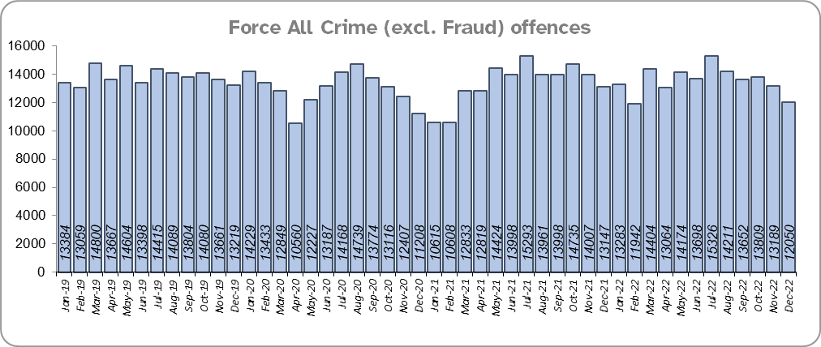
Priority 1 – Further investment in crime prevention
Grade: Adequate
There was a 1.9% decrease in All Crime in the 12 months to December 2022 compared to the 12 months to December 2019; this equates to 3,211 fewer offences. There was, however, a 3.8% increase in All Crime (6,016 more offences) for the 12 months to December 2022 compared to the 12 months to December 2021. The volumes of crimes recorded by the police has been influenced by the Government’s restrictions on gathering and movement in relation to COVID-19; fewer offences were recorded when there were more restrictions in place. Essex is seventh in its Most Similar Group of forces (MSG) for all crime per 1,000 population.
Essex Police recorded a daily average of 389 crimes in December 2022, compared to an average of 440 crimes recorded in November 2022. This equates to a decrease of 11.6%, or an average of 51 fewer crimes recorded per day.
12,050 offences were recorded in the month of December 2022, a decrease of 8.3% (1,097 fewer offences) compared to the month of December 2021 (13,147 offences), and a decrease of 12.7% (1,754 fewer offences) compared to the month of December 2019.
The All Crime Harm (Crime Severity) Score* (14.7) places Essex seventh in its MSG.
Please note:
* Crime Severity Scores (as calculated by the Office for National Statistics) measure the ‘relative harm’ of crimes by taking into account both their volume and their severity. As national data are only available to October 2022, the score for the 12 months to October for the preceding year has been included.

Slide 5
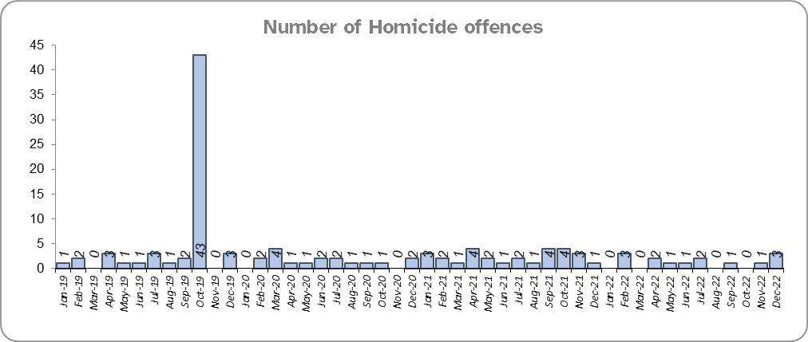
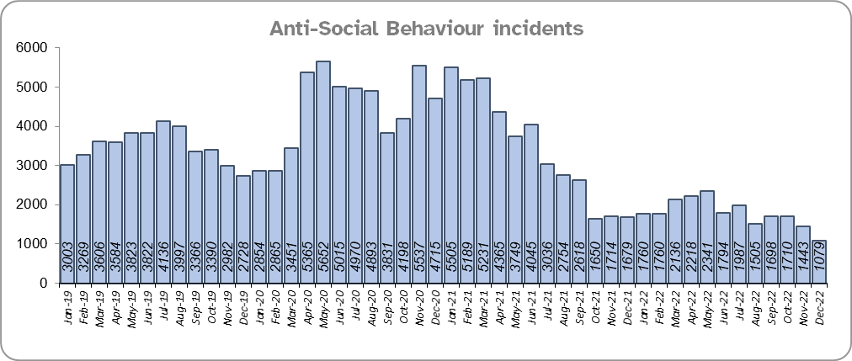
Priority 1 - Further investment in crime prevention - continued
Grade: Adequate
Ten fewer Homicides (to 15 offences) were recorded for the 12 months to December 2022 compared to the 12 months to December 2021. Three Homicides were recorded in December 2022 compared to one offence in December 2021.
The number of Homicides decreased by 75.4% (46 fewer offences) in the 12 months to December 2022 compared to the 12 months to December 2019.*
Essex experienced a 41.5% decrease (16,982 fewer) in Anti-Social Behaviour (ASB) incidents for the 12 months to December 2022 compared to the 12 months to December 2021.** There was a decrease of 42.9% ASB reports in December 2022 compared to December 2019 (17,992 fewer incidents). The average daily number of ASB incidents decreased by 27.6% in December 2022 (35 incidents) compared to November 2022 (48 incidents).
Please note:
* In October 2019 the bodies of 39 Vietnamese nationals were discovered in a lorry trailer in Grays. This tragic incident is reflected in the Homicide numbers for the 12 months to December 2019.
** October 2021 saw the implementation of Operation SOMERTON, which aims to both improve the service given to victims of ASB and ensure crimes are correctly recorded.

Slide 6
Priority 1 - Further investment in crime prevention - continued
Grade: Adequate
Essex Police received 9,137 fewer 101 calls to the Force Control Room (a decrease of 3.6%) in the 12 months to December 2022 (246,801 calls) compared to the 12 months to December 2021 (255,938). There was a 15.8% decrease compared to the 12 months to December 2019 (293,049 calls).
33.4% of 101 calls were abandoned in December 2022, an increase of 15.8% pts. when compared to the same period last year, (17.7%). There was a small decrease of 0.6% when compared to December 2019 (34.0%). The average wait time increased by just over six minutes in December 2022 when compared to December 2021, and an increase of two minutes when compared to December 2019.
The number of online reports increased by 23.1% (6,331 more) in the 12 months to December 2022 compared to the 12 months to December 2021. The number of reports also increased by 37.9% (9,272 more) compared to the 12 months to December 2019.
Confidence has experienced a statistically significant improvement compared to levels reported prior to the pandemic (by 11.6% points from 64.7% for the 12 months to December 2019). It was during the height of the pandemic that confidence reached its highest levels. Although there was a statistically significant decrease in confidence of 4.5% points (from the independent survey commissioned by Essex Police) in the 12 months to September 2022 (76.3%) compared to the 12 months to September 2021 (80.9%), falls in confidence are reflected in publicly available trackers; in the past year, YouGov reported fall of 10% in the number of people who say the Police are doing a ‘Good Job’. Forces contacted separately by Essex Police similarly reported patterns similar to Essex Police: confidence was high during COVID, but has been in general decline ever since (the last two quarters especially have seen significant decreases).
Four of the nine metrics in this Priority have improved when compared to the 12 months to December 2021 (homicides, ASB incidents, 101 calls received and online reports), five have deteriorated (all crime offences, Crime Severity Score, percentage of 101 calls abandoned, average wait time and confidence). Furthermore, when compared to the pre-COVID period, there has been a reduction in crime and an increase in confidence, although this pattern is reversed when comparing the 12 months to September 2022 with the 12 months to September 2021: crime has increased and confidence has decreased. As such, a grade of Adequate is recommended.

Slide 7
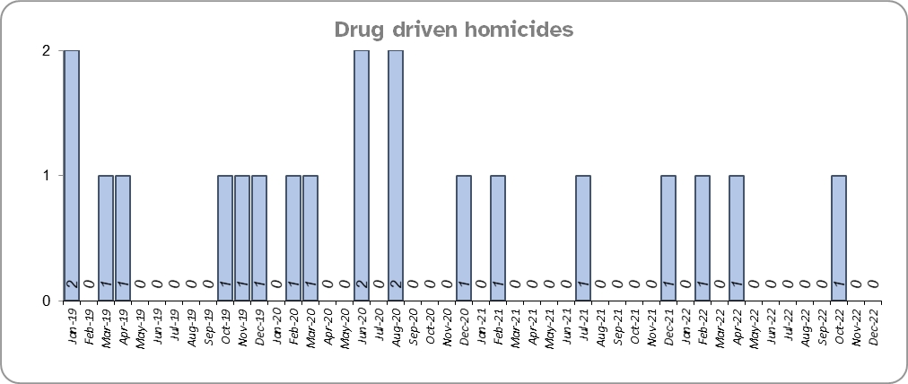
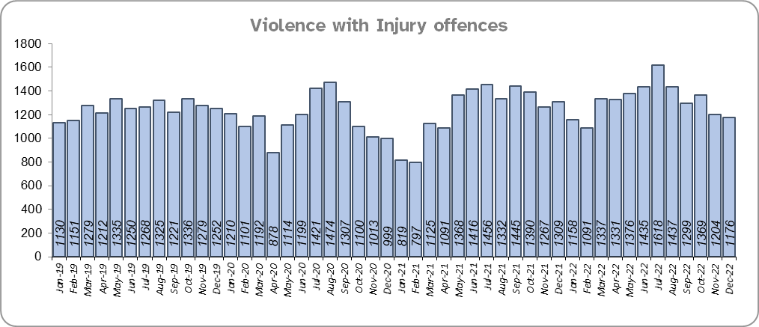
Priority 2 – Reducing drug driven violence
Grade: Adequate
Essex experienced the same number of drug related homicides (3) for the 12 months to December 2022 compared to the 12 months to December 2021 and four fewer compared to the 12 months to December 2019.
There was an 8.6% increase (1,275 more offences) in Violence with Injury (VWI) offences for the 12 months to December 2022 compared to the 12 months to December 2021. There was a 4.5% increase compared to the 12 months to December 2019 (685 more offences).
Please note:
* The methodology used for identifying investigations as being drug-related is subjective (qualitative data) and based on the circumstances presented. These figures include investigations where the victim and/or suspect are suspected of being involved in Drug Use, Possession or Selling.
** The confidence question was added to the external independent survey in September 2021. A year on year comparison is therefore not available.

Slide 8
Priority 2 – Reducing drug driven violence – continued
Grade: Adequate
There was a 19.1% increase (69 more) in the number of knife-enabled crime offences in the 12 months to December 2022 compared to the 12 months to December 2021. The number of knife-enabled crime offences also increased by 2.4% (39 more) in the 12 months to December 2022 compared to the 12 months to December 2019.
Essex conducted 11.4% more Organised Crime Group (OCG) disruptions (37 more) for the 12 months to December 2022 compared to the 12 months to December 2021. Although there was a 265.7% increase compared with the 12 months to December 2019 (263 more), this is due to a breakdown in the communication between the data from the operation activity to the figures which were produced by the Eastern Region Special Operations Unit (ERSOU).
Confidence that Essex Police and partners are dealing with drug crime (from the independent survey commissioned by Essex Police) is at 61.0% for the 12 months to September 2022. The results for this question have been stable since it was first asked in September 2021.
Drug related homicides are stable, confidence is relatively high and OCG disruptions are higher. However, due to the fact that the number of VWI and knife-enabled crime offences have increased when compared to the same periods, a grade of Adequate is recommended.
Please note:
* The number of knife crime offences is an indicator of how effective Essex Police is at identifying knife-enabled offences, and is not necessarily reflective of the number of these offences that have been committed in the county. This is because the identification of these offences is reliant on the appropriate indicator being manually added to the crime record. A new data quality process was introduced in June 2020 and Essex Police is currently working with the National Data Quality Improvement Service (NDQIS) to revise knife crime flags. In September 2021, data from April 2019 was revised; this resulted in an increase in the number of offences recorded. This has enabled Essex Police to better understand knife crime in Essex.
** The confidence question was added to the external independent survey in September 2021. A year on year comparison is therefore not available.
*** In the fiscal year 2019/20 the disruption returns to the Eastern Region Special Operations Unit (ERSOU) averaged 25 a quarter. A process review identified a breakdown in the communication of the data from the operation activity to the figures produced by ERSOU. A project of improvement was implemented which focussed on improving the communication between teams internally, and more importantly with ERSOU, to understand the parameters of what a disruption is and share this information with all teams within Essex Police. Over a two year period a continual improvement of disruption figures has come from a refinement of the communication and claiming process. This has been focussed on ensuring that we are claiming all possible disruptions of OCGs, tracking all activity from inception to closure, being innovative in our activity led by the Organised Crime Group Management Unit (OCGMU) and highlighting and educating new teams on how they can impact OCGs in their daily work. The moderation process has also been refined to ensure consistency with ERSOU.

Slide 9
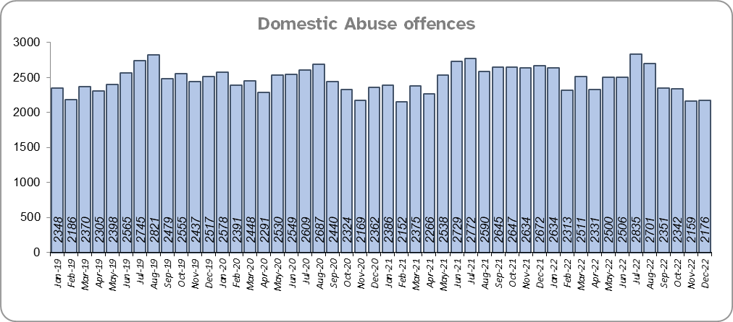
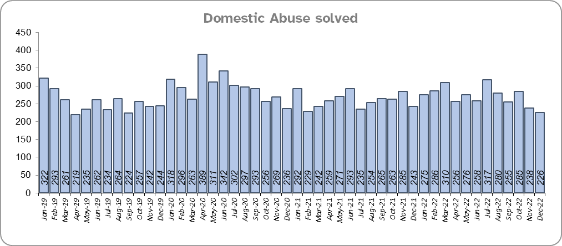
Priority 3 - Protecting vulnerable people and breaking the cycle of domestic abuse
Grade: Good
Essex experienced a 3.4% decrease (1,047 fewer) in the number of recorded Domestic Abuse (DA) offences for the 12 months to December 2022 compared to the 12 months to December 2021. The Force recorded 1,276 fewer offences in the three months to December 2022 compared to the same period in 2021 (6,677 v. 7,953). It is of note that Stalking & Harassment offences account for more than a fifth (21.5%) of all Domestic Abuse investigations and that Essex Police are currently auditing and – where appropriate – cancelling Stalking & Harassment offences to ensure additional crimes have not been unnecessarily recorded.
Essex Police solved 4.2% (131) more DA offences for the 12 months to December 2022 compared to the 12 months to December 2021. The Force solved 42 fewer offences in the three months to December 2022 compared to the same period in 2021 (749 v 791).
There was a 1.2% decrease (367 fewer) in DA offences and an 8.6% increase (257 more) in the number of DA offences solved for the 12 months to December 2022 compared to the 12 months to December 2019.
There were 1,396 fewer repeat victims of DA in the 12 months to December 2022 compared to the 12 months to December 2021 (6.7% less). There was also a decrease of 4.7% (974 fewer) compared to the 12 months to December 2019.
Please note:
* A repeat victim is someone who has been named as a victim for more than one crime within a 12-month period; to mitigate the fact that multiple crimes can be associated with the same incident, additional crimes with the same victim on the same date are not counted.

Slide 10
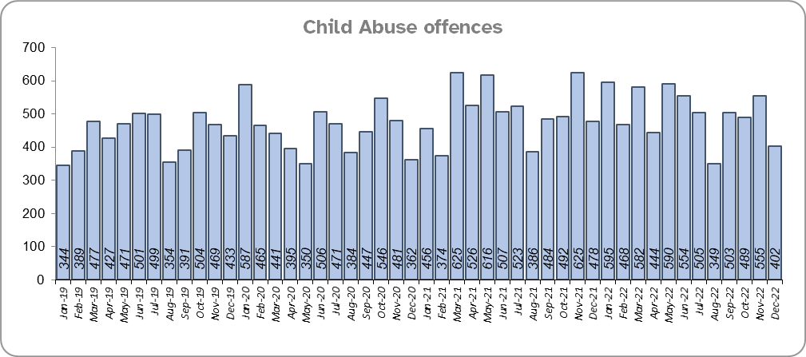
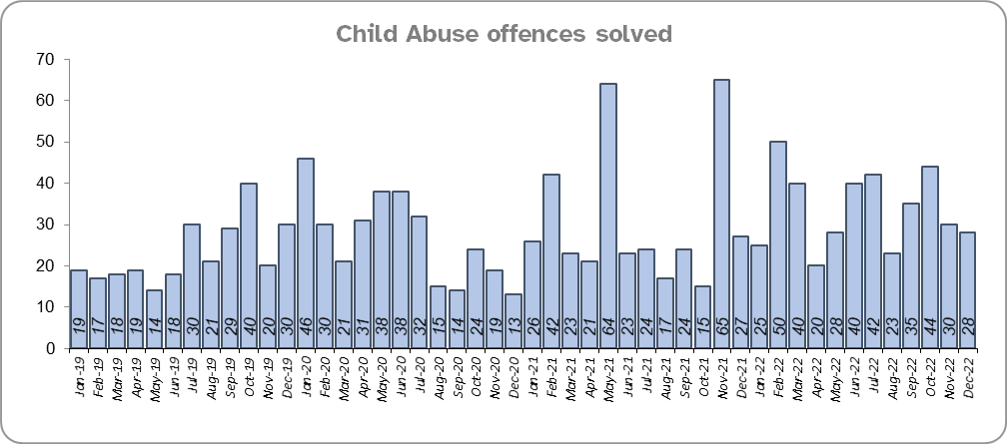
Priority 3 - Protecting vulnerable people and breaking the cycle of domestic abuse - continued
Grade: Good
Essex Police solved 34 more (9.2%) child abuse offences for the 12 months to December 2022 compared to the 12 months to December 2021; there was a 0.9% decrease (56 fewer) in offences for the same comparison periods.
Essex Police also solved 70 more (34.5%) offences for the 12 months to December 2022 compared to the 12 months to December 2019; there was also a 25.9% increase (986 more) in Child Abuse offences for the same comparison periods.

Slide 11
Priority 3 - Protecting vulnerable people and breaking the cycle of domestic abuse - continued
Grade: Good
208 Modern Slavery referrals were made in the 12 months to December 2022 compared with 169 in the 12 months to December 2021 (39 more).
The number of Domestic Violence Protection Notices (DVPN) decreased by 26.5% (74 fewer notices) in the 12 months to December 2022 compared to the 12 months to December 2021. There was an increase of 21.3% (36 more notices) compared to the 12 months to December 2019.
There were 72 fewer Domestic Violence Protection Orders (DVPO), a decrease of 28.3% in the 12 months to December 2022 compared to the 12 months to December 2021. A 7.7% increase was recorded compared to the 12 months to December 2019, (182 v. 169 DVPOs).
Confidence that the policing response to protect children and vulnerable people (from the independent survey commissioned by Essex Police) is at 79.2% (results to the 12 months to September 2022). Compared to year ending September 2021, confidence has decreased by 10.1% points but nevertheless remains at a high level.
Six of the nine metrics have improved when compared to the 12 months to December 2021 (DA offences, DA solved, repeat victims of DA, CA offences, CA solved and NRM referrals), three have deteriorated (DVPNs, DVPOs and confidence). Five metrics also improved when compared with the 12 months to December 2019. As such, a grade of Good is recommended.
Please note:
* The number of Modern Slavery referrals made to the National Referral Model are only available from April 2019 due to a change in the method of recording. A year on year comparison for the 12 months to December 2019 is therefore not possible.
** DVPN’s are the first stage of the process, and DVPO the second. An officer issues a DVPN which has to go to court to become a DVPO, there are always less orders than notices as a result, as not all are approved or process hasn’t been followed.

Slide 12
Priority 4 – Reducing violence against women and girls
Grade: Requires Improvement
Where gender is detailed, over half of victims of Violence Against the Person (VAP) offences identified as female* (55.8%). 3.0% of offences (2,132 offences) had no gender recorded**.
Essex experienced a 1.4% decrease (527 fewer) in the number of VAP offences committed against females in the 12 months to December 2022 compared to the 12 months to December 2021. There was an 8.0% increase (2,826 more) in the number of VAP offences committed against females in the 12 months to December 2022 compared to the 12 months to December 2019. A rise in these types of offences, however, is often driven by an increased confidence in reporting. This not only raises more awareness of VAWG-related issues but better enables the Force to understand the problem and thereby meet victims' needs.
Essex Police prides itself on having excellent Crime Data Accuracy (CDA). In its most recent inspection by HMICFRS, Essex Police was graded as Outstanding in relation to its CDA. Maintaining excellent CDA, however, requires the Force to neither under-record nor over-record offences. To this end, Essex Police is auditing and – where appropriate – cancelling Stalking & Harassment offences to ensure additional crimes have not been unnecessarily recorded. Essex Police have also been educating those working within the Resolution Centre to ensure they fully research the individuals involved in these types of offences before they create new crimes; where previous records exist, these additional incidents are instead referred to the relevant officer(s) in order that they can be investigated together. This activity has therefore not only resulted in a decrease of 138 offences since the start of the review (August 2022) but has enabled the Force to better coordinate these types of investigation. It is of note that Stalking and Harassment offences comprise the largest volume of VAWG offences; there were, for example, 1,835 fewer Stalking and Harassment crimes committed against females in the 12 months to December 2022 (16,022 crimes) compared to the 12 months to December 2021 (17,857 crimes).
There was a 2.4% increase (112 more) in the number of Sexual Offences committed against females in the 12 months to December 2022 compared to the 12 months to December 2021, and a 25.9% increase (986 more) compared to the 12 months to December 2019. Although Essex Police solved 13 fewer of these offences in the 12 months to December 2022 compared to the 12 months to December 2021, it solved 70 more compared to the 12 months to December 2019.
Please note:
***iOfficer defined gender.
***iNot Recorded also includes records where gender is unknown or unspecified.
*** Please see slide 35 for tables detailing Offences, Solved Outcomes and Solved Rates% for Violence against the Person and Sexual offences (by crime type) split by gender.

Slide 13
Priority 4 – Reducing violence against women and girls - continued
Grade: Requires Improvement
44.5% of females feel safe walking alone in their area after dark (from the independent survey commissioned by Essex Police) for the 12 months to September 2022 compared to 76.2% of males.
The Home Office is trialling a new online tool called Street Safe on police.uk to enable people, particularly women and girls, to pin-point locations where they feel unsafe or have felt unsafe and identify why that location made them feel unsafe. Street-Safe was developed by the Digital Public Contact (DPC) Programme in cooperation with the Home Office and the National Police Chiefs’ Council (NPCC) and was launched on 2 September 2021 as a national pilot for three months. Street Safe was introduced into Essex as part of the government’s strategy to tackle Violence against Women and Girls (VAWG). In December 2022, 35 reports were submitted in Essex. In total 317 reports have been submitted for Essex.
Essex Police is regularly reporting to the national VAWG Taskforce and HMICFRS in respect of its performance, its action plan to tackle VAWG, and its internal conduct and behaviour. This contact also shares best practice and innovation. The national VAWG Taskforce categorise work in three distinct areas: improving trust and confidence in policing; relentless pursuit of offenders; and creating safer spaces. Partnership engagement is key in tackling VAWG, as there are many strands which policing cannot tackle alone; these include education and the prevalence of VAWG and the anonymity of the internet.
White Ribbon Day (International Day for the Elimination of Violence Against Women and Girls) started on 25 November. This is a global campaign that encourages people, and especially men and boys, to individually and collectively take action and change the behaviour and culture that leads to abuse and violence; to wear a white ribbon is to promise to never commit, excuse or remain silent about male violence against women. As a White Ribbon accredited force, Essex Police promoted the day and hosted several events across the Local Policing Areas to reignite the conversation. By raising awareness among employees, people can learn how to become allies and call out violent and abusive behaviour when they see it. Essex Police once again joined everyone across the country in participating in the 16 days of action, although its prime concern will be to tackle violence against women all year round. The Force’s VAWG strategy sets out our priorities to relentlessly pursue perpetrators with a focus on high harm offenders, improving trust and confidence in policing through addressing culture and behaviours as well as working with partners to create safer spaces in Essex.
Essex Police Officer, Detective Superintendent Neil Pudney was awarded the King’s Police Medal (KPM) in the New Year Honours list. As head of Investigations in the Force’s Crime and Public Protection Command for the past three years, Neil has worked to achieve justice for victims of some of the most serious crimes, such as rape and sexual assault. During this time, the number of solved rape offences has risen by more than 80% and the number of charges secured for rape and serious sexual offences is now higher than the national average.
Essex Police encourage reporting and are working to gain a better understand this type of offence. While an increase in offences should therefore not necessarily be viewed negatively, the number of solved Sexual Offences committed against women has fallen in the 12 months to December 2022 compared to the same period last year (even though solved volumes are higher compared to the 12 months to December 2019). As such a grade of Requires Improvement is recommended.
Please note:
The confidence question was added to the internal survey in September 2021 so year on year comparison is not available.

Slide 14
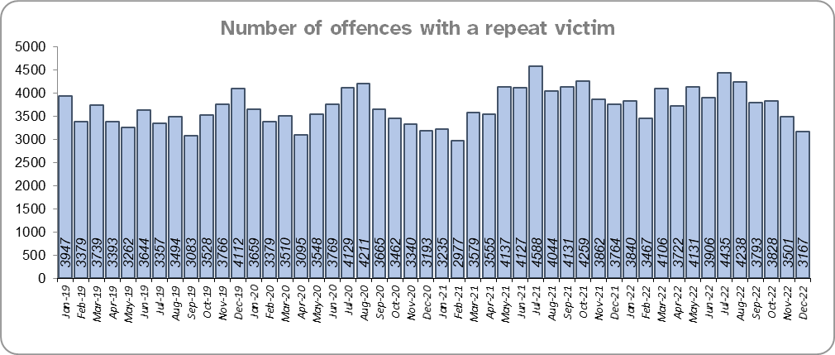
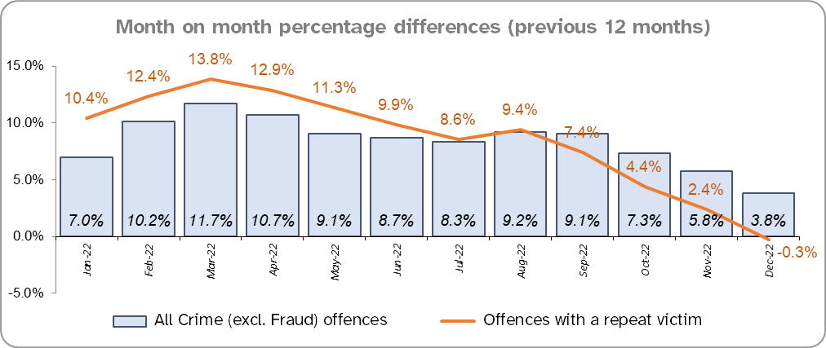
Priority 5 – Improving support for victims of crime
Grade:
Requires Improvement
Essex experienced a 0.3% decrease (124 fewer) in the number of offences with a repeat victim for the 12 months to December 2022 (46,134 offences) compared to the 12 months to December 2021 (46,258 offences) and an 8.0% increase (3,430 more) compared to the 12 months to December 2019 (42,704 offences).* Except for August 2022, the year on year increase for repeat victimisation, however, has decreased each month since March 2022 (decrease of 14.1 %pts. in that period).
The number of individual repeat victims increased by 3.3% (720 more) for the 12 months to December 2022 (22,502 individual victims) compared to the 12 months to December 2021 (21,782 individual victims). There was a slightly larger overall rise of 5.6% (1,195 more) compared to the 12 months to December 2019 (21,307 individual victims).
The average number of days taken to investigate High Harm offences increased to 52.9 in December 2022 compared to 44.8 in December 2021 (52.9 v. 44.8 days). This is a similar increase when compared to December 2019 (44.2 days).
There was a 2.4% increase in the number of referrals to Victim Support in the 12 months to December 2022 compared to the 12 months to December 2021; this equates to 669 more referrals. There was, however, a 31.5% decrease (12,934 fewer referrals) for the 12 months to December 2022 compared to the 12 months to December 2019.
Please note:
* This metric details how many crimes had a repeat victim rather than the number of individual people who are repeat victims of crime. A repeat victim is someone who has been named as a victim for more than one crime within a 12-month period; to mitigate the fact that multiple crimes can be associated with the same incident, additional crimes with the same victim on the same date are not counted.
** Data are for December only for all three years.

Slide 15
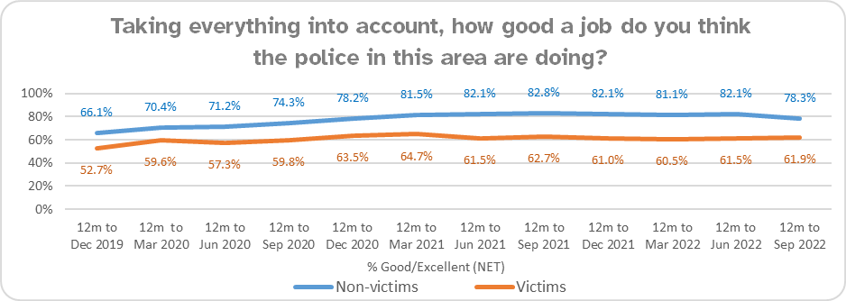
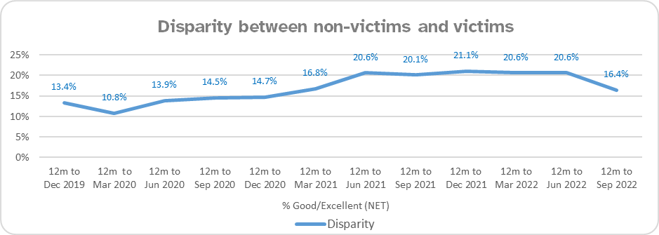
Priority 5 – Improving support for victims of crime - continued
Grade:
Requires Improvement
Confidence among victims (from the independent survey commissioned by Essex Police) is at 61.9% (results to the 12 months to September 2022). Although is 16.4% points lower than confidence of non-victims for the same period (78.3%), the gap has narrowed from 20.1 %pts. compared to the same period last year. However, the disparity has increased by 3.0%pts compared to the 12 months to December 2019 (13.4%).
Compared to year ending September 2021, confidence in the local police among victims is stable, in contrast to confidence amongst non-victims for whom there was a statistically significantly reduction of 4.5% points.
Due to the fact that the number of repeat victims has increased in the 12 months to December 2022 compared to the 12 months to December 2019 and the average number of days taken to investigate high harm offences has increased when compared to the 12 months to December 2021 and 2019, a grade of Requires Improvement is recommended.

Slide 16
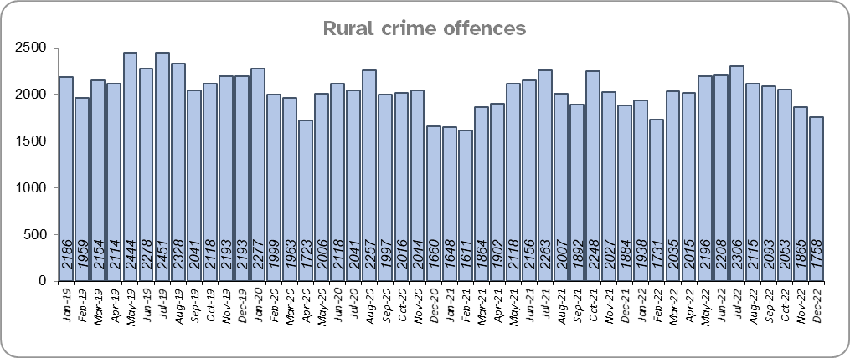
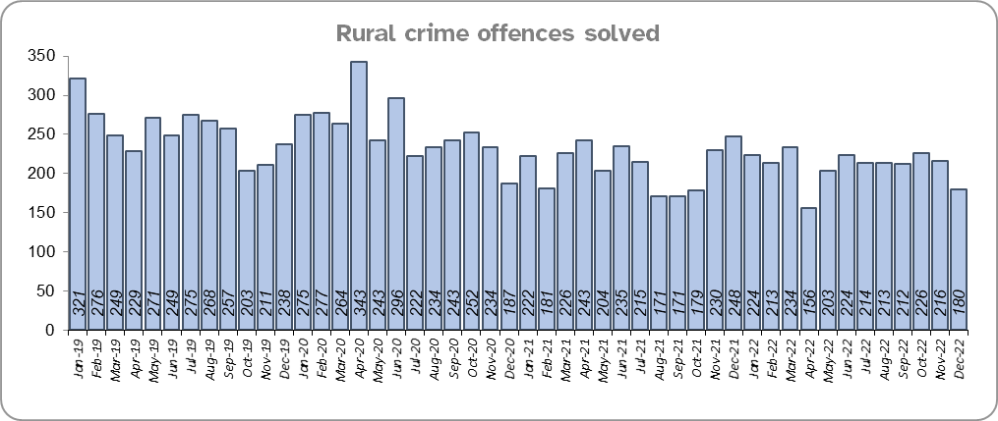
Priority 6 – Protecting rural and isolated areas
Grade: Good
Rural Crime decreased by 8.1% (2,146 fewer offences) in the 12 months to December 2022 compared to the 12 months to December 2019 pre-COVID period (All Crime in Essex decreased by 1.9% in the same period). Essex experienced a 2.9% increase in rural crime (693 more offences) for the 12 months to December 2022 compared to the 12 months to December 2021; All Crime in Essex increased by 3.8% in the same period.
Essex Police solved 0.4% (10) fewer rural crime offences for the 12 months to December 2022 compared to the 12 months to December 2021, and 532 fewer (a 17.5% decrease) compared to the 12 months to December 2019.
The rural crime Harm (Crime Severity) Score* was 8.8 for the 12 months to December 2022, a rise of 0.6 when compared to the 12 months to December 2021. However, this is lower than the All Crime Harm Score in Essex (14.7) which increased by 1.2 over the same period.
Please note:
* Crime Severity Scores (as calculated by the Office for National Statistics) measure the ‘relative harm’ of crimes by taking into account both their volume and their severity. National data are not available for crimes committed in rural areas, so it is not possible to measure against an MSG average; due to this, Essex Police data (to December 2022) have been used rather than national data (which are to October 2022).

Slide 17
Priority 6 – Protecting rural and isolated areas - continued
Grade: Good
Confidence in rural policing (from the independent survey commissioned by Essex Police) is at 77.4% (results to the 12 months to September 2022). Compared to year ending September 2021, confidence in rural policing has deteriorated, although it remains higher than the current overall Essex average (rural and urban combined) of 76.3%. In all four of the more rural districts in Essex, more than 75% of people believe Essex are doing a good or excellent job. Since 2019, confidence in Essex Police has increased significantly in every area across Essex. The four districts with the lowest levels of confidence (between 69%-75%) are urban.
Essex Police is one of only 15 forces who have dedicated Rural Policing Teams. The Rural Engagement Team establishment is two Sergeants and 11 PCs, one of whom is a dedicated Wildlife and Heritage Crime Officer. Four special constables are also fully embedded into the team. Delivery of the Rural Crime Strategy is overseen by the LPSU Chief Inspector and LPSU Inspector with the Rural Engagement Team delivering much of the activity.
Essex Police are continuing their commitment to prevent rural and heritage crime with the innovative launch of a horseback volunteer scheme in Uttlesford. The idea behind the scheme is that horse riders are in a unique position to spot signs of suspicious activity related to offences such as hare coursing, stolen agricultural vehicles, unlawful metal detecting or theft of lead from protected heritage buildings. The horseback volunteers will be trained in what to look out for and will be able to report any concerns or suspicious activity, helping the Force target those committing offences and stop criminality before it happens.
As confidence in the local police in rural areas is higher than in Essex as a whole, and offence levels in the 12 months to September 2022 compared to the 12 months to December 2019 (pre-COVID) are lower, a grade of Good is recommended.
Please note:
* Rural districts: Braintree, Maldon, Tendring and Uttlesford

Slide 18
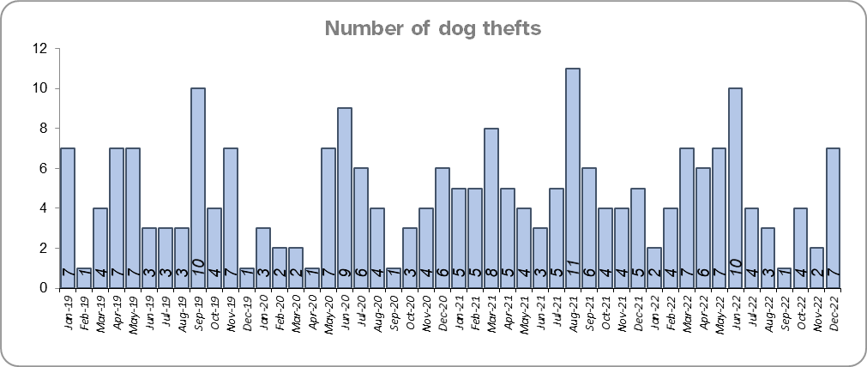
Priority 7 – Preventing dog theft
Grade: Good
There were eight fewer dog thefts in Essex for the 12 months to December 2022 compared to the 12 months to December 2021 (57 v. 65). There were the same number of dog thefts in the 12 months to December 2022 compared to the 12 months to December 2019.
Essex Police solved one fewer dog theft offence for the 12 months to December 2022 compared to the 12 months to December 2021 and the 12 months to December 2019.
Confidence in how Essex Police and the organisations they work with are dealing with dog theft (from the independent survey commissioned by Essex Police) is at 63.4% for the 12 months to September 2022.
Due to the low and reducing number of thefts across the county (given the comparatively large population of Essex), along with relatively high confidence levels, a grade of Good is recommended.
Please note:
* This is number of thefts in which dogs were stolen, and not quantity of dogs stolen in each theft. Data are based on theft offence crimes and robbery offence crimes where the ‘property code’ is ‘pet animal – dog’ and the ‘property status’ is ‘stolen’ and/or ‘stolen/recovered’.
** The confidence question was added to the internal survey in September 2021 so year on year comparison is not available.

Slide 19
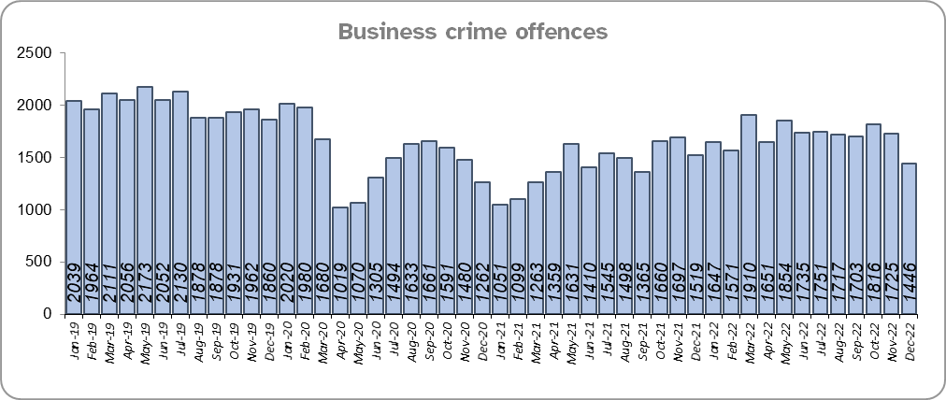
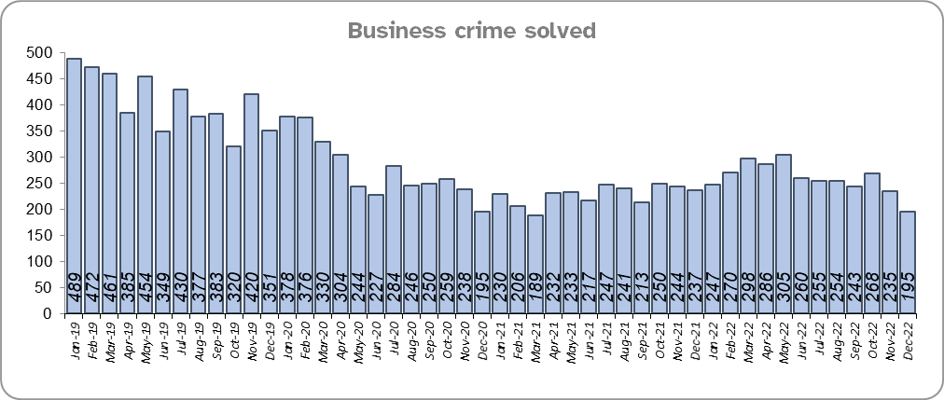
Priority 8 – Reducing business crime, fraud and cyber crime
Grade: Adequate
Business Crime offences include any notifiable crimes recorded with a victim which is an organisation; it does not include Fraud offences. All reports of Fraud are recorded by the National Fraud Intelligence Bureau (NFIB) rather than Essex Police. In the 12 months to December 2022, a total of 1,861 Fraud investigations were allocated to Essex Police by NFIB for investigation. For data on the number and type of Fraud investigations reported as being committed within the Essex Police area, please visit the NFIB Fraud and Cyber Crime Dashboard.
Essex experienced a 20.1% increase (3,429 more) in the number of Business Crime offences and a 13.8% increase (377 more) in the number of these offences which were solved in the 12 months to December 2022 compared to the 12 months to December 2021. COVID restrictions were lifted at the end of January 2021 resulting in lower figures in the 12 months to December 2021 as this includes periods when businesses were not open; shoplifting accounts for approximately 46% of business crime. Essex Police have been working with businesses to encourage them to record more offences.
There was a 14.6% decrease (3,508 fewer) in the number of Business Crime offences and a 36.3% decrease (1,775 fewer) in the number of Business Crimes solved in the 12 months to December 2022 compared to the 12 months to December 2019.

Slide 20
Priority 8 – Reducing business crime, fraud and cyber crime - continued
Grade: Adequate
There was a 3.7% increase in the number of fraud offences related to business crime in the 12 months to December 2022 compared to the 12 months to December 2021; this equates to 13 more offences. There was also a 25.6% decrease in the 12 months to December 2022 compared to the 12 months to December 2019; this equates to 124 fewer offences.
Confidence that Essex Police are dealing with cyber crime (from the independent survey commissioned by Essex Police) is at 51.1% for the 12 months to September 2022. Confidence has significantly increased from the previous quarter when it was at 25.2%.
Three of the five metrics deteriorating when compared to the 12 months to December 2021 (Business Crime offences, fraud offences related to Business Crime and the total number of fraud offences). However, due to the fact that these measures are improving when compared to the 12 months to December 2019, a grade of Adequate is recommended.
Please note:
* Fraud offences recorded on Athena where the victim is either an organisation or a person with the Business Victim flag.
** The confidence question was added to the internal survey in September 2021 so year on year comparison is not yet available.

Slide 21
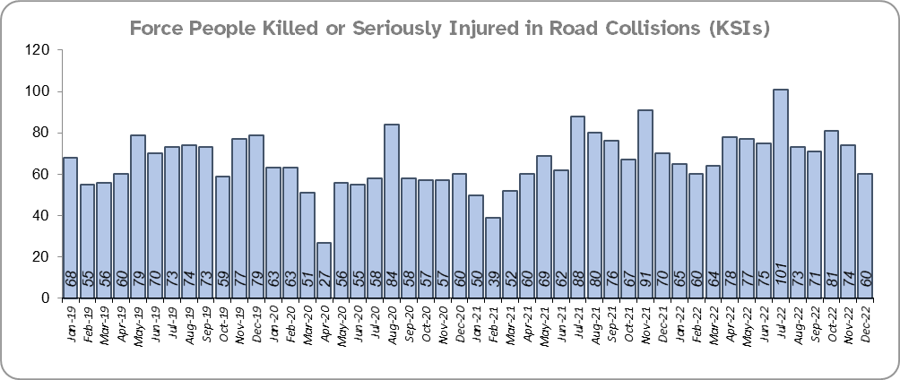
Priority 9 - Improving safety on our roads
Grade: Requires Improvement
Road traffic safety is the responsibility of the Safer Essex Roads Partnership (SERP). SERP comprises reprentatives from Essex Police, Essex County Fire & Rescue Service, Essex County Council, Southend on Sea Borough Council, Thurrock Council, National Highways, East of England Ambulance Service Trust, Essex and Herts Air Ambulance Service Trust and The Safer Roads Foundation (Registered Charity). The aspiration of Essex Police and partners is ‘Vision Zero’, namely to have no road deaths or serious injuries by 2040. The SERP Safety delivery plan sets out a structured programme of educational and engagement activity to address this and support behavioural changes.
There was a 9.3% increase (75 more) in the number of those Killed or Seriously Injured (KSI) in Essex for the 12 months to December 2022 compared to the 12 months to December 2021 with the rate of increase slowing more recently. The number of KSIs also increased by 56 in the 12 months to December 2022 compared to the 12 months to December 2019.
Essex is sixth in its Most Similar Group (MSG) of forces for casualties per 100 million vehicle kilometres (results to June 2021) and is slightly higher than the MSG average. However, due to the fact that more recent national figures have not been released, the current position cannot be determined (the date of the next national release has not yet been confirmed).
Please note that most KSIs do not necessarily result in criminal offences (such as death or serious injury caused by dangerous driving) being recorded.

Slide 22
Priority 9 - Improving safety on our roads - continued
Grade: Requires Improvement
There was a 7.4% decrease (184 fewer offences) in drink/drug driving offences for the 12 months to December 2022 compared to the 12 months to December 2021. This is mainly due to a decrease in recorded drug driving offences; there was a 0.8% decrease (11 fewer offences) in drink driving and a 15.8% decrease (173 fewer offences) in drug driving. There was also a 30.6% decrease (1,013 fewer offences) in drink/drug driving offences for the 12 months to December 2022 compared to the 12 months to December 2019; of these offences, there was a 6.1% decrease (90 fewer offences) in drink driving and a 50.0% decrease (923 fewer offences) in drug driving. All of these offence types are primarily driven by police proactivity in relation to road safety.
The number of Failure to Provide samples decreased by 3.5% (12 fewer) in the 12 months to December 2022 compared to the same period last year, and by 16.8% compared to the 12 months to December 2019.
There was a 169.0% increase (774 more offences) in the number of driving related mobile phone offences recorded for the 12 months to December 2022 compared to the 12 months to December 2021.*
Confidence in Essex Police and organisations with whom they police the roads (from the independent survey commissioned by Essex Police) is at 65.8% (results to the 12 months to September 2022). Confidence in the local police and organisations they work with has remained stable when compared to year ending September 2021 (66.0%).
Due to the increase in KSIs and the decrease in the number of driving under the influence of drink drug driving in the past 12 months compared to the previous 12 months and the 12 months to December 2019 a grade of Requires Improvement is recommended.
Please note:
* In 2019, the definition as to what constituted “use” of a mobile phone in relation to driver-related mobile phone offences was subject to a legal challenge. This resulted in a ruling, which held that while “use” included accessing the interactive functions of the mobile phone (such as making calls, sending messages or using the internet), it did not extend to solely accessing the device’s internal functions (such as making use of the camera). Fewer mobile phone offences were subsequently prosecuted from this point. In 2021 the government announced that the law was to be changed making it illegal to “hold” a phone or sat nav when driving or riding a motorcycle. This law was finally passed on 25th March 2022.

Slide 23
Priority 10 – Encouraging volunteers and community support
Grade: Adequate
Essex Watch Liaison Officers continue to work with Neighbourhood Watch (NHW) to offer crime and fraud prevention advice.*
Citizens in Policing and the Special Constabulary play an integral part in supporting Essex Police. In January 2022, the Local Policing Support Unit (LPSU) introduced a Strategic Co-ordination Group which proactively supports, throughout the county, the mobilisation of all Special Constables, Police Support Volunteers, Active Citizens, Accredited Persons and, where appropriate our Volunteer Police Cadets, with local operations and initiatives under the Chief Constable’s Plan on a Page and the Police, Fire Crime Commissioner’s Police and Fire Plan.
Since last month’s report, there are now: two more allotment group members, one fewer caravan group members, six more dog group members, three fewer farm and rural group members and one fewer heritage group members.
There are currently 2,366 NHW Co-ordinators and 92,500 NHW members.
Please note:
* Neighbourhood Watch data were first produced in March 2022 so year on year comparison is not available.

Slide 24
Priority 10 – Encouraging volunteers and community support
Grade: Adequate
The Special Constabulary headcount is currently 353 (as of 31 December 2022). There are 223 Volunteer Police Cadets (VPCs) and 89 Volunteer Cadet Leaders across 13 Cadet Units. In addition there are 105 Police Support Volunteers and 59 Active Citizens within Essex Police across the county, a total of 164 Volunteers. These volunteers also are part of the Strategic Co-ordination Group and support their Local Community Policing Teams with local events.
Confidence that there are good opportunities for volunteers to assist policing and reduce crime in Essex (from the independent survey commissioned by Essex Police) is at 49.4% for 12 months to September 2022. Confidence has increased each quarter since Q4 2021/22 (2021/22 Q4 45.1%; 2022/23 Q1 48.6%).
The Essex Police Christmas Giving Appeal was a huge success. This year, more than 9,000 presents were donated. Every present donated was passed on to young people and children who might otherwise have nothing at Christmas. The Force’s Children Social Care specialist teams worked with voluntary groups, charities, local councils, schools, refuges, foodbanks, hospital children’s wards, hospices and social housing association to make sure all the presents were given to young victims of crimes, such as burglary and domestic abuse.
The total number of volunteers decreased in the 12 months to December 2022 compared to the 12 months to December 2021 and 2019. However, due to the fact that Essex has the second largest Special Constabulary in the country, and that the Essex Police makes use of Ethics Boards to inform its work, a grade of Adequate is recommended.
Please note:
* VPC data are taken from the cadet census and are for the 31st January each year.
** The confidence question was added to the internal survey in September 2021 so year on year comparison is not available.

Slide 25
Priority 11 – Supporting our officers and staff
Grade: Adequate
There has been a slight decrease (0.2%) in the proportion of ethnic minority employees in December 2022 (269) compared to December 2021 (281); this equates to twelve fewer employees. However, in contrast, there has been a 24.0% increase compared to December 2019 (217); this equates to 52 additional employees.
Essex Police reached record strength in its 182-year history. 74 new officers took their oaths to the King and started their Essex Police careers as the Force now has more officers protecting and serving the county than ever before. The new officers pledged their commitment to police with the consent of every community at a time when the force is welcoming more new colleagues from a range of different backgrounds.
The average days lost per person for sickness deteriorated for Officers but improved for Staff and PCSOs in the 12 months to December 2022 compared to the 12 months to December 2021. Full Time Employee vacancies deteriorated for all employee types over the same period.
Please note:
* Ethnic minority employees as a percentage of the total workforce.
** Ethnic minority employees as a percentage of type of employee.

Slide 26
Grade:
Requires Improvement
Priority 12 – Increasing collaboration
302 school visits were conducted in the 12 months to September 2022.*
There was a 61.7% decrease (1,658 fewer) in the number of programmes delivered in the 12 months to September 2022 compared to the 12 months to December 2019.**
A decrease of 25.5% (53,410 fewer) was recorded for Audience Numbers in the 12 months to September 2022 compared to the 12 months to December 2019.**
Due to the decrease in programmes delivered and audience numbers in the 12 months to September 2022 compared to the 12 months to December 2019 a grade of Requires Improvement is recommended.
Please note:
All data from the Joint Essex Fire and Police Education in Schools Programme (2022) have been provided by the Fire Service.
* Only data for the 12 months to September 2022 has been provided so year on year comparisons are not available.
** Schools and colleges reopened in September 2020 due to the pandemic, but were closed again from January to March 2021. In addition, throughout most of the September 2020 to July 2021 period there were still government restrictions on gathering and movement, especially for non-essential mixing.

Slide 27
Monthly Performance Overview: Exceptions
Exceptions Overview
Stalking and Harassment and Criminal Damage experienced statistically significant decreases for the month of December 2022. Trafficking of Drugs experienced a statistically significant increase in offences and a statistically significant decrease in solved offences.
Stalking and Harassment – Decrease
12.3% decrease (3,485 fewer crimes) for the 12 months to December 2022 compared to the 12 months to December 2021. There were statistically exceptional increases in four Districts in December 2022, three of which were in North LPA: Chelmsford, Maldon, Tendring. The other district which experienced a statistically significant decrease was Southend.
Criminal Damage – Decrease
1.8% increase (250 more crimes) for the 12 months to December 2022 compared to the 12 months to December 2021. The Force experienced a statistically exceptional decrease in December 2022.
Trafficking of Drugs – Increase
7.3% increase (91 more crimes) for the 12 months to December 2022 compared to the 12 months to December 2021. The Force experienced a statistically exceptional increase in December 2022. It is of note that these offences are an indication of police proactivity rather than of the level of drug dealing activity in the county.

Slide 28
2021-2024 Police and Crime Plan Performance Indicators
Table 1
Please view above table with the explanations and caveats detailed on slides 31 and 32.

Slide 29
2021-2024 Police and Crime Plan Performance Indicators - continued
Table 2
Please view above table with the explanations and caveats detailed on slides 31 and 32.

Slide 30
2021-2024 Police and Crime Plan Performance Indicators - continued
Table 3
Please view above table with the explanations and caveats detailed on slides 31 and 32.

Slide 31
End Notes
¹ Crime Severity Score measures ‘relative harm’ of crimes by taking into account both the volume and the severity of offences, and by weighting offences differently. National data for the 12 months to October 2022 have been used in order that comparisons can be made to Essex’s Most Similar Group of Forces (MSG).
² Please note that on Wednesday 23 October 2019 the bodies of 39 Vietnamese nationals were discovered in a lorry trailer in Grays. This tragic incident is reflected in the Homicide numbers.
³ October 2021 saw the implementation of Operation SOMERTON, which aims to both improve the service given to victims of ASB and ensure crimes are correctly recorded.
⁴ Question from the independent survey commissioned by Essex Police. Results are for the period 12 months September 2022 versus the 12 months to September 2021.
⁵ The confidence interval is the range +/- within which the survey result will lie. This is mainly influenced by the number of people answering the survey. The more people that answer the survey, the smaller the interval range.
⁶ The methodology used for identifying these investigations as drug related is subjective and based on the circumstances presented. These figures will include investigations where the victim or the suspect are involved Drug Use, Possession or Selling.
⁷ The number of knife crime offences is an indicator of how effective Essex Police is at identifying knife-enabled offences, and is not necessarily reflective of the number of these offences that have been committed in the county. This is because the identification of these offences is reliant on the appropriate indicator being manually added to the crime record. A manual review of knife flags was conducted and missing flags were added retrospectively. Additionally a new data quality process was introduced in June 2020. Whilst this has enabled us to better understand knife crime in Essex, the process has consequently inflated the figures. As such, no inferences can be drawn as to the current trend.
⁸ OCG disruptions are reported quarterly. Data are to December 2022.
⁹ Solved outcomes are crimes that result in: charge or summons, caution, crimes taken into consideration, fixed penalty notice, cannabis warning or community resolution.
¹⁰ NRM data only available from April 2019 due to recording change at that time.
¹¹ High Harm offences: Violence with Injury, Rape, Other Sexual Offences, Robbery of Personal Property and Residential Burglary. Average number of days are for the previous month in all three periods.
¹² This is the number of theft offences in which dogs were stolen, and not necessarily the number of dogs which were stolen.

Slide 32
End Notes
¹³ ‘Killed or Seriously Injured’ (KSI) refers to all people killed or seriously injured on Essex’s roads, regardless of whether any criminal offences were committed. ‘Causing Death/Serious Injury by Dangerous/Inconsiderate Driving’ offences (detailed on slide 21) refers to the number of crimes of this type.
¹⁴ In 2019, the definition as to what constituted “use” of a mobile phone in relation to driver-related mobile phone offences was subject to a legal challenge. This resulted in a ruling, which held that while “use” included accessing the interactive functions of the mobile phone (such as making calls, sending messages or using the internet), it did not extend to solely accessing the device’s internal functions (such as making use of the camera). Fewer mobile phone offences were subsequently prosecuted from this point. In 2021 the government announced that the law was to be changed making it illegal to “hold” a phone or sat nav when driving or riding a motorcycle. This law was finally passed on 25th March 2022.
¹⁵ Neighbourhood Watch data are reported quarterly. Data as at 31st December 2022.
¹⁶ Ethnic minority employees as a percentage of the total workforce.
¹⁷ Absence data: Rolling from 1st April each year.
¹⁸ Data provided by the Fire Service and to the 12 months to September 2022.
¹⁹ Number of offences with repeat victim including month on month percentage change.

Slide 33
Crime Tree Data – Rolling 12 Months to December
Table 4

Slide 34
Crime Tree Data – Rolling 12 Months to December - continued
Table 5

Slide 35
Crime Tree Data - Rolling 12 months to December Violence against the Person and Sexual offences and outcomes (by crime type) split by gender
Table 6
Please note: the breakdown of data for the previous 12 months within these tables may not tally with the totals on slide 12 as gender data is rerun on a monthly basis.

