Slide 1
Police and Crime Plan 2021-2024
Monthly Performance Update
October 2022
National and MSG positions are to 31 August 2022 (Essex Police data are to 31 October 2022).
Version 2.1
Produced November 2022
Performance Analysis Unit, Research & Analysis Department, Essex Police
Sensitivity: Official

Slide 2
Executive Summary
The Police and Crime Plan 2021-2024 was introduced in April 2021, with new measures that reflect the Essex Police, Fire and Crime Commissioner’s (PFCC) strategic commitment to targeted prevention and early intervention.
Four of the eleven PFCC Priorities have been given a recommended grade of ‘Good’: 2 (Reduce drug driven violence), 6 (Protect rural and isolated areas), 7 (Dog Theft) and 10 (Encouraging Volunteers and Community Support). Four have been given a recommended grade of ‘Adequate’ and three have been given a recommended grade of ‘Requires Improvement’: 4 (Violence against women and girls), 5 (Improving our service to support victims of crime) and 9 (Improving safety on our roads). There have been no changes in the recommended grades since the last report.
Confidence (from the independent survey commissioned by Essex Police) is at 77.9% (results to the 12 months to June 2022). Confidence has increased by 13.2 percentage points compared to the 12 months to December 2019 (64.7%); the 12 months to December 2019 has been used as a comparative period as it was the last full year (and last full financial quarter) in which society, crime and policing was not affected by the pandemic. However, compared to year ending June 2021 (79.8%), confidence in the local police has deteriorated slightly.
There was a decrease in All Crime (0.9%), Rural Crime (7.0%) and Business Crime (14.6%) for the 12 months to October 2022 compared to the 12 months to December 2019. However, compared to the 12 months to October 2021, All Crime increased by 7.3%; this equates to 11,367 more offences. The volume of crimes recorded by the police has been influenced by the Government’s restrictions on gathering and movement in relation to COVID-19; fewer offences were recorded when more restrictions were in place.
Essex Police prides itself on having excellent Crime Data Accuracy (CDA). In its most recent inspection by HMICFRS, Essex Police was graded as Outstanding in relation to its CDA. Maintaining excellent CDA, however, requires the Force to neither under-record nor over-record offences. To this end, Essex Police is auditing and – where appropriate – cancelling Stalking & Harassment offences to ensure additional crimes have not been unnecessarily recorded. Essex Police have also been educating those working within the Resolution Centre to ensure they fully research the individuals involved in these types of offences before they create new crimes; where previous records exist, these additional incidents are instead referred to the relevant officer(s) in order that they can be investigated together. This activity has therefore not only resulted in a decrease in offences since the start of the review (August 2022) but has enabled the Force to better coordinate these types of investigation. It is of note that Stalking and Harassment offences comprise the largest volume of Violence Against Women & Girls offences (VAWG) and accounts for 21.3% of all Domestic Abuse investigations. There were, for example, 1,222 fewer Stalking and Harassment crimes committed against females in the 12 months to October 2022 (16,597 crimes) compared to the 12 months to October 2021 (17,819 crimes).
Essex experienced a 4.4% increase (1,997 more) in the number of offences with a repeat victim for the 12 months to October 2022 (47,111 offences) compared to the 12 months to October 2021 (45,114 offences); however, there were 389 fewer offences with repeat victims in October 2022 compared to October 2021. The year on year increase in repeat victimisation has been reducing since March 2022 (decrease of 9.4 %pts.)¹. The number of individual repeat victims increased by 6.1% (1,311 more) for the 12 months to October 2022 (22,730 individual victims) compared to the 12 months to October 2021 (21,419 individual victims); this is a higher proportion than that experienced for the number of offences with a repeat victim. It is of note that any over-recording of Stalking and Harassment offences will impact both the number of repeat victims and the number of offences with a repeat victim.

Slide 3
Executive Summary - continued
Over half of victims of Violence Against the Person (VAP) offences identify as female (56.3%)¹. VAP offences committed against females increased by 2.0% (779 more), and there was a 9.5% increase (423 more) in the number of sexual offences against females in the 12 months to October 2022 compared to the 12 months to October 2021. These increases are smaller than those committed against males; there was a 3.9% rise (1,129 more) in VAP offences committed against males and a 15.3% rise (113 more) in sexual offences against males in the same period.
Violence Against Women and Girls (VAWG) offences are increasing year on year. A rise in these types of offences, however, is often driven by an increased confidence in reporting. This not only raises more awareness of VAWG-related issues but better enables the Force to understand the problem and thereby meet victims' needs.
There were nine fewer solved sexual offences committed against females in the 12 months to October 2022 compared to the 12 months to October 2021. This compares to an increase of six more solved sexual offences committed against males in the same period.
When comparing High Harm offences to its Most Similar Group (MSG) by crimes per 1,000 population, Essex is placed third for Other Sexual Offences, fifth for Violence with Injury and Burglary Residential, and eighth for Rape and Robbery of Personal Property.
There was a 17.5% increase (133 more) in the number of those Killed or Seriously Injured (KSI) in Essex for the 12 months to October 2022 compared to the 12 months to October 2021. Since August 2022, the number of incidents reported each month has been slightly below those experienced in 2021 (although there were four more incidents in October 2022 compared to October 2021: 71 v. 67). It is of note that road traffic safety is the responsibility of the Safer Essex Roads Partnership (SERP) which includes organisations such as Essex Police; Essex County Fire & Rescue Service; Essex County Council; Southend on Sea Borough Council; Thurrock Council; National Highways; East of England Ambulance Service Trust; Essex and Herts Air Ambulance Service Trust; and The Safer Roads Foundation (Registered Charity).
Essex Police now has the highest numbers of officers in its 182-year old history. The Force is also on track to have a total of 3,755 officers by March 2023. It is also of note that there has been a steady and continual increase in the numbers of employed female colleagues, as well as those from ethnic minority backgrounds.
There was a statistically significant increase in Robbery of Personal Property for the month of October 2022. There were statistically exceptional increases in two Districts, namely Colchester and Tendring. In the 12 months to October 2022, there has been a 15.0% increase in offences compared to the same period the previous year; this equates to 178 additional offences.

Slide 4
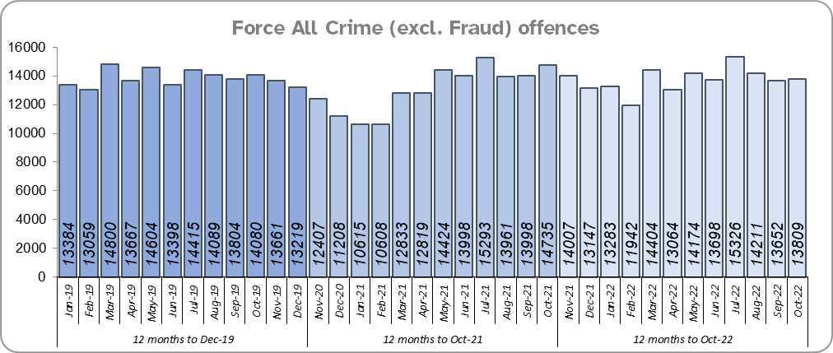
Priority 1 – Further investment in crime prevention
Grade: Adequate
There was a 0.9% decrease in All Crime in the 12 months to October 2022 compared to the 12 months to December 2019; this equates to 1,557 fewer offences. There was, however, a 7.3% increase in All Crime (11,367 more offences) for the 12 months to October 2022 compared to the 12 months to October 2021. The volumes of crimes recorded by the police has been influenced by the Government’s restrictions on gathering and movement in relation to COVID-19; fewer offences were recorded when there were more restrictions in place. Essex is seventh in its Most Similar Group of forces (MSG) for all crime per 1,000 population.
Essex Police recorded a daily average of 445 crimes in October 2022, compared to an average of 455 crimes recorded in September 2022. This equates to a decrease of 2.1%, or an average of 10 fewer crimes recorded per day.
13,809 offences were recorded in the month of October 2022, a decrease of 6.3% (926 fewer offences) compared to the month of October 2021 (14,735 offences), and a decrease of 1.9% (271 fewer offences) compared to the month of October 2019.

Slide 5
Priority 1 - Further investment in crime prevention - continued
Grade: Adequate
Confidence has experienced a statistically significant improvement compared to levels reported prior to the pandemic (by 13.2% points from 64.7% for the 12 months to December 2019). It was during the height of the pandemic that confidence reached its highest levels. There was, however, a statistically significant decrease in confidence of 1.9% points (from the independent survey commissioned by Essex Police) in the 12 months to June 2022 (77.9%) compared to the 12 months to June 2021 (79.8%).
The All Crime Harm (Crime Severity) Score* (14.9) places Essex seventh in its MSG.
Compared to the pre-COVID period, there has been a reduction in crime and an increase in confidence. However, when comparing the 12 months to September 2022 with the 12 months to September 2021, this pattern is reversed: crime has increased and confidence has decreased. As such, a grade of Adequate is recommended.
Please note:
* Crime Severity Scores (as calculated by the Office for National Statistics) measure the ‘relative harm’ of crimes by taking into account both their volume and their severity. As national data are only available to August 2022, the score for the 12 months to August for the preceding year has been included.

Slide 6
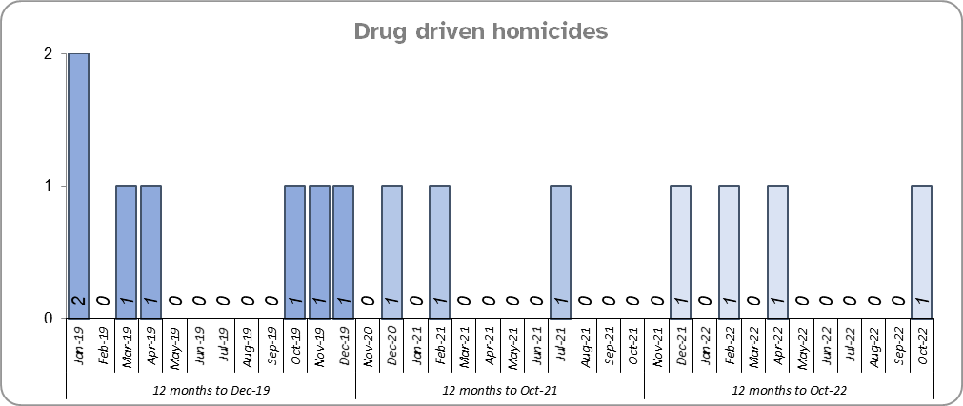
Priority 2 – Reducing drug driven violence
Grade: Good
Essex experienced an increase of one drug related homicide for the 12 months to October 2022 compared to the 12 months to October 2021 and three fewer compared to the 12 months to December 2019.
Confidence that Essex Police and partners are dealing with drug crime (from the independent survey commissioned by Essex Police) is at 62.4% for the period September 2021 to June 2022. The results for this question have been stable since it was first asked in September 2021.
Due to the fact that drug related homicides are lower compared to the pre-COVID period, and that confidence is relatively high, a grade of Good is recommended.
Please note:
* The methodology used for identifying investigations as being drug-related is subjective (qualitative data) and based on the circumstances presented. These figures include investigations where the victim and/or suspect are suspected of being involved in Drug Use, Possession or Selling.
** The confidence question was added to the external independent survey in September 2021. A year on year comparison is therefore not available.

Slide 7
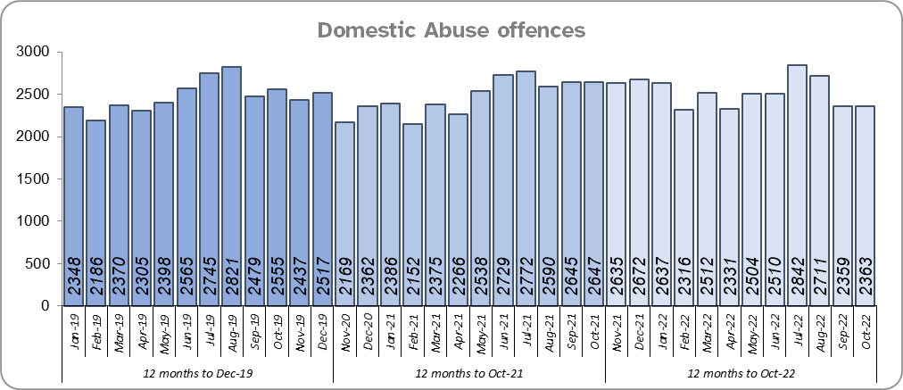
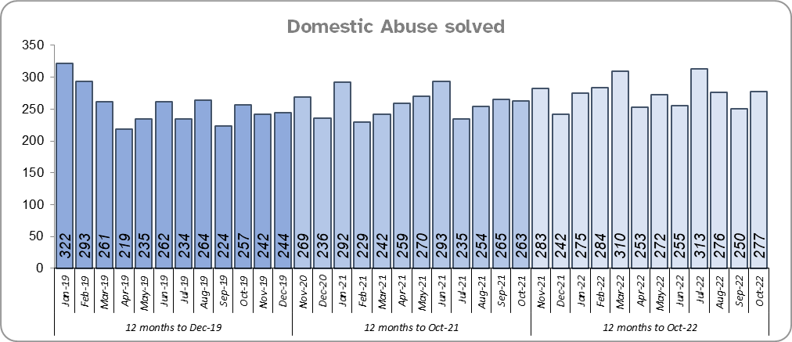
Priority 3 - Protecting vulnerable people and breaking the cycle of domestic abuse
Grade: Adequate
Essex experienced a 2.6% increase (761 more) in Domestic Abuse (DA) offences for the 12 months to October 2022 compared to the 12 months to October 2021. However, the Force recorded 449 fewer offences in the three months to October 2022 compared to the same period in 2021 (7,433 v. 7,882). It is of note that Stalking & Harassment offences account for more than a fifth (21.3%) of all Domestic Abuse investigations.
Essex Police solved 5.9% (183) more DA offences for the 12 months to October 2022 compared to the 12 months to October 2021. The Force also solved 21 more offences in the three months to October 2022 compared to the same period in 2021 (803 v 782).
There was a 2.2% increase (666 more) in DA offences and a 9.5% increase (285 more) in the number of DA offences solved for the 12 months to October 2022 compared to the 12 months to December 2019.
The Essex Police Domestic Abuse Problem Solving Teams (DAPST) were formed in March 2021 and are divided into a victim focused contingent (Problem-Solving officers) and an Offender Management contingent (Offender Management officers). They work alongside DAIT, who manage the most prolific DA perpetrators and the most vulnerable victims. The team provide a continual and sustained problem-solving approach, focusing on preventing future harm and reducing repeat victimisation.

Slide 8
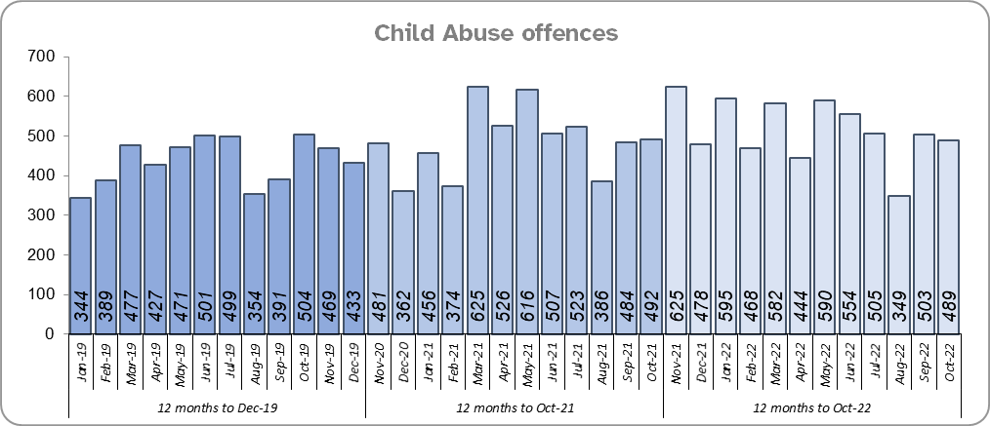
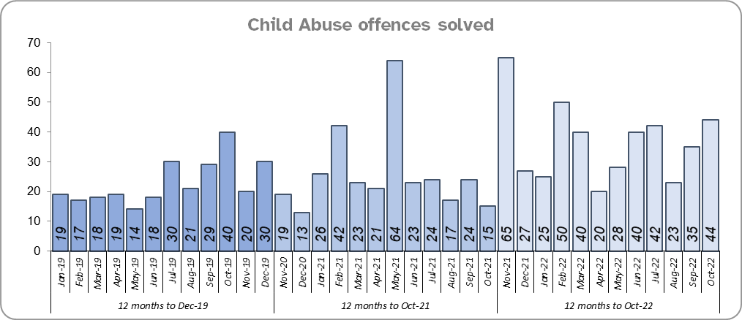
Priority 3 - Protecting vulnerable people and breaking the cycle of domestic abuse - continued
Grade: Adequate
Essex Police solved 128 more (41.2%) child abuse offences for the 12 months to October 2022 compared to the 12 months to October 2021. There was also a 6.0% increase (350 more) in offences for the same comparison periods.
Essex Police solved 164 more (59.6%) offences for the 12 months to October 2022 compared to the 12 months to December 2019. There was also a 17.6% increase (923 more) in Child Abuse offences for the same comparison periods.
Confidence that the policing response to protect children and vulnerable people (from the independent survey commissioned by Essex Police) is at 81.7% (results to the 12 months to June 2022). Compared to year ending June 2021, confidence has decreased by 7.5% points but nevertheless remains at a high level.
There has been a continuing increase in the number of Child Abuse and Domestic Abuse offences solved in the 12 months to October 2022 compared to the previous 12 months and the 12 months to December 2019, even though offences have increased over the same time periods. As such, a grade of Adequate is recommended.

Slide 9
Priority 4 – Reducing violence against women and girls
Grade: Requires Improvement
Where gender is detailed, over half of victims of Violence Against the Person (VAP) offences identified as female* (56.3%). 3.0% of offences (2,140 offences) had no gender recorded**.
More VAWG offences are being reported. Essex experienced a 2.0% increase (779 more) in the number of VAP offences committed against females in the 12 months to October 2022 compared to the 12 months to October 2021. There was also a 9.8% increase (3,479 more) in the number of VAP offences committed against females in the 12 months to October 2022 compared to the 12 months to December 2019. A rise in these types of offences, however, is often driven by an increased confidence in reporting. This not only raises more awareness of VAWG-related issues but better enables the Force to understand the problem and thereby meet victims' needs.
Essex Police prides itself on having excellent Crime Data Accuracy (CDA). In its most recent inspection by HMICFRS, Essex Police was graded as Outstanding in relation to its CDA. Maintaining excellent CDA, however, requires the Force to neither under-record nor over-record offences. To this end, Essex Police is auditing and – where appropriate – cancelling Stalking & Harassment offences to ensure additional crimes have not been unnecessarily recorded. Essex Police have also been educating those working within the Resolution Centre to ensure they fully research the individuals involved in these types of offences before they create new crimes; where previous records exist, these additional incidents are instead referred to the relevant officer(s) in order that they can be investigated together. This activity has therefore not only resulted in a decrease in offences since the start of the review (August 2022) but has enabled the Force to better coordinate these types of investigation. It is of note that Stalking and Harassment offences comprise the largest volume of VAWG offences; there were, for example, 1,222 fewer Stalking and Harassment crimes committed against females in the 12 months to October 2022 (16,597 crimes) compared to the 12 months to October 2021 (17,819 crimes).
There was a 9.5% increase (423 more) in the number of Sexual Offences committed against females in the 12 months to October 2022 compared to the 12 months to October 2021, and a 28.4% increase (1,081 more) compared to the 12 months to December 2019. Although Essex Police solved nine fewer of these offences in the 12 months to October 2022 compared to the 12 months to October 2021, it solved 61 more compared to the 12 months to December 2019.
Please note:
**** Officer defined gender.
**** Not Recorded also includes records where gender is unknown or unspecified.
**** Please see page 28 for table of violence against the person and sexual offences and outcomes (by crime type) split by gender.
**** The confidence question was added to the internal survey in September 2021 so year on year comparison is not available.

Slide 10
Priority 4 – Reducing violence against women and girls - continued
Grade: Requires Improvement
43.8% of females feel safe walking alone in their area after dark (from the independent survey commissioned by Essex Police) for the period September 2021 to June 2022 compared to 76.4% of males.
The Home Office is trialling a new online tool called Street Safe on police.uk to enable people, particularly women and girls, to pin-point locations where they feel unsafe or have felt unsafe and identify why that location made them feel unsafe. Street-Safe was developed by the Digital Public Contact (DPC) Programme in cooperation with the Home Office and the National Police Chiefs’ Council (NPCC) and was launched on 2 September 2021 as a national pilot for three months. Street Safe was introduced into Essex as part of the government’s strategy to tackle Violence against Women and Girls (VAWG). In October 2022, 13 reports were submitted in Essex. In total 219 reports have been submitted for Essex.
Essex Police is regularly reporting to the national VAWG Taskforce and HMICFRS in respect of its performance, its action plan to tackle VAWG, and its internal conduct and behaviour. This contact also shares best practice and innovation. The national VAWG Taskforce categorise work in three distinct areas: improving trust and confidence in policing; relentless pursuit of offenders; and creating safer spaces. Partnership engagement is key in tackling VAWG, as there are many strands which policing cannot tackle alone; these include education and the prevalence of VAWG and the anonymity of the internet.
Essex Police encourage reporting and are working to gain a better understand this type of offence. While an increase in offences should therefore not necessarily be viewed negatively, the number of solved Sexual Offences committed against women has fallen in the 12 months to October 2022 compared to the same period last year (even though solved volumes are higher compared to the 12 months to December 2019). As such a grade of Requires Improvement is recommended.
Please note:
**** Officer defined gender.
**** Not Recorded also includes records where gender is unknown or unspecified.
**** Please see page 28 for table of violence against the person and sexual offences and outcomes (by crime type) split by gender.
**** The confidence question was added to the internal survey in September 2021 so year on year comparison is not available.

Slide 11
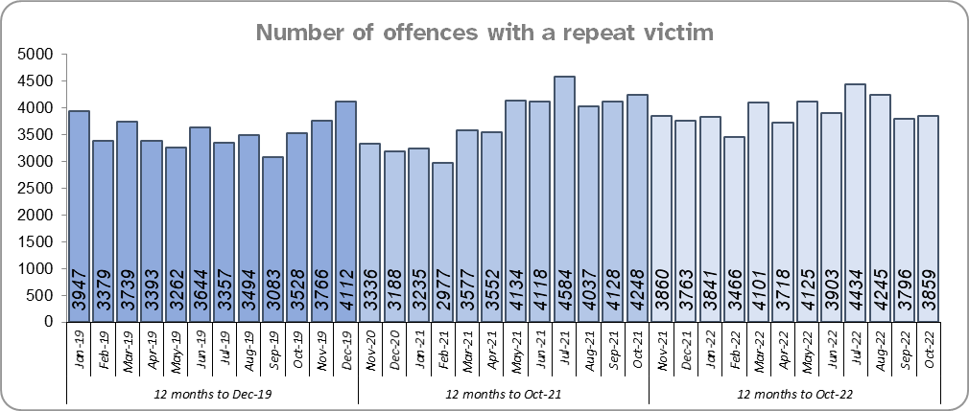
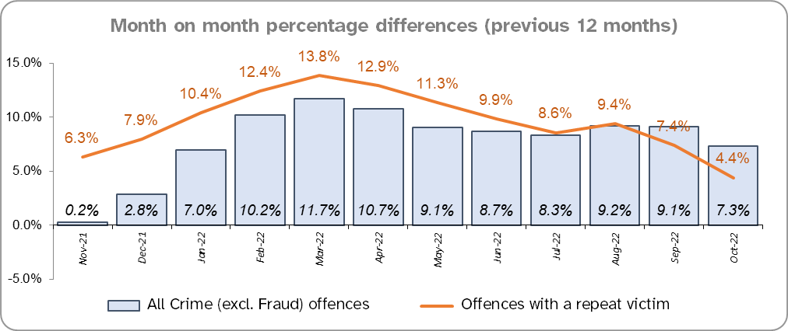
Priority 5 – Improving support for victims of crime
Grade: Requires Improvement
Essex experienced a 4.4% increase (1,997 more) in the number of offences with a repeat victim for the 12 months to October 2022 (47,111 offences) compared to the 12 months to October 2021 (45,114 offences) and a 10.3% increase (4,407 more) compared to the 12 months to December 2019 (42,704 offences).* Except for August 2022, the year on year increase for repeat victimisation, however, has decreased each month since March 2022 (decrease of 9.4 %pts. in that period).
The number of individual repeat victims increased by 6.1% (1,311 more) for the 12 months to October 2022 (22,730 individual victims) compared to the 12 months to October 2021 (21,419 individual victims). There was a slightly larger overall rise of 6.7% (1,423 more) compared to the 12 months to December 2019 (21,307 individual victims).
Please note:
* This metric details how many crimes had a repeat victim rather than the number of individual people who are repeat victims of crime. A repeat victim is someone who has been named as a victim for more than one crime within a 12-month period; to mitigate the fact that multiple crimes can be associated with the same incident, additional crimes with the same victim on the same date are not counted.

Slide 12
Priority 5 – Improving support for victims of crime - continued
Grade: Requires Improvement
Confidence among victims (from the independent survey commissioned by Essex Police) is at 62.7% (results to the 12 months to June 2022). This is 17.0% points lower than confidence of non-victims for the same period (79.7%) but the gap has narrowed.
Compared to year ending June 2021, confidence in the local police among victims is stable, in contrast to confidence amongst non-victims for whom there was a statistically significantly reduction of 2.4% points.
Due to the fact that the number of repeat victims has increased in the 12 months to October 2022 compared to the same period last year and the 12 months to December 2019, a grade of Requires Improvement is recommended.

Slide 13
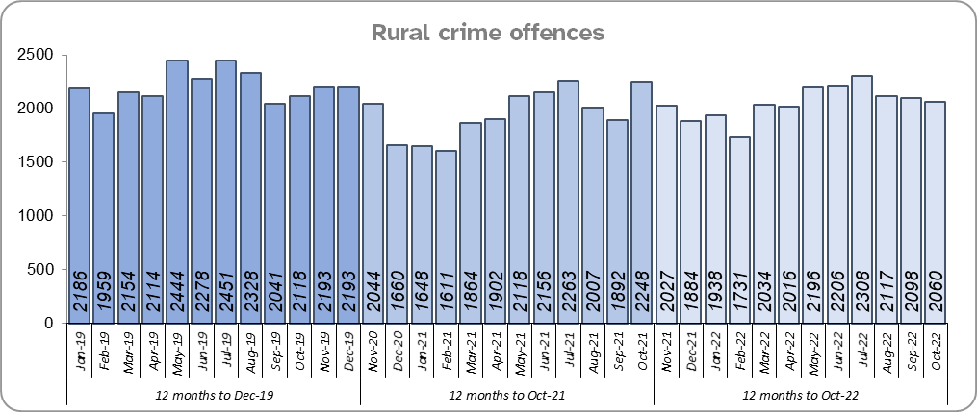
Priority 6 – Protecting rural and isolated areas
Grade: Good
Rural Crime decreased by 7.0% (1,844 fewer offences) in the 12 months to October 2022 compared to the 12 months to December 2019 pre-COVID period (All Crime in Essex decreased by 0.9% in the same period). Essex experienced a 5.1% increase in rural crime (1,202 more offences) for the 12 months to October 2022 compared to the 12 months to October 2021; All Crime in Essex increased by 7.3% in the same period.
The rural crime Harm (Crime Severity) Score* was 8.9 for the 12 months to October 2022, a rise of 1.1 when compared to the 12 months to October 2021. However, this is lower than the All Crime Harm Score in Essex (14.9) which increased by 1.8 over the same period.
Please note:
* Crime Severity Scores (as calculated by the Office for National Statistics) measure the ‘relative harm’ of crimes by taking into account both their volume and their severity. National data are not available for crimes committed in rural areas, so it is not possible to measure against an MSG average; due to this, Essex Police data (to October 2022) have been used rather than national data (which are to August 2022).

Slide 14
Priority 6 – Protecting rural and isolated areas - continued
Grade: Good
Confidence in rural policing (from the independent survey commissioned by Essex Police) is at 80.1% (results to the 12 months to June 2022). Compared to year ending June 2021, confidence in rural policing has remained stable and is higher than the current overall Essex average (rural and urban combined) of 77.9%. In all four of the more rural districts in Essex, more than 79% of people believe Essex are doing a good or excellent job. Since 2019, confidence in Essex Police has increased significantly in every area across Essex. The four districts with the lowest levels of confidence (between 72%-74%) are urban.
Essex Police is one of only 15 forces who have dedicated Rural Policing Teams. The Rural Engagement Team establishment is 2 Sergeants and 11 PCs, one of whom is a dedicated Wildlife and Heritage Crime Officer. 4 special constables are also fully embedded into the team. Delivery of the Rural Crime Strategy is overseen by the LPSU Chief Inspector and LPSU Inspector with the Rural Engagement Team delivering much of the activity.
As confidence in the local police in rural areas is higher than in Essex as a whole, and offence levels in the 12 months to September 2022 compared to the 12 months to December 2019 (pre-COVID) are lower, a grade of Good is recommended.
Please note:
* Rural districts: Braintree, Maldon, Tendring and Uttlesford

Slide 15
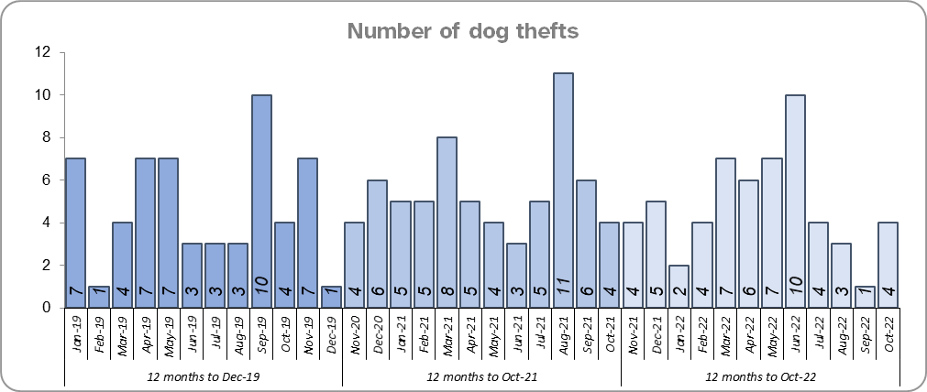
Priority 7 – Preventing dog theft
Grade: Good
There were 9 fewer dog thefts in Essex for the 12 months to October 2022 compared to the 12 months to October 2021 (57 v. 66). There were the same number of dog thefts in the 12 months to October 2022 compared to the 12 months to December 2019.
Confidence in how Essex Police and the organisations they work with are dealing with dog theft (from the independent survey commissioned by Essex Police) is at 64.6% for the period September 2021 to June 2022.
Due to the low and reducing number of thefts across the county (given the comparatively large population of Essex), along with relatively high confidence levels, a grade of Good is recommended.
Please note:
* This is number of thefts in which dogs were stolen, and not quantity of dogs stolen in each theft. Data are based on theft offence crimes and robbery offence crimes where the ‘property code’ is ‘pet animal – dog’ and the ‘property status’ is ‘stolen’ and/or ‘stolen/recovered’.
** The confidence question was added to the internal survey in September 2021 so year on year comparison is not available.

Slide 16
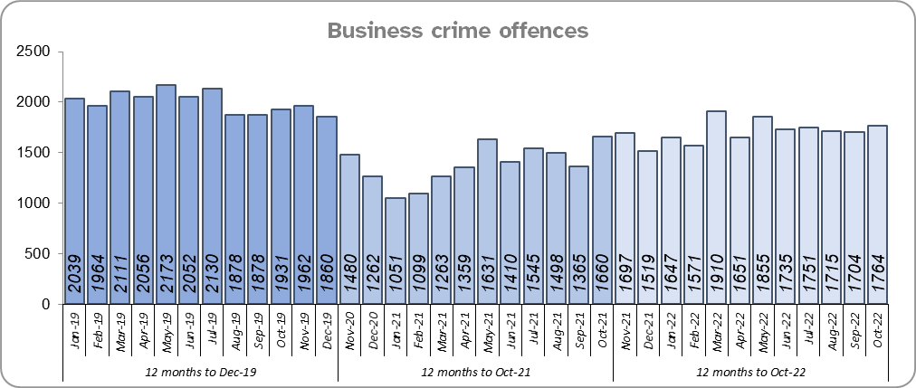
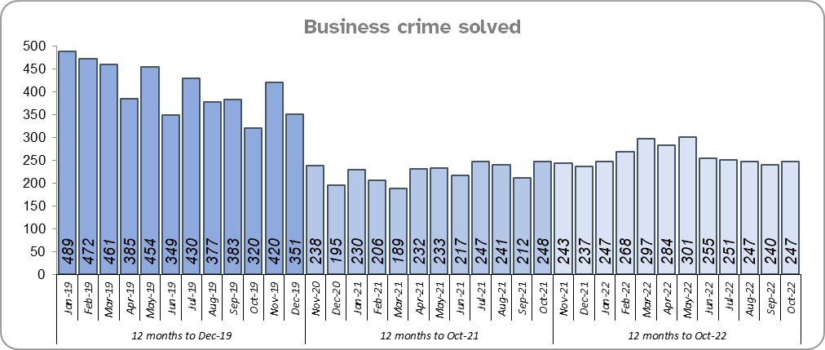
Priority 8 – Reducing business crime, fraud and cyber crime
Grade: Adequate
Business Crime offences include any notifiable crimes recorded with a victim which is an organisation; it does not include Fraud offences. All reports of Fraud are recorded by the National Fraud Intelligence Bureau (NFIB) rather than Essex Police. In the 12 months to October 2022, a total of 1,727 Fraud investigations were allocated to Essex Police by NFIB for investigation. For data on the number and type of Fraud investigations reported as being committed within the Essex Police area, please visit the NFIB Fraud and Cyber Crime Dashboard.
Essex experienced a 23.4% increase (3,896 more) in the number of Business Crime offences and a 16.0% increase (429 more) in the number of these offences which were solved in the 12 months to October 2022 compared to the 12 months to October 2021. COVID restrictions were lifted at the end of January 2021 resulting in lower figures in the 12 months to October 2021 as this includes periods when businesses were not open; shoplifting accounts for approximately 46% of business crime. Essex Police have been working with businesses to encourage them to record more offences.
There was a 14.6% decrease (3,515 fewer) in the number of Business Crime offences and a 36.3% decrease (1,774 fewer) in the number of Business Crimes solved in the 12 months to October 2022 compared to the 12 months to December 2019.
Confidence that Essex Police are dealing with cyber crime (from the independent survey commissioned by Essex Police) is at 25.2% for the period September 2021 to June 2022. Confidence has significantly increased from quarter 4, 2021/2022, when it was at 23.5%, to quarter 1, 2022/2023 when it was at 27.2%.
Due to the increase in the number of solved Business Crime offences, a grade of Adequate is recommended.
* The confidence question was added to the internal survey in September 2021 so year on year comparison is not yet available.

Slide 17
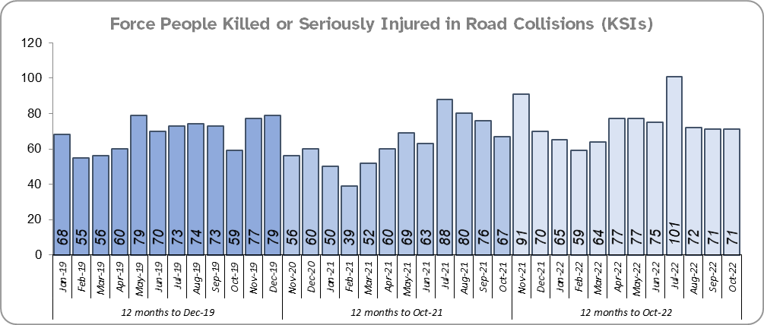
Priority 9 - Improving safety on our roads
Grade: Requires Improvement
Road traffic safety is the responsibility of the Safer Essex Roads Partnership (SERP). Members of SERP comprise Essex Police, Essex County Fire & Rescue Service, Essex County Council, Southend on Sea Borough Council, Thurrock Council, National Highways, East of England Ambulance Service Trust, Essex and Herts Air Ambulance Service Trust and The Safer Roads Foundation (Registered Charity). The aspiration of Essex Police and partners is ‘Vision Zero’, namely to have no road deaths or serious injuries by 2040. The SERP Safety delivery plan sets out a structured programme of educational and engagement activity to address this and support behavioural changes.
There was a 17.5% increase (133 more) in the number of those Killed or Seriously Injured (KSI) in Essex for the 12 months to October 2022 compared to the 12 months to October 2021 with the rate of increase slowing more recently. The number of KSIs also increased by 70 in the 12 months to October 2022 compared to the 12 months to December 2019.
Essex is sixth in its Most Similar Group (MSG) of forces for casualties per 100 million vehicle kilometres (results to December 2020) and is slightly higher than the MSG average. However, due to the fact that more recent national figures have not been released, the current position cannot be determined (the date of the next national release has not yet been confirmed).
Please note that most KSIs do not necessarily result in criminal offences (such as death or serious injury caused by dangerous driving) being recorded.

Slide 18
Priority 9 - Improving safety on our roads - continued
Grade: Requires Improvement
There was an 8.5% decrease (247 fewer offences) in drink/drug driving offences for the 12 months to October 2022 compared to the 12 months to October 2021. This is due to a decrease in recorded drug driving offences; there was an 8.7% increase (114 more offences) in drink driving but a 27.6% decrease (343 fewer offences) in drug driving. There was also a 28.4% decrease (1,055 fewer offences) in drink/drug driving offences for the 12 months to October 2022 compared to the 12 months to December 2019; of these offences, there was a 2.6% decrease (38 fewer offences) in drink driving and a 51.2% decrease (945 fewer offences) in drug driving. All of these offence types are primarily driven by police proactivity in relation to road safety.
There was a 117.1% increase (540 more offences) in the number of driving related mobile phone offences recorded for the 12 months to October 2022 compared to the 12 months to October 2021.*
Confidence in Essex Police and organisations with whom they police the roads (from the independent survey commissioned by Essex Police) is at 64.1% (results to the 12 months to June 2022). Compared to year ending June 2021, there was a statistically significant decrease in confidence in the local police and organisations they work with.
Due to the increase in KSIs in the past 12 months compared to the previous 12 months and the 12 months to December 2019 a grade of Requires Improvement is recommended.
Please note:
* In 2019, the definition as to what constituted “use” of a mobile phone in relation to driver-related mobile phone offences was subject to a legal challenge. This resulted in a ruling, which held that while “use” included accessing the interactive functions of the mobile phone (such as making calls, sending messages or using the internet), it did not extend to solely accessing the device’s internal functions (such as making use of the camera). Fewer mobile phone offences were subsequently prosecuted from this point. In 2021 the government announced that the law was to be changed making it illegal to “hold” a phone or sat nav when driving or riding a motorcycle. This law was finally passed on 25th March 2022. In addition, due to some processing issues there may be outstanding tickets not yet included in October’s total.

Slide 19
Priority 10 – Encouraging volunteers and community support
Grade: Good
Essex Watch Liaison Officers continue to work with Neighbourhood Watch to offer crime and fraud prevention advice.*
Citizens in Policing and the Special Constabulary play an integral part in supporting Essex Police. In January 2022, the Local Policing Support Unit (LPSU) introduced a Strategic Co-ordination Group which proactively supports, throughout the county, the mobilisation of all Special Constables, Police Support Volunteers, Active Citizens, Accredited Persons and, where appropriate our Volunteer Police Cadets, with local operations and initiatives under the Chief Constable’s Plan on a Page and the Police, Fire Crime Commissioner’s Police and Fire Plan.
The Special Constabulary headcount is currently 367 (as of 31 October 2022). There are 428 Volunteer Police Cadets (VPCs) and 97 Volunteer Cadet Leaders across 13 Cadet Units. In addition there are 188 Volunteers across the county; there are 125 Police Support Volunteers and 63 Active Citizens. These volunteers also are part of the Strategic Co-ordination Group and support their Local Community Policing Teams with local events.
Since last month’s report, there are now: 1 more business group members, 29 more dog group members, 2 more farm and rural group members and 4 more heritage group members.
Please note:
* Neighbourhood Watch data were first produced in March 2022 so year on year comparison is not available.

Slide 20
Priority 10 – Encouraging volunteers and community support
Grade: Good
Confidence that there are good opportunities for volunteers to assist policing and reduce crime in Essex (from the independent survey commissioned by Essex Police) is at 48.6% for the period September 2021 to June 2022. Confidence has increased significantly each quarter since the question was first asked in Q3 2021/22 (Q3 39.7%; Q4 50.6%; Q1 55.6%).
Due to the fact that Essex has the second largest Special Constabulary in the country, and the fact that the Essex Police makes use of Ethics Boards to inform its work, a grade of Good is recommended.
Please note:
* The confidence question was added to the internal survey in September 2021 so year on year comparison is not available.

Slide 21
Priority 11 – Supporting our officers and staff
Grade: Adequate
There has been a slight decrease (0.1%) in the proportion of ethnic minority employees in October 2022 (273) compared to October 2021 (280); this equates to 7 fewer employees. However, in contrast, there has been a 25.8% increase compared to December 2019 (217); this equates to 56 additional employees.
There is a 3.4% point disparity in the proportion of ethnic minority residents in Essex*** (7.6%) compared to the proportion of ethnic minority employees in Essex Police (4.2%).
Please note:
****Ethnic minority employees as a percentage of the total workforce.
****Ethnic minority employees as a percentage of type of employee.
****Office for National Statistics Population Estimates 2019: Essex population 1,846,655, ethnic minority residents 140,641.

Slide 22
Monthly Performance Overview: Exceptions
Exceptions Overview
Robbery of Personal Property experienced a statistically significant increase for the month of October 2022: There were no statistically exceptional decreases.
Robbery of Personal Property – Increase
15.0% increase (178 more crimes) for the 12 months to October 2022 compared to the 12 months to October 2021. There were statistically exceptional increases in two Districts in October 2022.

Slide 23
2021-2024 Police and Crime Plan Performance Indicators
Table 1
Please view above table with the explanations and caveats detailed on page 25.

Slide 24
2021-2024 Police and Crime Plan Performance Indicators - continued
Table 2
Please view above table with the explanations and caveats detailed on page 25.

Slide 25
End Notes
¹ Question from the independent survey commissioned by Essex Police. Results are for the period 12 months June 2022 versus the 12 months to June 2021.
² The confidence interval is the range +/- within which the survey result will lie. This is mainly influenced by the number of people answering the survey. The more people that answer the survey, the smaller the interval range.
³ Crime Severity Score measures ‘relative harm’ of crimes by taking into account both the volume and the severity of offences, and by weighting offences differently. National data for the 12 months to August 2022 have been used in order that comparisons can be made to Essex’s Most Similar Group of Forces (MSG).
⁴ The methodology used for identifying these investigations as drug related is subjective and based on the circumstances presented. These figures will include investigations where the victim or the suspect are involved Drug Use, Possession or Selling.
⁵ ‘Killed or Seriously Injured’ (KSI) refers to all people killed or seriously injured on Essex’s roads, regardless of whether any criminal offences were committed. ‘Causing Death/Serious Injury by Dangerous/Inconsiderate Driving’ offences (detailed on page 17) refers to the number of crimes of this type.
⁶ In 2019, the definition as to what constituted “use” of a mobile phone in relation to driver-related mobile phone offences was subject to a legal challenge. This resulted in a ruling, which held that while “use” included accessing the interactive functions of the mobile phone (such as making calls, sending messages or using the internet), it did not extend to solely accessing the device’s internal functions (such as making use of the camera). Fewer mobile phone offences were subsequently prosecuted from this point. In 2021 the government announced that the law was to be changed making it illegal to “hold” a phone or sat nav when driving or riding a motorcycle. This law was finally passed on 25th March 2022.
⁷ Solved outcomes are crimes that result in: charge or summons, caution, crimes taken into consideration, fixed penalty notice, cannabis warning or community resolution.
⁸ This is the number of theft offences in which dogs were stolen, and not necessarily the number of dogs which were stolen.
⁹ Ethnic minority employees as a percentage of the total workforce.
¹⁰ Number of offences with repeat victim including month on month percentage change.

Slide 26
Crime Tree Data – Rolling 12 Months to October
Table 3

Slide 27
Crime Tree Data – Rolling 12 Months to October - continued
Table 4

Slide 28
Crime Tree Data - Rolling 12 months to October Violence against the Person and Sexual offences and outcomes (by crime type) split by gender
Table 5
Please note: the breakdown of data for the previous 12 months within these tables may not tally with the totals on page 9 as gender data is rerun on a monthly basis.

