Slide 1
Police and Crime Plan 2021-2024
Monthly Performance Update
June 2022
National and MSG positions are to 30 April 2022 (Essex Police data are to 30 June 2022).
Version 1.5
Produced July 2022
Performance Analysis Unit, Essex Police
Sensitivity: Official

Slide 2
Executive Summary
The Police and Crime Plan 2021-2024 was introduced in April 2021, with new measures that reflect the Police, Fire and Crime Commissioner (PFCC) for Essex’s strategic commitment to targeted prevention and early intervention.
Four of the eleven PFCC Priorities have been given a recommended grade of ‘Good’. Five have been given a recommended grade of ‘Adequate’ and two have been given a recommended grade of ‘Requires Improvement’.
Confidence (from the independent survey commissioned by Essex Police) is at 79.0% (results to the 12 months to March 2022). Compared to year ending March 2021, confidence in the local police has remained stable.
All Crime increased by 8.7% for the 12 months to June 2022 compared to the 12 months to June 2021; this equates to 13,306 more offences. This increase has been primarily influenced by the Government’s easing of restrictions on gathering and movement in relation to COVID-19. The Force also recorded 3,138 more offences in June 2022 compared to April 2020, when the Government implemented the first lockdown; this equates to 29.7% more offences. Each change in the rules relating to social distancing has affected the number of All Crime offences reported to Essex Police. A comparison with the 12 months to December 2019 has been provided to allow a comparison with a year in which society, crime and policing was not affected by the pandemic. By way of context, there was a 1.1% decrease in All Crime in the 12 months to June 2022 compared to the 12 months to December 2019; this equates to 1,814 fewer offences.
There was a 25.5% increase (179 more) in the number of those Killed or Seriously Injured (KSI) in Essex for the 12 months to June 2022 compared to the 12 months to June 2021.
Essex experienced a 9.9% increase (4,280 more) in the number of offences with a repeat victim for the 12 months to June 2022 compared to the 12 months to June 2021. The SERP Safety delivery plan sets out a structured programme of educational and engagement activity to address problem driving and support behavioural and structural changes, more information about SERP can be found at page 8.
Where gender is detailed, over half of victims of Violence Against the Person (VAP) offences identify as female (56.2%). VAP offences committed against females increased by 6.5% (2,412 more), and there was an 18.6% increase (773 more) in the number of sexual offences against females in the 12 months to June 2022 compared to the 12 months to June 2021. This compares to a 9.6% rise (2,706 more) in VAP offences committed against males and a 24.4% rise (164 more) in sexual offences against males in the same period.
Essex Police prides itself on having excellent Crime Data Accuracy (CDA). In its most recent inspection by HMICFRS, Essex Police was graded as Outstanding in relation to its CDA. Maintaining excellent CDA, however, requires the Force to neither under-record nor over-records offences. To this end, Essex Police are currently investigating whether the Force are over-recording Stalking & Harassment offences, which comprise the largest volume of Violence Against Women & Girls offences (VAWG) and around a quarter of all Domestic Abuse offences (25.3%).
The number of solved sexual offences committed against females decreased by 9.3% (26 fewer) in the 12 months to June 2022 compared to the 12 months to June 2021. This compares to a decrease of 2.3% (1 fewer) sexual offences committed against males solved in the same period.
There were 228 fewer Stalking and Harassment crimes committed against females in the 12 months to June 2022 (16,308 crimes) compared to the 12 months to June 2021 (16,536 crimes).
There has been a slight increase (0.1%) in the proportion of ethnic minority employees in June 2022 (276) compared to June 2021 (275). This equates to 1 additional employee.

Slide 3
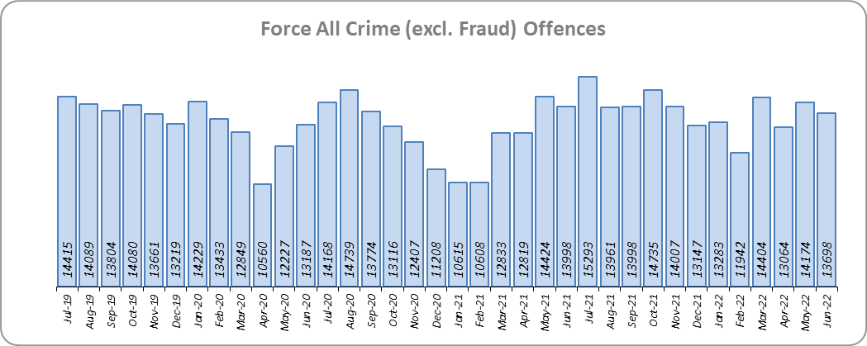
Priority 1 – Further investment in Crime Prevention
Grade: Adequate
Essex experienced an 8.7% increase in All Crime (13,306 more offences) for the 12 months to June 2022 compared to the 12 months to June 2021. This increase in crime has been primarily influenced by the Government’s easing of restrictions on movement and gathering in relation to COVID-19. Essex is seventh in its Most Similar Group of forces (MSG) for crime per 1,000 population.
There was a 1.1% decrease in All Crime in the 12 months to June 2022 compared to the 12 months to December 2019; this equates to 1,814 fewer offences.
Essex Police recorded the same daily average of 457 crimes in June 2022 and May 2022.
13,698 offences were recorded in the month of June 2022, a decrease of 2.1% (300 offences) compared to the month of June 2021 (13,998 offences). There was a 29.7% increase in offences in the month of June 2022 compared to the month of April 2020 (10,560 offences), when the Government first implemented national restrictions.

Slide 4
Priority 1 - Further investment in Crime Prevention (cont.)
Grade: Adequate
Confidence (from the independent survey commissioned by Essex Police) is at 79.0% (results to the 12 months to March 2022). Compared to year ending March 2021, confidence in the local police has remained stable.
The All Crime Harm (Crime Severity) Score* (14.9) places Essex eighth in its MSG.
Due to the fact that, compared to year ending March 2021, confidence in policing in Essex has remained stable, a grade of Adequate is recommended.
Please note:
* Crime Severity Scores (as calculated by the Office for National Statistics) measure the ‘relative harm’ of crimes by taking into account both their volume and their severity. As national data are only available to April 2022, the score for the 12 months to April for the preceding year has been included.

Slide 5
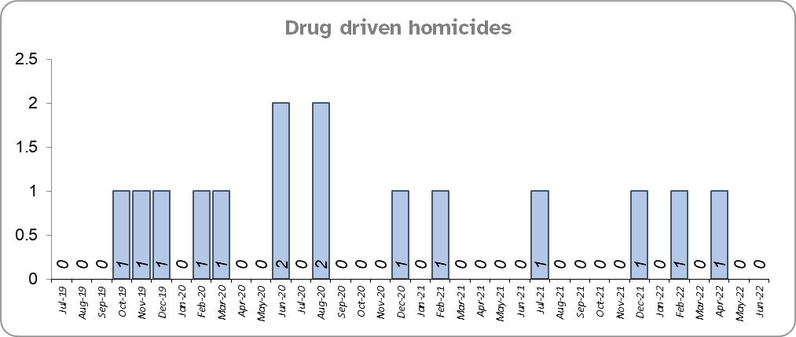
Priority 2 – Reducing Drug Driven Violence
Grade: Good
Essex experienced four drug related homicides for the periods 12 months to June 2022 and the 12 months to June 2021.
Three fewer drug related homicides were recorded in the 12 months to June 2022 compared to the 12 months to December 2019.
Confidence that Essex Police and partners are dealing with drug crime (from the independent survey commissioned by Essex Police) is at 60.9% for the period September 2021 to March 2022.
Due to the fact that drug related homicides are low, stable compared to the pre-COVID period, and confidence is relatively high, a grade of Good is recommended.
Please note:
* The methodology used for identifying investigations as being drug-related is subjective (qualitative data) and based on the circumstances presented. These figures include investigations where the victim and/or suspect are suspected of being involved in Drug Use, Possession or Selling.
** The confidence question was added to the internal survey in September 2021. A year on year comparison is therefore not available.

Slide 6
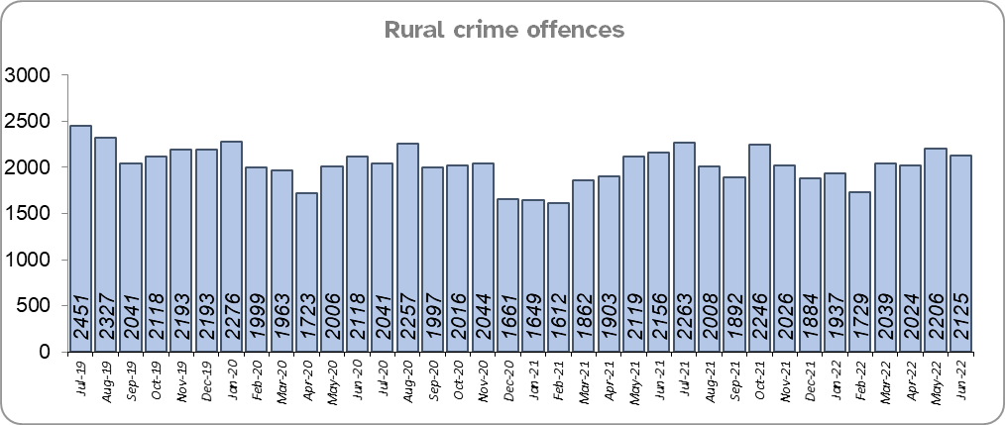
Priority 3 – Protect rural and isolated areas
Grade: Good
Essex experienced a 4.6% increase in rural crime (1,062 more offences) for the 12 months to June 2022 compared to the 12 months to June 2021 (by way of context, All Crime in Essex increased by 8.7% in the same period). Rural Crime decreased by 7.9% (2,080 fewer offences) in the 12 months to June 2022 compared to the 12 months to December 2019 (All Crime in Essex decreased by 1.1% in the same period).
The rural crime Harm (Crime Severity) Score* was 8.8 for the 12 months to June 2022, a rise of 1.4 when compared to the 12 months to June 2021 (by way of context, the All Crime Harm Score in Essex was 14.9, an increase of 2.9 for the same period).
Please note:
* Crime Severity Scores (as calculated by the Office for National Statistics) measure the ‘relative harm’ of crimes by taking into account both their volume and their severity. National data are not available for crimes committed in rural areas, so it is not possible to measure against an MSG average; due to this, Essex Police data (to June 2022) have been used rather than national data (which are to April 2022).

Slide 7
Priority 3 – Protect rural and isolated areas
Grade: Good
Confidence in rural policing (from the independent survey commissioned by Essex Police) is at 81.5% (results to the 12 months to March 2022). Compared to year ending March 2021, confidence in rural policing has remained stable and is higher than the Essex average of 79.0%.
Essex Police is one of only 15 forces who have dedicated Rural Policing Teams. The Rural Engagement Team establishment is two Sergeants and eleven PCs, one of which is a dedicated Wildlife and Heritage Crime Officer. Four special constables are also fully embedded into the team. Delivery of the Rural Crime Strategy is overseen by the LPSU Chief Inspector and LPSU Inspector with the Rural Engagement Team delivering much of the activity.
As confidence in the local police has remained stable, and offence levels in the 12 months to June 2022 compared to the 12 months to December 2019 (pre-COVID) are lower, a grade of Good is recommended.

Slide 8
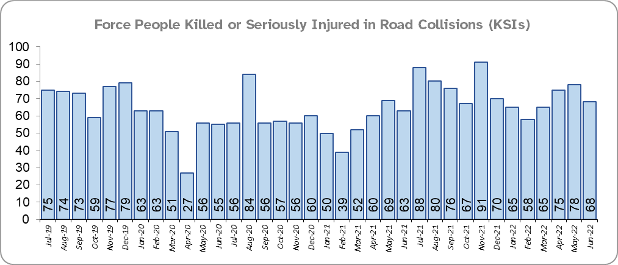
Priority 4 - Improving safety on our roads
Grade: Requires Improvement
Road traffic safety is the responsibility of the Safer Essex Roads Partnership (SERP). Members of SERP comprise Essex Police, Essex County Fire & Rescue Service, Essex County Council, Southend on Sea Borough Council, Thurrock Council, National Highways, East of England Ambulance Service Trust, Essex and Herts Air Ambulance Service Trust and The Safer Roads Foundation (Registered Charity). The aspiration of Essex Police and partners is ‘Vision Zero’, namely to have no road deaths or serious injuries by 2040. The SERP Safety delivery plan sets out a structured programme of educational and engagement activity to address problem driving and support behavioural and structural changes.
There was a 25.5% increase (179 more) in the number of those Killed or Seriously Injured (KSI) in Essex for the 12 months to June 2022 compared to the 12 months to June 2021. There was an increase in the number of collisions, particularly those resulting in serious injuries (24.3%), in the same period. The number of KSIs also increased by 58 in the 12 months to June 2022 compared to the 12 months to December 2019.
Essex is sixth in its Most Similar Group (MSG) of forces for casualties per 100 million vehicle kilometres (results to December 2020) and is slightly higher than the MSG average. However, due to the fact that more recent national figures have not been released, the current position cannot be determined (the date of the next national release has not yet been confirmed).
Please note that most KSIs do not necessarily result in criminal offences (such as death or serious injury caused by dangerous driving) being recorded.

Slide 9
Priority 4 - Improving safety on our roads (cont.)
Grade: Requires Improvement
There was a 15.8% decrease (522 fewer offences) in drink/drug driving offences for the 12 months to June 2022 compared to the 12 months to June 2021. This is due to a decrease in recorded drug driving offences; there was an 15.6% increase (203 more offences) in drink driving but a 43.6% decrease (716 fewer offences) in drug driving. There was also a 24.9% decrease (924 fewer offences) in drink/drug driving offences for the 12 months to June 2022 compared to the 12 months to December 2019; of these offences, there was a 2.8% increase (41 more offences) in drink driving and a 49.7% decrease (917 fewer offences) in drug driving. All of these offence types are primarily driven by police proactivity in relation to road safety.
There was a 33.2% increase (164 more offences) in the number of driving related mobile phone offences recorded for the 12 months to June 2022 compared to the 12 months to June 2021.*
Confidence in Essex Police and organisations with whom they police the roads (from the independent survey commissioned by Essex Police) is at 64.0% (results to the 12 months to March 2022). Compared to year ending March 2021, confidence in the local police and organisations they work with has decreased by 9.3% points.
Due to the increase in KSIs in the past 12 months and the significant decrease in public confidence a grade of Requires Improvement is recommended.
Please note:
* In 2019, the definition as to what constituted “use” of a mobile phone in relation to driver-related mobile phone offences was subject to a legal challenge. This resulted in a ruling, which held that while “use” included accessing the interactive functions of the mobile phone (such as making calls, sending messages or using the internet), it did not extend to solely accessing the device’s internal functions (such as making use of the camera). Fewer mobile phone offences were subsequently prosecuted from this point. In 2021 the government announced that the law was to be changed making it illegal to “hold” a phone or sat nav when driving or riding a motorcycle. This law was finally passed on 25th March 2022.

Slide 10
Priority 5 – Encouraging Volunteers and Community Support
Grade: Good
Confidence that there are good opportunities for volunteers to assist policing and reduce crime in Essex (from the independent survey commissioned by Essex Police) is at 45.1% for the period September 2021 to March 2022.
Essex Watch Liaison Officers continue to work with Neighbourhood Watch to offer crime and fraud prevention advice.**
The Special Constabulary headcount is currently 432 (as of 30 June 2022). There are 394 Volunteer Police Cadets (VPCs) and 96 Volunteer Cadet Leaders across 13 Cadet Units.
Due to the high number of Specials and Volunteer Cadets in Force, and the fact that the Essex Police makes use of Ethics Boards to inform its work, a grade of Good is recommended.
Please note:
* The confidence question was added to the internal survey in September 2021 so year on year comparison is not available.
** Neighbourhood Watch data were first produced in March 2022 so year on year comparison is not available.

Slide 11
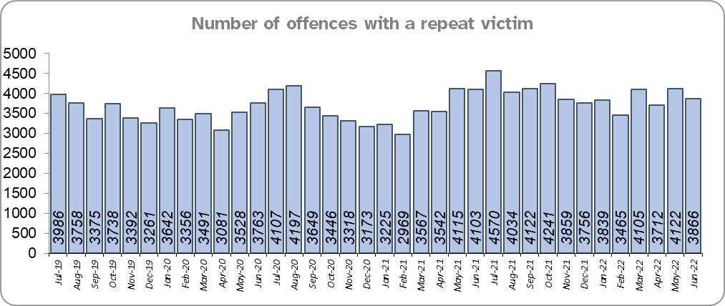
Priority 6 – Improving our services to support victims of crime
Grade: Requires Improvement
Essex experienced an 9.9% increase (4,280 more) in the number of offences with a repeat victim for the 12 months to June 2022 compared to the 12 months to June 2021.
There was also an 11.7% increase (4,987 more) in the number of offences with a repeat victim in the 12 months to June 2022 compared to the 12 months to December 2019. See the note below.
In contrast to the year on year rise in the number of offences with a repeat victim over the three periods, the number of actual repeat victims decreased by 1.7% in the 12 months to June 2021 (20,945 victims) compared to the 12 months to December 2019, (21,307 victims), and increased by 7.6% (22,528 victims) in the 12 months to June 2022 compared to the previous year. This resulted in an overall increase over the three periods but not a year on year rise.
Please note:
* This metric details how many crimes had a repeat victim rather than the number of individual people who are repeat victims of crime. A repeat victim is someone who has been named as a victim for more than one crime within a 12-month period; to mitigate the fact that multiple crimes can be associated with the same incident, additional crimes with the same victim on the same date are not counted.

Slide 12
Priority 6 – Improving our services to support victims of crime
Grade: Requires Improvement
Confidence among victims (from the independent survey commissioned by Essex Police) is at 60.5% (results to the 12 months to March 2022). This is 20.6% points lower than confidence of non-victims for the same period (81.1%).
Compared to year ending March 2021, confidence among victims in the local police is deteriorating, and among non-victims has remained stable.
Due to the fact that confidence in policing in Essex has decreased for victims of crime, and that the number of repeat victims has increased, a grade of Requires Improvement is recommended.

Slide 13
Priority 7 – Violence against women and girls
Grade: Adequate
Where gender is detailed, over half of victims of Violence Against the Person (VAP) offences identified as female* (56.2%). 3.0% of offences (2,170 offences) had no gender recorded**.
Essex experienced a 6.5% increase (2,412 more) in the number of VAP offences committed against females in the 12 months to June 2022 compared to the 12 months to June 2021; this compares to a 9.6% increase (2,706 more) in the number of VAP offences committed against males in the same period. There was an 11.8% increase (4,167 more) in the number of VAP offences committed against females in the 12 months to June 2022 compared to the 12 months to December 2019, this compares to an increase of 13.6% (3,706 more) in the number of VAP offences committed against males in the same period.
Essex Police prides itself on having excellent Crime Data Accuracy (CDA). In its most recent inspection by HMICFRS, Essex Police was graded as Outstanding in relation to its CDA. Maintaining excellent CDA, however, requires the Force to neither under-record nor over-records offences. To this end, Essex Police are currently investigating whether the Force are over-recording Stalking & Harassment offences, which comprise the largest volume of Violence Against Women & Girls (VAWG).
There was an 18.6% increase (773 more) in the number of Sexual Offences committed against females and a 9.3% decrease (26 fewer) in the number of these offences solved in the 12 months to June 2022 compared to the 12 months to June 2021. By contrast, there was a 24.4% increase (164 more) in the number of Sexual Offences committed against males and a 2.3% decrease (1 fewer) in the number of these offences solved in the same period.
A 29.5% increase (1,124 more) was observed in the number of Sexual Offences committed against females and a 25.6% increase (52 more) in the number of sexual offences against females solved in the 12 months to June 2022 compared to the 12 months to December 2019. By contrast, there was a 35.3% increase (218 more) in the number of Sexual Offences committed against males and a 22.9% increase (8 more) in the number of sexual offences against males solved in the same period.
There were 228 fewer Stalking and Harassment crimes committed against females in the 12 months to June 2022 (16,308 crimes) compared to the 12 months to June 2021 (16,536 crimes).
Please note:
**** Officer defined gender.
**** Not Recorded also includes records where gender is unknown or unspecified.
**** Please see page 27 for table of violence against the person and sexual offences and outcomes (by crime type) split by gender.
**** The confidence question was added to the internal survey in September 2021 so year on year comparison is not available.

Slide 14
Priority 7 – Violence against women and girls
Grade: Adequate
41.1% of females feel safe walking alone in their area after dark (from the independent survey commissioned by Essex Police) for the period September 2021 to March 2022 compared to 75.4% of males.
The Home Office are trialling a new online tool called Street Safe on police.uk to enable people, particularly women and girls to pin-point locations where they feel or have felt unsafe and to identify why that location made them feel unsafe. Street-Safe was developed by the Digital Public Contact (DPC) Programme in cooperation with the Home Office and the National Police Chiefs’ Council (NPCC) and was launched on 2 September 2021 as a national pilot for three months. Street-Safe was introduced into Essex as part of the government’s strategy to tackle Violence against Women and Girls (VAWG).
The Home Office Safer Streets fund enables Police and Crime Commissioners and local authorities to invest in initiatives that seek to provide targeted improvements to the physical environment, with the aim to both prevent crime and improve feelings of safety. With the emergence of the various tranches of Safer Street funding, the new Essex Crime Prevention Strategy aligns this to numerous strategies, including the Essex Police Force Plan. The latest wave of funding aims to address issues related to VAWG.
Due to the fact that Essex Police solved more VAWG offences in the 12 months to June 2022 compared to the 12 months to December 2019, a grade of Adequate is recommended. While only 4 in 10 females feel safe walking in their area after dark, no comparable data are available at this time.
Please note:
**** Officer defined gender.
**** Not Recorded also includes records where gender is unknown or unspecified.
**** Please see page 27 for table of violence against the person and sexual offences and outcomes (by crime type) split by gender.
**** The confidence question was added to the internal survey in September 2021 so year on year comparison is not available.

Slide 15
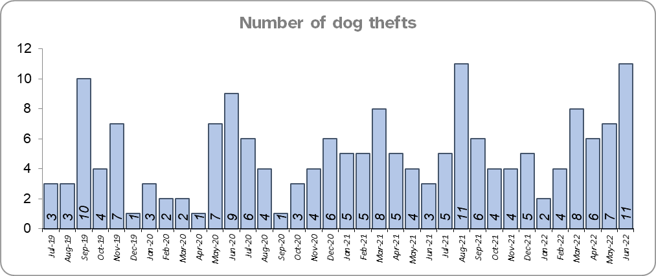
Priority 8 – Dog theft
Grade: Good
Essex experienced 3 fewer dog thefts for the 12 months to June 2022 compared to the 12 months to June 2021 (54 v. 57). There were 3 fewer dog thefts in the 12 months to June 2022 compared to the 12 months to December 2019.
Confidence as to how Essex Police and the organisations they work with are dealing with dog theft (from the independent survey commissioned by Essex Police) is at 63.5% for the period September 2021 to March 2022.
Due to the low number of thefts across the county (given the comparatively large population size in Essex), and a reduction in thefts along with high confidence levels***, a grade of Good is recommended.
Please note:
* This is number of thefts in which dogs were stolen, and not quantity of dogs stolen in each theft. Data are based on theft offence crimes and robbery offence crimes where the ‘property code’ is ‘pet animal – dog’ and the ‘property status’ is ‘stolen’ and/or ‘stolen/recovered’.
** The confidence question was added to the internal survey in September 2021 so year on year comparison is not available.
*** Data based on previous six months.

Slide 16
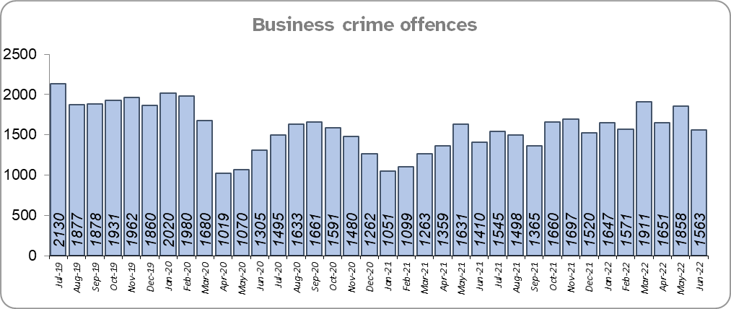
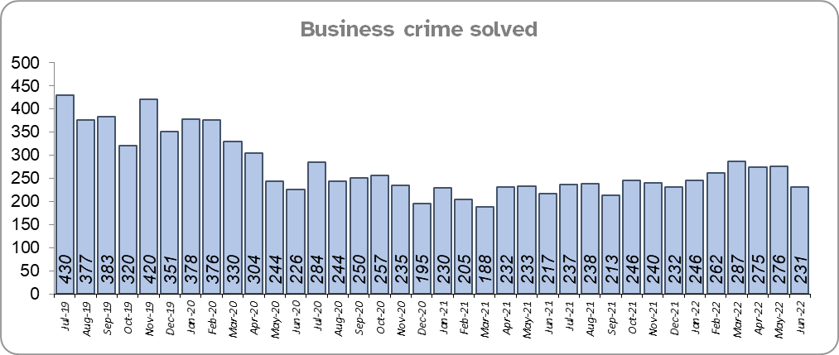
Priority 9 – Business Crime, Fraud and Cyber Crime
Grade: Adequate
Business Crime offences include any notifiable crimes recorded with a victim which is an organisation; it does not include Fraud offences. All reports of Fraud are recorded by the National Fraud Intelligence Bureau (NFIB) rather than Essex Police. In the 12 months to June 2022, a total of 1,587 Fraud investigations were allocated to Essex Police by NFIB for investigation. For data on the number and type of Fraud investigations reported as being committed within the Essex Police area, please visit the NFIB Fraud and Cyber Crime Dashboard
Essex experienced a 15.1% increase (2,551 more) in the number of Business Crime offences and a 7.7% increase (213 more) in the number of these offences which were solved in the 12 months to June 2022 compared to the 12 months to June 2021.
There was an 18.9% decrease (4,548 fewer) in the number of Business Crime offences and a 39.0% decrease (1,908 fewer) in the number of Business Crimes solved in the 12 months to June 2022 compared to the 12 months to December 2019.
Confidence as to whether the police response to tackling cyber crime is improving (from the independent survey commissioned by Essex Police) and is at 50.8% for the period September 2021 to March 2022. The confidence question was added to the internal survey in September 2021 so a year-on-year comparison is not available.
Due to the increase in the number of Business Crime offences that are solved, a grade of Adequate is recommended.

Slide 17
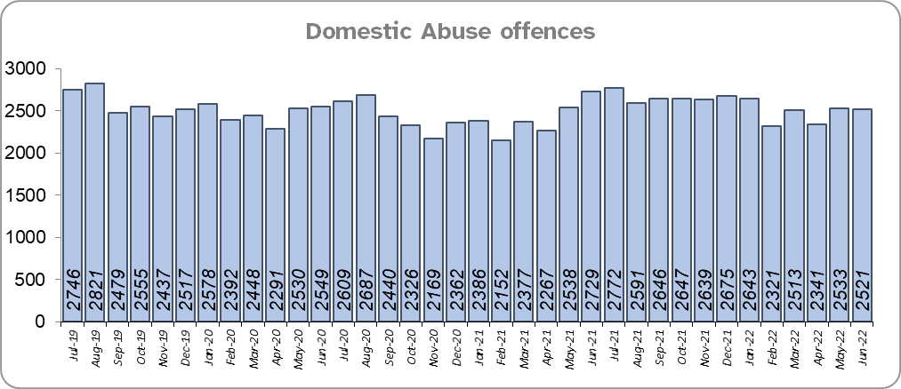
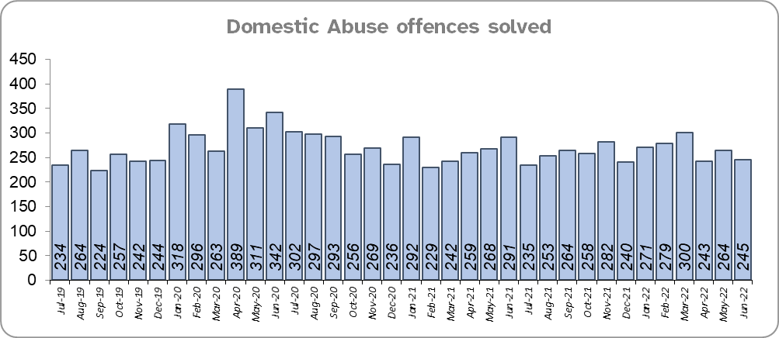
Priority 10 - Protecting vulnerable people and supporting victims of crime
Grade: Adequate
Essex experienced a 6.2% increase (1,800 more) in Domestic Abuse (DA) offences for the 12 months to June 2022 compared to the 12 months to June 2021. Essex Police also recorded 139 fewer offences in the three months to June 2022 compared to the same period in 2021 (7,395 v. 7,534). Essex Police prides itself on having excellent Crime Data Accuracy (CDA). In its most recent inspection by HMICFRS, Essex Police was graded as Outstanding in relation to its CDA. Maintaining excellent CDA, however, requires the Force to neither under-record nor over-records offences. To this end, Essex Police are currently investigating whether the Force are over-recording Stalking & Harassment offences, which accounts for around a quarter of all Domestic Abuse offences (25.3%).
Essex Police solved 4.6% (151 fewer) DA offences for the 12 months to June 2022 compared to the 12 months to June 2021. The Force also solved 66 fewer offences in the three months to June 2022 compared to the same period in 2021 (752 v 818).
There was a 3.8% increase (1,116 more) in DA offences and a 4.3% increase (129 more) in the number of DA offences solved for the 12 months to June 2022 compared to the 12 months to December 2019.
The Essex Police Domestic Abuse Problem Solving Teams (DAPST) were formed in March 2021 and are divided into a victim focused contingent (Problem-Solving officers) and an Offender Management contingent (Offender Management officers). They work alongside DAIT, who manage the most prolific DA perpetrators and the most vulnerable victims. The team has been implemented to provide a continual and sustained problem-solving approach, focussing on preventing future harm and reducing repeat victimisation.

Slide 18
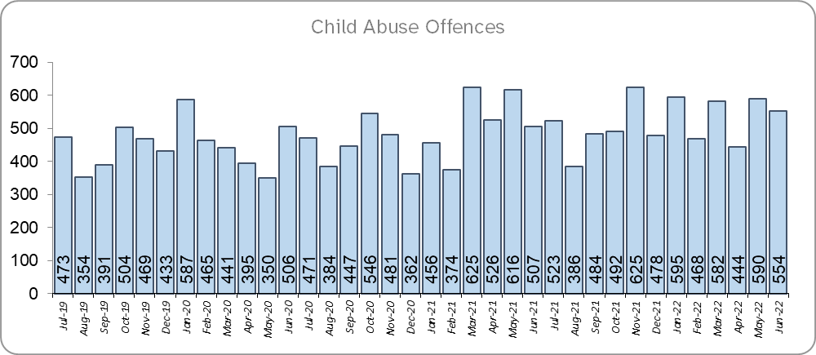
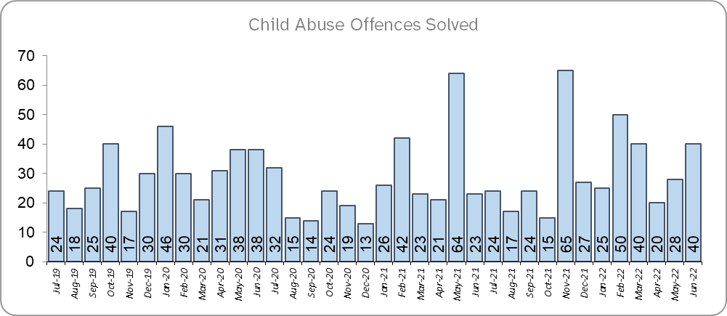
Priority 10 - Protecting vulnerable people and supporting victims of crime (cont.)
Grade: Adequate
Essex experienced a 16.1% increase (934 more) in Child Abuse offences and an 18.7% increase (59 more) in the number of these offences which were solved for the 12 months to June 2022 compared to the 12 months to June 2021.
There was a 27.9% increase (1,469 more) in Child Abuse offences and a 36.4% increase (100 more) in the number of these offences which were solved for the 12 months to June 2022 compared to the 12 months to December 2019.
Confidence that the policing response to protect children and vulnerable people (from the independent survey commissioned by Essex Police) is at 83.8% (results to the 12 months to March 2022). Compared to year ending March 2021, confidence has decreased by 6.2% points.
Due to the fact that there has been a continual increase in the number of Child Abuse offences solved in the 12 months to June 2022 compared to the 12 months to December 2019, a grade of Adequate is recommended.

Slide 19
Priority 11 - Staff
Grade: Adequate
There has been a slight increase (0.1%) in the proportion of ethnic minority employees in June 2022 (276) compared to June 2021 (275); this equates to 1 additional employee. There has also been an increase (27.2%) compared to Dec 2019 (217); this equates to 59 additional employees.
There is a disparity of 3.3% points between the proportion of ethnic minority residents in Essex*** (7.6%) and the proportion of ethnic minority employees in Essex Police (4.3%).
Please note:
****Ethnic minority employees as a percentage of the total workforce.
****Ethnic minority employees as a percentage of type of employee.
****Office for National Statistics Population Estimates 2019: Essex population 1,846,655, ethnic minority residents 140,641.

Slide 20
Monthly Performance Overview: Exceptions
Exceptions Overview
Possession of Weapons experienced a statistically significant increase for the month of June 2022.
Possession of Weapons – Increase
22.1% increase (268 more crimes) for the 12 months to June 2022 compared to the 12 months to June 2021. There were statistically exceptional increases in three Districts in June 2022. This crime type is predominantly driven by police proactivity.

Slide 21
Monthly Performance Overview: Of Note
2022 June – Pride Month
Essex Police value difference and believe people from all walks of life shape the Force and reflect its diverse communities. The LGBTQ+ network provides a support network for officers and staff who identify as LGBTQ+, for those who supervise a member of staff who identifies as LGBTQ+, and for those who have friends or family members who identify as LGBTQ+. It is also there for advice for officers in relation to other issues that may be occurring in the community.
1-7 June Volunteers’ Week
Essex Police recognised the selfless and important work of 1,800 volunteers across the Force who give up their time to help support, protect and inform Essex’s communities. Volunteers have many roles within the Force, including but not limited, to: Special Constables, Volunteer Police Cadets (VPC), Neighbourhood Watch, Chaplaincy, Essex Search and Rescue and Pastors.
Our Special Constables, VPCs and Cadet Leaders, Police Support Volunteers/Active Citizens, Essex Watch along with Neighbourhood Watch are an integral part of the extended Policing Family.

Slide 22
2021-2024 Police and Crime Plan Performance Indicators
Table 1
Please view above table with the explanations and caveats detailed on page 24.

Slide 23
2021-2024 Police and Crime Plan Performance Indicators (cont.)
Table 2
Please view above table with the explanations and caveats detailed on page 24.

Slide 24
End Notes
¹ Question from the independent survey commissioned by Essex Police. Results are for the period 12 months March 2022 versus the 12 months to March 2021.
² The confidence interval is the range +/- within which the survey result will lie. This is mainly influenced by the number of people answering the survey. The more people that answer the survey, the smaller the interval range.
³ Crime Severity Score measures ‘relative harm’ of crimes by taking into account both the volume and the severity of offences, and by weighting offences differently. National data for the 12 months to April 2022 have been used in order that comparisons can be made to Essex’s Most Similar Group of Forces (MSG).
⁴ The methodology used for identifying these investigations as drug related is subjective and based on the circumstances presented. These figures will include investigations where the victim or the suspect are involved Drug Use, Possession or Selling.
⁵ ‘Killed or Seriously Injured’ (KSI) refers to all people killed or seriously injured on Essex’s roads, regardless of whether any criminal offences were committed. ‘Causing Death/Serious Injury by Dangerous/Inconsiderate Driving’ offences (detailed on p.9) refers to the number of crimes of this type.
⁶ In 2019, the definition as to what constituted “use” of a mobile phone in relation to driver-related mobile phone offences was subject to a legal challenge. This resulted in a ruling, which held that while “use” included accessing the interactive functions of the mobile phone (such as making calls, sending messages or using the internet), it did not extend to solely accessing the device’s internal functions (such as making use of the camera). Fewer mobile phone offences were subsequently prosecuted from this point. In 2021 the government announced that the law was to be changed making it illegal to “hold” a phone or sat nav when driving or riding a motorcycle. This law was finally passed on 25th March 2022.
⁷ Solved outcomes are crimes that result in: charge or summons, caution, crimes taken into consideration, fixed penalty notice, cannabis warning or community resolution.
⁸ This is the number of theft offences in which dogs were stolen, and not necessarily the number of dogs which were stolen.
⁹ Ethnic minority employees as a percentage of the total workforce.

Slide 25
Crime Tree Data – Rolling 12 Months to June
Table 3

Slide 26
Crime Tree Data – Rolling 12 Months to June (cont.)
Table 4

Slide 27
Crime Tree Data - Rolling 12 months to June Violence against the Person and Sexual offences and outcomes (by crime type) split by gender
Table 5
Please note: the breakdown of data for the previous 12 months within these tables may not tally with the totals on page 25 as gender data is rerun on a monthly basis.

