Slide 1
Police and Crime Plan 2021-2024
Monthly Performance Update
August 2022
National and MSG positions are to 30 June 2022 (Essex Police data are to 31 August 2022).
Version 1.5
Produced September 2022
Performance Analysis Unit, Analysis & Research Team, Essex Police
Sensitivity: Official

Slide 2
Executive Summary
The Police and Crime Plan 2021-2024 was introduced in April 2021, with new measures that reflect the Police, Fire and Crime Commissioner (PFCC) for Essex’s strategic commitment to targeted prevention and early intervention.
Four of the eleven PFCC Priorities have been given a recommended grade of ‘Good’: 2 (Reduce drug driven violence), 3 (Protect rural and isolated areas), 5 (Encouraging Volunteers and Community Support and 8 (Dog Theft). Four have been given a recommended grade of ‘Adequate’ and three have been given a recommended grade of ‘Requires Improvement’: 4 (Improving safety on our roads), 6 (Improving our service to support victims of crime) and 7 (Violence against women and girls).
Confidence (from the independent survey commissioned by Essex Police) is at 77.9% (results to the 12 months to June 2022). Compared to year ending June 2021 (79.8%), confidence in the local police has deteriorated slightly but still remains high. However, confidence has increased by 13.2 percentage points compared to the 12 months to December 2019 (64.7%); a comparison with a year in which society, crime and policing was not affected by the pandemic.
There was a decrease in All Crime (0.4%), Rural Crime (7.1%) and Business Crime (16.7%) compared to the 12 months to December 2019. For the 12 months to August 2022, however, All Crime increased by 9.2% compared to the 12 months to August 2021; this equates to 14,086 more offences. The volumes of crimes recorded by the police has been influenced by the Government’s restrictions on gathering and movement in relation to COVID-19; fewer offences were recorded when there were more restrictions in place.
Essex Police prides itself on having excellent Crime Data Accuracy (CDA). In its most recent inspection by HMICFRS, Essex Police was graded as Outstanding in relation to its CDA. Maintaining excellent CDA, however, requires the Force to neither under-record nor over-records offences. To this end, Essex Police are currently investigating whether the Force are over-recording Stalking & Harassment offences, which comprise the largest volume of Violence Against Women & Girls offences (VAWG) and accounts for 21.6% of all Domestic Abuse offences. Under current recording processes, there were 569 fewer Stalking and Harassment crimes committed against females in the 12 months to August 2022 (16,136 crimes) compared to the 12 months to August 2021 (16,705 crimes).

Slide 3
Executive Summary - continued
Essex experienced a 9.4% increase (4,107 more) in the number of offences with a repeat victim for the 12 months to August 2022 (47,879 offences) compared to the 12 months to August 2021 (43,772 offences). The number of individual repeat victims increased by 8.1% (1,698 more) for the 12 months to August 2022 (22,754 individual victims) compared to the 12 months to August 2021 (21,056 individual victims); this is a lower proportion than that experienced for the number of offences with a repeat victim. Of note is the fact that there is an ongoing investigation as to whether the Force are over-recording Stalking and Harassment; this may impact the number of repeat victims (and the number of offences with a repeat victim).
Over half of victims of Violence Against the Person (VAP) offences identify as female (56.3%)¹. VAP offences committed against females increased by 6.2% (2,315 more), and there was a 15.3% increase (657 more) in the number of sexual offences against females in the 12 months to August 2022 compared to the 12 months to August 2021. These increases are smaller than those committed against males; there was a 8.6% rise (2,435 more) in VAP offences committed against males and a 23.4% rise (160 more) in sexual offences against males in the same period.
The number of solved sexual offences committed against females decreased by 10.5% (30 fewer) in the 12 months to August 2022 compared to the 12 months to August 2021. This compares to a decrease of 11.4% (5 fewer) solved sexual offences committed against males in the same period.
There was a 21.1% increase (154 more) in the number of those Killed or Seriously Injured (KSI) in Essex for the 12 months to August 2022 compared to the 12 months to August 2021. The rate of increase has slowed in recent months, in April 2022 there was a 25.8% year on year increase. Road traffic safety is the responsibility of the Safer Essex Roads Partnership (SERP) which includes a number of organisations including Essex Police: Essex County Fire & Rescue Service; Essex County Council; Southend on Sea Borough Council; Thurrock Council; National Highways; East of England Ambulance Service Trust; Essex and Herts Air Ambulance Service Trust; and The Safer Roads Foundation (Registered Charity).
There has been a slight decrease (0.1%) in the proportion of ethnic minority employees in August 2022 (269) compared to August 2021 (278). This equates to 9 fewer employees.

Slide 4
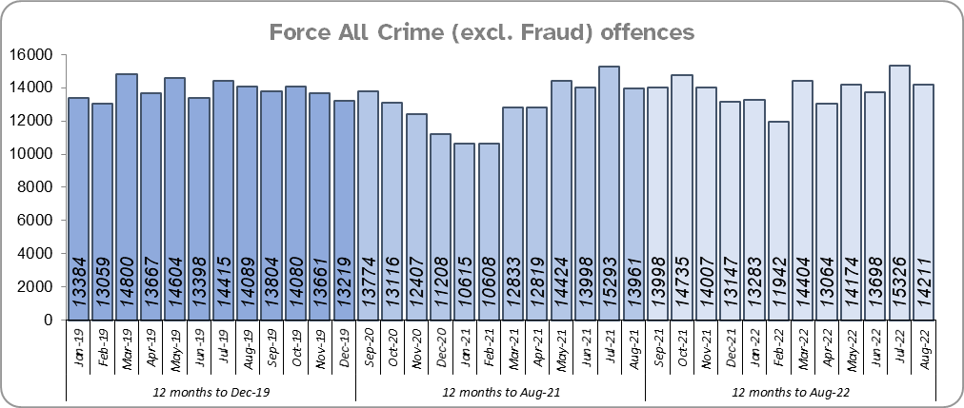
Priority 1 – Further investment in Crime Prevention
Grade: Adequate
There was a 0.4% decrease in All Crime in the 12 months to August 2022 compared to the 12 months to December 2019; this equates to 662 fewer offences. There was, however, a 9.2% increase in All Crime (14,086 more offences) for the 12 months to August 2022 compared to the 12 months to August 2021. The volumes of crimes recorded by the police has been influenced by the Government’s restrictions on gathering and movement in relation to COVID-19; fewer offences were recorded when there were more restrictions in place.
Essex is seventh in its Most Similar Group of forces (MSG) for crime per 1,000 population.
Essex Police recorded a daily average of 458 crimes in August 2022, compared to an average of 494 crimes recorded in July 2022. This equates to a decrease of 7.3%, or an average of 36 fewer crimes recorded per day. There tend to be more offences in July than they are in August each year; this is a relatively consistent seasonal pattern.
14,211 offences were recorded in the month of August 2022, an increase of 1.8% (250 more offences) compared to the month of August 2021 (13,961 offences), and an increase of 0.9% (122 more offences) compared to the month of August 2019 .

Slide 5
Priority 1 - Further investment in Crime Prevention (cont.)
Grade: Adequate
There was a statistically significant decrease in confidence of 1.9% points (from the independent survey commissioned by Essex Police) in the 12 months to June 2022 (77.9%) compared to the 12 months to June 2021 (79.8%). It was during the height of the pandemic that confidence reached its highest levels. Confidence has experienced a statistically significantly improvement compared to levels reported prior to the pandemic (by 13.2% points from 64.7% for the 12 months to December 2019).
The All Crime Harm (Crime Severity) Score* (14.9) places Essex eighth in its MSG.
Due to the fact that compared to the pre-covid period there has been a reduction in crime and an increase in confidence with the reverse true for the comparison with the 12 months to August 2021, a grade of Adequate is recommended.
Please note:
* Crime Severity Scores (as calculated by the Office for National Statistics) measure the ‘relative harm’ of crimes by taking into account both their volume and their severity. As national data are only available to June 2022, the score for the 12 months to June for the preceding year has been included.

Slide 6
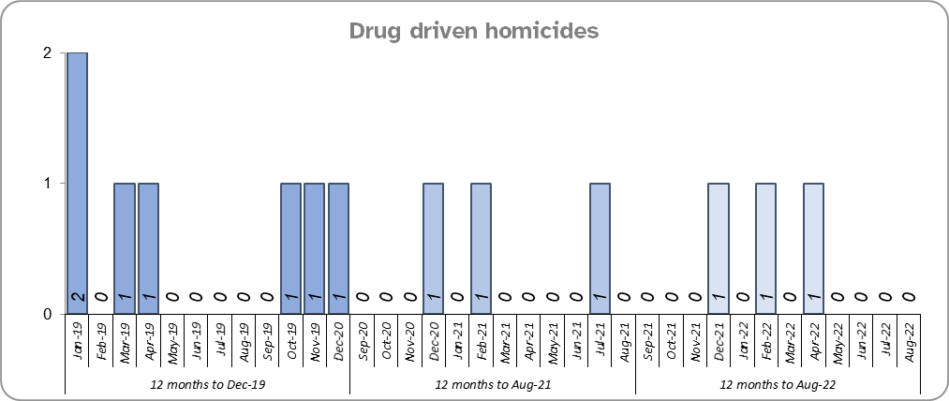
Priority 2 – Reducing Drug Driven Violence
Grade: Good
Essex experienced the same number of drug related homicides for the 12 months to August 2022 compared to the 12 months to August 2021 and four fewer compared to the 12 months to December 2019.
Confidence that Essex Police and partners are dealing with drug crime (from the independent survey commissioned by Essex Police) is at 62.4% for the period September 2021 to June 2022. The results for this question have been stable since it was first asked in September 2021.
Due to the fact that drug related homicides are lower compared to the pre-COVID period, and that confidence is relatively high, a grade of Good is recommended.
Please note:
* The methodology used for identifying investigations as being drug-related is subjective (qualitative data) and based on the circumstances presented. These figures include investigations where the victim and/or suspect are suspected of being involved in Drug Use, Possession or Selling.
** The confidence question was added to the external independent survey in September 2021. A year on year comparison is therefore not available.

Slide 7
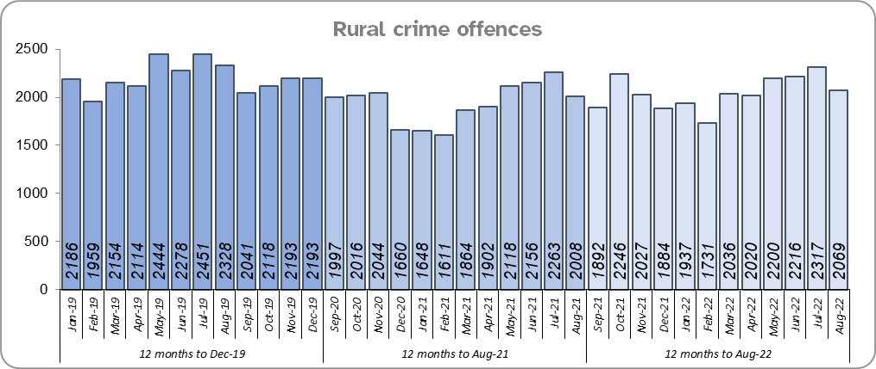
Priority 3 – Protect rural and isolated areas
Grade: Good
Rural Crime decreased by 7.1% (1,884 fewer offences) in the 12 months to August 2022 compared to the 12 months to December 2019 pre-covid period (All Crime in Essex decreased by 0.4% in the same period). However, Essex experienced a 5.5% increase in rural crime (1,288 more offences) for the 12 months to August 2022 compared to the 12 months to August 2021; proportionately, All Crime in Essex increased by almost double that of rural crime (9.2%) in the same period.
The rural crime Harm (Crime Severity) Score* was 8.8 for the 12 months to August 2022, a rise of 0.9 when compared to the 12 months to August 2021 but lower than the All Crime Harm Score in Essex (14.9) which increased by 2.1 over the same period.
Please note:
* Crime Severity Scores (as calculated by the Office for National Statistics) measure the ‘relative harm’ of crimes by taking into account both their volume and their severity. National data are not available for crimes committed in rural areas, so it is not possible to measure against an MSG average; due to this, Essex Police data (to August 2022) have been used rather than national data (which are to June 2022).

Slide 8
Priority 3 – Protect rural and isolated areas
Grade: Good
Confidence in rural policing (from the independent survey commissioned by Essex Police) is at 80.1% (results to the 12 months to June 2022). Compared to year ending June 2021, confidence in rural policing has remained stable and is higher than the current Essex average of 77.9%. In all four of the more rural districts in Essex, more than 79% of people believe Essex are doing a good or excellent job. Since 2019, confidence in Essex Police has increased significantly across Essex in every area but the four districts with the lowest levels of confidence (between 72%-74%) are urban.
Essex Police is one of only 15 forces who have dedicated Rural Policing Teams. The Rural Engagement Team establishment is two Sergeants and eleven PCs, one of whom is a dedicated Wildlife and Heritage Crime Officer. Four special constables are also fully embedded into the team. Delivery of the Rural Crime Strategy is overseen by the LPSU Chief Inspector and LPSU Inspector with the Rural Engagement Team delivering much of the activity.
As confidence in the local police is high and has remained stable, and offence levels in the 12 months to August 2022 compared to the 12 months to December 2019 (pre-COVID) are lower, a grade of Good is recommended.

Slide 9
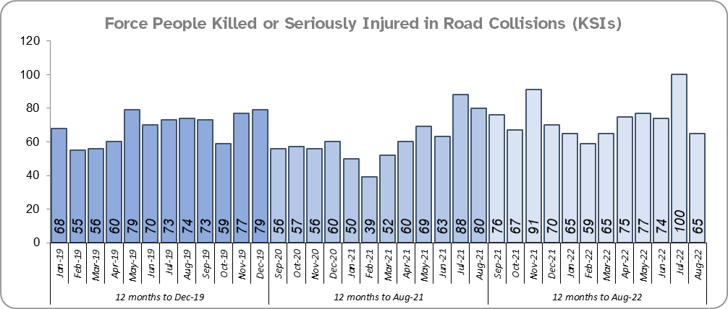
Priority 4 - Improving safety on our roads
Grade: Requires Improvement
Road traffic safety is the responsibility of the Safer Essex Roads Partnership (SERP). Members of SERP comprise Essex Police, Essex County Fire & Rescue Service, Essex County Council, Southend on Sea Borough Council, Thurrock Council, National Highways, East of England Ambulance Service Trust, Essex and Herts Air Ambulance Service Trust and The Safer Roads Foundation (Registered Charity). The aspiration of Essex Police and partners is ‘Vision Zero’, namely to have no road deaths or serious injuries by 2040. The SERP Safety delivery plan sets out a structured programme of educational and engagement activity to address this and support behavioural changes.
In August, the Roads Policing Unit continued the six week #SummerRoadSafetyEssex campaign, asking our communities to help us keep our strategic road network and local roads moving and all our road users safe. Each week focussed on a different road safety issue and the supporting policing activity.*
There was a 21.1% increase (154 more) in the number of those Killed or Seriously Injured (KSI) in Essex for the 12 months to August 2022 compared to the 12 months to August 2021. The number of KSIs also increased by 61 in the 12 months to August 2022 compared to the 12 months to December 2019.
Essex is sixth in its Most Similar Group (MSG) of forces for casualties per 100 million vehicle kilometres (results to December 2020) and is slightly higher than the MSG average. However, due to the fact that more recent national figures have not been released, the current position cannot be determined (the date of the next national release has not yet been confirmed).
Please note that most KSIs do not necessarily result in criminal offences (such as death or serious injury caused by dangerous driving) being recorded.
* Please see slide 22 for the August focus week themes.

Slide 10
Priority 4 - Improving safety on our roads (cont.)
Grade: Requires Improvement
There was a 10.2% decrease (306 fewer offences) in drink/drug driving offences for the 12 months to August 2022 compared to the 12 months to August 2021. This is due to a decrease in recorded drug driving offences; there was a 14.8% increase (191 more offences) in drink driving but a 35.1% decrease (483 fewer offences) in drug driving. There was also a 27.0% decrease (1,003 fewer offences) in drink/drug driving offences for the 12 months to August 2022 compared to the 12 months to December 2019; of these offences, there was a 0.9% increase (13 more offences) in drink driving and a 51.5% decrease (951 fewer offences) in drug driving. All of these offence types are primarily driven by police proactivity in relation to road safety.
There was a 70.4% increase (338 more offences) in the number of driving related mobile phone offences recorded for the 12 months to August 2022 compared to the 12 months to August 2021.*
Confidence in Essex Police and organisations with whom they police the roads (from the independent survey commissioned by Essex Police) is at 64.1% (results to the 12 months to June 2022). Compared to year ending June 2021, there was a statistically significant decrease in confidence in the local police and organisations they work with.
Due to the increase in KSIs in the past 12 months and the decrease in public confidence a grade of Requires Improvement is recommended.
Please note:
* In 2019, the definition as to what constituted “use” of a mobile phone in relation to driver-related mobile phone offences was subject to a legal challenge. This resulted in a ruling, which held that while “use” included accessing the interactive functions of the mobile phone (such as making calls, sending messages or using the internet), it did not extend to solely accessing the device’s internal functions (such as making use of the camera). Fewer mobile phone offences were subsequently prosecuted from this point. In 2021 the government announced that the law was to be changed making it illegal to “hold” a phone or sat nav when driving or riding a motorcycle. This law was finally passed on 25th March 2022.

Slide 11
Priority 5 – Encouraging Volunteers and Community Support
Grade: Good
Confidence that there are good opportunities for volunteers to assist policing and reduce crime in Essex (from the independent survey commissioned by Essex Police) is at 48.6% for the period September 2021 to June 2022. Confidence has increased significantly each quarter since the question was first asked in Q3 2021/22 (Q3 39.7% ; Q4 50.6% ; Q1 55.6%).
Essex Watch Liaison Officers continue to work with Neighbourhood Watch to offer crime and fraud prevention advice.**
In August, the six week #SummerRoadsSafetyEssex campaign continued allowing for our partners and volunteers to support a summer of road safety including the invaluable contribution from Special Constables and Community Speed Watch volunteers. Each week will focus on a different road safety issue and the supporting policing activity.***
The Special Constabulary headcount is currently 404 (as of 31 August 2022). There are 394 Volunteer Police Cadets (VPCs) and 97 Volunteer Cadet Leaders across 13 Cadet Units.
Due to the fact that Essex has the second largest Special Constabulary in the country, and the fact that the Essex Police makes use of Ethics Boards to inform its work, a grade of Good is recommended.
Please note:
* The confidence question was added to the internal survey in September 2021 so year on year comparison is not available.
** Neighbourhood Watch data were first produced in March 2022 so year on year comparison is not available.
*** Please see slide 21 for the August focus week themes.

Slide 12
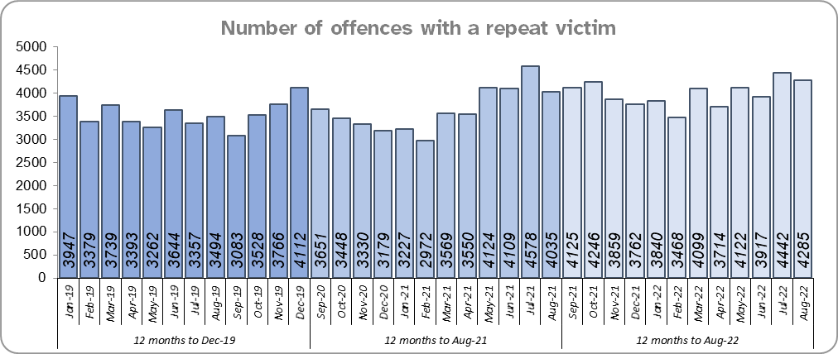
Priority 6 – Improving our services to support victims of crime
Grade: Requires Improvement
Essex experienced a 9.4% increase (4,107 more) in the number of offences with a repeat victim for the 12 months to August 2022 (47,879 offences) compared to the 12 months to August 2021 (43,772 offences) and a 12.1% increase (5,175 more) compared to the 12 months to December 2019 (42,704 offences). See the note below.
The number of individual repeat victims increased by 8.1% (1,698 more) for the 12 months to August 2022 (22,754 individual victims) compared to the 12 months to August 2021 (21,056 individual victims). There has been a smaller overall rise of 6.8% (1,447 more) compared to the 12 months to December 2019 (21,307 individual victims). Of note, is the ongoing investigation of whether the Force are over recording Stalking and Harassment; this may impact the number of repeat victims.
Please note:
* This metric details how many crimes had a repeat victim rather than the number of individual people who are repeat victims of crime. A repeat victim is someone who has been named as a victim for more than one crime within a 12-month period; to mitigate the fact that multiple crimes can be associated with the same incident, additional crimes with the same victim on the same date are not counted.

Slide 13
Priority 6 – Improving our services to support victims of crime
Grade: Requires Improvement
Confidence among victims (from the independent survey commissioned by Essex Police) is at 62.7% (results to the 12 months to June 2022). This is 17.0% points lower than confidence of non-victims for the same period (79.7%) but the gap has narrowed.
Compared to year ending June 2021, confidence in the local police among victims is stable, in contrast to confidence amongst non-victims for whom there was a statistically significantly reduction of 2.4% points.
Due to the fact that the number of repeat victims has increased in the 12 months to August 2022 compared to the same period last year and the 12 months to December 2019, a grade of Requires Improvement is recommended.

Slide 14
Priority 7 – Violence against women and girls
Grade: Requires Improvement
Where gender is detailed, over half of victims of Violence Against the Person (VAP) offences identified as female* (56.3%). 3.0% of offences (2,170 offences) had no gender recorded**.
Essex experienced a 6.2% increase (2,315 more) in the number of VAP offences committed against females in the 12 months to August 2022 compared to the 12 months to August 2021; this compares to an 8.6% increase (2,435 more) in the number of VAP offences committed against males in the same period.
There was a 12.1% increase (4,276 more) in the number of VAP offences committed against females in the 12 months to August 2022 compared to the 12 months to December 2019, compared to a 13.5% increase (3,662 more) in the number of VAP offences committed against males in the same period.
Essex Police prides itself on having excellent Crime Data Accuracy (CDA). In its most recent inspection by HMICFRS, Essex Police was graded as Outstanding in relation to its CDA. Maintaining excellent CDA, however, requires the Force to neither under-record nor over-record offences. To this end, Essex Police are currently investigating whether the Force are over-recording Stalking & Harassment offences, which comprise the largest volume of Violence Against Women & Girls (VAWG). It is of note that 569 fewer Stalking and Harassment crimes were committed against females in the 12 months to August 2022 (16,136 crimes) compared to the 12 months to August 2021 (16,705 crimes).
There was a 15.3% increase (657 more) in the number of Sexual Offences committed against females and a 10.5% decrease (30 fewer) in the number of these offences solved in the 12 months to August 2022 compared to the 12 months to August 2021. By contrast, there was a 23.4% increase (160 more) in the number of Sexual Offences committed against males and an 11.4% decrease (5 fewer) in the number of these offences solved in the same period.
A 29.7% increase (1,132 more) was observed in the number of Sexual Offences committed against females and a 25.6% increase (52 more) in the number of solved sexual offences against females in the 12 months to August 2022 compared to the 12 months to December 2019. By contrast, there was a 36.6% increase (226 more) in the number of Sexual Offences committed against males and an 11.4% increase (4 more) in the number of sexual offences against males solved in the same period.
Please note:
**** Officer defined gender.
**** Not Recorded also includes records where gender is unknown or unspecified.
**** Please see page 28 for table of violence against the person and sexual offences and outcomes (by crime type) split by gender.
**** The confidence question was added to the internal survey in September 2021 so year on year comparison is not available.

Slide 15
Priority 7 – Violence against women and girls
Grade: Requires Improvement
43.8% of females feel safe walking alone in their area after dark (from the independent survey commissioned by Essex Police) for the period September 2021 to June 2022 compared to 76.4% of males.
The Home Office is trialling a new online tool called Street Safe on police.uk to enable people, particularly women and girls to pin-point locations where they feel or have felt unsafe and to identify why that location made them feel unsafe. Street-Safe was developed by the Digital Public Contact (DPC) Programme in cooperation with the Home Office and the National Police Chiefs’ Council (NPCC) and was launched on 2 September 2021 as a national pilot for three months. Street-Safe was introduced into Essex as part of the government’s strategy to tackle Violence against Women and Girls (VAWG). In August 2022, 42 reports were submitted in Essex, the highest total since the service was launched. In total 194 reports have been submitted for Essex.
The Home Office Safer Streets fund enables Police and Crime Commissioners and local authorities to invest in initiatives that seek to provide targeted improvements to the physical environment, with the aim to both prevent crime and improve feelings of safety. With the emergence of the various tranches of Safer Street funding, the new Essex Crime Prevention Strategy aligns this to numerous strategies, including the Essex Police Force Plan. The latest wave of funding aims to address issues related to VAWG.
Due to the fact that the number offences has increased in the 12 months to August 2022 compared to the same period last year and the 12 months to December 2019, a grade of Requires Improvement is recommended.
Please note:
**** Officer defined gender.
**** Not Recorded also includes records where gender is unknown or unspecified.
**** Please see page 28 for table of violence against the person and sexual offences and outcomes (by crime type) split by gender.
**** The confidence question was added to the internal survey in September 2021 so year on year comparison is not available.

Slide 16
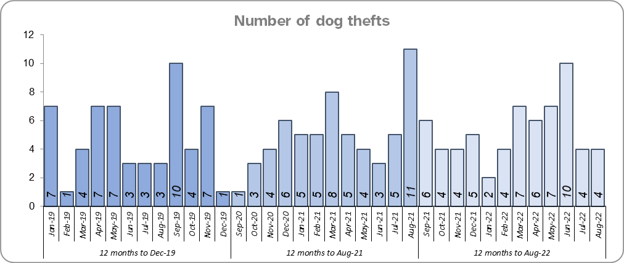
Priority 8 – Dog theft
Grade: Good
Essex experienced 3 more dog thefts for the 12 months to August 2022 compared to the 12 months to August 2021 (63 v. 60). There were 6 more dog thefts in the 12 months to August 2022 compared to the 12 months to December 2019.
Confidence in how Essex Police and the organisations they work with are dealing with dog theft (from the independent survey commissioned by Essex Police) is at 64.6% for the period September 2021 to June 2022.
Due to the low number of thefts across the county (given the comparatively large population of Essex), along with high confidence levels, a grade of Good is recommended.
Please note:
* This is number of thefts in which dogs were stolen, and not quantity of dogs stolen in each theft. Data are based on theft offence crimes and robbery offence crimes where the ‘property code’ is ‘pet animal – dog’ and the ‘property status’ is ‘stolen’ and/or ‘stolen/recovered’.
** The confidence question was added to the internal survey in September 2021 so year on year comparison is not available.

Slide 17
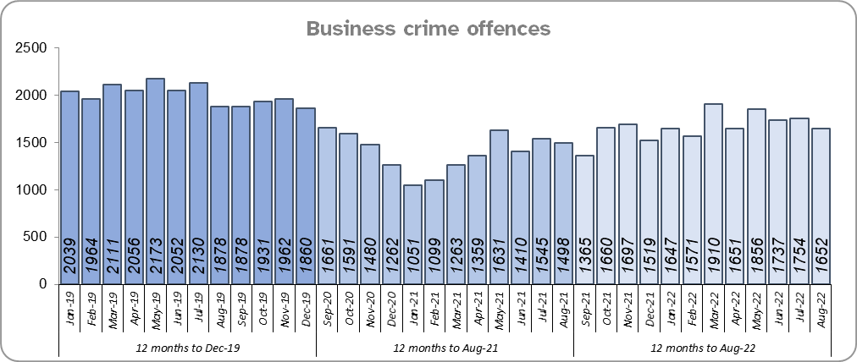
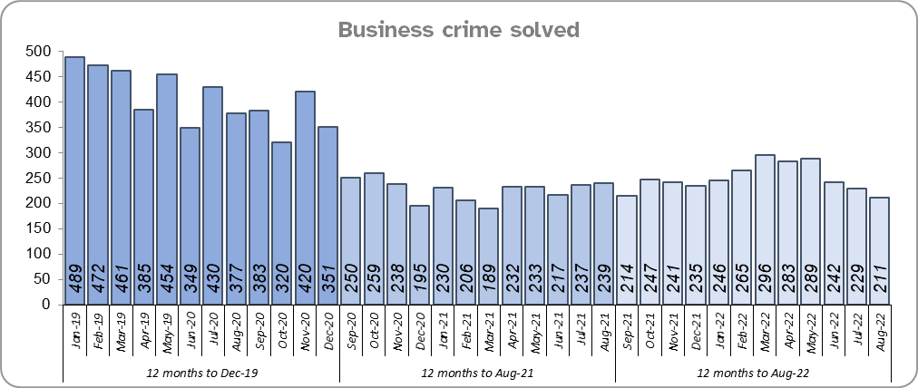
Priority 9 – Business Crime, Fraud and Cyber Crime
Grade: Adequate
Business Crime offences include any notifiable crimes recorded with a victim which is an organisation; it does not include Fraud offences. All reports of Fraud are recorded by the National Fraud Intelligence Bureau (NFIB) rather than Essex Police. In the 12 months to August 2022, a total of 1,612 Fraud investigations were allocated to Essex Police by NFIB for investigation. For data on the number and type of Fraud investigations reported as being committed within the Essex Police area, please visit the NFIB Fraud and Cyber Crime Dashboard
Essex experienced an 18.8% increase (3,169 more) in the number of Business Crime offences and a 10.0% increase (273 more) in the number of these offences which were solved in the 12 months to August 2022 compared to the 12 months to August 2021. COVID restrictions were lifted at the end of January 2021 resulting in lower figures in the 12 months to August 2021 as this includes periods when businesses were not open; shoplifting accounts for roughly 46% of business crime. Essex Police have been working with businesses to encourage them to record more offences.
There was a 16.7% decrease (4,015 fewer) in the number of Business Crime offences and a 38.7% decrease (1,893 fewer) in the number of Business Crimes solved in the 12 months to August 2022 compared to the 12 months to December 2019.
Confidence that Essex Police are dealing with cyber crime (from the independent survey commissioned by Essex Police) is at 25.2% for the period September 2021 to June 2022. Confidence has significantly increased from quarter 4 2021/2022, when it was at 23.5%, to quarter 1 2022/2023 when it was at 27.2%.
Due to the increase in the number of Business Crime offences that are solved, a grade of Adequate is recommended.
* The confidence question was added to the internal survey in September 2021 so year on year comparison is not available.

Slide 18
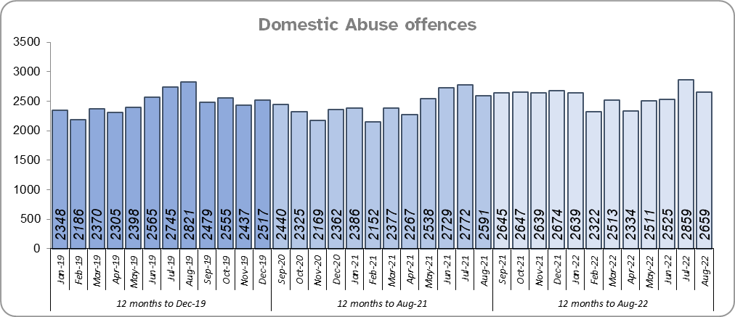
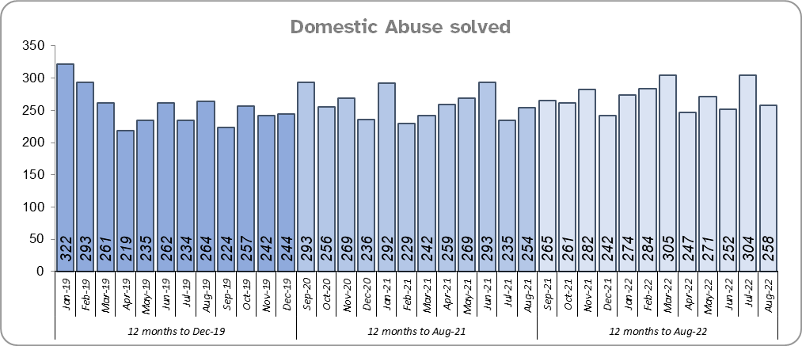
Priority 10 - Protecting vulnerable people and supporting victims of crime
Grade: Adequate
Essex experienced a 6.4% increase (1,859 more) in Domestic Abuse (DA) offences for the 12 months to August 2022 compared to the 12 months to August 2021. However, the Force recorded 49 fewer offences in the three months to August 2022 compared to the same period in 2021 (8,043 v. 8,092). Essex Police are currently investigating whether the Force are over-recording Stalking & Harassment offences, which accounts for more than a fifth (21.1%) of all Domestic Abuse offences.
Essex Police solved 3.8% (118) more DA offences for the 12 months to August 2022 compared to the 12 months to August 2021. The Force also solved 32 more offences in the three months to August 2022 compared to the same period in 2021 (814 v 782).
There was a 4.2% increase (1,241 more) in DA offences and an 8.0% increase (240 more) in the number of DA offences solved for the 12 months to August 2022 compared to the 12 months to December 2019.
The Essex Police Domestic Abuse Problem Solving Teams (DAPST) were formed in March 2021 and are divided into a victim focused contingent (Problem-Solving officers) and an Offender Management contingent (Offender Management officers). They work alongside DAIT, who manage the most prolific DA perpetrators and the most vulnerable victims. The team has been implemented to provide a continual and sustained problem-solving approach, focusing on preventing future harm and reducing repeat victimisation.

Slide 19
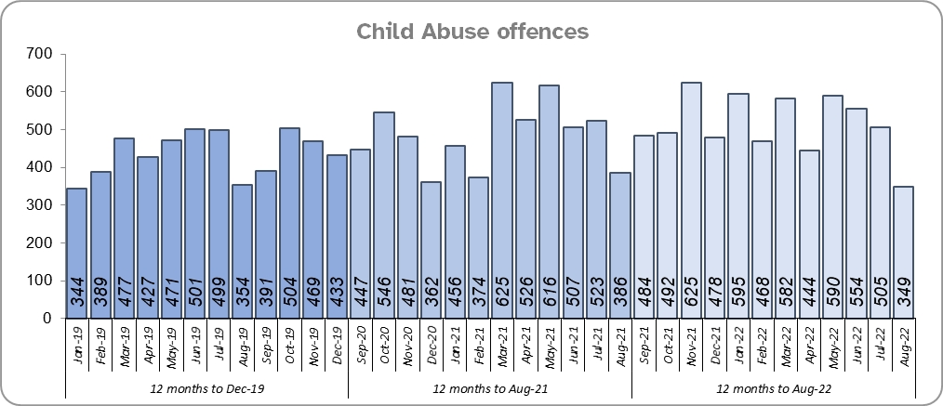
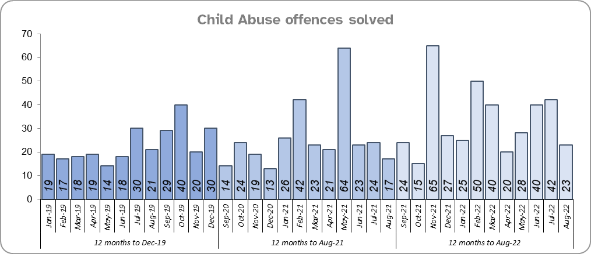
Priority 10 - Protecting vulnerable people and supporting victims of crime (cont.)
Grade: Adequate
Essex Police solved 89 more (28.7%) offences for the 12 months to August 2022 compared to the 12 months to August 2021. There was also an 11.1% increase (656 more) in Child Abuse offences for the same comparison periods.
Essex Police solved 124 more (45.1%) offences for the 12 months to August 2022 compared to the 12 months to December 2019. There was also a 24.6% increase (1,293 more) in Child Abuse offences for the same comparison periods.
Confidence that the policing response to protect children and vulnerable people (from the independent survey commissioned by Essex Police) is at 81.7% (results to the 12 months to June 2022). Compared to year ending June 2021, confidence has decreased by 7.5% points.
Due to the fact that there has been a continuing increase in the number of Child Abuse offences in the 12 months to August 2022 compared to the previous 12 months and the 12 months to December 2019 and an increase in the number of DA offences solved over the same time periods, a grade of Adequate is recommended.

Slide 20
Priority 11 - Staff
Grade: Adequate
There has been a slight decrease (0.1%) in the proportion of ethnic minority employees in August 2022 (269) compared to August 2021 (278); this equates to 9 fewer employees. However, in contrast there has been an increase (24.0%) compared to December 2019 (217); this equates to 52 additional employees.
There is a 3.4% point disparity in the proportion of ethnic minority residents in Essex*** (7.6%) compared to the proportion of ethnic minority employees in Essex Police (4.2%).
Please note:
****Ethnic minority employees as a percentage of the total workforce.
****Ethnic minority employees as a percentage of type of employee.
****Office for National Statistics Population Estimates 2019: Essex population 1,846,655, ethnic minority residents 140,641.

Slide 21
Monthly Performance Overview: Exceptions
Exceptions Overview
Arson experienced statistically significant increase for the month of August 2022.
Arson – Increase
39.3% increase (384 more crimes) for the 12 months to August 2022 compared to the 12 months to August 2021. There were statistically exceptional increases in seven Districts (Chelmsford, Braintree, Colchester, Tendring, Southend, Epping and Harlow) in August 2022.

Slide 22
Monthly Performance Overview: Of Note
#SummerRoadsSafetyEssex Campaign
Our Roads Policing Unit continued the six week #SummerRoadSafetyEssex campaign.
August’s themes were:
Week 3 (1 to 7 August): Road crime – High harm offenders
Week 4 (8 to 14 August): Citizenship week – How residents can get involved
Week 5 (15 to 21 August): Rural roads
Week 6 (22 to 28 August): National drug drive enforcement week
2022 August – Our Town Centre Teams are growing
Local, visible and accessible policing and preventing crime from happening in the first place are key priorities in our Police and Crime Plan. Essex Police is now investing even more into the Town Centre Teams and more than 30 new posts have been created across the county.
Since the launch of the Town Centre Teams in July 2019, officers have made a huge impact within their local communities by being visible to residents, building relationships with local traders and businesses, and focusing on longer-term problem solving for crimes like anti-social behaviour, drug offences and knife crime.
2022 August – 52 new officers prepare to serve the county as the Force reaches record strength
52 new officers are preparing for front line duties in the villages, towns and cities of Essex. With these new recruits, Essex Police is the largest it has ever been. Including officers currently in training, there are now 3,623 officers in our ranks. By the end of March 2023 we are on course to have 3,755 officers protecting and serving our county.

Slide 23
2021-2024 Police and Crime Plan Performance Indicators
Table 1
Please view above table with the explanations and caveats detailed on page 25.

Slide 24
2021-2024 Police and Crime Plan Performance Indicators (cont.)
Table 2
Please view above table with the explanations and caveats detailed on page 25.

Slide 25
End Notes
¹ Question from the independent survey commissioned by Essex Police. Results are for the period 12 months June 2022 versus the 12 months to June 2021.
² The confidence interval is the range +/- within which the survey result will lie. This is mainly influenced by the number of people answering the survey. The more people that answer the survey, the smaller the interval range.
³ Crime Severity Score measures ‘relative harm’ of crimes by taking into account both the volume and the severity of offences, and by weighting offences differently. National data for the 12 months to June 2022 have been used in order that comparisons can be made to Essex’s Most Similar Group of Forces (MSG).
⁴ The methodology used for identifying these investigations as drug related is subjective and based on the circumstances presented. These figures will include investigations where the victim or the suspect are involved Drug Use, Possession or Selling.
⁵ ‘Killed or Seriously Injured’ (KSI) refers to all people killed or seriously injured on Essex’s roads, regardless of whether any criminal offences were committed. ‘Causing Death/Serious Injury by Dangerous/Inconsiderate Driving’ offences (detailed on p.8) refers to the number of crimes of this type.
⁶ In 2019, the definition as to what constituted “use” of a mobile phone in relation to driver-related mobile phone offences was subject to a legal challenge. This resulted in a ruling, which held that while “use” included accessing the interactive functions of the mobile phone (such as making calls, sending messages or using the internet), it did not extend to solely accessing the device’s internal functions (such as making use of the camera). Fewer mobile phone offences were subsequently prosecuted from this point. In 2021 the government announced that the law was to be changed making it illegal to “hold” a phone or sat nav when driving or riding a motorcycle. This law was finally passed on 25th March 2022.
⁷ Solved outcomes are crimes that result in: charge or summons, caution, crimes taken into consideration, fixed penalty notice, cannabis warning or community resolution.
⁸ This is the number of theft offences in which dogs were stolen, and not necessarily the number of dogs which were stolen.
⁹ Ethnic minority employees as a percentage of the total workforce.

Slide 26
Crime Tree Data – Rolling 12 Months to August
Table 3

Slide 27
Crime Tree Data – Rolling 12 Months to August (cont.)
Table 4

Slide 28
Crime Tree Data - Rolling 12 months to August Violence against the Person and Sexual offences and outcomes (by crime type) split by gender
Table 5
Please note: the breakdown of data for the previous 12 months within these tables may not tally with the totals on page 26 as gender data is rerun on a monthly basis.

