Slide 1
Police and Crime Plan 2021-2024
Monthly Performance Update
DRAFT REPORT for July 2022 (not yet cleared by COG)
National and MSG positions are to 31 May 2022 (Essex Police data are to 31 July 2022).
Version 1.6
Produced August 2022
Performance Analysis Unit, Analysis & Research Team, Essex Police
Sensitivity: Official

Slide 2
Executive Summary
The Police and Crime Plan 2021-2024 was introduced in April 2021, with new measures that reflect the Police, Fire and Crime Commissioner (PFCC) for Essex’s strategic commitment to targeted prevention and early intervention.
Four of the eleven PFCC Priorities have been given a recommended grade of ‘Good’; 2 (Reduce drug driven violence), 3 (Protect rural and isolated areas), 5 (Encouraging Volunteers and Community Support and 8 (Dog Theft). Four have been given a recommended grade of ‘Adequate’ and three have been given a recommended grade of ‘Requires Improvement’; 4 (Improving safety on our roads), 6 (Improving our service to support victims of crime) and 7 (Violence against women and girls). Since the last report, the recommended grade for Priority 7 (Violence against Women and Girls) has been downgraded from ‘Adequate’ to ‘Requires Improvement’.
Confidence (from the independent survey commissioned by Essex Police) is at 77.9% (results to the 12 months to June 2022). Compared to year ending June 2021 (79.8%), confidence in the local police has deteriorated slightly but still remains comparatively high. A comparison with the 12 months to December 2019 has been provided to allow a comparison with a year in which society, crime and policing was not affected by the pandemic. Confidence has increased by 13.2 percentage points compared to the 12 months to December 2019 (64.7%).
All Crime increased by 8.3% for the 12 months to July 2022 compared to the 12 months to July 2021; this equates to 12,873 more offences. This increase has been primarily influenced by the Government’s easing of restrictions on gathering and movement in relation to COVID-19. The year on year increase has slowed in the last three months. By way of context there were decreases in All Crime (0.6%), Rural Crime (7.3%) and Business Crime (17.5%) offences in the 12 months to July 2022 compared to the 12 months to December 2019.
Essex Police prides itself on having excellent Crime Data Accuracy (CDA). In its most recent inspection by HMICFRS, Essex Police was graded as Outstanding in relation to its CDA. Maintaining excellent CDA, however, requires the Force to neither under-record nor over-records offences. To this end, Essex Police are currently investigating whether the Force are over-recording Stalking & Harassment offences, which comprise the largest volume of Violence Against Women & Girls offences (VAWG) and accounts for 21.0% of all Domestic Abuse offences. Under current recording processes, there were 544 fewer Stalking and Harassment crimes were committed against females in the 12 months to July 2022 (16,167 crimes) compared to the 12 months to July 2021 (16,711 crimes).
Essex experienced an 8.6% increase (3,762 more) in the number of offences with a repeat victim for the 12 months to July 2022 (47,667 offences) compared to the 12 months to July 2021 (43,905 offences). The number of individual repeat victims saw a lower percentage increase at 7.3% (1537 more) for the 12 months to July 2022 (22,648 individual victims) compared to the 12 months to July 2021 (21,111 individual victims). Of note, is the ongoing investigation of possible over recording of Stalking and Harassment which may impact the number of repeat victims.
Over half of victims of Violence Against the Person (VAP) offences identify as female (56.3%). ¹ VAP offences committed against females increased by 5.8% (2,160 more), and there was an 16.7% increase (709 more) in the number of sexual offences against females in the 12 months to July 2022 compared to the 12 months to July 2021. This compares to an 8.0% rise (2,275 more) in VAP offences committed against males and a 21.0% rise (146 more) in sexual offences against males in the same period. It is of note that 544 fewer Stalking and Harassment crimes were committed against females in the 12 months to July 2022 (16,167 crimes) compared to the 12 months to July 2021 (16,711 crimes).
The number of solved sexual offences committed against females decreased by 10.2% (29 fewer) in the 12 months to July 2022 compared to the 12 months to July 2021. This compares to a decrease of 2.4% (1 fewer) solved sexual offences committed against males in the same period.
There was a 20.4% increase (150 more) in the number of those Killed or Seriously Injured (KSI) in Essex for the 12 months to July 2022 compared to the 12 months to July 2021. The rate of increase has slowed in recent months, in April 2022 there has a 25.8% year on year increase. Road traffic safety is the responsibility of the Safer Essex Roads Partnership (SERP) which includes a number of organisations including Essex Police: Essex County Fire & Rescue Service; Essex County Council; Southend on Sea Borough Council; Thurrock Council; National Highways; East of England Ambulance Service Trust; Essex and Herts Air Ambulance Service Trust; and The Safer Roads Foundation (Registered Charity).
There has been a slight decrease (0.1%) in the proportion of ethnic minority employees in July 2022 (268) compared to July 2021 (273). This equates to 5 fewer employees.
Violence with Injury, Other Sexual Offences and Arson experienced statistically significant increases for the month of July 2022: There were no statistically exceptional decreases.

Slide 3
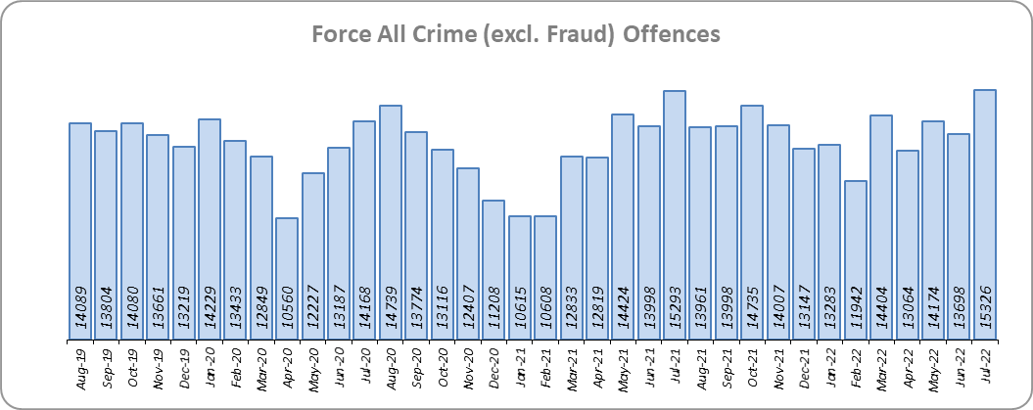
Priority 1 – Further investment in Crime Prevention
Grade: Adequate
Essex experienced an 8.3% increase in All Crime (12,873 more offences) for the 12 months to July 2022 compared to the 12 months to July 2021 – influenced primarily by the Government’s easing of restrictions on movement and gathering in relation to COVID-19. Essex is seventh in its Most Similar Group of forces (MSG) for crime per 1,000 population. By way of context, there was a 0.6% decrease in All Crime in the 12 months to July 2022 compared to the 12 months to December 2019; this equates to 1,036 fewer offences.
Essex Police recorded a daily average of 494 crimes in July 2022, compared to an average of 457 crimes recorded in June 2022. This equates to an increase of 8.3%, or an average of 38 more crimes recorded per day.
15,326 offences were recorded in the month of July 2022, an increase of 0.2% (33 offences) compared to the month of July 2021 (15,293 offences).

Slide 4
Priority 1 - Further investment in Crime Prevention (cont.)
Grade: Adequate
There was a statistically significant decrease in confidence of 1.9% points (from the independent survey commissioned by Essex Police) in the 12 months to June 2022 (77.9%) compared to the 12 months to June 2021 (79.8%). It was during this period at the height of the pandemic that confidence reached the highest levels. A comparison with confidence levels prior to the pandemic (the 12 months to December 2019) shows confidence has risen significantly by 13.2% points from 64.7%. This is a statistically significant increase in public confidence.
The All Crime Harm (Crime Severity) Score* (14.9) places Essex eighth in its MSG.
Due to the fact that compared to the pre-covid period there has been a reduction in crime and an increase in confidence with the reverse true for the comparison with the 12 months to July 2021, a grade of Adequate is recommended.
Please note:
* Crime Severity Scores (as calculated by the Office for National Statistics) measure the ‘relative harm’ of crimes by taking into account both their volume and their severity. As national data are only available to May 2022, the score for the 12 months to May for the preceding year has been included.

Slide 5
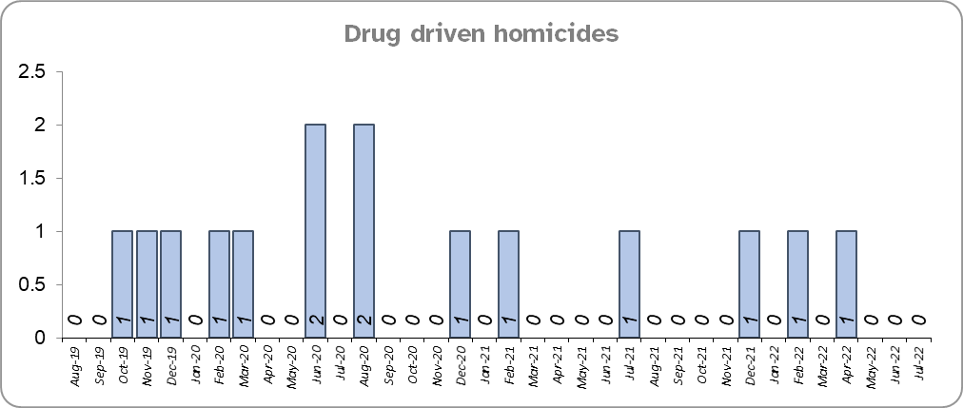
Priority 2 – Reducing Drug Driven Violence
Grade: Good
Essex experienced two fewer drug related homicides for the 12 months to July 2022 compared to the 12 months to July 2021 and four fewer compared to the 12 months to December 2019.
Confidence that Essex Police and partners are dealing with drug crime (from the independent survey commissioned by Essex Police) is at 62.4% for the period September 2021 to June 2022. The results of this question have been stable since it was first asked in September 2021.
Due to the fact that drug related homicides are lower compared to both the pre-COVID period and 12 months to July 2021, and that confidence is relatively high, a grade of Good is recommended.
Please note:
* The methodology used for identifying investigations as being drug-related is subjective (qualitative data) and based on the circumstances presented. These figures include investigations where the victim and/or suspect are suspected of being involved in Drug Use, Possession or Selling.
** The confidence question was added to the external independent survey in September 2021. A year on year comparison is therefore not available.

Slide 6
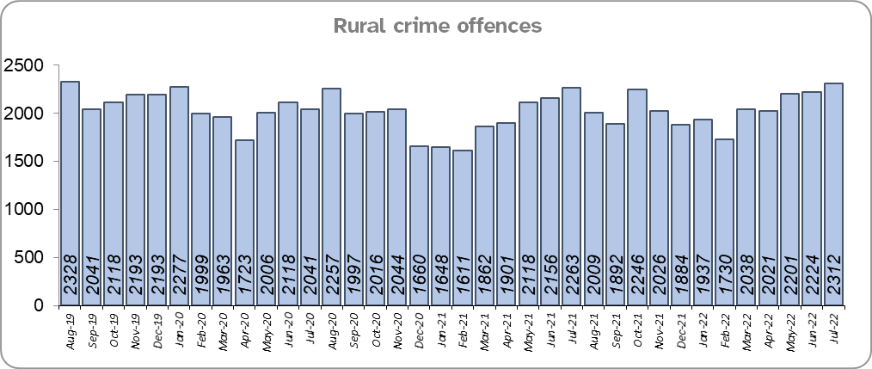
Priority 3 – Protect rural and isolated areas
Grade: Good
Essex experienced a 4.2% increase in rural crime (987 more offences) for the 12 months to July 2022 compared to the 12 months to July 2021. However, proportionately, All Crime in Essex increased by almost double that of rural crime (8.3%) in the same period. Rural Crime decreased by 7.3% (1,939 fewer offences) in the 12 months to July 2022 compared to the 12 months to December 2019 pre-covid period (All Crime in Essex decreased by 0.6% in the same period).
The rural crime Harm (Crime Severity) Score* was 8.9 for the 12 months to July 2022, a rise of 1.2 when compared to the 12 months to July 2021 but lower than the All Crime Harm Score in Essex (14.9) which increased by 2.2 over the same period.
Please note:
* Crime Severity Scores (as calculated by the Office for National Statistics) measure the ‘relative harm’ of crimes by taking into account both their volume and their severity. National data are not available for crimes committed in rural areas, so it is not possible to measure against an MSG average; due to this, Essex Police data (to July 2022) have been used rather than national data (which are to May 2022).

Slide 7
Priority 3 – Protect rural and isolated areas
Grade: Good
Confidence in rural policing (from the independent survey commissioned by Essex Police) is at 80.1% (results to the 12 months to June 2022). Compared to year ending June 2021, confidence in rural policing has remained stable and is higher than the current Essex average of 77.9%.
Essex Police is one of only 15 forces who have dedicated Rural Policing Teams. The Rural Engagement Team establishment is two Sergeants and eleven PCs, one of which is a dedicated Wildlife and Heritage Crime Officer. Four special constables are also fully embedded into the team. Delivery of the Rural Crime Strategy is overseen by the LPSU Chief Inspector and LPSU Inspector with the Rural Engagement Team delivering much of the activity.
As confidence in the local police is high and has remained stable, and offence levels in the 12 months to July 2022 compared to the 12 months to December 2019 (pre-COVID) are lower, a grade of Good is recommended.

Slide 8
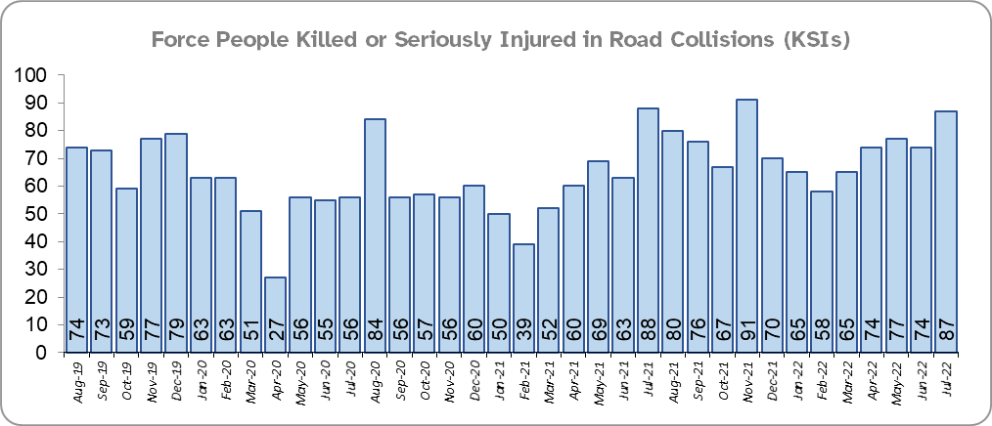
Priority 4 - Improving safety on our roads
Grade: Requires Improvement
Road traffic safety is the responsibility of the Safer Essex Roads Partnership (SERP). Members of SERP comprise Essex Police, Essex County Fire & Rescue Service, Essex County Council, Southend on Sea Borough Council, Thurrock Council, National Highways, East of England Ambulance Service Trust, Essex and Herts Air Ambulance Service Trust and The Safer Roads Foundation (Registered Charity). The aspiration of Essex Police and partners is ‘Vision Zero’, namely to have no road deaths or serious injuries by 2040. The SERP Safety delivery plan sets out a structured programme of educational and engagement activity to address this and support behavioural changes.
In July, the Roads Policing Unit launched the six week #SummerRoadSafetyEssex campaign, asking our communities to help us keep our strategic road network and local roads moving and all our road users safe. Each week will focus on a different road safety issue and the supporting policing activity.*
There was a 20.4% increase (150 more) in the number of those Killed or Seriously Injured (KSI) in Essex for the 12 months to July 2022 compared to the 12 months to July 2021. The rate of increase has slowed in recent months, in April 2022 there has a 25.8% year on year increase. There was an increase in the number of collisions, particularly those resulting in serious injuries (19.5%), in the same period. The number of KSIs also increased by 61 in the 12 months to July 2022 compared to the 12 months to December 2019.
Essex is sixth in its Most Similar Group (MSG) of forces for casualties per 100 million vehicle kilometres (results to December 2020) and is slightly higher than the MSG average. However, due to the fact that more recent national figures have not been released, the current position cannot be determined (the date of the next national release has not yet been confirmed).
Please note that most KSIs do not necessarily result in criminal offences (such as death or serious injury caused by dangerous driving) being recorded.
* Please see slide 22 for the July focus week themes.

Slide 9
Priority 4 - Improving safety on our roads (cont.)
Grade: Requires Improvement
There was an 11.3% decrease (350 fewer offences) in drink/drug driving offences for the 12 months to July 2022 compared to the 12 months to July 2021. This is due to a decrease in recorded drug driving offences; there was a 15.2% increase (197 more offences) in drink driving but a 37.9% decrease (553 fewer offences) in drug driving. There was also a 25.9% decrease (960 fewer offences) in drink/drug driving offences for the 12 months to July 2022 compared to the 12 months to December 2019; of these offences, there was a 1.8% increase (26 more offences) in drink driving and a 50.8% decrease (938 fewer offences) in drug driving. All of these offence types are primarily driven by police proactivity in relation to road safety.
There was a 50.0% increase (247 more offences) in the number of driving related mobile phone offences recorded for the 12 months to July 2022 compared to the 12 months to July 2021.*
Confidence in Essex Police and organisations with whom they police the roads (from the independent survey commissioned by Essex Police) is at 64.1% (results to the 12 months to June 2022). Compared to year ending June 2021, there was a statistically significant decrease in confidence in the local police and organisations they work with.
Due to the increase in KSIs in the past 12 months and the decrease in public confidence a grade of Requires Improvement is recommended.
Please note:
* In 2019, the definition as to what constituted “use” of a mobile phone in relation to driver-related mobile phone offences was subject to a legal challenge. This resulted in a ruling, which held that while “use” included accessing the interactive functions of the mobile phone (such as making calls, sending messages or using the internet), it did not extend to solely accessing the device’s internal functions (such as making use of the camera). Fewer mobile phone offences were subsequently prosecuted from this point. In 2021 the government announced that the law was to be changed making it illegal to “hold” a phone or sat nav when driving or riding a motorcycle. This law was finally passed on 25th March 2022.

Slide 10
Priority 5 – Encouraging Volunteers and Community Support
Grade: Good
Confidence that there are good opportunities for volunteers to assist policing and reduce crime in Essex (from the independent survey commissioned by Essex Police) is at 48.6% for the period September 2021 to June 2022.
Essex Watch Liaison Officers continue to work with Neighbourhood Watch to offer crime and fraud prevention advice.**
In July, the six week #SummerRoadsSafetyEssex campaign will allow for our partners and volunteers to support a summer of road safety including the invaluable contribution from Special Constables and Community Speed Watch volunteers. Each week will focus on a different road safety issue and the supporting policing activity.***
The Special Constabulary headcount is currently 422 (as of 31 July 2022). There are 394 Volunteer Police Cadets (VPCs) and 97 Volunteer Cadet Leaders across 13 Cadet Units.
Due to the fact that Essex has the second largest Specials Constabulary in the country, and the fact that the Essex Police makes use of Ethics Boards to inform its work, a grade of Good is recommended.
Please note:
* The confidence question was added to the internal survey in September 2021 so year on year comparison is not available.
** Neighbourhood Watch data were first produced in March 2022 so year on year comparison is not available.
*** Please see slide 22 for the July focus week themes.

Slide 11
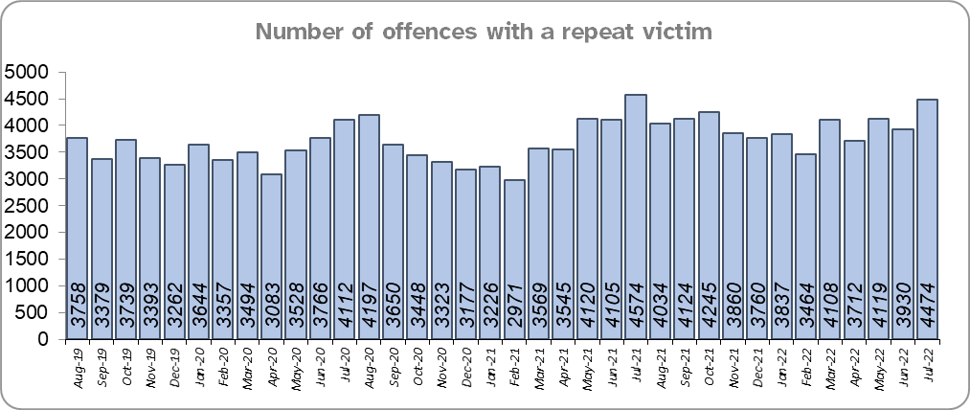
Priority 6 – Improving our services to support victims of crime
Grade: Requires Improvement
Essex experienced an 8.6% increase (3,762 more) in the number of offences with a repeat victim for the 12 months to July 2022 (47,667 offences) compared to the 12 months to July 2021 (43,905 offences) and an 11.6% increase (4,963 more) compared to the 12 months to December 2019 (42,704 offences). See the note below.
The number of individual repeat victims increased by 7.3% (1537 more) for the 12 months to July 2022 (22,648 individual victims) compared to the 12 months to July 2021 (21,111 individual victims). There has been a smaller overall rise of 6.3% (1,341 more) compared to the 12 months to December 2019 (21,307 individual victims. Of note, is the ongoing investigation of possible over recording of Stalking and Harassment which may impact the number of repeat victims.
Please note:
* This metric details how many crimes had a repeat victim rather than the number of individual people who are repeat victims of crime. A repeat victim is someone who has been named as a victim for more than one crime within a 12-month period; to mitigate the fact that multiple crimes can be associated with the same incident, additional crimes with the same victim on the same date are not counted.

Slide 12
Priority 6 – Improving our services to support victims of crime
Grade: Requires Improvement
Confidence among victims (from the independent survey commissioned by Essex Police) is at 62.7% (results to the 12 months to June 2022). This is 17.0% points lower than confidence of non-victims for the same period (79.7%) but the gap has narrowed.
Compared to year ending June 2021, confidence in the local police among victims is stable in contrast to confidence amongst non-victims which has seen a statistically significantly reduction of 2.4% points.
Due to the fact that the number of repeat victims has increased in the 12 months to June 2022 compared to the same period last year and the 12 months to December 2019, a grade of Requires Improvement is recommended.

Slide 13
Priority 7 – Violence against women and girls
Grade: Requires Improvement
Where gender is detailed, over half of victims of Violence Against the Person (VAP) offences identified as female* (56.3%). 3.0% of offences (2,173 offences) had no gender recorded**.
Essex experienced a 5.8% increase (2,160 more) in the number of VAP offences committed against females in the 12 months to July 2022 compared to the 12 months to July 2021; this compares to an 8.0% increase (2,275 more) in the number of VAP offences committed against males in the same period.
There was an 11.8% increase (4,196 more) in the number of VAP offences committed against females in the 12 months to July 2022 compared to the 12 months to December 2019 compared to 13.3% increase (3,616 more) in the number of VAP offences committed against males in the same period.
Essex Police prides itself on having excellent Crime Data Accuracy (CDA). In its most recent inspection by HMICFRS, Essex Police was graded as Outstanding in relation to its CDA. Maintaining excellent CDA, however, requires the Force to neither under-record nor over-records offences. To this end, Essex Police are currently investigating whether the Force are over-recording Stalking & Harassment offences, which comprise the largest volume of Violence Against Women & Girls (VAWG). It is of note that 544 fewer Stalking and Harassment crimes were committed against females in the 12 months to July 2022 (16,167 crimes) compared to the 12 months to July 2021 (16,711 crimes).
There was a 16.7% increase (709 more) in the number of Sexual Offences committed against females and a 10.2% decrease (29 fewer) in the number of these offences solved in the 12 months to July 2022 compared to the 12 months to July 2021. By contrast, there was a 21.0% increase (146 more) in the number of Sexual Offences committed against males and a 2.4% decrease (1 fewer) in the number of these offences solved in the same period.
A 29.8% increase (1,134 more) was observed in the number of Sexual Offences committed against females and a 25.1% increase (51 more) in the number of sexual offences against females solved in the 12 months to July 2022 compared to the 12 months to December 2019. By contrast, there was a 35.9% increase (222 more) in the number of Sexual Offences committed against males and a 20.0% increase (7 more) in the number of sexual offences against males solved in the same period.
Please note:
**** Officer defined gender.
**** Not Recorded also includes records where gender is unknown or unspecified.
**** Please see page 28 for table of violence against the person and sexual offences and outcomes (by crime type) split by gender.
**** The confidence question was added to the internal survey in September 2021 so year on year comparison is not available.

Slide 14
Priority 7 – Violence against women and girls
Grade: Requires Improvement
43.8% of females feel safe walking alone in their area after dark (from the independent survey commissioned by Essex Police) for the period September 2021 to June 2022 compared to 76.4% of males.
The Home Office is trialling a new online tool called Street Safe on police.uk to enable people, particularly women and girls to pin-point locations where they feel or have felt unsafe and to identify why that location made them feel unsafe. Street-Safe was developed by the Digital Public Contact (DPC) Programme in cooperation with the Home Office and the National Police Chiefs’ Council (NPCC) and was launched on 2 September 2021 as a national pilot for three months. Street-Safe was introduced into Essex as part of the government’s strategy to tackle Violence against Women and Girls (VAWG).
The Home Office Safer Streets fund enables Police and Crime Commissioners and local authorities to invest in initiatives that seek to provide targeted improvements to the physical environment, with the aim to both prevent crime and improve feelings of safety. With the emergence of the various tranches of Safer Street funding, the new Essex Crime Prevention Strategy aligns this to numerous strategies, including the Essex Police Force Plan. The latest wave of funding aims to address issues related to VAWG.
Due to the fact that the number offences has increased in the 12 months to June 2022 compared to the same period last year and the 12 months to December 2019, a grade of Requires Improvement is recommended.
Please note:
**** Officer defined gender.
**** Not Recorded also includes records where gender is unknown or unspecified.
**** Please see page 28 for table of violence against the person and sexual offences and outcomes (by crime type) split by gender.
**** The confidence question was added to the internal survey in September 2021 so year on year comparison is not available.

Slide 15
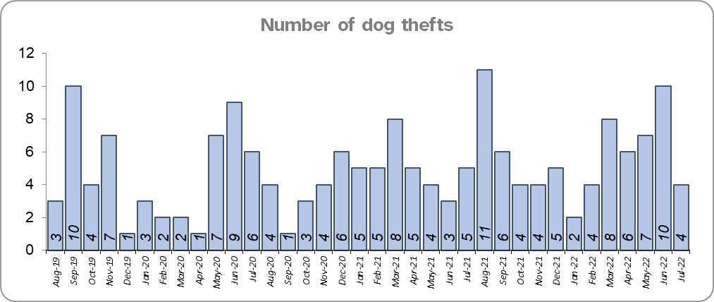
Priority 8 – Dog theft
Grade: Good
Essex experienced 18 more dog thefts for the 12 months to July 2022 compared to the 12 months to July 2021 (71 v. 53). There were 14 more dog thefts in the 12 months to July 2022 compared to the 12 months to December 2019.
Confidence in how Essex Police and the organisations they work with are dealing with dog theft (from the independent survey commissioned by Essex Police) is at 64.6% for the period September 2021 to June 2022.
Due to the low number of thefts across the county (given the comparatively large population of Essex), along with high confidence levels, a grade of Good is recommended.
Please note:
* This is number of thefts in which dogs were stolen, and not quantity of dogs stolen in each theft. Data are based on theft offence crimes and robbery offence crimes where the ‘property code’ is ‘pet animal – dog’ and the ‘property status’ is ‘stolen’ and/or ‘stolen/recovered’.
** The confidence question was added to the internal survey in September 2021 so year on year comparison is not available.

Slide 16
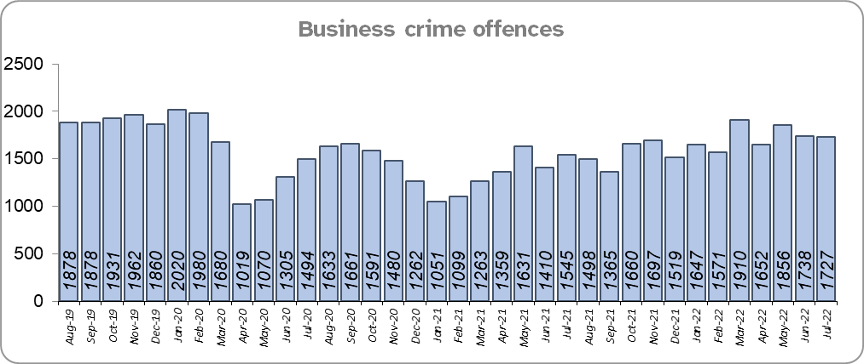
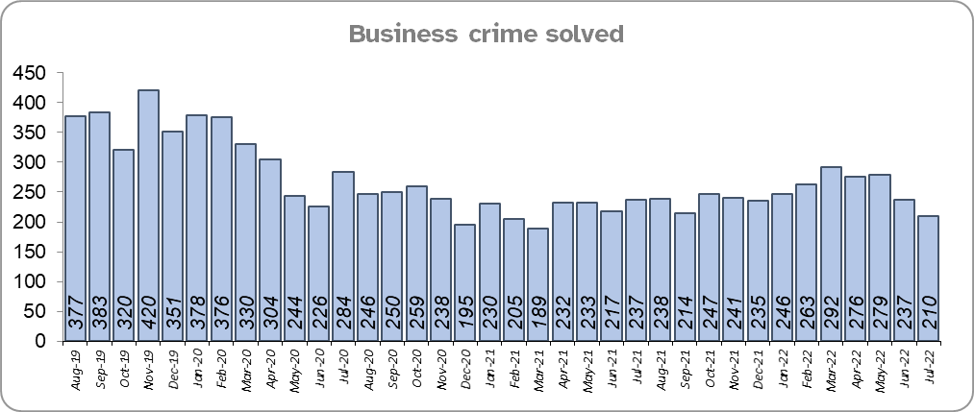
Priority 9 – Business Crime, Fraud and Cyber Crime
Grade: Adequate
Business Crime offences include any notifiable crimes recorded with a victim which is an organisation; it does not include Fraud offences. All reports of Fraud are recorded by the National Fraud Intelligence Bureau (NFIB) rather than Essex Police. In the 12 months to July 2022, a total of 1,587 Fraud investigations were allocated to Essex Police by NFIB for investigation. For data on the number and type of Fraud investigations reported as being committed within the Essex Police area, please visit the NFIB Fraud and Cyber Crime Dashboard
Essex experienced a 16.8% increase (2,855 more) in the number of Business Crime offences and a 9.0% increase (247 more) in the number of these offences which were solved in the 12 months to July 2022 compared to the 12 months to July 2021. Covid restrictions were finally lifted at the end of January 2021 resulting in lower figures in the 12m to June 2021 as this includes periods when businesses weren't open, with shoplifting accounting for roughly 60% of business crime. Essex Police have been working with businesses to encourage them to record more offences.
There was an 17.5% decrease (4,194 fewer) in the number of Business Crime offences and a 39.1% decrease (1,913 fewer) in the number of Business Crimes solved in the 12 months to July 2022 compared to the 12 months to December 2019.
Confidence that Essex Police are dealing with cyber crime (from the independent survey commissioned by Essex Police) is at 25.2% for the period September 2021 to June 2022.
Due to the increase in the number of Business Crime offences that are solved, a grade of Adequate is recommended.
* The confidence question was added to the internal survey in September 2021 so year on year comparison is not available.

Slide 17
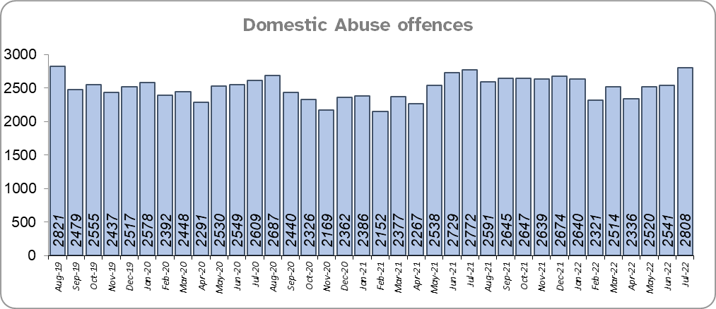
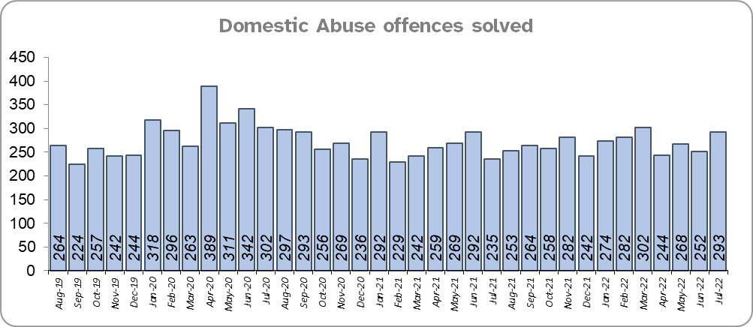
Priority 10 - Protecting vulnerable people and supporting victims of crime
Grade: Adequate
Essex experienced a 5.7% increase (1,671 more) in Domestic Abuse (DA) offences for the 12 months to July 2022 compared to the 12 months to July 2021. However, the Force recorded 170 fewer offences in the three months to July 2022 compared to the same period in 2021 (7,869 v. 8,039). Essex Police are currently investigating whether the Force are over-recording Stalking & Harassment offences, which accounts for more than a fifth (21.0%) of all Domestic Abuse offences.
Essex Police solved 1.4% (45 more) DA offences for the 12 months to July 2022 compared to the 12 months to July 2021. The Force also solved 17 more offences in the three months to July 2022 compared to the same period in 2021 (813 v 796).
There was a 3.9% increase (1,150 more) in DA offences and a 7.0% increase (209 more) in the number of DA offences solved for the 12 months to July 2022 compared to the 12 months to December 2019.
The Essex Police Domestic Abuse Problem Solving Teams (DAPST) were formed in March 2021 and are divided into a victim focused contingent (Problem-Solving officers) and an Offender Management contingent (Offender Management officers). They work alongside DAIT, who manage the most prolific DA perpetrators and the most vulnerable victims. The team has been implemented to provide a continual and sustained problem-solving approach, focusing on preventing future harm and reducing repeat victimisation.

Slide 18
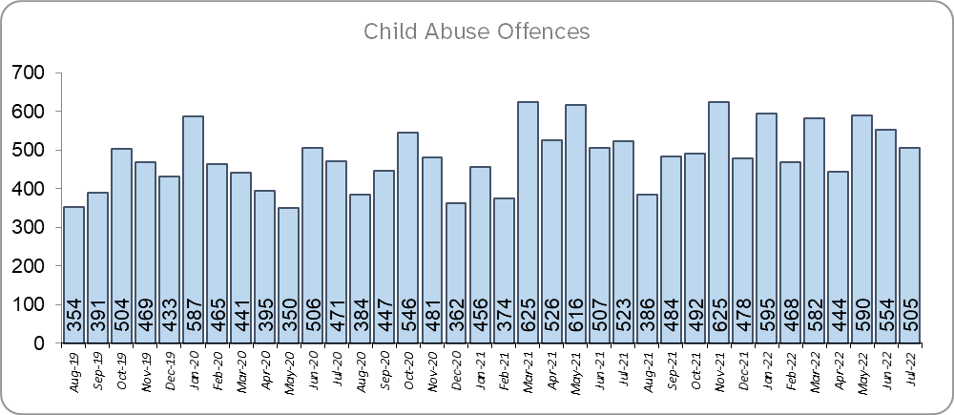
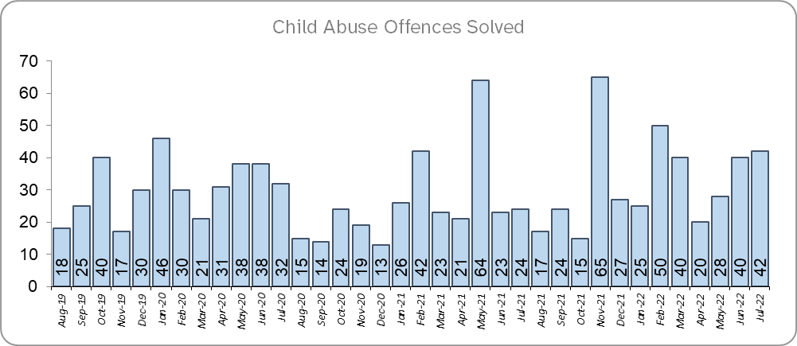
Priority 10 - Protecting vulnerable people and supporting victims of crime (cont.)
Grade: Adequate
Essex experienced a 16.1% increase (931 more) in Child Abuse offences and a 27.6% increase (85 more) in the number of these offences which were solved for the 12 months to July 2022 compared to the 12 months to July 2021.
There was a 27.9% increase (1,467 more) in Child Abuse offences and a 42.9% increase (118 more) in the number of these offences which were solved for the 12 months to July 2022 compared to the 12 months to December 2019.
Confidence that the policing response to protect children and vulnerable people (from the independent survey commissioned by Essex Police) is at 81.7% (results to the 12 months to June 2022). Compared to year ending June 2021, confidence has decreased by 7.5% points.
Due to the fact that there has been a continuing increase in the number of Child Abuse offences solved in the 12 months to July 2022 compared to the previous 12 months and the 12 months to December 2019 and an increase in the number of DA offences solved over the same time periods, a grade of Adequate is recommended.

Slide 19
Priority 11 - Staff
Grade: Adequate
There has been a slight decrease (0.1%) in the proportion of ethnic minority employees in July 2022 (268) compared to July 2021 (273); this equates to 5 fewer employees. However, in contrast there has been an increase (23.5%) compared to Dec 2019 (217); this equates to 51 additional employees.
There is a 3.5% point disparity in the proportion of ethnic minority residents in Essex*** (7.6%) compared to the proportion of ethnic minority employees in Essex Police (4.1%).
Please note:
****Ethnic minority employees as a percentage of the total workforce.
****Ethnic minority employees as a percentage of type of employee.
****Office for National Statistics Population Estimates 2019: Essex population 1,846,655, ethnic minority residents 140,641.

Slide 20
Monthly Performance Overview: Exceptions
Exceptions Overview
Violence with Injury, Other Sexual Offences and Arson experienced statistically significant increases for the month of July 2022: There were no statistically exceptional decreases.
Violence with Injury – Increase
16.8% increase (2,336 more crimes) for the 12 months to July 2022 compared to the 12 months to July 2021. There were statistically exceptional increases in three Districts (Braintree, Tendring and Basildon) and Stansted Airport in July 2022.
Other Sexual Offences – Increase
14.3% increase (447 more crimes) for the 12 months to July 2022 compared to the 12 months to July 2021. There were statistically exceptional increases in three Districts (Chelmsford, Tendring and Southend) in July 2022.
Arson – Increase
19.6% increase (202 more crimes) for the 12 months to July 2022 compared to the 12 months to July 2021. There were statistically exceptional increases in four Districts (Tendring, Rochford, Basildon and Harlow) in July 2022.

Slide 21
Monthly Performance Overview: Of Note
Memorial service to remember PC Ian Dibell GM
A special memorial service to remember and celebrate the life of PC Ian Dibell GM was held in July.
Ian was shot and killed on 9 July 2012. He was off duty and at home at the time of the incident but heroically put himself back ‘on duty’.
He was posthumously awarded the George Medal for gallantry and was the first police officer in 21 years to be given the award.
Dispatch Colchester Edition has launched
The very first edition of Colchester Dispatch, which showcases the district’s excellent work within the community, was launched. Dispatch is a weekly e-newsletter which provides an overview to our communities about what we have been doing across Essex that week, along with crime prevention advice, the latest job vacancies, information about upcoming community events, and more.
Police Officer recruitment
Essex Police have re-opened the traditional entry pathway for new police constables. Individuals can apply to become a police officer through the traditional entry pathway of the enhanced Initial Police Learning and Development Programme. The route will be suitable to those individuals who do not hold the formal qualifications currently required for the Police Constable Degree Apprenticeship route or Degree Holder Entry Programme but do have equivalent and valuable work experience.
Essex Police has been recognised as a gold standard employer by the Ministry of Defence
The Ministry of Defence Employer Recognition Scheme has awarded Essex Police with the Gold Award, which acknowledges our commitment to valuing, supporting, and developing those who have experience within the defence sector. This is the highest level to achieve, and Essex Police now becomes one of seven forces in the country to have accomplished this.
Anti-Social Behaviour Awareness Week
The week of 18-24 July saw the second annual Anti-Social Behaviour (ASB) Awareness Week. Police forces across the country are working with Resolve, the UK’s leading ASB and community safety organisation, to ensure that victims are aware of how they can report this crime, and how we can help them. In Essex, we have seen reports of anti-social behaviour fall in 2022, and we need to make sure this crime type isn’t being underreported so that we can support victims as best as we can.

Slide 22
Monthly Performance Overview: Of Note (contd.)
#SummerRoadsSafetyEssex Campaign
Our Roads Policing Unit launched the six week #SummerRoadSafetyEssex campaign, asking our communities to help us keep our strategic road network and local roads moving, and all our road users safe. The focus will allow for our partners and volunteers to support a summer of road safety including the invaluable contribution from Special Constables and Community Speed Watch volunteers. Each week will focus on a road safety issue and the supporting policing activity.
July’s themes were:
Week 1 - 18 to 24 July Drink driving
Week 2 – 25 to 31 July Two-wheel vehicle safety and vulnerability
More focus weeks are planned for August 2022.
Specials attestation ceremony
We welcomed 10 new Special Constables to the Essex Police family in a Specials attestation ceremony. Seven females and three males proudly stepped forward and vowed to protect and serve the county of Essex on a voluntary basis.
We have the second largest Special Constabulary in the country with more than 450 serving officers who dedicate at least 16 hours a month to policing alongside their work and family commitments.
Recognising our call handlers
We’ve welcomed 19 call handlers into our Essex Police Family. Last year, call handlers in our Force Control Room answered an average of 909 emergency calls, 733 non-emergency calls and 64 Live Chats on our website each day.

Slide 23
2021-2024 Police and Crime Plan Performance Indicators
Table 1
Please view above table with the explanations and caveats detailed on page 25.

Slide 24
2021-2024 Police and Crime Plan Performance Indicators (cont.)
Table 2
Please view above table with the explanations and caveats detailed on page 25.

Slide 25
End Notes
¹ Question from the independent survey commissioned by Essex Police. Results are for the period 12 months June 2022 versus the 12 months to June 2021.
² The confidence interval is the range +/- within which the survey result will lie. This is mainly influenced by the number of people answering the survey. The more people that answer the survey, the smaller the interval range.
³ Crime Severity Score measures ‘relative harm’ of crimes by taking into account both the volume and the severity of offences, and by weighting offences differently. National data for the 12 months to May 2022 have been used in order that comparisons can be made to Essex’s Most Similar Group of Forces (MSG).
⁴ The methodology used for identifying these investigations as drug related is subjective and based on the circumstances presented. These figures will include investigations where the victim or the suspect are involved Drug Use, Possession or Selling.
⁵ ‘Killed or Seriously Injured’ (KSI) refers to all people killed or seriously injured on Essex’s roads, regardless of whether any criminal offences were committed. ‘Causing Death/Serious Injury by Dangerous/Inconsiderate Driving’ offences (detailed on p.8) refers to the number of crimes of this type.
⁶ In 2019, the definition as to what constituted “use” of a mobile phone in relation to driver-related mobile phone offences was subject to a legal challenge. This resulted in a ruling, which held that while “use” included accessing the interactive functions of the mobile phone (such as making calls, sending messages or using the internet), it did not extend to solely accessing the device’s internal functions (such as making use of the camera). Fewer mobile phone offences were subsequently prosecuted from this point. In 2021 the government announced that the law was to be changed making it illegal to “hold” a phone or sat nav when driving or riding a motorcycle. This law was finally passed on 25th March 2022.
⁷ Solved outcomes are crimes that result in: charge or summons, caution, crimes taken into consideration, fixed penalty notice, cannabis warning or community resolution.
⁸ This is the number of theft offences in which dogs were stolen, and not necessarily the number of dogs which were stolen.
⁹ Ethnic minority employees as a percentage of the total workforce.

Slide 26
Crime Tree Data – Rolling 12 Months to July
Table 3

Slide 27
Crime Tree Data – Rolling 12 Months to July (cont.)
Table 4

Slide 28
Crime Tree Data - Rolling 12 months to July Violence against the Person and Sexual offences and outcomes (by crime type) split by gender
Table 5
Please note: the breakdown of data for the previous 12 months within these tables may not tally with the totals on page 26 as gender data is rerun on a monthly basis.

