Slide 1
Police and Crime Plan 2021-2024
Monthly Performance Update
March 2022
National and MSG positions are to 31 January 2022 (Essex Police data are to 31 March 2022).
Version 1.3
Produced April 2022
Performance Analysis Unit, Essex Police
Sensitivity: Official

Slide 2
Executive Summary
The Police and Crime Plan 2021-2024 was introduced in April 2021 with new measures that reflect the Police, Fire and Crime Commissioner (PFCC) for Essex’s strategic commitment to targeted prevention and early intervention.
There have been no changes to the recommended grades since the last report. Six of the eleven PFCC Priorities have been given a recommended grade of ‘Adequate’. Five have been given a recommended grade of ‘Requires Improvement’: 4 (Improving safety on our roads), 6 (Improving our service to support victims of crime), 7 (Violence against women and girls), 9 (Business Crime, Fraud and Cyber Crime) and 10 (Protecting vulnerable people and supporting victims of crime). It is of note that in order to remain in line with the HMICFRS 5 grade structure, a new grade of “Adequate” was introduced into these reports in February 2022 (data to 31 January 2022); the grades of “Outstanding”, “Good”, “Requires Improvement” and “Inadequate” remain.
Confidence (from the independent survey commissioned by Essex Police) is at 80.1% (results to the 12 months to December 2021). Compared to year ending December 2020, confidence in the local police has increased by 3.8% points.
All Crime increased by 11.7% for the 12 months to March 2022 compared to the 12 months to March 2021; this equates to 17,383 more offences. This increase has been primarily influenced by the Government’s easing of restrictions on gathering and movement in relation to COVID-19. The Force also recorded 3,844 more offences in March 2022 compared to April 2020, when the Government implemented the first lockdown; this equates to 36.4% more offences.
Each change in the rules relating to social distancing affected the number of All Crime offences reported to Essex Police.
There was a 1.0% decrease in All Crime in the 12 months to March 2022 compared to the 12 months to March 2020. This equates to 1,748 fewer offences.
There was a 30.6% increase (198 more) in the number of those Killed or Seriously Injured (KSI) in Essex for the 12 months to March 2022 compared to the 12 months to March 2021.
Essex experienced a 13.8% increase (5,798) in the number of repeat victims for the 12 months to March 2022 compared to the 12 months to March 2021.
Where gender is detailed, over half of victims of Violence Against the Person (VAP) offences identify as female (56.2%). VAP offences committed against females increased by 10.0% (3,601 more), and there was a 37.1% increase (1,382 more) in the number of sexual offences against females in the 12 months to March 2022 compared to the 12 months to March 2021. This compares to a 15.8% rise (4,234 more) in VAP offences committed against males and a 43.2% rise (258 more) in sexual offences against males in the same period.
The number of solved sexual offences committed against females increased by 2.6% (7 more) in the 12 months to March 2022 compared to the 12 months to March 2021. This compares to an increase of 2.4% (1 more) in sexual offences against males solved in the same period.
There has been a slight increase (0.2%) in the proportion of ethnic minority employees in March 2022 (286) compared to March 2021 (270). This equates to 16 additional employees.
There were no statistical outliers in the month of March 2022.

Slide 3
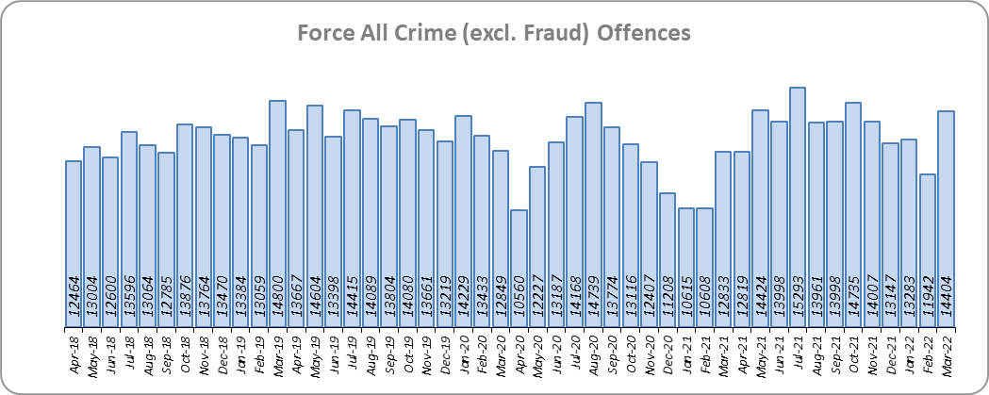
Priority 1 – Further investment in Crime Prevention
Grade: Adequate
Essex experienced a 11.7% increase in All Crime (17,383 more offences) for the 12 months to March 2022 compared to the 12 months to March 2021. This increase in crime has been primarily influenced by the Government’s easing of restrictions on movement and gathering in relation to COVID-19. Essex is seventh in its Most Similar Group of forces (MSG) for crime per 1,000 population.
There was a 1.0% decrease in All Crime in the 12 months to March 2022 compared to the 12 months to March 2020; this equates to 1,748 fewer offences.
Essex Police recorded a daily average of 465 crimes in March 2022, compared to an average of 427 crimes recorded in February 2022. This equates to an increase of 8.9%, or an average of 38 more crimes recorded per day.
14,404 offences were recorded in the month of March 2022, an increase of 12.2% (1,571 offences) compared to the month of March 2021 (12,833 offences). There was a 12.1% increase in offences the month of March 2022 compared to the month of March 2020 (12,849 offences).

Slide 4
Priority 1 - Further investment in Crime Prevention (cont.)
Grade: Adequate
Confidence (from the independent survey commissioned by Essex Police) is at 80.1% (results to the 12 months to December 2021). Compared to year ending December 2020, confidence in the local police has increased (an improvement of 3.8% points).
The All Crime Harm (Crime Severity) Score* (14.3) places Essex seventh in its MSG.
Although confidence in policing in Essex has improved, Essex is seventh in its Most Similar Group of forces (MSG) for crime per 1,000 population, and the All Crime Harm (Crime Severity) Score is above the MSG average. A grade of Adequate is therefore recommended.
Please note:
* Crime Severity Scores (as calculated by the Office for National Statistics) measure the ‘relative harm’ of crimes by taking into account both their volume and their severity. As national data are only available to January 2022, scores for the 12 months to January for the preceding three years have been included.

Slide 5
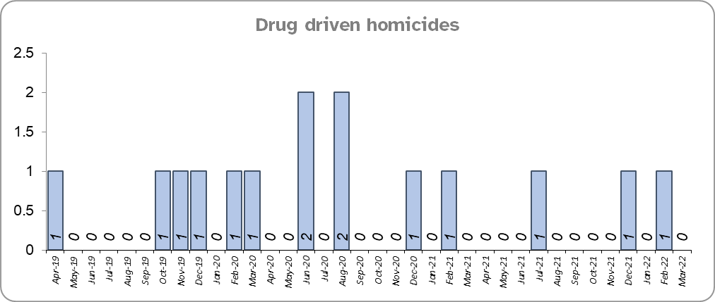
Priority 2 – Reducing Drug Driven Violence
Grade: Adequate
Essex experienced three fewer drug related homicides for the 12 months to March 2022 compared to the 12 months to March 2021.
There were three fewer drug related homicides for the 12 months to March 2022 compared to the 12 months to March 2020.
Confidence that Essex Police and partners are dealing with drug crime (from the independent survey commissioned by Essex Police) is at 61.3% for the period September 2021 to December 2021.
Due to the low level of data relating to drug related homicides, and as confidence data are for one quarter only, a grade of Adequate is recommended.
Please note:
* The methodology used for identifying investigations as being drug-related is subjective (qualitative data) and based on the circumstances presented. These figures include investigations where the victim and/or suspect are suspected of being involved in Drug Use, Possession or Selling.
** The confidence question was added to the internal survey in September 2021. A year on year comparison is therefore not available.

Slide 6
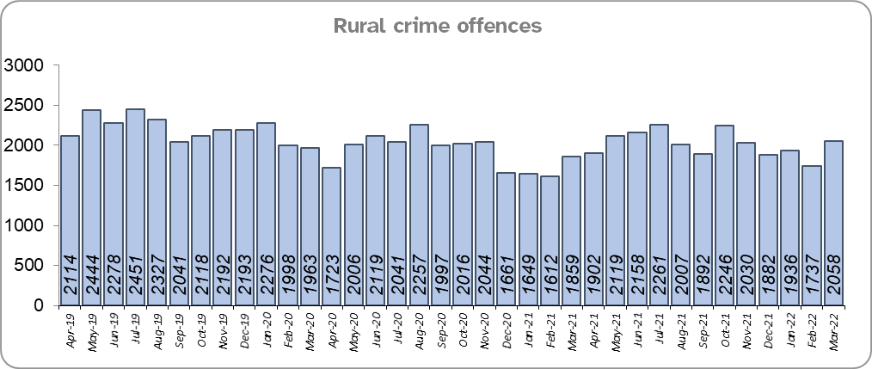
Priority 3 – Protect rural and isolated areas
Grade: Adequate
Essex experienced a 5.4% increase in rural crime (1,244 more offences) for the 12 months to March 2022 compared to the 12 months to March 2021 (by way of context, All Crime in Essex increased by 11.7% in the same period). Rural Crime decreased by 8.2% (2,167 fewer offences) in the 12 months to March 2022 compared to the 12 months to March 2020, (All Crime in Essex decreased by 1.0% in the same period).
The rural crime Harm (Crime Severity) Score* was 8.8 for the 12 months to March 2022, a rise of 1.7 when compared to the 12 months to March 2021 (by way of context, the All Crime Harm Score in Essex was 14.3, an increase of 2.3 for the same period).
Confidence in rural policing (from the independent survey commissioned by Essex Police) is at 82.9% (results to the 12 months to December 2021). Compared to year ending December 2020, confidence in rural policing has increased (an improvement of 4.5% points) and is higher than the Essex average of 80.1%.
While confidence in the local police has increased, a grade of Adequate is recommended due to the increase in rural crime offences.
Please note:
* Crime Severity Scores (as calculated by the Office for National Statistics) measure the ‘relative harm’ of crimes by taking into account both their volume and their severity. National data are not available for crimes committed in rural areas, so it is not possible to measure against an MSG average; due to this, Essex Police data (to March 2022) have been used rather than national data (which are to January 2022).

Slide 7
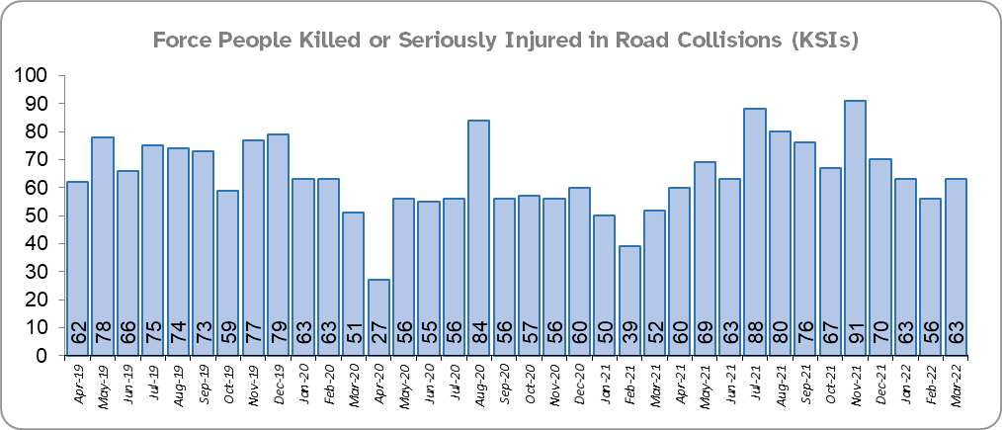
Priority 4 - Improving safety on our roads
Grade: Requires Improvement
There was a 30.6% increase (198 more) in the number of those Killed or Seriously Injured (KSI) in Essex for the 12 months to March 2022 compared to the 12 months to March 2021. There was an increased number of collisions, particularly those resulting in serious injuries (31.0%), in the same period. The number of KSIs also increased by 26 in the 12 months to March 2022 compared to the 12 months to March 2020.
Essex is sixth in its Most Similar Group (MSG) of forces for casualties per 100 million vehicle kilometres (results to December 2020) and is slightly higher than the MSG average. However, due to the fact that more recent national figures have not been released, the current position cannot be determined (the date of the next national release has not yet been confirmed).
Please note that most KSIs do not necessarily result in criminal offences (such as death or serious injury caused by dangerous driving) being recorded.

Slide 8
Priority 4 - Improving safety on our roads (cont.)
Grade: Requires Improvement
There was a 25.7% decrease (998 fewer offences) in drink/drug driving offences for the 12 months to March 2022 compared to the 12 months to March 2021; of these offences, there was a 25.9% increase (317 more offences) in drink driving but a 56.8% decrease (1,286 fewer offences) in drug driving. There was also a 21.9% decrease (809 fewer offences) in drink/drug driving offences for the 12 months to March 2022 compared to the 12 months to March 2020; of these offences, there was a 5.5% increase (80 more offences) in drink driving and a 46.3% decrease (844 fewer offences) in drug driving. All of these offence types are primarily driven by police proactivity in relation to road safety.
There was a 7.6% decrease (37 fewer offences) in the number of driving related mobile phone offences recorded for the 12 months to March 2022 compared to the 12 months to March 2021.*
Confidence in Essex Police and organisations they work with policing the roads (from the independent survey commissioned by Essex Police) is at 63.9% (results to the 12 months to December 2021). Compared to year ending December 2020, confidence in the local police and organisations they work with has decreased by 11.6% points.
Due to the increase in KSIs in the past 12 months and the significant decrease in public confidence a grade of Requires Improvement is recommended.
Please note:
* In 2019, the definition as to what constituted “use” of a mobile phone in relation to driver-related mobile phone offences was subject to a legal challenge. This resulted in a ruling, which held that while “use” included accessing the interactive functions of the mobile phone (such as making calls, sending messages or using the internet), it did not extend to solely accessing the device’s internal functions (such as making use of the camera). Fewer mobile phone offences were subsequently prosecuted from this point. In 2021 the government announced that the law was to be changed making it illegal to “hold” a phone or sat nav when driving or riding a motorcycle. This law was finally passed on 25th March 2022.

Slide 9
Priority 5 – Encouraging Volunteers and Community Support
Grade: Adequate
Confidence that there are good opportunities for volunteers to assist policing and reduce crime in Essex (from the independent survey commissioned by Essex Police) is at 61.6% for the period September 2021 to December 2021.
Essex Watch Liaison Officers continue to work with Neighbourhood Watch to offer crime and fraud prevention advice, and, in the last quarter, supported 23 community engagement events which involved the seven main Watch Groups.**
As confidence data are for one quarter only (and there is no comparison), a grade of Adequate is recommended.
Please note:
* The confidence question was added to the internal survey in September 2021 so year on year comparison is not available.
** This is the first time these data have been produced so year on year comparison is not available.

Slide 10
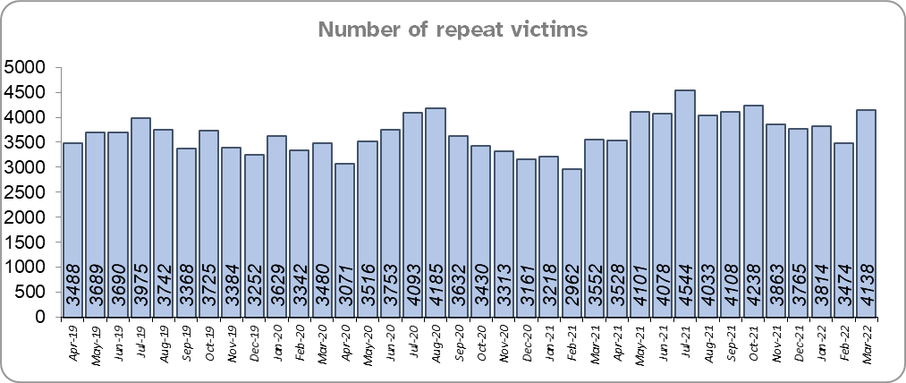
Priority 6 – Improving our services to support victims of crime
Grade: Requires Improvement
Essex experienced a 13.8% increase (5,798 more) in the number of repeat victims for the 12 months to March 2022 compared to the 12 months to March 2021.
There was an 11.5% increase (4,920 more) in the number of repeat victims in the 12 months to March 2022 compared to the 12 months to March 2020.
Confidence among victims (from the independent survey commissioned by Essex Police) is at 61.0% (results to the 12 months to December 2021). This is 21.1% points lower than confidence of non-victims for the same period (82.1%).
Compared to year ending December 2020, confidence among victims in the local police has remained stable, and among non-victims is increasing.
Due to the fact that the number of repeat victims has increased, a grade of Requires Improvement is recommended.
Please note:
* Repeat victims will have reported more than one crime to Essex Police in the previous year.

Slide 11
Priority 7 – Violence against women and girls
Grade: Requires Improvement
Where gender is detailed, over half of victims of Violence Against the Person (VAP) offences identified as female* (56.2%). 2.9% of offences (2,082 offences) had no gender recorded**.
Essex experienced a 10.0% increase (3,601 more) in the number of VAP offences committed against females in the 12 months to March 2022 compared to the 12 months to March 2021; this compares to a 15.8% increase (4,234 more) in the number of VAP offences committed against males in the same period. There was a 12.2% increase (4,326 more) in the number of VAP offences committed against females in the 12 months to March 2022 compared to the 12 months to March 2020; and the same increase of 12.2% (3,362 more) in the number of VAP offences committed against males in the same period.
There was a 37.1% increase (1,382 more) in the number of Sexual Offences committed against females and a 2.6% increase (7 more) in the number of these offences solved in the 12 months to March 2022 compared to the 12 months to March 2021. By contrast, there was a 43.2% increase (258 more) in the number of Sexual Offences committed against males and a 2.4% increase (1 more) in the number of these offences solved in the same periods.
A 27.5% increase (1,100 more) was observed in the number of Sexual Offences committed against females and a 10.6% increase (27 more) in the number of sexual offences against females solved in the 12 months to March 2022 compared to the 12 months to March 2020. By contrast, there was a 32.8% increase (211 more) in the number of Sexual Offences committed against males and an 8.7% decrease (4 fewer) in the number of sexual offences against males solved in the same periods.
41.2% of females feel safe walking alone in their area after dark (from the independent survey commissioned by Essex Police) for the period September 2021 to December 2021 compared to 74.1% of males.
The number of VAP offences with female victims has increased in each of the past six year-on-year comparisons, as has the number of Sexual Offences committed against females. Due to the deterioration in these measures, a grade of Requires Improvement is recommended.
Please note:
**** Officer defined gender.
**** Not Recorded also includes records where gender is unknown or unspecified.
**** Please see page 23 for table of violence against the person and sexual offences and outcomes (by crime type) split by gender.
**** The confidence question was added to the internal survey in September 2021 so year on year comparison is not available.

Slide 12
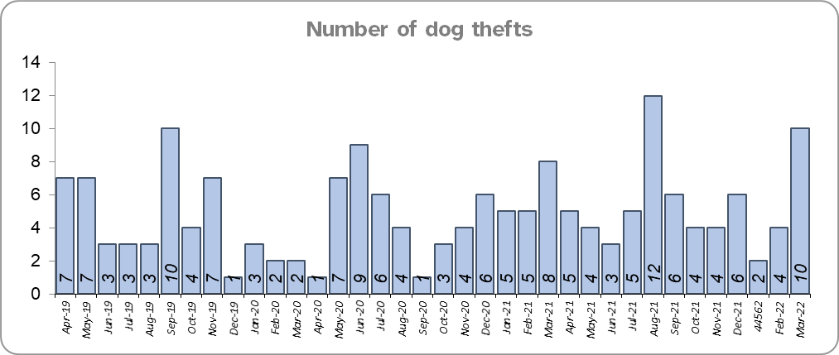
Priority 8 – Dog theft
Grade: Adequate
Essex experienced 6 more dog thefts for the 12 months to March 2022 compared to the 12 months to March 2021. There were 13 more dog thefts in the 12 months to March 2022 compared to the 12 months to March 2020.
Confidence as to how Essex Police and the organisations they work with are dealing with dog theft (from the independent survey commissioned by Essex Police) is at 63.6% for the period September 2021 to December 2021.
As confidence data are for one quarter only, a grade of Adequate is recommended.
Please note:
* This is number of thefts in which dogs were stolen, and not quantity of dogs stolen in each theft. Data are based on theft offence crimes and robbery offence crimes where the ‘property code’ is ‘pet animal – dog’ and the ‘property status’ is ‘stolen’ and/or ‘stolen/recovered’.
** The confidence question was added to the internal survey in September 2021 so year on year comparison is not available.

Slide 13
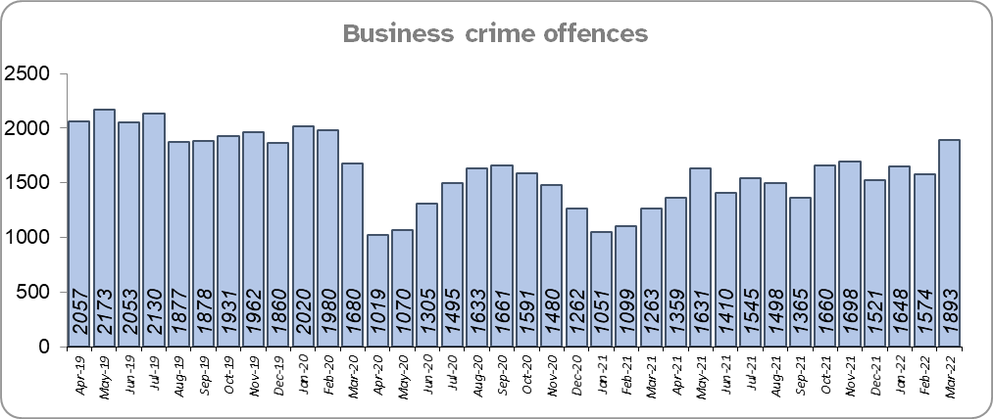
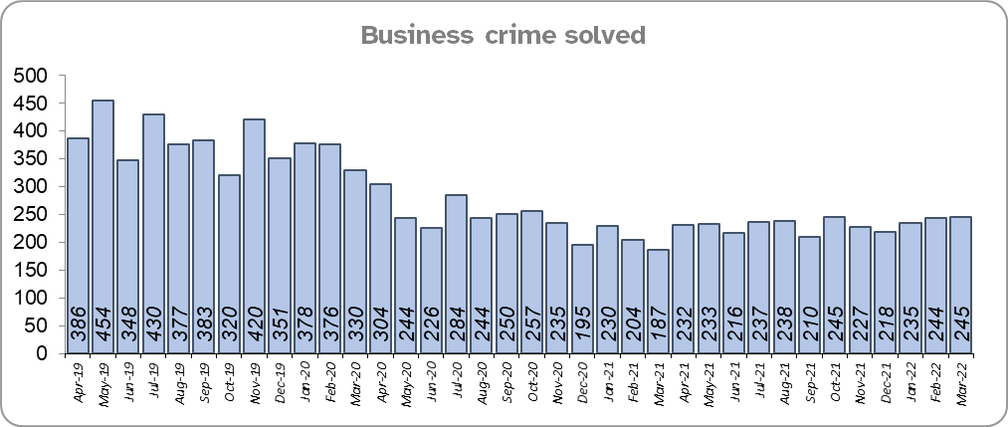
Priority 9 – Business Crime, Fraud and Cyber Crime
Grade: Requires Improvement
Essex experienced an 18.0% increase (2,873 more) in the number of Business Crime offences and a 2.8% decrease (80 fewer) in the number of these offences which were solved in the 12 months to March 2022 compared to the 12 months to March 2021.
There was a 20.3% decrease (4,799 fewer) in the number of Business Crime offences and a 38.9% decrease (1,773 fewer) in the number of Business Crimes solved in the 12 months to March 2022 compared to the 12 months to March 2020.
Confidence as to whether the police response to tackling cyber crime is improving (from the independent survey commissioned by Essex Police) is at 51.1% for the period September 2021 to December 2021.
Due to the decrease in the number of Business Crime offences that are solved, a grade of Requires Improvement is recommended.
Please note:
* The confidence question was added to the internal survey in September 2021 so year on year comparison is not available.

Slide 14
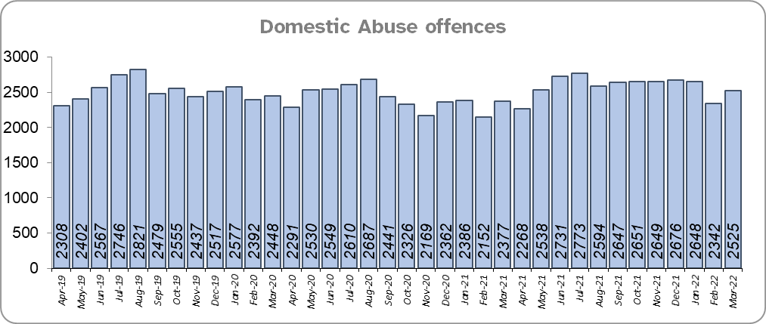
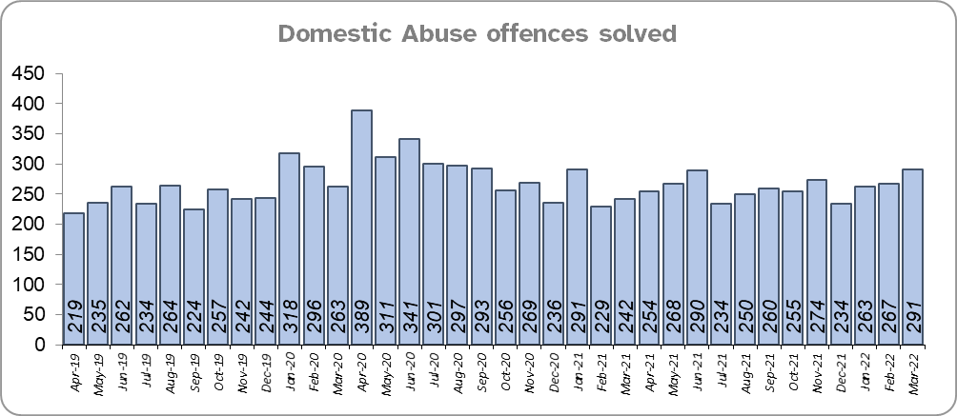
Priority 10 - Protecting vulnerable people and supporting victims of crime
Grade: Requires Improvement
Essex experienced a 6.7% increase (1,943 more) in Domestic Abuse (DA) offences and a 9.1% decrease (315 fewer) in the number of DA offences solved for the 12 months to March 2022 compared to the 12 months to March 2021.
There was an 11.1% increase (3,093 more) in DA offences and a 2.7% increase (82 more) in the number of DA offences solved for the 12 months to March 2022 compared to the 12 months to March 2020.

Slide 15
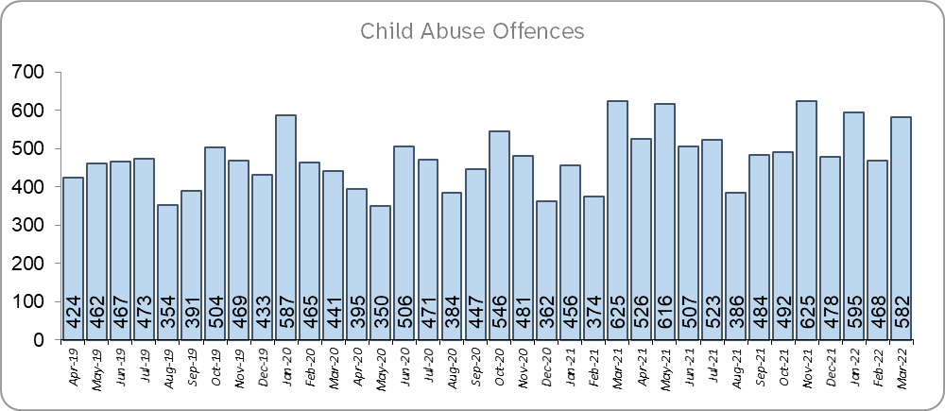
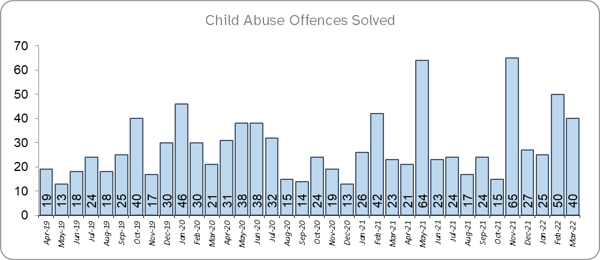
Priority 10 (cont.) - Protecting vulnerable people and supporting victims of crime
Grade: Requires Improvement
Essex experienced a 16.4% increase (885 more) in Child Abuse offences and a 25.4% increase (80 more) in the number of these offences which were solved for the 12 months to March 2022 compared to the 12 months to March 2021.
There was a 14.8% increase (812 more) in Child Abuse offences and a 31.2% increase (94 more) in the number of these offences which were solved for the 12 months to March 2022 compared to the 12 months to March 2020.
Confidence that the policing response to protect children and vulnerable people is improving (from the independent survey commissioned by Essex Police) is at 86.3% (results to the 12 months to December 2021). Compared to year ending December 2020, confidence has decreased by 3.4% points.
Due to the fact that confidence levels and the number of domestic abuse offences solved have decreased, a grade of Requires Improvement is recommended.

Slide 16
Priority 11 - Staff
Grade: Adequate
There has been a slight increase (0.2%) in the proportion of ethnic minority employees in March 2022 (286) compared to March 2021 (270); this equates to 16 additional employees. There has also been an increase (0.7%) compared to March 2020 (231); this equate to 55 additional employees.
There is a disparity of 3.2% between the proportion of ethnic minority residents in Essex*** (7.6%) and the proportion of ethnic minority employees in Essex Police (4.4%).
Please note:
****Ethnic minority employees as a percentage of the total workforce.
****Ethnic minority employees as a percentage of type of employee.
****Office for National Statistics Population Estimates 2019: Essex population 1,846,655, ethnic minority residents 140,641.

Slide 17
Monthly Performance Overview: Of Note
Recognition from the Essex High Sheriff
Four Essex Police teams have been recognised for their outstanding work by the Essex High Sheriff. The teams were recognised for their hard work, dedication and determination striving tirelessly to dismantle drug gangs, helping victims of modern slavery and domestic abuse, and protecting and supporting vulnerable people.
The whole of Essex Police was also recognised for working tirelessly throughout the COVID pandemic upholding law and order and keeping the people of Essex safe during extremely challenging times.
County Lines week of action
As part of a national week of action aimed at disrupting County Lines drug gangs in Essex, our specialist officers made 49 arrests across the county and into London and Kent, seizing 5 weapons, £96,509 in cash, 300g of loose Class A drugs, and more than 1,100 prepared wraps of cocaine. From 7 March to 13 March, 8 County Lines have been disrupted and 11 people have been charged.
In addition, our officers work closely with partners such as local authorities and the Essex Violence and Vulnerability Unit to ensure those people who may appear to be perpetrators, but are in fact victims in their own right, are safeguarded and steered away from crime and drugs.

Slide 18
2021-2024 Police and Crime Plan Performance Indicators
Table 1
Please view above table with the explanations and caveats detailed on page 20.

Slide 19
2021-2024 Police and Crime Plan Performance Indicators (cont.)
Table 2
Please view above table with the explanations and caveats detailed on page 20.

Slide 20
End Notes
¹ Question from the independent survey commissioned by Essex Police. Results are for the period 12 months December 2021 versus the 12 months to December 2020.
² The confidence interval is the range +/- within which the survey result will lie. This is mainly influenced by the number of people answering the survey. The more people that answer the survey, the smaller the interval range.
³ Crime Severity Score measures ‘relative harm’ of crimes by taking into account both the volume and the severity of offences, and by weighting offences differently. National data for the 12 months to January 2022 have been used in order that comparisons can be made to Essex’s Most Similar Group of Forces (MSG).
⁴ The methodology used for identifying these investigations as drug related is subjective and based on the circumstances presented. These figures will include investigations where the victim or the suspect are involved Drug Use, Possession or Selling.
⁵ ‘Killed or Seriously Injured’ (KSI) refers to all people killed or seriously injured on Essex’s roads, regardless of whether any criminal offences were committed. ‘Causing Death/Serious Injury by Dangerous/Inconsiderate Driving’ offences (detailed on p.7) refers to the number of crimes of this type.
⁶ In 2019, the definition as to what constituted “use” of a mobile phone in relation to driver-related mobile phone offences was subject to a legal challenge. This resulted in a ruling, which held that while “use” included accessing the interactive functions of the mobile phone (such as making calls, sending messages or using the internet), it did not extend to solely accessing the device’s internal functions (such as making use of the camera). Fewer mobile phone offences were subsequently prosecuted from this point. In 2021, however, the law was changed: it is now illegal to “hold” a phone or sat nav when driving or riding a motorcycle.
⁷ Solved outcomes are crimes that result in: charge or summons, caution, crimes taken into consideration, fixed penalty notice, cannabis warning or community resolution.
⁸ This is the number of theft offences in which dogs were stolen, and not necessarily the number of dogs which were stolen.
⁹ Ethnic minority employees as a percentage of the total workforce.

Slide 21
Crime Tree Data – Rolling 12 Months to March
Table 3

Slide 22
Crime Tree Data – Rolling 12 Months to March
Table 4

Slide 23
Crime Tree Data - Rolling 12 months to March Violence against the Person and Sexual offences and outcomes (by crime type) split by gender
Table 5
Please note: the breakdown of data within these tables may not tally with the totals on page 21 as gender data is rerun on a monthly basis.

