Slide 1
Police and Crime Plan 2021-2024
Monthly Performance Update
February 2022
National and MSG positions are to 31 December 2021 (Essex Police data are to 28 February 2022).
Version 1.3
Produced March 2022
Performance Analysis Unit, Essex Police
Sensitivity: Official

Slide 2
Executive Summary
The Police and Crime Plan 2021-2024 was introduced in April 2021¹ with new measures that reflect the Police, Fire and Crime Commissioner (PFCC) for Essex’s strategic commitment to targeted prevention and early intervention.
Six of the eleven PFCC Priorities have been given a recommended grade of ‘Adequate’. Five of the eleven PFCC priorities have been given a recommended grade of ‘Requires Improvement’: 4 (Improving safety on our roads), 6 (Improving our service to support victims of crime), 7 (Violence against women and girls), 9 (Business Crime, Fraud and Cyber Crime) and 10 (Protecting vulnerable people and supporting victims of crime). It is of note that in order to remain in line with the HMICFRS 5 grade structure, a new grade of “Adequate” was introduced into these reports in February 2022 (data to 31 January 2022); the grades of “Outstanding”, “Good”, “Requires Improvement” and “Inadequate” remain.
Confidence (from the independent survey commissioned by Essex Police) is at 80.1% (results to the 12 months to December 2021). Compared to year ending December 2020, confidence in the local police has increased by 3.8% points.
All Crime increased by 10.2% for the 12 months to February 2022 compared to the 12 months to February 2021; this equates to 15,060 more offences. This increase has been primarily influenced by the Government’s restrictions on gathering and movement in relation to COVID-19. The Force also recorded 1,382 more offences in February 2022 compared to April 2020, when the Government implemented the first lockdown; this equates to 13.1% more offences.
Each change in the rules relating to social distancing has affected the number of All Crime offences reported to Essex Police.
There was a 3.6% decrease in All Crime in the 12 months to February 2022 compared to the 12 months to February 2020. This equates to 6,085 fewer offences.
There was a 28.6% increase (185 more) in the number of those Killed or Seriously Injured (KSI) in Essex for the 12 months to February 2022 compared to the 12 months to February 2021.
Essex experienced a 12.4% increase (5,179) in the number of repeat victims for the 12 months to February 2022 compared to the 12 months to February 2021.
Where gender is detailed, over half of victims of Violence Against the Person (VAP) offences identify as female (56.3%). VAP offences committed against females increased by 10.1% (3,632 more), and there was a 38.9% increase (1,413 more) in the number of sexual offences against females in the 12 months to February 2022 compared to the 12 months to February 2021. This compares to a 13.7% rise (3,690 more) in VAP offences committed against males and a 44.0% rise (257 more) in sexual offences against males in the same period.
The number of sexual offences against females solved increased by 3.7% (10 more) in the 12 months to February 2022 compared to the 12 months to February 2021. This compares to a rise of 9.8% (4 more) in sexual offences against males solved in the same period.
There has been a slight increase (0.2%) in the proportion of ethnic minority employees in February 2022 (289) compared to February 2021 (266). This equates to 23 additional employees.
There were no statistical outliers in the month of February 2022.
¹ Data for the period April 2021 to February 2022 can be seen on pages 18 and 19.

Slide 3
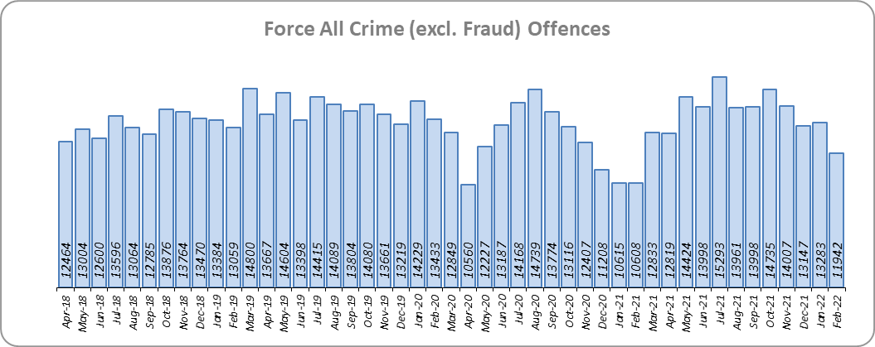
Priority 1 – Further investment in Crime Prevention
Grade: Adequate
Essex experienced a 10.2% increase in All Crime (15,060 more offences) for the 12 months to February 2022 compared to the 12 months to February 2021. This increase in crime has been primarily influenced by the Government’s restrictions on gathering and movement in relation to COVID-19. Essex is eighth in its Most Similar Group of forces (MSG) for crime per 1,000 population.
There was a 3.6% decrease in All Crime in the 12 months to February 2022 compared to the 12 months to February 2020; this equates to 6,085 fewer offences.
Essex Police recorded a daily average of 427 crimes in February 2022, compared with an average of 428 crimes in January 2022. This equates to a decrease of 0.5%, or an average of 1 fewer crime recorded per day.
11,942 offences were recorded in the month of February 2022, an increase of 12.6% (1,334 offences) compared to the month of February 2021 (10,608 offences). There was an 11.1% decrease in offences the month of February 2022 compared to the month of February 2020 (13,433 offences).

Slide 4
Priority 1 - Further investment in Crime Prevention
Grade: Adequate
Confidence (from the independent survey commissioned by Essex Police) is at 80.1% (results to the 12 months to December 2021). Compared to year ending December 2020, confidence in the local police has increased (an improvement of 3.8% points).
The All Crime Harm (Crime Severity) Score* (14.1) places Essex seventh in its MSG.
Although confidence in policing in Essex has improved, Essex is eighth in its Most Similar Group of forces (MSG) for crime per 1,000 population, and the All Crime Harm (Crime Severity) Score is above the MSG average. A grade of Adequate is therefore recommended.
Please note:
* Crime Severity Scores (as calculated by the Office for National Statistics) measure the ‘relative harm’ of crimes by taking into account both their volume and their severity. As national data are only available to December 2021, scores for the 12 months to December for the preceding three years have been included.

Slide 5
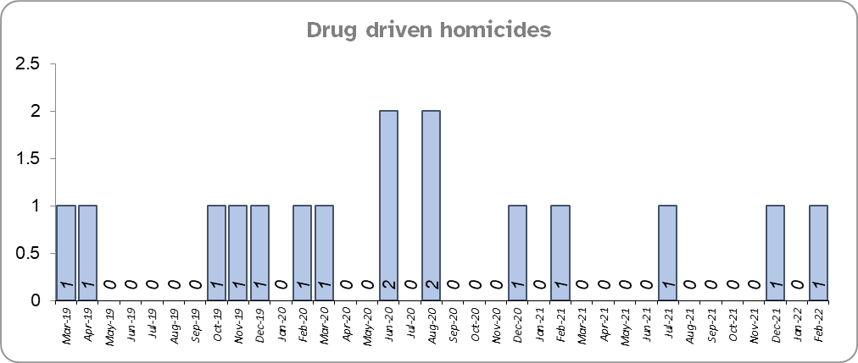
Priority 2 – Reducing Drug Driven Violence
Grade: Adequate
Essex experienced four fewer drug related homicides for the 12 months to February 2022 compared to the 12 months to February 2021.
There were three fewer drug related homicides for the 12 months to February 2022 compared to the 12 months to February 2020.
Confidence that Essex Police and partners are dealing with drug crime (from the independent survey commissioned by Essex Police) is at 61.3% for the period September 2021 to December 2021.
Due to the low level of data relating to drug related homicides, and as confidence data are for one quarter only, a grade of Adequate is recommended.
Please note:
* The methodology used for identifying these investigations as drug related is subjective (qualitative data) and based on the circumstances presented. These figures will include investigations where the victim and/or suspect are suspected of being involved in Drug Use, Possession or Selling.
** The confidence question was added to the internal survey in September 2021. A year on year comparison is therefore not available.

Slide 6
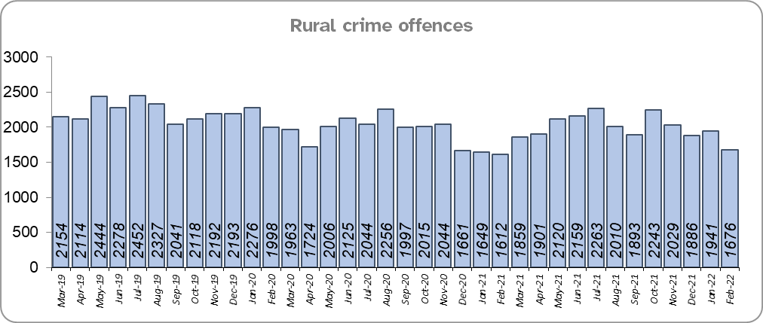
Priority 3 – Protect rural and isolated areas
Grade: Adequate
Essex experienced a 3.8% increase in rural crime (884 more offences) for the 12 months to February 2022 compared to the 12 months to February 2021 (by way of context, All Crime in Essex increased by 10.2% in the same period). Rural Crime decreased by 9.8% (2,607 fewer offences) in the 12 months to February 2022 compared to the 12 months to February 2020, however (All Crime in Essex decreased by 3.6% in the same period).
The rural crime Harm (Crime Severity) Score* was 8.7 for the 12 months to February 2022, a rise of 1.4 when compared to the 12 months to February 2021 (by way of contrast, the All Crime Harm Score in Essex was 14.1, an increase of 1.7 for the same period).
Confidence in rural policing (from the independent survey commissioned by Essex Police) is at 82.9% (results to the 12 months to December 2021). Compared to year ending December 2020, confidence in the local police has increased (an improvement of 4.5% points) and is higher than the Essex average of 80.1%.
While confidence in the local police has increased, due to the number of rural crime offences increasing, a grade of Adequate is recommended.
Please note:
* Crime Severity Scores (as calculated by the Office for National Statistics) measure the ‘relative harm’ of crimes by taking into account both their volume and their severity. National data are not available for crimes committed in rural areas, so it is not possible to measure against an MSG average; due to this, Essex Police data (to February 2022) have been used rather than national data (which are to December 2021).

Slide 7
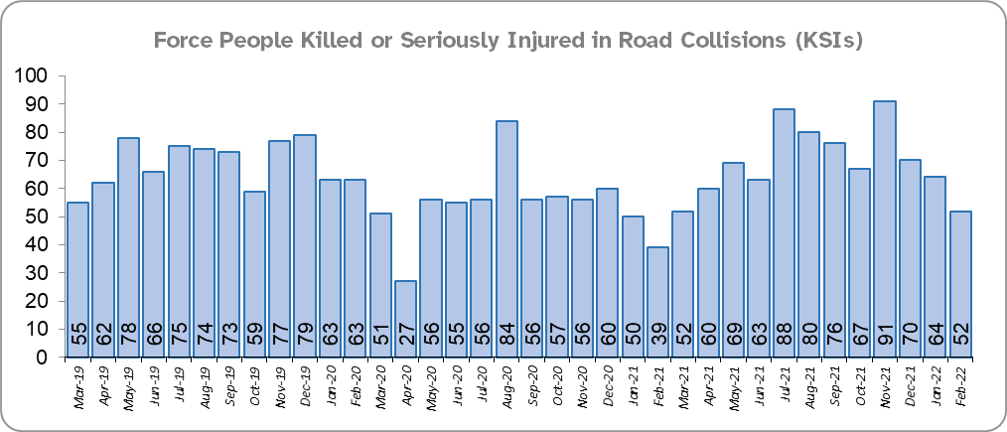
Priority 4 - Improving safety on our roads
Grade: Requires Improvement
There was a 28.6% increase (185 more) in the number of those Killed or Seriously Injured (KSI) in Essex for the 12 months to February 2022 compared to the 12 months to February 2021. There was an increased number of collisions, and particularly serious injuries (29.6%), in the same period. The number of KSIs also increased by eight in the 12 months to February 2022 compared to the 12 months to February 2020.
Essex is sixth in its Most Similar Group (MSG) of forces for casualties per 100 million vehicle kilometres (results to December 2020) and is slightly higher than the MSG average. However, due to the fact that more recent national figures have not been released, the current position cannot be determined (the date of the next national release has not yet been confirmed).
Please note that most KSIs do not necessarily result in criminal offences (such as death or serious injury caused by dangerous driving) being recorded.

Slide 8
Priority 4 - Improving safety on our roads (cont.)
Grade: Requires Improvement
There was a 28.4% decrease (1,128 fewer offences) in drink/drug driving offences for the 12 months to February 2022 compared to the 12 months to February 2021; of these offences, there was a 17.6% increase (221 more offences) in drink driving and a 56.3% decrease (1,297 fewer offences) in drug driving. This compares with a 23.7% decrease (879 fewer offences) in drink/drug driving offences for the 12 months to February 2022 compared to the 12 months to February 2020; of these offences, there was a 0.1% decrease (2 fewer offences) in drink driving and a 45.0% decrease (823 fewer offences) in drug driving. All of these offence types are primarily driven by police proactivity in relation to road safety.
There was an 8.5% decrease (41 fewer offences) in the number of driving related mobile phone offences recorded for the 12 months to February 2022 compared to the 12 months to February 2021.*
Confidence in Essex Police and organisations they work with policing the roads (from the independent survey commissioned by Essex Police) is at 63.9% (results to the 12 months to December 2021). Compared to year ending December 2020, confidence in the local police and organisations they work with has decreased by 11.6% points.
Due to the increase in KSIs in the past 12 months and the significant decrease in public confidence a grade of Requires Improvement is recommended.
Please note:
* In 2019, the definition as to what constituted “use” of a mobile phone in relation to driver-related mobile phone offences was subject to a legal challenge. This resulted in a ruling, which held that while “use” included accessing the interactive functions of the mobile phone (such as making calls, sending messages or using the internet), it did not extend to solely accessing the device’s internal functions (such as making use of the camera). Fewer mobile phone offences were subsequently prosecuted from this point. In 2021, however, the law was changed: it is now illegal to “hold” a phone or sat nav when driving or riding a motorcycle.

Slide 9
Priority 5 – Encouraging Volunteers and Community Support
Grade: Adequate
Confidence that there are good opportunities for volunteers to assist policing and reduce crime in Essex (from the independent survey commissioned by Essex Police) is at 61.6% for the period September 2021 to December 2021.
As confidence data are for one quarter only (and there is no comparison), a grade of Adequate is recommended.
Please note:
* The confidence question was added to the internal survey in September 2021 so year on year comparison is not available.

Slide 10
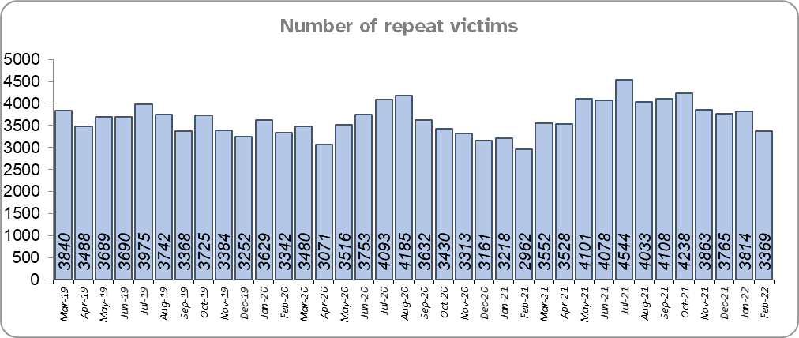
Priority 6 – Improving our services to support victims of crime
Grade: Requires Improvement
Essex experienced a 12.4% increase (5,179 more) in the number of repeat victims for the 12 months to February 2022 compared to the 12 months to February 2021.
There was an 9.0% increase (3,869 more) in the number of repeat victims in the 12 months to February 2022 compared to the 12 months to February 2020.
Confidence among victims (from the independent survey commissioned by Essex Police) is at 61.0% (results to the 12 months to December 2021). Compared to year ending December 2020, confidence in the local police has remained stable (the change is not statistically significant).
Due to the fact that the number of repeat victims has increased, a grade of Requires Improvement is recommended.
Please note:
* Repeat victims will have reported more than one crime to Essex Police in the previous year.

Slide 11
Priority 7 – Violence against women and girls
Grade: Requires Improvement
Where gender is detailed, over half of victims of Violence Against the Person (VAP) offences are identified as female* (56.3%). 2.9% (2,017 offences) have no gender recorded**).
Essex experienced a 10.1% increase (3,632 more) in the number of VAP offences committed against females in the 12 months to February 2022 compared to the 12 months to February 2021. There was a 10.9% increase in the 12 months to February 2022 compared to the 12 months to February 2020; this equates to 3,882 more offences. This compares to a 13.7% increase (3,690 more) in the number of VAP offences committed against males in the 12 months to February 2022 compared to the 12 months to February 2021. There was a 10.8% increase (2,982 more) in the 12 months to February 2022 compared to the 12 months to February 2020.
There was a 38.9% increase (1,413 more) in the number of Sexual Offences committed against females and a 3.7% increase (10 more) in the number of these offences solved in the 12 months to February 2022 compared to the 12 months to February 2021. There was a 44.0% increase (257 more) in the number of Sexual Offences committed against males and a 9.8% increase (4 more) in the number of these offences solved in the 12 months to February 2022 compared to the 12 months to February 2021.
A 25.5% increase (1,025 more) was observed in the number of Sexual Offences committed against females and a 15.8% increase (38 more) in the number of sexual offences against females solved in the 12 months to February 2022 compared to the 12 months to February 2020. There was a 26.8% increase (178 more) in the number of Sexual Offences committed against males and a 4.7% increase (2 more) in the number of sexual offences against males solved in the 12 months to February 2022 compared to the 12 months to February 2020.
41.2% of females feel safe walking alone in their area after dark (from the independent survey commissioned by Essex Police) for the period September 2021 to December 2021 compared to 74.1% of males in the same period.
The number of Violence Against the Person offences has increased in each of the past six year-on-year comparisons, and the number of Sexual Offences against females has increased significantly in each of the past five year-on-year comparisons. Due to the deterioration in these measures, a grade of Requires Improvement is recommended.
Please note:
**** Officer defined gender.
**** Not Recorded also includes records where gender is unknown or unspecified.
**** Please see page 23 for table of violence against the person and sexual offences and outcomes (by crime type) split by gender.
**** The confidence question was added to the internal survey in September 2021 so year on year comparison is not available.

Slide 12
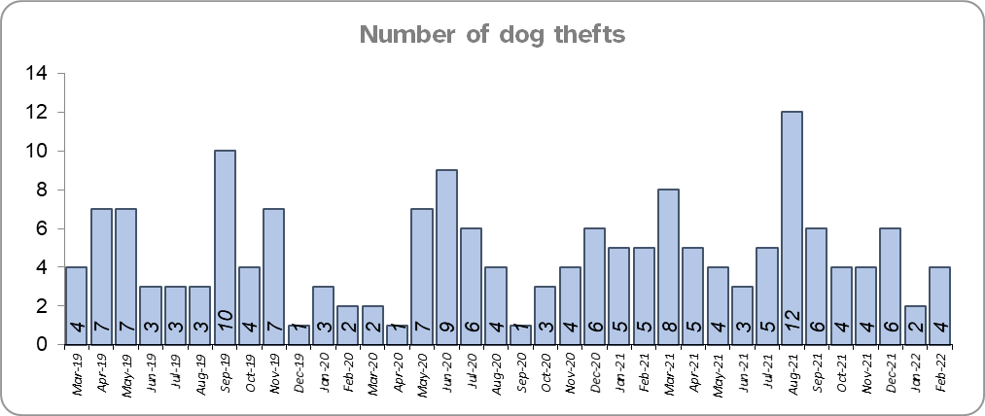
Priority 8 – Dog theft
Grade: Adequate
Essex experienced 10 more dog thefts for the 12 months to February 2022 compared to the 12 months to February 2021. There were 9 more dog thefts in the 12 months to February 2022 compared to the 12 months to February 2020.
Confidence as to how Essex Police and the organisations they work with are dealing with dog theft (from the independent survey commissioned by Essex Police) is at 63.6% for the period September 2021 to December 2021.
As confidence data are for one quarter only, a grade of Adequate is recommended.
Please note:
* This is number of thefts in which dogs were stolen, and not quantity of dogs stolen in each theft. Data are based on theft offence crimes and robbery offence crimes where the ‘property code’ is ‘pet animal – dog’ and the ‘property status’ is ‘stolen’ and/or ‘stolen/recovered’, broken down by month and year as requested.
** The confidence question was added to the internal survey in September 2021 so year on year comparison is not available.

Slide 13
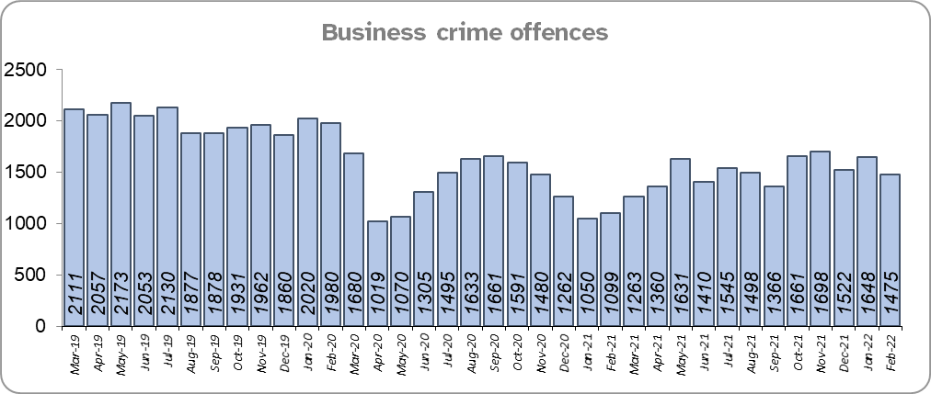
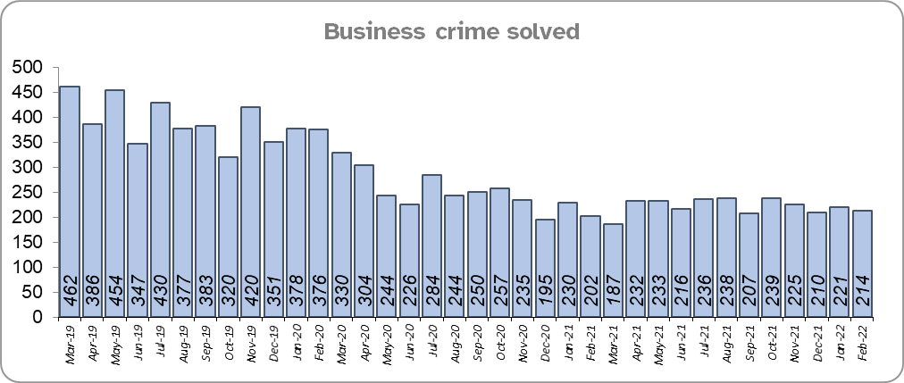
Priority 9 – Business Crime, Fraud and Cyber Crime
Grade: Requires Improvement
Essex experienced a 10.6% increase (1,732 more) in the number of Business Crime offences and an 11.4% decrease (343 fewer) in the number of these offences which were solved in the 12 months to February 2022 compared to the 12 months to February 2021.
There was a 24.8% decrease (5,955 fewer) in the number of Business Crime offences and a 43.3% decrease (2,026 fewer) in the number of Business Crimes solved in the 12 months to February 2022 compared to the 12 months to February 2020.
Confidence as to whether the police response to tackling cyber crime is improving (from the independent survey commissioned by Essex Police) is at 51.1% for the period September 2021 to December 2021.
Due to the decrease in the number of Business Crime offences that are solved, a grade of Requires Improvement is recommended.
Please note:
* The confidence question was added to the internal survey in September 2021 so year on year comparison is not available.

Slide 14
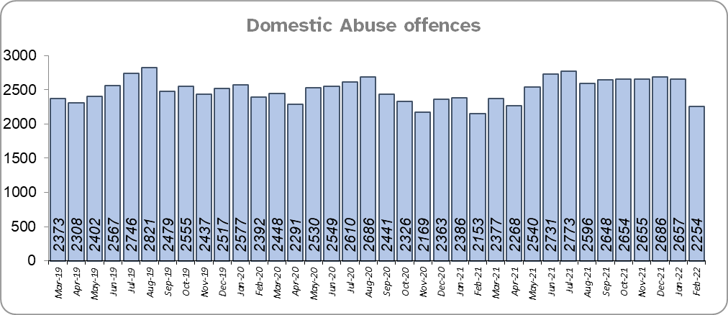
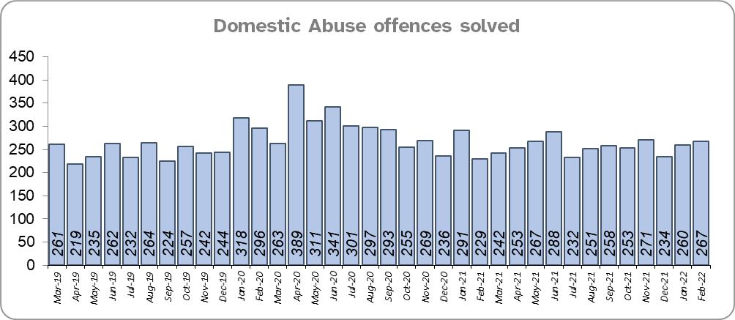
Priority 10 - Protecting vulnerable people and supporting victims of crime
Grade: Requires Improvement
Essex experienced a 6.5% increase (1,887 more) in Domestic Abuse (DA) offences and an 11.5% decrease (399 fewer) in the number of DA offences solved for the 12 months to February 2022 compared to the 12 months to February 2021.
There was a 2.2% increase (665 more) in DA offences and a 0.7% increase (22 more) in the number of DA offences solved for the 12 months to February 2022 compared to the 12 months to February 2020.

Slide 15
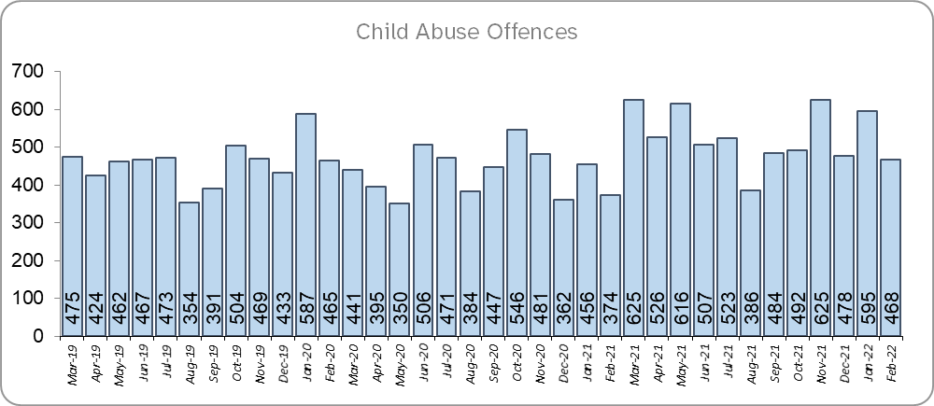
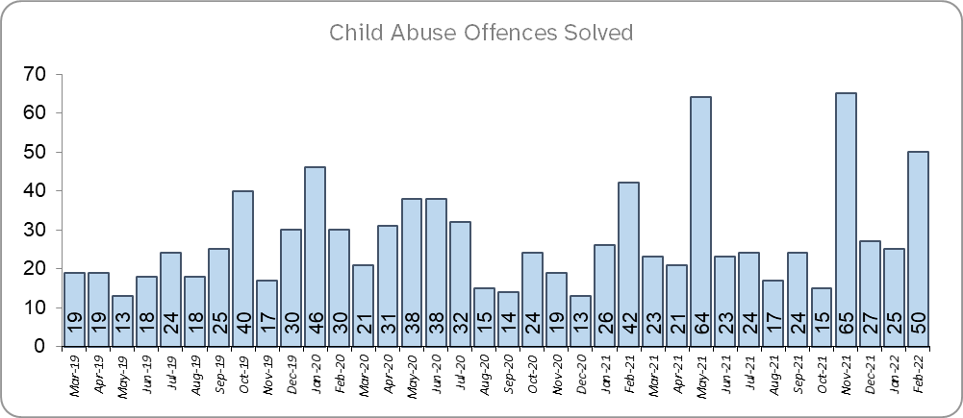
Priority 10 (cont.) - Protecting vulnerable people and supporting victims of crime
Grade: Requires Improvement
Essex experienced a 21.3% increase (1,112 more) in Child Abuse offences and a 20.8% increase (65 more) in the number of these offences which were solved for the 12 months to February 2022 compared to the 12 months to February 2021.
There was a 14.9% increase (821 more) in Child Abuse offences and a 26.4% increase (79 more) in the number of these offences which were solved for the 12 months to February 2022 compared to the 12 months to February 2020.
Confidence that the policing response to protect children and vulnerable people is improving (from the independent survey commissioned by Essex Police) is at 86.3% (results to the 12 months to December 2021). Compared to year ending December 2020, confidence has decreased by 3.4% points.
Due to the fact that confidence levels and the number of domestic abuse offences solved have decreased, a grade of Requires Improvement is recommended.

Slide 16
Priority 11 - Staff
Grade: Adequate
There has been a slight increase (0.2%) in the proportion of ethnic minority employees in February 2022 (289) compared to February 2021 (266); this equates to 23 additional employees. There has also been an increase (0.7%) compared to February 2020 (230); this equates to 59 additional employees.
Due to the low percentage of ethnic minority employees (0.02%) compared to the population of Essex***, a grade of Adequate is recommended.
Please note:
****Ethnic minority employees as a percentage of the total workforce.
****Ethnic minority employees as a percentage of type of employee.
****Office for National Statistics Population Estimates 2019: 1,846,655

Slide 17
Of Note
Essex Police welcomes new officers in first passing out ceremony of 2022
The first 70 new officers of 2022 were welcomed into the Essex Police family. They join more than 3,500 officers who protect and serve our county all year round. Of the 70 student officers, 31 were women.
The Force is welcoming more people from a wider range of backgrounds who want to make a difference to society. This is not just police officers, but also essential police staff, special constables, volunteer police cadets and volunteers who complete the team.

Slide 18
2021-2024 Police and Crime Plan Performance Indicators
Table 1
As the new measures were implemented in April 2021, an additional column showing data for the interim period is included.
Please view above table with the explanations and caveats detailed on page 20.

Slide 19
2021-2024 Police and Crime Plan Performance Indicators (Continued)
Table 2
As the new measures were implemented in April 2021, an additional column showing data for the interim period is included.
Please view above table with the explanations and caveats detailed on page 20.

Slide 20
End Notes
¹ Question from the independent survey commissioned by Essex Police. Results are for the period 12 months December 2021 versus the 12 months to December 2020.
² The confidence interval is the range +/- between where the survey result may lie. This is mainly influenced by the number of people answering the survey. The more people that answer the survey, the smaller the interval range.
³ Crime Severity Score measures ‘relative harm’ of crimes by taking into account both the volume and the severity of offences, and by weighting offences differently. National data for the 12 months to December 2021 have been used in order that comparisons can be made to Essex’s Most Similar Group of Forces (MSG).
⁴ The methodology used for identifying these investigations as drug related is subjective and based on the circumstances presented. These figures will include investigations where the victim or the suspect are involved Drug Use, Possession or Selling.
⁵ ‘Killed or Seriously Injured’ (KSI) refers to all people killed or seriously injured on Essex’s roads, regardless of whether any criminal offences were committed. ‘Causing Death/Serious Injury by Dangerous/Inconsiderate Driving’ offences (detailed on p.7) refers to the number of crimes of this type.
⁶ In 2019, the definition as to what constituted “use” of a mobile phone in relation to driver-related mobile phone offences was subject to a legal challenge. This resulted in a ruling, which held that while “use” included accessing the interactive functions of the mobile phone (such as making calls, sending messages or using the internet), it did not extend to solely accessing the device’s internal functions (such as making use of the camera). Fewer mobile phone offences were subsequently prosecuted from this point. In 2021, however, the law was changed: it is now illegal to “hold” a phone or sat nav when driving or riding a motorcycle.
⁷ Solved outcomes are crimes that result in: charge or summons, caution, crimes taken into consideration, fixed penalty notice, cannabis warning or community resolution.
⁸ This is number of theft offences in which dogs were stolen, and not necessarily the number of dogs which were stolen.
⁹ Ethnic minority employees as a percentage of the total workforce.

Slide 21
Crime Tree Data – Rolling 12 Months to February
Table 3

Slide 22
Crime Tree Data – Rolling 12 Months to February
Table 4

Slide 23
Crime Tree Data - Rolling 12 months to February Violence against the Person and Sexual offences and outcomes (by crime type) split by gender
Table 5
Please note: the breakdown of data within these tables may not tally with the totals on page 21 as gender data is rerun on a monthly basis.

