Slide 1
Police and Crime Plan 2021-2024
Monthly Performance Update
April 2022
National and MSG positions are to 28 February 2022 (Essex Police data are to 30 April 2022).
Version 1.4
Produced May 2022
Performance Analysis Unit, Essex Police
Sensitivity: Official

Slide 2
Executive Summary
The Police and Crime Plan 2021-2024 was introduced in April 2021 with new measures that reflect the Police, Fire and Crime Commissioner (PFCC) for Essex’s strategic commitment to targeted prevention and early intervention.
Since the last report, the recommended grade for Priority 9 (Business Crime, Fraud and Cyber Crime) has been upgraded from ‘Requires Improvement’ to ‘Adequate’. This is because Essex Police solved more Business Crime offences in the 12 months to April 2022 than in the 12 months to April 2021.
As a result of the above, seven of the eleven PFCC Priorities have been given a recommended grade of ‘Adequate’. Four have been given a recommended grade of ‘Requires Improvement’: 4 (Improving safety on our roads), 6 (Improving our service to support victims of crime), 7 (Violence against women and girls) and 10 (Protecting vulnerable people and supporting victims of crime). It is of note that in order to remain in line with the HMICFRS grade structure, a new grade of “Adequate” was introduced into these reports in February 2022 (data to 31 January 2022); the grades of “Outstanding”, “Good”, “Requires Improvement” and “Inadequate” remain.
Confidence (from the independent survey commissioned by Essex Police) is at 79.0% (results to the 12 months to March 2022). Compared to year ending March 2021, confidence in the local police has remained stable.
All Crime increased by 10.7% for the 12 months to April 2022 compared to the 12 months to April 2021; this equates to 16,126 more offences. This increase has been primarily influenced by the Government’s easing of restrictions on gathering and movement in relation to COVID-19. The Force also recorded 2,504 more offences in April 2022 compared to April 2020, when the Government implemented the first lockdown; this equates to 23.7% more offences.
Each change in the rules relating to social distancing has affected the number of All Crime offences reported to Essex Police.
There was a 1.6% increase in All Crime in the 12 months to April 2022 compared to the 12 months to April 2020. This equates to 2,631 more offences.
There was a 25.8% increase (176 more) in the number of those Killed or Seriously Injured (KSI) in Essex for the 12 months to April 2022 compared to the 12 months to April 2021.
Essex experienced a 12.9% increase (5,475) in the number of repeat victims for the 12 months to April 2022 compared to the 12 months to April 2021.
Where gender is detailed, over half of victims of Violence Against the Person (VAP) offences identify as female (56.1%). VAP offences committed against females increased by 9.2% (3,373 more), and there was a 30.0% increase (1,170 more) in the number of sexual offences against females in the 12 months to April 2022 compared to the 12 months to April 2021. This compares to a 14.4% rise (3,939 more) in VAP offences committed against males and a 33.6% rise (213 more) in sexual offences against males in the same period.
The number of solved sexual offences committed against females increased by 3.3% (9 more) in the 12 months to April 2022 compared to the 12 months to April 2021. This compares to an increase of 2.4% (1 more) in sexual offences against males solved in the same period.
There has been a slight increase (0.1%) in the proportion of ethnic minority employees in April 2022 (282) compared to April 2021 (272). This equates to 10 additional employees.
There were no statistical outliers in the month of April 2022.

Slide 3
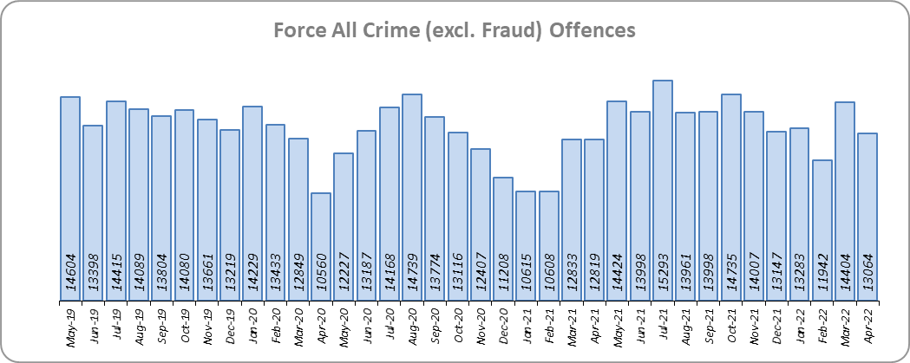
Priority 1 – Further investment in Crime Prevention
Grade: Adequate
Essex experienced a 10.7% increase in All Crime (16,126 more offences) for the 12 months to April 2022 compared to the 12 months to April 2021. This increase in crime has been primarily influenced by the Government’s easing of restrictions on movement and gathering in relation to COVID-19. Essex is seventh in its Most Similar Group of forces (MSG) for crime per 1,000 population.
There was a 1.6% increase in All Crime in the 12 months to April 2022 compared to the 12 months to April 2020; this equates to 2,631 more offences.
Essex Police recorded a daily average of 421 crimes in April 2022, compared to an average of 465 crimes recorded in March 2022. This equates to a decrease of 9.3%, or an average of 43 fewer crimes recorded per day.
13,064 offences were recorded in the month of April 2022, a decrease of 1.9% (245 offences) compared to the month of April 2021 (12,819 offences). There was a 23.7% increase in offences the month of April 2022 compared to the month of April 2020 (10,560 offences), when the Government first implemented national restrictions.

Slide 4
Priority 1 - Further investment in Crime Prevention (cont.)
Grade: Adequate
Confidence (from the independent survey commissioned by Essex Police) is at 79.0% (results to the 12 months to March 2022). Compared to year ending March 2021, confidence in the local police has remained stable.
The All Crime Harm (Crime Severity) Score* (14.7) places Essex eighth in its MSG.
Due to the fact that, compared to year ending March 2021, confidence in policing in Essex has remained stable, a grade of Adequate is recommended.
Please note:
* Crime Severity Scores (as calculated by the Office for National Statistics) measure the ‘relative harm’ of crimes by taking into account both their volume and their severity. As national data are only available to February 2022, scores for the 12 months to February for the preceding three years have been included.

Slide 5
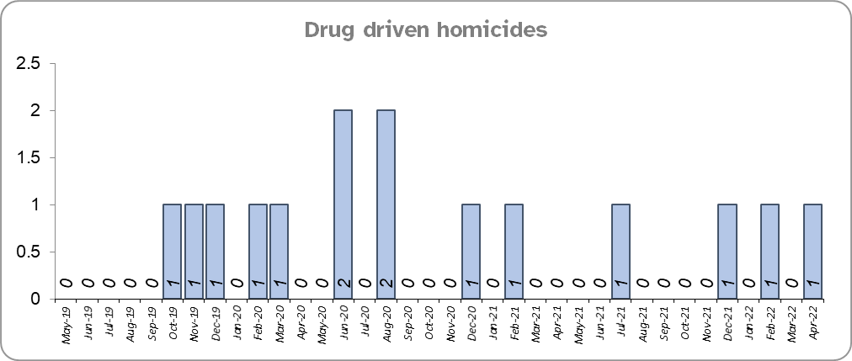
Priority 2 – Reducing Drug Driven Violence
Grade: Adequate
Essex experienced two fewer drug related homicides for the 12 months to April 2022 compared to the 12 months to April 2021.
One fewer drug related homicide was recorded in the 12 months to April 2022 compared to the 12 months to April 2020.
Confidence that Essex Police and partners are dealing with drug crime (from the independent survey commissioned by Essex Police) is at 60.9% for the period September 2021 to March 2022.
Due to the low level of data relating to drug related homicides, and as confidence data are for two quarters only, a grade of Adequate is recommended.
Please note:
* The methodology used for identifying investigations as being drug-related is subjective (qualitative data) and based on the circumstances presented. These figures include investigations where the victim and/or suspect are suspected of being involved in Drug Use, Possession or Selling.
** The confidence question was added to the internal survey in September 2021. A year on year comparison is therefore not available.

Slide 6
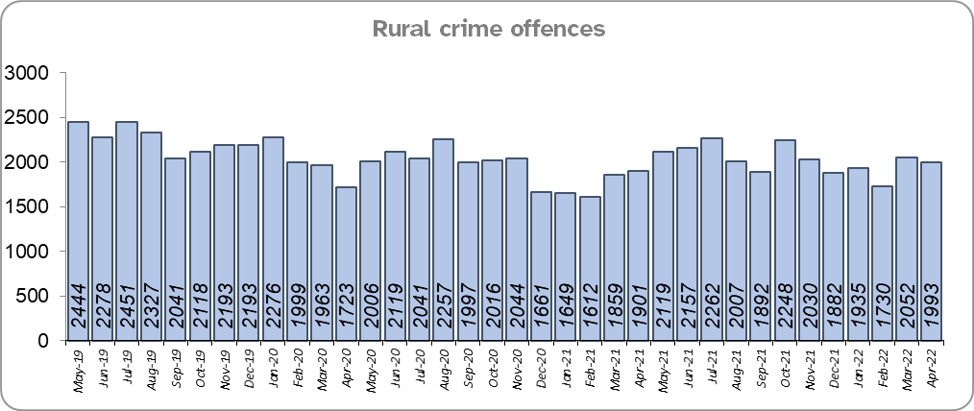
Priority 3 – Protect rural and isolated areas
Grade: Adequate
Essex experienced a 4.9% increase in rural crime (1,145 more offences) for the 12 months to April 2022 compared to the 12 months to April 2021 (by way of context, All Crime in Essex increased by 10.7% in the same period). Rural Crime decreased by 6.5% (1,699 fewer offences) in the 12 months to April 2022 compared to the 12 months to April 2020 (All Crime in Essex increased by 1.6% in the same period).
The rural crime Harm (Crime Severity) Score* was 8.9 for the 12 months to April 2022, a rise of 1.7 when compared to the 12 months to April 2021 (by way of context, the All Crime Harm Score in Essex was 14.7, an increase of 2.9 for the same period).
Confidence in rural policing (from the independent survey commissioned by Essex Police) is at 81.5% (results to the 12 months to March 2022). Compared to year ending March 2021, confidence in rural policing has remained stable and is higher than the Essex average of 79.0%.
As confidence in the local police has remained stable, a grade of Adequate is recommended.
Please note:
* Crime Severity Scores (as calculated by the Office for National Statistics) measure the ‘relative harm’ of crimes by taking into account both their volume and their severity. National data are not available for crimes committed in rural areas, so it is not possible to measure against an MSG average; due to this, Essex Police data (to April 2022) have been used rather than national data (which are to February 2022).

Slide 7
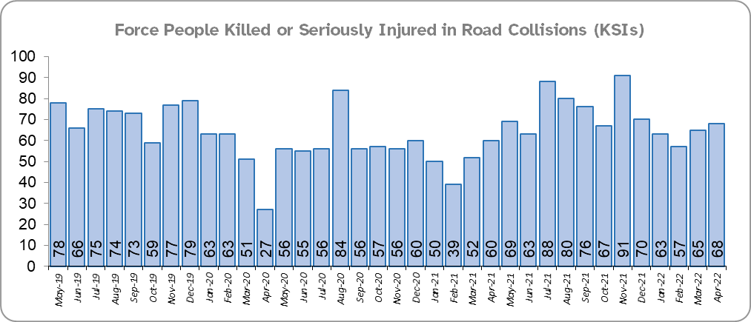
Priority 4 - Improving safety on our roads
Grade: Requires Improvement
There was a 25.8% increase (176 more) in the number of those Killed or Seriously Injured (KSI) in Essex for the 12 months to April 2022 compared to the 12 months to April 2021. There was an increase in the number of collisions, particularly those resulting in serious injuries (26.6%), in the same period. The number of KSIs also increased by 72 in the 12 months to April 2022 compared to the 12 months to April 2020.
Essex is sixth in its Most Similar Group (MSG) of forces for casualties per 100 million vehicle kilometres (results to December 2020) and is slightly higher than the MSG average. However, due to the fact that more recent national figures have not been released, the current position cannot be determined (the date of the next national release has not yet been confirmed).
Please note that most KSIs do not necessarily result in criminal offences (such as death or serious injury caused by dangerous driving) being recorded.

Slide 8
Priority 4 - Improving safety on our roads (cont.)
Grade: Requires Improvement
There was a 24.7% decrease (926 fewer offences) in drink/drug driving offences for the 12 months to April 2022 compared to the 12 months to April 2021. This is due to a decrease in recorded drug driving offences; there was a 21.6% increase (272 more offences) in drink driving but a 55.8% decrease (1,173 fewer offences) in drug driving. There was also a 24.7% decrease (926 fewer offences) in drink/drug driving offences for the 12 months to April 2022 compared to the 12 months to April 2020; of these offences, there was a 7.8% increase (111 more offences) in drink driving and a 51.4% decrease (981 fewer offences) in drug driving. All of these offence types are primarily driven by police proactivity in relation to road safety.
There was a 3.7% decrease (19 fewer offences) in the number of driving related mobile phone offences recorded for the 12 months to April 2022 compared to the 12 months to April 2021.*
Confidence in Essex Police and organisations they work with policing the roads (from the independent survey commissioned by Essex Police) is at 64.0% (results to the 12 months to March 2022). Compared to year ending March 2021, confidence in the local police and organisations they work with has decreased by 9.3% points.
Due to the increase in KSIs in the past 12 months and the significant decrease in public confidence a grade of Requires Improvement is recommended.
Please note:
* In 2019, the definition as to what constituted “use” of a mobile phone in relation to driver-related mobile phone offences was subject to a legal challenge. This resulted in a ruling, which held that while “use” included accessing the interactive functions of the mobile phone (such as making calls, sending messages or using the internet), it did not extend to solely accessing the device’s internal functions (such as making use of the camera). Fewer mobile phone offences were subsequently prosecuted from this point. In 2021 the government announced that the law was to be changed making it illegal to “hold” a phone or sat nav when driving or riding a motorcycle. This law was finally passed on 25th March 2022.

Slide 9
Priority 5 – Encouraging Volunteers and Community Support
Grade: Adequate
Confidence that there are good opportunities for volunteers to assist policing and reduce crime in Essex (from the independent survey commissioned by Essex Police) is at 45.1% for the period September 2021 to March 2022.
Essex Watch Liaison Officers continue to work with Neighbourhood Watch to offer crime and fraud prevention advice.** The number of Dog Watch groups increased by 233 compared to March 2022 (2,176 groups).
As confidence data are for two quarters only (and there is no comparison to the same periods in previous years), a grade of Adequate is recommended.
Please note:
* The confidence question was added to the internal survey in September 2021 so year on year comparison is not available.
** Neighbourhood Watch data were first produced in March 2022 so year on year comparison is not available.

Slide 10
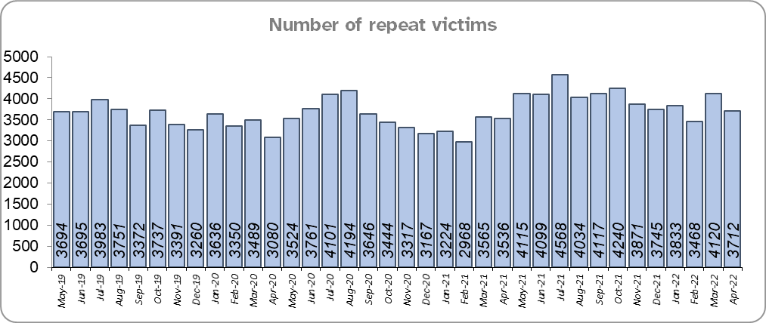
Priority 6 – Improving our services to support victims of crime
Grade: Requires Improvement
Essex experienced a 12.9% increase (5,475 more) in the number of repeat victims for the 12 months to April 2022 compared to the 12 months to April 2021.
There was also a 12.9% increase (5,484 more) in the number of repeat victims in the 12 months to April 2022 compared to the 12 months to April 2020.
Confidence among victims (from the independent survey commissioned by Essex Police) is at 60.5% (results to the 12 months to March 2022). This is 20.6% points lower than confidence of non-victims for the same period (81.1%).
Compared to year ending March 2021, confidence among victims in the local police is deteriorating, and among non-victims has remained stable.
Due to the fact that confidence in policing in Essex has decreased for victims of crime, and that the number of repeat victims has increased, a grade of Requires Improvement is recommended.
Please note:
* A victim of crime is regarded as a repeat if they have reported at least one other crime in the 365 days prior to the most recent crime occurring. An individual victim may be counted as a repeat several times over the course of the year if they report multiple crimes.

Slide 11
Priority 7 – Violence against women and girls
Grade: Requires Improvement
Where gender is detailed, over half of victims of Violence Against the Person (VAP) offences identified as female* (56.1%). 2.9% of offences (2,132 offences) had no gender recorded**.
Essex experienced a 9.2% increase (3,373 more) in the number of VAP offences committed against females in the 12 months to April 2022 compared to the 12 months to April 2021; this compares to a 14.4% increase (3,939 more) in the number of VAP offences committed against males in the same period. There was a 13.4% increase (4,722 more) in the number of VAP offences committed against females in the 12 months to April 2022 compared to the 12 months to April 2020; this compares to an increase of 14.4% (3,943 more) in the number of VAP offences committed against males in the same period.
There was a 30.0% increase (1,170 more) in the number of Sexual Offences committed against females and a 3.3% increase (9 more) in the number of these offences solved in the 12 months to April 2022 compared to the 12 months to April 2021. By contrast, there was a 33.6% increase (213 more) in the number of Sexual Offences committed against males and a 2.4% increase (1 more) in the number of these offences solved in the same period.
A 29.9% increase (1,168 more) was observed in the number of Sexual Offences committed against females and a 5.7% increase (15 more) in the number of sexual offences against females solved in the 12 months to April 2022 compared to the 12 months to April 2020. By contrast, there was a 33.4% increase (212 more) in the number of Sexual Offences committed against males and an 8.7% decrease (4 fewer) in the number of sexual offences against males solved in the same period.
41.1% of females feel safe walking alone in their area after dark (from the independent survey commissioned by Essex Police) for the period September 2021 to March 2022 compared to 75.4% of males.
Although Essex Police have solved slightly more Sexual Offences committed against women in the previous 12 months, only 4 in 10 females feel safe walking in their area after dark. Until comparisons to previous years are available (to determine if confidence is increasing or decreasing), a grade of Requires Improvement is recommended.
Please note:
**** Officer defined gender.
**** Not Recorded also includes records where gender is unknown or unspecified.
**** Please see page 23 for table of violence against the person and sexual offences and outcomes (by crime type) split by gender.
**** The confidence question was added to the internal survey in September 2021 so year on year comparison is not available.

Slide 12
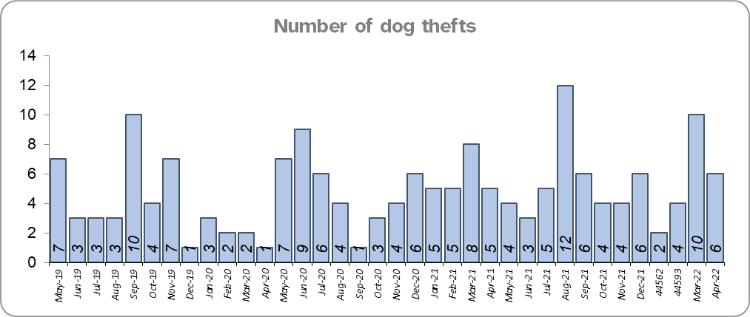
Priority 8 – Dog theft
Grade: Adequate
Essex experienced 3 more dog thefts for the 12 months to April 2022 compared to the 12 months to April 2021. There were 20 more dog thefts in the 12 months to April 2022 compared to the 12 months to April 2020.
Confidence as to how Essex Police and the organisations they work with are dealing with dog theft (from the independent survey commissioned by Essex Police) is at 63.5% for the period September 2021 to March 2022.
As confidence data are for two quarters only, a grade of Adequate is recommended.
Please note:
* This is number of thefts in which dogs were stolen, and not quantity of dogs stolen in each theft. Data are based on theft offence crimes and robbery offence crimes where the ‘property code’ is ‘pet animal – dog’ and the ‘property status’ is ‘stolen’ and/or ‘stolen/recovered’.
** The confidence question was added to the internal survey in September 2021 so year on year comparison is not available.

Slide 13
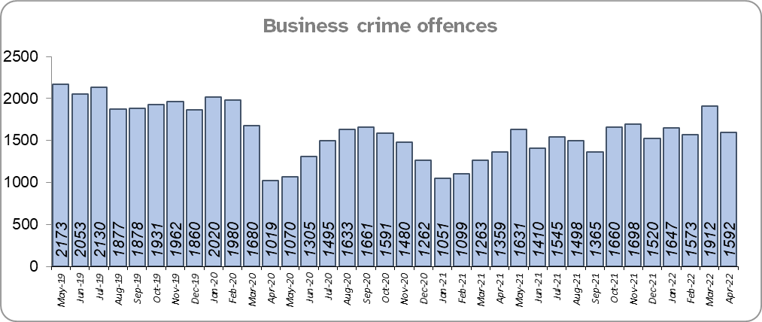
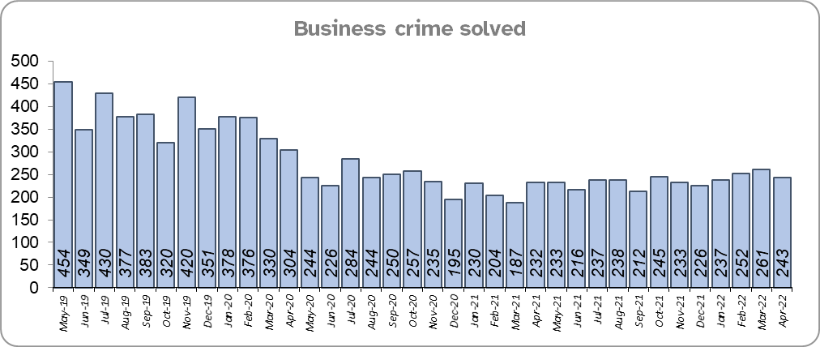
Priority 9 – Business Crime, Fraud and Cyber Crime
Grade: Adequate
Essex experienced a 17.1% increase (2,782 more) in the number of Business Crime offences and a 1.6% increase (45 more) in the number of these offences which were solved in the 12 months to April 2022 compared to the 12 months to April 2021.
There was a 15.6% decrease (3,512 fewer) in the number of Business Crime offences and a 36.7% decrease (1,639 fewer) in the number of Business Crimes solved in the 12 months to April 2022 compared to the 12 months to April 2020.
Confidence as to whether the police response to tackling cyber crime is improving (from the independent survey commissioned by Essex Police) is at 50.8% for the period September 2021 to March 2022.
Due to the increase in the number of Business Crime offences that are solved, a grade of Adequate is recommended.
Please note:
* The confidence question was added to the internal survey in September 2021 so year on year comparison is not available.

Slide 14
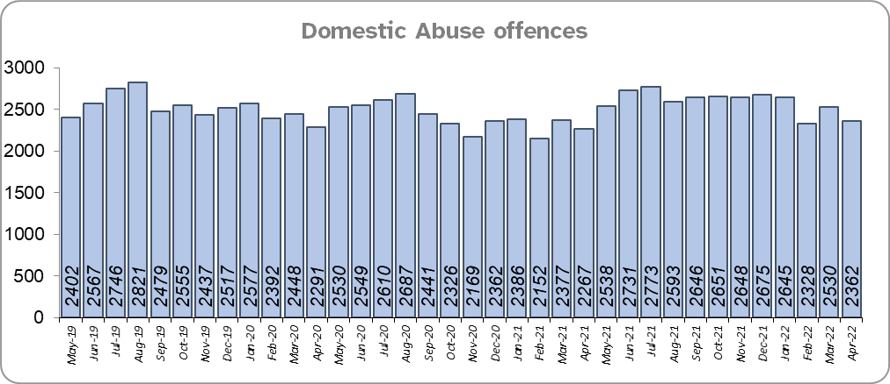
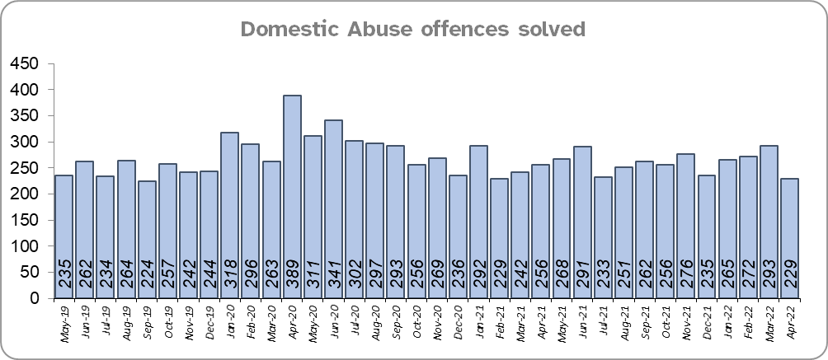
Priority 10 - Protecting vulnerable people and supporting victims of crime
Grade: Requires Improvement
Essex experienced a 7.8% increase (2,264 more) in Domestic Abuse (DA) offences and a 5.8% decrease (193 fewer) in the number of DA offences solved for the 12 months to April 2022 compared to the 12 months to April 2021.
There was an 2.9% increase (888 more) in DA offences and a 3.0% decrease (97 fewer) in the number of DA offences solved for the 12 months to April 2022 compared to the 12 months to April 2020.

Slide 15
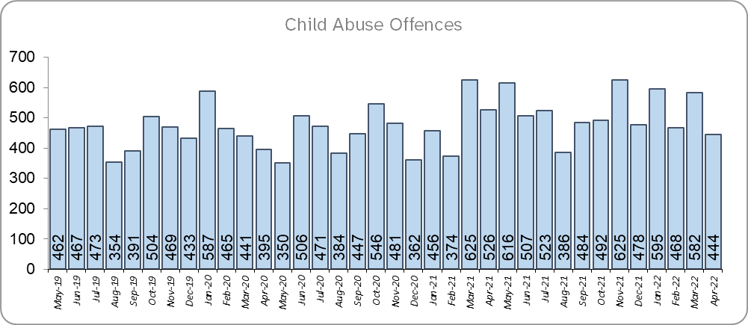
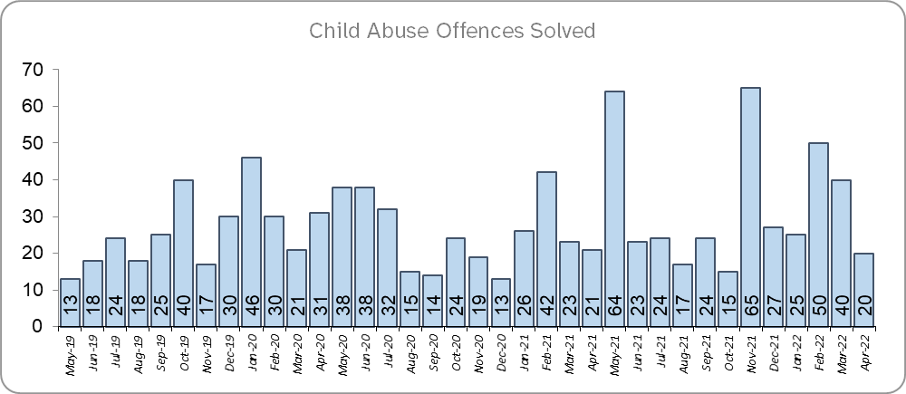
Priority 10 - Protecting vulnerable people and supporting victims of crime (cont.)
Grade: Requires Improvement
Essex experienced a 12.2% increase (672 more) in Child Abuse offences and a 29.2% increase (89 more) in the number of these offences which were solved for the 12 months to April 2022 compared to the 12 months to April 2021.
There was a 13.9% increase (759 more) in Child Abuse offences and a 25.9% increase (81 more) in the number of these offences which were solved for the 12 months to April 2022 compared to the 12 months to April 2020.
Confidence that the policing response to protect children and vulnerable people is deteriorating (from the independent survey commissioned by Essex Police) is at 83.8% (results to the 12 months to March 2022). Compared to year ending March 2021, confidence has decreased by 6.2% points.
Due to the fact that confidence levels and the number of domestic abuse offences solved have decreased, a grade of Requires Improvement is recommended.

Slide 16
Priority 11 - Staff
Grade: Adequate
There has been a slight increase (0.1%) in the proportion of ethnic minority employees in April 2022 (282) compared to April 2021 (272); this equates to 10 additional employees. There has also been an increase (0.7%) compared to April 2020 (229); this equates to 53 additional employees.
There is a disparity of 3.3% points between the proportion of ethnic minority residents in Essex*** (7.6%) and the proportion of ethnic minority employees in Essex Police (4.3%).
Please note:
****Ethnic minority employees as a percentage of the total workforce.
****Ethnic minority employees as a percentage of type of employee.
****Office for National Statistics Population Estimates 2019: Essex population 1,846,655, ethnic minority residents 140,641.

Slide 17
Monthly Performance Overview: Of Note
Just Stop Oil protests
Throughout April, Just Stop Oil carried out sustained protest activity at petrochemical distribution sites in West Essex. Large numbers of protestors disrupted multiple sites simultaneously and used a wide range of disruption tactics including road blockades and ‘lock on’, causing significant disruption. Officers were called upon to support the Force; their rest days were cancelled, their duty times were changed, and they worked extended hours when required. Without this extra commitment, the resultant risk to life would have been significant, as the ability of emergency services would have been diminished, as would have key critical infrastructures. The extra effort also ensured that the effect on the people of Essex was minimal.
Essex Police have made 461 arrests to date and have secured the first conviction in the country in connection with these protests.
Chief Constable’s Commendations
Seven police officers have been commended by Chief Constable BJ Harrington for their dedication and commitment to protecting the people of Essex, for saving lives and for securing justice for vulnerable people. Mr. Harrington said it was a privilege to be able to present Chief Constable’s Commendations to officers who have gone above and beyond in the course of their duties.
New staff roles
The new financial year marks a year of growth for Essex Police. The Force will be employing an extra 200 officers and 72 police staff; by March 2023, there will be 3,750 officers and almost 2,400 police staff. The police staff roles will provide extra resilience to existing teams and focus growth in areas where the Force is facing increasing demand.

Slide 18
2021-2024 Police and Crime Plan Performance Indicators
Table 1
Please view above table with the explanations and caveats detailed on page 20.

Slide 19
2021-2024 Police and Crime Plan Performance Indicators (cont.)
Table 2
Please view above table with the explanations and caveats detailed on page 20.

Slide 20
End Notes
¹ Question from the independent survey commissioned by Essex Police. Results are for the period 12 months March 2022 versus the 12 months to March 2021.
² The confidence interval is the range +/- within which the survey result will lie. This is mainly influenced by the number of people answering the survey. The more people that answer the survey, the smaller the interval range.
³ Crime Severity Score measures ‘relative harm’ of crimes by taking into account both the volume and the severity of offences, and by weighting offences differently. National data for the 12 months to February 2022 have been used in order that comparisons can be made to Essex’s Most Similar Group of Forces (MSG).
⁴ The methodology used for identifying these investigations as drug related is subjective and based on the circumstances presented. These figures will include investigations where the victim or the suspect are involved Drug Use, Possession or Selling.
⁵ ‘Killed or Seriously Injured’ (KSI) refers to all people killed or seriously injured on Essex’s roads, regardless of whether any criminal offences were committed. ‘Causing Death/Serious Injury by Dangerous/Inconsiderate Driving’ offences (detailed on p.8) refers to the number of crimes of this type.
⁶ In 2019, the definition as to what constituted “use” of a mobile phone in relation to driver-related mobile phone offences was subject to a legal challenge. This resulted in a ruling, which held that while “use” included accessing the interactive functions of the mobile phone (such as making calls, sending messages or using the internet), it did not extend to solely accessing the device’s internal functions (such as making use of the camera). Fewer mobile phone offences were subsequently prosecuted from this point. In 2021 the government announced that the law was to be changed making it illegal to “hold” a phone or sat nav when driving or riding a motorcycle. This law was finally passed on 25th March 2022.
⁷ Solved outcomes are crimes that result in: charge or summons, caution, crimes taken into consideration, fixed penalty notice, cannabis warning or community resolution.
⁸ This is the number of theft offences in which dogs were stolen, and not necessarily the number of dogs which were stolen.
⁹ Ethnic minority employees as a percentage of the total workforce.

Slide 21
Crime Tree Data – Rolling 12 Months to April
Table 3

Slide 22
Crime Tree Data – Rolling 12 Months to April (cont.)
Table 4

Slide 23
Crime Tree Data - Rolling 12 months to April Violence against the Person and Sexual offences and outcomes (by crime type) split by gender
Table 5
Please note: the breakdown of data for the previous 12 months within these tables may not tally with the totals on page 21 as gender data is rerun on a monthly basis.

