Slide 1
Police and Crime Plan 2016-2021
Monthly Performance Update
December 2021
National and MSG positions are to 31 October 2021 (Essex Police data are to 31 December 2021).
Version 1.5
Produced January 2022
Performance Analysis Unit, Essex Police
Sensitivity: Official

Slide 2
Executive Summary
Since the last report, the recommended grade for Priority 1 (More local visible and accessible policing) has been downgraded from Good to Requires Improvement. This is because the Harm (Crime Severity) Score in Essex is 2.2 points higher than the MSG average, the biggest difference in the past 12 months, and the emergency response attendance is below target.
As a result of the above, four of the seven PFCC Priorities for Essex Police now have a recommended grade of Good. Three of the seven PFCC priorities have been given a recommended grade of ‘Requires Improvement’: 1 – (More local, visible and accessible policing), 3 (Breaking the cycle of Domestic Abuse) and 4 (Tackling Gangs and Serious Violence). Recommended grades have been determined with reference to comparisons with Essex Police’s Most Similar Group (MSG) of forces, Key Performance Indicators (KPIs), and professional judgement.
All Crime increased by 2.8% for the 12 months to December 2021 compared to the 12 months to December 2020; this equates to 4,361 more offences. This increase has been primarily influenced by the Government’s restrictions on gathering and movement in relation to COVID-19. The Force also recorded 2,587 more offences in December 2021 compared to April 2020, when the Government implemented the first restrictions in relation to gathering and movement; this equates to 24.5% more offences.
Each change in the rules relating to social distancing has affected the number of All Crime offences reported to Essex Police.*
There was a 5.5% decrease in All Crime in the 12 months to December 2021 compared to the 12 months to December 2019; this equates to 9,227 fewer offences.
The Force recorded 434 more Violence with Injury (VWI) offences (49.6% increase) in the month of December 2021 compared to the month of April 2020 (1,309 v. 875 offences). The number of VWI offences recorded in the 12 months to December 2021, however, was lower than the number recorded before COVID restrictions were introduced; compared with the 12 months to December 2019, there was a 3.8% decrease (590 fewer crimes).
Essex experienced a 23.6% decrease (12,628 fewer) in Anti-Social Behaviour (ASB) incidents for the 12 months to December 2021 compared to the 12 months to December 2020. December 2021 saw a new procedure introduced ensuring more accurate recording of ASB incidents. This followed the implementation of Operation SOMERTON in October and November 2021 which involved the manual review of ASB records, many of which were later reclassified from ASB to other incident types, such as crime.
ASB incidents in the 12 months to December 2021 were 2.4% lower compared to pre-COVID levels; there were 1,010 fewer incidents in the 12 months to December 2021 compared to the 12 months to December 2019 (40,965 v. 41,975 incidents).
Confidence (from the independent survey commissioned by Essex Police) is at 80.9% (results to the 12 months to September 2021). Compared to year ending September 2020, confidence in the local police increased by 8.5% points.
70 more Modern Slavery referrals were made in the 12 months to December 2021 compared to the same period in 2019-20. Essex Police have increased the number of referrals and worked to achieve greater range and engagement with hard to access groups, thereby creating more opportunities to help vulnerable people. This has resulted in the number of referrals being higher in the 12 months to December 2021 compared to the same period the previous year.
No crime type was either statistically high or low in the month of December 2021.
* Please see table showing the effect of social distancing measures on pages 12 - 14.

Slide 3
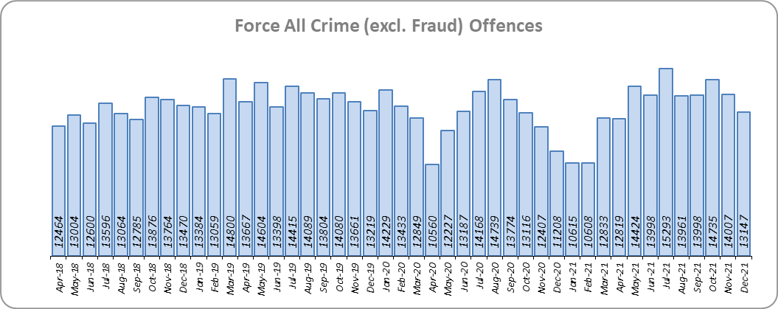
Priority 1 - More local, visible and accessible policing
Grade: Requires Improvement
Essex experienced a 2.8% increase in All Crime (4,361 more offences) for the 12 months to December 2021 compared to the 12 months to December 2020. This increase in crime has been primarily influenced by the Government’s restrictions on gathering and movement in relation to COVID-19. Essex is eighth in its Most Similar Group of forces (MSG) for crime per 1,000 population.
There was a 5.5% decrease in All Crime in the 12 months to December 2021 compared to the 12 months to December 2019; this equates to 9,227 fewer offences.
Essex Police recorded a daily average of 424 crimes in December 2021, compared with an average of 467 crimes in November 2021. This equates to a decrease of 9.2%, or an average of 43 fewer crimes recorded per day.
13,147 offences were recorded in the month of December 2021, an increase of 17.3% (1,939 more offences) compared to the month of December 2020 (11,208 offences). There was a 0.5% decrease in the month of December 2021 compared to the month of December 2019 (13,219 offences).

Slide 4
Priority 1 - More local, visible and accessible policing
Grade: Requires Improvement
Confidence (from the independent survey commissioned by Essex Police) is at 80.9% (results to the 12 months to September 2021). Compared to year ending September 2020, confidence in the local police has significantly increased (an improvement of 8.5% points).
The All Crime Harm (Crime Severity) Score** (13.5) places Essex seventh in its MSG and is 2.2 points higher than the MSG average, the biggest difference in the past 12 months
Essex Police’s performance in relation to emergency response attendance within 15 minutes (urban) or 20 minutes (rural) has reduced by 0.3 percentage points to 79.8% in the 12 months to December 2021 compared to the 12 months to December 2020. This is below the 80% target.
Although confidence has increased year on year we are slightly below our emergency response times for emergency incidents. Until this target is met a grade of Requires Improvement is recommended. For a grade of ‘Good’ to be recommended, the target for emergency response attendance would need to be met.
Please note:
* Crime Survey of England and Wales data are no longer available at Force level. Data are for the 12 months to March 2020.
** Crime Severity Scores (as calculated by the Office for National Statistics) measure the ‘relative harm’ of crimes by taking into account both their volume and their severity. Data are for the 12 months to October in all three years.
*** Grade of Service.

Slide 5
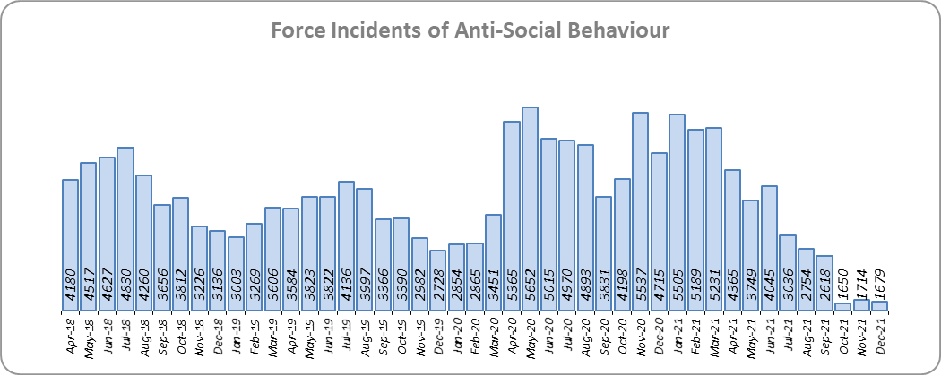
Priority 2 - Crack down on anti-social behaviour
Grade: Good
Essex experienced a 23.6% decrease (12,628 fewer) in Anti-Social Behaviour (ASB) incidents for the 12 months to December 2021 compared to the 12 months to December 2020. Since March 2020, the number of ASB incidents reported has generally been higher when tighter Government COVID-19 restrictions have been implemented by the Government, and lower when restrictions have been eased.**
There was a decrease of 64.4% ASB reports in December 2021 compared to December 2020 (3,036 fewer incidents). The average daily number of ASB incidents decreased by 5.2% in December 2021 (54 incidents) compared to November 2021 (57 incidents).
The number of ASB incidents for the 12 months to December 2021 compared to the 12 months to December 2019 decreased by 2.4% (1,010 fewer incidents).
The results of Essex’s independent survey in relation to how well residents perceive Essex Police and partner organisations to be dealing with ASB showed an improvement: 1.8% points (results to the 12 months to September 2021).
Due to the significant decrease in the number of Anti-Social Behaviour incidents, a grade of Good is recommended.**
Please note:
* Crime Survey of England and Wales data are no longer available at Force level. Data are for the 12 months to March 2020.
** In December 2021 a new procedure was introduced ensuring more accurate recording of ASB incidents. This followed the implementation of Operation SOMERTON in October and November 2021 which involved the manual review of ASB records, many of which were later reclassified from ASB to other incident types, such as crime.

Slide 6
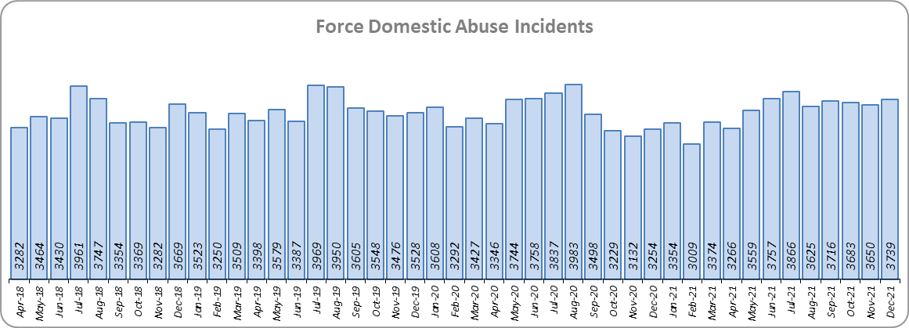
Priority 3 - Breaking the cycle of domestic abuse
Grade: Requires Improvement
Essex experienced a 1.2% increase (490 more) in Domestic Abuse incidents and a 9.2% increase (1,771 more) in repeat incidents of Domestic Abuse for the 12 months to December 2021 compared to the 12 months to December 2020. There was also an 8.8% increase (1,236 more) in Domestic Abuse arrests but a 3.4% decrease (8 fewer) in the number of Domestic Violence Protection Notices (DVPN) and Protection Orders (DVPO) issued in the 12 months to December 2021 compared to the 12 months to December 2020.
There was a 0.3% decrease (124 fewer) in Domestic Abuse incidents but a 2.1% increase (422 more) in repeat incidents of Domestic Abuse for the 12 months to December 2021 compared to the 12 months to December 2019. There was also a 29.4% increase (3,486 more) in Domestic Abuse arrests and a 34.3% increase (58 more) in the number of Domestic Violence Protection Notices (DVPN) and Protection Orders (DVPO) issued for the 12 months to December 2021 compared to the 12 months to December 2019.
There was a 13.6% decrease (477 fewer) in the number of solved Domestic Abuse outcomes in the 12 months to December 2021 compared to the 12 months to December 2020 and a 0.9% increase (27 more) compared to the 12 months to December 2019.
Due to the fact that the number of DA solved offences has decreased for the eighth month in a row, a grade of Requires Improvement is recommended. For a grade of ‘Good’ to be recommended, the number of repeat incidents of Domestic Abuse would need to reduce and the number of solved Domestic Abuse offences would need to increase.

Slide 7
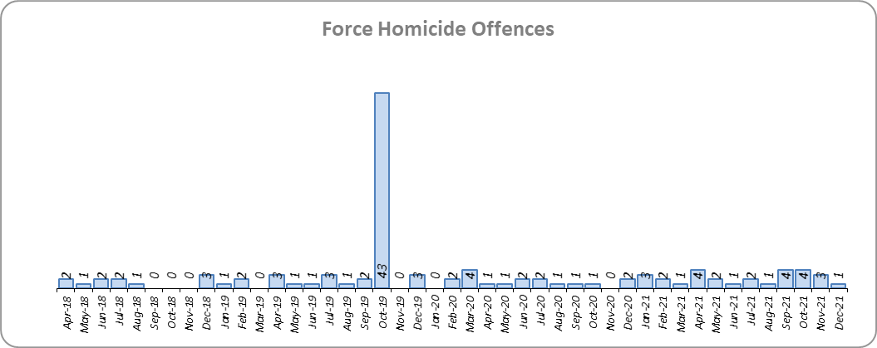
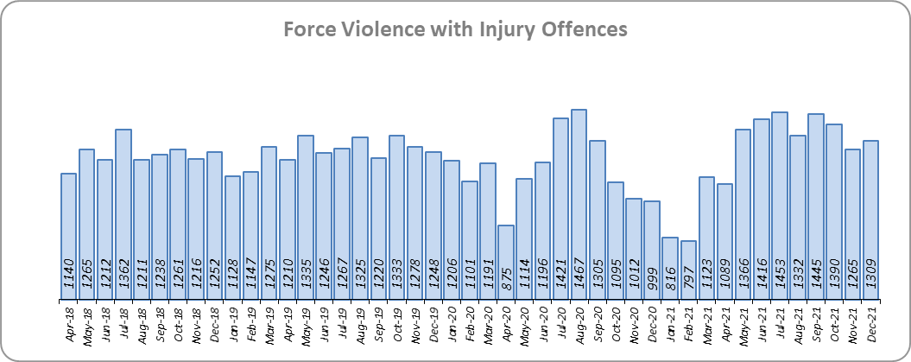
Priority 4 – Tackling gangs and serious violence
Grade: Requires Improvement
8 more Homicides (to 25 offences) were recorded for the 12 months to December 2021 compared to the 12 months to December 2020. Essex is seventh in its Most Similar Group (MSG) of forces for offences per 1,000 population, and is higher than the MSG average.
One Homicide was recorded in December 2021 compared to two offences in December 2020.
The number of Homicides decreased by 59.0% (36 fewer offences) in the 12 months to Dec 2021 compared to the 12 months to December 2019. Please note, the 12 months to December 2019 includes the tragic incident where 39 Vietnamese nationals were discovered in a lorry trailer in Grays in October 2019.
There was a 5.6% increase (789 more offences) in Violence with Injury offences for the 12 months to December 2021 compared to the 12 months to December 2020. The average daily number of Violence with Injury offences was 42 for the months of December 2021 and November 2021. 434 more offences (49.6%) were recorded in the month of December 2021 (1,309 offences) compared to the month of April 2020 (875 offences) when the Government first implemented national restrictions.
The number of Violence with Injury offences decreased by 3.8% (590 fewer offences) in the 12 months to December 2021 compared to the 12 months to December 2019.
Essex is fifth in its MSG for Violence with Injury offences per 1,000 population and has a lower rate of offences than the MSG average. There was also a decrease in domestic abuse-related Violence with Injury (0.4% decrease, 24 fewer offences). 37.9% of Violence with Injury is domestic abuse-related.

Slide 8
Priority 4 – Tackling gangs and serious violence
Grade: Requires Improvement
The combined High Harm (Crime Severity) Score* (8.8) for Violence with Injury, Rape, Other Sexual Offences and Robbery of Personal Property places Essex seventh in its Most Similar Group of Forces (MSG).
There was a 9.0% decrease (269 fewer) in the number of solved High Harm offences (Violence with Injury, Rape, Other Sexual Offences and Robbery of Personal Property combined) in the 12 months to December 2021 compared to the 12 months to December 2020. Please see page 20 for the numbers of solved for each category. The number of solved High Harm offences also decreased by 4.6% (130 fewer) in the 12 months to December 2021 compared to the 12 months to December 2019.
There was a 60.9% decrease (1,870 fewer) in the number of stop and search for weapons in the 12 months to December 2021 compared to the 12 months to December 2020. The number of stop and search for weapons also decreased by 56.3% (1,546 fewer) in the 12 months to December 2021 compared to the 12 months to December 2019.
There was an 8.5% decrease (147 fewer) in the number of knife-enabled crime offences in the 12 months to December 2021** compared to the 12 months to December 2020. The number of knife-enabled crime offences also decreased by 3.3% (54 fewer) in the 12 months to December 2021 compared to the 12 months to December 2019
Due to the fact that Essex is higher than the MSG average for the number of Homicides recorded per 1,000 pop., and that the number of solved High Harm offences has reduced, a grade of Requires Improvement is recommended. For a grade of ‘Good’ to be recommended, there would need to be a reduction in the number of Homicides; there would also need to be an increase in the number of solved High Harm offences.
Please note:
* Crime Severity Scores (as calculated by the Office for National Statistics) measure the ‘relative harm’ of crimes by taking into account both their volume and their severity. Data are for the 12 months to October in all three years.
** The number of knife crime offences is an indicator of how effective Essex Police is at identifying knife-enabled offences, and is not necessarily reflective of the number of these offences that have been committed in the county. This is because the identification of these offences is reliant on the appropriate indicator being manually added to the crime record. A new data quality process was introduced in June 2020 and Essex Police is currently working with the National Data Quality Improvement Service (NDQIS) to revise knife crime flags. In September 2021, data from April 2019 was revised; this resulted in an increase in the number of offences recorded, particularly in the 2019/20 financial year. This has enabled Essex Police to better understand knife crime in Essex.

Slide 9
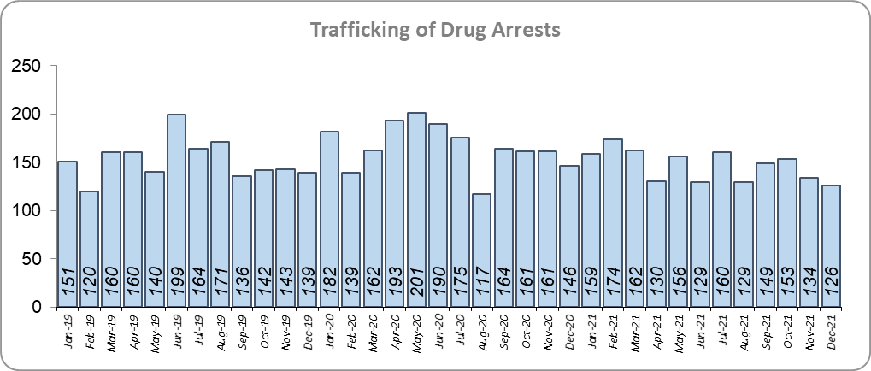
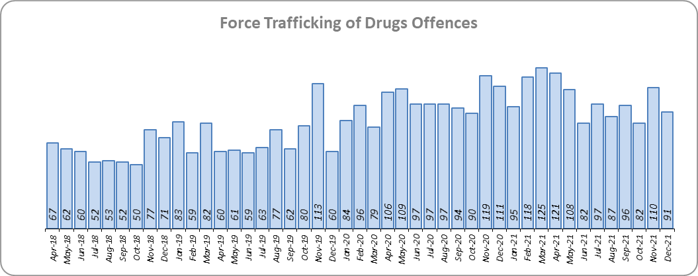
Priority 5 – Disrupting and preventing organised crime
Grade: Good
Essex experienced a 31.4% increase in Organised Crime Group (OCG) disruptions (69 more) for the 12 months to December 2021 compared to the 12 months to December 2020. In January 2019 there was a change in the way in which the number of OCG disruptions were counted; this follows National Crime Agency (NCA) and Eastern Region Special Operations Unit (ERSOU) guidance to ensure that all forces record disruptions in the same way.
Trafficking of drug arrests, which are primarily driven by police proactivity, decreased by 11.8% (235 fewer) in the 12 months to December 2021 compared to the 12 months to December 2020 and decreased by 3.6% (65 fewer) compared to the 12 months to December 2019. 3.2% more trafficking of drugs offences have been recorded (39 more offences to 1,246) in the 12 months to December 2021 compared to the 12 months to December 2020. There was a 36.8% increase (335 more) in the number of trafficking of drugs offences in the 12 months to December 2021 compared to the 12 months to December 2019.
Due to the increase in OCG disruptions, a grade of Good is recommended.
* Due to the change in recording in January 2019 it is not possible to compare the 12 months to December 2019 to the 12 months to December 2021.

Slide 10
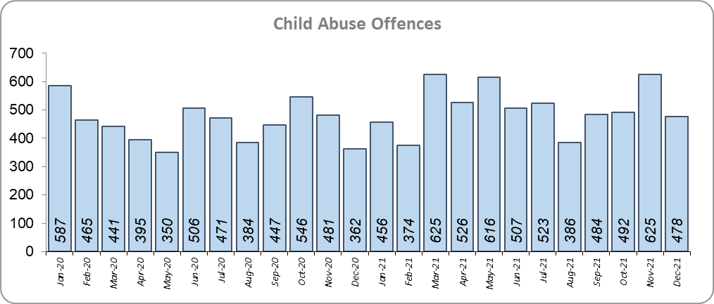
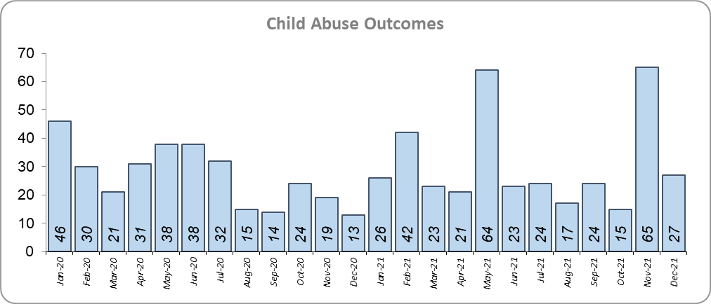
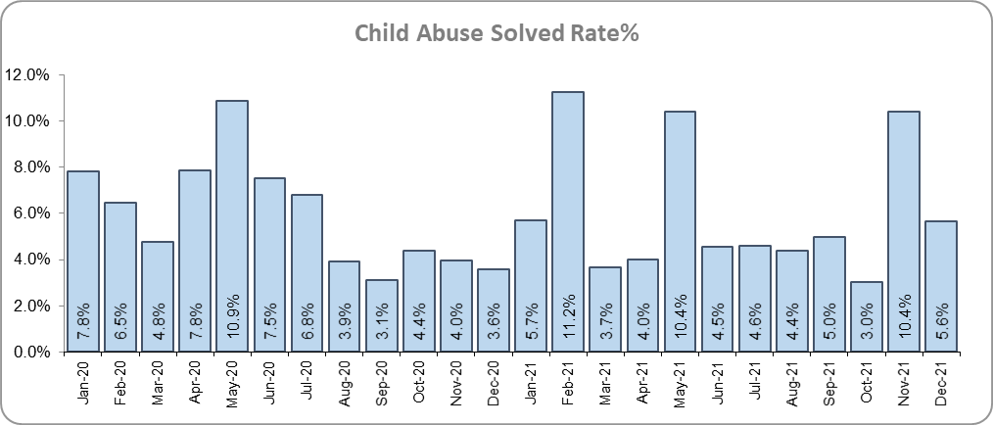
Priority 6 - Protecting children & vulnerable people
Grade: Good
There was a 23.7% increase (476 more) in the number of Child Sexual Abuse/Exploitation investigations in the 12 months to December 2021 compared to the 12 months to December 2020 and a 13.2% increase (44 more) in the number of solved Child Abuse Outcomes. Compared to the 12 months to December 2019, the number of child abuse solved outcomes in the last year increased by 37.5% (103 more outcomes).
21.6% more Child Sexual Abuse/Exploitation investigations (an increase of 441) were recorded in the 12 months to December 2021 compared to the 12 months to December 2019.
11.9% more Child Abuse offences (an increase of 650) were recorded in the 12 months to December 2021 compared to the 12 months to December 2020. The number of child abuse offences increased by 16.6% (871 more offences) in the 12 months to December 2021 compared to the 12 months to December 2019.
173 Modern Slavery referrals were made in the 12 months to December 2021 compared with 103 in the 12 months to December 2020 (70 more).
Following continued improving performance over the preceding 12 months, Essex Police have now solved 44 more Child Abuse investigations in the 12 months to December 2021 compared to the 12 months to December 2020. Due to the increase in the number of child abuse outcomes, a grade of Good is recommended.
* Due to a change in recording of Modern Slavery referrals in April 2019 it is not possible to compare the 12 months to December 2019 to the 12 months to December 2021.

Slide 11
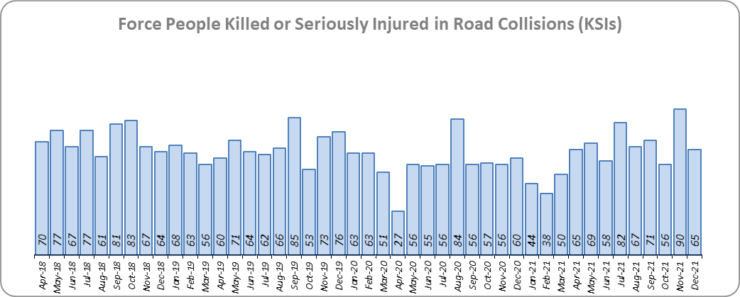
Priority 7 - Improve safety on our roads
Grade: Good
There was a 10.4% increase (71 more) in the number of those Killed or Seriously Injured (KSI) in Essex for the 12 months to December 2021 compared to the 12 months to December 2020. The number of KSIs decreased by 8.3% (68 fewer offences) in the 12 months to December 2021 compared to the 12 months to December 2019. Please note that most KSIs do not necessarily result in criminal offences (such as death or serious injury caused by dangerous driving) being recorded. Essex is sixth in its Most Similar Group (MSG) of forces for casualties per 100 million vehicle kilometres (results to December 2020) and is slightly worse than the MSG average. However, due to the fact that more recent national figures have not been released, the current position cannot be determined (the date of the next national release has not yet been confirmed).
There was an 13.2% decrease (69 fewer offences) in the number of driving related mobile phone offences recorded for the 12 months to December 2021 compared to the 12 months to December 2020.*
There was also a 31.5% decrease (1,299 fewer offences) in drink/drug driving offences for the 12 months to December 2021 compared to the 12 months to December 2020; of these offences, there was a 2.5% increase (34 more offences) in drink driving and a 53.3% decrease (1,251 fewer offences) in drug driving. This compares with a 23.8% decrease (884 fewer offences) in drink/drug driving offences for the 12 months to December 2021 compared to the 12 months to December 2019; of these offences, there was a 5.4% decrease (79 fewer offences) in drink driving and a 40.7% decrease (750 fewer offences) in drug driving. All of these offence types are primarily driven by police proactivity in relation to road safety.
Due to the decrease in the number of drink/drug driving offences in the past 12 months, a grade of Good is recommended.
* In 2019, the definition as to what constituted “use” of a mobile phone in relation to driver-related mobile phone offences was subject to a legal challenge. This resulted in a ruling, which held that while “use” included accessing the interactive functions of the mobile phone (such as making calls, sending messages or using the internet), it did not extend to solely accessing the device’s internal functions (such as making use of the camera). Fewer mobile phone offences were subsequently prosecuted from this point. In 2021, however, the law was changed: it is now illegal to “hold” a phone or sat nav when driving or riding a motorcycle. Offences may therefore start to increase. No data are not available for the 12 months to December 2019 due to a technical issue.

Slide 12
Monthly Performance Overview: Of Note
Monthly Performance Overview: Exceptions
COVID-19: Restrictions of movement and social distancing
Since 13 March 2020, the Government implemented a series of alert levels and steps regarding the level of social distancing allowed in relation to COVID-19. Each change has affected the number of All Crime offences recorded.
On 20 December 2020 the Government introduced Tier 4 – Stay at Home and on 5th January 2021 a third period of increased restrictions was implemented.
In March 2021 the Government announced its roadmap out of restrictions, starting with Step 1 on 8th March, Step 1a on 29th March and Step 2 on 12th April.

Slide 13
Monthly Performance Overview: Of Note (continued)
Monthly Performance Overview: Exceptions
COVID-19: Restrictions of movement and social distancing
The Government continued on its roadmap out of restrictions with Step 3 on 17th May 2021 and Step 3a on 21st June.

Slide 14
Monthly Performance Overview: Of Note (continued)
Monthly Performance Overview: Exceptions
COVID-19: Restrictions of movement and social distancing
On 19th July 2021 all legal restrictions were lifted but the Government urged caution due to rising case numbers.
On 30th November 2021 the Government reintroduced the mandatory wearing of face coverings in some settings due to the discovery of the highly transmissible variant Omicron.
On 10th December the Government announced Plan B with extra restrictions being implemented on the 10th, 13th and 15th December.

Slide 15
2016-2021 Police and Crime Plan Performance Indicators
Table 1
Please view above table with the explanations and caveats detailed on page 16.

Slide 16
End Notes
¹ Question from the independent survey commissioned by Essex Police (Percentage of people who have confidence in policing in Essex). Results are for the period 12 months September 2021 versus the 12 months to September 2020.
² The confidence interval is the range +/- between where the survey result may lie. This is mainly influenced by the number of people answering the survey. The more people that answer the survey, the smaller the interval range.
³ Crime Survey of England and Wales data are no longer available at Force level. Data are for the 12 months to March 2020.
⁴ Question from Essex Police’s own confidence and perception survey (Percentage of people who have confidence that the policing response to ASB is improving). Results are for the period 12 months to September 2021 versus the 12 months to September 2020.
⁵ Solved outcomes are crimes that result in: charge or summons, caution, crimes taken into consideration, fixed penalty notice, cannabis warning or community resolution.
⁶ ‘Killed or Seriously Injured’ (KSI) refers to all people killed or seriously injured on Essex’s roads, regardless of whether any criminal offences were committed. ‘Causing Death/Serious Injury by Dangerous/Inconsiderate Driving’ offences (detailed on p.11) refers to the number of crimes of this type.
⁷ Please note that on Wednesday 23 October 2019 the bodies of 39 Vietnamese nationals were discovered in a lorry trailer in Grays. This tragic incident is reflected in the Homicide numbers.
⁸ Crime Severity Score measures ‘relative harm’ of crimes by taking into account both the volume and the severity of offences, and by weighting offences differently. Data are for the 12 months to October 2021.
⁹ The number of knife crime offences is an indicator of how effective Essex Police is at identifying knife-enabled offences, and is not necessarily reflective of the number of these offences that have been committed in the county. This is because the identification of these offences is reliant on the appropriate indicator being manually added to the crime record. A manual review of knife flags was conducted and missing flags were added retrospectively. Additionally a new data quality process was introduced in June 2020. Whilst this has enabled us to better understand knife crime in Essex, the process has consequently inflated the figures. As such, no inferences can be drawn as to the current trend.
¹⁰ In 2019, the definition as to what constituted “use” of a mobile phone in relation to driver-related mobile phone offences was subject to a legal challenge. This resulted in a ruling, which held that while “use” included accessing the interactive functions of the mobile phone (such as making calls, sending messages or using the internet), it did not extend to solely accessing the device’s internal functions (such as making use of the camera). Fewer mobile phone offences were subsequently prosecuted from this point. In 2021, however, the law was changed: it is now illegal to “hold” a phone or sat nav when driving or riding a motorcycle. It is therefore likely that offences will now start to increase.
¹¹ NRM data only available from April 2019 due to recording change at that time.
¹² OCG disruptions are now reported quarterly. Data are to December 2021.
¹³ October 2021 saw the implementation of Operation SOMERTON, which aims to both improve the service given to victims of ASB and ensure crimes are correctly recorded.
¹⁴ During the 2016-2021 period Home Office Counting Rules changed in April 2018 (Stalking and Harassment double-counting introduced) and July 2019 (all breaches recorded in addition to main crime resulting in double-counting). Additionally, in January 2019 the Fire Service began reporting intentional fires to the police. These changes resulted in a higher number of offences being recorded.

Slide 17
2016-2021 Police and Crime Plan Final Summary: Of Note
Monthly Performance Overview: Exceptions
Essex Police won two Gold iESE Public Sector Transformation Awards: September 2021
Essex Police was awarded two Gold Awards in the Improvement and Efficiency Social Enterprise (iESE) Public Sector Transformation Awards, which celebrate the most innovative practices in transforming local public services. The first award, ‘Police Force of the Year’, was for transforming the Force to an organisation which is ‘exceptional’ in respecting victims of crime by accurately recording offences, and with record levels of trust. The second award, the ‘Customer Focus’ award, was for Operation HARRIER, which makes use of GPS technology to support vulnerable, high risk missing persons living with Alzheimer’s and Dementia who have previously been reported missing to the police.
Essex Police Specials honoured by the Queen: November 2021
Our volunteer police officers were presented with The Queen’s Award to mark the huge contribution they make in helping to keep our county safe.
The Queen’s Award for Voluntary Service is described as the MBE for voluntary groups. It recognises the very special achievement by volunteers who regularly devote their time to helping others in the community, improving the quality of life and opportunity for others and providing outstanding service. It is the highest award for local voluntary groups and is awarded for life.
The award included a ‘special designation’ for the support our Specials provided during the early months of the COVID-19 pandemic last year. During the first lockdown, many of our Specials were furloughed from their day jobs and increased their contribution, volunteering more than 54,000 operational hours and providing visible policing to help their communities during unprecedented times.
We Value Difference: September 2020
Essex Police launched its ‘We Value Difference’ campaign, which is a part of Essex Police’s ‘Fit the Bill’ recruitment drive. This campaign promotes diversity and inclusivity within the Force and celebrates difference throughout the Force. The overall message is ‘we are all different but share the same values’, and dispels myths that you must be a certain type of person to be a police officer. The campaign predominantly focuses on nine strands of difference: personality, age, cultural background, ethnicity, sexual orientation, gender, language, education and faith ensuring that Essex Police better represent the people they serve. In December 2021 ethnic minorities accounted for 4.3% of the total work force (281 employees), this is an increase of 1.7% points compared to December 2016 (2.6% of the total work force, 141 employees).
Essex graded as Outstanding in its HMICFRS Crime Data Integrity (CDI) inspection: September 2020
Essex was graded as Outstanding in its HMICFRS Crime Data Integrity (CDI) inspection. Essex Police was only the third force of the 41 that have been inspected judged as outstanding on the first visit in this inspection programme.
7 Force Commercial Services team won national Public Procurement Award: September 2020
The 7 Force Commercial Services team won the Team of the Year award at the national Government Opportunities Excellence in Public Procurement Awards 2020/21. The awards recognise the tireless efforts of those working in procurement and commercial functions who ensure public money is spent effectively to deliver key public services. The team was recognised for showing innovation and ingenuity to ensure spending of public money creates lasting social and economic benefit for our communities.
Essex Police Cyber Crime Unit (CCU) named top in country: June 2020
In June 2020 the City of London Police published their annual data on cyber and fraud, which highlighted that the Essex Police Cyber Crime Unit was the most successful of all police forces. 56% of all charges for cybercrime offences in the UK were gained by Essex Police’s CCU, and two of its officers were recognised for their work at the National Police Chiefs’ Council Cyber Awards. At the same time, the Unit have been working on a number of prevention initiatives to support people to protect themselves against online fraud and crime.

Slide 18
Crime Tree Data – Rolling 12 Months to December
Table 3

Slide 19
Crime Tree Data – Rolling 12 Months to December
Table 4

