Slide 1
Police and Crime Plan 2021-2024
Monthly Performance Update
January 2022
National and MSG positions are to 30 November 2021 (Essex Police data are to 31 January 2022).
Version 1.4_1
Produced February 2022
Performance Analysis Unit, Essex Police
Sensitivity: Official

Slide 2
Executive Summary
The Police and Crime Plan 2021 -2024 was introduced in April 2021¹ with new measures that reflect the new strategic commitment of targeted prevention and early intervention. This is the first report detailing Essex Police’s performance against these measures.
Six of the eleven PFCC Priorities have been given a recommended grade of ‘Adequate’. Five of the eleven PFCC priorities have been given a recommended grade of ‘Requires Improvement’: 4 (Improving safety on our roads), 6 (Improving our service to support victims of crime), 7 (Violence against women and girls), 9 (Business Crime, Fraud and Cyber Crime) and 10 (Protecting vulnerable people and supporting victims of crime). It is of note that in order to remain in line with the HMICFRS grading structure, a new grade of “Adequate” has been introduced; the grades of “Outstanding”, “Good”, and “Requires Improvement” remain.
Confidence (from the independent survey commissioned by Essex Police) is at 80.1% (results to the 12 months to December 2021). Compared to year ending December 2020, confidence in the local police has increased by 3.8% points.
All Crime increased by 7.0% for the 12 months to January 2022 compared to the 12 months to January 2021; this equates to 10,530 more offences. This increase has been primarily influenced by the Government’s restrictions on gathering and movement in relation to COVID-19. The Force also recorded 2,668 more offences in January 2022 compared to April 2020, when the Government implemented the first lockdown; this equates to 25.8% more offences.
Each change in the rules relating to social distancing has affected the number of All Crime offences reported to Essex Police.²
There was a 4.3% decrease in All Crime in the 12 months to January 2022 compared to the 12 months to January 2020. This equates to 7,278 fewer offences.
There was a 21.9% increase (147 more) in the number of those Killed or Seriously Injured (KSI) in Essex for the 12 months to January 2022 compared to the 12 months to January 2021.
Essex experienced a 10.4% increase (4,392) in the number of repeat victims for the 12 months to January 2022 compared to the 12 months to January 2021.
Violence against the person offences against females increased by 9.2% (3,308 more), and there was a 33.4% increase (1,228 more) in the number of sexual offences against females in the 12 months to January 2022 compared to the 12 months to January 2021. The number of sexual offences against females solved decreased by 6.0% (17 fewer) in the same period.
There has been a slight increase (0.3%) in the proportion of ethnic minority employees in January 2022 (291) compared to January 2021 (265). This equates to 26 additional employees.
There were no statistical outliers in the month of January 2022.
¹ Data for the period April 2021 to January 2022 can be seen on pages 21 and 22.
² Please see table showing the effect of social distancing measures on pages 17-20.

Slide 3
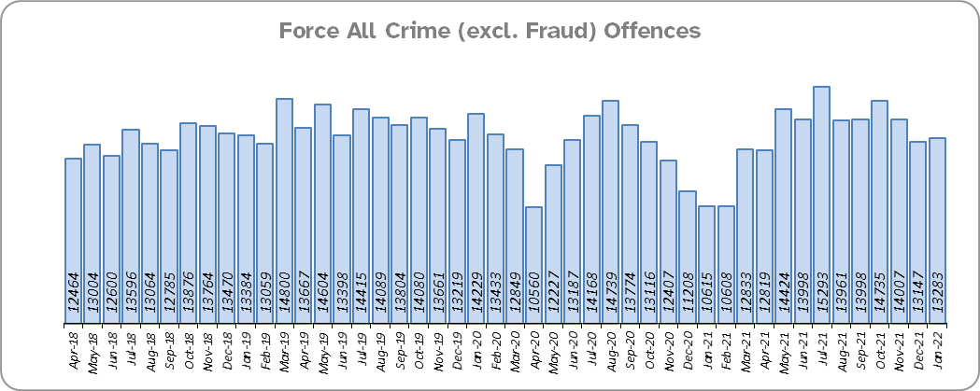
Priority 1 – Further investment in Crime Prevention
Grade: Adequate
Essex experienced a 7.0% increase in All Crime (10,530 more offences) for the 12 months to January 2022 compared to the 12 months to January 2021. This increase in crime has been primarily influenced by the Government’s restrictions on gathering and movement in relation to COVID-19. Essex is eighth in its Most Similar Group of forces (MSG) for crime per 1,000 population.
There was a 4.3% decrease in All Crime in the 12 months to January 2022 compared to the 12 months to January 2020; this equates to 7,278 fewer offences.
Essex Police recorded a daily average of 428 crimes in January 2022, compared with an average of 424 crimes in December 2021. This equates to an increase of 1.0%, or an average of 4 more crimes recorded per day.
13,283 offences were recorded in the month of January 2022, an increase of 25.1% (2,668 more offences) compared to the month of January 2021 (10,615 offences). There was a 6.6% decrease in the month of January 2022 compared to the month of January 2020 (14,229 offences).

Slide 4
Priority 1 - Further investment in Crime Prevention
Grade: Adequate
Confidence (from the independent survey commissioned by Essex Police) is at 80.1% (results to the 12 months to December 2021). Compared to year ending December 2020, confidence in the local police has increased (an improvement of 3.8% points).
The All Crime Harm (Crime Severity) Score** (13.7) places Essex seventh in its MSG.
Although confidence in policing in Essex has improved, Essex is eighth in its Most Similar Group of forces (MSG) for crime per 1,000 population, and the All Crime Harm (Crime Severity) Score is above the MSG average. A grade of Adequate is therefore recommended.
Please note:
* Crime Severity Scores (as calculated by the Office for National Statistics) measure the ‘relative harm’ of crimes by taking into account both their volume and their severity. Data are for the 12 months to November in all three years.

Slide 5
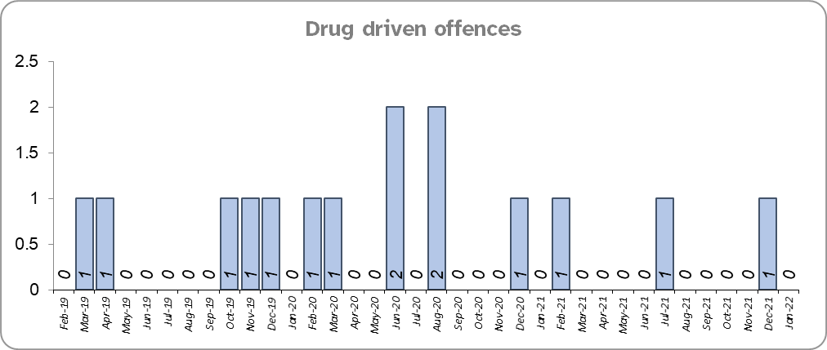
Priority 2 – Reducing Drug Driven Violence
Grade: Adequate
Essex experienced 4 fewer drug related homicides for the 12 months to January 2022 compared to the 12 months to January 2021.
There were two fewer drug related homicides for the 12 months to January 2022 compared to the 12 months to January 2020.
Confidence that Essex Police and partners are dealing with drug crime (from the independent survey commissioned by Essex Police) is at 61.3% for the period September 2021 to December 2021.
Due to the low number of drug related homicides, and as confidence data are for one quarter only, a grade of Adequate is recommended.
Please note:
* The methodology used for identifying these investigations as drug related is subjective and based on the circumstances presented. These figures will include investigations where the victim and/or suspect are suspected of being involved in Drug Use, Possession or Selling.
** The confidence question was added to the internal survey in September 2021. A year on year comparison is therefore not available.

Slide 6
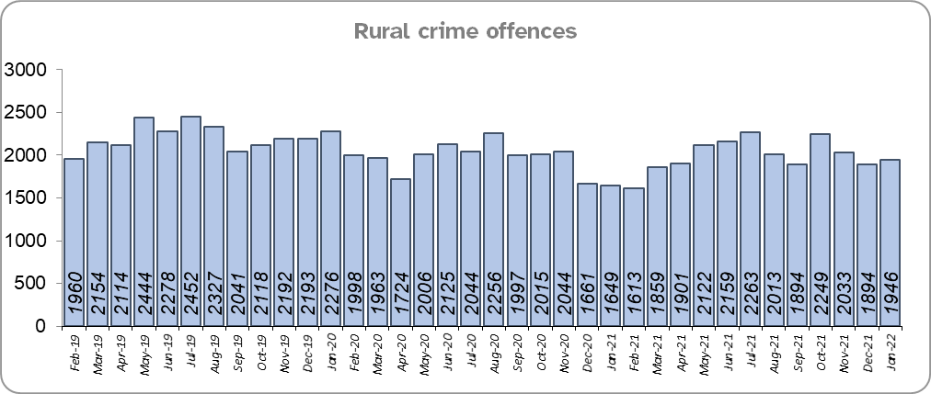
Priority 3 – Protect rural and isolated areas
Grade: Adequate
Essex experienced a 2.0% increase in rural crime (464 more offences) for the 12 months to January 2022 compared to the 12 months to January 2021 (All Crime in Essex increased by 7.0% in the same period). Rural Crime decreased by 9.8% (2,603 fewer offences), however, in the 12 months to January 2022 compared to the 12 months to January 2020 (All Crime in Essex decreased by 4.3% in the same period).
The rural crime Harm (Crime Severity) Score* was 8.5 for November 2021.
Confidence in rural policing (from the independent survey commissioned by Essex Police) is at 82.9% (results to the 12 months to December 2021). Compared to year ending December 2020, confidence in the local police has increased (an improvement of 4.5% points).
Due to the fact that confidence in the local police has increased, but the number of rural crime offences has also increased, a grade of Adequate is recommended.
Please note:
* Crime Severity Scores (as calculated by the Office for National Statistics) measure the ‘relative harm’ of crimes by taking into account both their volume and their severity. eeData are for the 12 months to November in all three years. National data are not available so it is not possible to measure against an MSG average.

Slide 7
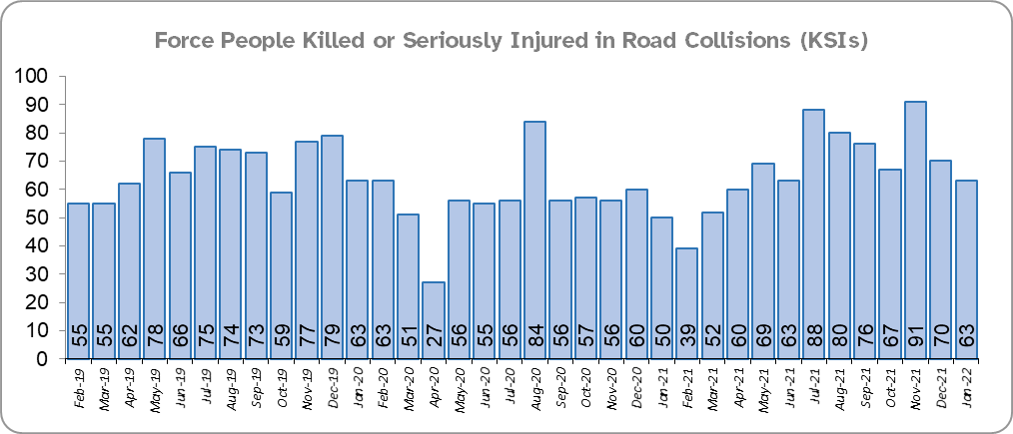
Priority 4 - Improving safety on our roads
Grade: Requires Improvement
There was a 21.9% increase (147 more) in the number of those Killed or Seriously Injured (KSI) in Essex for the 12 months to January 2022 compared to the 12 months to January 2021. The number of KSIs also increased in the 12 months to January 2022 compared to the 12 months to January 2020 (two more casualties).
Essex is sixth in its Most Similar Group (MSG) of forces for casualties per 100 million vehicle kilometres (results to December 2020) and is slightly higher than the MSG average. However, due to the fact that more recent national figures have not been released, the current position cannot be determined (the date of the next national release has not yet been confirmed).
Please note that most KSIs do not necessarily result in criminal offences (such as death or serious injury caused by dangerous driving) being recorded.

Slide 8
Priority 4 - Improving safety on our roads
Grade: Requires Improvement
There was a 30.1% decrease (1,227 fewer offences) in drink/drug driving offences for the 12 months to January 2022 compared to the 12 months to January 2021; of these offences, there was an 8.5% increase (112 more offences) in drink driving and a 54.7% decrease (1,276 fewer offences) in drug driving. This compares with a 23.5% decrease (872 fewer offences) in drink/drug driving offences for the 12 months to January 2021 compared to the 12 months to January 2020; of these offences, there was a 3.0% decrease (44 fewer offences) in drink driving and a 42.1% decrease (769 fewer offences) in drug driving. All of these offence types are primarily driven by police proactivity in relation to road safety.
There was also an 11.9% decrease (60 fewer offences) in the number of driving related mobile phone offences recorded for the 12 months to January 2022 compared to the 12 months to January 2021.*
Confidence that Essex Police and organisations they work with policing the roads (from the independent survey commissioned by Essex Police) is at 63.9% (results to the 12 months to December 2021). Compared to year ending December 2020, confidence in the local police has decreased by 11.6% points.
Due to the increase in KSIs in the past 12 months, and significant decreases in the past six months in the number of driving under the influence of drink and/or drugs, a grade of Requires Improvement is recommended.
Please note:
* In 2019, the definition as to what constituted “use” of a mobile phone in relation to driver-related mobile phone offences was subject to a legal challenge. This resulted in a ruling, which held that while “use” included accessing the interactive functions of the mobile phone (such as making calls, sending messages or using the internet), it did not extend to solely accessing the device’s internal functions (such as making use of the camera). Fewer mobile phone offences were subsequently prosecuted from this point. In 2021, however, the law was changed: it is now illegal to “hold” a phone or sat nav when driving or riding a motorcycle. Offences may therefore start to increase.

Slide 9
Priority 5 – Encouraging Volunteers and Community Support
Grade: Adequate
Confidence that there are good opportunities for volunteers to assist policing and reduce crime in Essex (from the independent survey commissioned by Essex Police) is at 61.6% for the period September 2021 to December 2021.
As confidence data are for one quarter only (and there is no comparison), a grade of Adequate is recommended.
Please note:
* The confidence question was added to the internal survey in September 2021 so year on year comparison is not available.

Slide 10
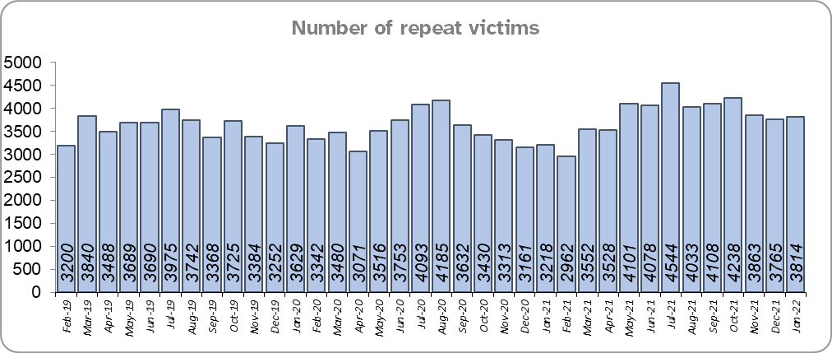
Priority 6 – Improving our services to support victims of crime
Grade: Requires Improvement
Essex experienced a 10.4% increase (4,392) in the number of repeat victims for the 12 months to January 2022 compared to the 12 months to January 2021.
There was an 8.4% increase (3,604 more) in the number of repeat victims in the 12 months to January 2022 compared to the 12 months to January 2020.
Confidence (from the independent survey commissioned by Essex Police) is at 61.0% (results to the 12 months to December 2021). Compared to year ending December 2020, confidence in the local police has remained stable.
Due to the fact that the number of repeat victims has increased, a grade of Requires Improvement is recommended.
Please note:
* Repeat victims will have reported more than one crime to Essex Police in the previous year.

Slide 11
Priority 7 – Violence against women and girls
Grade: Requires Improvement
Essex experienced a 9.2% increase (3,308 more) in the number of violence against the person offences against females in the 12 months to January 2022 compared to the 12 months to January 2021. There was a 10.2% increase in the 12 months to January 2022 compared to the 12 months to January 2020; this equates to 3,640 more offences.
There was a 33.4% increase (1,228 more) in the number of sexual offences against females and a 6.0% decrease (17 fewer) in the number of sexual offences against females solved in the 12 months to January 2022 compared to the 12 months to January 2021.
There was a 21.6% increase (871 more) in the number of sexual offences against females and a 20.5% increase (45 more) in the number of sexual offences against females solved in the 12 months to January 2022 compared to the 12 months to January 2020.
Confidence of those who feel safe walking alone in their area after dark (from the independent survey commissioned by Essex Police) is at 41.2% for the period September 2021 to December 2021.
The number of sexual offences solved has decreased, the number of violence against the person offences has increased in each of the past six year-on-year comparisons, and the number of sexual offences against females has increased significantly in each of the past four year-on-year comparisons. Due to the deterioration in these measures, a grade of Requires Improvement is recommended.
Please note:
* Please see page 26 for table of violence against the person and sexual offences and outcomes (by crime type) split by gender.
** The confidence question was added to the internal survey in September 2021 so year on year comparison is not available.

Slide 12
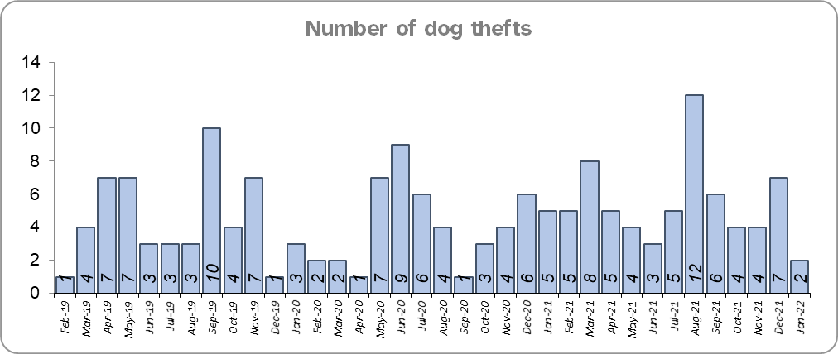
Priority 8 – Dog theft
Grade: Adequate
Essex experienced 15 more dog thefts for the 12 months to January 2022 compared to the 12 months to January 2021. There were 12 more dog thefts in the 12 months to January 2022 compared to the 12 months to January 2020.
Confidence as to how Essex Police and the organisations they work with are dealing with dog theft (from the independent survey commissioned by Essex Police) is at 63.6% for the period September 2021 to December 2021.
As confidence data are for one quarter only, a grade of Adequate is recommended.
Please note:
* This is number of thefts in which dogs were stolen, and not quantity of dogs stolen in each theft. Data are based on theft offence crimes and robbery offence crimes where the ‘property code’ is ‘pet animal – dog’ and the ‘property status’ is ‘stolen’ and/or ‘stolen/recovered’, broken down by month and year as requested.
** The confidence question was added to the internal survey in September 2021 so year on year comparison is not available.

Slide 13
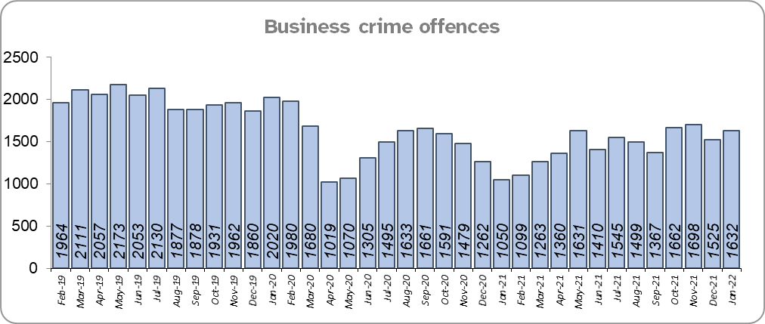
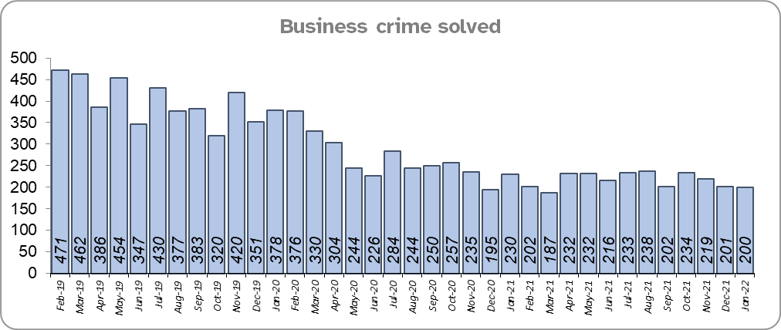
Priority 9 – Business Crime, Fraud and Cyber Crime
Grade: Requires Improvement
Essex experienced a 2.7% increase (466 more) in the number of business crime offences and an 18.2% decrease (579 fewer) in the number of business crime offences solved in the 12 months to January 2022 compared to the 12 months to January 2021.
There was a 26.3% decrease (6,325 fewer) in the number of business crime offences and a 45.7% decrease (2,183 fewer) in the number of business crime solved in the 12 months to January 2022 compared to the 12 months to January 2020.
Confidence as to whether the police response to tackling cyber crime is improving (from the independent survey commissioned by Essex Police) is at 51.1% for the period September 2021 to December 2021.
Due to the decrease in the number of business crime solved a grade of Requires Improvement is recommended.
Please note:
* Please see page 27 for business crimes grouped into retail clusters
** The confidence question was added to the internal survey in September 2021 so year on year comparison is not available.

Slide 14
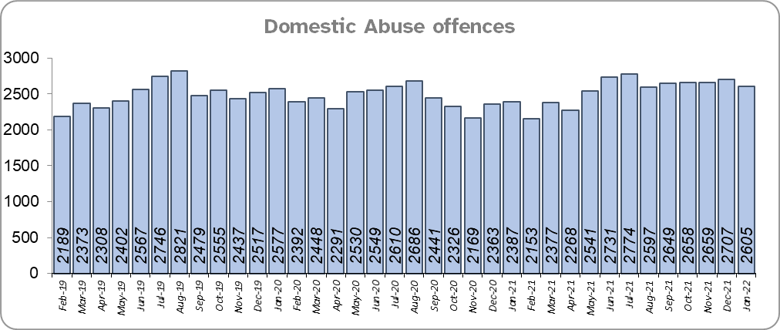
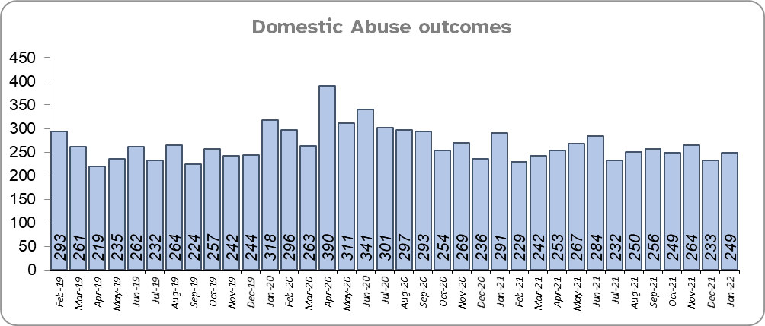
Priority 10 - Protecting vulnerable people and supporting victims of crime
Grade: Requires Improvement
Essex experienced a 5.2% increase (1,527 more) in Domestic abuse incidents and a 15.1% decrease (534 fewer) in the number of Domestic abuse incidents solved for the 12 months to January 2022 compared to the 12 months to January 2021.
There was a 2.5% increase (748 more) in Domestic Abuse incidents and a 1.4% decrease (43 fewer) in the number of Domestic abuse incidents solved for the 12 months to January 2022 compared to the 12 months to January 2020.

Slide 15
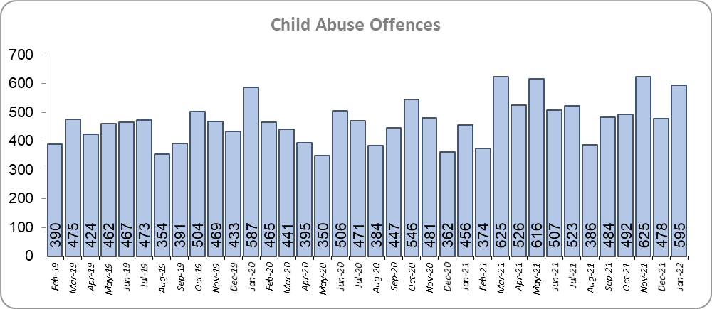
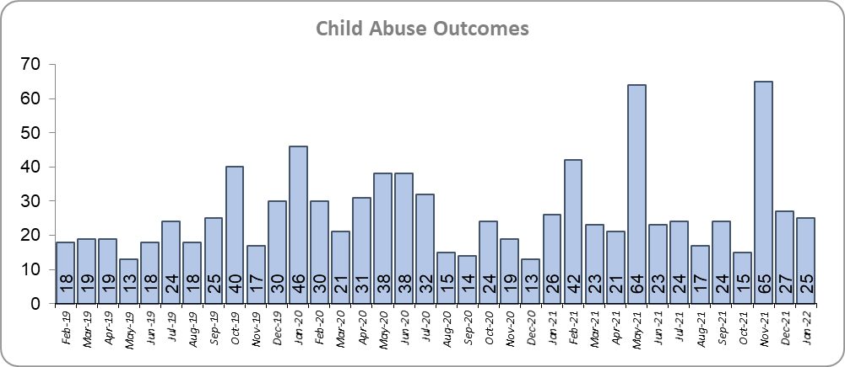
Priority 10 - Protecting vulnerable people and supporting victims of crime
Grade: Requires Improvement
Essex experienced a 17.5% increase (927 more) in child abuse offences and a 22.9% increase (69 more) in the number of child abuse offences solved for the 12 months to January 2022 compared to the 12 months to January 2021.
There was a 14.8% increase (802 more) in child abuse offences and a 28.9% increase (83 more) in the number of child abuse offences solved for the 12 months to January 2022 compared to the 12 months to January 2020.
Confidence that the policing response to protect children and vulnerable people is improving (from the independent survey commissioned by Essex Police) is at 86.3% (results to the 12 months to December 2021). Compared to year ending December 2020, confidence has decreased by 3.4% points.
Due to the fact that confidence levels and the number of domestic abuse offences solved have decreased, a grade of Requires Improvement is recommended.

Slide 16
Priority 11 - Staff
Grade: Adequate
There has been a slight increase (0.3%) in the proportion of ethnic minority employees in January 2022 (291) compared to January 2021 (265); this equates to 26 additional employees. There has also been an increase (0.9%) compared to January 2020 (217); this equates to 74 additional employees.
Due to the low percentage of ethnic minority employees a grade of Adequate is recommended.
Please note:
* Ethnic minority employees as a percentage of the total workforce.
** Type of employee as a percentage of all ethnic minority employees.

Slide 17
2021-2024 Police and Crime Plan Performance Indicators
Table 1
As the new measures were implemented in April 2021, an additional column showing data for the interim period is included.
Please view above table with the explanations and caveats detailed on page 23.

Slide 18
2021-2024 Police and Crime Plan Performance Indicators (Continued)
Table 2
As the new measures were implemented in April 2021, an additional column showing data for the interim period is included.
Please view above table with the explanations and caveats detailed on page 23.

Slide 19
End Notes
¹ Question from the independent survey commissioned by Essex Police. Results are for the period 12 months December 2021 versus the 12 months to December 2020.
² The confidence interval is the range +/- between where the survey result may lie. This is mainly influenced by the number of people answering the survey. The more people that answer the survey, the smaller the interval range.
³ Crime Severity Score measures ‘relative harm’ of crimes by taking into account both the volume and the severity of offences, and by weighting offences differently. Data are for the 12 months to September 2021.
⁴ The methodology used for identifying these investigations as drug related is subjective and based on the circumstances presented. These figures will include investigations where the victim or the suspect are involved Drug Use, Possession or Selling.
⁵ ‘Killed or Seriously Injured’ (KSI) refers to all people killed or seriously injured on Essex’s roads, regardless of whether any criminal offences were committed. ‘Causing Death/Serious Injury by Dangerous/Inconsiderate Driving’ offences (detailed on p.7) refers to the number of crimes of this type.
⁶ In 2019, the definition as to what constituted “use” of a mobile phone in relation to driver-related mobile phone offences was subject to a legal challenge. This resulted in a ruling, which held that while “use” included accessing the interactive functions of the mobile phone (such as making calls, sending messages or using the internet), it did not extend to solely accessing the device’s internal functions (such as making use of the camera). Fewer mobile phone offences were subsequently prosecuted from this point. In 2021, however, the law was changed: it is now illegal to “hold” a phone or sat nav when driving or riding a motorcycle. It is therefore likely that offences will now start to increase.
⁷ Solved outcomes are crimes that result in: charge or summons, caution, crimes taken into consideration, fixed penalty notice, cannabis warning or community resolution.
⁸ This is number of thefts in which dogs were stolen, and not quantity of dogs stolen in each theft.
⁹ Ethnic minority employees as a percentage of the total workforce.

Slide 20
Crime Tree Data – Rolling 12 Months to January
Table 3

Slide 21
Crime Tree Data – Rolling 12 Months to January
Table 4

Slide 22
Crime Tree Data - Rolling 12 months to January Violence against the Person and Sexual offences and outcomes (by crime type) split by gender
Table 5
Please note: the breakdown may not agree with the totals on page 24 as gender data is rerun on a monthly basis

Slide 23
April 2016 – March 2021 police and Crime Plan Final Summary¹
All Crime increased by 22.8% for the 12 months to March 2021 compared to the 12 months to March 2017; this equates to 27,470 more offences. Changes in the way offences are recorded and improvements in crime data accuracy as indicated in the nationally recognised work carried out by the Performance Analysis Unit (PAU) at Essex Police, have affected the totals over this period.² In November 2019, the PAU produced a paper detailing the estimated ‘actual’ increase in crime, namely how many additional calls for service are being received that relate to crime. This was in order to distinguish this actual rise from the volume of additional offences that are now being recorded by Essex Police as a result of improved Crime Data Accuracy (CDA), or changes to Home Office Counting Rules (HOCR). This paper concluded that 1 in 10 of the 70,000 additional crimes Essex Police recorded each year between May 2015 and July 2019 was as a result of an actual increase in crime. 9 out of 10 of the additional crimes recorded in each of these years is as a result of better CDA, and changes to HOCR; this equates to around 60,000 additional offences per year.
From March 2020 to December 2021 all data have been skewed by the pandemic. The All Crime totals were heavily influenced by the Government’s restrictions on gathering and movement in relation to COVID-19. Each change in the rules relating to COVID-19 have affected the number of All Crime offences reported to Essex Police. April 2020 was the first full month of restrictions during which the lowest number of offences since April 2018 (10,560) were seen. January and February 2021 also saw low numbers of offences (10,615 and 10,608 respectively) due to a period of increased restrictions.³
Essex experienced a 15.6% increase (8,159) in Anti-Social Behaviour (ASB) incidents for the 12 months to March 2021 compared to the 12 months to March 2017. The number of ASB incidents decreased year on year in the period 12 months to March 2017 to the 12 months to March 2020 but rose by 46.2% (19,067 incidents) in the 12 months to March 2021 (60,329 incidents) compared to the same period in the previous year (41,262 incidents) following the restrictions implemented by the Government during the pandemic.
There was a 20.0% increase (3 more) in the number of Homicides in the 12 months to March 2021 (18 offences) compared to the 12 months to March 2017 (15 offences). There is a very high correlation (97%) between population and homicide and since 2017 the overall 12-monthly trend for homicides has remained stable. Homicides are monitored closely at homicide prevention meetings which were well received by the policing minister.
The number of people killed or seriously injured (KSI) in road collisions decreased by 34.4% in the 12 months to March 2021 (641) compared to the 12 months to March 2017 (977).
¹ Additional priority indicators were added to the Police and Crime Plan 2016-2020 in the 12 months to December 2017 and the 12 months to December 2019. Please see etable on page 31. In 2020 the Police and Crime Plan 2016-2020 was extended to 2021 due to the COVID-19 pandemic.
² During the 2016-2021 period Home Office Counting Rules changed in April 2018 (Stalking and Harassment double-counting introduced) and July 2019 (all breaches erecorded in addition to main crime resulting in double-counting). Additionally, in January 2019 the Fire Service began reporting intentional fires to the police. These echanges resulted in a higher number of offences being recorded.
³ Please see chart on page 3 for the breakdown of monthly totals for all crime offences.

Slide 24
April 2016 – March 2021 Police and Crime Plan Final Summary: Of Note
We Value Difference: September 2020
Essex Police launched its ‘We Value Difference’ campaign, which is a part of Essex Police’s ‘Fit the Bill’ recruitment drive. This campaign promotes diversity and inclusivity within the Force and celebrates difference throughout the Force. The overall message is ‘we are all different but share the same values’, and dispels myths that you must be a certain type of person to be a police officer. The campaign predominantly focuses on nine strands of difference: personality, age, cultural background, ethnicity, sexual orientation, gender, language, education and faith ensuring that Essex Police better represent the people they serve. On 31st March 2021 ethnic minorities accounted for 4.2% of the total work force (270 employees), this is an increase of 1.7% points compared to 31st March 2016 (2.5% of the total work force, 140 employees).
Essex graded as Outstanding in its HMICFRS Crime Data Integrity (CDI) inspection: September 2020
Essex was graded as Outstanding in its HMICFRS Crime Data Integrity (CDI) inspection. Essex Police was only the third force of the 41 that have been inspected judged as outstanding on the first visit in this inspection programme.
7 Force Commercial Services team won national Public Procurement Award: September 2020
The 7 Force Commercial Services team won the Team of the Year award at the national Government Opportunities Excellence in Public Procurement Awards 2020/21. The awards recognise the tireless efforts of those working in procurement and commercial functions who ensure public money is spent effectively to deliver key public services. The team was recognised for showing innovation and ingenuity to ensure spending of public money creates lasting social and economic benefit for our communities.
Essex Police Cyber Crime Unit (CCU) named top in country: June 2020
In June 2020 the City of London Police published their annual data on cyber and fraud, which highlighted that the Essex Police Cyber Crime Unit was the most successful of all police forces. 56% of all charges for cybercrime offences in the UK were gained by Essex Police’s CCU, and two of its officers were recognised for their work at the National Police Chiefs’ Council Cyber Awards. At the same time, the Unit have been working on a number of prevention initiatives to support people to protect themselves against online fraud and crime.

Slide 25
April 2016 – March 2021 Police and Crime Plan Final Summary: Performance Indicators
Table 7

