Slide 1
Police and Crime Plan 2016-2021
Monthly Performance Update
November 2021
National and MSG positions are to 30 September 2021 (Essex Police data are to 30 November 2021).
Version 1.3_4
Produced December 2021
Performance Analysis Unit, Essex Police
Sensitivity: Official

Slide 2
Executive Summary
Since the last report, the recommended grade for Priority 6 (Protecting Children & Vulnerable People) has improved from Requires Improvement to Good. This is because, following continued improving performance over the preceding 12 months, Essex Police have now solved 13 more Child Abuse investigations in the 12 months to November 2021 compared to the 12 months to November 2020.
As a result of the above, five of the seven PFCC Priorities for Essex Police have now been given a recommended grade of ‘Good’; two of the seven PFCC priorities – 3 (Breaking the cycle of Domestic Abuse) and 4 (Tackling Gangs and Serious Violence) – have been given a recommended grade of ‘Requires Improvement’. Recommended grades have been determined with reference to comparisons with Essex Police’s Most Similar Group (MSG) of forces, Key Performance Indicators (KPIs), and professional judgement.
All Crime increased by 0.2% for the 12 months to November 2021 compared to the 12 months to November 2020; this equates to 384 more offences. This increase has been primarily influenced by the Government’s restrictions on gathering and movement in relation to COVID-19. The Force also recorded 3,447 more offences in November 2021 than in April 2020, when the Government implemented the first lockdown; this equates to 32.6% more offences.
Each change in the rules relating to social distancing has affected the number of All Crime offences reported to Essex Police.*
There was a 6.8% decrease in All Crime in the 12 months to November 2021 compared to the 12 months to November 2019; this equates to 11,511 fewer offences.
The Force recorded 390 more Violence with Injury (VWI) offences (44.6% increase) in the month of November 2021 compared to the month of April 2020 (1,265 v. 875 offences). The number of VWI offences recorded in the 12 months to November 2021, however, was lower than the number recorded before COVID restrictions were introduced; compared with the 12 months to November 2019, there was a 6.0% decrease (919 fewer crimes).
Essex experienced a 14.7% decrease (7,596 fewer) in Anti-Social Behaviour (ASB) incidents for the 12 months to November 2021 compared to the 12 months to November 2020. This decrease was due to both a general reduction in the volume of ASB reports received, and the introduction of Operation SOMERTON, which aimed to improve the service given to victims of ASB and ensure that crimes are being correctly recorded; this operation involved the manual review of ASB records, many of which were later reclassified from ASB to other incident types, such as crime.
ASB incidents in the 12 months to November 2021 were 3.8% higher compared to pre-COVID levels; there were 1,619 more incidents in the 12 months to November 2021 compared to the 12 months to November 2019 (43,987 v. 42,368 incidents).
Confidence (from the independent survey commissioned by Essex Police) is at 80.9% (results to the 12 months to September 2021). Compared to year ending September 2020, confidence in the local police increased by 8.5% points.
58 more Modern Slavery referrals were made in the 12 months to November 2021 compared to the same period in 2019-20. Essex Police have increased the number of referrals and worked to achieve greater range and engagement with hard to access groups, thereby creating more opportunities to help vulnerable people. This has resulted in the number of referrals being higher in the 12 months to November 2021 compared to the same period the previous year.
* Please see table showing the effect of social distancing measures on pages 13 - 15.

Slide 3
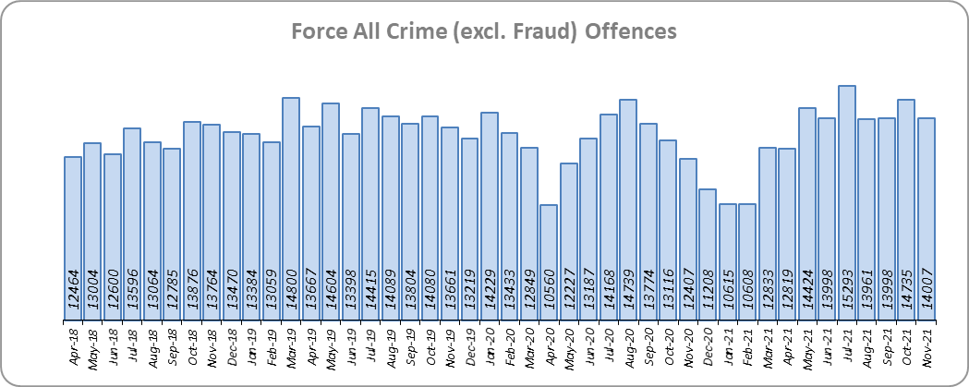
Priority 1 - More local, visible and accessible policing
Grade: Good
Essex experienced a 0.2% increase in All Crime (384 more offences) for the 12 months to November 2021 compared to the 12 months to November 2020. This increase in crime has been primarily influenced by the Government’s restrictions on gathering and movement in relation to COVID-19. Essex is eighth in its Most Similar Group of forces (MSG) for crime per 1,000 population.
There was a 6.8% decrease in All Crime in the 12 months to November 2021 compared to the 12 months to November 2019; this equates to 11,511 fewer offences.
Essex Police recorded a daily average of 467 crimes in November 2021, compared with an average of 475 crimes in October 2021. This equates to a decrease of 1.8%.
14,007 offences were recorded in the month of November 2021, an increase of 12.9% (1,600 more offences) compared to the month of November 2020 (12,407 offences). There was also a 2.5% increase in the month of November 2021 compared to the month of November 2019 (13,661 offences).

Slide 4
Priority 1 - More local, visible and accessible policing
Grade: Good
Confidence (from the independent survey commissioned by Essex Police) is at 80.9% (results to the 12 months to September 2021). Compared to year ending September 2020, confidence in the local police has significantly increased (an improvement of 8.5% points).
The All Crime Harm (Crime Severity) Score** (13.2) places Essex seventh in its MSG.
Essex Police’s performance in relation to emergency response attendance within 15 minutes (urban) or 20 minutes (rural) has improved by 0.6 percentage points to 80.1% in the 12 months to November 2021 compared to the 12 months to November 2020. This is above the 80% target.
Due to the fact that the percentage of people who have confidence in policing in Essex has increased and the emergency response attendance is above the 80% target, a grade of Good is recommended.
Please note:
* Crime Survey of England and Wales data are no longer available at Force level. Data are for the 12 months to March 2020.
** Crime Severity Scores (as calculated by the Office for National Statistics) measure the ‘relative harm’ of crimes by taking into account both their volume and their severity. Data are for the 12 months to September in all three years.
*** Grade of Service.

Slide 5
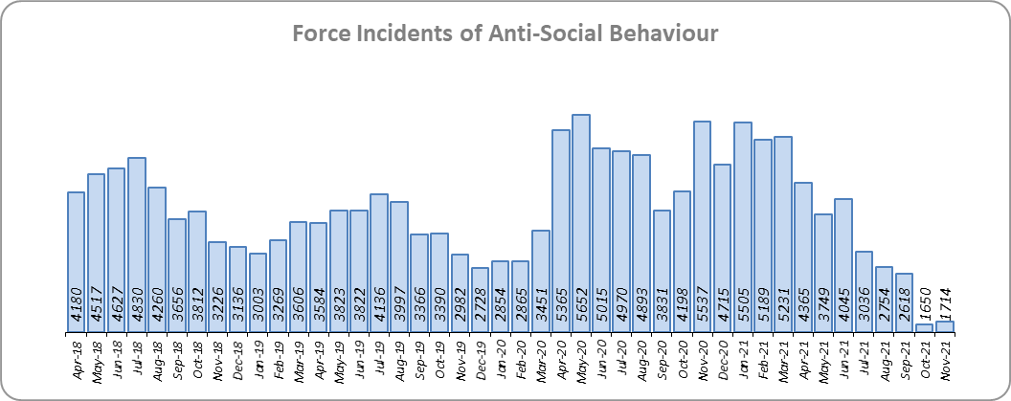
Priority 2 - Crack down on anti-social behaviour
Grade: Good
Essex experienced a 14.7% decrease (7,596 fewer) in Anti-Social Behaviour (ASB) incidents for the 12 months to November 2021 compared to the 12 months to November 2020. Since March 2020, the number of ASB incidents reported has generally been higher when tighter restrictions have been implemented by the Government, and lower when restrictions have been eased.
There was a decrease of 69.0% ASB reports in November 2021 compared to November 2020 (3,823 fewer incidents). The average daily number of ASB incidents increased by 7.3% in November 2021 (57 incidents) compared to October 2021 (53 incidents).
The number of ASB incidents for the 12 months to November 2021 compared to the 12 months to November 2019 increased by 3.8% (1,619 more incidents).
The results of Essex’s independent survey in relation to how well residents perceive Essex Police and partner organisations to be dealing with ASB showed an improvement: 1.8% points.
Due to the decrease in the number of anti-social behaviour incidents, a grade of Good is recommended.**
Please note:
*Crime Survey of England and Wales data are no longer available at Force level. Data are for the 12 months to March 2020.
**October 2021 saw the implementation of Operation SOMERTON, which aims to improve the service given to victims of ASB and ensure correct recording.

Slide 6
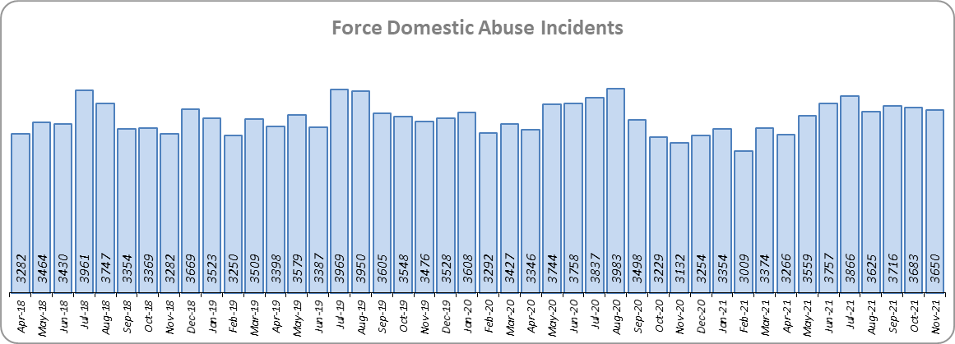
Priority 3 - Breaking the cycle of domestic abuse
Grade: Requires Improvement
Essex experienced a 0.6% decrease (269 fewer) in Domestic Abuse incidents but a 7.5% increase (1,446 more) in repeat incidents of Domestic Abuse for the 12 months to November 2021 compared to the 12 months to November 2020. There was also a 7.9% increase (1,106 more) in Domestic Abuse arrests but a 7.2% decrease (17 fewer) in the number of Domestic Violence Protection Notices (DVPN) and Protection Orders (DVPO) issued in the 12 months to November 2021 compared to the 12 months to November 2020.
There was a 1.7% decrease (750 fewer) in Domestic Abuse incidents but a 0.6% increase (128 more) in repeat incidents of Domestic Abuse for the 12 months to November 2021 compared to the 12 months to November 2019. There was also a 25.3% increase (3,038 more) in Domestic Abuse arrests and a 24.4% increase (43 more) in the number of Domestic Violence Protection Notices (DVPN) and Protection Orders (DVPO) issued in this same period.
There was a 13.9% decrease (488 fewer) in the number of solved Domestic Abuse outcomes in the 12 months to November 2021 compared to the 12 months to November 2020 and a 1.5% decrease (45 fewer) compared to the 12 months to November 2019.
Due to the fact that the number of DA solved offences has decreased for the seventh month in a row, a grade of Requires Improvement is recommended. For a grade of ‘Good’ to be recommended, the number of repeat incidents of domestic abuse would need to reduce and the number of solved domestic abuse offences increase.

Slide 7
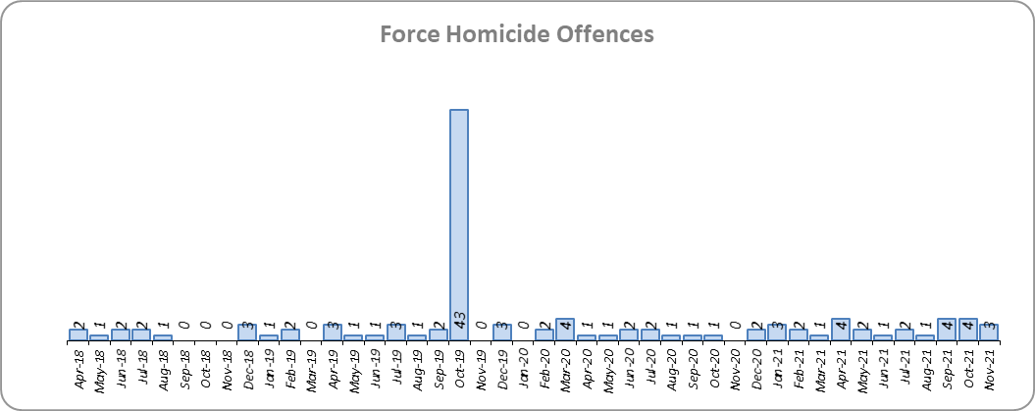
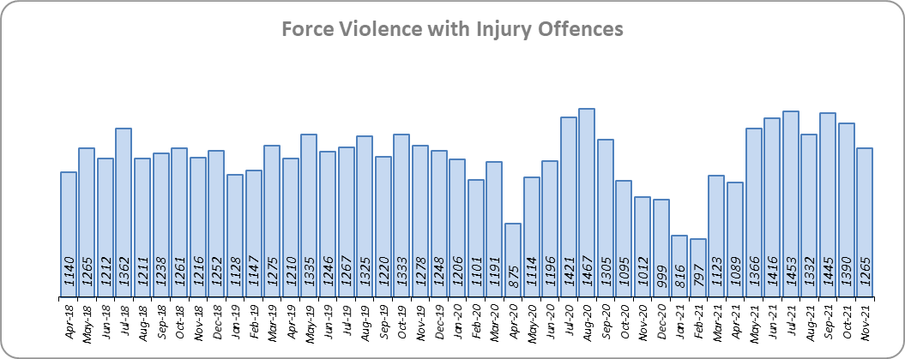
Priority 4 – Tackling gangs and serious violence
Grade: Requires Improvement
7 more Homicides (to 25 offences) were recorded for the 12 months to November 2021 compared to the 12 months to November 2020. Essex is fifth in its Most Similar Group (MSG) of forces for offences per 1,000 population, and is slightly higher than the MSG average.
Three Homicides were recorded in November 2021 compared to no offences in November 2020.
There was a 1.6% increase (233 more offences) in Violence with Injury offences for the 12 months to November 2021 compared to the 12 months to November 2020. The average daily number of Violence with Injury offences was 42 for the month of November 2021 and 45 for the month of October 2021. 390 more offences (44.6%) were recorded in the month of November 2021 (1,265 offences) compared to the month of April 2020 (875 offences) when the Government first implemented national restrictions.
The number of Homicides decreased by 59.7% (37 fewer offences) in the 12 months to November 2021 compared to the 12 months to November 2019. Please note, the 12 months to November 2019 includes the tragic incident where 39 Vietnamese nationals were discovered in a lorry trailer in Grays in October 2019.
The number of Violence with Injury offences decreased by 6.0% (919 fewer offences) in the 12 months to November 2021 compared to the 12 months to November 2019.
Essex is fifth in its MSG for Violence with Injury offences per 1,000 population and has a lower rate of offences than the MSG average. There was also a decrease in domestic abuse-related Violence with Injury (2.7% decrease, 154 fewer offences). 38.1% of Violence with Injury is domestic abuse-related.

Slide 8
Priority 4 – Tackling gangs and serious violence
Grade: Requires Improvement
The combined harm (Crime Severity) score* (8.6) for Violence with Injury, Rape, Other Sexual Offences and Robbery of Personal Property places Essex seventh in its Most Similar Group of Forces (MSG).
There was a 12.2% decrease (370 fewer) in the number of solved high harm offences (Violence with Injury, Rape, Other Sexual Offences and Robbery of Personal Property combined) in the 12 months to November 2021 compared to the 12 months to November 2020. Please see page 19 for the numbers of solved for each category.
There was a 62.5% decrease (2,024 fewer) in the number of stop and search for weapons in the 12 months to November 2021 compared to the 12 months to November 2020.
There was an 11.5% decrease (205 fewer) in the number of Knife-enabled crime offences in the 12 months to November 2021** compared to the 12 months to November 2020.
The number of solved high harm offences decreased by 7.1% (204 fewer) in the 12 months to November 2021 compared to the 12 months to November 2019. The number of stop and search for weapons also decreased, by 53.9% (1,418 fewer), and the number of Knife-enabled crime offences decreased by 1.0% (16 fewer) in the same period.
Due to the fact that Essex is higher than the MSG average for the number of Homicides recorded per 1,000 pop., and that the number of solved high harm offences has reduced, a grade of Requires Improvement is recommended. For a grade of ‘Good’ to be recommended, a reduction in the harm severity score and an increase in the number of solved high harm offences are required.
Please note:
* Crime Severity Scores (as calculated by the Office for National Statistics) measure the ‘relative harm’ of crimes by taking into account both their volume and their severity. Data are for the 12 months to September in all three years.
** The number of knife crime offences is an indicator of how effective Essex Police is at identifying knife-enabled offences, and is not necessarily reflective of the number of these offences that have been committed in the county. This is because the identification of these offences is reliant on the appropriate indicator being manually added to the crime record. A new data quality process was introduced in June 2020 and Essex Police is currently working with the National Data Quality Improvement Service (NDQIS) to revise knife crime flags. In September 2021, data from April 2019 was revised; this resulted in an increase in the number of offences recorded, particularly in the 2019/20 financial year. This has enabled Essex Police to better understand knife crime in Essex.

Slide 9
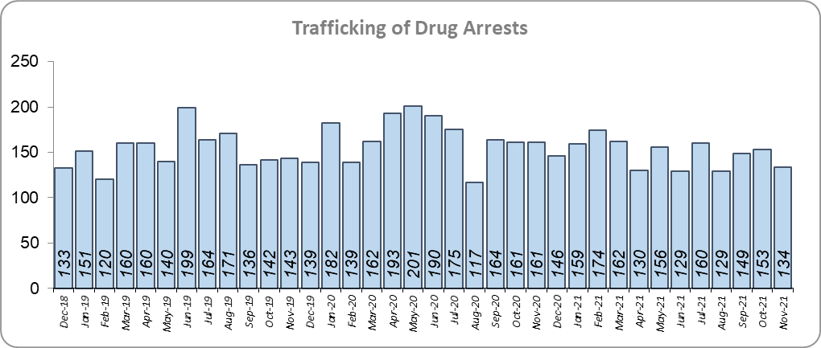
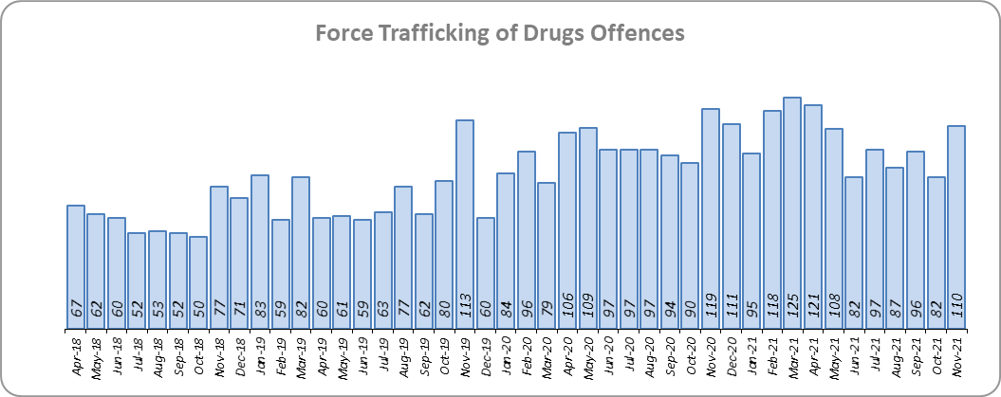
Priority 5 – Disrupting and preventing organised crime
Grade: Good
Essex experienced a 50.3% increase in Organised Crime Group (OCG) disruptions (96 more) for the 12 months to September 2021 compared to the 12 months to September 2020. In January 2019 there was a change in the way in which the number of OCG disruptions were counted; this follows National Crime Agency (NCA) and Eastern Region Special Operations Unit (ERSOU) guidance to ensure that all forces record disruptions in the same way.
Trafficking of drug arrests, which are primarily driven by police proactivity, decreased by 10.6% (210 fewer) in the 12 months to November 2021 compared to the 12 months to November 2020 and decreased by 2.3% (41 fewer) compared to the 12 months to November 2019. 9.8% more trafficking of drugs offences have been recorded (113 more offences to 1,263) in the 12 months to November 2021 compared to the 12 months to November 2020. There was a 37.3% increase (343 more) in the number of trafficking of drugs offences in the 12 months to November 2021 compared to the 12 months to November 2019.
Due to the increase in OCG disruptions, a grade of Good is recommended.
* OCG disruptions are now reported quarterly. Data are to September 2021. Due to the change in recording in January 2019 it is not possible to compare the 12 months to September 2019 to the 12 months to September 2021.

Slide 10
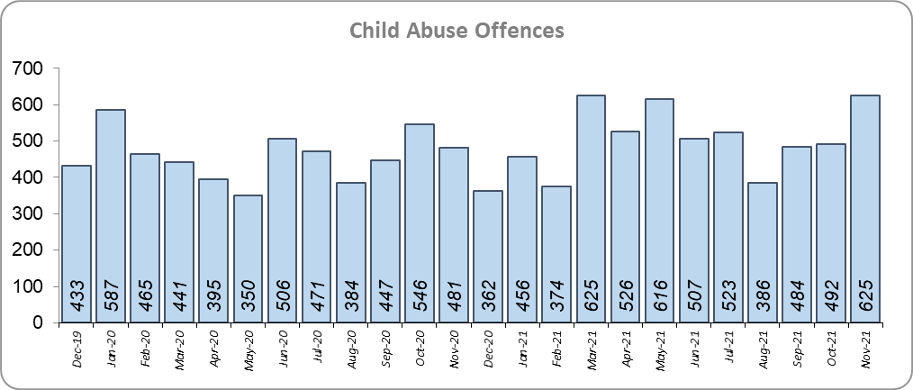
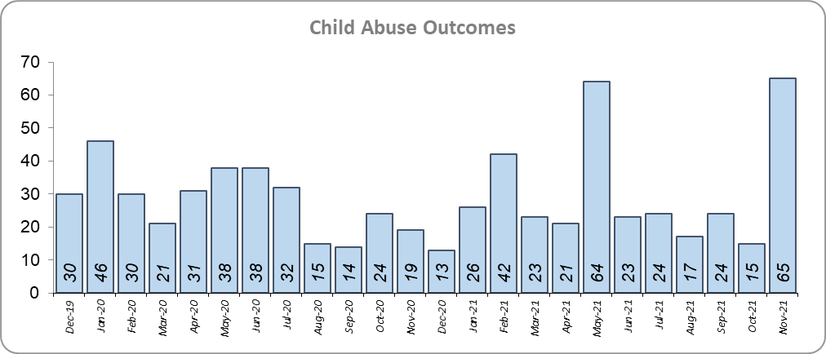
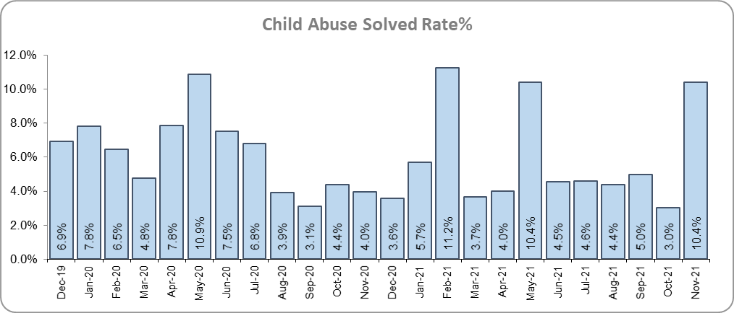
Priority 6 - Protecting children & vulnerable people
Grade: Good
There was an 18.4% increase (378 more) in the number of Child Sexual Abuse/Exploitation investigations in the 12 months to November 2021 compared to the 12 months to November 2020 and a 3.7% increase (13 more) in the number of solved Child Abuse Outcomes. Compared to the 12 months to November 2019, the number of child abuse solved outcomes in the last year increased by 45.0% (113 more outcomes).
19.4% more Child Sexual Abuse/Exploitation investigations (an increase of 394) were recorded in the 12 months to November 2021 compared to the 12 months to November 2019.
8.1% more Child Abuse offences (an increase of 451) were recorded in the 12 months to November 2021 compared to the 12 months to November 2020. This increase in offences can be partly attributed to a rise in referrals from schools in the latter part of 2020. The number of child abuse offences increased by 17.9% (910 more offences) in the 12 months to November 2021 compared to the 12 months to November 2019.
165 Modern Slavery referrals were made in the 12 months to November 2021 compared with 107 in the 12 months to November 2020 (58 more).
Following continued improving performance over the preceding 12 months, Essex Police have now solved 13 more Child Abuse investigations in the 12 months to November 2021 compared to the 12 months to November 2020. Due to the increase in the number of child abuse outcomes, a grade of Good is recommended.
* Due to a change in recording of Modern Slavery referrals in April 2019 it is not possible to compare the 12 months to November 2019 to the 12 months to November 2021.

Slide 11
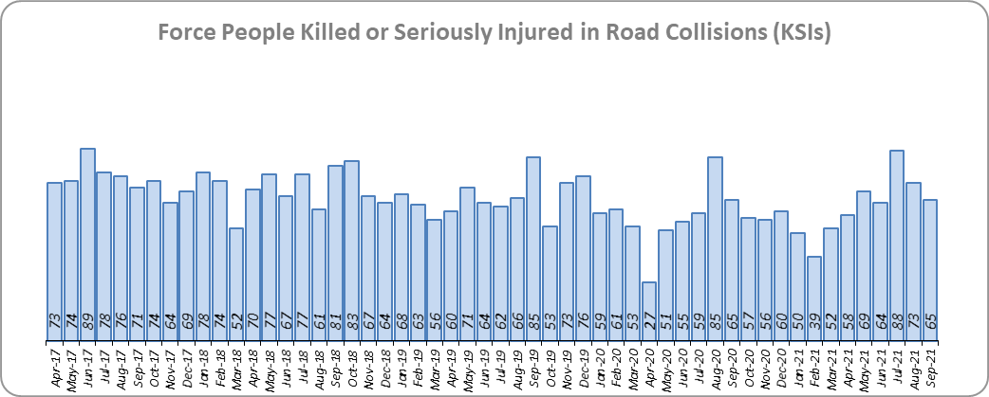
Priority 7 - Improve safety on our roads
Grade: Good
There was a 1.4% increase (10 more) in the number of those Killed or Seriously Injured (KSI) in Essex for the 12 months to September 2021 compared to the 12 months to September 2020. The number of KSIs decreased by 16.5% (145 fewer offences) in the 12 months to September 2021 compared to the 12 months to September 2019. Please note that most KSIs do not necessarily result in criminal offences (such as death or serious injury caused by dangerous driving) being recorded. Essex is sixth in its Most Similar Group (MSG) of forces for casualties per 100 million vehicle kilometres (results to December 2020) and slightly worse than the MSG average. However, due to the fact that more recent national figures have not been released, the current position cannot be determined (the date of the next national release has not yet been confirmed).
There was an 18.9% decrease (105 fewer offences) in the number of driving related mobile phone offences recorded for the 12 months to November 2021 compared to the 12 months to November 2020. The number of driving related mobile phone offences decreased by 80.1% (1,817 fewer offences) in the 12 months to November 2021 compared to the 12 months to November 2019; this extreme decrease was as a result of a legal challenge (and subsequent change in the legislation) as regards what constitutes “use” of a mobile phone.*
There was also a 33.3% decrease (1,415 fewer offences) in drink/drug driving offences for the 12 months to November 2021 compared to the 12 months to November 2020; of these offences, there was a 2.8% decrease (39 fewer offences) in drink driving and a 52.9% decrease (1,259 fewer offences) in drug driving. This compares with a 22.1% decrease (801 fewer offences) in drink/drug driving offences for the 12 months to November 2021 compared to the 12 months to November 2019; of these offences, there was a 5.1% decrease (73 fewer offences) in drink driving and a 38.1% decrease (692 fewer offences) in drug driving. All of these offence types are primarily driven by police proactivity in relation to road safety.
Due to the decrease in the number of drink/drug driving offences in the past 12 months, a grade of Good is recommended.
* In 2019, the definition as to what constituted “use” of a mobile phone in relation to driver-related mobile phone offences was subject to a legal challenge. This resulted in a ruling, which held that while “use” included accessing the interactive functions of the mobile phone (such as making calls, sending messages or using the internet), it did not extend to solely accessing the device’s internal functions (such as making use of the camera). Fewer mobile phone offences were subsequently prosecuted from this point. In 2021, however, the law was changed: it is now illegal to “hold” a phone or sat nav when driving or riding a motorcycle. Offences may therefore start to increase.
** Data are to September 2021 as the system used to provide these data is unavailable. Other forces are also affected.

Slide 12
Monthly Performance Overview: Exceptions
Exceptions Overview
Anti-Social Behaviour Incidents experienced a statistically significant decrease for the month of November 2021. Other Sexual Offences experienced a statistically significant increase for the month of November 2021.
Anti-Social Behaviour Incidents – Decrease
14.7% decrease (7,596 fewer incidents) for the 12 months to November 2021 compared to the 12 months to November 2020. There were statistically exceptional decreases in five Districts in November 2021.*
Other Sexual Offences – Increase
19.8% increase (545 more crimes) for the 12 months to November 2021 compared to the 12 months to November 2020. There were statistically exceptional increases in two Districts in November 2021.
* Please see note 13 on page 18

Slide 13
Monthly Performance Overview: Of Note
Monthly Performance Overview: Exceptions
COVID-19: Restrictions of movement and social distancing
Since 13 March 2020, the Government implemented a series of alert levels and steps regarding the level of social distancing allowed in relation to COVID-19. Each change has affected the number of All Crime offences recorded.
On 5 November 2020 the Government implemented a period of increased restrictions which ended on 2nd December 2020 when the country returned to the Tier system.
On 20 December the Government introduced Tier 4 – Stay at Home and on 5th January 2021 a third period of increased restrictions was implemented.
In March 2021 the Government announced its roadmap out of restrictions, starting with Step 1 on 8th March.

Slide 14
Monthly Performance Overview: Of Note (continued)
Monthly Performance Overview: Exceptions
COVID-19: Restrictions of movement and social distancing
The Government continued on its roadmap out of restrictions with Step 1a on 29th March, Step 2 on 12th April and Step 3 on 17th May 2021

Slide 15
Monthly Performance Overview: Of Note (continued)
Monthly Performance Overview: Exceptions
COVID-19: Restrictions of movement and social distancing
The Government continued on its roadmap out of restrictions with Step 3a on 21st June.
On 19th July 2021 all legal restrictions were lifted but the Government urged caution due to rising case numbers.
On 30th November 2021 the Government reintroduced the mandatory wearing of face coverings in some settings due to the discovery of the highly transmissible variant Omicron.

Slide 16
Monthly Performance Overview: Of Note (continued)
Monthly Performance Overview: Exceptions
Essex Police Specials are honoured by the Queen
Our volunteer police officers were presented with The Queen’s Award to mark the huge contribution they make in helping to keep our county safe.
The Queen’s Award for Voluntary Service is described as the MBE for voluntary groups. It recognises the very special achievement by volunteers who regularly devote their time to helping others in the community, improving the quality of life and opportunity for others and providing outstanding service.
The Essex Lord-Lieutenant presented the award on behalf of the Queen to the Deputy Chief Officer of the Essex Police Special Constabulary, who received it on behalf of the Force’s 504 Specials. It is the highest award for local voluntary groups and is awarded for life.
The award includes a ‘special designation’ for the support our Specials provided during the early months of the COVID-19 pandemic last year. During the first lockdown many of our Specials were furloughed from their day jobs and increased their contribution, volunteering more than 54,000 operational hours and providing visible policing to help their communities during unprecedented times.

Slide 17
2016-2021 Police and Crime Plan Performance Indicators
Table 1
Please view above table with the explanations and caveats detailed on page 18.

Slide 18
End Notes
¹ Question from the independent survey commissioned by Essex Police (Percentage of people who have confidence in policing in Essex). Results are for the period 12 months September 2021 versus the 12 months to September 2020.
² The confidence interval is the range +/- between where the survey result may lie. This is mainly influenced by the number of people answering the survey. The more people that answer the survey, the smaller the interval range.
³ Crime Survey of England and Wales data are no longer available at Force level. Data are for the 12 months to March 2020.
⁴ Question from Essex Police’s own confidence and perception survey (Percentage of people who have confidence that the policing response to ASB is improving). Results are for the period 12 months to September 2021 versus the 12 months to September 2020.
⁵ Solved outcomes are crimes that result in: charge or summons, caution, crimes taken into consideration, fixed penalty notice, cannabis warning or community resolution.
⁶ ‘Killed or Seriously Injured’ (KSI) refers to all people killed or seriously injured on Essex’s roads, regardless of whether any criminal offences were committed. ‘Causing Death/Serious Injury by Dangerous/Inconsiderate Driving’ offences (detailed on p.11) refers to the number of crimes of this type.
Data are to September 2021 due to problems with the system used to provide them. Other forces are also affected.
⁷ Please note that on Wednesday 23 October 2019 the bodies of 39 Vietnamese nationals were discovered in a lorry trailer in Grays. This tragic incident is reflected in the Homicide numbers.
⁸ Crime Severity Score measures ‘relative harm’ of crimes by taking into account both the volume and the severity of offences, and by weighting offences differently. Data are for the 12 months to September 2021.
⁹ The number of knife crime offences is an indicator of how effective Essex Police is at identifying knife-enabled offences, and is not necessarily reflective of the number of these offences that have been committed in the county. This is because the identification of these offences is reliant on the appropriate indicator being manually added to the crime record. A manual review of knife flags was conducted and missing flags were added retrospectively. Additionally a new data quality process was introduced in June 2020. Whilst this has enabled us to better understand knife crime in Essex, the process has consequently inflated the figures. As such, no inferences can be drawn as to the current trend.
¹⁰ In 2019, the definition as to what constituted “use” of a mobile phone in relation to driver-related mobile phone offences was subject to a legal challenge. This resulted in a ruling, which held that while “use” included accessing the interactive functions of the mobile phone (such as making calls, sending messages or using the internet), it did not extend to solely accessing the device’s internal functions (such as making use of the camera). Fewer mobile phone offences were subsequently prosecuted from this point. In 2021, however, the law was changed: it is now illegal to “hold” a phone or sat nav when driving or riding a motorcycle. It is therefore likely that offences will now start to increase.
¹¹ NRM data only available from April 2019 due to recording change at that time.
¹² OCG disruptions are now reported quarterly. Data are to September 2021.
¹³ October 2021 saw the implementation of Operation SOMERTON, which aims to both improve the service given to victims of ASB and ensure crimes are correctly recorded.

Slide 19
Crime Tree Data – Rolling 12 Months to November
Table 2

Slide 20
Crime Tree Data – Rolling 12 Months to November
Table 3

