Slide 1
Police and Crime Plan 2016-2021
Monthly Performance Update
October 2021
National and MSG positions are to 31 August 2021 (Essex Police data are to 31 October 2021).
Version 1.4
Produced November 2021
Performance Analysis Unit, Essex Police
Sensitivity: Official

Slide 2
Executive Summary
Four of the seven PFCC Priorities for Essex Police have been given a recommended grade of ‘Good’. Recommended grades have been determined with reference to comparisons with Essex Police’s Most Similar Group (MSG) of forces, Key Performance Indicators (KPIs), and professional judgement.
Three of the seven PFCC priorities – 3 (Breaking the cycle of Domestic Abuse), 4 (Tackling Gangs and Serious Violence) and 6 (Protecting children and vulnerable people) – have been given a recommended grade of ‘Requires Improvement’. The level of improvement required to reach ‘Good’ has been added to the narrative for each priority.
All Crime fell by 1.6% for the 12 months to October 2021 compared to the 12 months to October 2020; this equates to 2,552 fewer offences. This decrease has been primarily influenced by the Government’s restrictions on gathering and movement in relation to COVID-19.
Each change in the rules relating to social distancing has affected the number of All Crime offences reported to Essex Police.*
There was a 4.7% increase in All Crime in October 2021 compared to October 2019 (14,735 October 2021 v. 14,080 October 2019). The Force also recorded 4,175 more offences in October 2021 than in April 2020 (10,560 offences), when the Government implemented the first lockdown; this equates to 39.5% more offences.
The Force recorded 515 more Violence with Injury (VWI) offences (58.9% increase) in October 2021 compared to April 2020 (1,390 v. 875 offences). The number of VWI offences recorded in October 2021 was higher than the number recorded before COVID restrictions were introduced; compared with October 2019, there was a 4.3% increase (57 more crimes).
There was a 37.0% decrease (968 fewer incidents) in the number of ASB incidents recorded in October 2021 (1,650 incidents) compared to September 2021 (2,618 incidents). The average daily number of ASB incidents was also 39.0% lower in October 2021 (ave. 53 incidents) compared to September 2021 (ave. 87 incidents). This decrease was both due to a general reduction in the volume of ASB reports received and the introduction of Operation SOMERTON, which aimed to improve the service given to victims of ASB and ensure that crimes are being correctly recording. This operation involved the manual review of ASB records, many of which were later reclassified from ASB to other incident types, such as crime.
Confidence (from the independent survey commissioned by Essex Police) is at 79.8% (results to the 12 months to June 2021). Compared to year ending June 2020, confidence in the local police increased by 10.1% points.
55 more Modern Slavery referrals were made in the 12 months to October 2021 compared to the same period in 2019-20. Essex Police have increased the number of referrals and worked to achieve greater range and engagement with hard to access groups, thereby creating more opportunities to help vulnerable people. This has resulted in the number of referrals being higher in the 12 months to October 2021 compared to the same period the previous year.
* Please see table showing the affect of social distancing measures on pages 13 - 16.

Slide 3
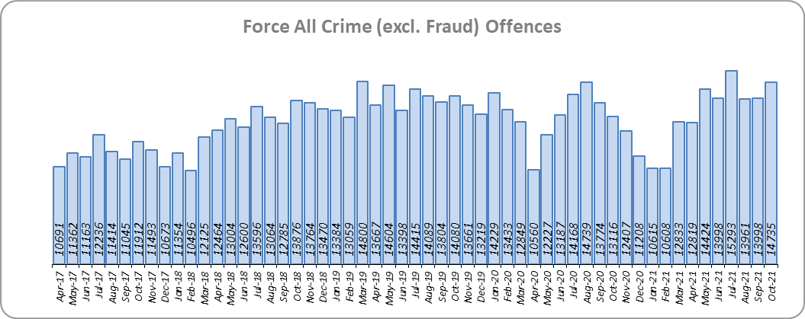
Priority 1 - More local, visible and accessible policing
Grade: Good
Essex experienced a 1.6% decrease in All Crime (2,552 fewer offences) for the 12 months to October 2021 compared to the 12 months to October 2020. This decrease in crime has been primarily influenced by the Government’s restrictions on gathering and movement in relation to COVID-19. Essex is eighth in its Most Similar Group of forces (MSG) for crime per 1,000 population.
Essex Police recorded a daily average of 475 crimes in October 2021, compared with an average of 467 crimes in September 2021. This equates to an increase of 1.9%.
14,735 offences were recorded in October 2021, an increase of 12.3% (1,619 more offences) compared to October 2020 (13,116 offences). There was a 4.7% increase in October 2021 compared to October 2019 (14,080 offences).

Slide 4
Priority 1 - More local, visible and accessible policing
Grade: Good
Confidence (from the independent survey commissioned by Essex Police) is at 79.8% (results to the 12 months to June 2021). Compared to year ending June 2020, confidence in the local police has significantly increased (an improvement of 10.1% points).
The All Crime Harm (Crime Severity) Score** (13.1) places Essex seventh in its MSG.
Essex Police’s performance in relation to emergency response attendance within 15 minutes (urban) or 20 minutes (rural) has improved by 1.3 percentage points to 80.4% in the 12 months to October 2021 compared to the 12 months to October 2020. This is above the 80% target.
Due to the fact that the percentage of people who have confidence in policing in Essex has increased and the emergency response attendance is above the 80% target, a grade of Good is recommended.
Please note:
* Crime Survey of England and Wales data are no longer available at Force level. Data are for the 12 months to March 2020.
** Crime Severity Scores (as calculated by the Office for National Statistics) measure the ‘relative harm’ of crimes by taking into account both their volume and their severity. Data are for the 12 months to August in all three years.
*** Grade of Service.

Slide 5
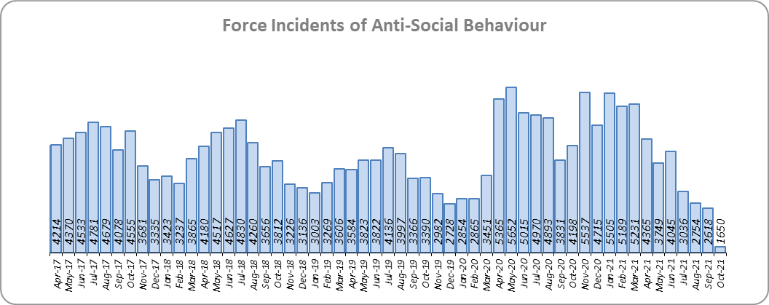
Priority 2 - Crack down on anti-social behaviour
Grade: Good
Essex experienced a 2.4% decrease (1,186 fewer) in Anti-Social Behaviour (ASB) incidents for the 12 months to October 2021 compared to the 12 months to October 2020. This decrease was due to the COVID-19 restriction period, during which many additional reports were received that related to activities that were not previously considered to be ASB; examples include social gatherings and shops and businesses continuing to trade. Since March 2020 the number of ASB incidents reported has generally been higher when tighter restrictions were implemented by the Government, and lower when restrictions were eased.
There was a decrease of 60.7% ASB reports in October 2021 compared to October 2020 (2,548 fewer incidents). The average daily number of ASB incidents decreased by 39.0% in October 2021 (53 incidents) compared to September 2021 (87 incidents). October 2021 experienced the lowest number of ASB incidents recorded per month since April 2017 (1,650 incidents).**
The number of ASB incidents for the 12 months to October 2021 compared to the 12 months to October 2019 increased by 12.7% (5,402 more incidents).**
The results of Essex’s independent survey in relation to how well residents perceive Essex Police and partner organisations to be dealing with ASB showed a slight improvement: 0.4% points.
Due to the increase in public perception from the Essex independent survey, a grade of Good is recommended.
Please note:
*Crime Survey of England and Wales data are no longer available at Force level. Data are for the 12 months to March 2020.
**October 2021 saw the implementation of Operation SOMERTON, which aims to improve the service given to victims of ASB and ensure correct recording.

Slide 6
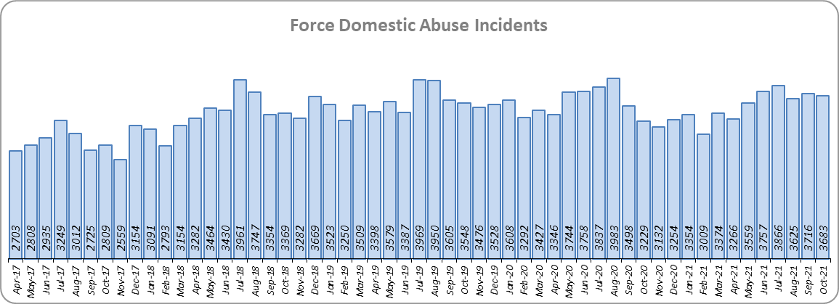
Priority 3 - Breaking the cycle of domestic abuse
Grade: Requires Improvement
Essex experienced a 3.7% decrease (1,567 fewer) in Domestic Abuse incidents but a 5.0% increase (967 more) in repeat incidents of Domestic Abuse for the 12 months to October 2021 compared to the 12 months to October 2020. There was also a 5.2% increase (727 more) in Domestic Abuse arrests but a 9.7% decrease (23 fewer) in the number of Domestic Violence Protection Notices (DVPN) and Protection Orders (DVPO) issued in the 12 months to October 2021 compared to the 12 months to October 2020.
Domestic Abuse incidents in October 2021 were higher than at pre-COVID levels, with a 3.8% increase (135 more incidents) compared to October 2019.
There was a 13.9% decrease (488 fewer) in the number of solved Domestic Abuse outcomes in the 12 months to October 2021 compared to the 12 months to October 2020 and a 1.9% decrease (57 fewer) compared to the 12 months to October 2019.
Due to the fact that the number of DA solved offences has decreased for the sixth month in a row, a grade of Requires Improvement is recommended. For a grade of ‘Good’ to be recommended, the number of repeat incidents of domestic abuse would need to reduce and the number of solved domestic abuse offences increase.

Slide 7
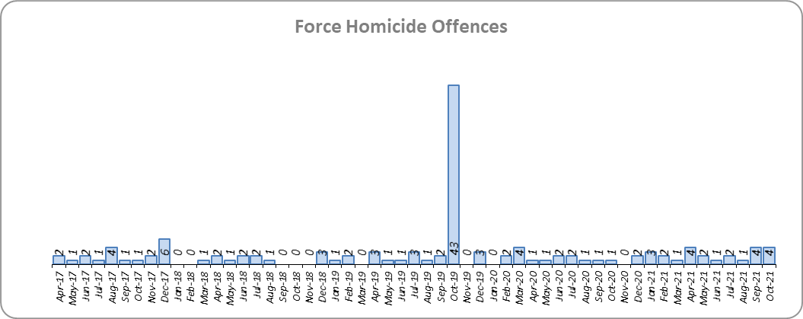
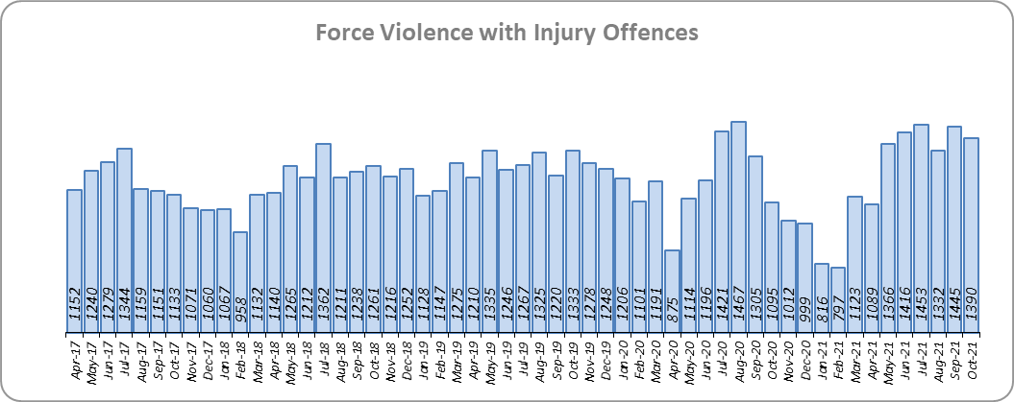
Priority 4 – Tackling gangs and serious violence
Grade: Requires Improvement
5 more Homicides (to 24 offences) were recorded for the 12 months to October 2021 compared to the 12 months to October 2020. Essex is fifth in its Most Similar Group (MSG) of forces for offences per 1,000 population, and is slightly higher than the MSG average.
Four Homicides were recorded in October 2021 compared to one offence in October 2020. In October 2019, 43 homicides were recorded; this figure includes the tragic incident in which 39 Vietnamese nationals were discovered in a lorry trailer in Grays.
There was a 2.0% decrease (283 fewer offences) in Violence with Injury offences for the 12 months to October 2021 compared to the 12 months to October 2020. The average daily number of Violence with Injury offences was 45 for October 2021 and 48 for September 2021. 515 more offences (58.9%) were recorded in October 2021 (1,390 offences) compared to April 2020 (875 offences) when the Government first implemented national restrictions.
The number of Violence with Injury offences decreased by 7.2% (1,095 fewer offences) in the 12 months to October 2021 compared to the 12 months to October 2019.
Essex is fifth in its MSG for Violence with Injury offences per 1,000 population and has a lower rate of offences than the MSG average. There was also a decrease in domestic abuse-related Violence with Injury (4.4% decrease, 251 fewer offences). 38.5% of Violence with Injury is domestic abuse-related.

Slide 8
Priority 4 – Tackling gangs and serious violence
Grade: Requires Improvement
The combined harm (Crime Severity) score* (8.5) for Violence with Injury, Rape, Other Sexual Offences and Robbery of Personal Property places Essex seventh in its Most Similar Group of Forces (MSG).
There was a 15.7% decrease (482 fewer) in the number of solved high harm offences (Violence with Injury, Rape, Other Sexual Offences and Robbery of Personal Property combined) in the 12 months to October 2021 compared to the 12 months to October 2020. Please see page 19 for the numbers of solved for each category.
There was a 63.4% decrease (2,111 fewer) in the number of stop and search for weapons in the 12 months to October 2021 compared to the 12 months to October 2020.
There was an 15.2% decrease (276 fewer) in the number of Knife-enabled crime offences in the 12 months to October 2021** compared to the 12 months to October 2020.
The number of solved high harm offences decreased by 10.1% (291 fewer) in the 12 months to October 2021 compared to the 12 months to October 2019. The number of stop and search for weapons also decreased by 52.2% (1,330 fewer) in the same period.
Due to the fact that Essex is higher than the MSG average for the number of Homicides recorded per 1,000 pop., and that the number of solved high harm offences has reduced, a grade of Requires Improvement is recommended. For a grade of ‘Good’ to be recommended, a reduction in the harm severity score and an increase in the number of solved high harm offences are required.
Please note:
* Crime Severity Scores (as calculated by the Office for National Statistics) measure the ‘relative harm’ of crimes by taking into account both their volume and their severity. Data are for the 12 months to August in all three years.
** The number of knife crime offences is an indicator of how effective Essex Police is at identifying knife-enabled offences, and is not necessarily reflective of the number of these offences that have been committed in the county. This is because the identification of these offences is reliant on the appropriate indicator being manually added to the crime record. A new data quality process was introduced in June 2020 and Essex Police is currently working with the National Data Quality Improvement Service (NDQIS) to revise knife crime flags. In September 2021, data from April 2019 was revised; this resulted in an increase in the number of offences recorded, particularly in the 2019/20 financial year. This has enabled Essex Police to better understand knife crime in Essex.

Slide 9
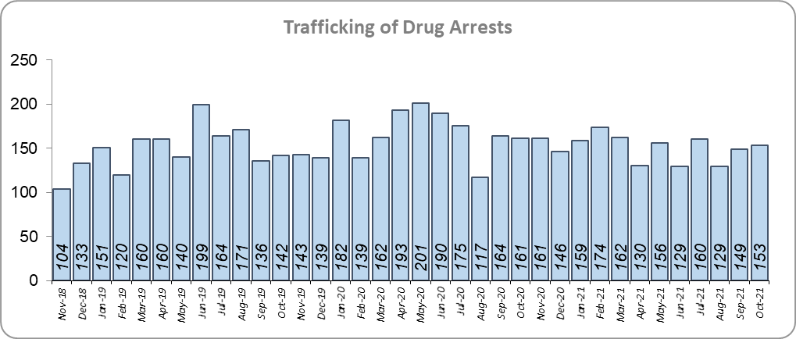
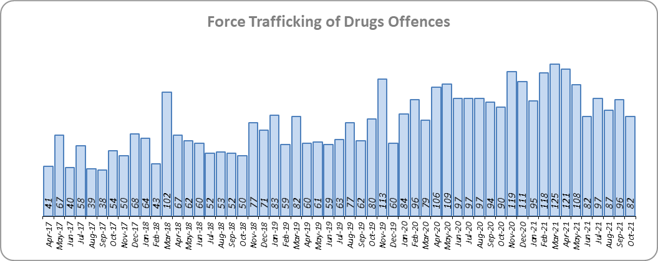
Priority 5 – Disrupting and preventing organised crime
Grade: Good
Essex experienced a 50.3% increase in Organised Crime Group (OCG) disruptions (96 more) for the 12 months to September 2021 compared to the 12 months to September 2020. In January 2019 there was a change in the way in which the number of OCG disruptions were counted; this follows National Crime Agency (NCA) and Eastern Region Special Operations Unit (ERSOU) guidance to ensure that all forces record disruptions in the same way.
Trafficking of drug arrests, which are primarily driven by police proactivity, decreased by 7.7% (151 fewer) in the 12 months to October 2021 compared to the 12 months to October 2020 but increased by 1.8% (32 more) compared to the 12 months to October 2019. In the same period, 12.9% more trafficking of drugs offences have been recorded (146 more offences to 1,278).
Due to the increase in OCG disruptions, a grade of Good is recommended.
* OCG disruptions are now reported quarterly. Data are to September 2021. Due to the change in recording in January 2019 it is not possible to compare the 12 months to September 2019 to the 12 months to September 2021.

Slide 10
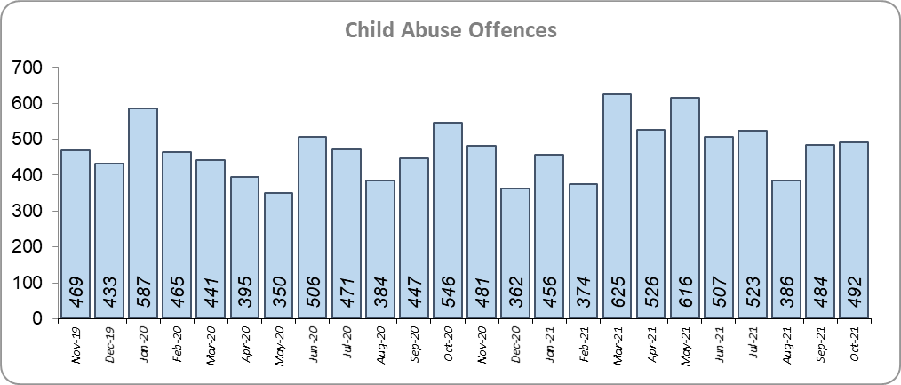
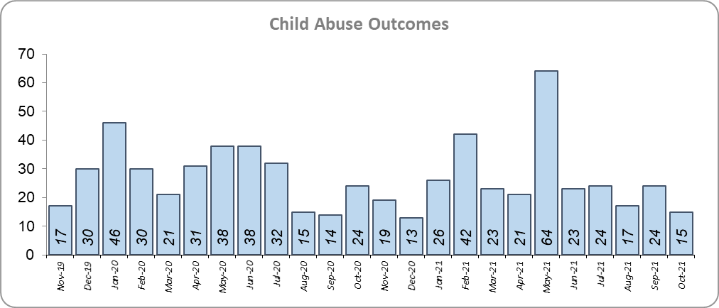
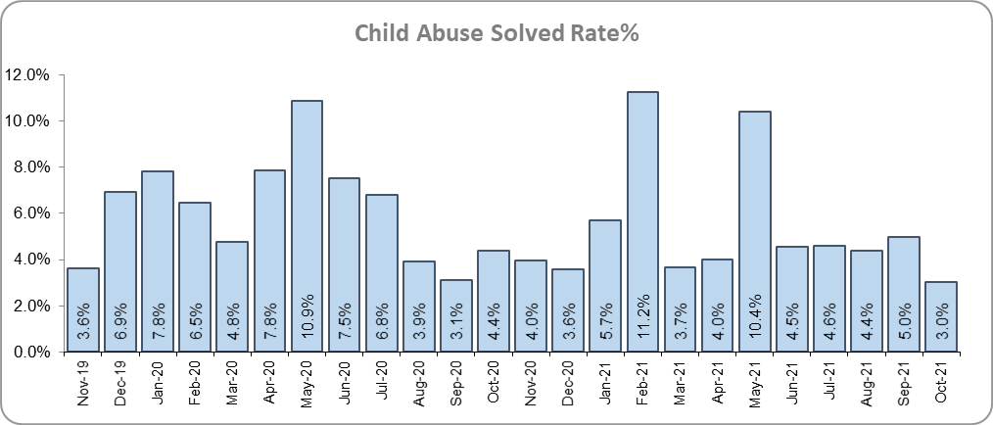
Priority 6 - Protecting children & vulnerable people
Grade: Requires Improvement
There was an 18.0% increase (364 more) in the number of Child Sexual Abuse/Exploitation investigations in the 12 months to October 2021 compared to the 12 months to October 2020 and a 9.1% decrease (32 fewer) in the number of solved Child Abuse Outcomes. Compared to the 12 months to October 2019, the number of child abuse solved outcomes in the last year increased by 29.1% (72 more outcomes).
15.6% more Child Sexual Abuse/Exploitation investigations (an increase of 323) were recorded in the 12 months to October 2021 compared to the 12 months to October 2019.
6.1% more Child Abuse offences (an increase of 340) were recorded in the 12 months to October 2021 compared to the 12 months to October 2020. This increase in offences can be partly attributed to a rise in referrals from schools in the latter part of 2020. The number of child abuse offences increased by 18.0% (897 more offences) in the 12 months to October 2021 compared to the 12 months to October 2019.
166 Modern Slavery referrals were made in the 12 months to October 2021 compared with 111 in the 12 months to October 2020 (55 more).
Due to the decrease in the number of child abuse outcomes and the increase in child abuse offences, a grade of Requires Improvement is recommended. For a grade of ‘Good’ to be recommended, an increase in the number of child abuse offences solved is required.
* Due to a change in recording of Modern Slavery referrals in April 2019 it is not possible to compare the 12 months to October 2019 to the 12 months to October 2021.

Slide 11
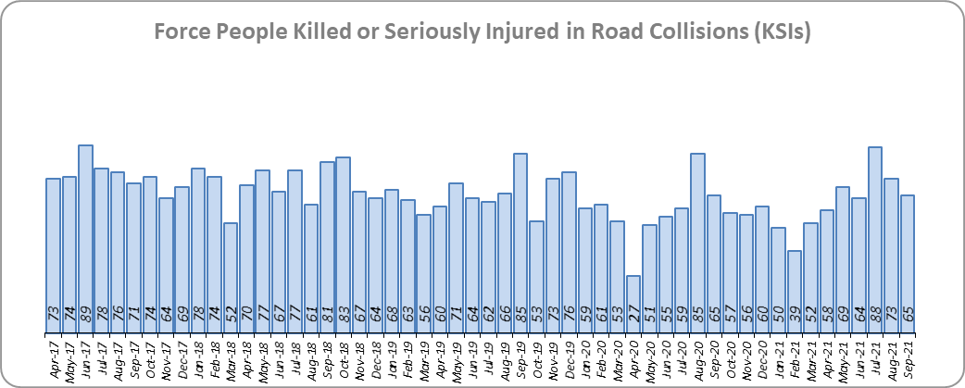
Priority 7 - Improve safety on our roads
Grade: Good
There was a 1.4% increase (10 more) in the number of those Killed or Seriously Injured (KSI) in Essex for the 12 months to September 2021 compared to the 12 months to September 2020. The number of KSIs decreased by 16.5% (145 fewer offences) in the 12 months to September 2021 compared to the 12 months to September 2019. Please note that most KSIs do not necessarily result in criminal offences (such as death or serious injury caused by dangerous driving) being recorded. Essex is sixth in its Most Similar Group (MSG) of forces for casualties per 100 million vehicle kilometres (results to June 2020) and slightly worse than the MSG average. However, due to the fact that more recent national figures have not been released, the current position cannot be determined (the date of the next national release has not yet been confirmed).
There was a 20.9% decrease (121 fewer offences) in the number of driving related mobile phone offences recorded for the 12 months to October 2021 compared to the 12 months to October 2020.* There was also a 32.1% decrease (1,370 fewer offences) in drink/drug driving offences for the 12 months to October 2021 compared to the 12 months to October 2020; of these offences, there was a 9.6% decrease (139 fewer offences) in drink driving and a 47.5% decrease (1,123 fewer offences) in drug driving. All of these offence types are primarily driven by police proactivity in relation to road safety.
Due to the decrease in the number of drink/drug driving offences in the past 12 months, a grade of Good is recommended.
* In 2019, the definition as to what constituted “use” of a mobile phone in relation to driver-related mobile phone offences was subject to a legal challenge. This resulted in a ruling, which held that while “use” included accessing the interactive functions of the mobile phone (such as making calls, sending messages or using the internet), it did not extend to solely accessing the device’s internal functions (such as making use of the camera). Fewer mobile phone offences were subsequently prosecuted from this point. In 2021, however, the law was changed: it is now illegal to “hold” a phone or sat nav when driving or riding a motorcycle. Offences may therefore start to increase.
** Data are to September 2021 as the system used to provide these data is unavailable. Other forces are also affected.

Slide 12
Monthly Performance Overview: Exceptions
Exceptions Overview
Anti-Social Behaviour Incidents experienced a statistically significant decrease for the month of October 2021. Racial/Religiously Aggravated Offences and Hate Crime HO Definition experienced statistically significant increases for the month of October 2021.
Anti-Social Behaviour Incidents – Decrease
2.4% decrease (1,186 fewer incidents) for the 12 months to October 2021 compared to the 12 months to October 2020. There were statistically exceptional decreases in nine Districts in October 2021.*
Racial/Religiously Aggravated Offences– Increase
11.5% increase (207 more crimes) for the 12 months to October 2021 compared to the 12 months to October 2020. There were statistically exceptional decreases in five Districts in October 2021.
Hate Crime HO Definition – Increase
28.9% increase (965 more crimes) for the 12 months to October 2021 compared to the 12 months to October 2020. Hate Crime was also statistically exceptionally high in the months of May, June, July, and September 2021 (as well as in October 2021).
* Please see note 13 on page 18

Slide 13
Monthly Performance Overview: Of Note
Monthly Performance Overview: Exceptions
COVID-19: Restrictions of movement and social distancing
Since 13 March 2020, the Government implemented a series of alert levels and steps regarding the level of social distancing allowed in relation to COVID-19. Each change has affected the number of All Crime offences recorded.
On 14 October 2020 the Government introduced three levels of restrictions according to different levels of infections around the country. Tier 1 – Medium, Tier 2 – High and Tier 3 – Very High.
On 5 November 2020 the Government implemented a period of increased restrictions which ended on 2nd December 2020 when the country returned to the Tier system.
On 20 December the Government introduced Tier 4 – Stay at Home and on 5th January 2021 a third period of increased restrictions was implemented.

Slide 14
Monthly Performance Overview: Of Note (continued)
Monthly Performance Overview: Exceptions
COVID-19: Restrictions of movement and social distancing
In March 2021 the Government announced its roadmap out of restrictions, starting with Step 1 on 8th March, Step 1a on 29th March and Step 2 on 12th April.

Slide 15
Monthly Performance Overview: Of Note (continued)
Monthly Performance Overview: Exceptions
COVID-19: Restrictions of movement and social distancing
The Government continued on its roadmap out of restrictions with Step 3 on 17th May 2021 and Step 3a on 21st June.

Slide 16
Monthly Performance Overview: Of Note (continued)
Monthly Performance Overview: Exceptions
COVID-19: Restrictions of movement and social distancing
On 19th July 2021 all legal restrictions were lifted but the Government urged caution due to rising case numbers.
County Lines Intensification Week: 11th to 17th October
55 arrests and cash, weapons and drugs seized
A week of action resulted in 55 arrests, £180,000 being seized and disruption to 13 drugs lines. Out of those arrested, 39 people were charged and 13 remain released under investigation.
The arrests were made across the county and beyond and were supported by the Eastern Region Special Operations Unit and the National County Lines Coordination Centre. Op Raptor, the Operational Support Group, the Dog Section and Custody all played a part.

Slide 17
2016-2021 Police and Crime Plan Performance Indicators
Table 1
Please view above table with the explanations and caveats detailed on page 18.

Slide 18
End Notes
¹ Question from the independent survey commissioned by Essex Police (Percentage of people who have confidence in policing in Essex). Results are for the period 12 months June 2021 versus the 12 months to June 2020.
² The confidence interval is the range +/- between where the survey result may lie. This is mainly influenced by the number of people answering the survey. The more people that answer the survey, the smaller the interval range.
³ Crime Survey of England and Wales data are no longer available at Force level. Data are for the 12 months to March 2020.
⁴ Question from Essex Police’s own confidence and perception survey (Percentage of people who have confidence that the policing response to ASB is improving). Results are for the period 12 months to June 2021 versus the 12 months to June 2020.
⁵ Solved outcomes are crimes that result in: charge or summons, caution, crimes taken into consideration, fixed penalty notice, cannabis warning or community resolution.
⁶ ‘Killed or Seriously Injured’ (KSI) refers to all people killed or seriously injured on Essex’s roads, regardless of whether any criminal offences were committed. ‘Causing Death/Serious Injury by Dangerous/Inconsiderate Driving’ offences (detailed on p.11) refers to the number of crimes of this type.
Data are to September 2021 due to problems with the system used to provide them. Other forces are also affected.
⁷ Please note that on Wednesday 23 October 2019 the bodies of 39 Vietnamese nationals were discovered in a lorry trailer in Grays. This tragic incident is reflected in the Homicide numbers.
⁸ Crime Severity Score measures ‘relative harm’ of crimes by taking into account both the volume and the severity of offences, and by weighting offences differently. Data are for the 12 months to August 2021.
⁹ The number of knife crime offences is an indicator of how effective Essex Police is at identifying knife-enabled offences, and is not necessarily reflective of the number of these offences that have been committed in the county. This is because the identification of these offences is reliant on the appropriate indicator being manually added to the crime record. A manual review of knife flags was conducted and missing flags were added retrospectively. Additionally a new data quality process was introduced in June 2020. Whilst this has enabled us to better understand knife crime in Essex, the process has consequently inflated the figures. As such, no inferences can be drawn as to the current trend.
¹⁰ In 2019, the definition as to what constituted “use” of a mobile phone in relation to driver-related mobile phone offences was subject to a legal challenge. This resulted in a ruling, which held that while “use” included accessing the interactive functions of the mobile phone (such as making calls, sending messages or using the internet), it did not extend to solely accessing the device’s internal functions (such as making use of the camera). Fewer mobile phone offences were subsequently prosecuted from this point. In 2021, however, the law was changed: it is now illegal to “hold” a phone or sat nav when driving or riding a motorcycle. It is therefore likely that offences will now start to increase.
¹¹ NRM data only available from April 2019 due to recording change at that time.
¹² OCG disruptions are now reported quarterly. Data are to September 2021.
¹³ October 2021 saw the implementation of Operation SOMERTON, which aims to both improve the service given to victims of ASB and ensure crimes are correctly recorded.

Slide 19
Crime Tree Data – Rolling 12 Months to October
Table 2

Slide 20
Crime Tree Data – Rolling 12 Months to October
Table 3

