Slide 1
Police and Crime Plan 2016-2021
Monthly Performance Update
September 2021
National and MSG positions are to 31 July 2021 (Essex Police data are to 30 September 2021).
Version 1.7
Produced October 2021
Performance Analysis Unit, Essex Police
Sensitivity: Official

Slide 2
Executive Summary
Four of the seven PFCC Priorities for Essex Police have been given a recommended grade of ‘Good’. Recommended grades have been determined with reference to comparisons with Essex Police’s Most Similar Group (MSG) of forces, Key Performance Indicators (KPIs), and professional judgement.
Three of the seven PFCC priorities – 3 (Breaking the cycle of Domestic Abuse), 4 (Tackling Gangs and Serious Violence) and 6 (Protecting children and vulnerable people) – have been given a recommended grade of ‘Requires Improvement’. The level of improvement required to reach ‘Good’ have been added to the narrative for each priority.
All Crime fell by 3.3% for the 12 months to September 2021 compared to the 12 months to September 2020; this equates to 5,268 fewer offences. This decrease has been primarily influenced by the Government’s restrictions on gathering and movement in relation to COVID-19.
Each change in the rules relating to social distancing has affected the number of All Crime offences reported to Essex Police.*
There was a 1.4% increase in All Crime in September 2021 compared to September 2019 (13,998 September 2021 v. 13,804 September 2019). The Force recorded 3,438 more offences in September 2021 than in April 2020 (10,560 offences), when the Government implemented the first lockdown; this equates to 32.6% more offences.
The Force recorded 570 more Violence with Injury (VWI) offences (65.1% increase) in September 2021 compared to April 2020 (1,445 v. 875 offences). The number of VWI offences recorded in September 2021 was higher than the number recorded before COVID restrictions were introduced; compared with September 2019, there was an 18.4% increase (225 more crimes).
There were 31.7% fewer reports of Anti-Social Behaviour (ASB) in September 2021 (2,618 incidents) compared to September 2020 (3,831 incidents). Since March 2020, the number of ASB incidents reported has generally been higher when tighter restrictions have been implemented by the Government, and lower when restrictions have been eased. The average daily number of ASB incidents was 1.8% lower in September 2021 (ave. 87 incidents) compared to August 2021 (ave. 89 incidents). ASB incidents in September 2021 were also 22.2% lower compared to pre-COVID levels; there were 748 fewer incidents in September 2021 compared to September 2019 (3,366 incidents). September 2021 experienced the lowest number of ASB incidents recorded per month since April 2017 (2,618 incidents).
Confidence (from the independent survey commissioned by Essex Police) is at 79.8% (results to the 12 months to June 2021). Compared to year ending June 2020, confidence in the local police increased by 10.1% points.
There was an increase of 36.0% (41 more) Modern Slavery referrals in the 12 months to September 2021 compared to the same period in 2019-20. Essex Police have worked towards increasing the number of referrals to achieve greater range and engagement with hard to access groups, thereby creating more opportunities to help vulnerable people. This has resulted in the number of referrals being higher in the 12 months to September 2021 compared to the same period the previous year.
Essex Police was awarded two Gold Awards in the Improvement and Efficiency Social Enterprise (iESE) Public Sector Transformation Awards, which celebrate the most innovative practices in transforming local public services. The first award, ‘Police Force of the Year’, was for transforming the Force to an organisation which is ‘exceptional’ in respecting victims of crime by accurately recording offences, and with record levels of trust. The second award, the ‘Customer Focus’ award, was for Operation HARRIER, which makes use of GPS technology to support vulnerable, high risk missing person living with Alzheimer’s and Dementia who have previously been reported missing to the police.
* Please see table showing the affect of social distancing measures on pages 14 - 17.

Slide 3
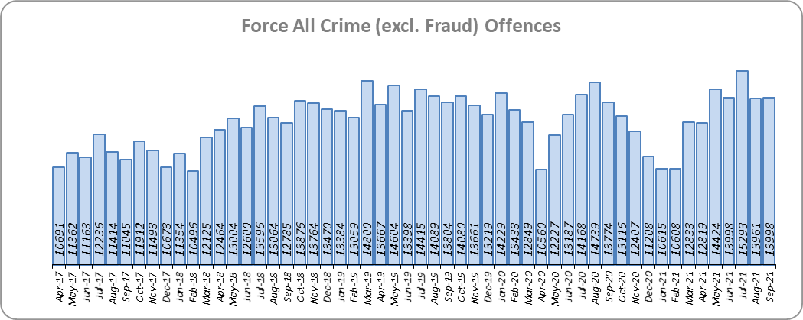
Priority 1 - More local, visible and accessible policing
Grade: Good
Essex experienced a 3.3% decrease in All Crime (5,268 fewer offences) for the 12 months to September 2021 compared to the 12 months to September 2020. This decrease in crime has been primarily influenced by the Government’s restrictions on gathering and movement in relation to COVID-19. Essex is eighth in its Most Similar Group of forces (MSG) for crime per 1,000 population.
Essex Police recorded a daily average of 467 crimes in September 2021, compared with an average of 450 crimes in August 2021. This equates to an increase of 3.6%.
13,998 offences were recorded in September 2021. This equates to an increase of 1.6% (224 more offences) compared to September 2020 (13,774 offences). There was a 1.4% increase in September 2021 compared to September 2019 (13,804 offences).
Essex Police was awarded two Gold Awards in the Improvement and Efficiency Social Enterprise (iESE) Public Sector Transformation Awards, which celebrate the most innovative practices in transforming local public services. The first award, ‘Police Force of the Year’, was for transforming the Force to an organisation which is ‘exceptional’ in respecting victims of crime by accurately recording offences, and with record levels of trust. The second award, the ‘Customer Focus’ award, was for Operation HARRIER, which makes use of GPS technology to support vulnerable, high risk missing person living with Alzheimer’s and Dementia who have previously been reported missing to the police.

Slide 4
Priority 1 - More local, visible and accessible policing
Grade: Good
Confidence (from the independent survey commissioned by Essex Police) is at 79.8% (results to the 12 months to June 2021). Compared to year ending June 2020, confidence in the local police has significantly increased (an improvement of 10.1% points).
The All Crime Harm (Crime Severity) Score** (13.0) places Essex seventh in its MSG.
Essex Police’s performance in relation to emergency response attendance within 15 minutes (urban) or 20 minutes (rural) has improved by 2.3 percentage points to 80.8% in the 12 months to September 2021 compared to the 12 months to September 2020. This is above the 80% target.
Due to the fact that the percentage of people who have confidence in policing in Essex has improved and the emergency response attendance is above the 80% target, a grade of Good is recommended.
Please note:
* Crime Survey of England and Wales data are no longer available at Force level. Data are for the 12 months to March 2020.
** Crime Severity Scores (as calculated by the Office for National Statistics) measure the ‘relative harm’ of crimes by taking into account both their volume and their severity. Data are for the 12 months to July in all three years.
*** Grade of Service.

Slide 5
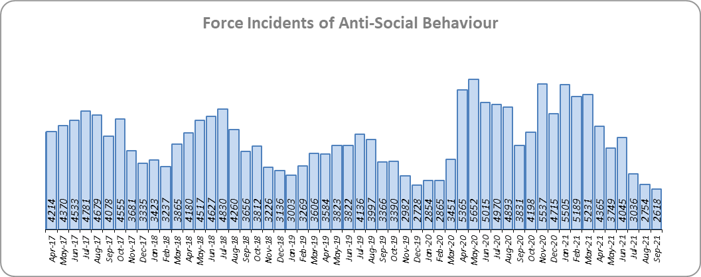
Priority 2 - Crack down on anti-social behaviour
Grade: Good
Essex experienced a 5.1% increase (2,488 more) in Anti-Social Behaviour (ASB) incidents for the 12 months to September 2021 compared to the 12 months to September 2020. This increase was due to the COVID-19 restriction period, during which many additional reports were received that related to activities that were not previously considered to be ASB; examples include social gatherings and shops and businesses continuing to trade. Since March 2020 the number of ASB incidents reported has generally been higher when tighter restrictions were implemented by the Government, and lower when restrictions were eased.
There was a decrease of 31.7% ASB reports in September 2021 compared to September 2020 (1,213 fewer incidents). The average daily number of ASB incidents decreased by 1.8% in September 2021 (87 incidents) compared to August 2021 (89 incidents). September 2021 experienced the lowest number of ASB incidents recorded per month since April 2017 (2,618 incidents).
The number of ASB incidents for the 12 months to September 2021 compared to the 12 months to September 2019 increased by 18.2% (7,839 more incidents).
The results of Essex’s independent survey in relation to how well residents perceive Essex Police and partner organisations to be dealing with ASB showed a slight improvement: 0.4% points.
Due to the increase in public perception from the Essex independent survey, and the fact that the lowest monthly number of ASB incidents since pre-COVID were recorded in September 2021, a grade of Good is recommended.
Please note:
* Crime Survey of England and Wales data are no longer available at Force level. Data are for the 12 months to March 2020.

Slide 6
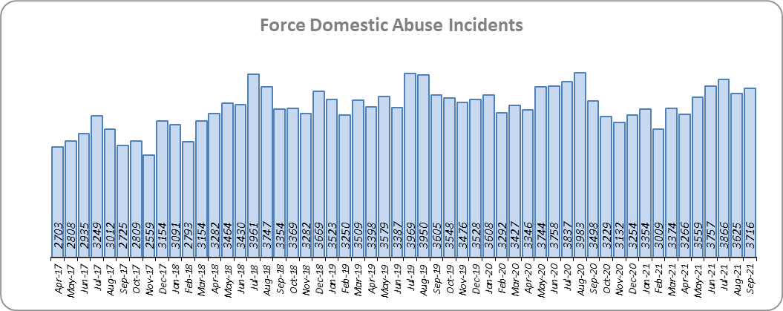
Priority 3 - Breaking the cycle of domestic abuse
Grade: Requires Improvement
Essex experienced a 5.0% decrease (2,135 fewer) in Domestic Abuse incidents but a 1.8% increase (351 more) in repeat incidents of Domestic Abuse for the 12 months to September 2021 compared to the 12 months to September 2020. There was also a 4.0% increase (560 more) in Domestic Abuse arrests but a 12.4% decrease (30 fewer) in the number of Domestic Violence Protection Notices (DVPN) and Protection Orders (DVPO) issued in the 12 months to September 2021 compared to the 12 months to September 2020.
Domestic Abuse incidents in September 2021 were higher than at pre-COVID levels, with a 3.1% increase (111 more incidents) compared to September 2019.
There was a 13.8% decrease (484 fewer) in the number of solved Domestic Abuse outcomes in the 12 months to September 2021 compared to the 12 months to September 2020 and a 3.6% decrease (112 fewer) compared to the 12 months to September 2019.
Due to the fact that the number of DA solved offences has decreased for the fifth month in a row, a grade of Requires Improvement is recommended. In the past 12 months, on average 251 Domestic Abuse offences were solved each month. A ‘Good’ grade required an average of 292 solved offences per month, put another way about 41 more solved offences were required each month. For DVPN/Os, an average of 18 were issued monthly in the last 12 months with an average of 20 needed to achieve a ‘Good’ grade.

Slide 7
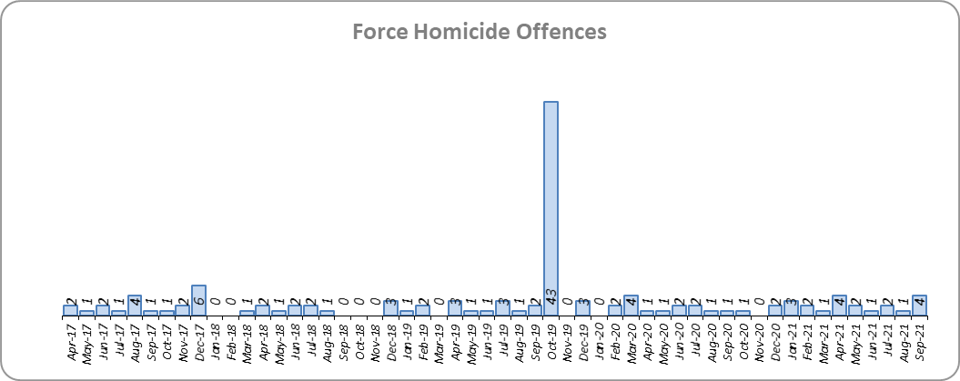
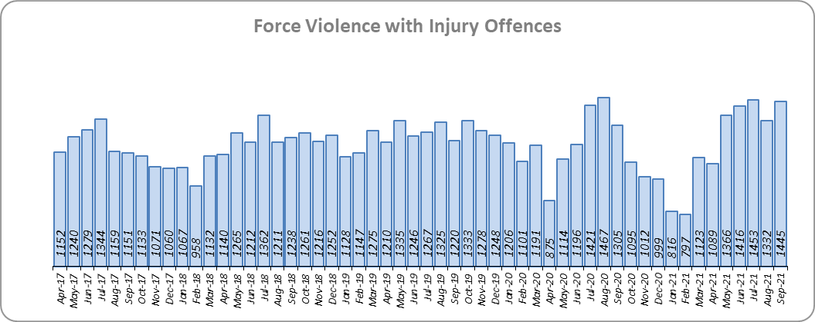
Priority 4 – Tackling gangs and serious violence
Grade: Requires Improvement
37 fewer Homicides (to 23 offences) were recorded for the 12 months to September 2021 compared to the 12 months to September 2020. The 12 months to September 2020 includes the tragic incident where 39 Vietnamese nationals were discovered in a lorry trailer in Grays in October 2019. Essex is fifth in its Most Similar Group (MSG) of forces for offences per 1,000 population, and is slightly higher than the MSG average.
There were four Homicide offences in September 2021 compared to one offence in September 2020 and two offences in September 2019.
There was a 5.6% decrease (829 fewer offences) in Violence with Injury offences for the 12 months to September 2021 compared to the 12 months to September 2020. The average daily number of Violence with Injury offences was 48 for September 2021 and 43 for August 2021. 570 more offences (65.1%) were recorded in September 2021 (1,445 offences) compared to April 2020 (875 offences) when the Government first implemented national restrictions.
The number of Violence with Injury offences decreased by 8.7% (1,318 fewer offences) in the 12 months to September 2021 compared to the 12 months to September 2019.
Essex is fifth in its MSG for Violence with Injury offences per 1,000 population, and is better than the MSG average. There was also a decrease in domestic abuse-related Violence with Injury (6.0% decrease, 348 fewer offences); 38.9% of Violence with Injury is domestic abuse-related.

Slide 8
Priority 4 – Tackling gangs and serious violence
Grade: Requires Improvement
The combined harm (Crime Severity) score* (8.4) for Violence with Injury, Rape, Other Sexual Offences and Robbery of Personal Property places Essex seventh in its Most Similar Group of Forces (MSG).
There was a 14.9% decrease (455 fewer) in the number of solved high harm offences (Violence with Injury, Rape, Other Sexual Offences and Robbery of Personal Property combined) in the 12 months to September 2021 compared to the 12 months to September 2020. Please see page 19 for the numbers of solved for each category.
There was a 63.1% decrease (2,195 fewer) in the number of stop and search for weapons in the 12 months to September 2021 compared to the 12 months to September 2020.
There was an 18.3% decrease (342 fewer) in the number of Knife-enabled crime offences in the 12 months to September 2021** compared to the 12 months to September 2020.
The number of solved high harm offences decreased by 11.8% (347 fewer) in the 12 months to September 2021 compared to the 12 months to September 2019. The number of stop and search for weapons also decreased by 45.9% (1,089 fewer) in the same period.
Due to the fact that Essex is higher than the MSG average in the number of Homicides, and that the number of solved high harm offences has reduced, a grade of Requires Improvement is recommended. On average in the last 12 months, 217 High Harm offences were solved each month. A ‘Good’ grade required a monthly average of 255 solved offences; put another way, about 38 more solved offences were required each month. Four fewer homicides in Essex in the last year would have been the equivalent of the average rate per 1,000 population in Essex’s MSG.
Please note:
* Crime Severity Scores (as calculated by the Office for National Statistics) measure the ‘relative harm’ of crimes by taking into account both their volume and their severity. Data are for the 12 months to July in all three years.
** The number of knife crime offences is an indicator of how effective Essex Police is at identifying knife-enabled offences, and is not necessarily reflective of the number of these offences that have been committed in the county. This is because the identification of these offences is reliant on the appropriate indicator being manually added to the crime record. A new data quality process was introduced in June 2020 and Essex Police is currently working with the National Data Quality Improvement Service (NDQIS) to revise knife crime flags. In September 2021, data from April 2019 was revised; this resulted in an increase in the number of offences recorded, particularly in the 2019/20 financial year. Whilst this has enabled Essex Police to better understand knife crime in Essex, the process has consequently inflated the figures. As such, no inferences can be drawn as to the current trend.

Slide 9
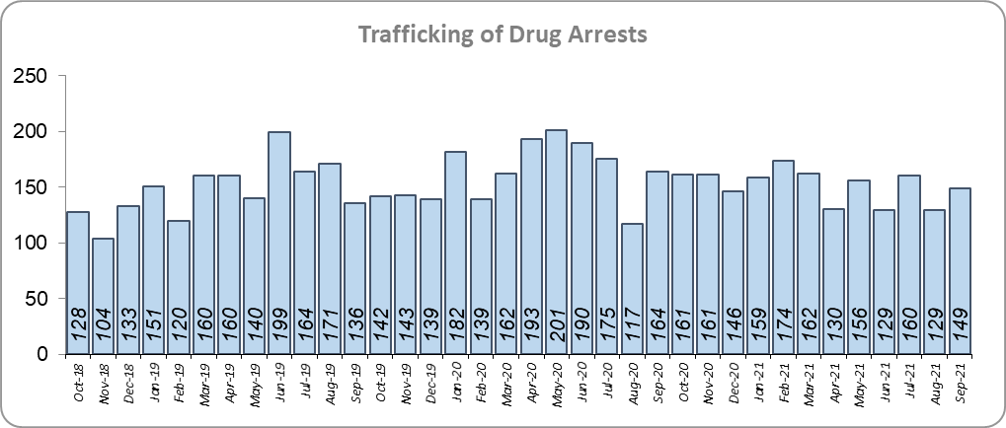
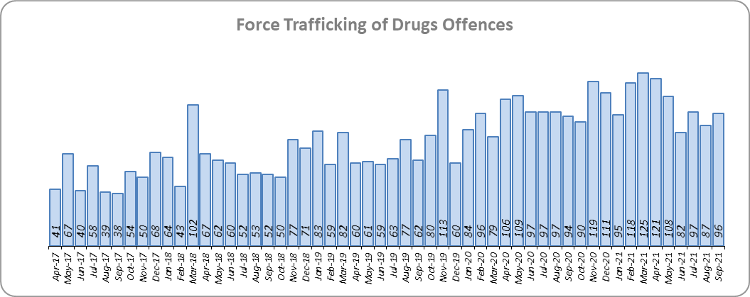
Priority 5 – Disrupting and preventing organised crime
Grade: Good
Essex experienced a 50.3% increase in Organised Crime Group (OCG) disruptions (96 more) for the 12 months to September 2021 compared to the 12 months to September 2020. In January 2019 there was a change in the way in which the number of OCG disruptions were counted; this follows National Crime Agency (NCA) and Eastern Region Special Operations Unit (ERSOU) guidance to ensure that all forces record disruptions in the same way.
Trafficking of drug arrests, which are primarily driven by police proactivity, decreased by 6.3% (123 fewer) for the 12 months to September 2021 compared to the 12 months to September 2020. In the same period, 13.3% more trafficking of drugs offences have been recorded (150 more offences to 1,278).
The number of trafficking of drug arrests increased by 1.4% (25 more) in the 12 months to September 2021 compared to the 12 months to September 2019.
Due to the increase in OCG disruptions, a grade of Good is recommended.
* OCG disruptions are now reported quarterly. Data are to September 2021. Due to the change in recording in January 2019 it is not possible to compare the 12 months to September 2019 to the 12 months to September 2021.

Slide 10
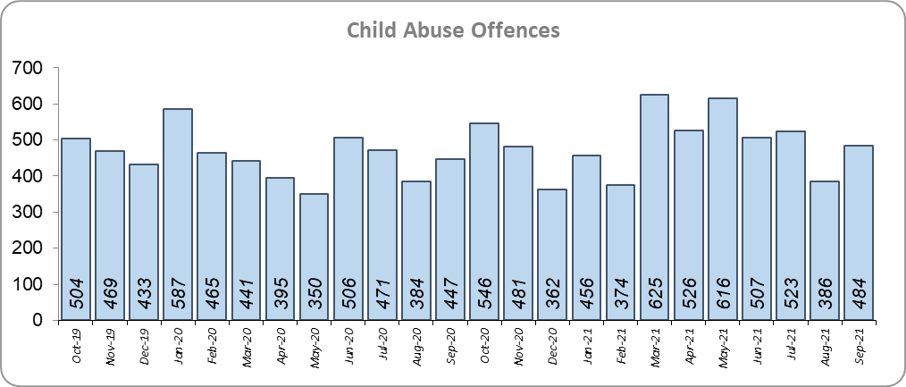
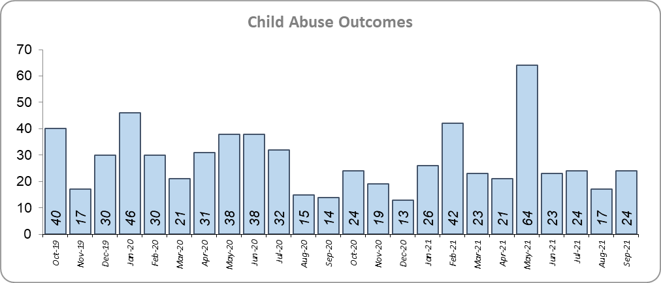
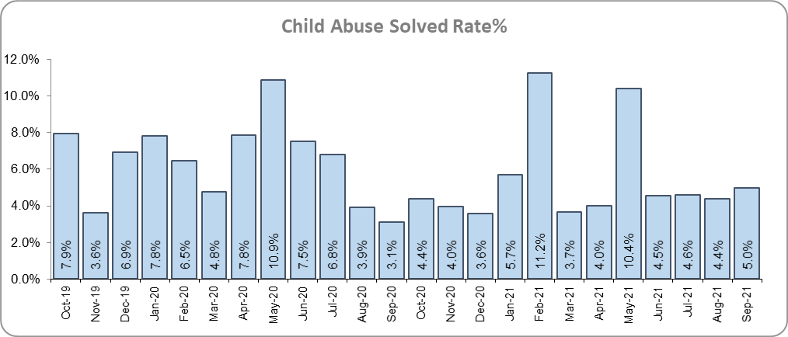
Priority 6 - Protecting children & vulnerable people
Grade: Requires Improvement
Although there was a 16.5% increase (332 more) in the number of Child Sexual Abuse/Exploitation investigations in the 12 months to September 2021 compared to the 12 months to September 2020, there was a 10.4% decrease (38 fewer) in the number of solved Child Abuse Outcomes.
7.9% more Child Abuse offences (an increase of 434) were recorded in the 12 months to September 2021 compared to the 12 months to September 2020. This increase in offences can be partly attributed to a rise in referrals from schools in the latter part of 2020. There was a 1.1% point decrease in the solved rate (from 6.6% to 5.5%).
155 Modern Slavery referrals were made in the 12 months to September 2021 compared with 114 in the 12 months to September 2020 (41 more).
The number of child abuse outcomes increased by 36.3% (87 more outcomes) and the number of child abuse offences increased by 24.2% (1,155 more offences) in the 12 months to September 2021 compared to the 12 months to September 2019.
13.7% more Child Sexual Abuse/Exploitation investigations (an increase of 284) were recorded in the 12 months to September 2021 compared to the 12 months to September 2019.
Due to the decrease in the number of child abuse outcomes and the increase of child abuse offences, a grade of Requires Improvement is recommended. On average in the last 12 months, 27 Child Abuse offences were solved each month. A ‘Good’ grade required a monthly average of 30 solved offences over the past 12 months.
* Due to a change in recording of Modern Slavery referrals in April 2019 it is not possible to compare the 12 months to September 2019 to the 12 months to September 2021.

Slide 11
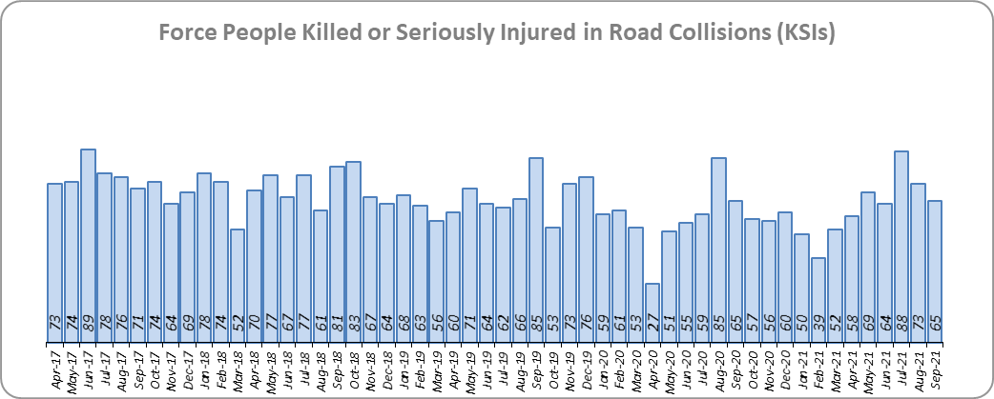
Priority 7 - Improve safety on our roads
Grade: Good
There was a 1.4% increase (10 more) in the number of those Killed or Seriously Injured (KSI) in Essex for the 12 months to September 2021 compared to the 12 months to September 2020. The number of KSIs decreased by 16.5% (145 fewer offences) in the 12 months to September 2021 compared to the 12 months to September 2019. Please note that most KSIs do not necessarily result in criminal offences (such as death or serious injury caused by dangerous driving) being recorded. Essex is sixth in its Most Similar Group (MSG) of forces for casualties per 100 million vehicle kilometres (results to June 2020) and slightly worse than the MSG average. However, due to the fact that more recent national figures have not been released, the current position cannot be determined (the date of the next national release has not yet been confirmed).
There was a 24.7% decrease (149 fewer offences) in the number of driving related mobile phone offences recorded for the 12 months to September 2021 compared to the 12 months to September 2020.* There was also a 31.5% decrease (1,356 fewer offences) in drink/drug driving offences for the 12 months to September 2021 compared to the 12 months to September 2020; of these offences, there was an 11.3% decrease (166 fewer offences) in drink driving and a 45.3% decrease (1,079 fewer offences) in drug driving. All of these offence types are primarily driven by police proactivity in relation to road safety.
Due to the decrease in the number of drink/drug driving offences in the past 12 months, a grade of Good is recommended.
* In 2019, the definition as to what constituted “use” of a mobile phone in relation to driver-related mobile phone offences was subject to a legal challenge. This resulted in a ruling, which held that while “use” included accessing the interactive functions of the mobile phone (such as making calls, sending messages or using the internet), it did not extend to solely accessing the device’s internal functions (such as making use of the camera). Fewer mobile phone offences were subsequently prosecuted from this point. In 2021, however, the law was changed: it is now illegal to “hold” a phone or sat nav when driving or riding a motorcycle. It is therefore likely that offences will now start to increase.

Slide 12
Monthly Performance Overview: Exceptions
Grade: Good
Exceptions Overview
Hate Crime HO Definition offences experienced a statistically a significant increase for the month of September 2021.
Hate Crime HO Definition – Increase
27.9% increase (909 more crimes) for the 12 months to September 2021 compared to the 12 months to September 2020. The Force saw a statistically exceptional increase in September 2021.

Slide 13
Monthly Performance Overview: Of Note
Monthly Performance Overview: Exceptions
COVID-19: Restrictions of movement and social distancing
Since 13 March 2020, the Government implemented a series of alert levels and steps regarding the level of social distancing allowed in relation to COVID-19. Each change has affected the number of All Crime offences recorded.
On 14 October 2020 the Government introduced three levels of restrictions according to different levels of infections around the country. Tier 1 – Medium, Tier 2 – High and Tier 3 – Very High.
On 5 November 2020 the Government implemented a period of increased restrictions which ended on 2nd December 2020 when the country returned to the Tier system.

Slide 14
Monthly Performance Overview: Of Note (continued)
Monthly Performance Overview: Exceptions
COVID-19: Restrictions of movement and social distancing
On 20 December the Government introduced Tier 4 – Stay at Home and on 5th January 2021 a third period of increased restrictions was implemented.
In March 2021 the Government announced its roadmap out of restrictions, starting with Step 1 on 8th March, Step 1a on 29th March and Step 2 on 12th April.

Slide 15
Monthly Performance Overview: Of Note (continued)
Monthly Performance Overview: Exceptions
COVID-19: Restrictions of movement and social distancing
The Government continued on its roadmap out of restrictions with Step 3 on 17th May 2021 and Step 3a on 21st June.

Slide 16
Monthly Performance Overview: Of Note (continued)
Monthly Performance Overview: Exceptions
COVID-19: Restrictions of movement and social distancing
On 19th July 2021 all legal restrictions were lifted but the Government urged caution due to rising case numbers.
Essex hotspot policing trial to be rolled out nationally
After identifying hotspots with higher levels of violence in Southend, and committing to visible policing by implementing regular patrols throughout 2020, Operation Grip resulted in a 73.5% drop in violent crime and a 31.9% drop in street crime in test areas in Southend.
The initiative, created and piloted in Essex, has been praised by Policing Minister Kit Malthouse and will be rolled out across the country.

Slide 17
2016-2021 Police and Crime Plan Performance Indicators
Table 1
Please view above table with the explanations and caveats detailed on page 19.

Slide 18
End Notes
¹ Question from the independent survey commissioned by Essex Police (Percentage of people who have confidence in policing in Essex). Results are for the period 12 months June 2021 versus the 12 months to June 2020.
² The confidence interval is the range +/- between where the survey result may lie. This is mainly influenced by the number of people answering the survey. The more people that answer the survey, the smaller the interval range.
³ Crime Survey of England and Wales data are no longer available at Force level. Data are for the 12 months to March 2020.
⁴ Question from Essex Police’s own confidence and perception survey (Percentage of people who have confidence that the policing response to ASB is improving). Results are for the period 12 months to June 2021 versus the 12 months to June 2020.
⁵ Solved outcomes are crimes that result in: charge or summons, caution, crimes taken into consideration, fixed penalty notice, cannabis warning or community resolution.
⁶ ‘Killed or Seriously Injured’ (KSI) refers to all people killed or seriously injured on Essex’s roads, regardless of whether any criminal offences were committed. ‘Causing Death/Serious Injury by Dangerous/Inconsiderate Driving’ offences (detailed on p.11) refers to the number of crimes of this type.
⁷ Please note that on Wednesday 23 October 2019 the bodies of 39 Vietnamese nationals were discovered in a lorry trailer in Grays. This tragic incident is reflected in the Homicide numbers.
⁸ Crime Severity Score measures ‘relative harm’ of crimes by taking into account both the volume and the severity of offences, and by weighting offences differently. Data are for the 12 months to July 2021.
⁹ The number of knife crime offences is an indicator of how effective Essex Police is at identifying knife-enabled offences, and is not necessarily reflective of the number of these offences that have been committed in the county. This is because the identification of these offences is reliant on the appropriate indicator being manually added to the crime record. A manual review of knife flags was conducted and missing flags were added retrospectively. Additionally a new data quality process was introduced in June 2020. Whilst this has enabled us to better understand knife crime in Essex, the process has consequently inflated the figures. As such, no inferences can be drawn as to the current trend.
¹⁰ The year on year data for driving offences related to mobile phones are not comparable due to a legal appeal (which occurred in October 2019). The current phone use legislation is awaiting clarification in the courts, which has been delayed due to the impact of COVID-19.
Since the appeal, fewer offences have been prosecuted.
¹¹ NRM data only available from April 2019 due to recording change at that time.
¹² OCG disruptions are now reported quarterly. Data are to September 2021.

Slide 19
Crime Tree Data – Rolling 12 Months to September
Table 2

Slide 20
Crime Tree Data – Rolling 12 Months to September
Table 3

