Slide 1
Police and Crime Plan 2016-2021
Monthly Performance Update
March 2021
National and MSG positions are to 31st January 2021 (Essex Police data are to 31st March 2021).
Version 1.2
Produced April 2021
Performance Analysis Unit, Essex Police
Sensitivity: Official

Slide 2
Executive Summary
Six of the seven PFCC Priorities for Essex Police have been given a recommended grade of ‘Good’. Recommended grades have been determined with reference to comparisons with Essex Police’s Most Similar Group (MSG) of forces, Key Performance Indicators (KPIs), and professional judgement.
One of the seven PFCC priorities – 4 (Tackling Gangs and Serious Violence) – has been given a recommended grade of ‘Requires Improvement’.
All Crime fell by 11.4% for the 12 months to March 2021 compared to the 12 months to March 2020; this equates to 19,131 fewer offences. This decrease has been primarily influenced by the Government’s restrictions on gathering and movement in relation to COVID-19. With the recent easing of COVID restrictions, crime volumes in March 2021 were virtually the same (-0.1% lower) as those experienced in March 2020; this equates to 16 fewer offences.
The Force recorded 2,273 more offences in March 2021 than in April 2020, when the Government implemented the first lockdown; (12,833 v. 10,560 offences); this equates to a 21.5% more offences. The Force recorded 248 more Violence with Injury offences (28.3% increase) in March 2021 compared to April 2020 (1,123 v. 875 offences).
Each change in the rules relating to social distancing has affected the number of All Crime offences reported to Essex Police.*
The number of anti-social behaviour (ASB) incidents was 51.6% higher in March 2021 (5,231 incidents) compared to March 2020 (3,451 incidents). Since May 2020, the number of ASB incidents reported have generally decreased when restrictions have been eased, and increased when further restrictions have been implemented by the Government. The average daily number of ASB incidents decreased by -8.9% in March 2021 (169 incidents) compared to February 2021 (185 incidents).
Confidence (from the independent survey commissioned by Essex Police) is at 76.3% (results to the 12 months to December 2020). Compared to year ending December 2019, confidence in the local police increased by 11.6% points.
In response to COVID-19, Essex Police have been following a 4E approach, engaging, explaining, encouraging and only enforcing as a last resort. In March 2021, Essex Police recorded 168 Fixed Penalty Notices (FPN / 4E); this represents 4% of all engagements. In total 1,410 FPNs (4E) have been issued in the period April 2020 to March 2021. The March total includes enforcement marked as having been sent to ACRO Criminal Records Office.
There was a decrease of 17.4% (23 fewer) Modern Slavery referrals from in the 12 months to March 2021 compared to the same period in 2019-20. Essex Police are working towards increasing the number of referrals to achieve greater range and engagement with hard to access groups, thereby creating more opportunities to help vulnerable people.
* Please see table showing the affect of social distancing measures on pages 13 - 15.

Slide 3
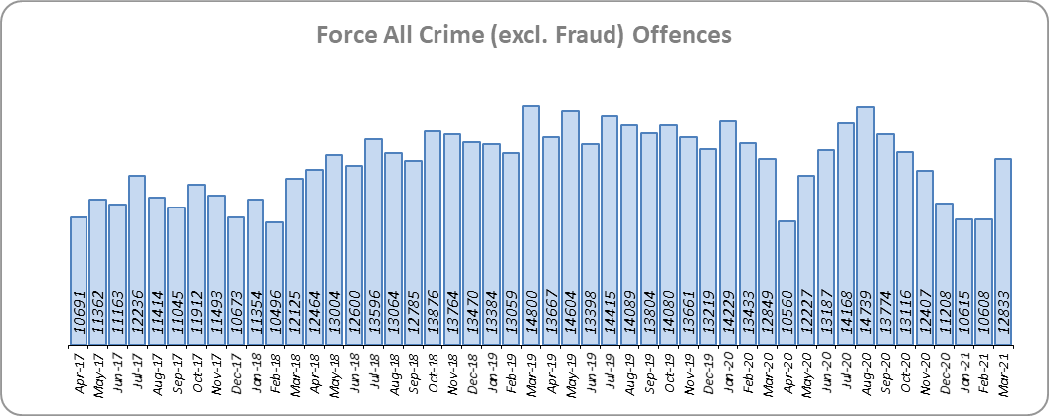
Priority 1 - More local, visible and accessible policing
Grade: Good
Essex experienced an 11.4% decrease in All Crime (19,131 fewer offences) for the 12 months to March 2021 compared to the 12 months to March 2020. Essex is eighth in its Most Similar Group of forces (MSG) for crime per 1,000 population.
This decrease in crime has been primarily influenced by the Government’s restrictions on gathering and movement in relation to COVID-19. Due to the Government’s easing of restrictions on 8 March 2021, Essex Police recorded a daily average of 414 crimes, compared with an average of 379 crimes in February 2021, an increase of 9.3%. 12,833 offences were recorded in March 2021, an increase of 21.5% (2,273 more offences) compared to April 2020 (10,560 offences), when the Government first implemented national restrictions.
Essex Police has been shortlisted in the Police Service of the Year category in the Improvement and Efficiency Social Enterprise (iESE) Public Sector Transformation Awards. These awards celebrate the most innovative practice in transforming local public services.

Slide 4
Priority 1 - More local, visible and accessible policing
Grade: Good
Confidence (from the independent survey commissioned by Essex Police) is at 76.3% (results to the 12 months to December 2020). Compared to year ending December 2019, confidence in the local police has significantly increased (an improvement of 11.6% points). Confidence in the local police from the Crime Survey of England and Wales (CSEW) places Essex eighth in its MSG, and 6.5% points below the Most Similar Group of Forces (MSG) average.* However, the sample size from this survey is not representative at a sufficiently small scale to measure local level results. The Essex Police independent survey (results detailed above) was therefore introduced to achieve a more accurate local measure, with only a small margin of error.
The All Crime Harm (Crime Severity) Score** (12.0) places Essex seventh in its MSG.
Essex Police performance in relation to emergency response attendance within 15 minutes (urban) or 20 minutes (rural) has improved by 5.4 percentage points to 82.6% in the 12 months to March 2021 compared to the 12 months to March 2020. This is above the 80% target.
Due to the fact that the percentage of people who have confidence in policing in Essex has improved and the emergency response attendance is above the 80% target, a grade of Good is recommended.
Please note:
* Crime Survey of England and Wales data are no longer available at Force level. Data are for the 12 months to March 2020.
** Crime Severity Scores (as calculated by the Office for National Statistics) measure the ‘relative harm’ of crimes by taking into account both their volume and their severity. Data are for the 12 months to January 2021.
*** Grade of Service.

Slide 5
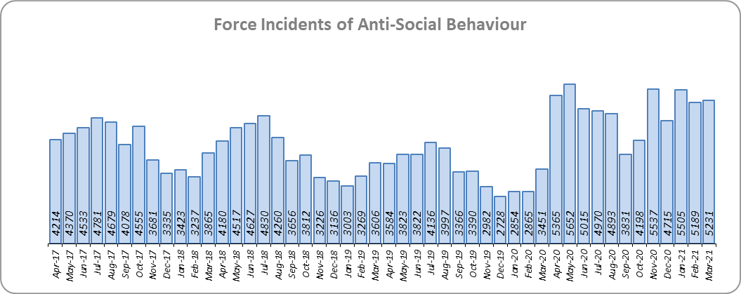
Priority 2 - Crack down on anti-social behaviour
Grade: Good
Essex experienced a 46.2% increase (19,067 more) in Anti-Social Behaviour (ASB) incidents for the 12 months to March 2021 compared to the 12 months to March 2020. This increase was due to the COVID-19 restriction period, during which many additional reports were received that related to activities that were previously not considered to be ASB, for example social gatherings and shops and businesses continuing to trade. Since May 2020 the number of ASB incidents reported has generally decreased when restrictions have been eased, and increased when further restrictions have been implemented by the Government. There was an increase of 51.6% ASB reports in March 2021 compared to March 2020 (1,780 more incidents). The average daily number of ASB incidents decreased by -8.9% in March 2021 (169 incidents) compared to February 2021 (185 incidents).
ASB Perception (from the Crime Survey of England and Wales)* in Essex experienced a 1.0% point increase (decline). Essex is 0.5% points better than the MSG average; this places Essex fourth in its Most Similar Group of forces. The results of Essex’s independent survey in relation to how well residents perceive Essex Police and partner organisations to be dealing with ASB showed a significant improvement: 6.3% points.
Due to the significant increase in public perception from the Essex independent survey, a grade of Good is recommended.
Please note:
* Crime Survey of England and Wales data are no longer available at Force level. Data are for the 12 months to March 2020.

Slide 6
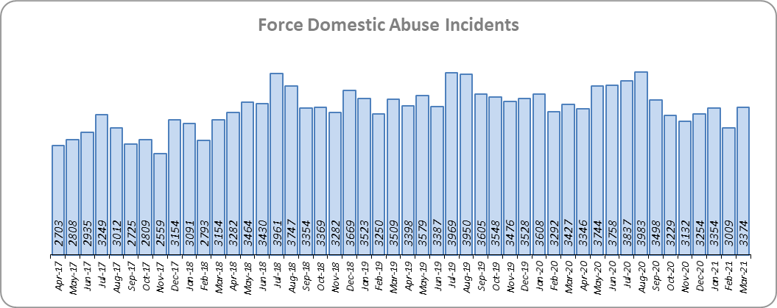
Priority 3 - Breaking the cycle of domestic abuse
Grade: Good
Essex experienced a 2.9% decrease (1,249 fewer) in Domestic Abuse incidents and a 7.8% decrease (1,611 fewer) in repeat incidents of Domestic Abuse for the 12 months to March 2021 compared to the 12 months to March 2020. There was also a 16.2% increase (1,982 more) in Domestic Abuse arrests and a 13.1% increase (26 more) in Domestic Violence Protection Notices (DVPN) and Protection Orders (DVPO) in the 12 months to March 2021 compared to the 12 months to March 2020.
There was a 14.4% increase (430 more) in the number of solved Domestic Abuse outcomes in the 12 months to March 2021 compared to the 12 months to March 2020.
Due to the decrease in repeat incidents of Domestic Abuse and the increase in Domestic Abuse offences solved, a grade of Good is recommended.

Slide 7
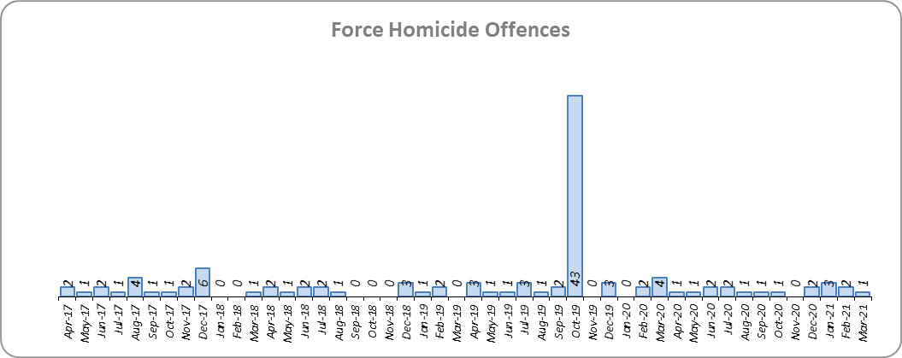
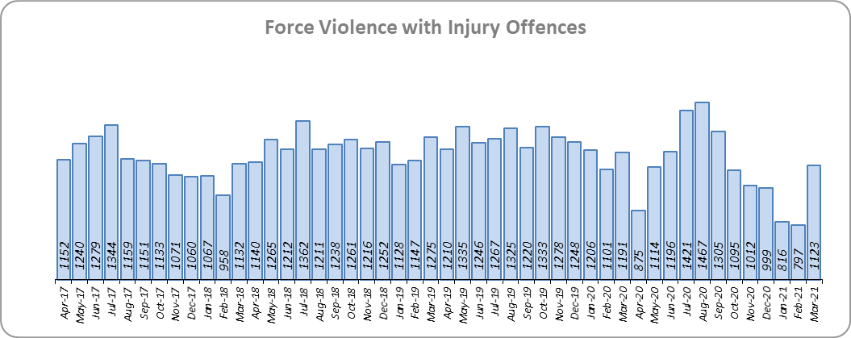
Priority 4 – Tackling gangs and serious violence
Grade: Requires Improvement
Essex saw a decrease of 45 homicides (to 18 offences) for the 12 months to March 2021 compared to the 12 months to March 2020. The 12 months to March 2020 includes the tragic incident where 39 Vietnamese nationals were discovered in a lorry trailer in Grays in October 2019. Essex is seventh in its Most Similar Group (MSG) of forces for offences per 1,000 population, and is slightly higher than the MSG average.
There was a 13.5% decrease (2,058 fewer offences) in Violence with Injury offences. With the recent easing of restrictions, the number of Violence with Injury offences in March 2021 is slightly lower than those experienced in March 2020: Essex Police recorded 68 fewer offences (-5.7%) in March 2021 compared to March 2020. 248 more offences (28.3%) were recorded in March 2021 (1,123 offences) compared to April 2020 (875 offences) when the Government first implemented national restrictions.
Essex is fifth in its MSG for Violence with Injury offences per 1,000 population, and is slightly better than the MSG average. There was a slight increase in domestic abuse-related Violence with Injury (0.3% increase, 14 more offences); 41.6% of Violence with Injury is domestic abuse-related.

Slide 8
Priority 4 – Tackling gangs and serious violence
Grade: Requires Improvement
The combined harm (Crime Severity) score* (7.4) for Violence with Injury, Rape, Other Sexual Offences and Robbery of Personal Property places Essex eighth in its Most Similar Group of Forces (MSG).
There was a 6.9% increase (190 more) in the number of solved high harm offences (Violence with Injury, Rape, Other Sexual Offences and Robbery of Personal Property combined) in the 12 months to March 2021 compared to the 12 months to March 2020. This is being driven by an increase in the number of Violence with Injury, Rape and Other Sexual Offences solved. Please see page 18 for the numbers of solved for each category.
There was a 32.6% decrease (1,091 fewer) in the number of stop and search for weapons in the 12 months to March 2021 compared to the 12 months to March 2020.
There was a 37.9% increase (420 more) in the number of Knife-enabled crime offences in the 12 months to March 2021** compared to the 12 months to March 2020.
Due to the fact that Essex is higher than the MSG average in both the number of homicides and high harm offences, a grade of Requires Improvement is recommended.
Please note:
* Crime Severity Scores (as calculated by the Office for National Statistics) measure the ‘relative harm’ of crimes by taking into account both their volume and their severity. Data are for the 12 months to January 2021.
** The number of knife crime offences is an indicator of how effective Essex Police is at identifying knife-enabled offences, and is not necessarily reflective of the number of these offences that have been committed in the county. This is because the identification of these offences is reliant on the appropriate indicator being manually added to the crime record. A manual review of knife flags was conducted and missing flags were added retrospectively. Additionally a new data quality process was introduced in June 2020. Whilst this has enabled us to better understand knife crime in Essex, the process has consequently inflated the figures. As such, no inferences can be drawn as to the current trend.

Slide 9
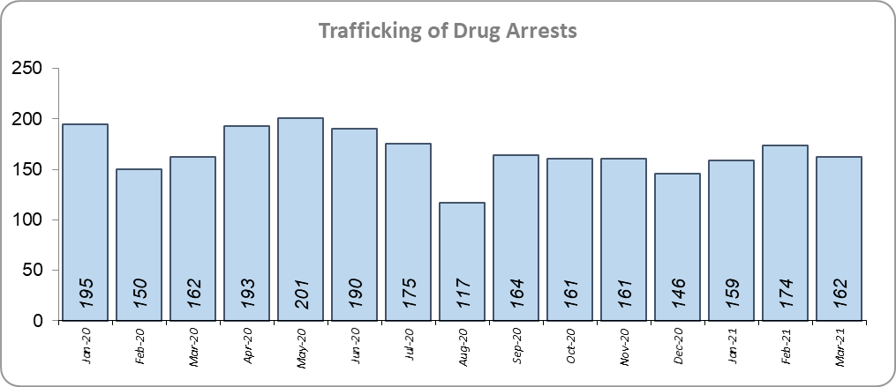
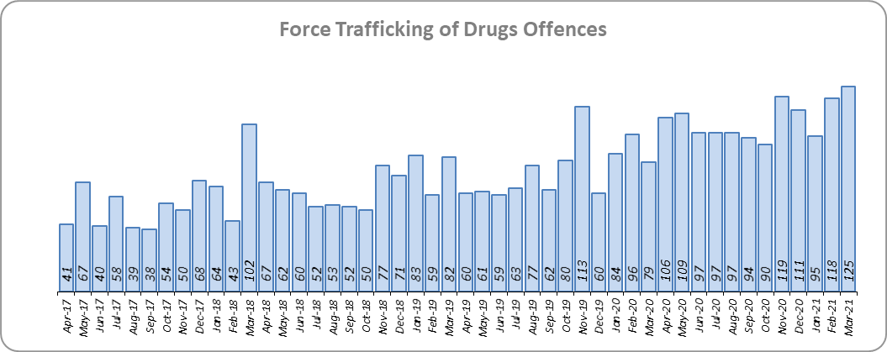
Priority 5 – Disrupting and preventing organised crime
Grade: Good
Essex experienced a 106.6% increase in Organised Crime Group (OCG) disruptions (130 more) for the 12 months to March 2021 compared to the 12 months to March 2020. In January 2019 there was a change in the way in which the number of OCG disruptions were counted; this follows National Crime Agency (NCA) and Eastern Region Special Operations Unit (ERSOU) guidance to ensure that all forces record disruptions in the same way.
Trafficking of drug arrests, which are as a result of police proactivity, increased by 6.9% (130 more) for the 12 months to March 2021 compared to the 12 months to March 2020. In the same period, 37.3% more trafficking of drugs offences have been recorded (350 more offences to 1,288).
Due to the increase in OCG disruptions and the increase in Trafficking of Drug Arrests, a grade of Good is recommended.

Slide 10
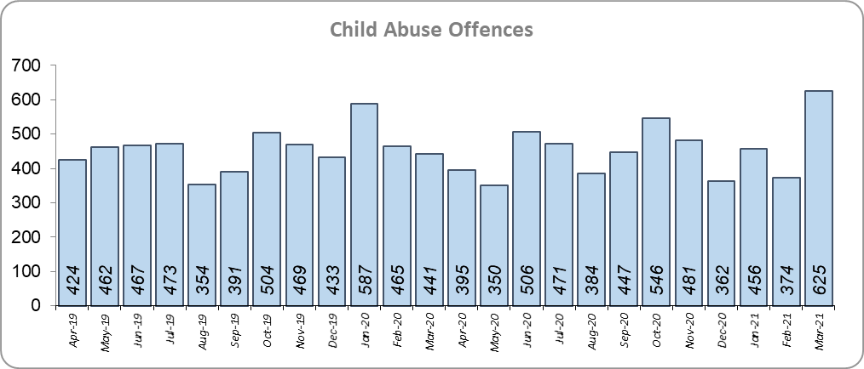
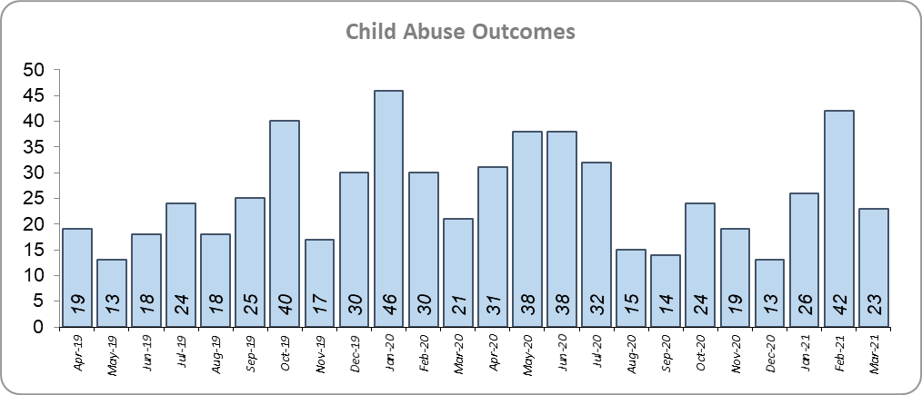
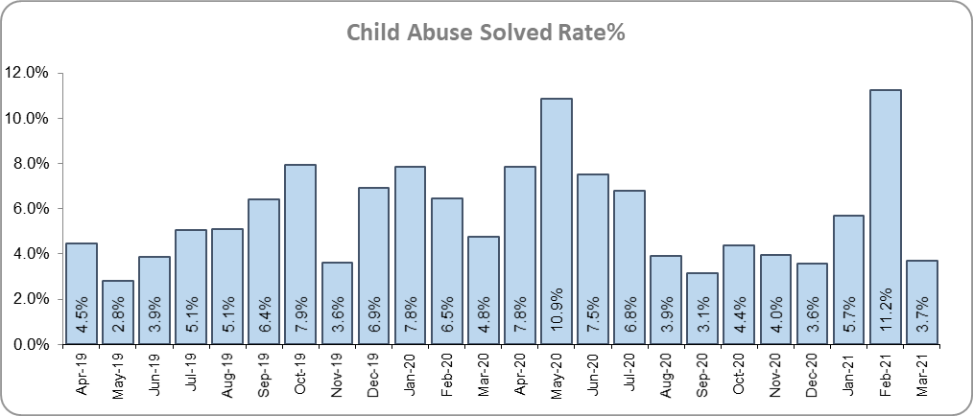
Priority 6 - Protecting children & vulnerable people
Grade: Good
Although there was a 4.2% increase (82 more) in the number of Child Sexual Abuse/Exploitation investigations in the 12 months to March 2021 compared to the 12 months to March 2020, there was a 1.2% decrease (4 fewer) in the number of solved Child Abuse Outcomes (12 months to March 2021 v. 12 months to March 2020.
1.6% fewer Child Abuse offences (a reduction of 89) were recorded in the 12 months to March 2021 compared to the 12 months to March 2020. The solved rate was 5.8% for both periods.
109 Modern Slavery referrals were made in the 12 months to March 2021 compared with 132 in the same months in 2019-20 (23 fewer).
While there has been a marginal decrease in the number of solved offences, this equates to an average of 0.01 fewer offences solved each day. Performance is therefore stable. Due also to the fact that the number of Child Sexual Abuse/Exploitation investigations has risen, and previous reports submitted in last 12 months have consistently identified an increase in the number of solved outcomes, a grade of Good is recommended. However, if the number of solved outcomes continues to decline for the 12 month period (when compared to the same period the previous year), a grade of Requires Improvement will be considered for future reports.

Slide 11
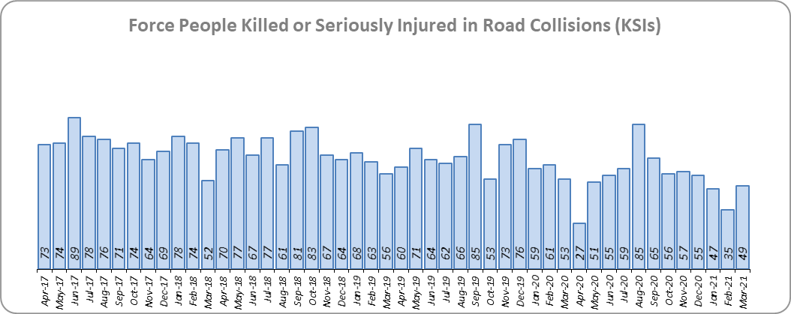
Priority 7 - Improve safety on our roads
Grade: Good
There was a 21.9% decrease (180 fewer) in the numbers of those Killed or Seriously Injured (KSI) in Essex for the 12 months to March 2021 compared to the 12 months to March 2020. Please note that most KSIs do not necessarily result in criminal offences (such as death or serious injury caused by dangerous driving) being recorded. Essex is placed sixth in its Most Similar Group (MSG) of forces for casualties per 100 million vehicle kilometres (results to June 2020).
There was a 68.8% decrease (1,052 fewer offences) in the number of driving related mobile phone offences recorded for the 12 months to March 2021 compared to the 12 months to March 2020.*
There was a 5.1% increase (189 more offences) in drink/drug driving, particularly drug drive offences recorded for the 12 months to March 2021 compared to the 12 months to March 2020. This is a measure of police proactivity in relation to road safety.
As of June 2020, Essex was slightly worse than the MSG average per 100 million km. However, due to the fact that more recent national figures have not been released, the current position cannot be determined (the date of the next national release has not yet been confirmed).
Due to the decrease in KSIs in the past 12 months, a grade of Good is recommended.
* The year on year data for driving offences related to mobile phones are not comparable due to a legal appeal (which occurred in October 2019). The current phone use legislation is awaiting clarification in the courts, which has been delayed due to the impact of COVID-19. Since the appeal, fewer offences have been prosecuted.

Slide 12
Monthly Performance Overview: Exceptions
Exceptions Overview
Trafficking of Drugs experienced a statistically significant increase for the month of March 2021: There were no statistically exceptional decreases.
Trafficking of Drugs – Increase
37.3% increase (350 more crimes) for the 12 months to March 2021 compared to the 12 months to March 2020. There were statistically exceptional increases in two Districts in March 2021.

Slide 13
Monthly Performance Overview: Of Note
Monthly Performance Overview: Exceptions
COVID-19: Restrictions of movement and social distancing
Since 13 March 2020, the Government implemented a series of alert levels and steps regarding the level of social distancing allowed in relation to COVID-19. Each change has affected the number of All Crime offences recorded.

Slide 14
Monthly Performance Overview: Of Note (continued)
Monthly Performance Overview: Exceptions
COVID-19: Restrictions of movement and social distancing
On 14 October 2020 the Government introduced three levels of restrictions according to different levels of infections around the country. Tier 1 – Medium, Tier 2 – High and Tier 3 – Very High.

Slide 15
Monthly Performance Overview: Of Note (continued)
Monthly Performance Overview: Exceptions
COVID-19: Restrictions of movement and social distancing
On 5 November 2020 the Government implemented a period of increased restrictions which ended on 2nd December 2020 when the country returned to the Tier system.
On 20 December the Government introduced Tier 4 – Stay at Home and on 5th January 2021 a third period of increased restrictions was implemented.

Slide 16
2016-2021 Police and Crime Plan Performance Indicators
Table 1
Please view above table with the explanations and caveats detailed on pages 17 and 18.

Slide 17
End Notes
¹ Question from the independent survey commissioned by Essex Police (Percentage of people who have confidence in policing in Essex). Results are for the period 12 months December 2020 versus the 12 months to December 2019.
² The confidence interval is the range +/- between where the survey result may lie. This is mainly influenced by the number of people answering the survey. The more people that answer the survey, the smaller the interval range.
³ Crime Survey of England and Wales data are no longer available at Force level. Data are for the 12 months to March 2020.
⁴ Question from Essex Police’s own confidence and perception survey (Percentage of people who have confidence that the policing response to ASB is improving). Results are for the period 12 months to December 2020 versus the 12 months to December 2019
⁵ Solved outcomes are crimes that result in: charge or summons, caution, crimes taken into consideration, fixed penalty notice, cannabis warning or community resolution.
⁶ ‘Killed or Seriously Injured’ (KSI) refers to all people killed or seriously injured on Essex’s roads, regardless of whether any criminal offences were committed. ‘Causing Death/Serious Injury by Dangerous/Inconsiderate Driving’ offences (detailed on p.11) refers to the number of crimes of this type.
⁷ Please note that on Wednesday 23 October 2019 the bodies of 39 Vietnamese nationals were discovered in a lorry trailer in Grays. This tragic incident is reflected in the Homicide numbers.
⁸ Crime Severity Score measures ‘relative harm’ of crimes by taking into account both the volume and the severity of offences, and by weighting offences differently. Data are for the 12 months to January 2021.
⁹ The number of knife crime offences is an indicator of how effective Essex Police is at identifying knife-enabled offences, and is not necessarily reflective of the number of these offences that have been committed in the county. This is because the identification of these offences is reliant on the appropriate indicator being manually added to the crime record. A manual review of knife flags was conducted and missing flags were added retrospectively. Additionally a new data quality process was introduced in June 2020. Whilst this has enabled us to better understand knife crime in Essex, the process has consequently inflated the figures. As such, no inferences can be drawn as to the current trend.
¹⁰ The year on year data for driving offences related to mobile phones are not comparable due to a legal appeal (which occurred in October 2019). The current phone use legislation is awaiting clarification in the courts, which has been delayed due to the impact of COVID-19.
Since the appeal, fewer offences have been prosecuted.

Slide 18
Crime Tree Data – Rolling 12 Months to March
Table 2

Slide 19
Crime Tree Data – Rolling 12 Months to March
Table 3

