Slide 1
Police and Crime Plan 2016-2021
Monthly Performance Update
June 2021
National and MSG positions are to 30 April 2021 (Essex Police data are to 30 June 2021).
Version 1.1
Produced July 2021
Performance Analysis Unit, Essex Police
Sensitivity: Official

Slide 2
Executive Summary
Five of the seven PFCC Priorities for Essex Police have been given a recommended grade of ‘Good’. Recommended grades have been determined with reference to comparisons with Essex Police’s Most Similar Group (MSG) of forces, Key Performance Indicators (KPIs), and professional judgement.
Two of the seven PFCC priorities – 4 (Tackling Gangs and Serious Violence) and 6 (Protecting children and vulnerable people) – have been given a recommended grade of ‘Requires Improvement’.
All Crime fell by 4.3% for the 12 months to June 2021 compared to the 12 months to June 2020; this equates to 6,924 fewer offences. This decrease has been primarily influenced by the Government’s restrictions on gathering and movement in relation to COVID-19.
Each change in the rules relating to social distancing has affected the number of All Crime offences reported to Essex Police.*
There was a 4.5% increase in All Crime in June 2021 compared to June 2019 (13,998 June 2021 v. 13,398 June 2019). However, the Force recorded 3,438 more offences in June 2021 than in April 2020 (10,560 offences), when the Government implemented the first lockdown; this equates to 32.6% more offences.
The Force recorded 541 more Violence with Injury (VWI) offences (61.8% increase) in June 2021 compared to April 2020 (1,416 v. 875 offences). VWI offences recorded in June 2021 were higher than before COVID restrictions were introduced; compared with June 2019 there was a 13.6% increase (170 more crimes).
There were 19.3% fewer Anti-Social Behaviour (ASB) in June 2021 (4,045 incidents) compared to June 2020 (5,015 incidents). Since May 2020, the number of ASB incidents reported have generally decreased when restrictions have been eased, and increased when further restrictions have been implemented by the Government. The average daily number of ASB incidents increased by 11.5% in June 2021 (135 incidents) compared to May 2021 (121 incidents). ASB incidents in June 2021 were 5.8% higher than pre-COVID levels: 223 more incidents compared to June 2019 (3,822 incidents).
Confidence (from the independent survey commissioned by Essex Police) is at 79.3% (results to the 12 months to March 2021). Compared to year ending March 2020, confidence in the local police increased by 13.7% points.
In response to COVID-19, Essex Police have been following a 4E approach, engaging, explaining, encouraging and only enforcing as a last resort. In June 2021, Essex Police recorded 3 Fixed Penalty Notices (FPN / 4E); this represents 0.8% of all engagements. In total, 1,480 FPNs (4E) have been issued in the period April 2020 to June 2021. The June 2021 total includes enforcement marked as having been sent to ACRO Criminal Records Office.
There was a decrease of 4.8% (six fewer) Modern Slavery referrals in the 12 months to June 2021 compared to the same period in 2019-20. Essex Police are working towards increasing the number of referrals to achieve greater range and engagement with hard to access groups, thereby creating more opportunities to help vulnerable people.
* Please see table showing the affect of social distancing measures on pages 13 - 16.

Slide 3
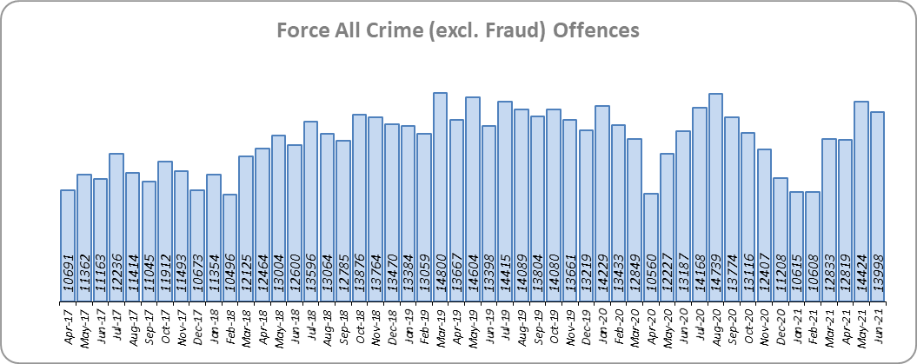
Priority 1 - More local, visible and accessible policing
Grade: Good
Essex experienced a 4.3% decrease in All Crime (6,924 fewer offences) for the 12 months to June 2021 compared to the 12 months to June 2020. This decrease in crime has been primarily influenced by the Government’s restrictions on gathering and movement in relation to COVID-19. Essex is eighth in its Most Similar Group of forces (MSG) for crime per 1,000 population.
Due to the Government’s easing of restrictions on 21 June 2021, Essex Police recorded a daily average of 467 crimes in June 2021, compared with an average of 465 crimes in May 2021. This equates to an increase of 0.3%.
13,998 offences were recorded in June 2021. This equates to an increase of 6.1% (811 more offences) compared to June 2020 (13,187 offences), when stricter Government restrictions were in place. There was a 4.5% increase in June 2021 compared to June 2019 (13,398 offences).
Essex Police has been shortlisted in the Police Service of the Year category in the Improvement and Efficiency Social Enterprise (iESE) Public Sector Transformation Awards. These awards celebrate the most innovative practice in transforming local public services.

Slide 4
Priority 1 - More local, visible and accessible policing
Grade: Good
Confidence (from the independent survey commissioned by Essex Police) is at 79.3% (results to the 12 months to March 2021). Compared to year ending March 2020, confidence in the local police has significantly increased (an improvement of 13.7% points).*
The All Crime Harm (Crime Severity) Score** (12.1) places Essex sixth in its MSG.
Essex Police performance in relation to emergency response attendance within 15 minutes (urban) or 20 minutes (rural) has improved by 5.5 percentage points to 81.1% in the 12 months to June 2021 compared to the 12 months to June 2020. This is above the 80% target.
Due to the fact that the percentage of people who have confidence in policing in Essex has improved and the emergency response attendance is above the 80% target, a grade of Good is recommended.
Please note:
* Crime Survey of England and Wales data are no longer available at Force level. Data are for the 12 months to March 2020.
** Crime Severity Scores (as calculated by the Office for National Statistics) measure the ‘relative harm’ of crimes by taking into account both their volume and their severity. Data are for the 12 months to April in all three years.
*** Grade of Service.

Slide 5
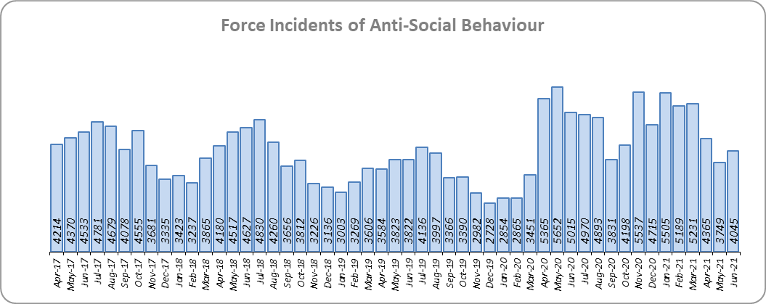
Priority 2 - Crack down on anti-social behaviour
Grade: Good
Essex experienced a 22.6% increase (10,380 more) in Anti-Social Behaviour (ASB) incidents for the 12 months to June 2021 compared to the 12 months to June 2020. This increase was due to the COVID-19 restriction period, during which many additional reports were received that related to activities that were not previously considered to be ASB; examples include social gatherings and shops and businesses continuing to trade. Since May 2020 the number of ASB incidents reported has generally decreased when restrictions have been eased, and increased when further restrictions have been implemented by the Government. There was a decrease of -19.3% ASB reports in June 2021 compared to June 2020 (970 fewer incidents). The average daily number of ASB incidents increased by 11.5% in June 2021 (135 incidents) compared to May 2021 (121 incidents).
The number of ASB incidents are higher than pre-COVID levels with a 5.8% increase (223 more incidents) compared to June 2019.
The results of Essex’s independent survey in relation to how well residents perceive Essex Police and partner organisations to be dealing with ASB showed a significant improvement: 4.1% points.*
Due to the significant increase in public perception from the Essex independent survey, a grade of Good is recommended.
Please note:
* Crime Survey of England and Wales data are no longer available at Force level. Data are for the 12 months to March 2020.

Slide 6
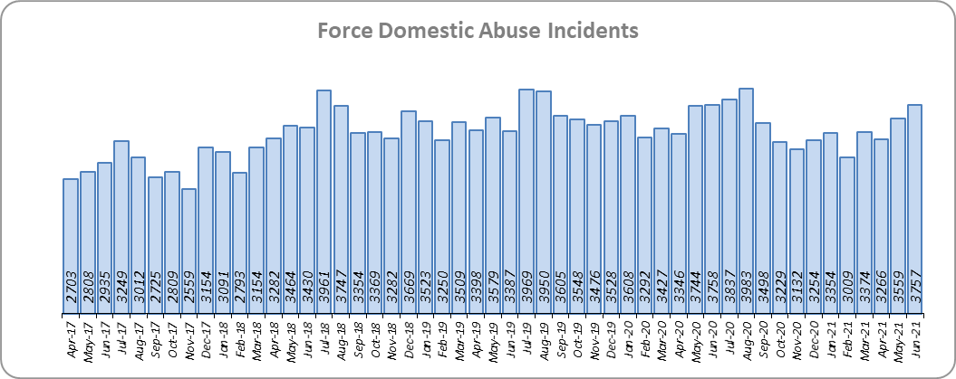
Priority 3 - Breaking the cycle of domestic abuse
Grade: Good
Essex experienced a 4.6% decrease (1,999 fewer) in Domestic Abuse incidents and a 5.1% decrease (1,055 fewer) in repeat incidents of Domestic Abuse for the 12 months to June 2021 compared to the 12 months to June 2020. There was a 10.2% increase (1,324 more) in Domestic Abuse arrests and a 6.5% increase (14 more) in the number of Domestic Violence Protection Notices (DVPN) and Protection Orders (DVPO) issued in the 12 months to June 2021 compared to the 12 months to June 2020.
Domestic Abuse incidents in June 2021 were higher than at pre-COVID levels, with a 10.9% increase (370 more incidents) compared to June 2019.
There was a 4.8% decrease (158 fewer) in the number of solved Domestic Abuse outcomes in the 12 months to June 2021 compared to the 12 months to June 2020 and a -2.0% decrease (64 fewer) compared to the 12 months to June 2019.
Due to the decrease in incidents and repeat incidents of Domestic Abuse and the increase in Domestic Abuse arrests, a grade of Good is recommended.

Slide 7
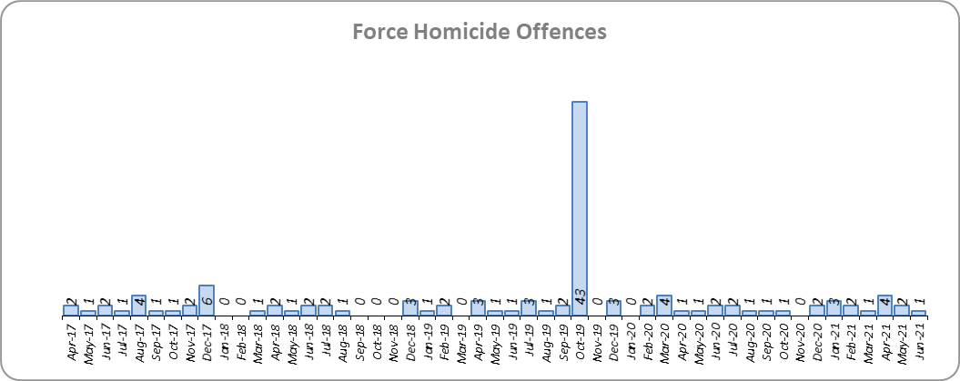
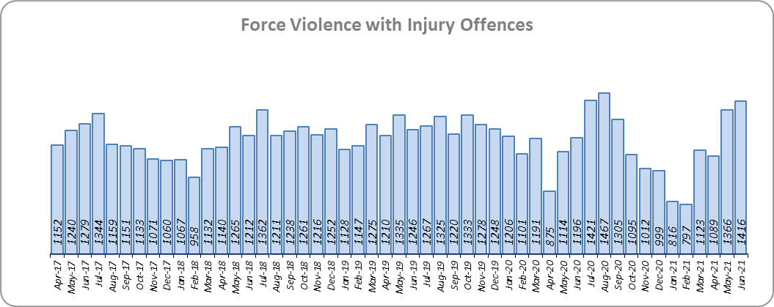
Priority 4 – Tackling gangs and serious violence
Grade: Requires Improvement
Essex saw a decrease of 40 Homicides (to 21 offences) for the 12 months to June 2021 compared to the 12 months to June 2020. The 12 months to June 2020 includes the tragic incident where 39 Vietnamese nationals were discovered in a lorry trailer in Grays in October 2019. Essex is sixth in its Most Similar Group (MSG) of forces for offences per 1,000 population, and is slightly higher than the MSG average.
There was one Homicide offence June 2021 compared to two offences in June 2020 and one offence in June 2019.
There was a 4.3% decrease (629 fewer offences) in Violence with Injury offences. With the recent easing of restrictions, the number of Violence with Injury offences in June 2021 is 18.4% higher (220 more offences) than those experienced in June 2020: 541 more offences (61.8%) were recorded in June 2021 (1,416 offences) compared to April 2020 (875 offences) when the Government first implemented national restrictions.
The number of Violence with Injury offences increased by 13.6% (170 more offences) in the 12 months to June 2021 compared to the 12 months to June 2019.
Essex is fifth in its MSG for Violence with Injury offences per 1,000 population, and is slightly better than the MSG average. There was a decrease in domestic abuse-related Violence with Injury (4.8% decrease, 269 fewer offences); 38.9% of Violence with Injury is domestic abuse-related.

Slide 8
Priority 4 – Tackling gangs and serious violence
Grade: Requires Improvement
The combined harm (Crime Severity) score* (7.5) for Violence with Injury, Rape, Other Sexual Offences and Robbery of Personal Property places Essex seventh in its Most Similar Group of Forces (MSG).
There was a -2.2% decrease (64 fewer) in the number of solved high harm offences (Violence with Injury, Rape, Other Sexual Offences and Robbery of Personal Property combined) in the 12 months to June 2021 compared to the 12 months to June 2020. Please see page 20 for the numbers of solved for each category.
There was a 52.2% decrease (1,867 fewer) in the number of stop and search for weapons in the 12 months to June 2021 compared to the 12 months to June 2020.
There was a 19.2% increase (249 more) in the number of Knife-enabled crime offences in the 12 months to June 2021** compared to the 12 months to June 2020.
The number of solved high harm offences decreased by -8.9% (276 fewer) and the number of stop and search for weapons decreased by -3.0% (53 fewer) in the 12 months to June 2021 compared to the 12 months to June 2019.
Due to the fact that Essex is higher than the MSG average in both the number of homicides and high harm offences, a grade of Requires Improvement is recommended.
Please note:
* Crime Severity Scores (as calculated by the Office for National Statistics) measure the ‘relative harm’ of crimes by taking into account both their volume and their severity. Data are for the 12 months to April in all three years.
** The number of knife crime offences is an indicator of how effective Essex Police is at identifying knife-enabled offences, and is not necessarily reflective of the number of these offences that have been committed in the county. This is because the identification of these offences is reliant on the appropriate indicator being manually added to the crime record. A manual review of knife flags was conducted and missing flags were added retrospectively. Additionally a new data quality process was introduced in June 2020. Whilst this has enabled us to better understand knife crime in Essex, the process has consequently inflated the figures. As such, no inferences can be drawn as to the current trend.

Slide 9
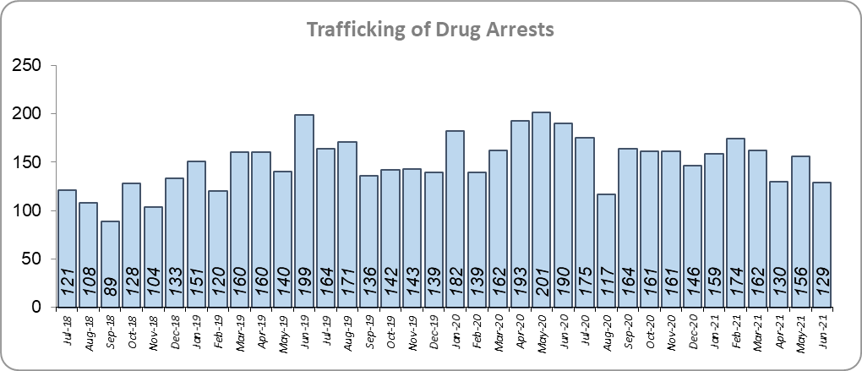
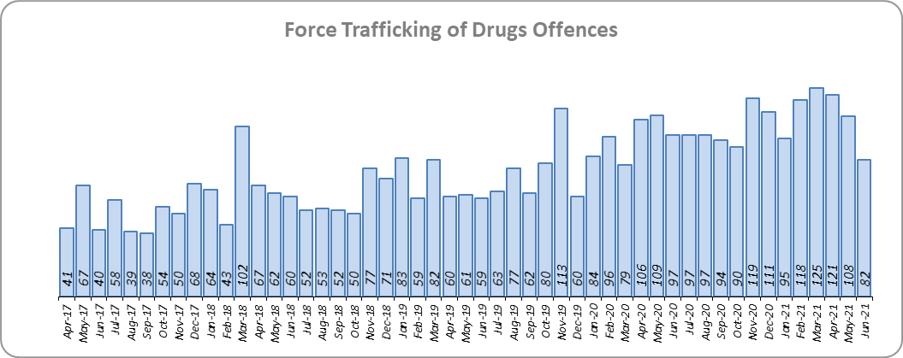
Priority 5 – Disrupting and preventing organised crime
Grade: Good
Essex experienced a 93.1% increase in Organised Crime Group (OCG) disruptions (134 more) for the 12 months to June 2021 compared to the 12 months to June 2020. In January 2019 there was a change in the way in which the number of OCG disruptions were counted; this follows National Crime Agency (NCA) and Eastern Region Special Operations Unit (ERSOU) guidance to ensure that all forces record disruptions in the same way.
Trafficking of drug arrests, which are primarily driven by police proactivity, decreased by 6.6% (130 fewer) for the 12 months to June 2021 compared to the 12 months to June 2020. In the same period, 21.0% more trafficking of drugs offences have been recorded (220 more offences to 1,267).
The number of trafficking of drug arrests increased by 13.6% (219 more) in the 12 months to June 2021 compared to the 12 months to June 2019.
Due to the increase in OCG disruptions a grade of Good is recommended.
* Due to the change in recording in January 2019 it is not possible to compare the 12 months to June 2019 to the 12 months to June 2021.

Slide 10
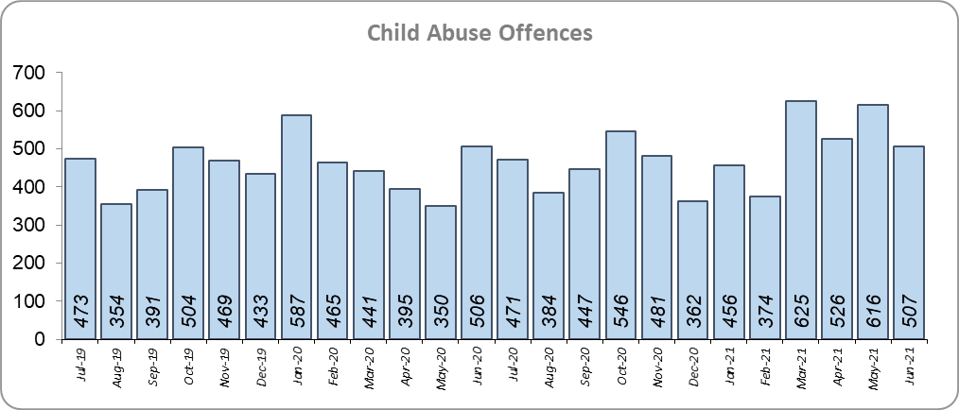
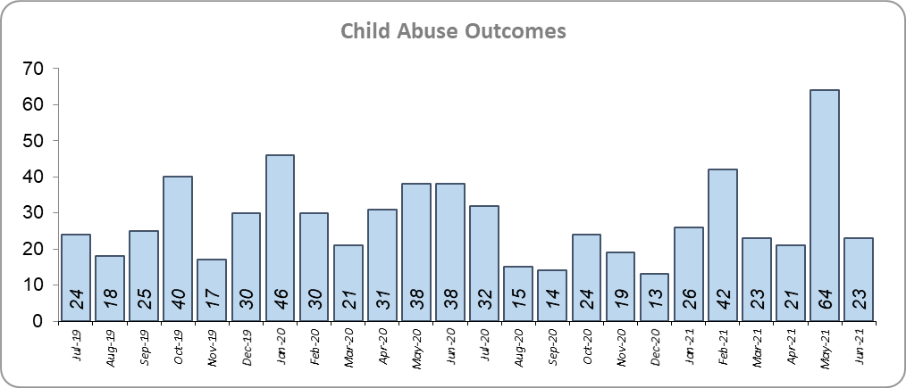
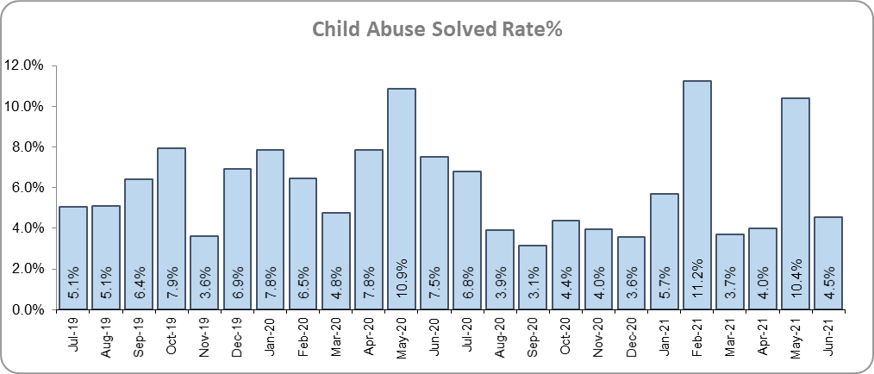
Priority 6 - Protecting children & vulnerable people
Grade: Requires Improvement
Although there was a 12.2% increase (241 more) in the number of Child Sexual Abuse/Exploitation investigations in the 12 months to June 2021 compared to the 12 months to June 2020, there was a 14.5% decrease (55 fewer) in the number of solved Child Abuse Outcomes in the 12 months to June 2021 compared to the 12 months to June 2020.
8.1% more Child Abuse offences (an increase of 438) were recorded in the 12 months to June 2021 compared to the 12 months to June 2020. This increase in offences can be partly attributed to a rise in referrals from schools in the latter part of 2020 (this increase has not been as significant in 2021). There was a -1.5% point decrease in the solved rate (from 7.0% to 5.5%).
118 Modern Slavery referrals were made in the 12 months to June 2021 compared with 124 in the 12 months to June 2020 (6 fewer).
The number of child abuse outcomes increased by 55.0% (115 more outcomes) and the number of child abuse offences increased by 36.0% (1,549 more offences) in the 12 months to June 2021 compared to the 12 months to June 2019.
5.3% more Child Sexual Abuse/Exploitation investigations (an increase of 112) were recorded in the 12 months to June 2021 compared to the 12 months to June 2019.
Due to the decrease in the number of child abuse outcomes and the increase of child abuse offences, a grade of Requires Improvement is recommended.
* Due to a change in recording of Modern Slavery referrals in April 2019 it is not possible to compare the 12 months to June 2019 to the 12 months to June 2021.

Slide 11
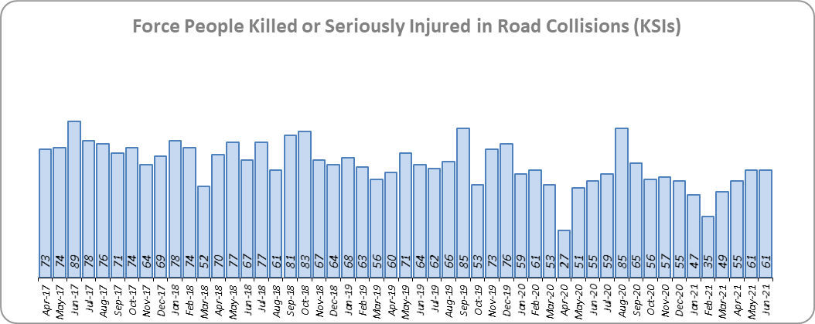
Priority 7 - Improve safety on our roads
Grade: Good
There was an 8.6% decrease (65 fewer) in the numbers of those Killed or Seriously Injured (KSI) in Essex for the 12 months to June 2021 compared to the 12 months to June 2020. Please note that most KSIs do not necessarily result in criminal offences (such as death or serious injury caused by dangerous driving) being recorded. Essex is sixth in its Most Similar Group (MSG) of forces for casualties per 100 million vehicle kilometres (results to June 2020).
There was a 44.6% decrease (396 fewer offences) in the number of driving related mobile phone offences recorded for the 12 months to June 2021 compared to the 12 months to June 2020.* There was also an 18.8% decrease (766 fewer offences) in drink/drug driving for the 12 months to June 2021 compared to the 12 months to June 2020; of these offences, there was an 8.0% decrease (114 fewer offences) in drink driving and a 25.7% decrease (569 fewer offences) in drug driving. All of these offence types are primarily driven by police proactivity in relation to road safety.
The number of people Killed or Seriously Injured (KSIs) in road collisions decreased by 22.1% (196 fewer offences) in the 12 months to June 2021 compared to the 12 months to June 2019.
As of June 2020, Essex was slightly worse than the MSG average per 100 million km. However, due to the fact that more recent national figures have not been released, the current position cannot be determined (the date of the next national release has not yet been confirmed).
Due to the decrease in KSIs in the past 12 months, a grade of Good is recommended.
* The year on year data for driving offences related to mobile phones are not comparable due to a legal appeal (which occurred in October 2019). The current phone use legislation is awaiting clarification in the courts, which has been delayed due to the impact of COVID-19. Since the appeal, fewer offences have been prosecuted.

Slide 12
Monthly Performance Overview: Exceptions
Exceptions Overview
Rape, Racial/Religiously Aggravated Offences, Hate Crime HO Definition and Public Order experienced a statistically significant increase for the month of June 2021: There were no statistically exceptional decreases.
Rape Offences – Increase
10.4% increase (210 more crimes) for the 12 months to June 2021 compared to the 12 months to June 2020. There were statistically exceptional increases in three Districts in June 2021.
Racial/Religiously Aggravated Offences – Increase
16.7% increase (273 more crimes) for the 12 months to June 2021 compared to the 12 months to June 2020. There were statistically exceptional increases in three Districts in June 2021.
Hate Crime HO Definition – Increase
25.0% increase (777 more crimes) for the 12 months to June 2021 compared to the 12 months to June 2020. The Force saw a statistically exceptional increase in June 2021.
Public Order Offences – Increase
7.5% increase (1,163 more crimes) for the 12 months to June 2021 compared to the 12 months to June 2020. There were statistically exceptional increases in four Districts in June 2021.

Slide 13
Monthly Performance Overview: Of Note
Monthly Performance Overview: Exceptions
COVID-19: Restrictions of movement and social distancing
Since 13 March 2020, the Government implemented a series of alert levels and steps regarding the level of social distancing allowed in relation to COVID-19. Each change has affected the number of All Crime offences recorded.

Slide 14
Monthly Performance Overview: Of Note (continued)
Monthly Performance Overview: Exceptions
COVID-19: Restrictions of movement and social distancing
On 14 October 2020 the Government introduced three levels of restrictions according to different levels of infections around the country. Tier 1 – Medium, Tier 2 – High and Tier 3 – Very High.
On 5 November 2020 the Government implemented a period of increased restrictions which ended on 2nd December 2020 when the country returned to the Tier system.

Slide 15
Monthly Performance Overview: Of Note (continued)
Monthly Performance Overview: Exceptions
COVID-19: Restrictions of movement and social distancing
On 20 December the Government introduced Tier 4 – Stay at Home and on 5th January 2021 a third period of increased restrictions was implemented.
In March 2021 the Government announced its roadmap out of restrictions, starting with Step 1 on 8th March, Step 1a on 29th March 2021 and Step 2 on 12th April 2021.

Slide 16
Monthly Performance Overview: Of Note (continued)
Monthly Performance Overview: Exceptions
COVID-19: Restrictions of movement and social distancing
The Government continued on its roadmap out of restrictions with Step 3 on 17th May 2021 and Step 3a on 21st June 2021.

Slide 17
Monthly Performance Overview: Of Note (continued)
Monthly Performance Overview: Exceptions
1 June to 7 June 2021 – Volunteers’ Week
Essex Police recognised the selfless and important work over 1,800 volunteers across the force do for the county of Essex. Volunteers have many roles within the force, including but not limited, to: Specials, Volunteer Police Cadets, Neighbourhood Watch, Chaplaincy, Essex Search and Rescue and Street Pastors.
There are also a number of Active Citizens who help our community policing teams and Police Support Volunteers and provide more specialist skills. They work together with Volunteer Police Cadets and their leaders to serve their local communities.
Whatever their role, the additional skills and experiences our volunteers bring to Essex Police play a vital part in protecting and serving our county. And they do all of this in their spare time.
Top honour for Essex Police Specials
Our volunteer police officers have been honoured with The Queen’s Award for Voluntary Service, the highest award a voluntary group can receive in the UK. The award also includes a ‘special designation’ for providing impactful support during the early months of the pandemic.
During the last year’s lockdown, between March and June, our Special Constabulary volunteered over 54,000 operational hours, providing visible policing and helping communities during unprecedented times.
Our Special Constabulary is the second largest in the UK, and one of the fastest-growing, with 513 officers dedicated to the people and communities of Essex. During an average month, our Specials contribute 17,300 hours to protect people and keep them safe from harm. In the past year, they have volunteered a total of 207,552 hours of their own time helping people, keeping people safe and catching criminals. This equates to 568 hours every single day.

Slide 18
2016-2021 Police and Crime Plan Performance Indicators
Table 1
Please view above table with the explanations and caveats detailed on page 19.

Slide 19
End Notes
¹ Question from the independent survey commissioned by Essex Police (Percentage of people who have confidence in policing in Essex). Results are for the period 12 months March 2021 versus the 12 months to March 2020.
² The confidence interval is the range +/- between where the survey result may lie. This is mainly influenced by the number of people answering the survey. The more people that answer the survey, the smaller the interval range.
³ Crime Survey of England and Wales data are no longer available at Force level. Data are for the 12 months to March 2020.
⁴ Question from Essex Police’s own confidence and perception survey (Percentage of people who have confidence that the policing response to ASB is improving). Results are for the period 12 months to March 2021 versus the 12 months to March 2020.
⁵ Solved outcomes are crimes that result in: charge or summons, caution, crimes taken into consideration, fixed penalty notice, cannabis warning or community resolution.
⁶ ‘Killed or Seriously Injured’ (KSI) refers to all people killed or seriously injured on Essex’s roads, regardless of whether any criminal offences were committed. ‘Causing Death/Serious Injury by Dangerous/Inconsiderate Driving’ offences (detailed on p.11) refers to the number of crimes of this type.
⁷ Please note that on Wednesday 23 October 2019 the bodies of 39 Vietnamese nationals were discovered in a lorry trailer in Grays. This tragic incident is reflected in the Homicide numbers.
⁸ Crime Severity Score measures ‘relative harm’ of crimes by taking into account both the volume and the severity of offences, and by weighting offences differently. Data are for the 12 months to April 2021.
⁹ The number of knife crime offences is an indicator of how effective Essex Police is at identifying knife-enabled offences, and is not necessarily reflective of the number of these offences that have been committed in the county. This is because the identification of these offences is reliant on the appropriate indicator being manually added to the crime record. A manual review of knife flags was conducted and missing flags were added retrospectively. Additionally a new data quality process was introduced in June 2020. Whilst this has enabled us to better understand knife crime in Essex, the process has consequently inflated the figures. As such, no inferences can be drawn as to the current trend.
¹⁰ The year on year data for driving offences related to mobile phones are not comparable due to a legal appeal (which occurred in October 2019). The current phone use legislation is awaiting clarification in the courts, which has been delayed due to the impact of COVID-19.
Since the appeal, fewer offences have been prosecuted.
¹¹ NRM data only available from April 2019 due to recording change at that time.
¹² OCG disruptions are now reported quarterly. Data are to June 2021.

Slide 20
Crime Tree Data – Rolling 12 Months to June
Table 2

Slide 21
Crime Tree Data – Rolling 12 Months to June
Table 3

