Slide 1
Police and Crime Plan 2016-2021
Monthly Performance Update
July 2021
National and MSG positions are to 31 May 2021 (Essex Police data are to 31 July 2021).
Version 1.2
Produced August 2021
Performance Analysis Unit, Essex Police
Sensitivity: Official

Slide 2
Executive Summary
Four of the seven PFCC Priorities for Essex Police have been given a recommended grade of ‘Good’. Recommended grades have been determined with reference to comparisons with Essex Police’s Most Similar Group (MSG) of forces, Key Performance Indicators (KPIs), and professional judgement.
Three of the seven PFCC priorities – 3 (Breaking the cycle of Domestic Abuse), 4 (Tackling Gangs and Serious Violence) and 6 (Protecting children and vulnerable people) – have been given a recommended grade of ‘Requires Improvement’.
All Crime fell by 2.7% for the 12 months to July 2021 compared to the 12 months to July 2020; this equates to 4,350 fewer offences. This decrease has been primarily influenced by the Government’s restrictions on gathering and movement in relation to COVID-19.
Each change in the rules relating to social distancing has affected the number of All Crime offences reported to Essex Police.*
There was a 6.1% increase in All Crime in July 2021 compared to July 2019 (15,293 July 2021 v. 14,415 July 2019). The Force recorded 4,733 more offences in July 2021 than in April 2020 (10,560 offences), when the Government implemented the first lockdown; this equates to 44.8% more offences.
The Force recorded 578 more Violence with Injury (VWI) offences (66.1% increase) in July 2021 compared to April 2020 (1,453 v. 875 offences). The number of VWI offences recorded in July 2021 was higher than the number recorded before COVID restrictions were introduced; compared with July 2019 there was a 14.7% increase (186 more crimes).
There were 38.9% fewer Anti-Social Behaviour (ASB) in July 2021 (3,036 incidents) compared to July 2020 (4,970 incidents). Since March 2020, the number of ASB incidents reported has generally been higher when tighter restrictions have been implemented by the Government, and lower when restrictions have been eased. The average daily number of ASB incidents was 27.4% lower in July 2021 (98 incidents) compared to June 2021 (135 incidents). ASB incidents in July 2021 were 26.6% lower compared to pre-COVID levels; there were 1,100 fewer incidents in July 2021 compared to July 2019 (4,136 incidents). July 2021 experienced the lowest number of ASB incidents recorded per month since February 2020 (2,865 incidents).
Confidence (from the independent survey commissioned by Essex Police) is at 79.8% (results to the 12 months to June 2021). Compared to year ending June 2020, confidence in the local police increased by 10.1% points.
In response to COVID-19, Essex Police have been following a 4E approach: engaging, explaining, encouraging, and only enforcing as a last resort. In July 2021, Essex Police recorded 19 Fixed Penalty Notices (FPN / 4E); this represents 70.0% of all engagements (18 out of the 19 tickets were for a single Unlicensed Music Event). In total, 1,499 FPNs (4E) have been issued in the period April 2020 to July 2021. The July 2021 total includes enforcement marked as having been sent to ACRO Criminal Records Office.
There was an increase of 26.4% (29 more) Modern Slavery referrals in the 12 months to July 2021 compared to the same period in 2019-20. Essex Police have worked towards increasing the number of referrals to achieve greater range and engagement with hard to access groups, thereby creating more opportunities to help vulnerable people. This has resulted in the number of referrals being higher in the 12 months to July 2021 compared to the same period in 2019-20 for the first time since these data have been included in this report (June 2020).
* Please see table showing the affect of social distancing measures on pages 13 - 16.

Slide 3
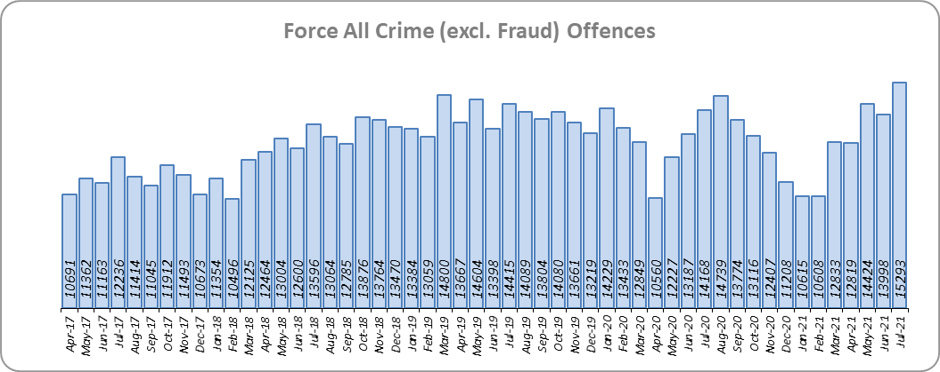
Priority 1 - More local, visible and accessible policing
Grade: Good
Essex experienced a 2.7% decrease in All Crime (4,350 fewer offences) for the 12 months to July 2021 compared to the 12 months to July 2020. This decrease in crime has been primarily influenced by the Government’s restrictions on gathering and movement in relation to COVID-19. Essex is eighth in its Most Similar Group of forces (MSG) for crime per 1,000 population.
Due to the Government’s easing of restrictions on 19 July 2021, Essex Police recorded a daily average of 493 crimes in July 2021, compared with an average of 467 crimes in June 2021. This equates to an increase of 5.7%.
15,293 offences were recorded in July 2021. This equates to an increase of 7.9% (1,125 more offences) compared to July 2020 (14,168 offences), when stricter Government restrictions were in place. There was a 6.1% increase in July 2021 compared to July 2019 (14,415 offences).
Essex Police has been shortlisted in the Police Service of the Year category in the Improvement and Efficiency Social Enterprise (iESE) Public Sector Transformation Awards. These awards celebrate the most innovative practice in transforming local public services.

Slide 4
Priority 1 - More local, visible and accessible policing
Grade: Good
Confidence (from the independent survey commissioned by Essex Police) is at 79.8% (results to the 12 months to June 2021). Compared to year ending June 2020, confidence in the local police has significantly increased (an improvement of 10.1% points).
The All Crime Harm (Crime Severity) Score** (12.7) places Essex seventh in its MSG.
Essex Police performance in relation to emergency response attendance within 15 minutes (urban) or 20 minutes (rural) has improved by 4.0 percentage points to 80.9% in the 12 months to July 2021 compared to the 12 months to July 2020. This is above the 80% target.
Due to the fact that the percentage of people who have confidence in policing in Essex has improved and the emergency response attendance is above the 80% target, a grade of Good is recommended.
Please note:
* Crime Survey of England and Wales data are no longer available at Force level. Data are for the 12 months to March 2020.
** Crime Severity Scores (as calculated by the Office for National Statistics) measure the ‘relative harm’ of crimes by taking into account both their volume and their severity. Data are for the 12 months to May in all three years.
*** Grade of Service.

Slide 5
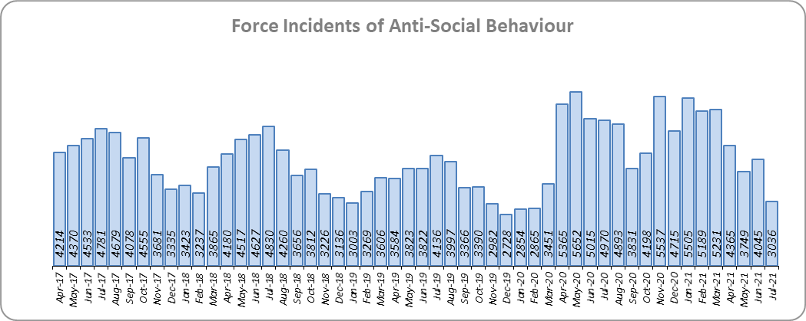
Priority 2 - Crack down on anti-social behaviour
Grade: Good
Essex experienced a 16.0% increase (7,473 more) in Anti-Social Behaviour (ASB) incidents for the 12 months to July 2021 compared to the 12 months to July 2020. This increase was due to the COVID-19 restriction period, during which many additional reports were received that related to activities that were not previously considered to be ASB; examples include social gatherings and shops and businesses continuing to trade. Since March 2020 the number of ASB incidents reported has generally been higher when tighter restrictions were implemented by the Government, and lower when restrictions were eased.
There was a decrease of -38.9% ASB reports in July 2021 compared to July 2020 (1,934 fewer incidents). The average daily number of ASB incidents decreased by 27.4% in July 2021 (98 incidents) compared to June 2021 (135 incidents). July 2021 experienced the lowest number of ASB incidents recorded per month since February 2020 (2,865 incidents).
The number of ASB incidents for the 12 months to July 2021 compared to the 12 months to July 2019 increased by 24.6% (10,707 more incidents).
The results of Essex’s independent survey in relation to how well residents perceive Essex Police and partner organisations to be dealing with ASB showed a slight improvement: 0.4% points.
Due to the increase in public perception from the Essex independent survey, and the fact that the lowest monthly number of ASB incidents since pre-COVID were recorded in July 2021 a grade of Good is recommended.
Please note:
* Crime Survey of England and Wales data are no longer available at Force level. Data are for the 12 months to March 2020.

Slide 6
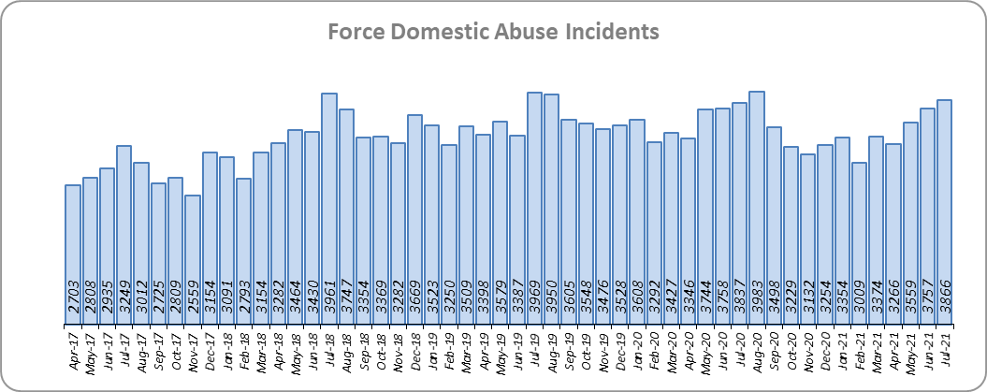
Priority 3 - Breaking the cycle of domestic abuse
Grade: Requires Improvement
Essex experienced a 4.3% decrease (1,838 fewer) in Domestic Abuse incidents and a 0.2% decrease (36 fewer) in repeat incidents of Domestic Abuse for the 12 months to July 2021 compared to the 12 months to July 2020. There was an 8.3% increase (1,105 more) in Domestic Abuse arrests and a 1.4% increase (3 more) in the number of Domestic Violence Protection Notices (DVPN) and Protection Orders (DVPO) issued in the 12 months to July 2021 compared to the 12 months to July 2020.
Domestic Abuse incidents in July 2021 were lower than at pre-COVID levels, with a 2.6% decrease (103 fewer incidents) compared to July 2019.
There was a 9.1% decrease (309 fewer) in the number of solved Domestic Abuse outcomes in the 12 months to July 2021 compared to the 12 months to July 2020 and a 3.7% decrease (118 fewer) compared to the 12 months to July 2019.
Due to the fact that the number of DA solved offences has decreased for the third month in a row, a grade of Requires Improvement is recommended.

Slide 7
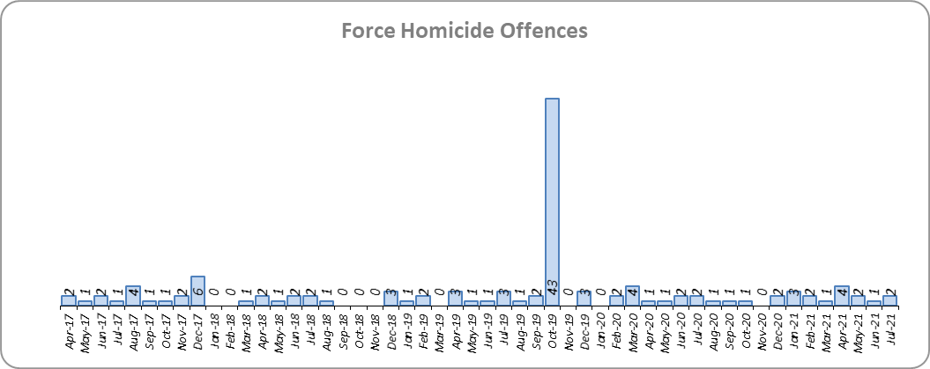
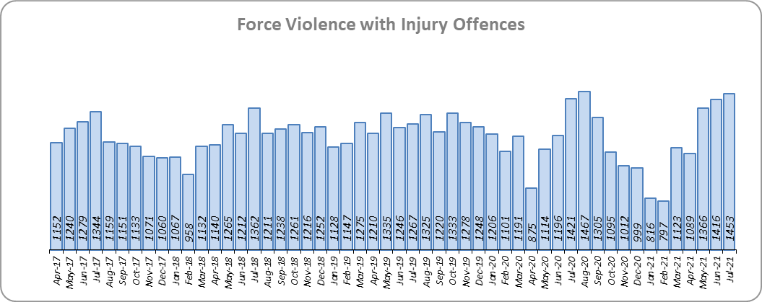
Priority 4 – Tackling gangs and serious violence
Grade: Requires Improvement
40 fewer Homicides (to 21 offences) were recorded for the 12 months to July 2021 compared to the 12 months to July 2020. The 12 months to July 2020 includes the tragic incident where 39 Vietnamese nationals were discovered in a lorry trailer in Grays in October 2019. Essex is seventh in its Most Similar Group (MSG) of forces for offences per 1,000 population, and is slightly higher than the MSG average.
There were two Homicides in both July 2021 and July 2020, and three offences in July 2019.
There was a 4.2% decrease (603 fewer offences) in Violence with Injury offences for the 12 months to July 2021 compared to the 12 months to July 2020. The average daily number of Violence with Injury offences was 47 for both the months of July 2021 and June 2021. 578 more offences (66.1%) were recorded in July 2021 (1,453 offences) compared to April 2020 (875 offences) when the Government first implemented national restrictions.
The number of Violence with Injury offences decreased by 6.9% (1,026 fewer offences) in the 12 months to July 2021 compared to the 12 months to July 2019.
Essex is fifth in its MSG for Violence with Injury offences per 1,000 population, and is better than the MSG average. There was a decrease in domestic abuse-related Violence with Injury (5.5% decrease, 314 fewer offences); 38.8% of Violence with Injury is domestic abuse-related.

Slide 8
Priority 4 – Tackling gangs and serious violence
Grade: Requires Improvement
The combined harm (Crime Severity) score* (8.0) for Violence with Injury, Rape, Other Sexual Offences and Robbery of Personal Property places Essex seventh in its Most Similar Group of Forces (MSG).
There was a 7.4% decrease (218 fewer) in the number of solved high harm offences (Violence with Injury, Rape, Other Sexual Offences and Robbery of Personal Property combined) in the 12 months to July 2021 compared to the 12 months to July 2020. Please see page 20 for the numbers of solved for each category.
There was a 64.8% decrease (2,420 fewer) in the number of stop and search for weapons in the 12 months to July 2021 compared to the 12 months to July 2020.
There was an 8.6% increase (121 more) in the number of Knife-enabled crime offences in the 12 months to July 2021** compared to the 12 months to July 2020.
The number of solved high harm offences decreased by 11.2% (345 fewer) and the number of stop and search for weapons decreased by 29.6% (555 fewer) in the 12 months to July 2021 compared to the 12 months to July 2019.
Due to the fact that Essex is higher than the MSG average in the number of homicides, and that the number of solved high harm offences has reduced, a grade of Requires Improvement is recommended.
Please note:
* Crime Severity Scores (as calculated by the Office for National Statistics) measure the ‘relative harm’ of crimes by taking into account both their volume and their severity. Data are for the 12 months to May in all three years.
** The number of knife crime offences is an indicator of how effective Essex Police is at identifying knife-enabled offences, and is not necessarily reflective of the number of these offences that have been committed in the county. This is because the identification of these offences is reliant on the appropriate indicator being manually added to the crime record. A manual review of knife flags was conducted and missing flags were added retrospectively. Additionally a new data quality process was introduced in June 2020. Whilst this has enabled us to better understand knife crime in Essex, the process has consequently inflated the figures. As such, no inferences can be drawn as to the current trend.

Slide 9
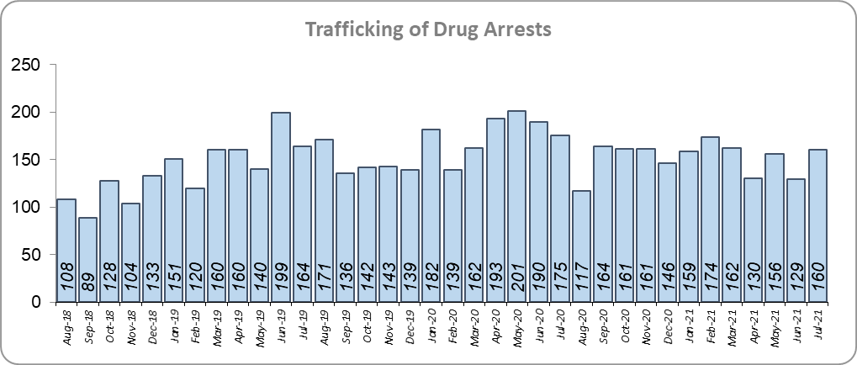
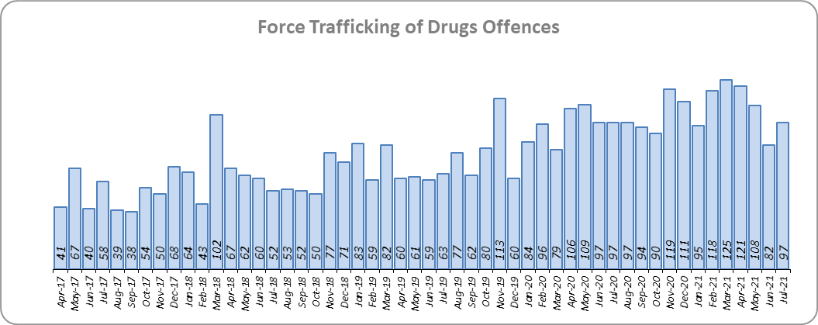
Priority 5 – Disrupting and preventing organised crime
Grade: Good
Essex experienced a 93.1% increase in Organised Crime Group (OCG) disruptions (134 more) for the 12 months to June 2021 compared to the 12 months to June 2020. In January 2019 there was a change in the way in which the number of OCG disruptions were counted; this follows National Crime Agency (NCA) and Eastern Region Special Operations Unit (ERSOU) guidance to ensure that all forces record disruptions in the same way.
Trafficking of drug arrests, which are primarily driven by police proactivity, decreased by 7.8% (154 fewer) for the 12 months to July 2021 compared to the 12 months to July 2020. In the same period, 19.1% more trafficking of drugs offences have been recorded (205 more offences to 1,276).
The number of trafficking of drug arrests increased by 9.8% (162 more) in the 12 months to July 2021 compared to the 12 months to July 2019.
Due to the increase in OCG disruptions a grade of Good is recommended.
* OCG disruptions are now reported quarterly. Data are to June 2021. Due to the change in recording in January 2019 it is not possible to compare the 12 months to June 2019 to the 12 months to June 2021.

Slide 10
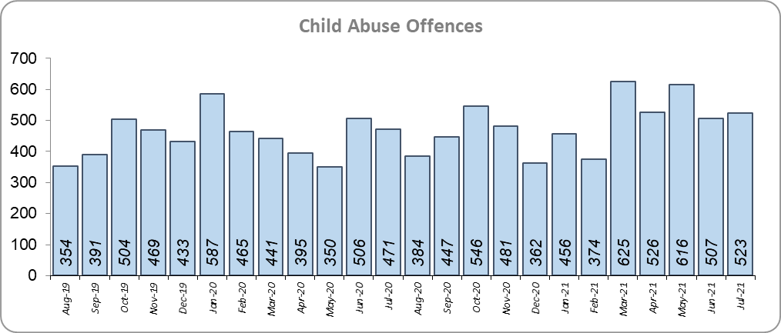
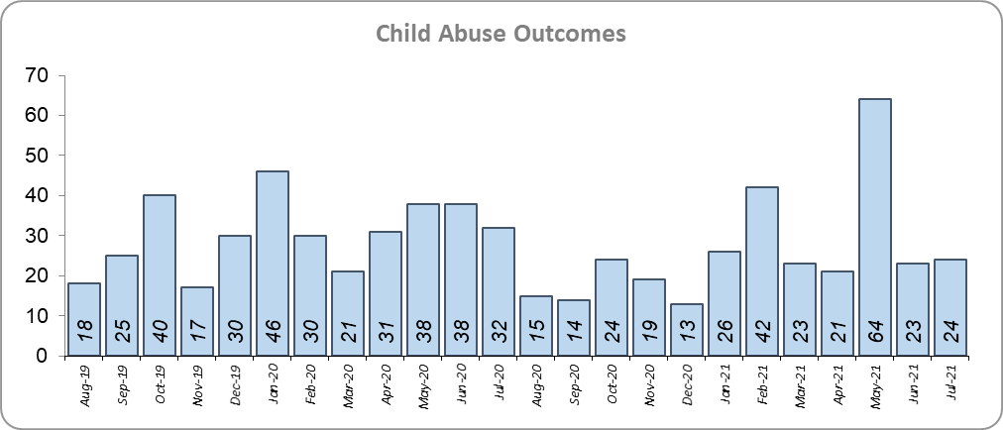
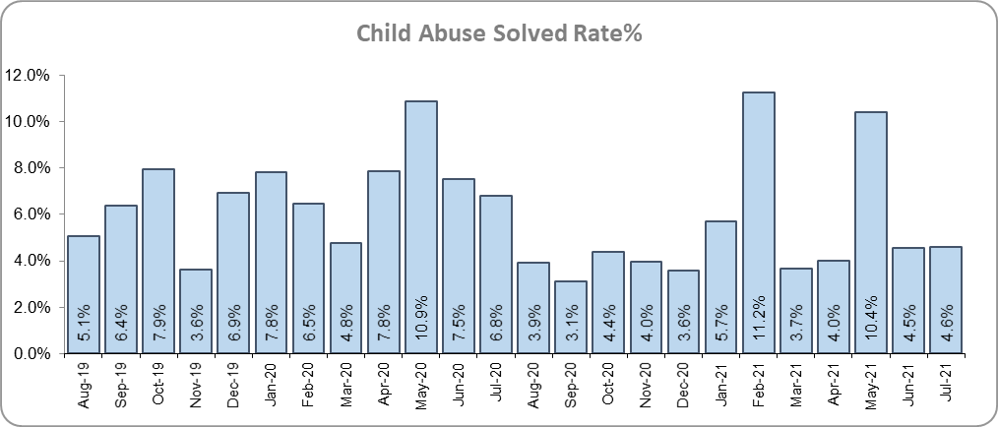
Priority 6 - Protecting children & vulnerable people
Grade: Requires Improvement
Although there was a 12.5% increase (249 more) in the number of Child Sexual Abuse/Exploitation investigations in the 12 months to July 2021 compared to the 12 months to July 2020, there was a 17.7% decrease (68 fewer) in the number of solved Child Abuse Outcomes.
9.5% more Child Abuse offences (an increase of 513) were recorded in the 12 months to July 2021 compared to the 12 months to July 2020. This increase in offences can be partly attributed to a rise in referrals from schools in the latter part of 2020. There was a 1.8% point decrease in the solved rate (from 7.1% to 5.4%).
139 Modern Slavery referrals were made in the 12 months to July 2021 compared with 110 in the 12 months to July 2020 (29 more).
The number of child abuse outcomes increased by 38.0% (87 more outcomes) and the number of child abuse offences increased by 30.4% (1,375 more offences) in the 12 months to July 2021 compared to the 12 months to July 2019.
6.3% more Child Sexual Abuse/Exploitation investigations (an increase of 132) were recorded in the 12 months to July 2021 compared to the 12 months to July 2019.
Due to the decrease in the number of child abuse outcomes and the increase of child abuse offences, a grade of Requires Improvement is recommended.
* Due to a change in recording of Modern Slavery referrals in April 2019 it is not possible to compare the 12 months to July 2019 to the 12 months to July 2021.

Slide 11
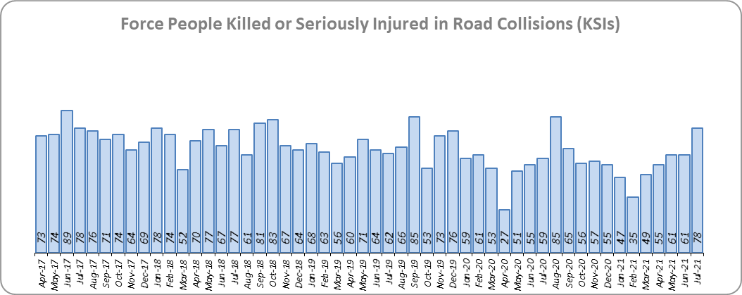
Priority 7 - Improve safety on our roads
Grade: Good
There was a 2.4% decrease (18 fewer) in the number of those Killed or Seriously Injured (KSI) in Essex for the 12 months to July 2021 compared to the 12 months to July 2020. The number of KSIs also decreased by 18.3% (161 fewer offences) in the 12 months to July 2021 compared to the 12 months to July 2019. Please note that most KSIs do not necessarily result in criminal offences (such as death or serious injury caused by dangerous driving) being recorded. Essex is sixth in its Most Similar Group (MSG) of forces for casualties per 100 million vehicle kilometres (results to June 2020) and slightly worse than the MSG average. However, due to the fact that more recent national figures have not been released, the current position cannot be determined (the date of the next national release has not yet been confirmed).
There was a 33.2% decrease (240 fewer offences) in the number of driving related mobile phone offences recorded for the 12 months to July 2021 compared to the 12 months to July 2020.* There was also a 26.7% decrease (1,132 fewer offences) in drink/drug driving for the 12 months to July 2021 compared to the 12 months to July 2020; of these offences, there was an 9.4% decrease (134 fewer offences) in drink driving and a 37.7% decrease (885 fewer offences) in drug driving. All of these offence types are primarily driven by police proactivity in relation to road safety.
Due to the decrease in KSIs and the number of drink/drug driving offences in the past 12 months, a grade of Good is recommended.
* The year on year data for driving offences related to mobile phones are not comparable due to a legal appeal (which occurred in October 2019). The current phone use legislation is awaiting clarification in the courts, which has been delayed due to the impact of COVID-19. Since the appeal, fewer offences have been prosecuted.

Slide 12
Monthly Performance Overview: Exceptions
Exceptions Overview
Violence without Injury, Stalking and Harassment, Rape, Racial/Religiously Aggravated Offences, Hate Crime HO Definition, Domestic Abuse and Public Order experienced statistically significant increases for the month of July 2021. The solved rate for Stalking and Harassment experienced a statistically significant decrease.
Violence without Injury Offences – Increase
0.01% increase (4 more crimes) for the 12 months to July 2021 compared to the 12 months to July 2020. There were statistically exceptional increases in five Districts in July 2021.
Stalking and Harassment - Offences – Increase
18.0% increase (4,102 more crimes) for the 12 months to July 2021 compared to the 12 months to July 2020. There were statistically exceptional increases in six Districts in July 2021.
Stalking and Harassment - Solved Rate - Decrease
2.2% increase (40 more solved offences) for the 12 months to July 2021 compared to the 12 months to July 2020. The Force saw a statistically exceptional decrease in July 2021.
Rape Offences – Increase
17.5% increase (344 more crimes) for the 12 months to July 2021 compared to the 12 months to July 2020. There were statistically exceptional increases in three Districts in July 2021.
Racial/Religiously Aggravated Offences – Increase
14.7% increase (246 more crimes) for the 12 months to July 2021 compared to the 12 months to July 2020. There were statistically exceptional increases in three Districts in July 2021.
Hate Crime HO Definition – Increase
26.4% increase (836 more crimes) for the 12 months to July 2021 compared to the 12 months to July 2020. The Force saw a statistically exceptional increase in July 2021.
Domestic Abuse Offences – Increase
3.2% decrease (969 fewer crimes) for the 12 months to July 2021 compared to the 12 months to July 2020. There were statistically exceptional increases in three Districts in July 2021.
Public Order Offences – Increase
8.9% increase (1,377 more crimes) for the 12 months to July 2021 compared to the 12 months to July 2020. There were statistically exceptional increases in ten Districts in July 2021.

Slide 13
Monthly Performance Overview: Of Note
Monthly Performance Overview: Exceptions
COVID-19: Restrictions of movement and social distancing
Since 13 March 2020, the Government implemented a series of alert levels and steps regarding the level of social distancing allowed in relation to COVID-19. Each change has affected the number of All Crime offences recorded.
On 14 October 2020 the Government introduced three levels of restrictions according to different levels of infections around the country. Tier 1 – Medium, Tier 2 – High and Tier 3 – Very High.

Slide 14
Monthly Performance Overview: Of Note (continued)
Monthly Performance Overview: Exceptions
COVID-19: Restrictions of movement and social distancing
On 5 November 2020 the Government implemented a period of increased restrictions which ended on 2nd December 2020 when the country returned to the Tier system.
On 20 December the Government introduced Tier 4 – Stay at Home and on 5th January 2021 a third period of increased restrictions was implemented.
In March 2021 the Government announced its roadmap out of restrictions, starting with Step 1 on 8th March.

Slide 15
Monthly Performance Overview: Of Note (continued)
Monthly Performance Overview: Exceptions
COVID-19: Restrictions of movement and social distancing
The Government continued on its roadmap out of restrictions with Step 1a on 29th March 2021, Step 2 on 12th April 2021 and Step 3 on 17th May 2021.

Slide 16
Monthly Performance Overview: Of Note (continued)
Monthly Performance Overview: Exceptions
COVID-19: Restrictions of movement and social distancing
The Government continued on its roadmap out of restrictions with Step 3a on 21st June 2021.
On 19th July 2021 all legal restrictions were lifted but the Government urged caution due to rising case numbers.

Slide 17
Monthly Performance Overview: Of Note (continued)
Monthly Performance Overview: Exceptions
19th to 25th July - Anti-Social Behaviour Awareness Week
Anti-Social Behaviour is not just nuisance behaviour: it can severely impact on victims and make their lives a misery. Essex Police work closely with councils and other organisations across Essex to support victims and deal with offenders. This was the UK’s first Anti-Social Behaviour Awareness Week; it was organised by community safety specialists Resolve, aiming to highlight how police, councils, housing providers, fire services and community groups keep communities safe. Essex Police are focussed on dealing with ASB, supporting victims and dealing with those responsible.
Essex Police welcomes 58 new officers
New recruit numbers passed 451 since the first lockdown in March 2020 as 58 more officers joined Essex Police. More than a third of the new officers are women.
As the country endured the biggest disruption to life since the Second World War, Essex Police have continued to train the next generation of police officers who are now catching criminals and keeping people safe on the streets of Essex. Throughout their training, the students took part in a series of charity challenges that have raised more than £3,000 for causes including Havens Hospices, the Helen Rollason Cancer Charity, Sepsis UK, the Isobel Parmenter Memorial Fund, Little Edi Foundation and our own Essex Retired Police Dog Fund.

Slide 18
2016-2021 Police and Crime Plan Performance Indicators
Table 1
Please view above table with the explanations and caveats detailed on page 19.

Slide 19
End Notes
¹ Question from the independent survey commissioned by Essex Police (Percentage of people who have confidence in policing in Essex). Results are for the period 12 months June 2021 versus the 12 months to June 2020.
² The confidence interval is the range +/- between where the survey result may lie. This is mainly influenced by the number of people answering the survey. The more people that answer the survey, the smaller the interval range.
³ Crime Survey of England and Wales data are no longer available at Force level. Data are for the 12 months to March 2020.
⁴ Question from Essex Police’s own confidence and perception survey (Percentage of people who have confidence that the policing response to ASB is improving). Results are for the period 12 months to June 2021 versus the 12 months to June 2020.
⁵ Solved outcomes are crimes that result in: charge or summons, caution, crimes taken into consideration, fixed penalty notice, cannabis warning or community resolution.
⁶ ‘Killed or Seriously Injured’ (KSI) refers to all people killed or seriously injured on Essex’s roads, regardless of whether any criminal offences were committed. ‘Causing Death/Serious Injury by Dangerous/Inconsiderate Driving’ offences (detailed on p.11) refers to the number of crimes of this type.
⁷ Please note that on Wednesday 23 October 2019 the bodies of 39 Vietnamese nationals were discovered in a lorry trailer in Grays. This tragic incident is reflected in the Homicide numbers.
⁸ Crime Severity Score measures ‘relative harm’ of crimes by taking into account both the volume and the severity of offences, and by weighting offences differently. Data are for the 12 months to May 2021.
⁹ The number of knife crime offences is an indicator of how effective Essex Police is at identifying knife-enabled offences, and is not necessarily reflective of the number of these offences that have been committed in the county. This is because the identification of these offences is reliant on the appropriate indicator being manually added to the crime record. A manual review of knife flags was conducted and missing flags were added retrospectively. Additionally a new data quality process was introduced in June 2020. Whilst this has enabled us to better understand knife crime in Essex, the process has consequently inflated the figures. As such, no inferences can be drawn as to the current trend.
¹⁰ The year on year data for driving offences related to mobile phones are not comparable due to a legal appeal (which occurred in October 2019). The current phone use legislation is awaiting clarification in the courts, which has been delayed due to the impact of COVID-19.
Since the appeal, fewer offences have been prosecuted.
¹¹ NRM data only available from April 2019 due to recording change at that time.
¹² OCG disruptions are now reported quarterly. Data are to June 2021.

Slide 20
Crime Tree Data – Rolling 12 Months to July
Table 2

Slide 21
Crime Tree Data – Rolling 12 Months to July
Table 3

