Slide 1
Police and Crime Plan 2016-2020
Monthly Performance Update
November 2019
National and MSG positions are to 30th September 2019 (Essex Police data are to 30th November 2019).
Version 1.5.1
Produced December 2019
Performance Analysis Unit, Essex Police
Sensitivity: Official

Slide 2
Executive Summary
Three of the seven PFCC Priorities for Essex Police have been given a recommended grade of “Good”. Recommended grades have been determined with reference to comparisons with Essex Police’s Most Similar Group (MSG) of forces, internal Key Performance Indicators (KPIs), and professional judgement.
Four of the seven PFCC priorities – 1 (More local, visible and accessible policing), 3 (Breaking the cycle of domestic abuse), 4 (Reverse the trend in serious violence) and 6 (Protecting children & vulnerable people) – have been given a recommended grade of “Requires Improvement”. None of these recommended grades have changed since the July 2019 report.
All Crime has risen by 13.6% for the 12 months to November 2019 compared to the 12 months to November 2018. It is estimated, however, that around 12.5% of this 13.6% rise (around 18,487 additional crimes) are attributed to changes to Home Office Counting Rules (HOCR) in relation to Stalking & Harassment, as well as a more rigorous approach to Crime Data Accuracy (CDA). Analysis conducted by Essex Police suggests that while there has been an ‘actual’ increase in crime (i.e. an increase in offences reported not as a result of improved CDA or changes to HOCR), this is at a lower rate to the increases being driven by improved CDA and changes to HOCR. Essex was graded as Outstanding in its recent HMICFRS Crime Data Integrity (CDI) inspection.
Essex Police solved 1,260 more crimes in the 12 months to November 2019 compared to the 12 months to November 2018; this equates to a 5.8% increase. However, the All Crime solved rate continues to decline due to the increase in the number of crimes reported. The solved rate is currently 13.7%.
Confidence in local policing (Essex Police internal survey) deteriorated for the 12 months to June 2019 compared to the 12 months to June 2018 (65.6% June 2019 v. 68.9% June 2018). Confidence in the local police from the Crime Survey of England and Wales (CSEW) places Essex eighth in its MSG, and 9.4% points below the MSG average.
Please note that on Wednesday 23 October 2019 the bodies of 39 Vietnamese nationals were discovered in a lorry trailer in Grays. This tragic incident is reflected in the Homicide numbers.

Slide 3
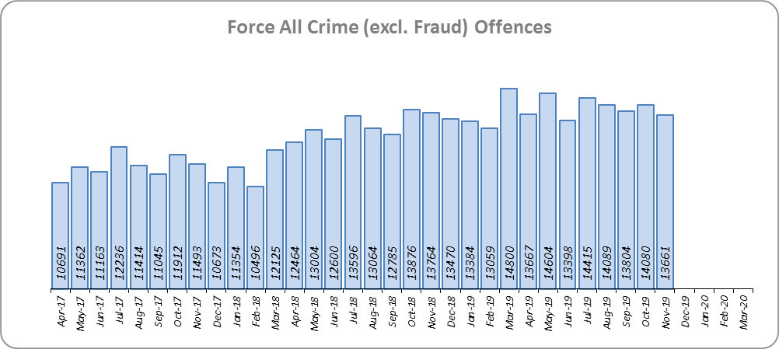
Priority 1 - More local, visible and accessible policing
Grade: Requires Improvement
Essex experienced a 13.6% increase in All Crime (20,147 additional offences) for the 12 months to November 2019 compared to the 12 months to November 2018. Essex is eighth in its Most Similar Group of forces (MSG) for crime per 1,000 population.
The increase in offences can, in part, be attributed to changes to Home Office Counting Rules in relation to Stalking & Harassment, as well as better Crime Data Accuracy (CDA). It is estimated that around 12.5% of the 13.6% rise (around 18,487 additional crimes) are as a result of improved CDA and changes to HOCR.
Essex was graded as Outstanding in its recent HMICFRS Crime Data Integrity (CDI) inspection. Essex Police is only the third force of the 39 that have been judged as outstanding on the first visit in this inspection programme.

Slide 4
Priority 1 - More local, visible and accessible policing
Grade: Requires Improvement
Confidence (Essex Police internal survey) is at 65.6% (results to the 12 months to June 2019). Compared to year ending June 2018, confidence in the local police has significantly decreased (deterioration of 3.3% points).
Confidence in the local police from the Crime Survey of England and Wales (CSEW) places Essex eighth in its MSG, and 9.4% points below the MSG average. However, the sample size from this survey is not representative at a sufficiently small scale to measure local issues. The Essex Police internal survey (results detailed above) was therefore introduced to achieve a more accurate local measure with a small margin of error. The results from the Essex Police survey show that the Force performs significantly better on confidence in local policing than the results from the CSEW, which asks the same question.
Due to the fact that Essex is 8th in its MSG for both crime per 1,000 population and for confidence in local police (CSEW), and that the Essex Police internal survey shows a deterioration in confidence in local police, a grade of Requires Improvement is recommended.

Slide 5
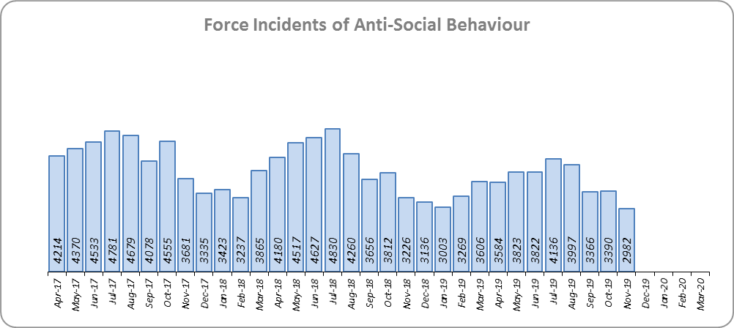
Priority 2 - Crack down on anti-social behaviour
Grade: Good
Essex experienced a 10.6% reduction (5,027 fewer) in Anti-Social Behaviour (ASB) incidents for the 12 months to November 2019 compared to the 12 months to November 2018. Part of this decrease is due to better Crime Data Accuracy (CDA); more incidents reported as ASB are now being correctly recorded as crimes. Some of the decrease may also be due to people reporting incidents directly to the Council and Housing Authorities.
ASB Perception (from the Crime Survey of England and Wales) in Essex experienced a 4.9% point decrease (improvement). Essex is 1.7% points better than the MSG average; this places Essex third in its Most Similar Group of forces. However, results of Essex’s internal survey significantly decreased in relation to how well Essex and the organisations they work with deal with ASB (deterioration of 5.6% points).
Due to the reduction in ASB incidents, and the fact that ASB Perception is better than the MSG average, a grade of Good is recommended.

Slide 6
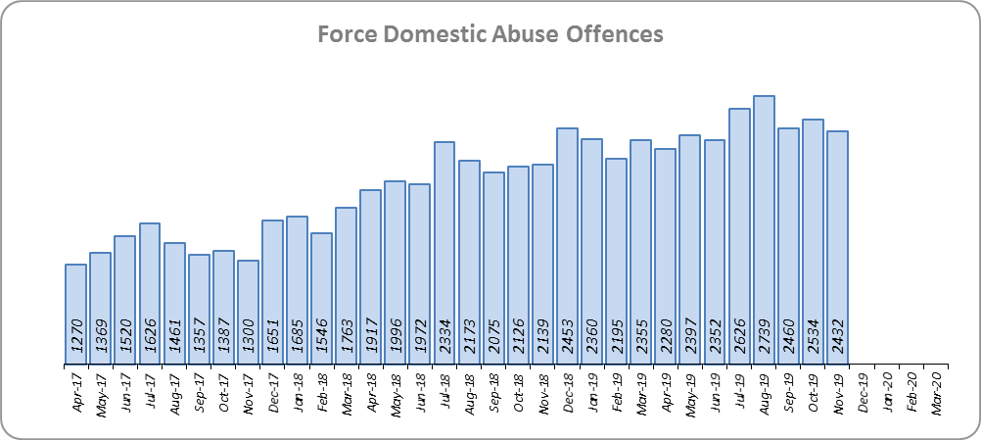
Priority 3 - Breaking the cycle of domestic abuse
Grade: Requires Improvement
Essex experienced a 6.9% increase (2,782 more) in Domestic Abuse incidents and a 15.0% increase (2,697 more) in repeat incidents of Domestic Abuse for the 12 months to November 2019 compared to the 12 months to November 2018. The increase in crime, in part, can be attributed to better Crime Data Accuracy (CDA), and changes to Home Office Counting Rules (HOCR) in relation to Stalking & Harassment.
The Domestic Abuse solved rate fell by 3.5% points to 10.4% during the same period. The number of offences solved has also fallen by 142 offences.
Due to the increase in repeat incidents and the decrease in both the solved rate and the solved volume, a grade of Requires Improvement is recommended.

Slide 7
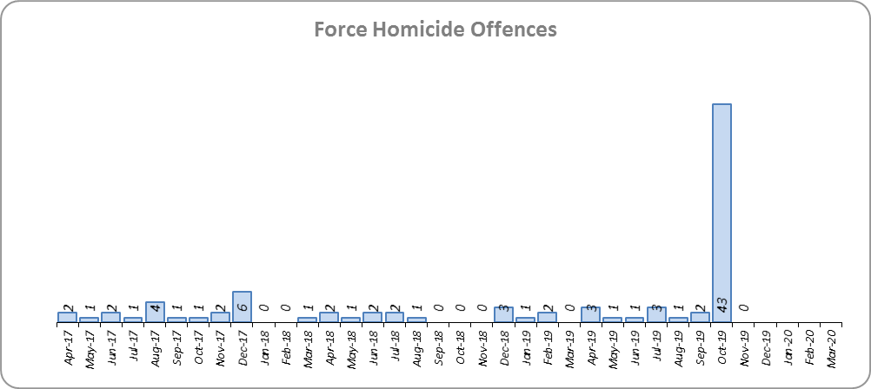
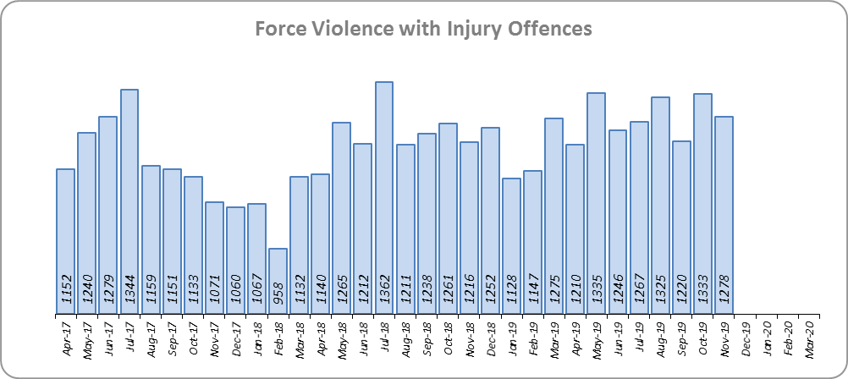
Priority 4 - Reverse the trend in serious violence
Grade: Requires Improvement
Essex saw an increase of 47 Homicides (to 62 offences) for the 12 months to November 2019 compared to the 12 months to November 2018. This includes the tragic incident where 39 Vietnamese nationals were discovered in a lorry trailer in Grays. Essex is sixth in its Most Similar Group (MSG) of forces for offences per 1,000 population, and slightly higher than the MSG average.
There was an 8.9% increase (1,250 more offences) in Violence with Injury. Essex is fourth in its MSG for offences per 1,000 population, and is slightly worse than the MSG average. The increase in this offence is, in part, due to the rise in domestic abuse related Violence with Injury (18.2% increase, 837 more offences); 35.4% of Violence with Injury is domestic abuse-related.
Due to the fact that Essex continues to experience an increase in Violence with Injury, a grade of Requires Improvement is recommended.

Slide 8
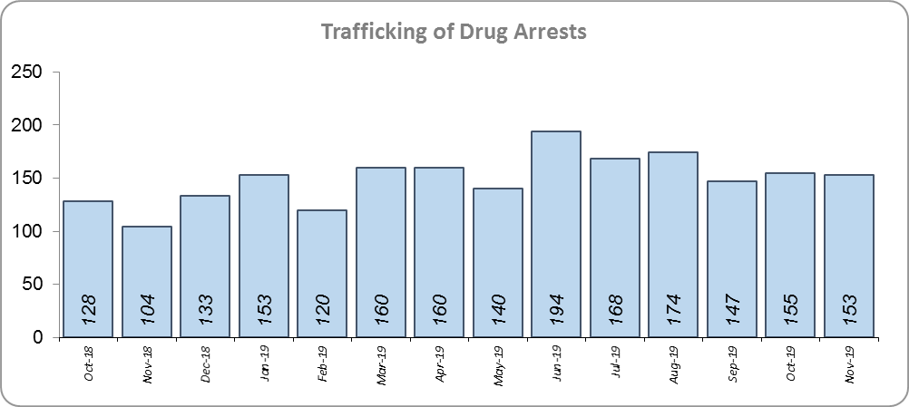
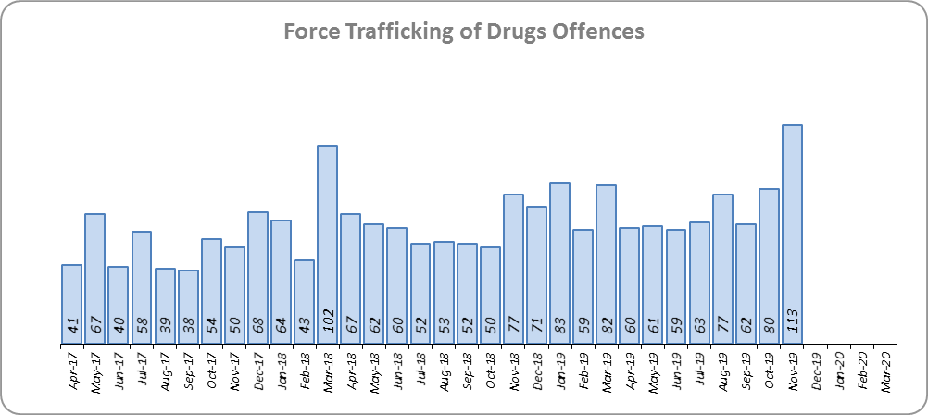
Priority 5 - Tackle gangs and organised crime
Grade: Good
80 Organised Crime Group (OCG) disruptions were conducted in Essex between January 2019 and November 2019.* In January 2019 there was a change in the way in which the number of OCG disruptions were counted; this follows National Crime Agency (NCA) and Eastern Region Special Operations Unit (ERSOU) guidance to ensure that all forces record disruptions in the same way. Previous data periods are not directly comparable but are included for completeness.
Trafficking of drug arrests, which are also as a result of police proactivity, increased by 38.7% (540 more) for the 12 months to November 2019 compared to the 12 months to November 2018. In the same period, there has also been 25.2% more trafficking of drugs offences recorded (185 more offences to 920).
Due to the increase in Trafficking of Drug Arrests, a grade of Good is recommended.
*Please note that the number of Organised Crime Group disruptions are not directly comparable due to a change in counting rules that occurred in January 2019. Direct comparisons will start to become available from the February 2020 Monthly Performance Report (when January 2020 can be compared to January 2019).

Slide 9
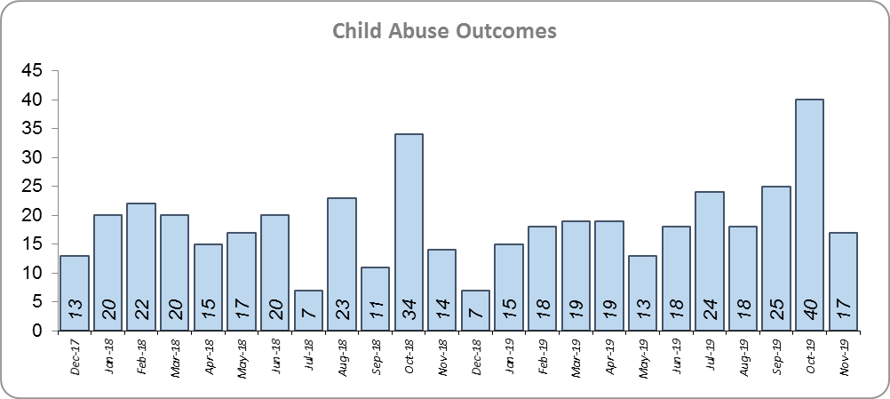
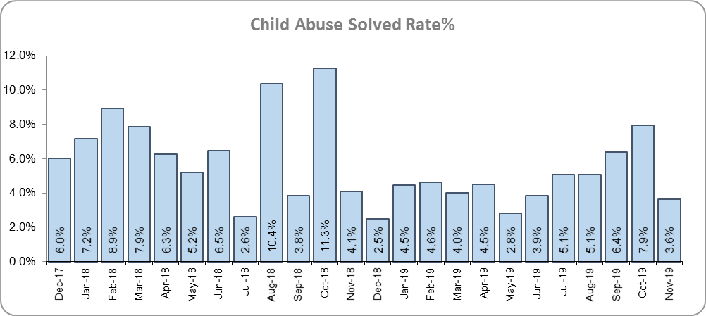
Priority 6 - Protecting children & vulnerable people
Grade: Requires Improvement
There was a 6.3% increase (14 more) in the number of positive solved Child Abuse Outcomes in the 12 months to November 2019 compared to the 12 months to November 2018.
There was a 2.1% point decrease in the solved rate (from 6.7% to 4.6%). 54.6% more offences (an additional 1,802) were recorded in the 12 months to November 2019 compared to the 12 months to November 2018.
In spite of the small increase in the number of Child Abuse solved outcomes, there is still a large reduction in the solved rate. A grade of Requires Improvement is therefore recommended.

Slide 10
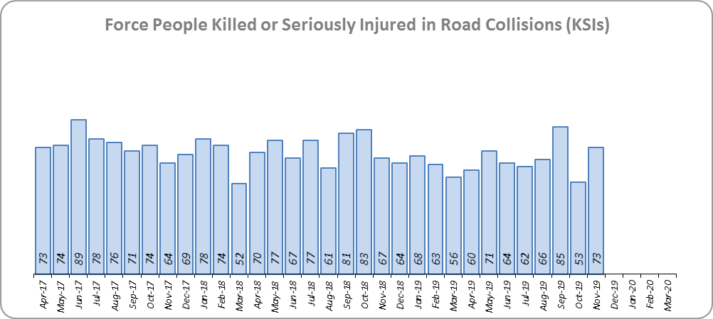
Priority 7 - Improve safety on our roads
Grade: Good
There was a 6.7% decrease (58 fewer) in the numbers of those Killed or Seriously Injured (KSI) in Essex for the 12 months to November 2019 compared to the 12 months to November 2018. Essex is placed sixth in its Most Similar Group (MSG) of forces for casualties per 100 million vehicle kilometres (results to December 2018).
There has been a 30.0% decrease in mobile phone crime (843 fewer offences) and a 40.5% increase (1,046 more offences) in drink/drug driving.
Due to the decrease in KSIs, a grade of Good is recommended. As of December 2018, Essex was slightly below the MSG average per 100 million km. However, due to the fact that more recent figures are not yet available, the current position cannot be included.

Slide 11
Monthly Performance Overview: Exceptions
Exceptions Overview
The following offence types experienced statistically significant changes for the month of November: Other Theft, Trafficking of Drugs and Possession of Drugs.
Other Theft *
2.4% decrease (321 fewer offences) for the 12 months to November 2019 compared to the 12 months to November 2018. The Force saw a statistically exceptional decrease in the month of November 2019.
Trafficking of Drugs
25.2% increase (185 more offences) for the 12 months to November 2019 compared to the 12 months to November 2018. The Force saw a statistically exceptional increase in the month of November 2019. The proportion that Cannabis (Possession of a controlled drug with intent to supply – Class B – Cannabis) makes up within the offence group Trafficking of Drugs, has increased from 19.2% to 23.7%. This increase is likely to be attributed to an increased use of Stop and Search powers as part of pro-active police activity.
Possession of Drugs
62.1% increase (1,815 more offences) for the 12 months to November 2019 compared to the 12 months to November 2018. The Force saw a statistically exceptional increase in the month of November 2019. Cannabis has seen the largest numerical increase 1,654 (69.9% more); the proportion has also risen from 80.4% to 84.5% of all possession of drugs. This increase is likely to be attributed to an increased use of Stop and Search powers as part of pro-active police activity.
* Other Theft comprises: Blackmail, Theft in a Dwelling, Theft by an Employee, Theft of mail, Dishonest Use of Electricity, Theft from Automatic Machines or Meters, Other Theft or Unauthorised Taking, Making Off without Payment

Slide 12
2016-2020 Police and Crime Plan Performance Indicators
Table 1
Please note that the number of Organised Crime Group disruptions are not directly comparable due to a change in counting rules that occurred in January 2019. Direct comparisons will start to become available from the February 2020 Monthly Performance Report (when January 2020 can be compared to January 2019).
Please view above table with the explanations and caveats detailed on page 13.

Slide 13
End Notes
¹ Question from Essex Police’s own confidence and perception survey (Question 13b). Results are for the period 12 months to June 2019 versus the 12 months to June 2018.
² The confidence interval is the range +/- between where the survey result may lie. This is mainly influenced by the number of people answering the survey. The more people that answer the survey, the smaller the interval range.
³ Crime Survey for England and Wales (CSEW): 12 months to June 2019 vs. 12 months to June 2018.
⁴ Question from Essex Police’s own confidence and perception survey (Question 8a). Results are for the period 12 months to June 2019 versus the 12 months to June 2018.
⁵ From January 2019, activity has been recorded rather than the number of people arrested. If there was a day of action, for example, and five people were arrested, this would formerly have counted as five disruptions, but now will count as one. The change stems from confusion over the previous guidelines, with police forces counting disruptions in different ways. The data are for January 2019 to October 2019. Previous data periods are not directly comparable but have been included for completeness.
⁶ Solved outcomes are crimes that result in: charge or summons, caution, crimes taken into consideration, fixed penalty notice, cannabis warning or community resolution.
⁷ ‘Killed or Seriously Injured’ (KSI) refers to all people killed or seriously injured on Essex’s roads, regardless of whether any criminal offences were committed. ‘Causing Death/Serious Injury by Dangerous/Inconsiderate Driving’ offences (detailed on p.14) refers to the number of crimes of this type.
*Please note that on Wednesday 23 October 2019 the bodies of 39 Vietnamese nationals were discovered in a lorry trailer in Grays. This tragic incident is reflected in the Homicide numbers.

Slide 14
Crime Tree Data – Rolling 12 Months to November
Table 2

Slide 15
Crime Tree Data – Rolling 12 Months to November
Table 3

