Slide 1
Police and Crime Plan 2016-2020
Monthly Performance Update
July 2019
National and MSG positions are to 31st May 2019 (Essex Police data are to 31st July 2019).
Version 1.8
Produced August 2019
Performance Analysis Unit, Essex Police
Sensitivity: Official

Slide 2
Executive Summary
Three of the seven PFCC Priorities for Essex Police have been given a recommended grade of “Good”. Recommended grades have been determined with reference to comparisons with Essex Police’s Most Similar Group (MSG) of forces, internal Key Performance Indicators (KPIs), and professional judgement.
Four of the seven PFCC priorities – 1 (More local, visible and accessible policing), 3 (Breaking the cycle of domestic abuse), 4 (Reverse the trend in serious violence) and 6 (Protecting children & vulnerable people) – have been given a recommended grade of “Requires Improvement”. None of these recommended grades have changed since the June 2019 report.
All Crime has risen by 17.2% for the 12 months to July 2019 compared to the 12 months to July 2018. Domestic Abuse (DA) has risen by 38.3%. The increase in both can, in part, be attributed to the increase seen in Stalking and Harassment following changes to Home Office Counting Rules (HOCR) in April 2018. Other analysis conducted by Essex Police also indicates that a more rigorous approach to Crime Data Accuracy (CDA), as well as a genuine increase in crime (offences not subject to CDA or changes to HOCR), are likely to be contributing to this rise.
Essex Police solved 2,491 more crimes in the 12 months to July 2019 compared to the 12 months to July 2018; this equates to a 11.8% increase. However, the All Crime solved rate continues to decline due to the increase in the number of crimes reported. The solved rate is currently 14.3%.
In the month of July 2019, four crime types experienced a statistically significant increase: Rape, Arson, Possession of Drugs and Public Order. Rape has been a statistical exception four times in the past five months. Arson has been a statistical exception every month since January 2019, when the Fire Service changed the way it reported fires that are started intentionally to the police.

Slide 3
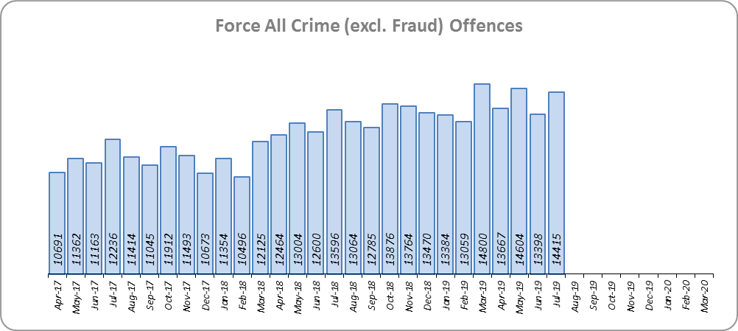
Priority 1 - More local, visible and accessible policing
Grade: Requires Improvement
Essex experienced a 17.2% increase in All Crime (24,156 additional offences) for the 12 months to July 2019 compared to the 12 months to July 2018. Essex is eighth in its Most Similar Group of forces (MSG) for both crime per 1,000 population and % change.
The increase in offences can, in part, be attributed to changes to Home Office Counting Rules in relation to Stalking & Harassment, as well as better Crime Data Accuracy (CDA). Of the forces in Essex’s MSG that have been subject to HMICFRS Crime Data Integrity (CDI) Inspections, two have been graded as “Good”, three as “Requires Improvement”, and two as “Inadequate”. While the results of Essex’s recent HMICFRS CDI Inspection have not yet been published, Essex attained an overall recording rate of 95.8%; two forces who attained a grading of Good in previous Inspections had recording rates of 91.02% and 94.59%.

Slide 4
Priority 1 - More local, visible and accessible policing
Grade: Requires Improvement
Confidence (Essex Police internal survey) is at 68.0% (results to the 12 months to December 2018). This measure is broadly stable, with nearly 7 out of 10 respondents saying Essex Police does an excellent or good job. Perceptions are difficult to change and can take one to two years to influence.
Confidence in the local police from the Crime Survey of England and Wales (CSEW) places Essex as eighth in its MSG, and 9.9% points below the MSG average. However, the sample size from this survey is not representative at a sufficiently small scale to measure local issues. The Essex Police internal survey (results detailed above) was therefore introduced to achieve a more accurate local measure with a small margin of error. The results from the Essex Police survey show that the Force performs significantly better on confidence in local policing than the results from the CSEW, which asks the same question.
Due to the fact that Essex is 8th in its MSG for both crime per 1,000 population and for confidence in local police (CSEW), a grade of Requires Improvement is recommended.

Slide 5
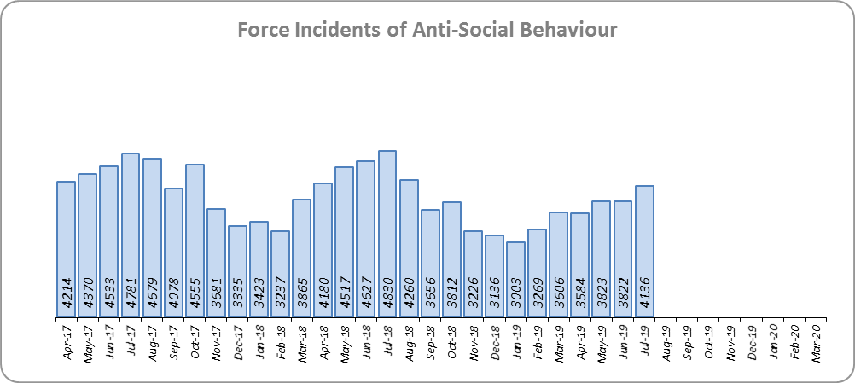
Priority 2 - Crack down on anti-social behaviour
Grade: Good
Essex experienced a 11.6% reduction (5,739 fewer) in Anti-Social Behaviour (ASB) incidents for the 12 months to July 2019 compared to the 12 months to July 2018. Part of this decrease is due to better Crime Data Accuracy (CDA); more incidents reported as ASB are now being correctly recorded as crimes rather than as ASB. Some of the decrease may also be due to people reporting incidents directly to the Council and Housing Authorities.
ASB Perception (from the Crime Survey of England and Wales) in Essex experienced a 7.7% point decrease (improvement) and is 2.8% points better than the MSG average. This places Essex first in its Most Similar Group (MSG) of forces.
Due to the reduction in ASB incidents, and the fact that ASB Perception is better than the MSG average, a grade of Good is recommended.

Slide 6
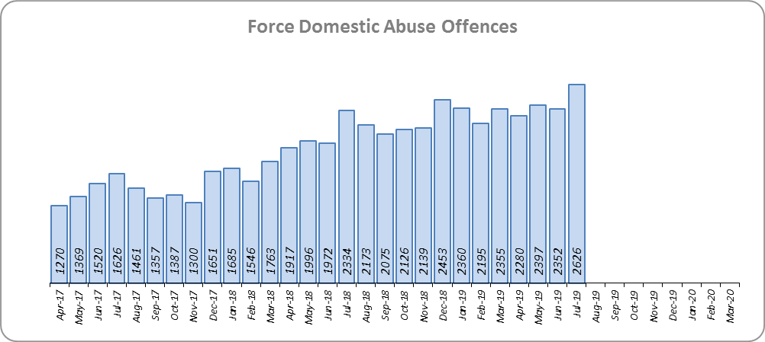
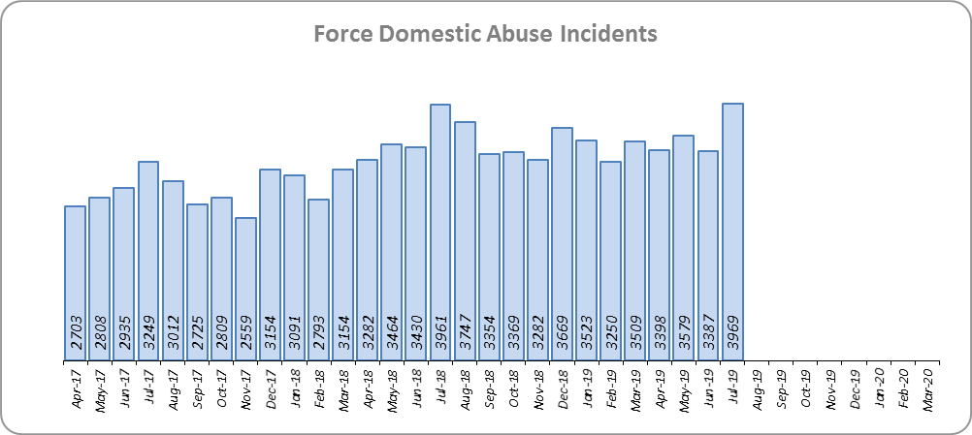
Priority 3 - Breaking the cycle of domestic abuse
Grade: Requires Improvement
Essex experienced a 12.3% increase (4,602 more) in Domestic Abuse incidents and a 19.5% increase (3,199 more) in repeat incidents of Domestic Abuse for the 12 months to July 2019 compared to the 12 months to July 2018. The increase in crime, in part, can be attributed to better Crime Data Accuracy (CDA), and changes to Home Office Counting Rules (HOCR) in relation to Stalking & Harassment.
While the Domestic Abuse solved rate has fallen by 4.1% points to 11.6% during the same period, the number of offences solved has increased by 57 offences (1.8% more). The decrease in the solved rate is therefore due to the rise in offences being greater than the increase in the volume of offences that are being solved.
Due to the increase in repeat Domestic Abuse and the decrease in solved rate, a grade of Requires Improvement is recommended.

Slide 7
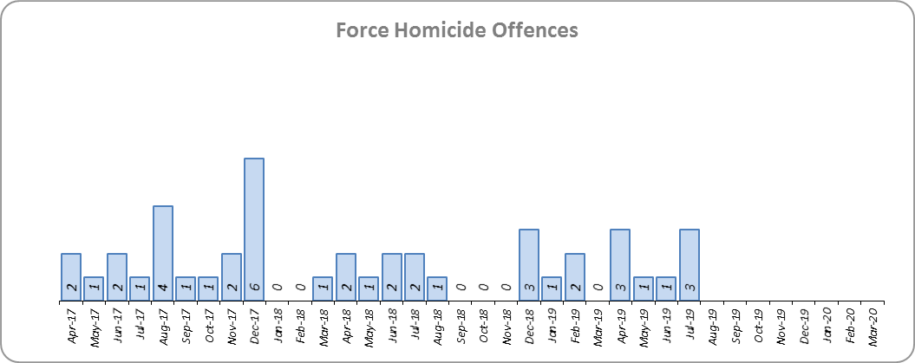
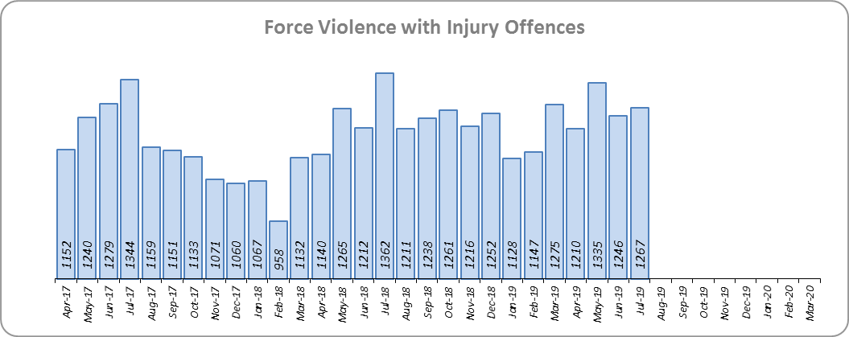
Priority 4 - Reverse the trend in serious violence
Grade: Requires Improvement
Essex saw a reduction of nine Homicides (25 to 16 offences) for the 12 months to July 2019 compared to the 12 months to July 2018. Essex is fifth in its Most Similar Group (MSG) of forces for offences per 1,000 population, and similar to the MSG average.
There was a 9.3% increase (1,275 more offences) in Violence with Injury. Essex is fourth in its MSG for offences per 1,000 population, and is slightly better than the MSG average. The increase in this offence is, in part, due to the rise in domestic abuse related Violence with Injury (16.4% increase, 720 more offences). 34.2% of Violence with Injury is domestic abuse-related.
Due to the fact that Essex is still seeing an increase in Violence with Injury, a grade of Requires Improvement is recommended.

Slide 8
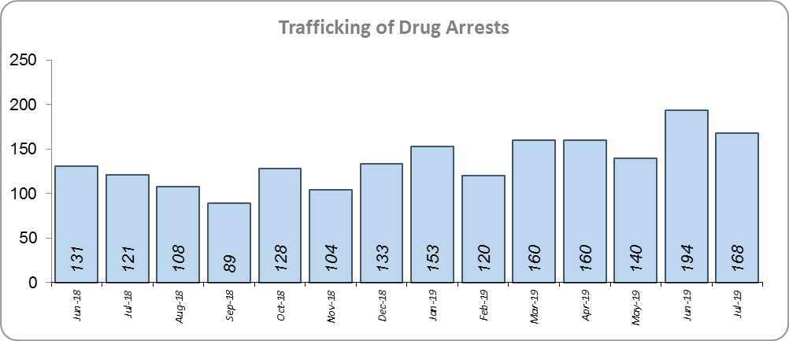
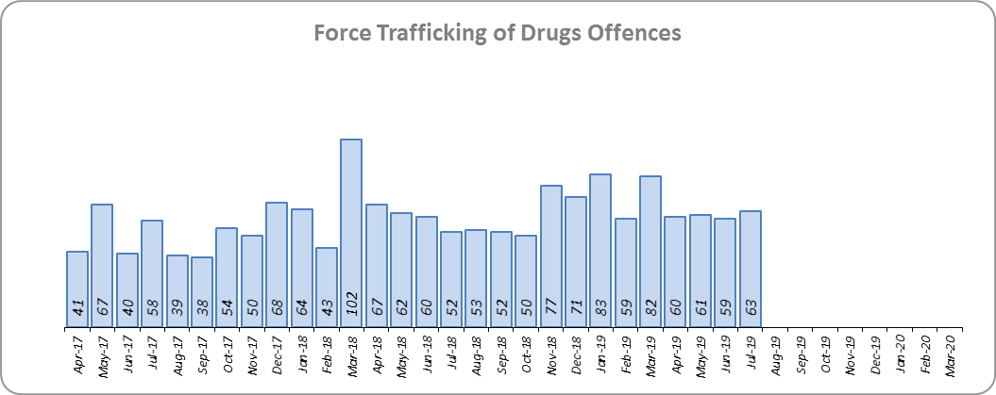
Priority 5 - Tackle gangs and organised crime
Grade: Good
42 Organised Crime Group (OCG) disruptions were conducted in Essex between January 2019 and July 2019. In January 2019 there was a change in the way in which the number of OCG disruptions were counted; this follows National Crime Agency (NCA) and Eastern Region Special Operations Unit (ERSOU) guidance to ensure that all forces record disruptions in the same way. Previous data periods are not directly comparable but are included for completeness.
Trafficking of drug arrests, which are also as a result of police proactivity, increased by 26.3% (354 more) for the 12 months to July 2019 compared to the 12 months to July 2018. In the same period, there have also been 14.4% more trafficking of drugs offences recorded (99 more offences to 785).
Due to the increase in Trafficking of Drug Arrests, a grade of Good is recommended.

Slide 9
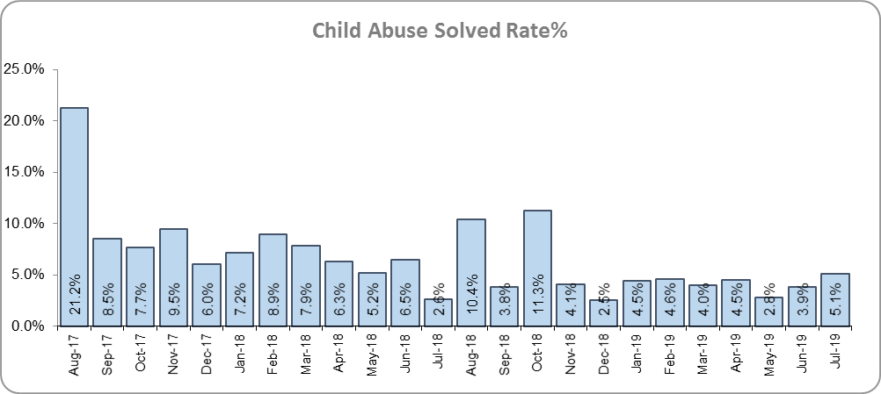
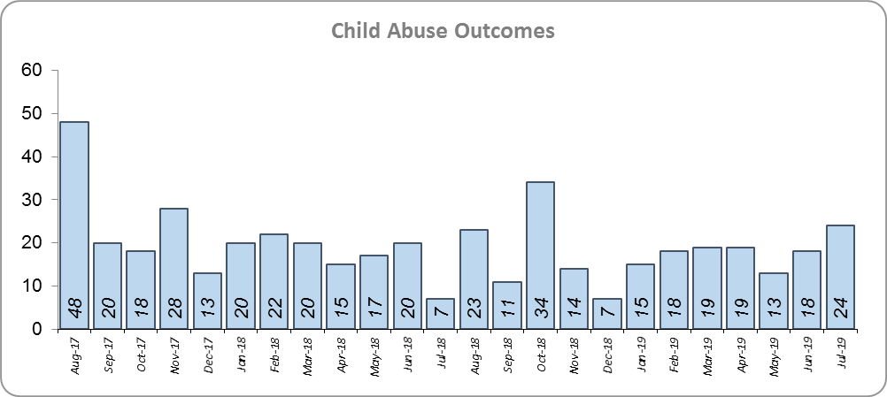
Priority 6 - Protecting children & vulnerable people
Grade: Requires Improvement
There was a 12.1% decrease (30 fewer) in the number of positive solved Child Abuse Outcomes in the 12 months to July 2019 compared to the 12 months to July 2018.
There was also a 3.1% point decrease in the solved rate (from 7.9% to 4.8%). This is due both to a reduction in the number of solved outcomes, as well an increase in the number of offences recorded; 43.5% more offences (an additional 1,363) were recorded in the 12 months to July 2019 compared to the 12 months to July 2018.
Due to the fall in the number of Child Abuse outcomes, and the reduction in the solved rate, a grade of Requires Improvement is recommended.

Slide 10
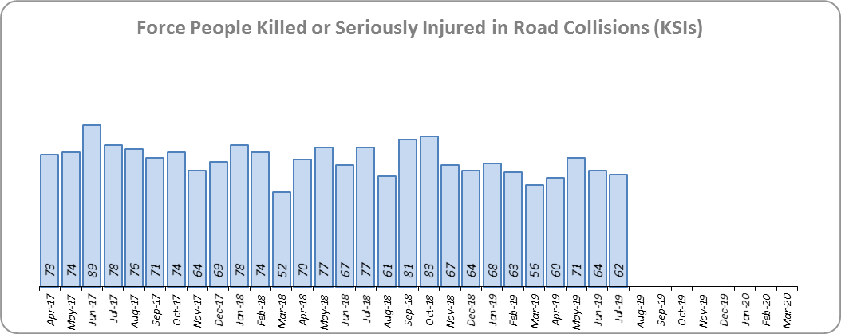
Priority 7 - Improve safety on our roads
Grade: Good
There was a 10.2% decrease (93 fewer) in the numbers of those Killed or Seriously Injured (KSI) in Essex for the 12 months to July 2019 compared to the 12 months to July 2018. This places Essex sixth in its Most Similar Group (MSG) of forces for casualties per 100 million vehicle kilometres (results to June 2018).
There has been a 11.6% decrease in mobile phone crime (322 fewer offences) and a 40.6% increase (981 more offences) in drink/drug driving.
Due to the decrease in KSIs, a grade of Good is recommended. As of June 2018, Essex was slightly below the MSG average per 100 million km; however, due to the fact that more recent figures are not yet available, the current position cannot be included.

Slide 11
Monthly Performance Overview: Exceptions
Exceptions Overview
The following offence types experienced a statistically significant increase for the month of July: Rape, Arson, Possession of Drugs and Public Order.
Rape
33.5% increase (475 additional offences) for the 12 months to July 2019 compared to the 12 months to July 2018. The Force and five districts saw a statistically exceptional increase in the month of July 2019. Rape has been a statistical exception four times in the past five months. This increase has not been caused by non-recent offences (those reported over 28 days after they were committed): the proportion of non-recent offences has fallen. Neither is the increase being driven by domestic offences, the proportion of which has remained stable (around 32%).
Arson
134.1% increase (673 additional offences) for the 12 months to July 2019 compared to the 12 months to July 2018. The Force and nine districts saw a statistically exceptional increase in the month of July 2019. This increase is mainly due to a change in the process by which the Fire & Rescue Service report these offences to the police. Arson has been a statistical exception every month since January 2019, when the Fire Service changed the way it reported fires to the police.
Possession of Drugs
53.7% increase (1,436 additional offences) for the 12 months to July 2019 compared to the 12 months to July 2018. The Force and three districts saw a statistically exceptional increase in the month of July 2019. This increase maybe attributed to the proactive use of Stop and Search operations, such as Operation Sceptre, to target knife crime, where knives are targeted but drugs are also found during the search.
Public Order
29.4% increase (3,237 additional offences) for the 12 months to July 2019 compared to the 12 months to July 2018. The Force and seven districts saw a statistically exceptional increase in the month of July 2019.

Slide 12
2016-2020 Police and Crime Plan Performance Indicators
Table 1
See page 12 for endnotes.

Slide 13
End Notes
¹ Question from Essex Police’s own confidence and perception survey. Results are for the period 12 months to December 2018 versus September 2017 to December 2017.
² The confidence interval is the range +/- between where the survey result may lie. This is mainly influenced by the number of people answering the survey. The more people that answer the survey, the smaller the interval range.
³ Crime Survey for England and Wales (CSEW): 12 months to March 2019 vs. 12 months to March 2018.
⁴ Question from Essex Police’s own confidence and perception survey. Results are for the period 12 months to December 2018 versus September to December 2017.
⁵ From January 2019, activity has been recorded rather than the number of people arrested. If there was a day of action, for example, and five people were arrested, this would formerly have counted as five disruptions, but now will count as one. The change stems from confusion over the previous guidelines, with police forces counting disruptions in different ways. The data are for January 2019 to July 2019. Previous data periods are not directly comparable but have been included for completeness.
⁶ Solved outcomes are crimes that result in: charge or summons, caution, crimes taken into consideration, fixed penalty notice, cannabis warning or community resolution.
⁷ ‘Killed or Seriously Injured’ (KSI) refers to all people killed or seriously injured on Essex’s roads, regardless of whether any criminal offences were committed. ‘Causing Death/Serious Injury by Dangerous/Inconsiderate Driving’ offences (detailed on p.13) refers to the number of crimes of this type.

Slide 14
Crime Tree Data – Rolling 12 Months to July
Table 2

Slide 15
Crime Tree Data – Rolling 12 Months to July
Table 3
Please note that at the time the data for this report was extracted, 2,063 July records were still awaiting categorisation by the Crime Bureau; of these records, around 1,209 are likely to be crimes. These crimes would not be featured in the figures within this report.

