Slide 1


Police and Crime Plan 2016-2020
Monthly Performance Update
June 2019
National and MSG positions are to 30th April 2019 (Essex Police data are to 30th June 2019).
Version 1.2
Produced July 2019
Performance Analysis Unit, Essex Police
Sensitivity: Official

Slide 2
Executive Summary
Three of the seven PFCC Priorities for Essex Police have been given a recommended grade of “Good”. Recommended grades have been determined with reference to comparisons with Essex Police’s Most Similar Group (MSG) of forces, internal Key Performance Indicators (KPIs), and professional judgement.
Four of the seven PFCC priorities – 1 (More local, visible and accessible policing), 3 (Breaking the cycle of domestic abuse), 4 (Reverse the trend in serious violence) and 6 (Protecting children & vulnerable people) – have been given a recommended grade of “Requires Improvement”. None of these recommended grades have changed since the May 2019 report.
All Crime has risen by 17.4% for the 12 months to June 2019 compared to the 12 months to June 2018. Domestic Abuse (DA) has risen by 41.0%. The increase in both can, in part, be attributed to the increase seen in Stalking and Harassment following changes to Home Office Counting Rules (HOCR) in April 2018. Other analysis conducted by Essex Police also indicates that a more rigorous approach to Crime Data Accuracy (CDA), as well as a genuine increase in crime (offences not subject to CDA or changes to HOCR), are likely to be contributing to this rise.
Essex Police solved 1,669 more crimes in the 12 months to June 2019 compared to the 12 months to June 2018; this equates to a 7.7% increase. However, the All Crime solved rate continues to decline due to the increase in the number of crimes reported.
In the month of June 2019, one crime type experienced a statistically significant increase: Arson.
In the month of June 2019, one crime type experienced a statistically significant decrease: Business Robbery.

Slide 3
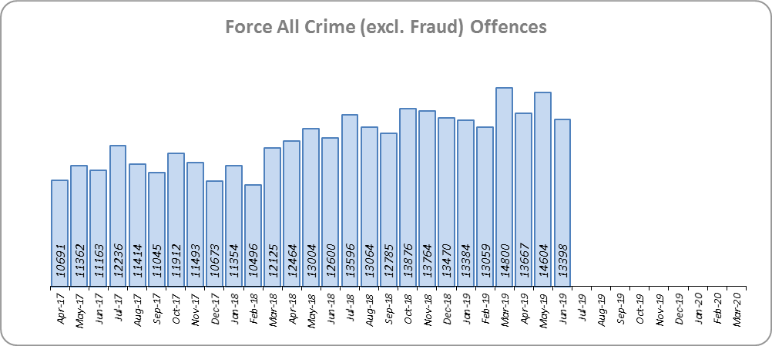
Priority 1 - More local, visible and accessible policing
Grade: Requires Improvement
Essex experienced a 17.4% increase in All Crime (24,107 additional offences) for the 12 months to June 2019 compared to the 12 months to June 2018. Essex is eighth in its Most Similar Group of forces (MSG) for both crime per 1,000 population and % change. No Districts experienced a statistically exceptional increase in the month of June 2019. The increase in offences can, in part, be attributed to better Crime Data Accuracy (CDA), as well as changes to Home Office Counting Rules in relation to Stalking & Harassment.
Confidence (Essex Police internal survey) is at 68.0% (results to the 12 months to December 2018). However, confidence in the local police from the Crime Survey of England and Wales (CSEW) places Essex as eighth in its MSG, and 10.2% points below the MSG average; the result for the 12 months to December 2018 compared to the 12 months to December 2017 is also within the confidence interval.
Due to the fact that Essex is 8th in its MSG for both crime per 1,000 population and for confidence in local police (CSEW), a grade of Requires Improvement is recommended.

Slide 4
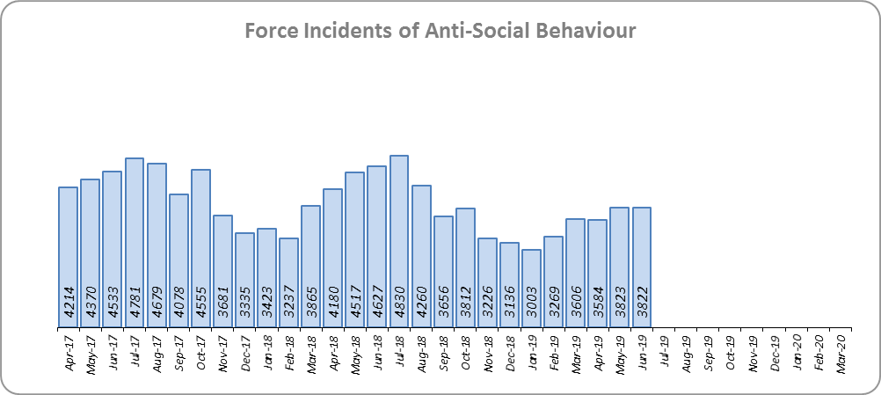
Priority 2 - Crack down on anti-social behaviour
Grade: Good
Essex experienced a 10.4% reduction (5,162 fewer) in Anti-Social Behaviour (ASB) incidents for the 12 months to June 2019 compared to the 12 months to June 2018. Part of this decrease is due to better Crime Data Accuracy (CDA); more incidents reported as ASB are now being correctly recorded as crimes rather than as ASB. Some of the decrease may also be due to people reporting incidents directly to the Council and Housing Authorities.
ASB Perception (from the Crime Survey of England and Wales) in Essex experienced a 4.5% point decrease (improvement) and is 0.9% points better than the MSG average. This places Essex fifth in its Most Similar Group (MSG) of forces.
Due to the reduction in ASB incidents, and the fact that ASB Perception is better than the MSG average, a grade of Good is recommended.

Slide 5
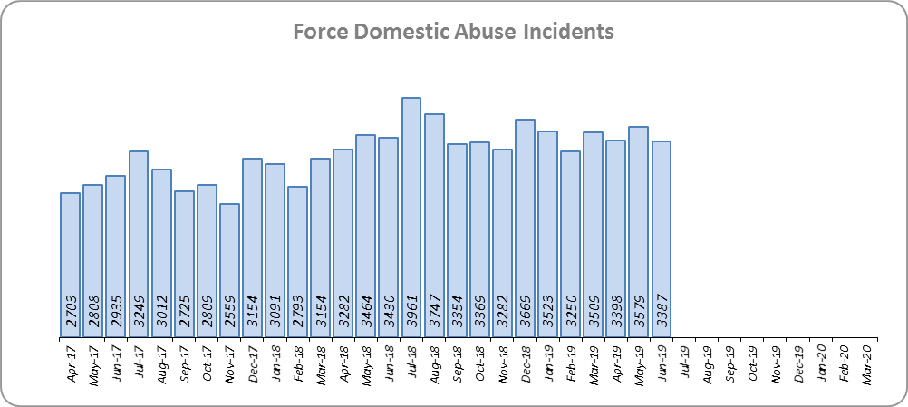
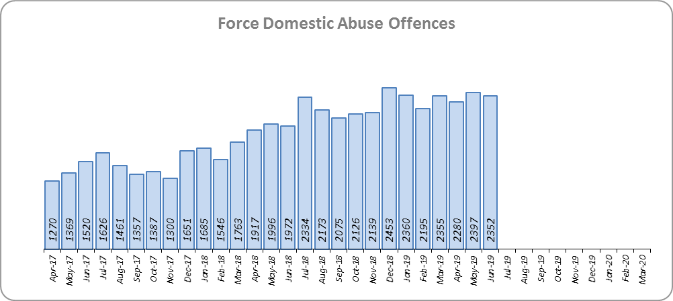
Priority 3 - Breaking the cycle of domestic abuse
Grade: Requires Improvement
Essex experienced a 14.4% increase (5,306 more) in Domestic Abuse incidents and a 21.2% increase (3,401 more) in repeat incidents of Domestic Abuse for the 12 months to June 2019 compared to the 12 months to June 2018. The increase in crime, in part, can be attributed to better Crime Data Accuracy (CDA), and changes to Home Office Counting Rules (HOCR) in relation to Stalking & Harassment.
While the Domestic Abuse solved rate has fallen by 4.8% points to 11.8% during the same period, the number of offences solved has increased by seven offences (0.2% more). The decrease in the solved rate is therefore due to the rise in offences being greater than the increase in the volume of offences that are being solved.
Due to the increase in repeat Domestic Abuse and the decrease in solved rate, a grade of Requires Improvement is recommended.

Slide 6
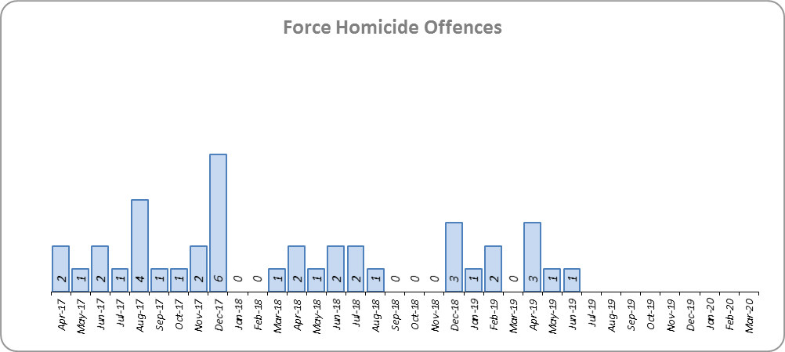
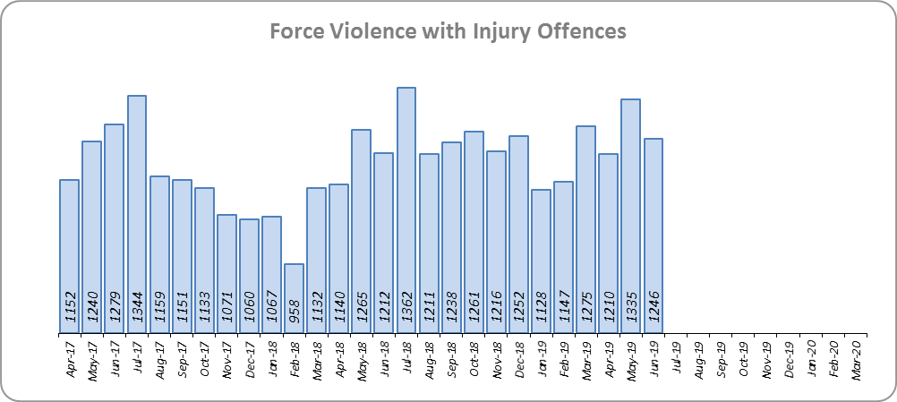
Priority 4 - Reverse the trend in serious violence
Grade: Requires Improvement
Essex saw a reduction of 11 Homicides (25 to 14 offences) for the 12 months to June 2019 compared to the 12 months to June 2018. Essex is sixth in its Most Similar Group (MSG) of forces for offences per 1,000 population, and similar to the MSG average.
There was a 9.7% increase (1,329 more offences) in Violence with Injury. Essex is fourth in its MSG for offences per 1,000 population, and is slightly better than the MSG average. The increase in this offence is, in part, due to the rise in domestic abuse related Violence with Injury (16.6% increase, 722 more offences). 33.8% of Violence with Injury is domestic abuse-related.
Due to the fact that Essex is still seeing an increase in Violence with Injury, a grade of Requires Improvement is recommended.

Slide 7
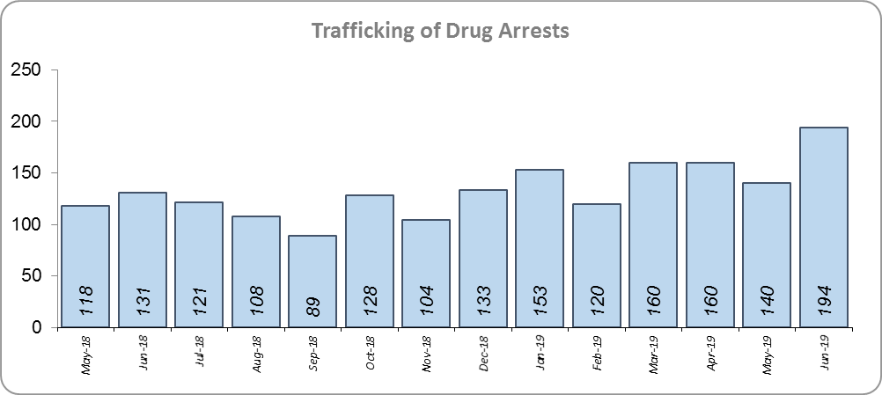
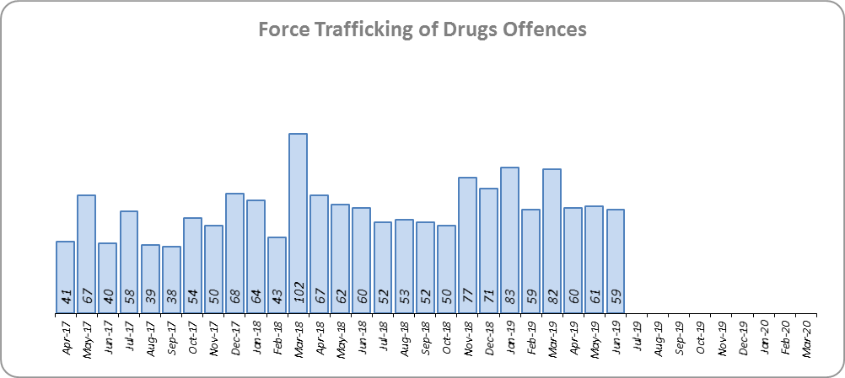
Priority 5 - Tackle gangs and organised crime
Grade: Good
32 Organised Crime Group (OCG) disruptions were conducted in Essex between January 2019 and June 2019. In January 2019 there was a change in the way in which the number of OCG disruptions were counted; this follows National Crime Agency (NCA) and Eastern Region Special Operations Unit (ERSOU) guidance to ensure that all forces record disruptions in the same way. Previous data periods are not directly comparable but are included for completeness.
Trafficking of drug arrests, which are also as a result of police proactivity, increased by 23.4% (312 more) for the 12 months to June 2019 compared to the 12 months to June 2018. In the same period, there have also been 10.3% more trafficking of drugs offences recorded (71 more offences to 763).
Due to the increase in Trafficking of Drug Arrests, a grade of Good is recommended.

Slide 8
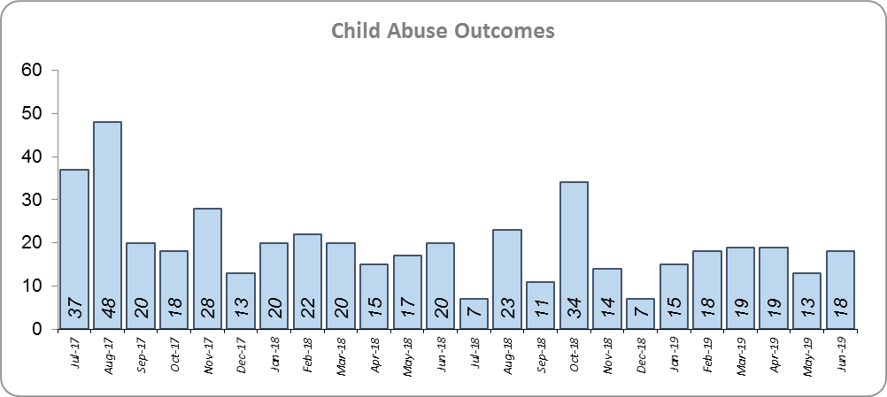
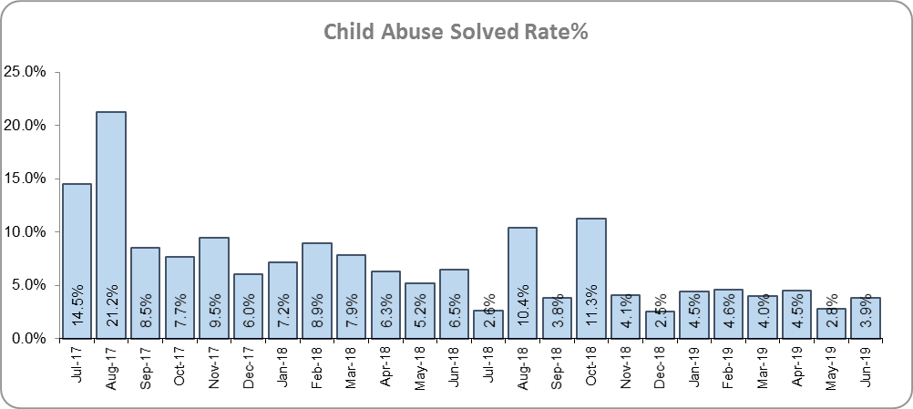
Priority 6 - Protecting children & vulnerable people
Grade: Requires Improvement
There was a 27.3% decrease (76 fewer) in the number of positive solved Child Abuse Outcomes in the 12 months to June 2019 compared to the 12 months to June 2018.
There was also a 4.2% point decrease in the solved rate (from 8.9% to 4.7%). This is due both to a reduction in the number of solved outcomes, as well an increase in the number of offences recorded; 36.5% more offences (an additional 1,138) were recorded in the 12 months to June 2019 compared to the 12 months to June 2018.
Due to the fall in the number of Child Abuse outcomes, and the reduction in the solved rate, a grade of Requires Improvement is recommended.

Slide 9
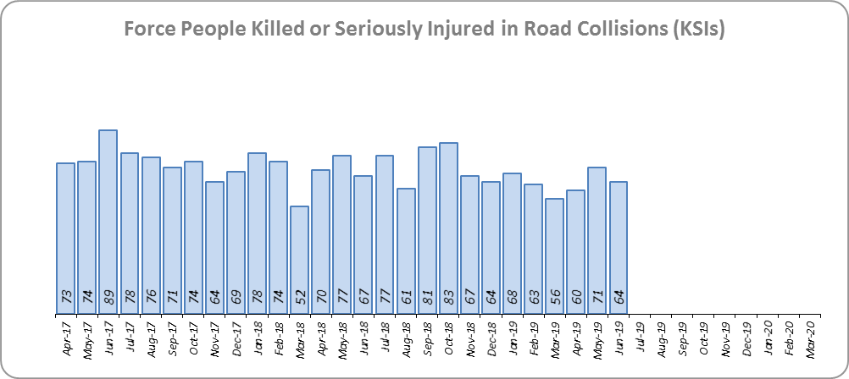
Priority 7 - Improve safety on our roads
Grade: Good
There was a 8.2% decrease (75 fewer) in the numbers of those Killed or Seriously Injured (KSI) in Essex for the 12 months to June 2019 compared to the 12 months to June 2018. This places Essex sixth in its Most Similar Group (MSG) of forces for casualties per 100 million vehicle kilometres (results to June 2018).
There has been a 15.6% decrease in mobile phone crime (444 fewer offences) and a 38.1% increase (917 more offences) in drink/drug driving.
Due to the decrease in KSIs, a grade of Good is recommended. As of June 2018, Essex was slightly below the MSG average per 100 million km; the current position is unknown, however.

Slide 10
Monthly Performance Overview: Exceptions
Exceptions Overview
The following offence type experienced a statistically significant increase for the month of June: Arson
The following offence type experienced a statistically significant decrease for the month of June: Business Robbery
Arson
100.8% increase (505 additional offences) for the 12 months to June 2019 compared to the 12 months to June 2018. The Force and five districts saw a statistically exceptional increase in the month of June 2019. This increase is mainly due to a change in the process by which the Fire & Rescue Service report these offences to the police.
Business Robbery
3.2% decrease (six fewer offences) for the 12 months to June 2019 compared to the 12 months to June 2018. The Force saw a statistically exceptional decrease in the month of June 2019.

Slide 11
2016-2020 Police and Crime Plan Performance Indicators
Table 1
See page 12 for endnotes.

Slide 12
End Notes
¹ Question from Essex Police’s own confidence and perception survey. Results are for the period 12 months to December 2018 versus September 2017 to December 2017.
² The confidence interval is the range +/- between where the survey result may lie. This is mainly influenced by the number of people answering the survey. The more people that answer the survey, the smaller the interval range.
³ Crime Survey for England and Wales (CSEW): 12 months to December 2018 vs. 12 months to December 2017.
⁴ Question from Essex Police’s own confidence and perception survey. Results are for the period 12 months to December 2018 versus 12 months to December 2017.
⁵ From January 2019, activity has been recorded rather than the number of people arrested. If there was a day of action, for example, and five people were arrested, this would formerly have counted as five disruptions, but now will count as one. The change stems from confusion over the previous guidelines, with police forces counting disruptions in different ways. The data are for January 2019 to June 2019. Previous data periods are not directly comparable but have been included for completeness.
⁶ Solved outcomes are crimes that result in: charge or summons, caution, crimes taken into consideration, fixed penalty notice, cannabis warning or community resolution.
⁷ ‘Killed or Seriously Injured’ (KSI) refers to all people killed or seriously injured on Essex’s roads, regardless of whether any criminal offences were committed. ‘Causing Death/Serious Injury by Dangerous/Inconsiderate Driving’ offences (detailed on p.13) refers to the number of crimes of this type.

Slide 13
Crime Tree Data – Rolling 12 Months to June
Table 2

Slide 14
Crime Tree Data – Rolling 12 Months to June
Table 3

