Slide 1
Police and Crime Plan 2016-2020
Monthly Performance Update
April 2019
National and MSG positions are to 31st March 2019 (Essex Police data are to 30th April 2019).
Version 1.3
Produced May 2019
Performance Analysis Unit, Essex Police
Sensitivity: Official

Slide 2
Executive Summary
Four of the seven PFCC Priorities for Essex Police have been given a recommended grade of “Good”. Recommended grades have been determined with reference to comparisons with Essex Police’s Most Similar Group (MSG) of forces, internal Key Performance Indicators (KPIs), and professional judgement.
Three of the seven PFCC priorities – 1 (More local, visible and accessible policing), 3 (Breaking the cycle of domestic abuse) and 6 (Protecting children & vulnerable people) – have been given a recommended grade of “Requires Improvement”. There has been no change to the recommended grades in this month’s report compared to those recommended in the March 2019 report.
All Crime has risen by 17.8% for the 12 months to April 2019 compared to the 12 months to April 2018. Domestic Abuse (DA) has risen by 43.8%. The increase in both can, in part, be attributed to the increase seen in Stalking and Harassment following changes to Home Office Counting Rules (HOCR) in April 2018. Other analysis conducted by Essex Police also indicates that a more rigorous approach to Crime Data Accuracy (CDA), as well as a genuine increase in crime (offences not subject to CDA or changes to HOCR), are likely to be contributing to this rise.
All Crime is forecast to be exceptionally high in July 2019 (All Crime did not experience a statistically exceptional increase in the month of April 2019, however).
The All Crime solved rate continues to decline due to an increase in the number of crimes. However, there has been a 6.8% increase (1,474 more) in the number of crimes considered ‘solved’.
In the month of April 2019, three crime types experienced statistically significant increases: Rape, Arson, and Possession of Drugs.
No crime types experienced a statistically significant decrease in the month of April 2019.

Slide 3
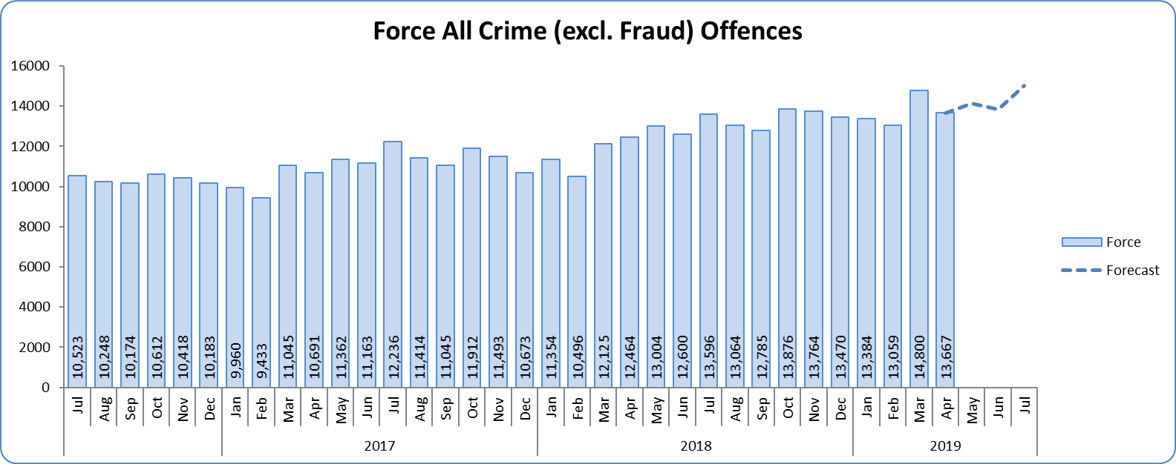
Priority 1 - More local, visible and accessible policing
Grade: Requires Improvement
Essex experienced an 17.8% increase in All Crime (24,248 additional offences) for the 12 months to April 2019 compared to the 12 months to April 2018. Essex is eighth in its Most Similar Group of forces (MSG) for both crime per 1,000 population and % change. Neither the Force nor any District experienced a statistically exceptional increase in the month of April 2019. The increase in offences can, in part, be attributed to better Crime Data Accuracy (CDA), as well as changes to Home Office Counting Rules in relation to Stalking & Harassment.
Confidence (Essex Police internal survey) is at 68.0% (results to the 12 months to September 2018). However, confidence in the local police from the Crime Survey of England and Wales (CSEW) places Essex as eighth in its MSG, and 10.2% points below the MSG average; the result for the 12 months to December 2018 compared to the 12 months to December 2017 is also within the confidence interval.
Due to the fact that Essex is 8th in its MSG for both crime per 1,000 population and for confidence in local police (CSEW), a grade of Requires Improvement is recommended.

Slide 4
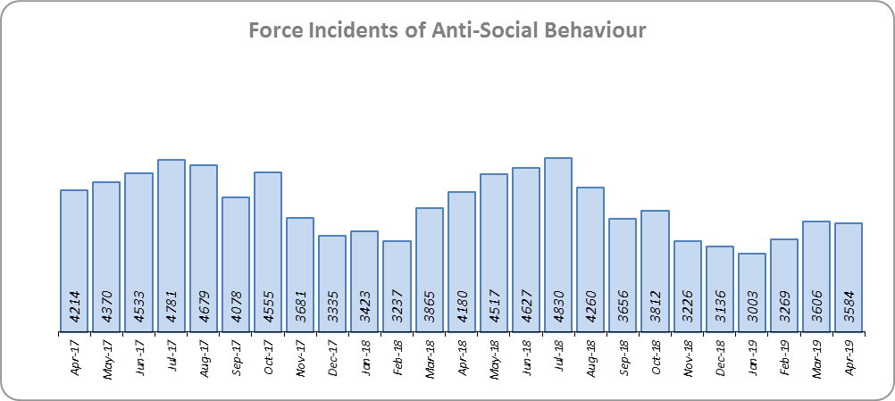
Priority 2 - Crack down on anti-social behaviour
Grade: Good
Essex experienced a 7.0% decrease in (3,442 fewer) Anti-Social Behaviour (ASB) incidents for the 12 months to April 2019 compared to the 12 months to April 2018. Part of this decrease is due to better Crime Data Accuracy (CDA); more incidents reported as ASB are now being correctly recorded as crimes rather than as ASB. Some of the decrease may also be due to people reporting incidents directly to the Council and Housing Authorities.
ASB Perception (from the Crime Survey of England and Wales) in Essex experienced a 4.5% point decrease (improvement) and is 0.9% points better than the MSG average. This places Essex fifth in its Most Similar Group (MSG) of forces.
Due to the reduction in ASB incidents, and the fact that ASB Perception is better than the MSG average, a grade of Good is recommended.

Slide 5
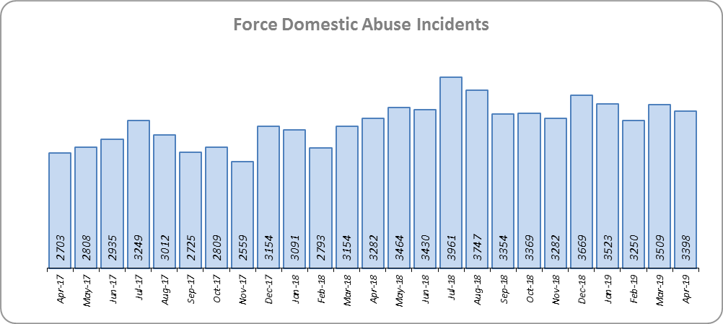
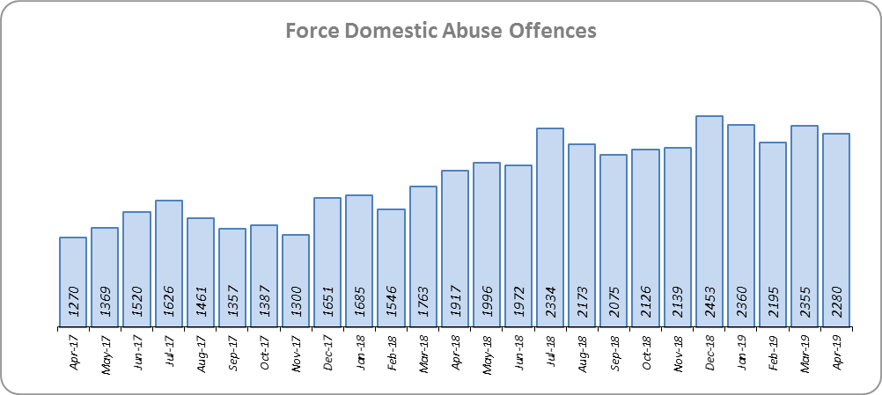
Priority 3 - Breaking the cycle of domestic abuse
Grade: Requires Improvement
Essex experienced a 18.0% increase (6,385 more) in Domestic Abuse incidents and a 24.7% (3,805 more) increase in repeat incidents of Domestic Abuse for the 12 months to April 2019 compared to the 12 months to April 2018. In last months report, this increase was 27.3% (4,107 more). The increase in crime, in part, can be attributed to better Crime Data Accuracy (CDA), and changes to Home Office Counting Rules (HOCR) in relation to Stalking & Harassment.
While the Domestic Abuse solved rate has fallen by 4.8% points to 12.5% during the same period, the number of offences solved has increased by 129 (4.1% more). The decrease in the solved rate is therefore due to the rise in offences being greater than the increase in the volume of offences that are being solved.
Due to the increase in repeat Domestic Abuse and the decrease in solved rate, a grade of Requires Improvement is recommended.

Slide 6
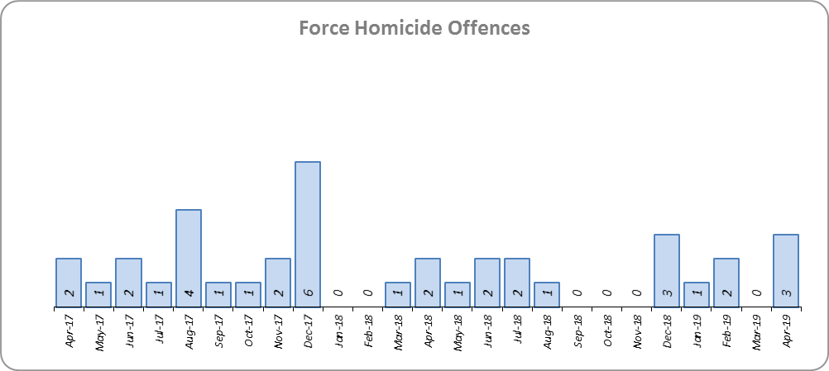
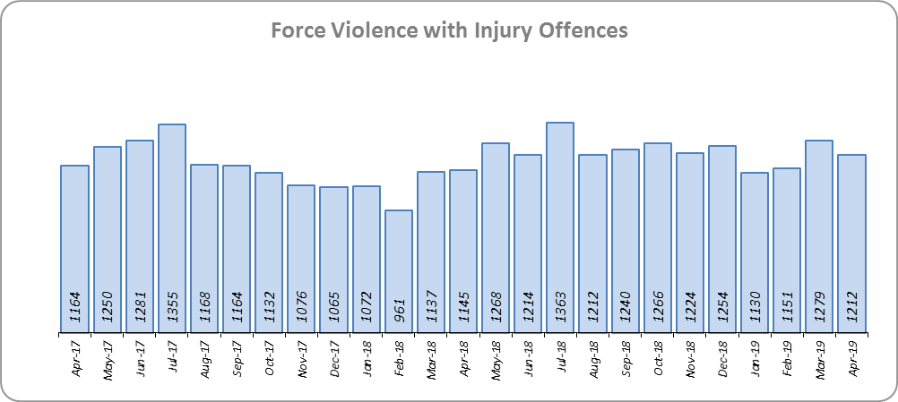
Priority 4 - Reverse the trend in serious violence
Grade: Good
Essex saw a reduction of eight Homicides (24 to 16 offences) for the 12 months to April 2019 compared to the 12 months to April 2018. Essex is fifth in its Most Similar Group (MSG) of forces for offences per 1,000 population, and is slightly worse than the MSG average.
There was a 8.3% increase (1,133 more offences) in Violence with Injury. Essex is fourth in its MSG for offences per 1,000 population, and is slightly better than the MSG average. The increase in this offence is, in part, due to the rise in domestic abuse related Violence with Injury (14.7% increase, 638 more offences). 33.5% of Violence with Injury is domestic abuse-related.
Due to the fact Essex is better than the MSG average for crimes per 1,000 population for Violence with Injury, and Homicide saw a reduction of eight offences, a grade of Good is recommended.

Slide 7
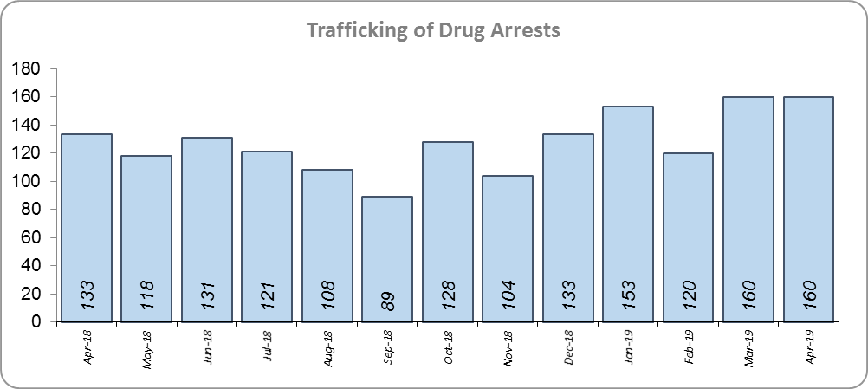
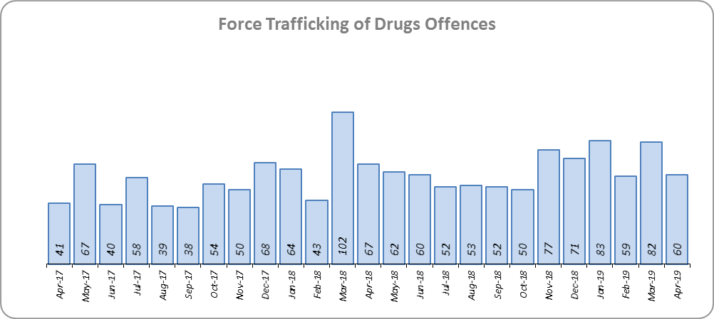
Priority 5 - Tackle gangs and organised crime
Grade: Good
19 Organised Crime Group (OCG) disruptions were conducted in Essex between January 2019 and April 2019. In January 2019 there was a change in the way in which the number of OCG disruptions were counted, following National Crime Agency (NCA) and Eastern Region Special Operations Unit (ERSOU) guidance to ensure that all forces record disruptions in the same way. Previous data periods and comparisons are therefore not available.
Trafficking of drug arrests, which are also as a result of police proactivity, increased by 22.5% (285 more) for the 12 months to April 2019 compared to the 12 months to April 2018. In the same period, there have also been 13.1% more trafficking of drugs offences recorded (87 more offences to 752).
Due to the increase in Trafficking of Drug Arrests, a grade of Good is recommended.

Slide 8
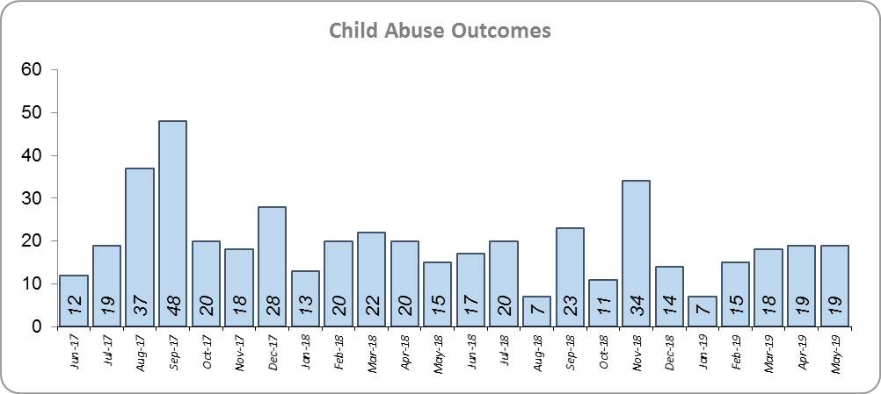
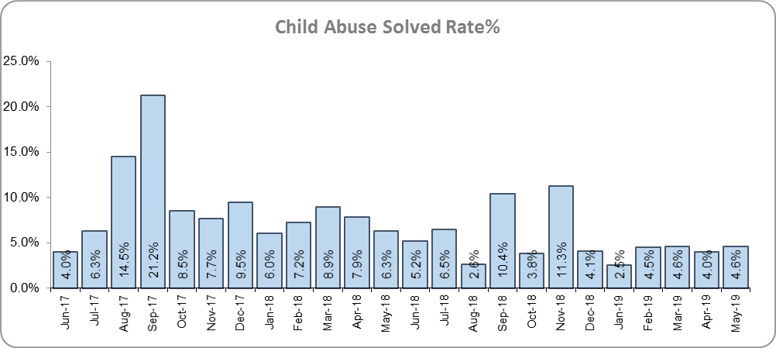
Priority 6 - Protecting children & vulnerable people
Grade: Requires Improvement
There was a 25.0% (68 fewer) decrease in the number of positive Child Abuse Outcomes in the 12 months to April 2019 compared to the 12 months to April 2018.
There was also a 3.7% point decrease in the solved rate (from 8.8% to 5.2%). This is due both a reduction in the number of solved, as well an increase in the number of offences recorded; 28.4% more offences (an additional 876) were recorded in the 12 months to April 2019 compared to the 12 months to April 2018.
Due to the fall in the number of Child Abuse outcomes, and the reduction in the solved rate, a grade of Requires Improvement is recommended.

Slide 9
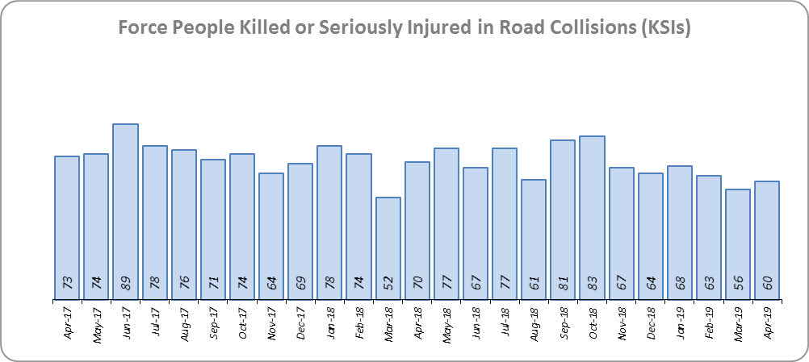
Priority 7 - Improve safety on our roads
Grade: Good
There was a 6.5% (60 fewer) decrease in the numbers of those Killed or Seriously Injured (KSI) in Essex for the 12 months to April 2019 compared to the 12 months to April 2018. This places Essex sixth in its Most Similar Group (MSG) for forces for casualties per 100 million vehicle kilometres (results to June 2018).
There has been a 9.8% decrease in mobile phone crime (264 fewer offences) and a 36.5% increase (846 more offences) in drink/drug driving. These are both measures of proactive police activity.
In spite of the fact that Essex is above (worse than) the MSG average for KSIs (to June 2018), there have been fewer. Because there has also been an increase in the number driving under the influence of drink/drugs offences, a grade of Good is recommended.

Slide 10
Monthly Performance Overview: Exceptions
Exceptions Overview
The following offence types experienced statistically significant increases for the month of April 2019 (there were no statistically significant decreases):
Rape
Arson
Possession of Drugs.
Rape
26.8% increase (368 additional offences) for the 12 months to April 2019 compared to the 12 months to April 2018. The Force and one district saw a statistically exceptional increase in the month of April 2019. Essex is fifth in its MSG for crimes per 1,000 pop. and seventh for % change. 31.7% of Rape is domestic abuse related.
Arson
48.0% increase (250 additional offences) for the 12 months to April 2019 compared to the 12 months to April 2018. The Force and 10 districts saw a statistically exceptional increase in the month of April 2019. Essex is fifth in its MSG for crimes per 1,000 pop. and sixth for % change. This increase is mainly due to a change in the process by which the Fire & Rescue Service report these offences to the police. Since June 2018 196 offences of Arson have been reported via this method.
Possession of Drugs
30.1% increase (814 additional offences) for the 12 months to April 2019 compared to the 12 months to April 2018. The Force and four districts saw a statistically exceptional increase in the month of April 2019. Essex is seventh in its MSG for crimes per 1,000 pop. and eighth for % change.

Slide 11
2016-2020 Police and Crime Plan Performance Indicators
Table 1
See page 12 for endnotes.

Slide 12
End Notes
¹ Question from Essex Police’s own confidence and perception survey. Results are for the period 12 months to September 2018.
² The confidence interval is the range +/- between where the survey result may lie. This is mainly influenced by the number of people answering the survey. The more people that answer the survey, the smaller the interval range.
³ Crime Survey for England and Wales (CSEW): 12 months to December 2018 vs. 12 months to December 2017.
⁴ Question from Essex Police’s own confidence and perception survey. Results are for the period 12 months to September 2018 versus the same period the previous year.
⁵ From January 2019, activity has been recorded rather than the number of people arrested. If there was a day of action, for example, and five people were arrested, this would formerly have counted as five disruptions, but now will count as one. The change stems from confusion over the previous guidelines, with police forces counting disruptions in different ways. The data are for January 2019 to April 2019.
⁶ Solved outcomes are crimes that result in: charge or summons, caution, crimes taken into consideration, fixed penalty notice, cannabis warning or community resolution.
⁷ ‘Killed or Seriously Injured’ (KSI) refers to all people killed or seriously injured on Essex’s roads, regardless of whether any criminal offences were committed. ‘Causing Death/Serious Injury by Dangerous/Inconsiderate Driving’ offences (detailed on p.13) refers to the number of crimes of this type.

Slide 13
Crime Tree Data – Rolling 12 Months to April
Table 2

Slide 14
Crime Tree Data – Rolling 12 Months to April
Table 3

