Slide 1
Police and Crime Plan 2016-2020
Monthly Performance Update
March 2019
National and MSG positions are to 28th February 2019 (Essex Police data are to 31st March 2019).
Version 1.9
Produced April 2019
Performance Analysis Unit, Essex Police
Sensitivity: Official

Slide 2
Executive Summary
Four of the seven PFCC Priorities for Essex Police have been given a recommended grade of “Good”. Recommended grades have been determined with reference to comparisons with Essex Police’s Most Similar Group (MSG) of forces, internal Key Performance Indicators (KPIs), and professional judgement.
Three of the seven PFCC priorities – 1 (More local, visible and accessible policing), 3 (Breaking the cycle of domestic abuse) and 6 (Protecting children & vulnerable people) – have been given a recommended grade of “Requires Improvement”.
All Crime has risen by 18.3% for the 12 months to March 2019 compared to the 12 months to March 2018. Domestic Abuse (DA) has risen by 46.2%. The increase in both can, in part, be attributed to the increase seen in Stalking and Harassment following changes to Home Office Counting Rules (HOCR) in April 2018. Other analysis conducted by Essex Police also indicates that a more rigorous approach to Crime Data Accuracy (CDA), as well as a genuine increase in crime (offences not subject to CDA or changes to HOCR), are likely to be contributing to this rise.
All Crime experienced a statistically exceptional increase in the month of March 2019. However, the next three months are not forecast to be exceptionally high.
The All Crime solved rate continues to decline due to an increase in the number of crimes. However, there has been a 7.6% increase (1,646 more) in the number of crimes considered ‘solved’.
In the month of March 2019, 11 crime types experienced statistically significant increases: All Crime, Violence without Injury, Stalking and Harassment, Rape, Robbery of Personal Property, Vehicle Interference, Arson, Racially Aggravated Offences, Possession of Drugs and Public Order.
No crime types experienced a statistically significant decrease in the month of March 2019.

Slide 3
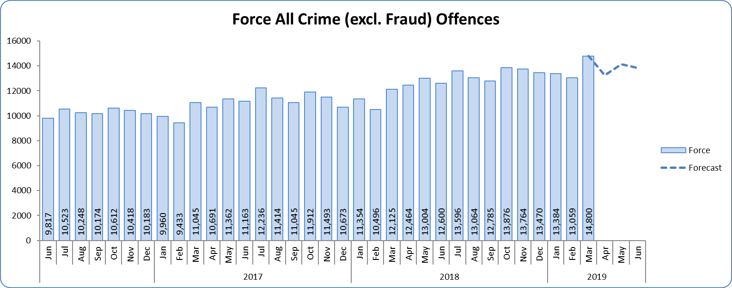
Priority 1 - More local, visible and accessible policing
Grade: Requires Improvement
Essex experienced an 18.3% increase (24,504 additional offences) for the 12 months to March 2019 compared to the 12 months to March 2018. Essex is eighth in its Most Similar Group of forces (MSG) for both crime per 1,000 population and % change. The Force (and six Districts) experienced a statistically exceptional increase for All Crime in the month of March 2019. The increase in offences can, in part, can be attributed to better Crime Data Accuracy (CDA), and also changes to Home Office Counting Rules (HOCR) in relation to Stalking & Harassment. 16.4% of All Crime is Domestic Abuse related (see Priority 3 – breaking the cycle of domestic abuse).
Confidence (internal survey) is at 68.0%. However, confidence in the local police from the Crime Survey of England and Wales (CSEW) places Essex as eighth in its MSG (and 8.8% points below the MSG average); the improvement for the 12 months to September 2018 compared to the 12 months to September 2017 is also within the confidence interval.
Due to the fact that Essex is 8th in its MSG for both crime per 1,000 population and for confidence in local police (CSEW), a grade of Requires Improvement is recommended.

Slide 4
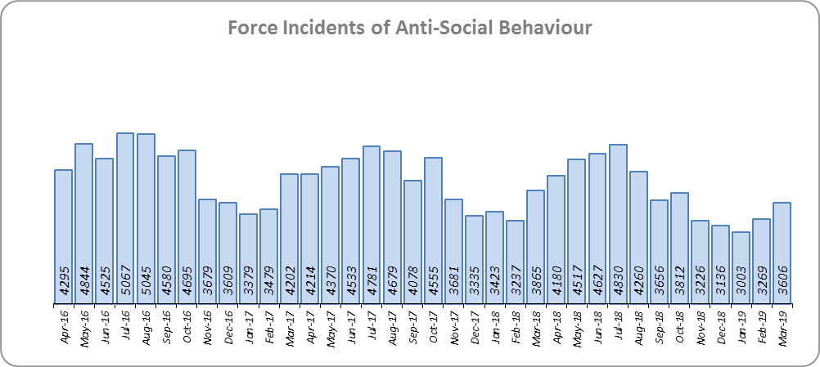
Priority 2 - Crack down on anti-social behaviour
Grade: Good
Essex experienced a 5.9% decrease (2,888 fewer) in anti-social behaviour incidents for the 12 months to March 2019 compared to the 12 months to March 2018. Part of this decrease is due to better Crime Data Accuracy (CDA); more incidents reported as ASB are now being correctly recorded as crimes rather than recorded as ASB. Some of the decrease may also be due to people reporting incidents directly to the council and Housing Authorities.
The ASB Perception from the Crime Survey of England and Wales (CSEW) has seen a 6.6% point decrease (improvement) and is 0.3% points better than the MSG average. This places Essex fifth in its Most Similar Group (MSG) of forces.
Due to the reduction in ASB incidents, and the fact that ASB Perception is better than the MSG average, a grade of Good is recommended.

Slide 5
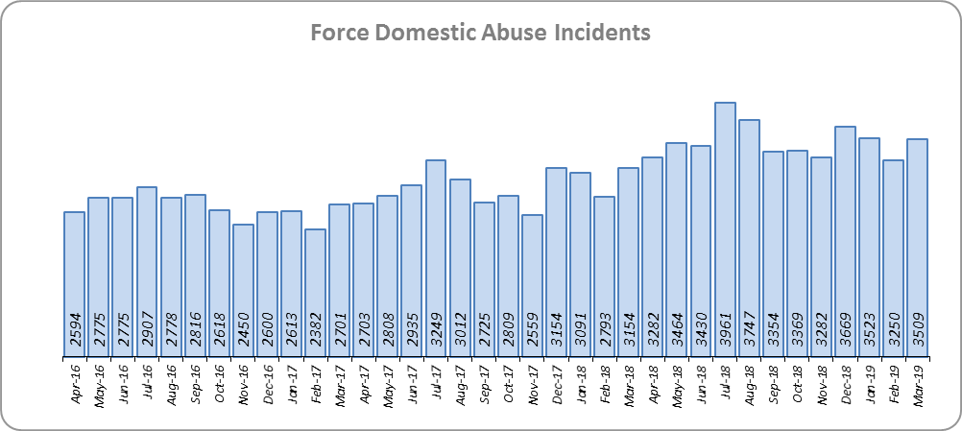
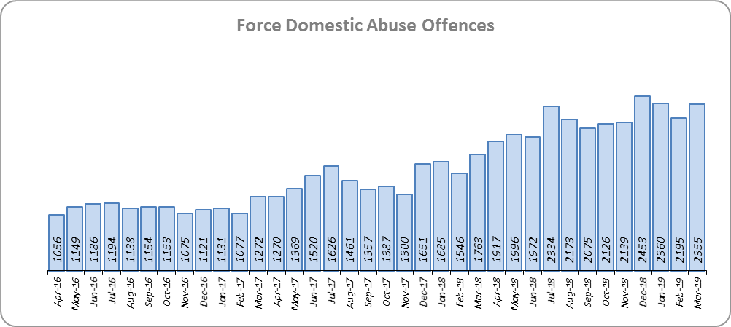
Priority 3 - Breaking the cycle of domestic abuse
Grade: Requires Improvement
Essex saw a 19.6% rise (6,848 more) in Domestic Abuse incidents and a 27.3% increase (4,107 more) in repeat incidents of Domestic Abuse for the 12 months to March 2019 compared to the 12 months to March 2018. The increase in crime, in part, can be attributed to better Crime Data Accuracy (CDA), and changes to Home Office Counting Rules (HOCR) in relation to Stalking & Harassment.
While the Domestic Abuse solved rate has fallen by 4.8% points to 12.9% during the same period, the number of offences solved has increased (46.2%, 8,215 more), and at every risk level. The decrease in the solved rate is therefore due to the rise in offences being greater than the increase in the volume of offences solved. However, the volumes of offences finalised with Outcomes 14 and 16 (outcomes where the victim declines/withdraws support for prosecution) have increased by 60.5% (6,193 more to 16,424).
Due to the increase in repeat Domestic Abuse and the decrease in solved rate, a grade of Requires Improvement is recommended.

Slide 6
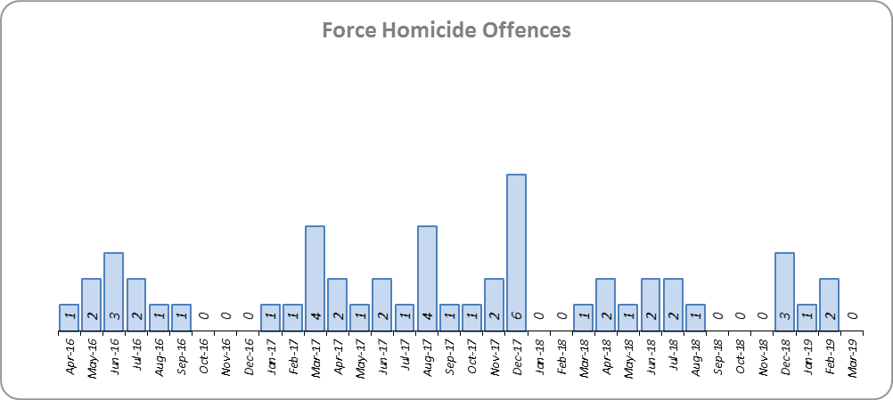
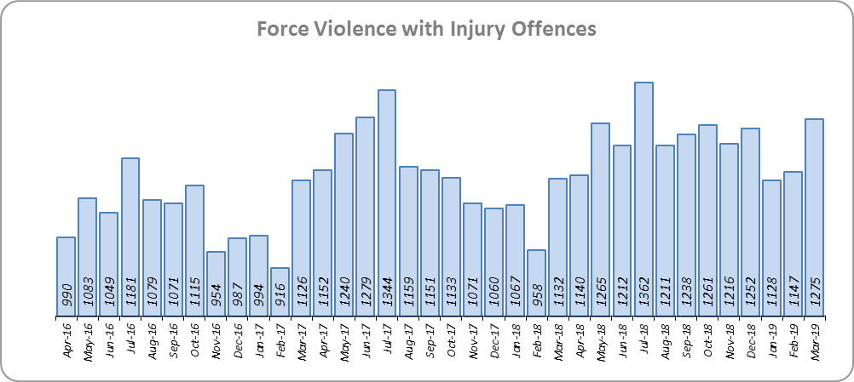
Priority 4 - Reverse the trend in serious violence
Grade: Good
Essex saw a reduction of 10 homicides (24 to 14) for the 12 months to March 2019 compared to the 12 months to March 2018. Essex is fourth in its Most Similar Group (MSG) of forces for offences per 1,000 population, and is slightly better than the MSG average.
There was a 7.5% increase (1,027 more offences) in Violence with Injury. Essex is fourth in its MSG for offences per 1,000 population, and is slightly better than the MSG average. The increase in offences is, in part, due to the rise in domestic abuse, with 33.5% of Violence with Injury domestic abuse related.
Due to the fact Essex is better than the MSG average for crimes per 1,000 population for both Homicide and Violence with Injury, a grade of Good is recommended.

Slide 7
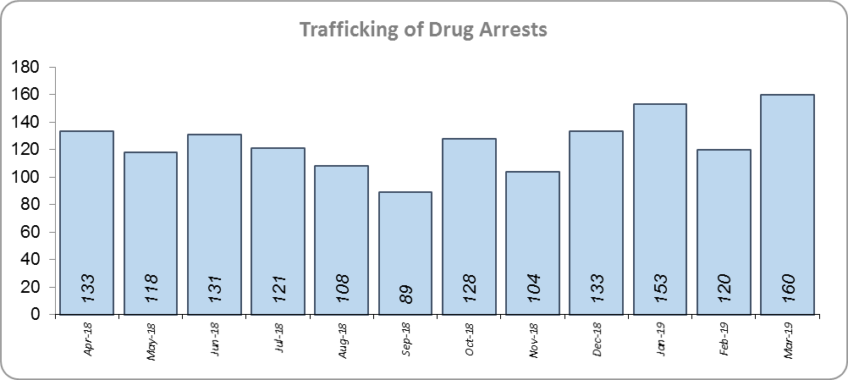
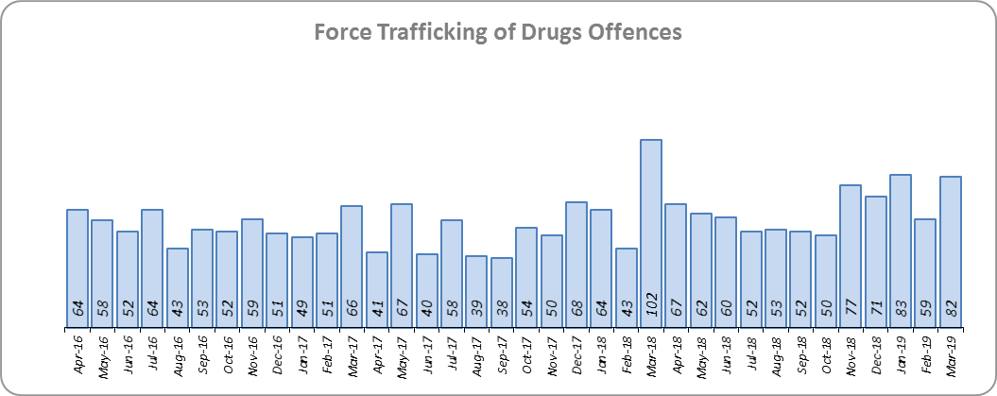
Priority 5 - Tackle gangs and organised crime
Grade: Good
There has been a change in the way in which the number of these disruptions are counted in Essex, however. This follows guidance issued by the National Crime Agency (NCA) and the Eastern Region Special Operations Unit (ERSOU) to ensure that all forces record disruptions in the same way. There was a slight change in the definition again in January 2019; no data is available at this time.
Trafficking of drug arrests, which are also as a result of police proactivity, rose by 12.0% (161 more) for the 12 months to March 2019 compared to the 12 months to March 2018. In the same period, there have also been a 18.0% more trafficking of drugs offences recorded (115 more offences to 754).
Due to the increase in Trafficking of Drug Arrests, a grade of Good is recommended.

Slide 8
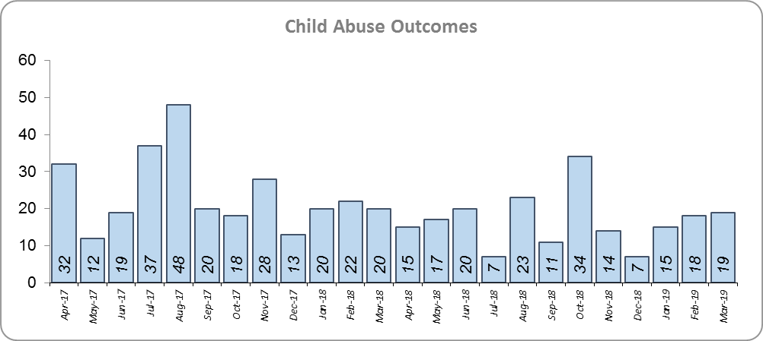
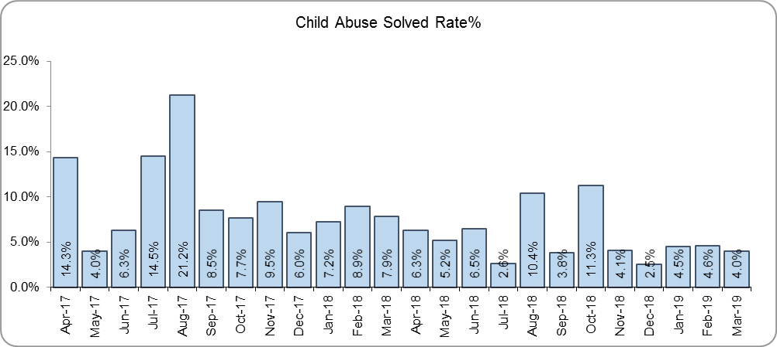
Priority 6 - Protecting children & vulnerable people
Grade: Requires Improvement
There was a 30.8% decrease (89 fewer) in the number of positive child abuse outcomes in the 12 months to March 2019 compared to the 12 months to March 2018.
There was also a 4.1% point decrease in the solved rate (from 9.4% to 5.3%). This is due both to a reduction in the number of solved, as well an increase in the number of offences recorded; 23.0% more offences (an additional 707) were recorded in the 12 months to March 2019 compared to the 12 months to March 2018.
Due to the fall in the number of Child Abuse outcomes, and the reduction in the solved rate, a grade of Requires Improvement is recommended.

Slide 9
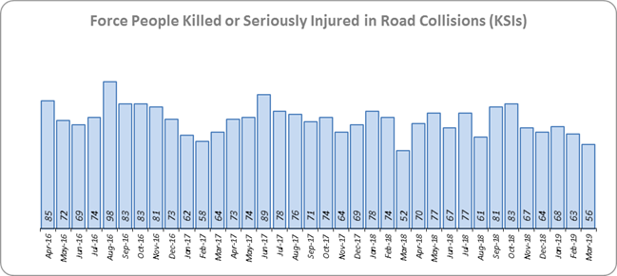
Priority 7 - Improve safety on our roads
Grade: Good
There was a 4.9% decrease (45 fewer) in the numbers of those Killed or Seriously Injured (KSI) in Essex for the 12 months to March 2019 compared to the 12 months to March 2018. This places Essex sixth in its Most Similar Group (MSG) for forces for casualties per 100 million vehicle kilometres.
There has been a 0.5% increase in mobile phone crime (14 more offences) and a 36.2% increase (803 more offences) in drink/drug driving. These are both measures of proactive police activity.
In spite of the fact that Essex is above (worse than) the MSG average for KSIs, there have been fewer KSIs (of all types). Because there has also been an increase in the number of mobile phone and driving under the influence of drink/drugs offences, a grade of Good is recommended.

Slide 10
Monthly Performance Overview: Exceptions
Exceptions Overview
The following offence types experienced statistically significant increases for the month of March 2019 (there were no statistically significant decreases). All Crime; Violence without Injury; Stalking and Harassment; Rape; Robbery of Personal Property; Vehicle Interference; Arson; Racially Aggravated Offences; Possession of Drugs; Public Order.
Violence Without Injury. 28.8% increase (4,858 additional offences) for the 12 months to March 2019 compared to the 12 months to March 2018. The force and seven districts saw a statistically exceptional increase in the month of March. Essex is eighth in its Most Similar Group of force (MSG) for crimes per 1,000 population and seventh for % change. This increase is due, in part, to the recent change in the Home Office Counting Rules (HOCR) relating to Stalking & Harassment (see below).
Stalking and Harassment. 97.6% increase (10,383 additional offences) for the 12 months to March 2019 compared to the 12 months to March 2018. The force and nine districts saw a statistically exceptional increase in the month of March. From April 2018, forces began to record both the Harassment and the most serious additional crime, whereas when someone previously committed a Harassment type offence and another offence (such as ABH) the police recorded just the other offence, and not the Harassment.
Rape. 23.6% increase (321 additional offences) for the 12 months to March 2019 compared to the 12 months to March 2018. The force and three districts saw a statistically exceptional increase in the month of March. Essex is fifth in its MSG for crimes per 1,000 pop. and sixth for % change. 31.0% of Rape is domestic abuse related.
Robbery of Personal Property. 20.0% increase (267 additional offences) for the 12 months to March 2019 compared to the 12 months to March 2018. The force and three districts saw a statistically exceptional increase in the month of March. Essex is seventh in its MSG for crimes per 1,000 pop. and fifth for % change.
Arson. 26.1% increase (141 additional offences) for the 12 months to March 2019 compared to the 12 months to March 2018. The force and five districts saw a statistically exceptional increase in the month of March. Essex is third in its MSG for crimes per 1,000 pop. and sixth for % change. This increase is mainly due to a change in the process by which the Fire & Rescue Service report these offences to the police.
Racially Aggravated Offences. 22.0% increase (260 additional offences) for the 12 months to March 2019 compared to the 12 months to March 2018. The force and one district saw a statistically exceptional increase in the month of March. Essex is fourth in its MSG for crimes per 1,000 pop. and seventh for % change.

Slide 11
2016-2020 Police and Crime Plan Performance Indicators
Table 1
See page 12 for endnotes.

Slide 12
End Notes
¹ Question from Essex Police’s own confidence and perception survey. Results are for the period 12 months to September 2018.
² The confidence interval is the range +/- between where the survey result may lie. This is mainly influenced by the number of people answering the survey. The more people that answer the survey, the smaller the interval range.
³ Crime Survey for England and Wales (CSEW): 12 months to September 2018 vs. 12 months to September 2017.
⁴ Question from Essex Police’s own confidence and perception survey. Results are for the period 12 months to September 2018 versus the same period the previous year.
⁵ Activity is now recorded rather than the number of people arrested. If there was a day of action, for example, and five people were arrested, this would formerly have counted as five disruptions, but now will count as one. The change stems from confusion over the previous guidelines, with police forces counting disruptions in different ways. The numbers of disruptions now being recorded will consequently be substantially lower. There was a slight change in the definition again in January 2019; no data is available at this time.
⁶ Solved outcomes are crimes that result in: charge or summons, caution, crimes taken into consideration, fixed penalty notice, cannabis warning or community resolution.
⁷ ‘Killed or Seriously Injured’ (KSI) refers to all people killed or seriously injured on Essex’s roads, regardless of whether any criminal offences were committed. ‘Causing Death/Serious Injury by Dangerous/Inconsiderate Driving’ offences (detailed on p.13) refers to the number of crimes of this type.

Slide 13
Crime Tree Data – Rolling 12 Months to March
Table 2

Slide 14
Crime Tree Data – Rolling 12 Months to March
Table 3

