Slide 1
Police and Crime Plan 2016-2020
Monthly Performance Update
February 2019
National and MSG positions are to 31st January 2019 (Essex Police data are to 28th February 2019).
Version 1.1
Produced March 2019
Performance Analysis Unit, Essex Police
Sensitivity: Official

Slide 2
Executive Summary
All Crime has risen by 17.0%. Domestic Abuse (DA) has risen by 46.3%. The increase in both can, in part, be attributed to the increase seen in Stalking and Harassment following changes to Home Office Counting Rules (HOCR) in April 2018. Other analysis conducted by Essex Police furthermore indicates that a more rigorous approach to Crime Data Accuracy (CDA), as well as a genuine increase in crime (offences not subject to CDA or changes to HOCR), are also likely to be contributing factors to this rise.
Stalking & Harassment was not a statistical exception in February 2019.
The All Crime solved rate continues to decline due to an increase in the number of crimes. However, there has been a 5.5% (1,184 more) increase in the number of crimes considered ‘solved’.
In February 2019 two crime types experienced statistically significant increases:
Robbery of Personal Property Offences. 240 additional offences (18.2% increase) for the 12 months to February 2019 compared to the 12 months to February 2018. February 2019 was the highest month since at least April 2013, with 159 offences.
Arson Offences. 64 additional offences (11.7% increase) for the 12 months to February 2019 compared to the 12 months to February 2018. This increase is mainly due to a change in the process by which the Fire & Rescue Service report these offences to the police.
The following crime type experienced a statistically significant decrease:
Burglary Other Offences. 146 fewer offences (2.5% decrease) for the 12 months to February 2019 compared to the 12 months to February 2018.
There has been a change in the way in which the number of Organised Criminal Group (OCG) disruptions are counted in Essex. This follows guidance issued by the National Crime Agency (NCA) and the Eastern Region Special Operations Unit (ERSOU) to ensure that all forces record disruptions in the same way. This measure changed again in January 2019. As a consequence, comparisons to previous data periods have not been provided.

Slide 3
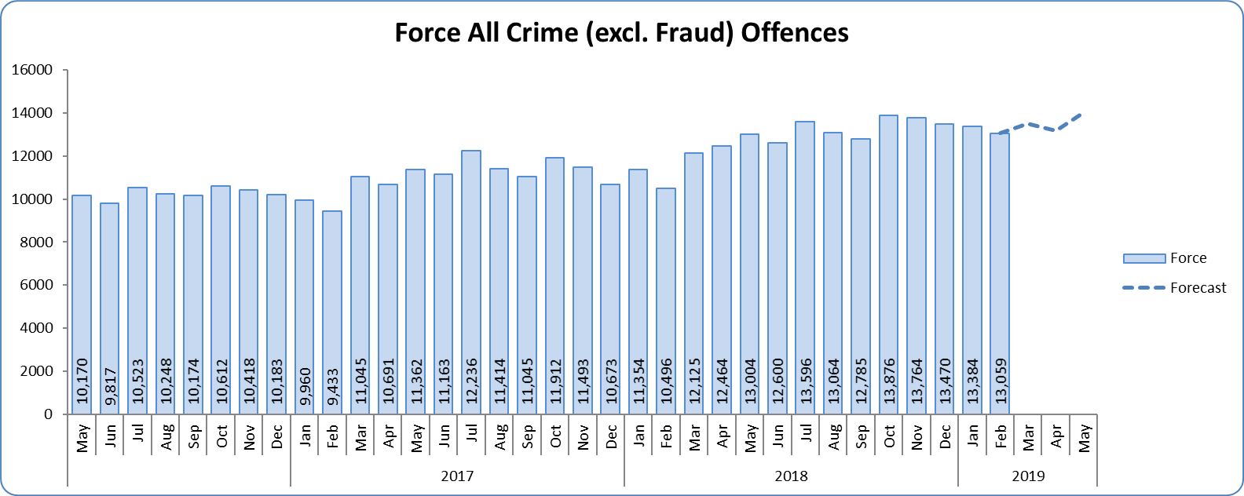
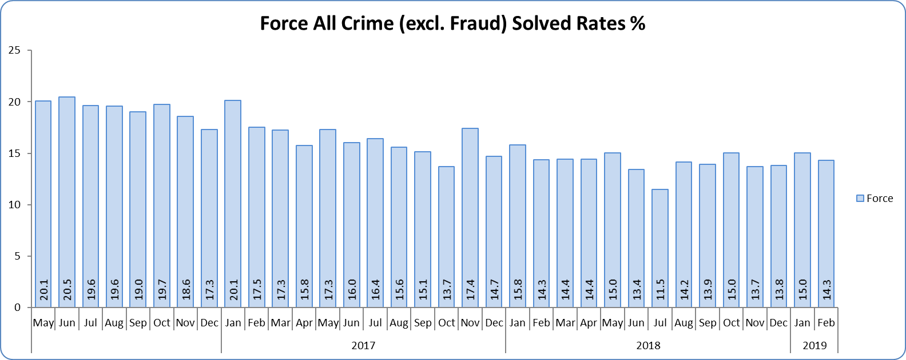
Monthly Performance Overview
Key Areas
All Crime
17.0% increase (22,604 additional offences) compared to the 12 months to February 2018⁺. The national increase~ was 8.5%.
Essex is 8th in its Most Similar Group of forces (MSG) and 26th nationally for crimes per 1,000 of the population. Essex is 8th (out of eight) in its MSG, and is 33rd nationally* for crime increase. Increases seen in 34 out of 42 forces.
No districts experienced a statistically significant increase in February 2019. Neither did the Force.
The forecast^ is that the All Crime level will be higher than that experienced in the same months in previous years. None of the next three months are forecast to be statistical exceptions.
All Crime Solved Rate
1.6% point decrease (to 14.7%) compared to the 12 months to February 2018 ⁺⁺.
The number of crimes solved increased: by 5.5% (1,184 more solved outcomes to 22,874) compared to the 12 months to February 2018.
Essex has the 4th highest solved rate in its MSG and is 20th nationally for its solved rate. Essex is 6th in its MSG and 16th nationally for solved rate % point change.
No districts experienced a statistically significant change in February 2019. Neither did the Force.
Figure 1 – Offences by month
Figure 2 – Solved rate by month
⁺ All crime increases/decreases shown are for 12 months to February 2019 compared to the same period to February 2018.
⁺⁺ Solved rate increases/decreases are for 12 months to February 2019 compared to the same period to February 2018. The quoted solved rate is for 12 months to February 2019.
* 1st is considered best performing, and 42nd worst.
~ The national increase (where the category is available) relates to the 12 months to September 2018 vs. 12 months to September 2017 and are the official Home Office figures.
^ Forward projection based on “Time Series Forecasting” method, which takes into account seasonality (when the data follows a statistically consistent pattern).

Slide 4
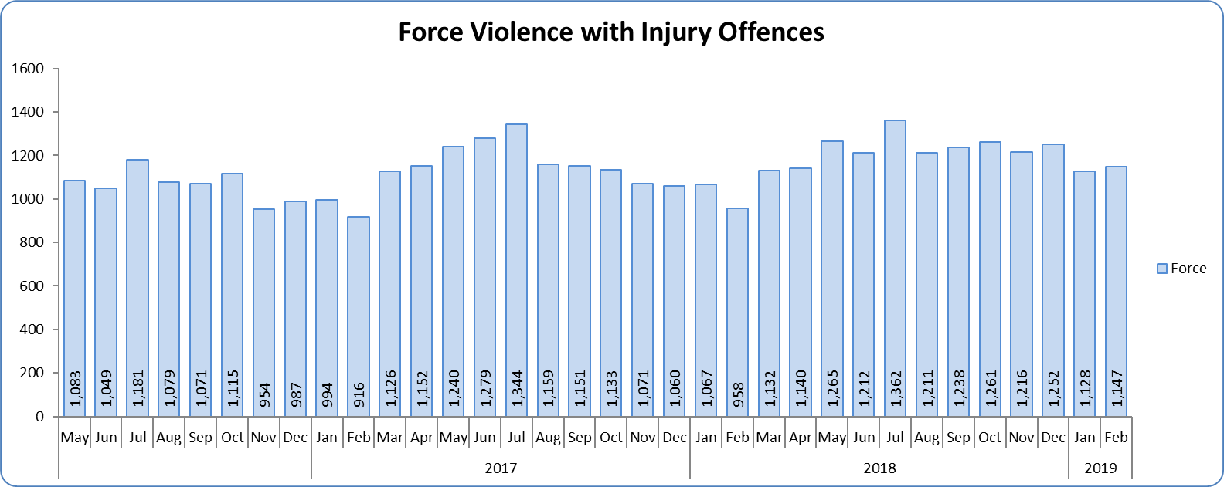
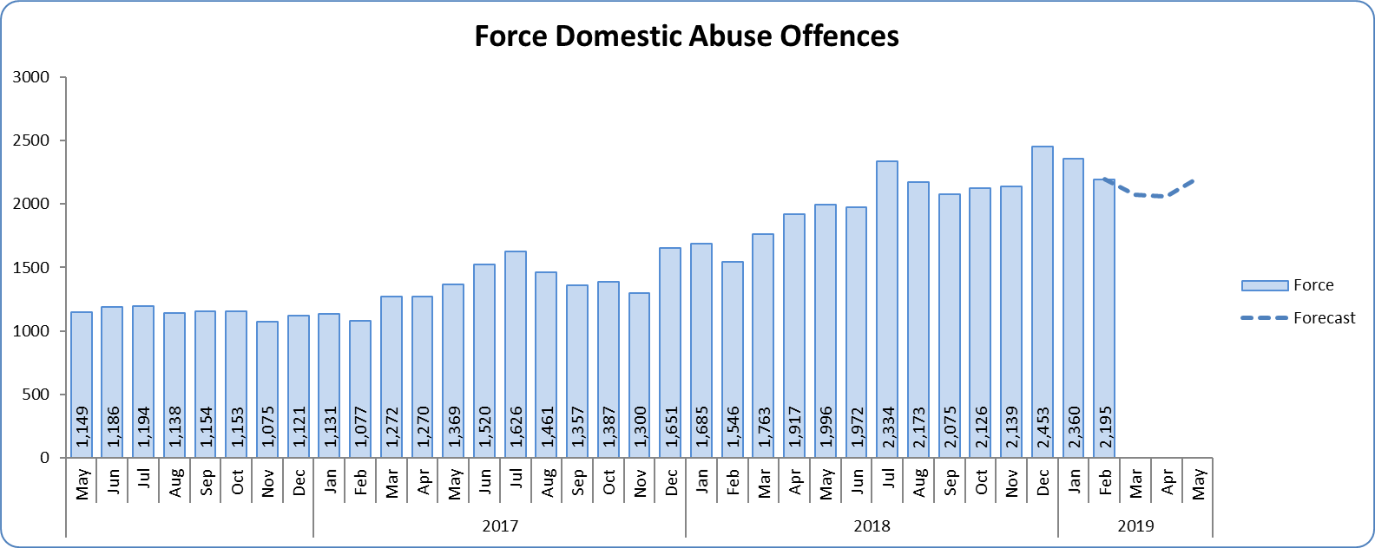
Monthly Performance Overview
Violence with Injury*
6.3% increase (866 additional offences) compared to the 12 months to February 2018. The national increase was 7.9%.
Essex is 4th in its MSG and 14th nationally for crimes per 1,000 of the population. Essex is 6th in its MSG and 19th nationally for crime increase.
Increases seen in 32 out of 42 forces.
83.4% of Violence with Injury is Actual Bodily Harm (ABH). By volume, ABH rose by 6.4% (732 additional offences).
84.5% of the increase in Violence with Injury is due to the rise in ABH.
33.4% of Violence with Injury is Domestic Abuse-related.
No districts experienced a statistically significant increase in February 2019. Neither did the Force.
There is no statistically consistent pattern for Violence with Injury offences. Forecasts cannot therefore be provided.
Domestic Abuse
46.3% increase (8,023 additional offences) compared to the 12 months to February 2018. This increase is being driven by the changes in the counting rules relating to Stalking & Harassment.
There are no national or MSG comparisons on iQuanta** for Domestic Abuse.
Two districts experienced statistically significant increases in February 2019. The Force did not.
High Risk Domestic Abuse 21.0% increase (424 additional offences).
Medium Risk Domestic Abuse 7.4% increase (328 additional offences).
Standard Risk Domestic Abuse 59.7% increase (6,153 additional offences).
The forecast is that Domestic Abuse Offences will be higher than that experienced in the same months in previous years.
Figure 3 - Offences by month
Figure 4 - Offences by month
* Offences included within the Violence with Injury classification changed in November 2017. Offences involving “Death or Serious Injury – Unlawful Driving” have now been removed and are in a separate category. Please note iQuanta related positions still relate to the former definition.
** A web-based service provided for the use of Police forces, Community Safety Partnerships (CSPs) and Her Majesty’s Inspectorate of Constabulary and Fire & Rescue Service (HMICFRS).

Slide 5
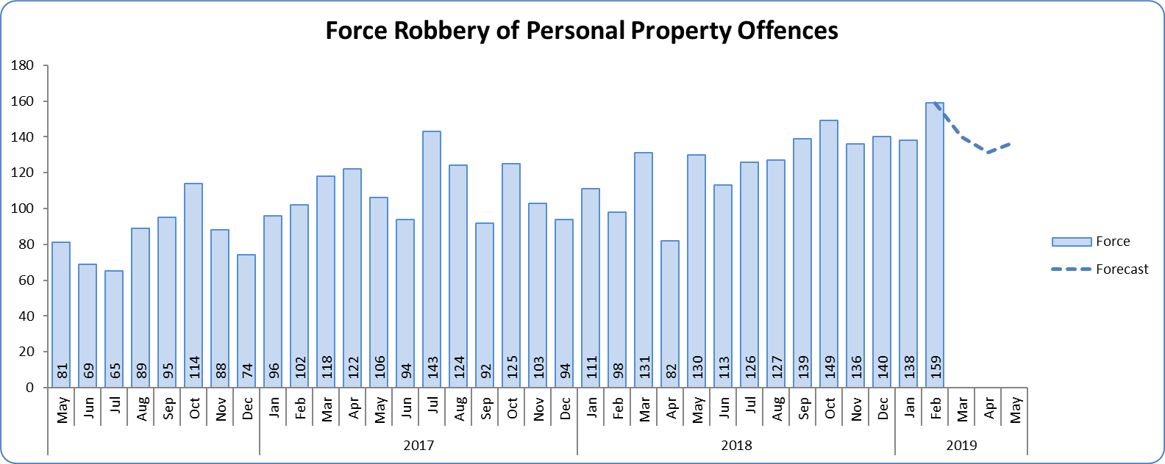
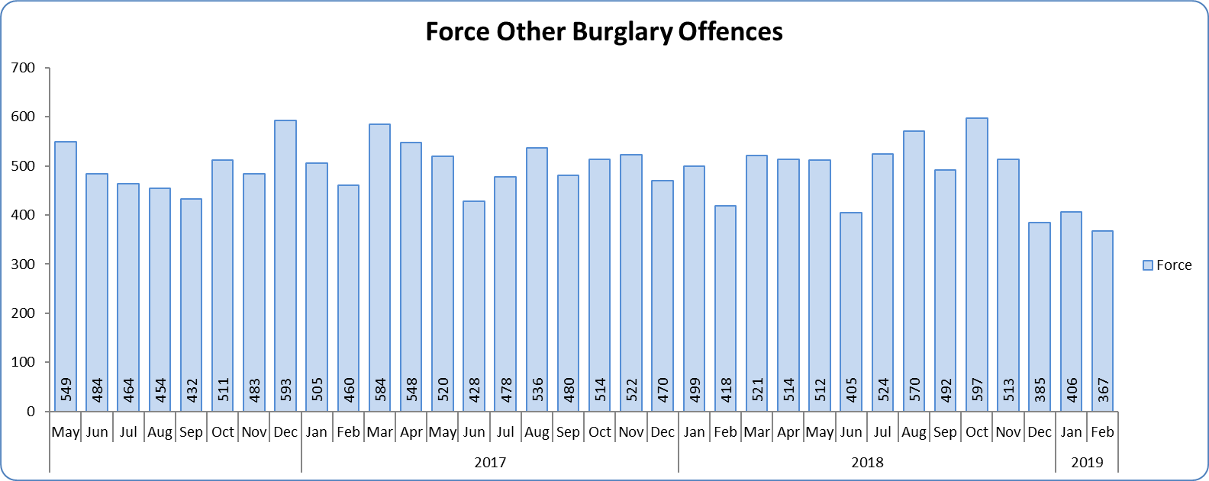
Monthly Performance Overview
Statistical Exceptions – Offences
Robbery of Personal Property Offences
The Force and three districts experienced a statistically significant increase in February 2019.
18.2% increase (240 offences) compared to the 12 months to February 2018.
Essex is 7th in its MSG and 28th nationally for crimes per 1,000 of the population. Essex is 4th in its MSG and 16th nationally for crime increase.
Increases seen in 38 out of 42 forces.
The forecast is that Robbery of Personal Property offences will be higher than that experienced in the same months in previous years. None of the next three months are forecast to be statistical exceptions.
Figure 5 - Offences by month
Burglary Other
The Force experienced a statistically significant decrease in February 2019. No districts experienced a statistically significant decrease.
2.5% decrease (146 fewer offences) compared to the 12 months to February 2018.
There are no national or MSG comparisons on iQuanta for Burglary Other.
There is no statistically consistent pattern for Burglary Other offences. Forecasts cannot therefore be provided.
Figure 6 - Offences by month

Slide 6
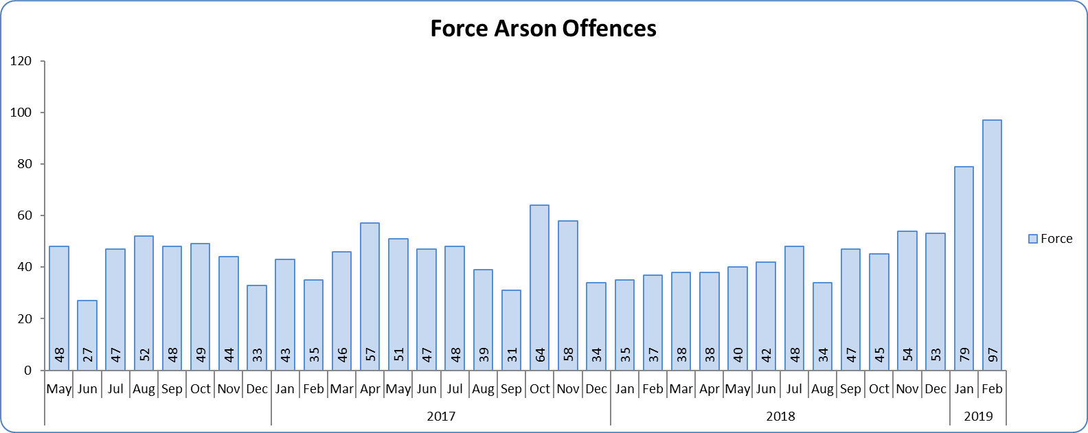
Monthly Performance Overview
Arson Offences
The Force and four districts experienced a statistically significant increase in February 2019.
11.7% increase (64 offences) compared to the 12 months to February 2018.
Essex is 3rd in its MSG and 10th nationally for crimes per 1,000 of the population. Essex is 6th in its MSG and 27th nationally for crime increase.
Increases seen in 16 out of 42 forces.
There is no statistically consistent pattern for Arson. Forecasts cannot therefore be provided.
From September 2018, the Fire and Rescue Service changed the method of reporting fires to the police to on-line reporting.
Figure 7 - Offences by month

Slide 7
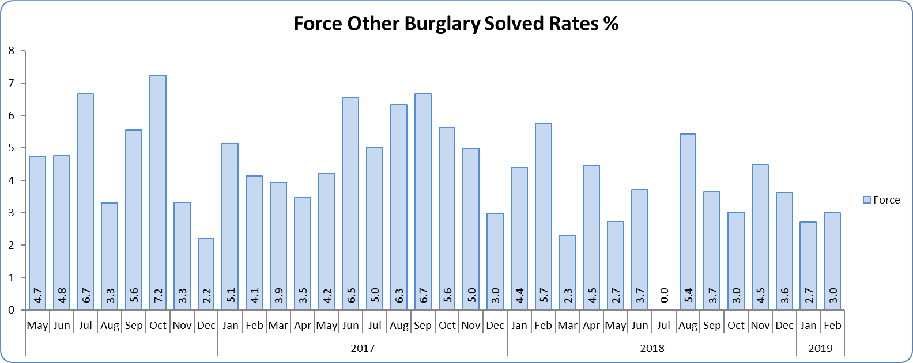
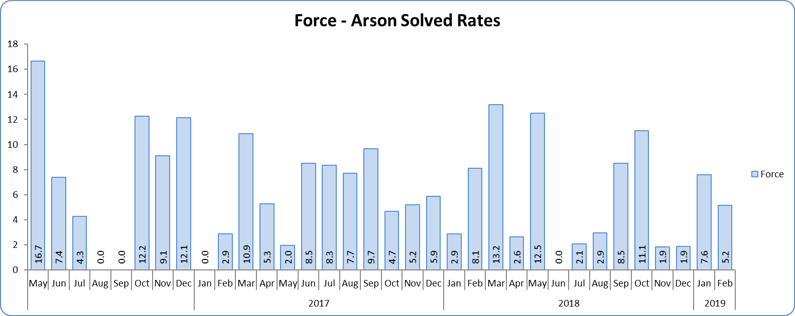
Monthly Performance Overview
Solved Rates by Exception
Burglary Other
Solved rate remains below 10% (at 4.6%).
The number of crimes solved decreased: by 17.3% (56 fewer to 267 solved outcomes) compared to the 12 months to February 2018.
There are no national or MSG comparisons on iQuanta Burglary Other solved rates.
One district experienced a statistically significant change in February 2019. The Force did not.
Figure 8 - Solved rate by month
Arson Solved Rate
Solved rate remains below 10% (at 6.0%).
The number of crimes solved remained at 37 for both rolling years.
Essex is 6th in its MSG and 24th nationally for solved rate. Essex is 5th in its MSG and 25th nationally for solved rate % point change.
The Force did not experience a statistically significant change in February 2019.
Figure 9 - Solved rate by month

Slide 8
2016-2020 Police and Crime Plan Performance Indicators
Table 1
See Appendix for endnotes.
Below is an explanation as to why certain indicators are considered to be improving or deteriorating:
Priority 1 – Number of all crime offences. Performance is considered to be deteriorating due to the rise in crime. No data are available to indicate how much of this rise is attributable to better crime data integrity. An increase in crime has been experienced in every UK police force .
Priority 3 - Number of incidents of domestic abuse. Performance is considered to be deteriorating due to the rise in incidents. No data are available to indicate whether this rise is attributable to media campaigns or initiatives that encourage reporting.
Priority 5 - Number of arrests in relation to the trafficking of drugs. Drug trafficking arrests are dependent on pro-active policing. This may include pre-planned operations conducted as a result of intelligence reports received, positive search warrants of residences/premises, and positive searches of individuals.
Priority 7 - Number of driving related mobile phone crime on Essex roads. This is considered to be deteriorating as there has been a noticeable increase in the number of drivers stopped whilst using a mobile phone at the wheel.
Priority 7 - Number of driving under the influence of drink and/or drugs on Essex roads. Operational Policing Command (OPC) have stated that a reduction indicates the public are adhering to the strong educational messages being delivered by drink/driving campaigns. Collisions attended by the police involve routine breath-testing of involved parties. An increase could also demonstrate proactive policing.

Slide 9
Appendix
¹ Results are for the period 12 months to September 2018. Essex Police performed significantly above the results for the local confidence question contained in the PFCC’s Plan for Q1 and Q2. This difference could not be explained and consequently an additional question was added in Q3 with the exact wording used in the CSEW. This is the question now being used.
² The confidence interval is the range +/- between where the survey result may lie. This is mainly influenced by the number of people answering the survey. The more people that answer the survey, the smaller the interval range.
³ Crime Survey for England and Wales (CSEW): 12 months to September 2018 vs. 12 months to September 2017.
⁴ Results are for the period 12 months to September 2018 versus the same period the previous year (based on Essex Police’s own survey).
⁵ Activity is now recorded rather than the number of people arrested. If there was a day of action, for example, and five people were arrested, this would formerly have counted as five disruptions, but now will count as one. The change stems from confusion over the previous guidelines, with police forces counting disruptions in different ways. The numbers of disruptions now being recorded will consequently be substantially lower. There was a slight change in the definition again in January 2019; data provided is therefore for January to February 2019.
⁶ Solved outcomes are crimes that result in: charge or summons, caution, crimes taken into consideration, fixed penalty notice, cannabis warning or community resolution.
⁷ ‘Killed or Seriously Injured’ refers to all people killed or seriously injured on Essex’s roads, regardless of whether any criminal offences were committed. ‘Causing Death/Serious Injury by Dangerous/Inconsiderate Driving’, however, refers to the number of crimes of this type. No data is available due to the national system being redesigned.

Slide 10
Crime Tree Data – Rolling 12 Months to February
Table 2

Slide 11
Crime Tree Data – Rolling 12 Months to February
Table 3

Slide 12
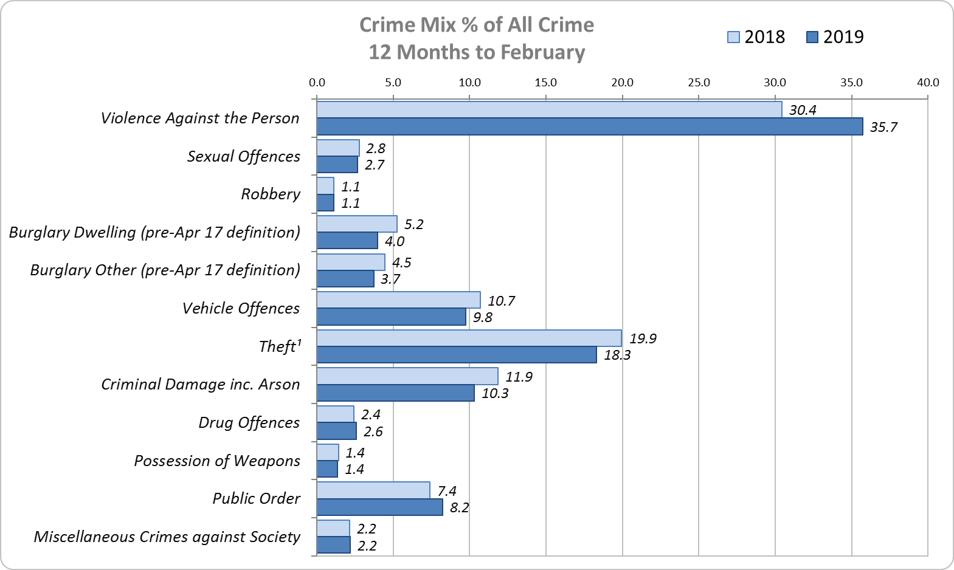
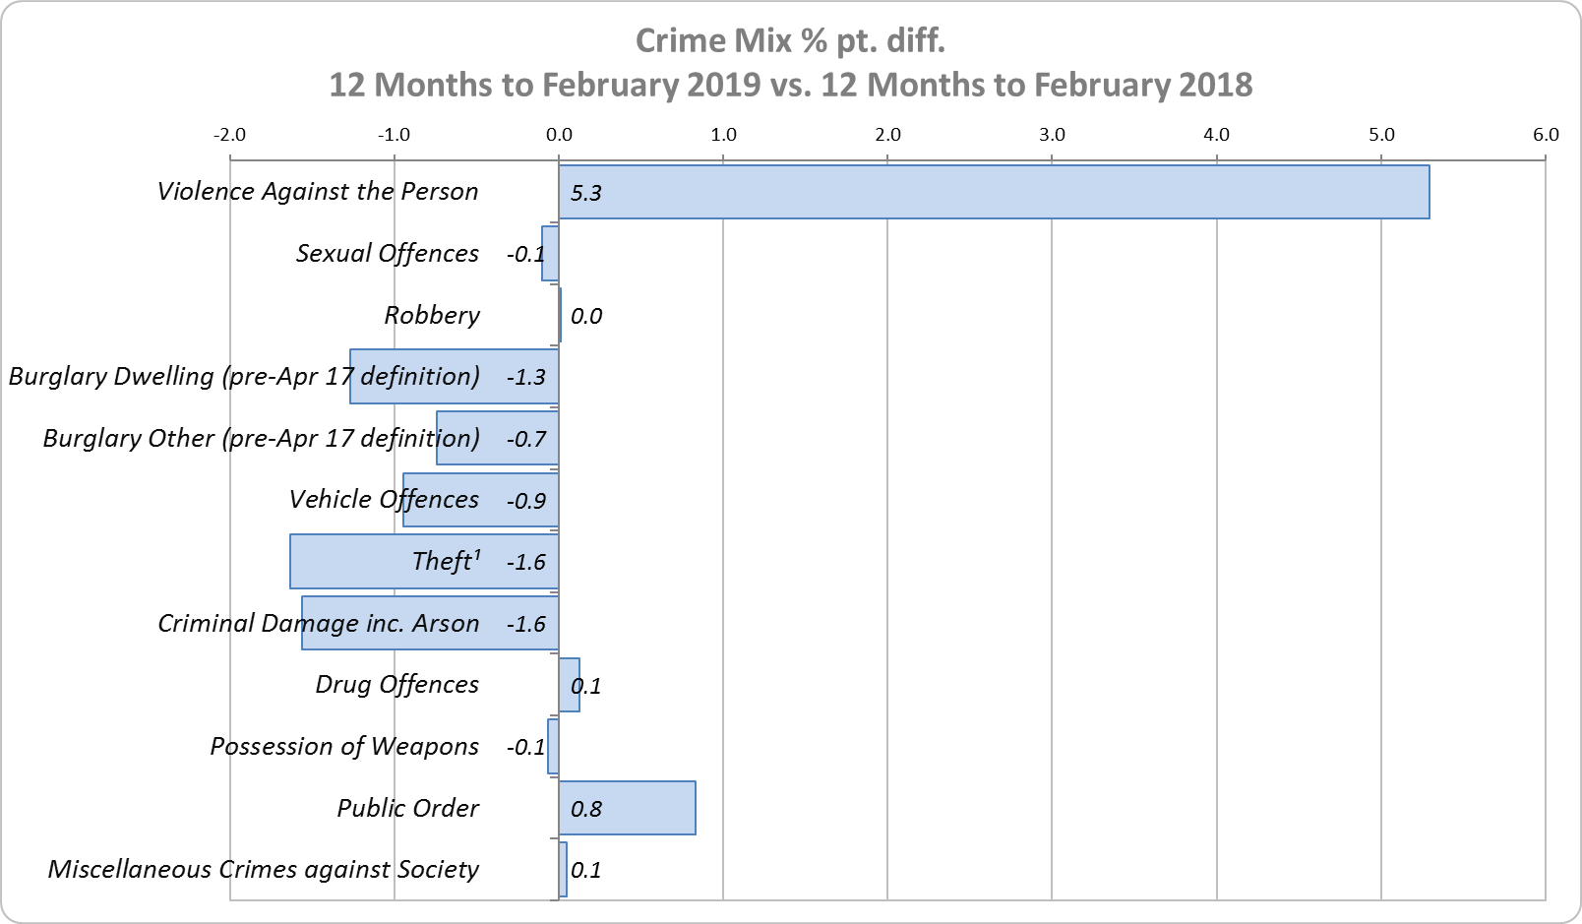
Crime Mix – Rolling 12 Months to February 2018 vs. 2019
Figure 10
Figure 11
Violence Against the Person saw a 5.3% point increase in the proportion of all crime; it also experienced the biggest volume rise (15,130 additional offences). This is being primarily driven by the increase in Stalking and Harassment.
Public Order Offences saw a 0.8% point increase in the proportion of all crime, and experienced the second biggest volume rise (2,974 additional offences).
16.3% of crime is Domestic Abuse-related; this proportion has increased from 16.1% for 12m to January 2019. Domestic Abuse-related Violence Against the Person decreased slightly to 35.9% from 36.0% 12m January 2019. As above, this increase is being driven by the increase in Stalking and Harassment.

