Slide 1
Police and Crime Plan 2016-2020
Monthly Performance Update
January 2019
National and MSG positions are to 31st December 2018 (Essex Police data are to 31st January 2019).
Version 1.3
Produced February 2019
Performance Analysis Unit, Essex Police
Sensitivity: Official

Slide 2
Executive Summary
All Crime has risen by 15.7%. Domestic Abuse (DA) has risen by 45.9%. The increase in both can, in part, be attributed to the increase seen in Stalking and Harassment (which was a statistical exception this month) following changes to the Home Office Counting Rules. Other analysis conducted by Essex Police furthermore indicates that better Crime Data Accuracy (CDA), as well as a genuine increase in crime, are also likely to be contributing factors to this rise.
The All Crime solved rate continues to decline due to an increase in the number of crimes. However, there has been a 3.1% (666 more) increase in the number of crimes considered ‘solved’.
In January 2019 three crime types experienced statistically significant changes:
Stalking and Harassment Offences: statistical increase. This rise has primarily been driven by the change in the means by which Stalking & Harassment has been recorded since April 2018. As now both the most serious offence and the Stalking & Harassment are recorded (rather than purely the most serious), there have been consequent increases in other categories of offences; this includes the Violence without Injury category.
Arson Offences: statistical increase. Of the 79 offences seen in January 2019, 70 were for ‘Arson not endangering life’.
Possession of Drug Offences: statistical increase. This can be seen as a result of proactive policing.
There has been a change in the way in which the number of Organised Criminal Group (OCG) disruptions are counted in Essex. This follows guidance issued by the National Crime Agency (NCA) and the Eastern Region Special Operations Unit (ERSOU) to ensure that all forces record disruptions in the same way. This measure changed again in January 2019. As a consequence, comparisons to previous data periods have not been provided.

Slide 3
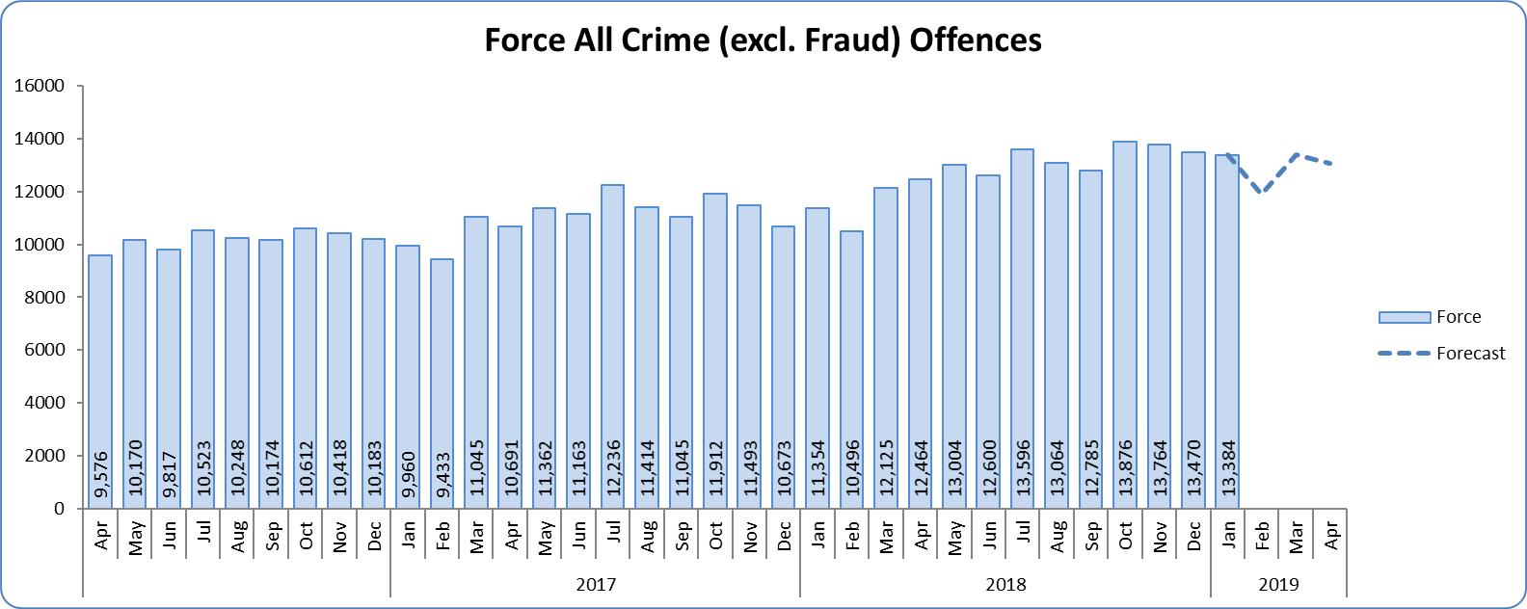
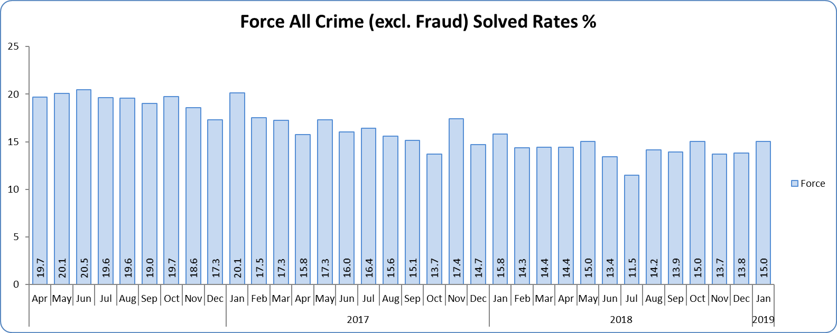
Monthly Performance Overview
Key Areas
All Crime
15.7% increase (20,847 additional offences) compared to the 12 months to January 2018⁺. The national increase~ was 8.5%.
Essex is 8th in its Most Similar Group of forces (MSG) and 25th nationally for crimes per 1,000 of the population. Essex is 8th (out of eight) in its MSG, and is 34th nationally* for crime increase. Increases seen in 34 out of 42 forces.
One out of 14 districts experienced a statistically significant increase in January 2019. The Force did not.
The forecast^ is that the All Crime level will be higher than that experienced in the same months in previous years. None of the next three months are forecasted to be statistical exceptions.
All Crime Solved Rate
1.8% point decrease (to 14.7%) compared to the 12 months to January 2018 ⁺⁺.
The number of crimes solved increased: by 3.1% (666 more solved outcomes to 22,490) compared to the 12 months to January 2018.
Essex has the 4th highest solved rate in its MSG and is 21st nationally for its solved rate. Essex is 6th in its MSG and 16th nationally for solved rate % point change.
No district experienced a statistically significant change in January 2019. Neither did the Force.
Figure 1 – Offences by month
Figure 2 – Solved rate by month
⁺ All crime increases/decreases shown are for 12 months to January 2019 compared to the same period to January 2018.
⁺⁺ Solved rate increases/decreases are for 12 months to January 2019 compared to the same period to January 2018. The quoted solved rate is for 12 months to January 2019.
* 1st is considered best performing, and 42nd worst.
~ The national increase (where the category is available) relates to the 12 months to September 2018 vs. 12 months to September 2017 and are the official Home Office figures.
^ Forward projection based on “Time Series Forecasting” method, which takes into account seasonality (when the data follows a statistically consistent pattern).

Slide 4
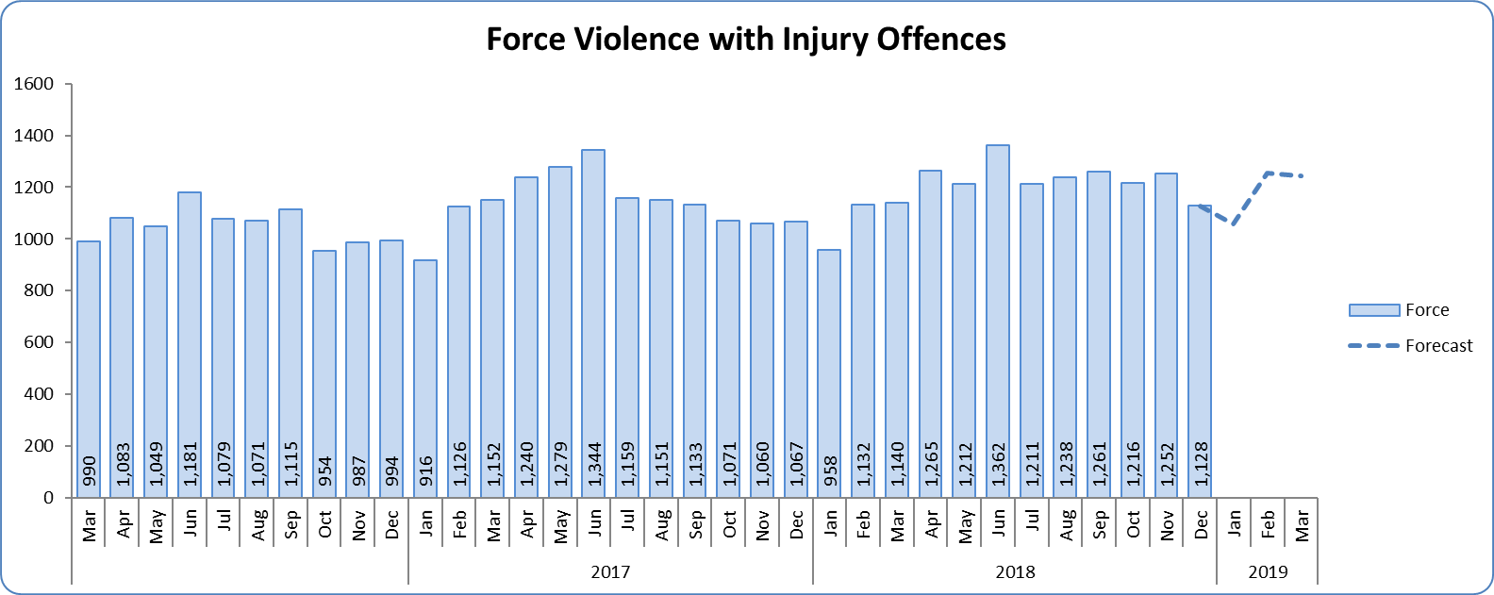
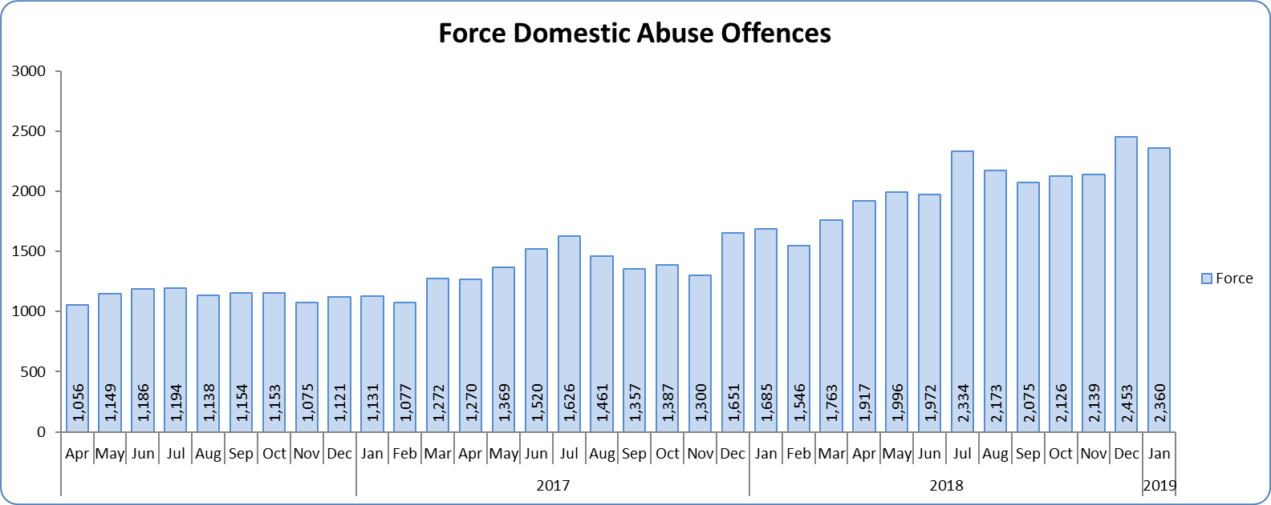
Monthly Performance Overview
Violence with Injury*
5.1% increase (701 additional offences) compared to the 12 months to January 2018. The national increase was 7.9%.
Essex is 4th in its MSG and 15th nationally for crimes per 1,000 of the population. Essex is 6th in its MSG and 20th nationally for crime increase.
Increases seen in 36 out of 42 forces.
83.6% of Violence with Injury is Actual Bodily Harm (ABH). By volume, ABH rose by 5.4% (619 additional offences).
88.3% of the increase in Violence with Injury is due to the rise in ABH.
33.3% of Violence with Injury is Domestic Abuse-related.
One district experienced a statistically significant increase in January 2019. The force did not.
The forecast is that none of the next three months will be statistical exceptions.
Domestic Abuse
45.9% increase (7,764 additional offences) compared to the 12 months to January 2018. This is being driven by the changes in the counting rules relating to Stalking & Harassment.
There are no national or MSG comparisons on iQuanta** for Domestic Abuse.
Five districts experienced statistically significant increases in January 2019. The force did not.
High Risk Domestic Abuse 20.3% increase (405 additional offences).
Medium Risk Domestic Abuse 7.2% increase (318 additional offences).
Standard Risk Domestic Abuse 59.4% increase (5,931 additional offences).
There is no statistically consistent pattern for Domestic Abuse. Forecasts cannot therefore be provided.
Figure 3 - Offences by month
Figure 4 - Offences by month
* Offences included within the Violence with Injury classification changed in November 2017. Offences involving “Death or Serious Injury – Unlawful Driving” have now been removed and are in a separate category. Please note iQuanta related positions still relate to the former definition.
** A web-based service provided for the use of Police forces, Community Safety Partnerships (CSPs) and Her Majesty’s Inspectorate of Constabulary and Fire & Rescue Service (HMICFRS).

Slide 5
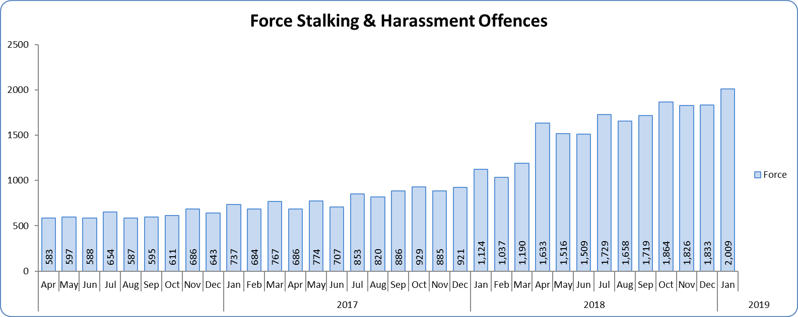
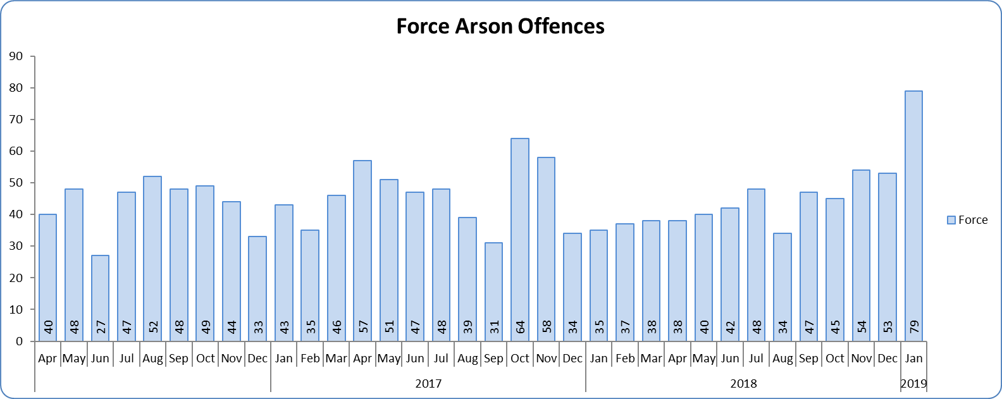
Monthly Performance Overview
Statistical Exceptions – Offences
Stalking and Harassment Offences
The Force and seven districts experienced statistically significant increases in January 2019.
91.4% increase (9,095 offences) compared to the 12 months to January 2018. The national increase was 41.3%.
From April 2018, forces began to record both the Harassment and the most serious additional crime, whereas when someone previously committed a Harassment type offence and another offence (such as ABH) we recorded just the other offence, not the Harassment.
Separate analysis also indicates that there has also been a genuine increase in crime. More incidents of harassment that result in a crime being created have been reported to the Force Control Room.
Essex is 8th in its MSG and 34th nationally for crimes per 1,000 of the population. Essex is 7th in its MSG and 32nd nationally for crime increase. Increases seen in all 42 forces.
35.7% of offences were Domestic Abuse-related.
There is no statistically consistent pattern for Stalking and Harassment due to the sudden increase in recording from April 2018. Forecasts cannot therefore be provided.
Figure 5 - Offences by month
Figure 6 - Offences by month
Arson Offences
The Force and four districts experienced a statistically significant increase in January 2019.
1.3% increase (7 offences) compared to the 12 months to January 2018.
Essex is 2nd in its MSG and 8th nationally for crimes per 1,000 of the population. Essex is 3rd in its MSG and 17th nationally for crime increase.
Increases seen in 14 out of 42 forces.
There is no statistically consistent pattern for Arson. Forecasts cannot therefore be provided.

Slide 6
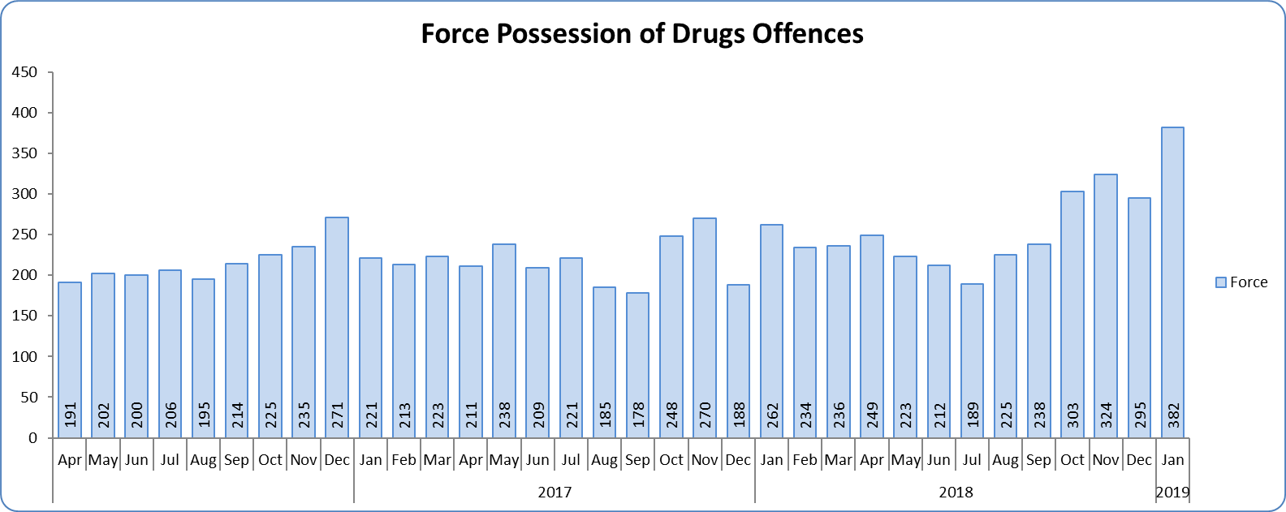
Monthly Performance Overview
Possession of Drugs Offences
The Force and six districts experienced a statistically significant increase in January 2019.
19.4% increase (512 offences) compared to the 12 months to January 2018.
Essex is 6th in its MSG and 25th nationally for crimes per 1,000 of the population. Essex is 7th in its MSG and 31st nationally for crime increase.
Increases seen in 31 out of 42 forces.
There is no statistically consistent pattern for Possession of Drugs Offences (which is also primarily generated by police proactivity). Forecasts cannot therefore be provided.
Figure 7 - Offences by month

Slide 7
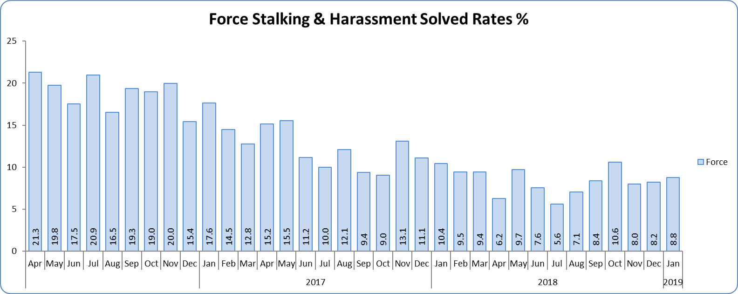
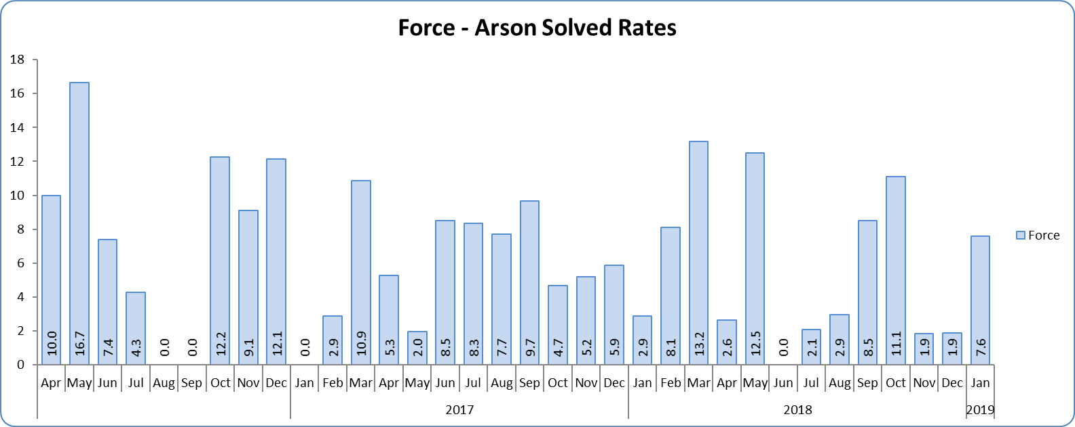
Monthly Performance Overview
Solved Rates by Exception
Stalking and Harassment Solved Rate
Solved rate remains below 10% (at 8.8%).
The number of crimes solved increased: by 41.5% (494 more to 1,683 solved outcomes) compared to the 12 months to January 2018.
There are no national or MSG comparisons on iQuanta** for Stalking and Harassment solved rates.
Neither the Force nor any of the districts experienced a statistically significant change in January 2019.
Figure 8 - Solved rate by month
Figure 9 - Solved rate by month
Arson Solved Rate
Solved rate remains below 10% (at 6.3%).
The number of crimes solved remained at 35 for both rolling years.
Essex is 7th in its MSG and 27th nationally for solved rate. Essex is 3rd in its MSG and 18th nationally for solved rate % point change.
The Force did not experience a statistically significant change in January 2019.

Slide 8
2016-2020 Police and Crime Plan Performance Indicators
Table 1
See Appendix for endnotes.
Below is an explanation as to why certain indicators are considered to be improving or deteriorating:
Priority 1 – Number of all crime offences. Performance is considered to be deteriorating due to the rise in crime. No data are available to indicate how much of this rise is attributable to better crime data integrity. An increase in crime has been experienced in every UK police force .
Priority 3 - Number of incidents of domestic abuse. Performance is considered to be deteriorating due to the rise in incidents. No data are available to indicate whether this rise is attributable to media campaigns or initiatives that encourage reporting.
Priority 5 - Number of arrests in relation to the trafficking of drugs. Drug trafficking arrests are dependent on pro-active policing. This may include pre-planned operations conducted as a result of intelligence reports received, positive search warrants of residences/premises, and positive searches of individuals.
Priority 7 - Number of driving related mobile phone crime on Essex roads. This is considered to be deteriorating as there has been a noticeable increase in the number of drivers stopped whilst using a mobile phone at the wheel.
Priority 7 - Number of driving under the influence of drink and/or drugs on Essex roads. Operational Policing Command (OPC) have stated that a reduction indicates the public are adhering to the strong educational messages being delivered by drink/driving campaigns. Collisions attended by the police involve routine breath-testing of involved parties. An increase could also demonstrate proactive policing.

Slide 9
Appendix
¹ Results are for the period October 2017 to June 2018. Essex Police performed significantly above the results for the local confidence question contained in the PFCC’s Plan for Q1 and Q2. This difference could not be explained and consequently an additional question was added in Q3 with the exact wording used in the CSEW. This is the question now being used.
² The confidence interval is the range +/- between where the survey result may lie. This is mainly influenced by the number of people answering the survey. The more people that answer the survey, the smaller the interval range.
³ Crime Survey for England and Wales (CSEW): 12 months to September 2018 vs. 12 months to September 2017.
⁴ Results are for the period October 2017 to September 2018 (based on Essex Police’s own survey).
⁵ Activity is now recorded rather than the number of people arrested. If there was a day of action, for example, and five people were arrested, this would formerly have counted as five disruptions, but now will count as one. The change stems from confusion over the previous guidelines, with police forces counting disruptions in different ways. The numbers of disruptions now being recorded will consequently be substantially lower. There was a slight change in the definition again in January 2019; data provided is therefore for January 2019 only.
⁶ Solved outcomes are crimes that result in: charge or summons, caution, crimes taken into consideration, fixed penalty notice, cannabis warning or community resolution.
⁷ ‘Killed or Seriously Injured’ refers to all people killed or seriously injured on Essex’s roads, regardless of whether any criminal offences were committed. ‘Causing Death/Serious Injury by Dangerous/Inconsiderate Driving’, however, refers to the number of crimes of this type. No data is available due to the national system being redesigned.

Slide 10
Future Assessments
Essex Police use the “Balanced Scorecard” strategic performance management framework to self-assess its performance; it also maps these assessments against the Police and Crime Plan priorities. This uses the grading categories adopted by Her Majesty's Inspectorate of Constabulary and Fire & Rescue Services (HMICFRS), Ofsted and the Care Quality Commission (CQC): ‘Outstanding’; ‘Good’; ‘Requires Improvement’; and ‘Inadequate’.
Where possible, Essex Police benchmarks its performance against data recorded by other forces in its Most Similar Group (MSG). By standardising the results, for example by looking at the average number of offences recorded per 1,000 population in this MSG, Essex Police is able to derive minimum standards; it can consequently assess what is ‘Good’ (if its performance is above average).
From April 2019, this same methodology will be applied to assess Essex Police’s performance against the Police and Crime Plan. The same HMICFRS grading names will also be used. This process will replace the “Direction of Travel” column in future Monthly Performance Update reports.

Slide 11
Crime Tree Data – Rolling 12 Months to January
Table 2

Slide 12
Crime Tree Data – Rolling 12 Months to January
Table 3

Slide 13
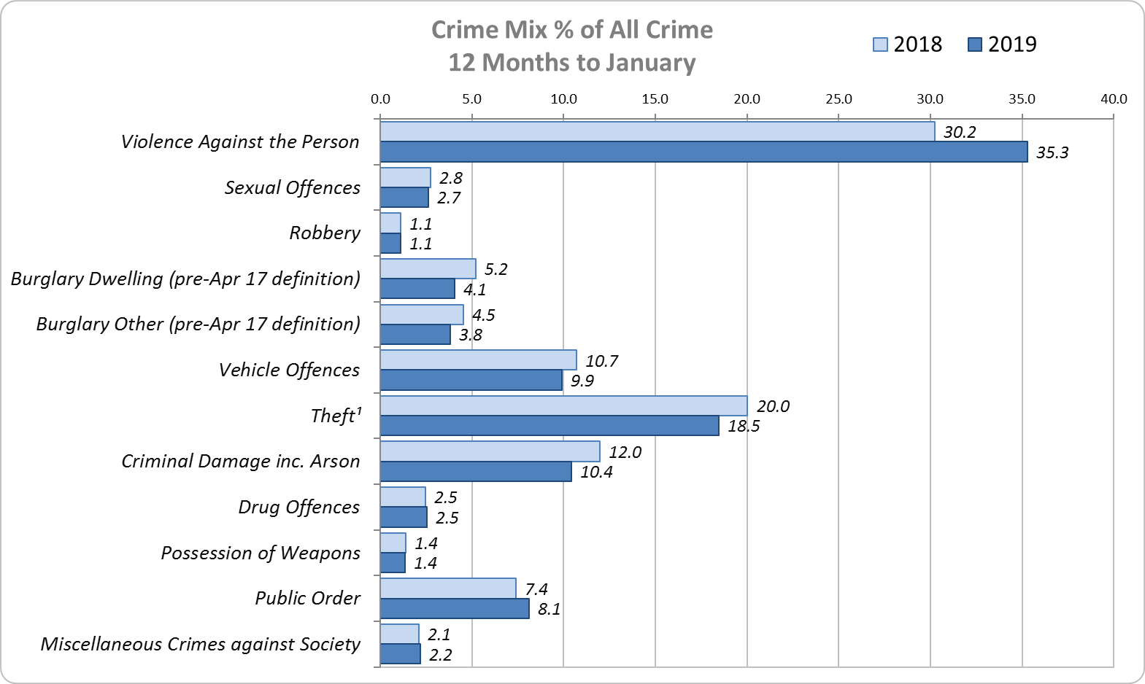
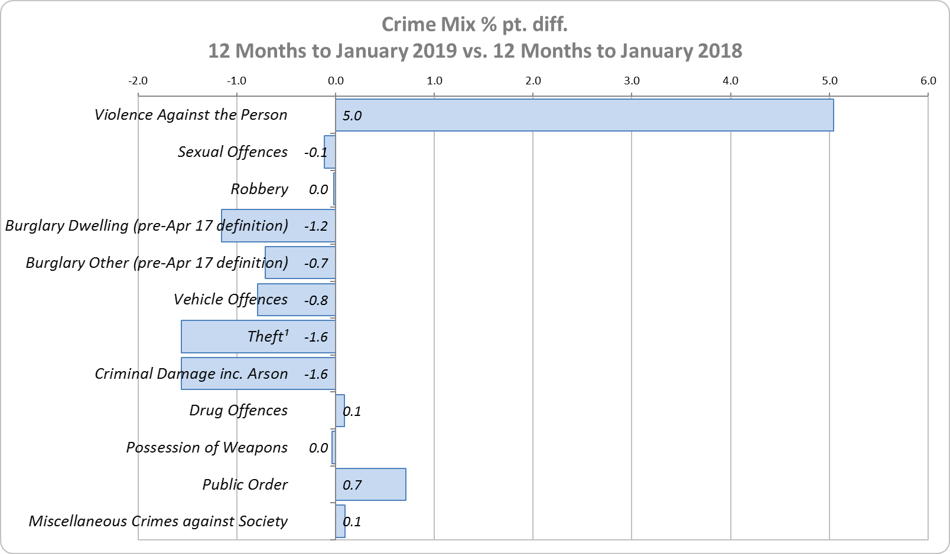
Crime Mix – Rolling 12 Months to January 2018 vs. 2019
Figure 10
Figure 11
Violence Against the Person saw a 5.0% point increase in the proportion of all crime; it also experienced the biggest volume rise (14,032 further offences). This is being primarily driven by the increase in Stalking and Harassment (see p.5 for further detail).
Public Order Offences saw a 0.7% point increase in the proportion of all crime, and experienced the second biggest volume rise (2,636 offences).
16.1% of crime is Domestic Abuse-related; this proportion has increased from 15.9% for 12m to December 2018. Domestic Abuse-related Violence Against the Person increased to 36.0% from 35.9% 12m December 2018. As above, this increase is being driven by the increase in Stalking and Harassment.

