Slide 1
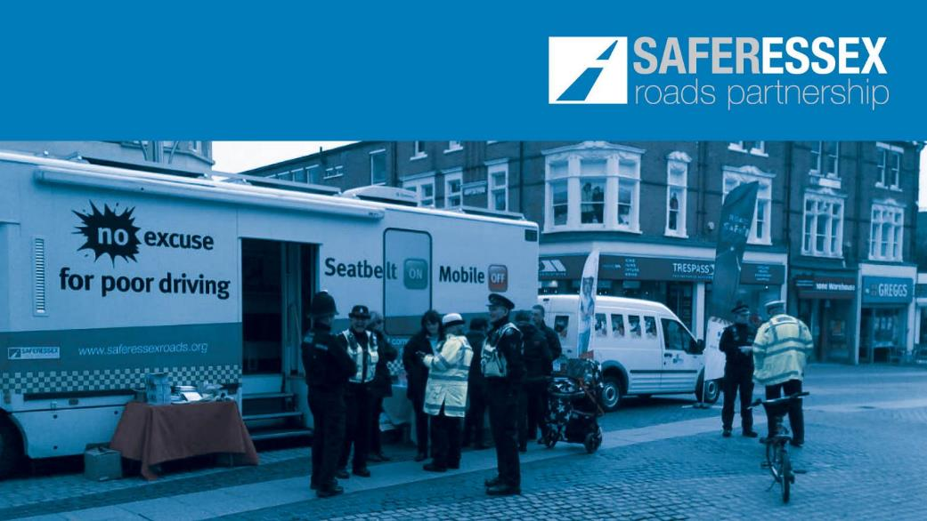
Casualty Reduction Tasking Briefing
January 2019

Slide 2
Routes
Classified roads showing the largest increase in all casualties, compared to the previous 5 year average.
The routes below have seen an increase in injury-collisions for the period October to December 2018, compared to the average for the same period over the previous 5 years.
The routes below have seen an increase in injury-collisions during January compared to the October to December monthly average over the previous 5 years:

Slide 3
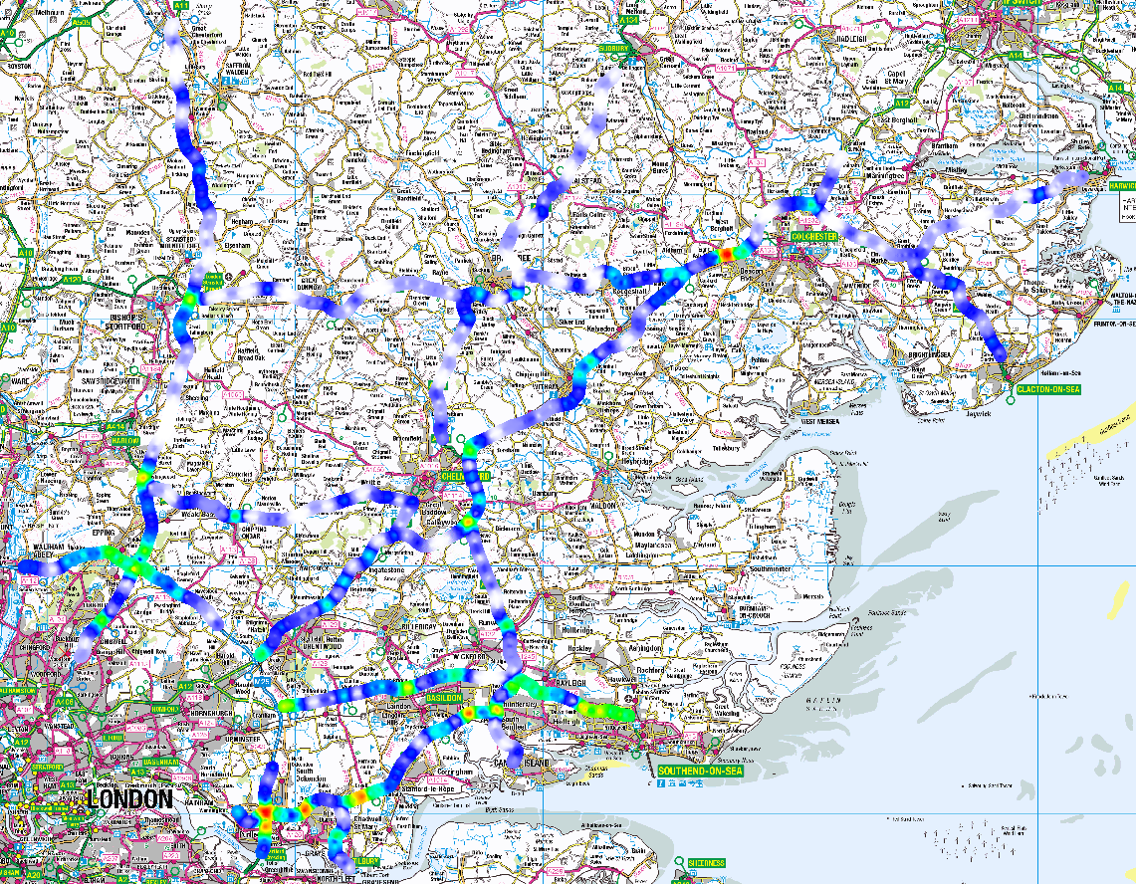
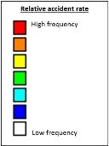
Major Routes
Major roads showing sections with highest collision frequency, last 12 months.
Highlighted sections:
M11 Birchanger
M11 / M25 Junction
M25 / A13 - DRC to A1089
A127 & A13 Basildon
A127 - A130 to Southend
A12 Marks Tey

Slide 4
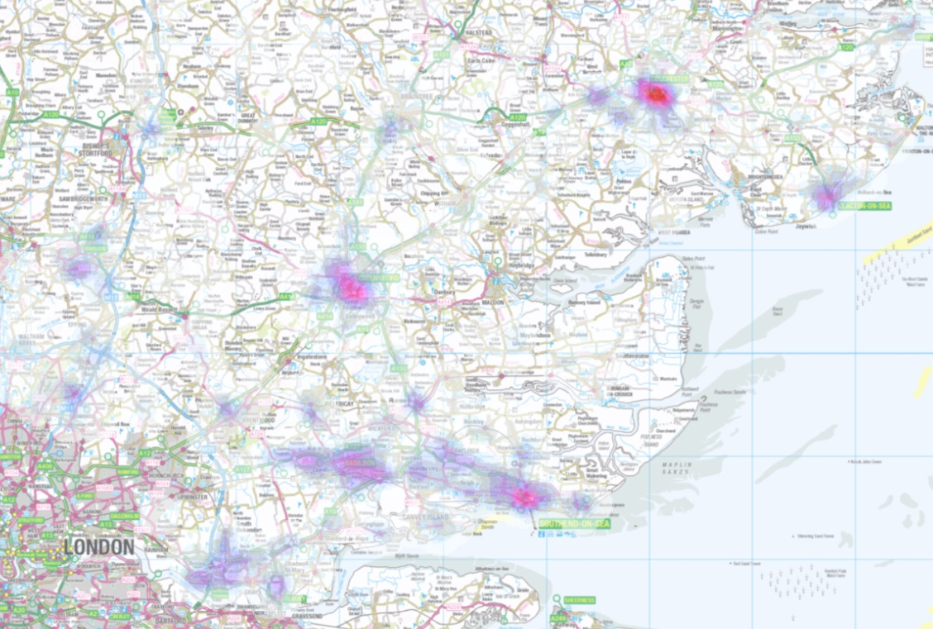
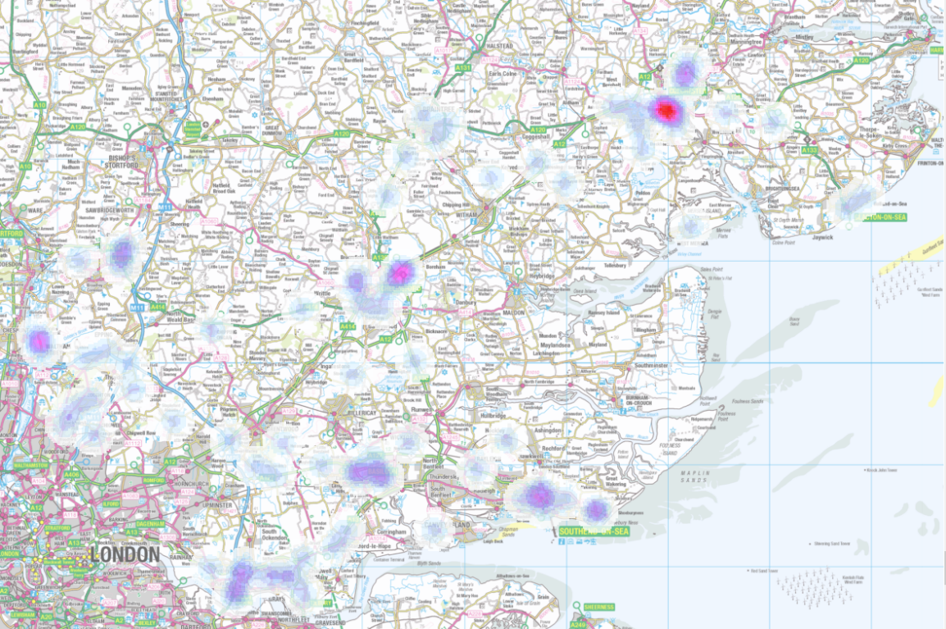
P2W (motorcycle) collision hotspots
Last 12 months
Last 3 months
1
2
3
Areas with a greater share of P2W collisions in the last 3 months compared to the last 12 months include:
Colchester
Boreham
Waltham Abbey
The Southend hotspot appears to have diminished over the last three months.
Peak times for the last 3 months:
Weekdays 07:00-09:00 (23% of collisions)
Weekdays 16:00-19:00 (16%)
Weekends 11:00-18:00 (18%)

Slide 5
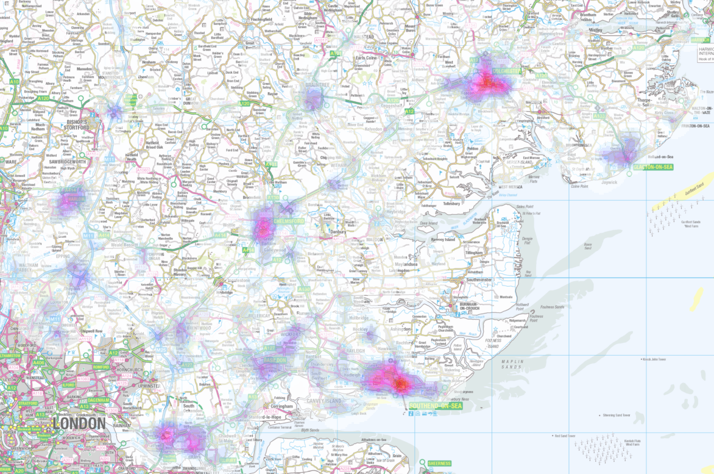
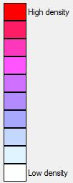
Hotspots
Areas showing the highest concentrations of collisions for the period xxx – xxx 20xx
Hotspots
Southend
Colchester
Grays
Chelmsford
Harlow
2
5
4
1
3

Slide 6
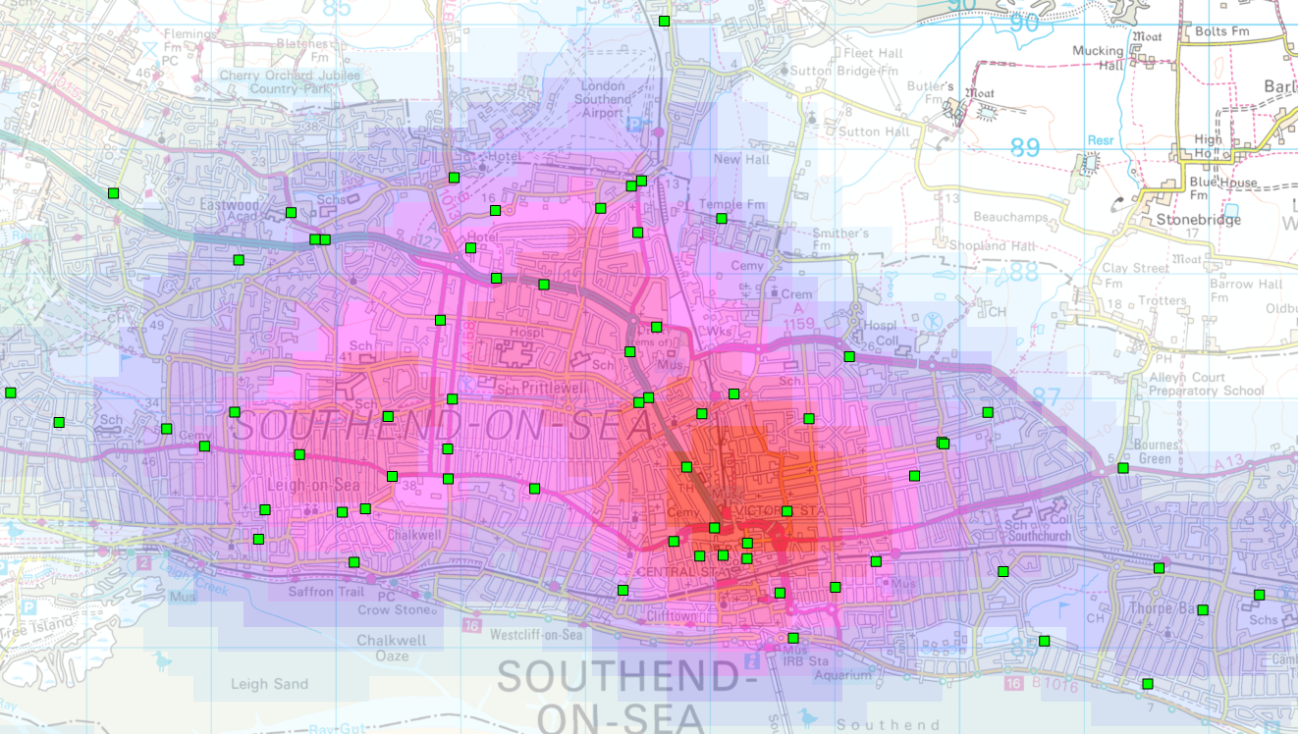
Hotspots
Hotspot 1: Southend
Peak times:
1600 – 1900 Weekdays
Wednesday daytime
27% pedestrians
19% OAP
76% at a junction

Slide 7
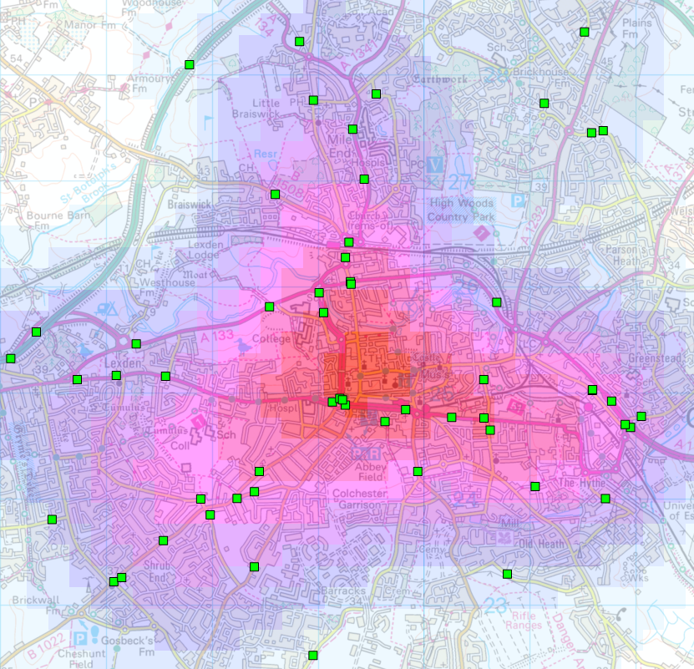
Hotspots
Hotspot 2: Colchester
Peak times:
Afternoons Weds-Thur-Fri
14% pedestrians
14% cycles
14% P2W
13% OAP
10% children
67% at a junction

Slide 8
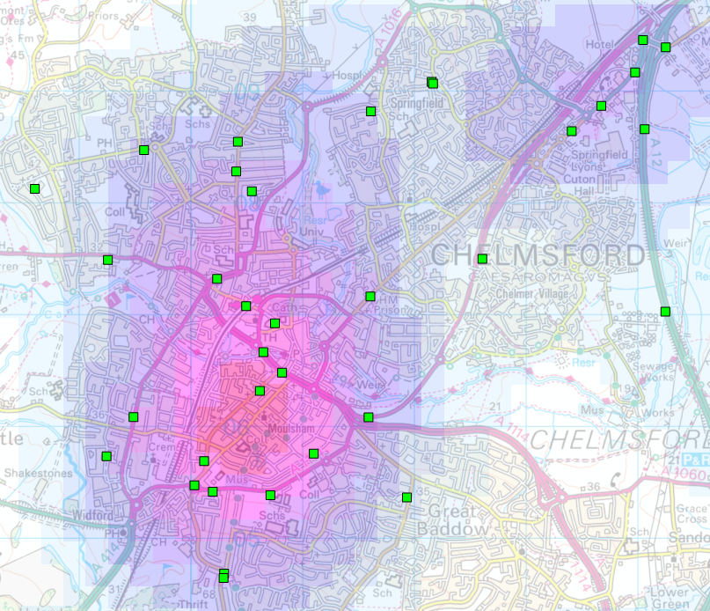
Hotspots
Hotspot 3: Chelmsford
Peak times:
1500 – 1700 Weekdays
21% pedestrian
16% cycles
21% P2W
11% OAP
54% at a junction

Slide 9
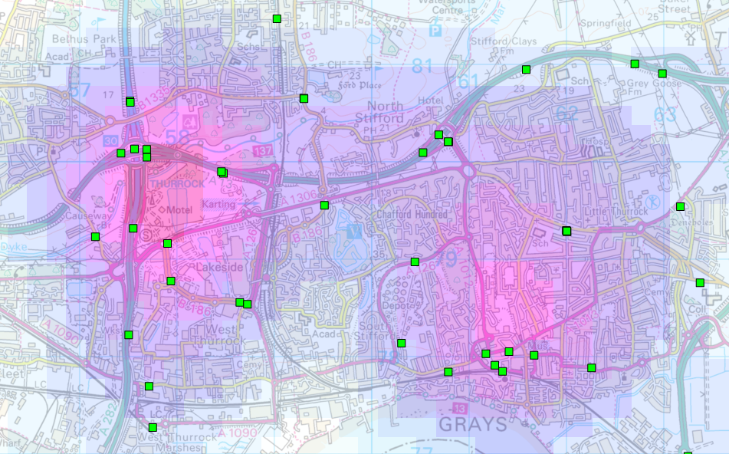
Hotspots
Hotspot 4: Grays
Peak times:
1600 – 2000 Weekdays
13% P2W
60% at a junction

Slide 10
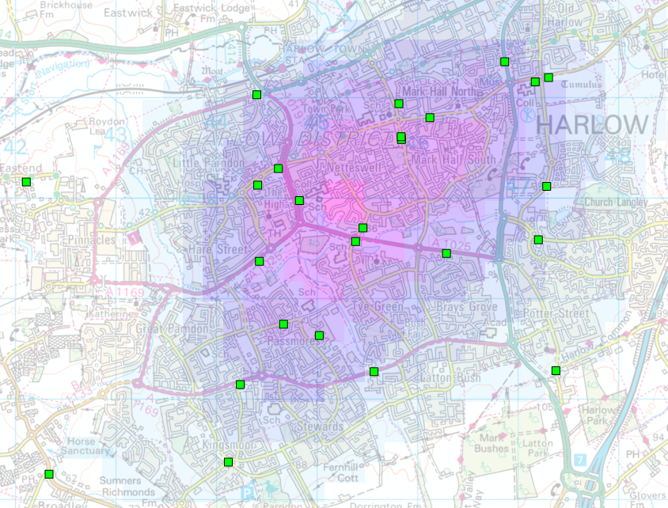
Hotspots
Hotspot 5: Harlow
Peak times:
Saturday daytime
29% pedestrians
10% P2W
10% OAP
10% children
52% at a junction

Slide 11


Small Changes Save Lives
SERP’s vision is to reduce death and serious injury due to road traffic collisions in Essex to zero. The partnership cannot do this alone, every road user plays a part in making sure that everyone gets home safely. A small change in everyone’s road user behaviour could have a huge impact on casualty numbers. Please go to www.saferessexroads.org and sign up to the #smallchanges pledge.

