Slide 1
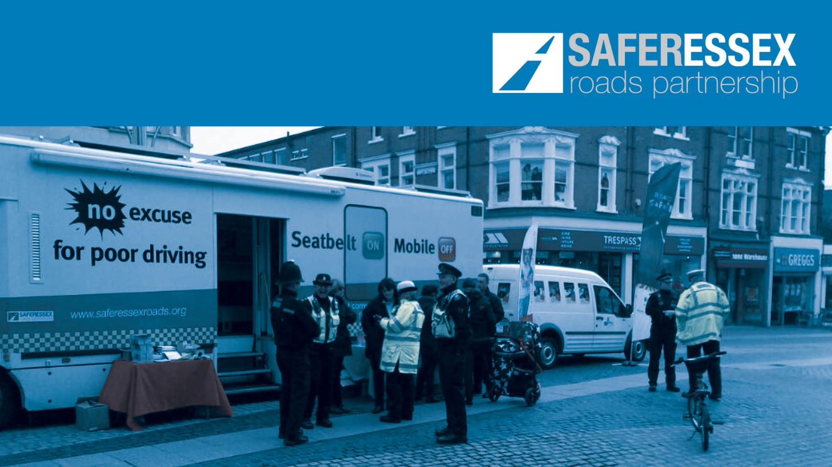
SERP Strategic Meeting
13th December 2018

Slide 2
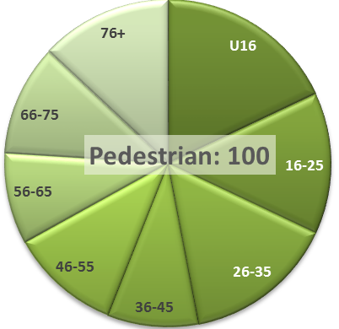
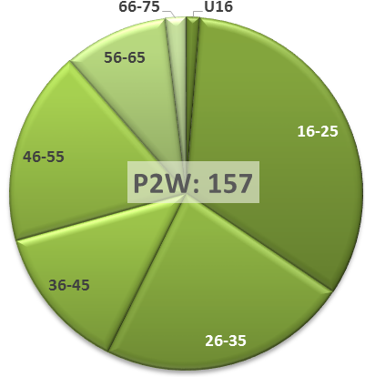
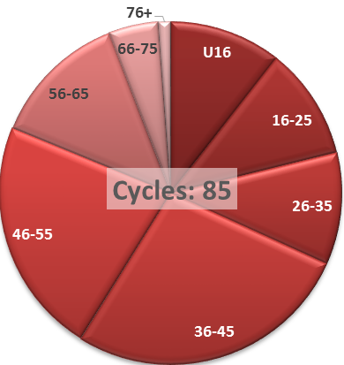
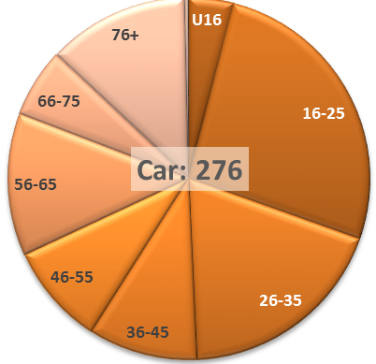
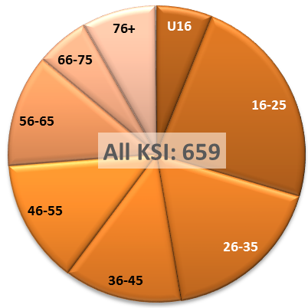
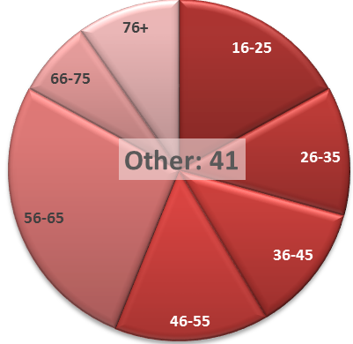
Casualties – Who is getting injured?
Provisional data to September 2018
YTD target: 113
YTD target: 172
YTD target: 80
YTD target: 280
YTD target: 683
YTD target: 38

Slide 3
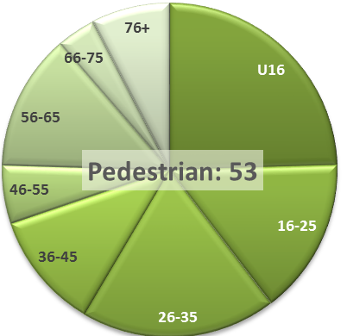
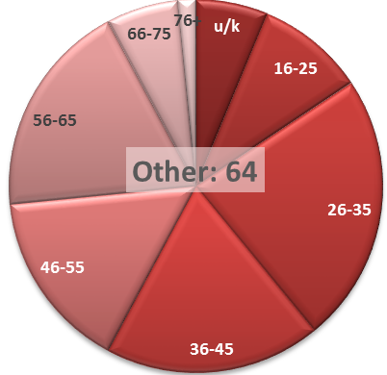
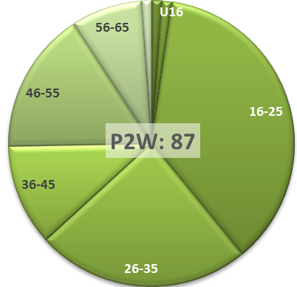
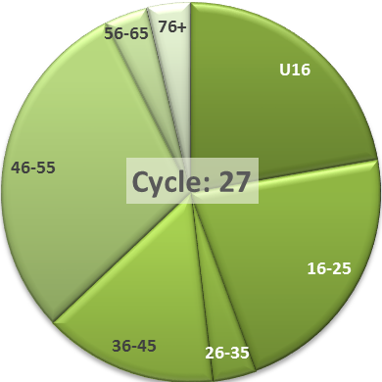
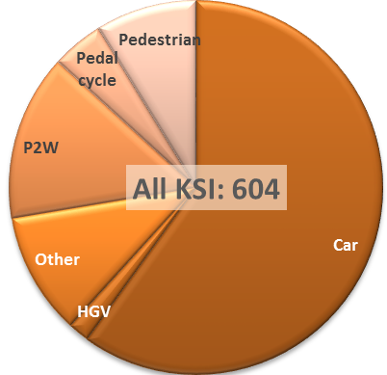
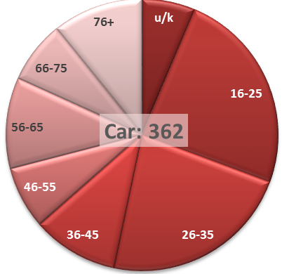
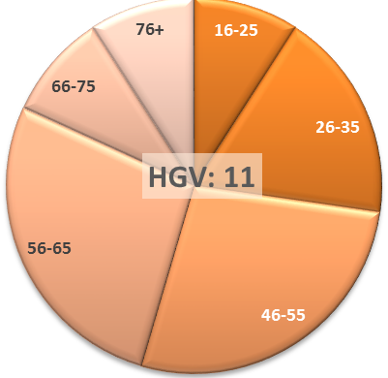
Collisions – Who is primarily at fault?
Provisional data to September 2018
YTD target: 67
YTD target: 50
YTD target: 101
YTD target: 35
YTD target: 344
YTD target: 611
YTD target: 11

Slide 4
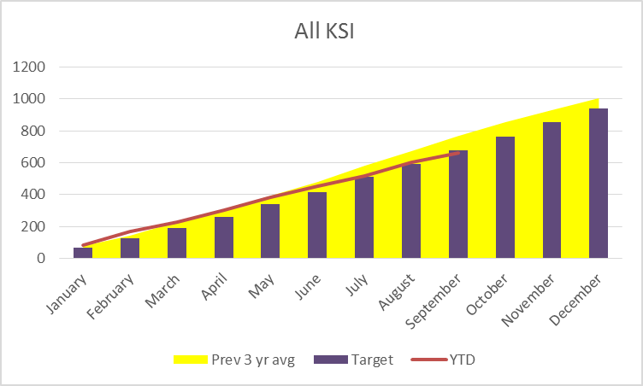
All KSI – Cumulative performance
Bad start to the year
Good summer – very close to target so risk it will be missed once all data is in

Slide 5
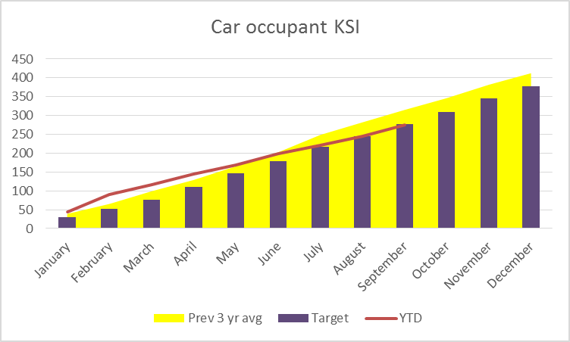
Car occupants – Cumulative performance
Reflects overall performance, but more exaggerated bad start + good summer
Contrary to what would be expected from weather

Slide 6
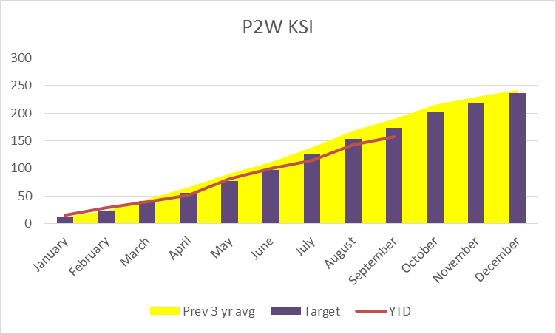
Powered two wheelers – Cumulative performance
Good performance throughout the year compared to previous years
Still high risk and vulnerable

Slide 7
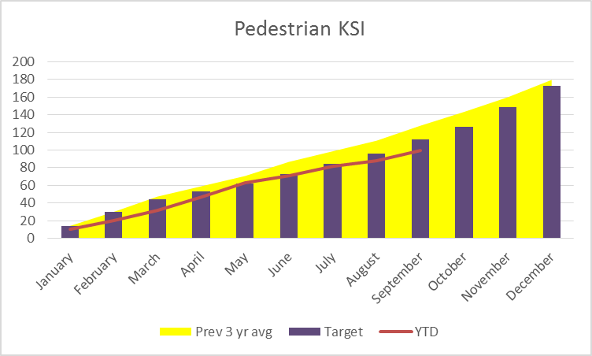
Pedestrians – Cumulative performance
Good summer
Preliminary notifications for October indicate this was a very bad month for pedestrians, as predicted by seasonal trends

Slide 8
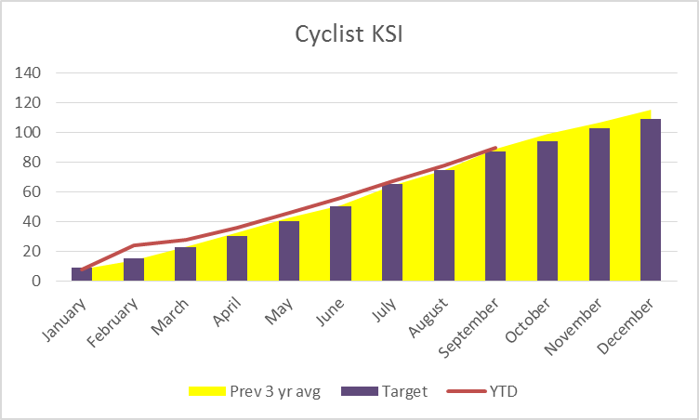
Pedal cyclists – Cumulative performance
Bad February bucked seasonal trend
Consistent numbers through the summer failed to counteract bad start

Slide 9
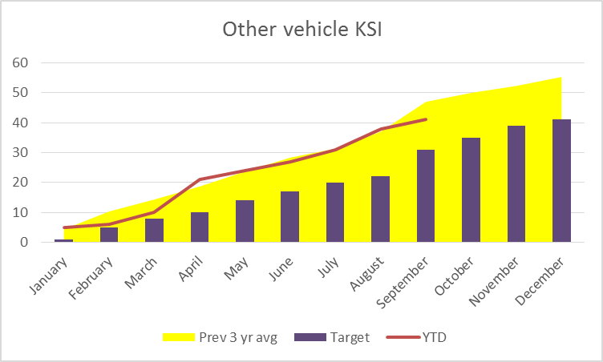
Other vehicle occupants – Cumulative performance
Multiple casualty event in April
Multiple casualty events can have big impact on small groups – as per September 2016 event skewing 3 year average

Slide 10
Conclusions
Close to performance target – but this is meant to be getting tougher every year
P2Ws a success story this year
Car driver behaviour putting most pressure on figures
Cyclist casualties
Car occupant casualties
Pedestrians likely to be an issue in last 3 months

Slide 11
Analysis roundup
Impact of SAT days
Collision numbers too blunt an instrument to gauge impact
Offence numbers tend to measure enforcement
Gradual reduction in offence numbers > need to record officer hours on Calypso returns to control for coverage
Mobile phone offences reduced in 2017 but have returned to pre 2017 levels
Females, young driver and business car drivers have poorer mobile phone compliance relative to their seatbelt compliance
Van drivers have poorer seatbelt compliance relative to their mobile phone compliance
Drug drive more of a daytime issue than drink drive – and more likely to be flagged by other offences (tints, seatbelts, phones etc.)

Slide 12
Analysis roundup
Fatals project
Long-term work in progress….
Issues are many and varied
Seatbelts appear quite frequently
Sports P2W speed and loss of control under heavy braking
Giving 100% focus on the task in hand whether driving, riding or crossing the road
Passengers
Emotional state
Drug impairment (decision making, rather than reactions/control)
Hitting things that are there to be seen (albeit hard to see)
Cornering at speed but within limits of grip
Mind elsewhere / autopilot

Slide 13
Small Changes Save Lives
SERP’s vision is to reduce death and serious injury due to road traffic collisions in Essex to zero. The partnership cannot do this alone, every road user plays a part in making sure that everyone gets home safely. A small change in everyone’s road user behaviour could have a huge impact on casualty numbers. Please go to www.saferessexroads.org and sign up to the #smallchanges pledge.

