Slide 1
Police and Crime Plan 2016-2020
Monthly Performance Update
September 2018
National and MSG positions are to 31th August 2018 (Essex Police data are to 30th September 2018).
Version 2.1
Produced October 2018
Performance Analysis Unit, Essex Police
Sensitivity: Official

Slide 2
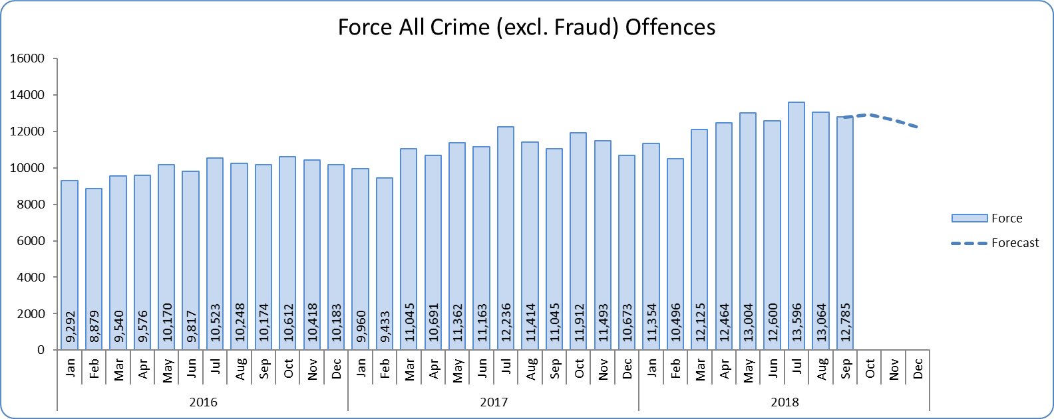
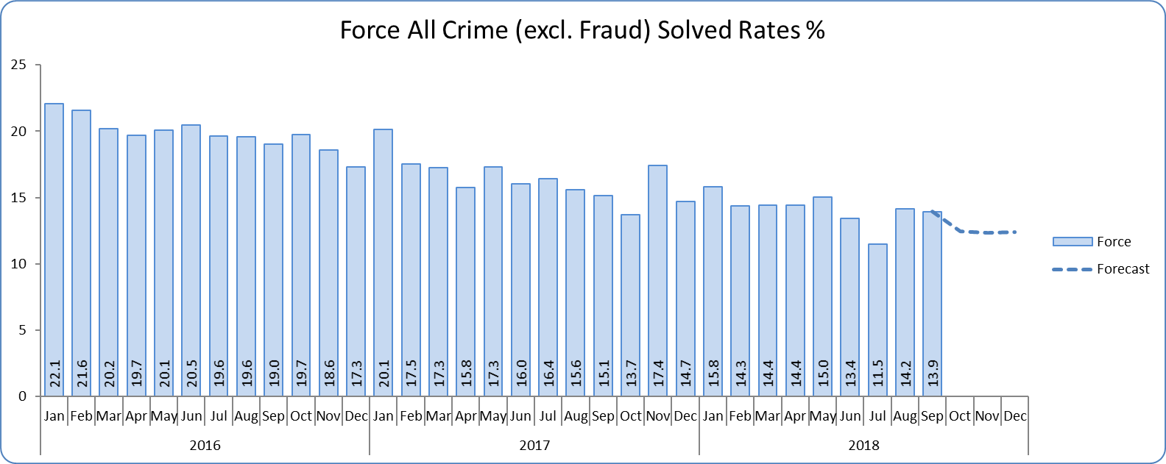
Monthly Performance Overview
Key Areas
All Crime
11.9% increase (15,347 additional offences)⁺. The national increase~ was 12.9%.
Essex is 5th in its MSG and 22nd nationally for crimes per 1,000 of the population. Essex is 7th (out of eight) in its Most Similar Group of forces (MSG), and is 27th nationally* for crime increase. Increases seen in 40 out of 42 forces.
Three out of 14 districts experienced statistically significant increases in September 2018.
The forecast^ is that although All Crime will decrease for the next three months, the level will be higher than that experienced in the same months in previous years. None of the next three months are forecasted to be statistical exceptions.
All Crime Solved Rate
2.7% point decrease (to 14.8%) ⁺⁺.
The number of crimes solved also fell: by 5.6% (1,251 fewer solved outcomes to 21,287).
Essex has the 4th highest solved rate in its MSG and is 23rd nationally for its solved rate. Essex is 5th in its MSG and 19th nationally for solved rate % point change. One district experienced a statistically significant decrease in September 2018.
The forecast is that the solved rate will decrease further in the next three months. None of the next three months are forecasted to be statistical exceptions.
Figure 1
Figure 2
⁺ All crime increases/decreases shown are for 12 months to September 2018 compared to the same period to September 2017.
⁺⁺ Solved rate increases/decreases are for 12 months to September 2018 compared to the same period to September 2017. The final solved rate is for 12 months to September 2018.
* 1st is considered best performing, and 42nd worst.
~ The national increase (where the category is available) relates to the 12 months to March 2018 vs. 12 months to March 2017 and are the official Home Office figures.
^ Forward projection based on “Time Series Forecasting” method, which takes into account seasonality (when this follows a statistically consistent pattern).

Slide 3
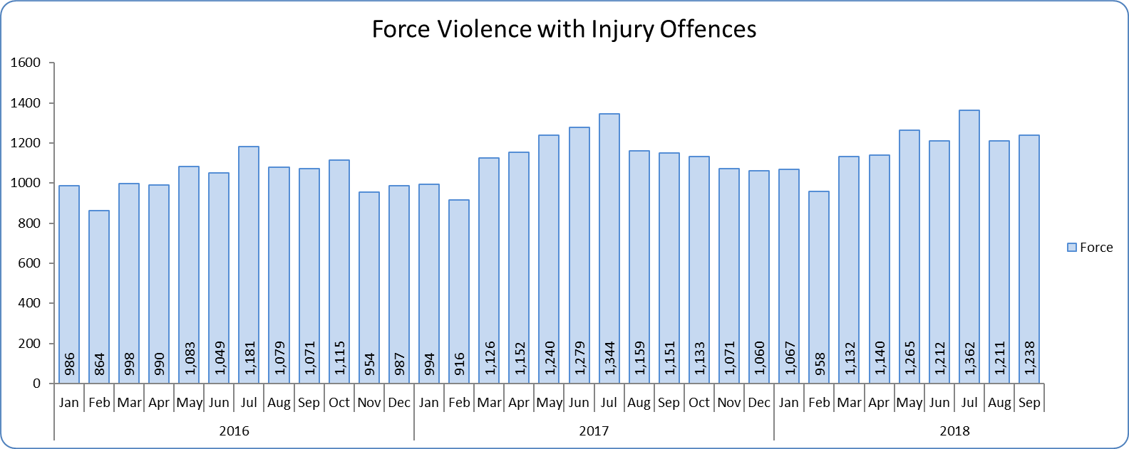
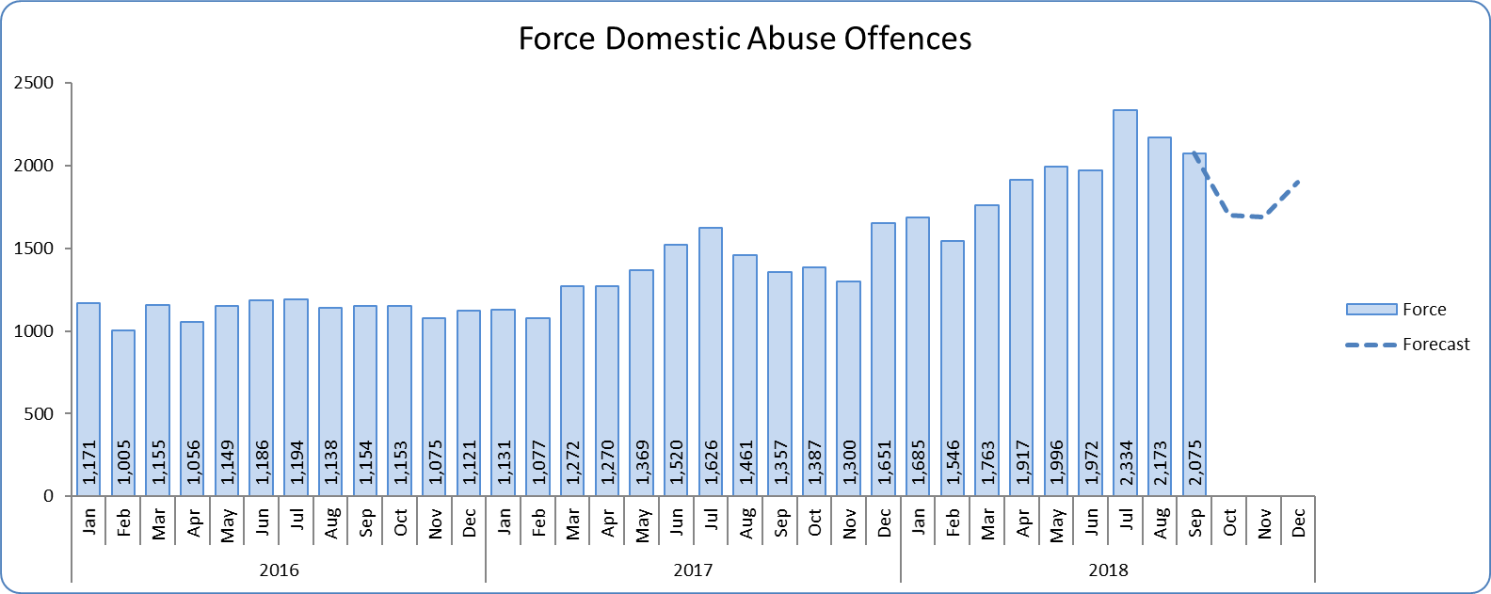
Monthly Performance Overview
Violence with Injury*
3.0% increase (402 additional offences).
Essex is 4th in its MSG and 14th nationally for crimes per 1,000 of the population. Essex is 3rd in its MSG and 11th nationally for crime increase.
Increases seen in 37 out of 42 forces. The national increase was 9.9%.
83.1% of Violence with Injury is Actual Bodily Harm (ABH). By volume, ABH rose by 2.1% (240 additional offences).
59.7% of the increase in Violence with Injury is due to the rise in ABH.
32.4% of Violence with Injury is Domestic Abuse-related.
Two districts experienced statistically significant increases in September 2018.
Although there is no consistent pattern to provide a statistical forecast **, Violence with Injury is likely to continue to increase in the medium to long-term.
Domestic Abuse
39.3% increase (6,078 additional offences).
There are no national or MSG comparisons on iQuanta*** for Domestic Abuse.
Four districts experienced statistically significant increases in September 2018.
The forecast is that that although Domestic Abuse (all risk levels combined) will decrease for the next two months, the level will be higher than that experienced in the same months in previous years.
High Risk Domestic Abuse 12.6% increase (254 additional offences).
Medium Risk Domestic Abuse 3.5% decrease (161 fewer offences).
Standard Risk Domestic Abuse 60.1% increase (5,084 additional offences).
Figure 3
Figure 4
* Offences included within the Violence with Injury classification changed in November 2017. Offences involving “Death or Serious Injury – Unlawful Driving” have now been removed and are in a separate category. Please note iQuanta related positions still relate to the former definition.
** When offences/solved rates do not follow a statistically consistent pattern (namely when the R² is below 0.6) no forecast has been shown.
*** A web-based service provided for the use of Police forces, Community Safety Partnerships (CSPs) and Her Majesty’s Inspectorate of Constabulary and Fire & Rescue Service (HMICFRS).

Slide 4
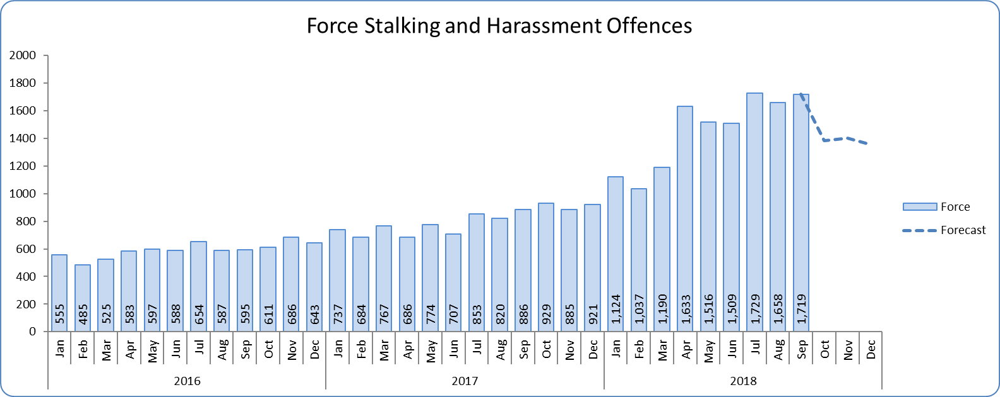
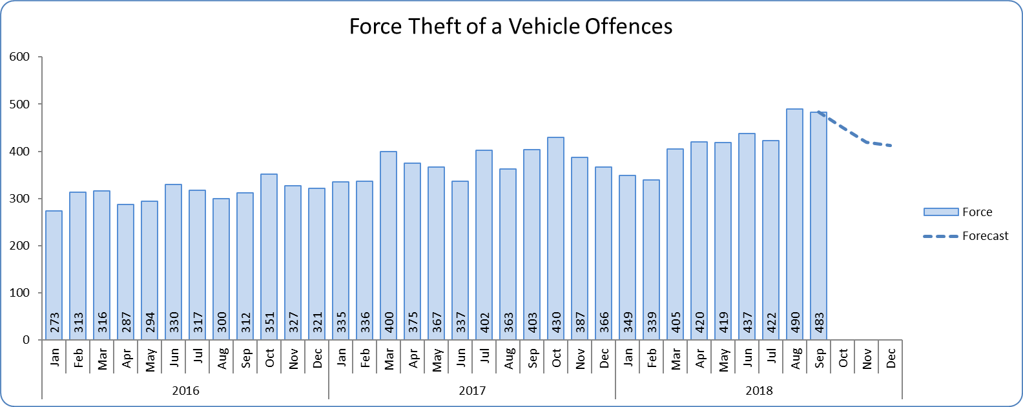
Monthly Performance Overview
Statistical Exceptions – Offences
Stalking and Harassment Offences
The Force and nine districts experienced statistically significant increases in September 2018.
73.3% increase (6,536 offences). The national increase was 30.1%.
From April 2018, forces began to record both the Harassment and the most serious additional crime, whereas when someone previously committed a Harassment type offence and another offence (such as ABH) we recorded just the other offence, not the Harassment.
There are no full year national or MSG comparisons on iQuanta.
35.2% of offences were Domestic Abuse-related.
The forecast is that Stalking and Harassment will decrease. None of the next three months are forecasted to be statistical exceptions.
Theft of a Vehicle Offences
The Force and four districts experienced statistically significant increases in September 2018.
13.0% increase (550 offences).
Essex is 8th in its MSG and 39th nationally for crimes per 1,000 of the population. Essex is 6th in its MSG and 29th nationally for crime increase.
Increases seen in 33 out of 42 forces.
The forecast is that Theft of a Vehicle offences will decrease over the next three months, none of which are forecasted to be statistical exceptions.
Figure 5
Figure 6

Slide 5
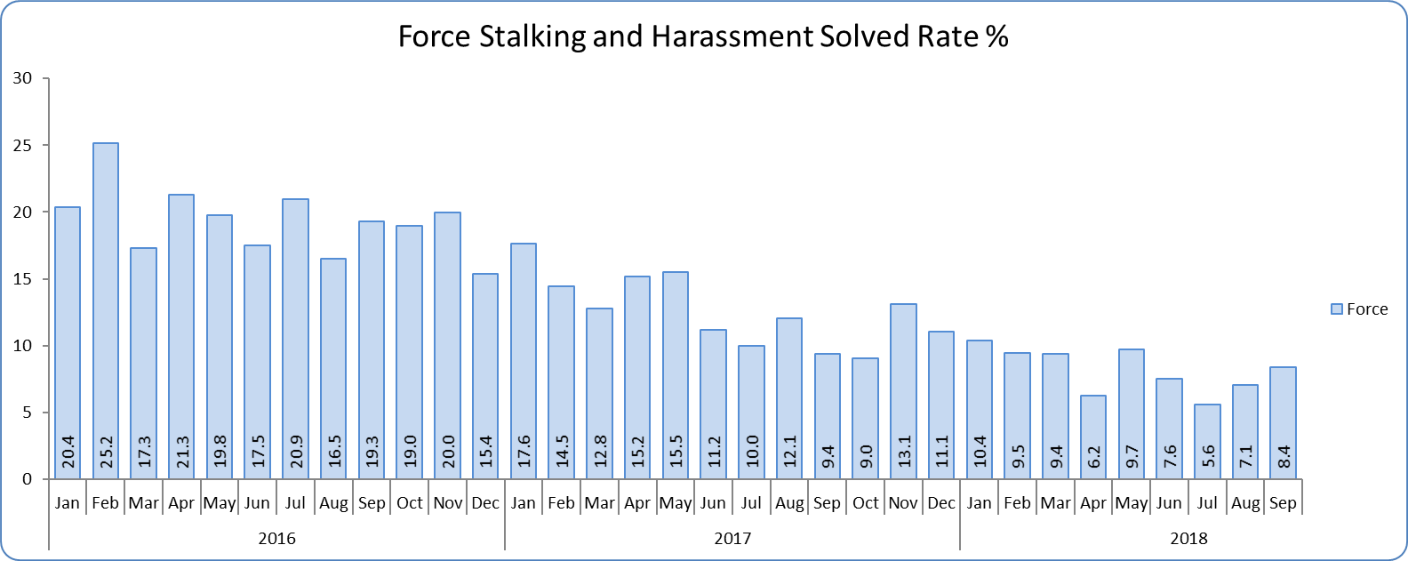
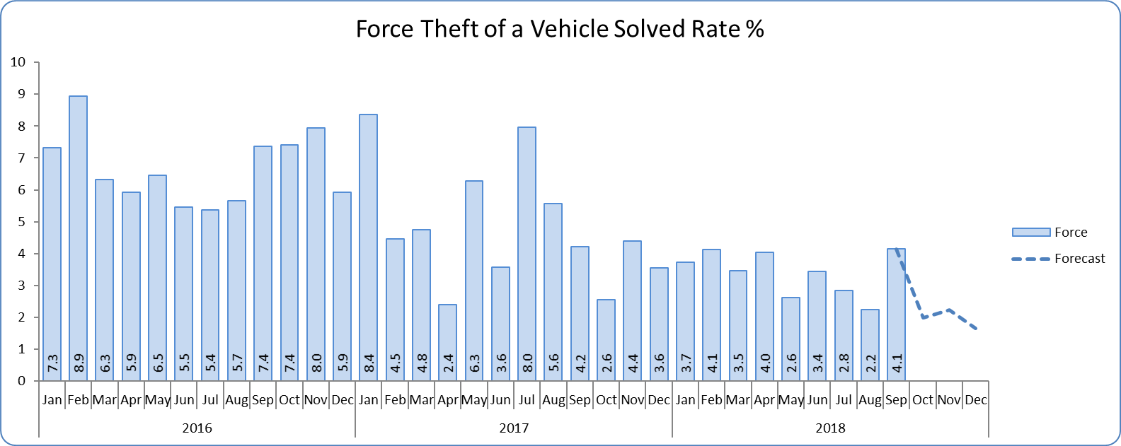
Monthly Performance Overview
Solved Rates by Exception
Figure 7
Stalking and Harassment Solved Rate
Solved rate remains below 10% (at 9.0%).
The number of crimes solved increased: by 12.0% (150 more to 1,395 solved outcomes).
Neither the Force nor any of the districts experienced a statistically significant change in September 2018.
Although there is no consistent pattern to provide a statistical forecast, the solved rate for Stalking and Harassment is likely to continue to decrease in the medium to long-term.
Theft of a Vehicle Solved Rate
Solved rate remains below 10% (at 3.8%).
The number of crimes solved decreased: by 26.8% (67 fewer solved outcomes to 183).
Essex is 8th in its MSG and 41st nationally for solved rate. Essex is 4th in its MSG and 23rd nationally for solved rate % point change.
The Force did not experience a statistically significant change in September 2018.
The forecast is that the solved rate will decrease over the next three months, none of which are forecasted to be statistical exceptions.
Figure 8

Slide 6
2016-2020 Police and Crime Plan Performance Indicators
Table 1
See Appendix for endnotes.
Below is an explanation as to why certain indicators are considered to be improving or deteriorating:
Priority 1 – Number of all crime offences. Performance is considered to be deteriorating due to the rise in crime. No data are available to indicate how much of this rise is attributable to better crime data integrity. An increase in crime has been experienced in every UK police force .
Priority 3 - Number of incidents of domestic abuse. Performance is considered to be deteriorating due to the rise in incidents. No data are available to indicate whether this rise is attributable to media campaigns or initiatives that encourage reporting.
Priority 5 - Number of arrests in relation to the trafficking of drugs. Drug trafficking arrests are dependent on pro-active policing. This may include pre-planned operations conducted as a result of intelligence reports received, positive search warrants of residences/premises, and positive searches of individuals.
Priority 7 - Number of driving related mobile phone crime on Essex roads. This is considered to be improving as Essex Police’s Operational Policing Command (OPC) have stated there has been a noticeable reduction in the number of drivers stopped whilst using a mobile phone at the wheel.
Priority 7 - Number of driving under the influence of drink and/or drugs on Essex roads. Operational Policing Command (OPC) have stated that a reduction indicates the public are adhering to the strong educational messages being delivered by drink/driving campaigns. Collisions attended by the police involve routine breath-testing of involved parties. An increase could also demonstrate proactive policing.

Slide 7
Appendix
¹ Results are for the period October 2017 to June 2018. Essex Police performed significantly above the results for the local confidence question contained in the PFCC’s Plan for Q1 and Q2. This difference could not be explained and consequently an additional question was added in Q3 with the exact wording used in the CSEW. This is the question now being used.
² The confidence interval is the range +/- between where the survey result may lie. This is mainly influenced by the number of people answering the survey. The more people that answer the survey, the smaller the interval range.
³ Crime Survey for England and Wales (CSEW): 12 months to March 2018 vs. 12 months to March 2017.
⁴ Results are for the period July 2017 to June 2018.
⁵ The number of Organised Criminal Group disruptions are for the periods July 2018 to September 2018 (Q2 2018) vs. April 2018 to June 2018 (Q1 2018). “A disruption has been achieved when intentional activity leads to an OCG or individual being unable to operate at its usual level of activity” (National Crime Agency National Disruption Guidance: Assessing Disruption Against Serious Organised Crime)
⁶ Solved outcomes are crimes that result in: charge or summons, caution, crimes taken into consideration, fixed penalty notice, cannabis warning or community resolution.
⁷ ‘Driving under the influence of drink and/or drugs’. In January 2017, Essex Police introduced a new system that records the number of those who failed to provide (FTP) in relation to drink/drug drive offences, as well as the number of drink/drug drive offences. Prior to this, FTP data was not recorded. The volume of those driving under the influence of drink and/or drugs will therefore appear higher in the past 12 months year when compared to the same period the previous year, as FTP data is included.
⁸ ‘Killed or Seriously Injured’ refers to all people killed or seriously injured on Essex’s roads, regardless of whether any criminal offences were committed. ‘Causing Death/Serious Injury by Dangerous/Inconsiderate Driving’, however, refers to the number of crimes of this type.

Slide 8
Crime Tree Data – Rolling 12 Months to September
Table 2

Slide 9
Crime Tree Data – Rolling 12 Months to September
Table 3

Slide 10
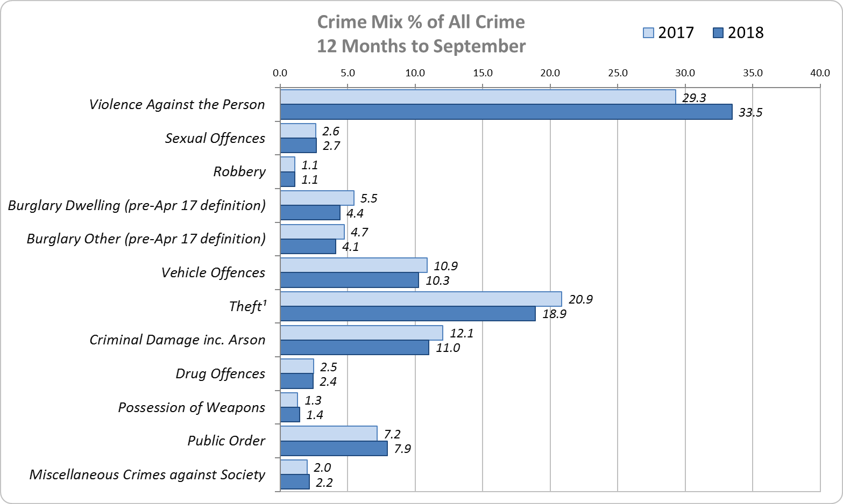
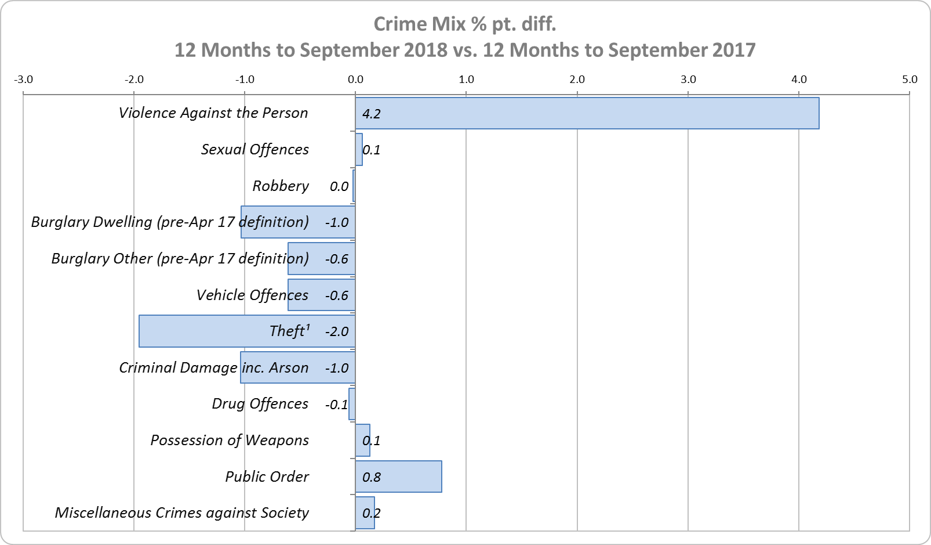
Crime Mix – Rolling 12 Months to September 2017 vs. 2018
Figure 9
Figure 10
Violence Against the Person saw a 4.2% point increase in the proportion of all crime; it also experienced the biggest volume rise (10,523 further offences). Public Order Offences saw a 0.8% point increase in the proportion of all crime, and experienced the second biggest volume rise (2,218 offences).
15.0% of crime is Domestic Abuse-related; this proportion has increased from 14.6% for 12 months to August 2018. Domestic Abuse-related Violence Against the Person increased to 35.3% (from 35.0% for 12 months to August 2018).

