Slide 1


Police and Crime Plan 2016-2020
Monthly Performance Update
November 2018
National and MSG positions are to 31st October 2018 (Essex Police data are to 30th November 2018).
Version 1.6
Produced December 2018
Performance Analysis Unit, Essex Police
Sensitivity: Official

Slide 2
Executive Summary
All Crime has risen by 13.5%. Domestic Abuse (DA) has risen by 45.9%. The increase in both can, in part, be attributed to the increase seen in Stalking and Harassment (see p.5 for further detail).
The All Crime solved rate continues to decline due to an increase in the number of crimes, as well as a reduction in the number of crimes considered ‘solved’.
In November, four crime types experienced statistically significant increases:
  Stalking and Harassment. The rise in this category has been caused by the change in the means by which this offence has been recorded since April 2018 (see p.5. for further detail).
  Death or Serious Injury caused by Unlawful Driving Offences. Eight offences were recorded in November. Due to this comparatively high number of offences in this month, and the investigation time these offences require, the solved rate also experienced a statistically significant decrease in November.
  Rape. November 2018 was the highest ever month for recorded offences (163).
  Possession of Drugs. Although this crime type experienced a statistically significant increase, it is a sign of proactive policing.
There has been a change in the way in which the number of Organised Criminal Group (OCG) disruptions are counted in Essex. This follows guidance issued by the National Crime Agency (NCA) and the Eastern Region Special Operations Unit (ERSOU) to ensure that all forces record disruptions in the same way. Data are consequently only available for November 2018 (see p.11 for further explanation).

Slide 3
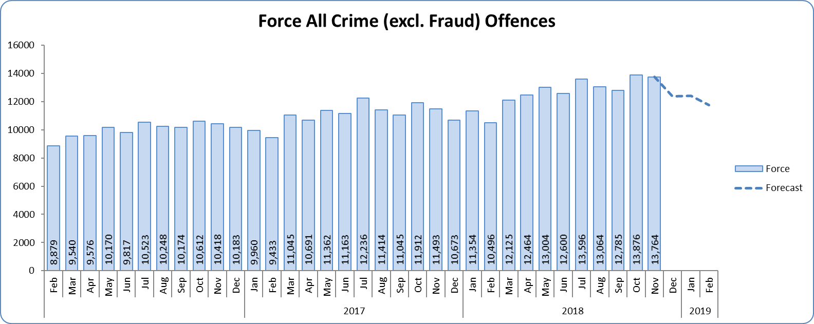
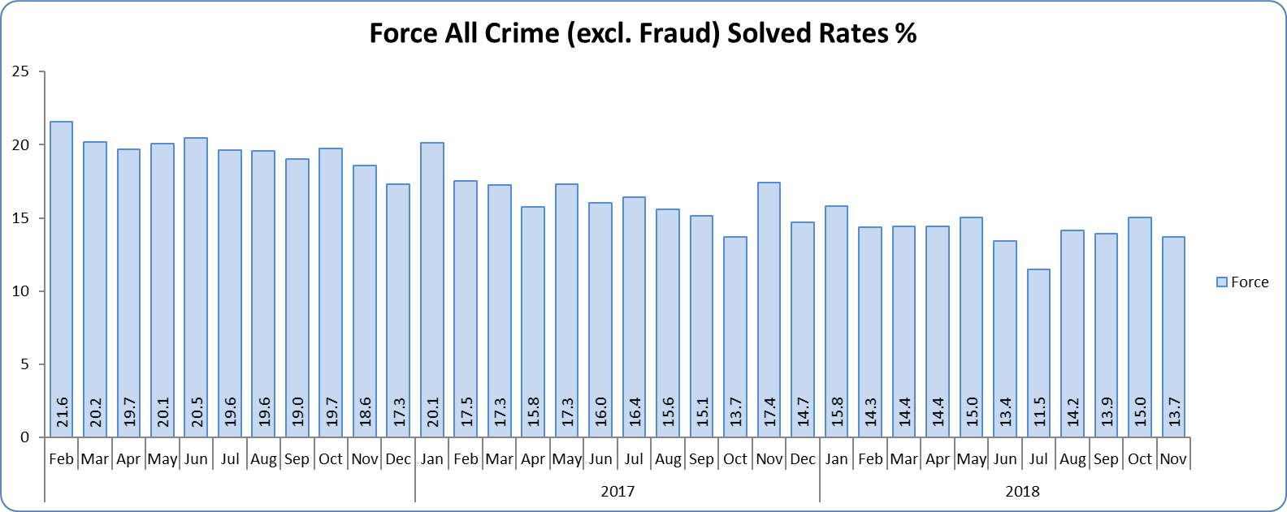
Monthly Performance Overview
Key Areas
All Crime
13.5% increase (17,612 additional offences) compared to the 12 months to November 2017⁺. The national increase~ was 10.3%.
Essex is 6th in its Most Similar Group of forces (MSG) and 23rd nationally for crimes per 1,000 of the population. Essex is 8th (out of eight) in its MSG, and is 33rd nationally* for crime increase. Increases seen in 35 out of 42 forces.
Five out of 14 districts experienced statistically significant increases in November 2018. The Force did not.
The forecast^ is that although All Crime will generally decrease for the next three months, the level will be higher than that experienced in the same months in previous years. None of the next three months are forecasted to be statistical exceptions.
All Crime Solved Rate
2.3% point decrease (to 14.7%) compared to the 12 months to November 2017 ⁺⁺.
The number of crimes solved also fell: by 1.7% (372 fewer solved outcomes to 21,840) compared to the 12 months to November 2017.
Essex has the 4th highest solved rate in its MSG and is 22nd nationally for its solved rate. Essex is 4th in its MSG and 11th nationally for solved rate % point change.
No district experienced a statistically significant change in November 2018. Neither did the Force.
The forecast is that the solved rate will decrease further in the next three months. None of the next three months are forecasted to be statistical exceptions.
Figure 1 – Offences by month
Figure 2 – Solved rate by month
⁺ All crime increases/decreases shown are for 12 months to November 2018 compared to the same period to November 2017.
⁺⁺ Solved rate increases/decreases are for 12 months to November 2018 compared to the same period to November 2017. The quoted solved rate is for 12 months to November 2018.
* 1st is considered best performing, and 42nd worst.
~ The national increase (where the category is available) relates to the 12 months to June 2018 vs. 12 months to June 2017 and are the official Home Office figures.
^ Forward projection based on “Time Series Forecasting” method, which takes into account seasonality (when the data follows a statistically consistent pattern).

Slide 4
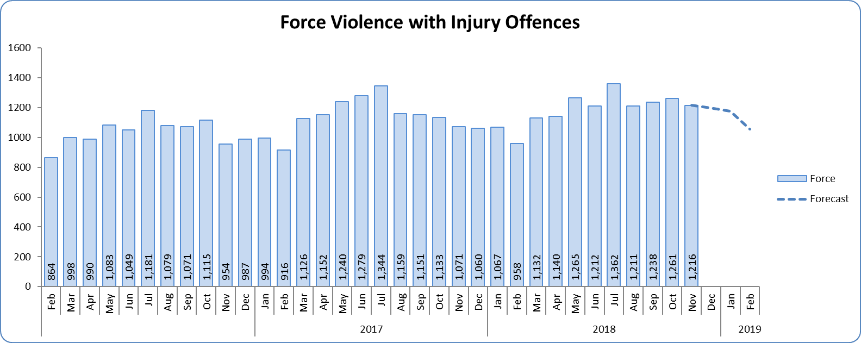
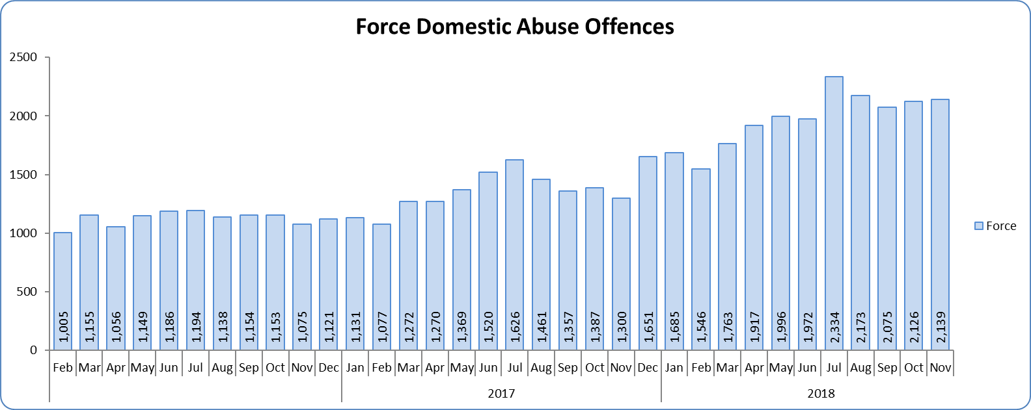
Monthly Performance Overview
Violence with Injury*
4.2% increase (572 additional offences) compared to the 12 months to November 2017. The national increase was 8.5%.
Essex is 4th in its MSG and 14th nationally for crimes per 1,000 of the population. Essex is 4th in its MSG and 12th nationally for crime increase.
Increases seen in 36 out of 42 forces.
83.4% of Violence with Injury is Actual Bodily Harm (ABH). By volume, ABH rose by 3.8% (436 additional offences).
76.2% of the increase in Violence with Injury is due to the rise in ABH.
32.6% of Violence with Injury is Domestic Abuse-related.
One district experienced a statistically significant increase in November 2018.
The forecast is that Violence with Injury will start to decrease. A statistically significant decrease is forecasted for February.
Domestic Abuse
45.9% increase (7,274 additional offences) compared to the 12 months to November 2017.
There are no national or MSG comparisons on iQuanta** for Domestic Abuse.
Two districts experienced statistically significant increases in November 2018. The Force did not.
The forecast is that that Domestic Abuse will continue to rise. This is partly due to the rise in Stalking and Harassment offences (see p.5).
High Risk Domestic Abuse 22.1% increase (429 additional offences).
Medium Risk Domestic Abuse 4.4% increase (196 additional offences).
Standard Risk Domestic Abuse 62.0% increase (5,634 additional offences).
Figure 3 - Offences by month
Figure 4 - Offences by month
* Offences included within the Violence with Injury classification changed in November 2017. Offences involving “Death or Serious Injury – Unlawful Driving” have now been removed and are in a separate category. Please note iQuanta related positions still relate to the former definition.
** A web-based service provided for the use of Police forces, Community Safety Partnerships (CSPs) and Her Majesty’s Inspectorate of Constabulary and Fire & Rescue Service (HMICFRS).

Slide 5
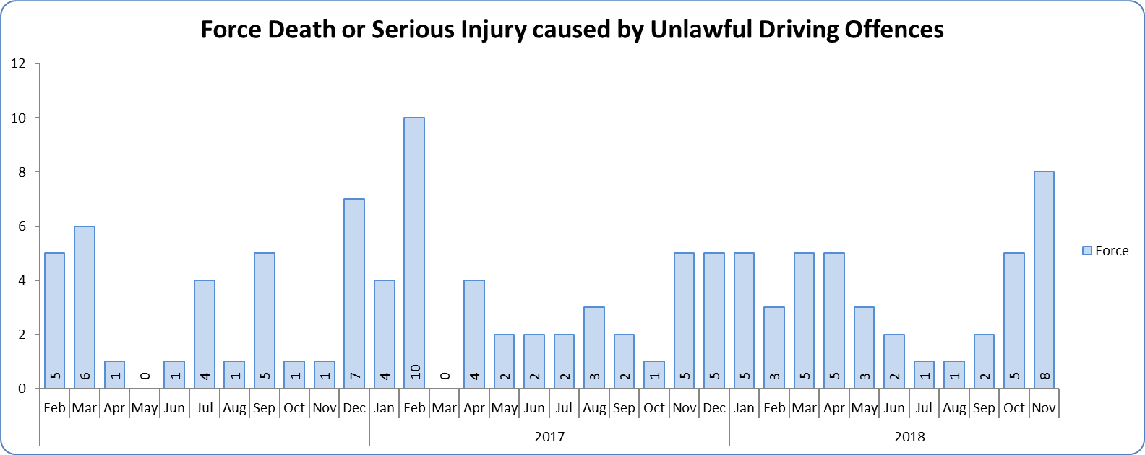
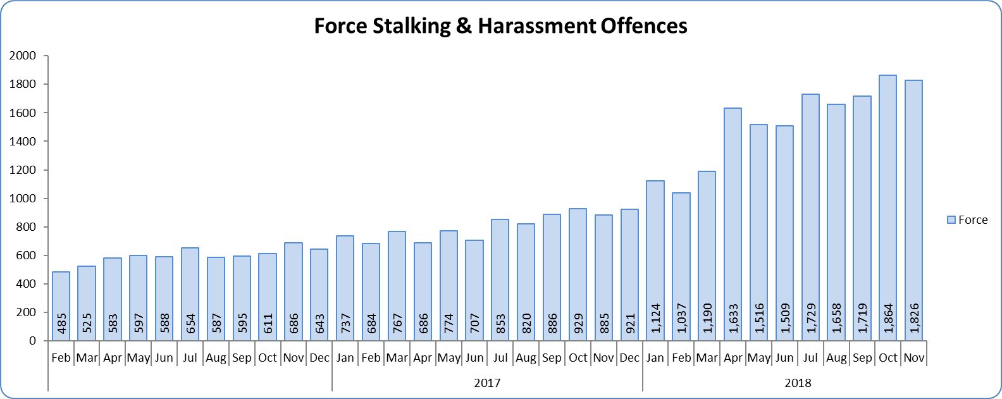
Monthly Performance Overview
Statistical Exceptions – Offences
Death or Serious Injury caused by Unlawful Driving Offences
The Force experienced a statistically significant increase in November 2018.
7.1% increase (3 offences) compared to the 12 months to November 2017.
Essex is 8th in its MSG and 35th nationally for crimes per 1,000 of the population. Essex is 5th in its MSG and 25th nationally for crime increase.
Increases seen in 15 out of 42 forces.
There is no consistent pattern to provide a statistical forecast.
Stalking and Harassment Offences
The Force and seven districts experienced statistically significant increases in November 2018.
84.4% increase (7,900 offences) compared to the 12 months to November 2017. The national increase was 35.9%.
From April 2018, forces began to record both the Harassment and the most serious additional crime, whereas when someone previously committed a Harassment type offence and another offence (such as ABH) we recorded just the other offence, not the Harassment.
Essex is 8th in its MSG and 34th nationally for crimes per 1,000 of the population. Essex is 7th in its MSG and 30th nationally for crime increase. Increases seen in all 42 forces.
35.8% of offences were Domestic Abuse-related.
Due to the change in the recording of Stalking and Harassment, no accurate statistical projection can be provided.
Figure 5 - Offences by month
Figure 6 - Offences by month

Slide 6
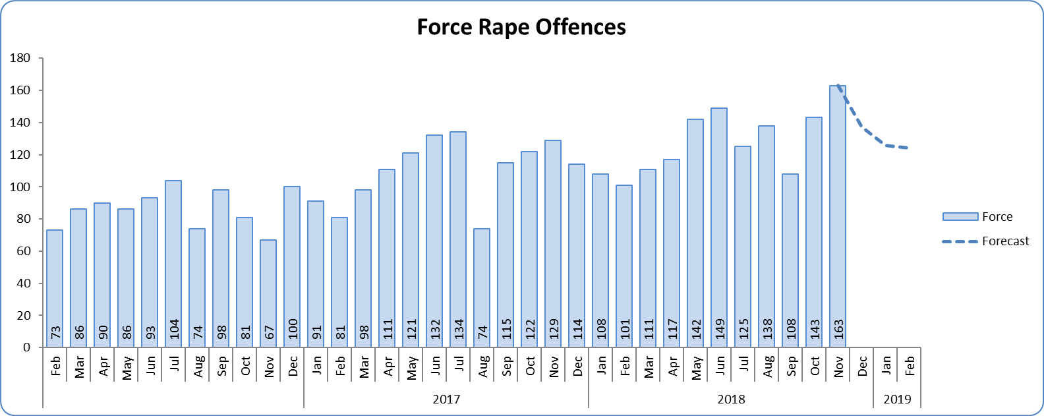
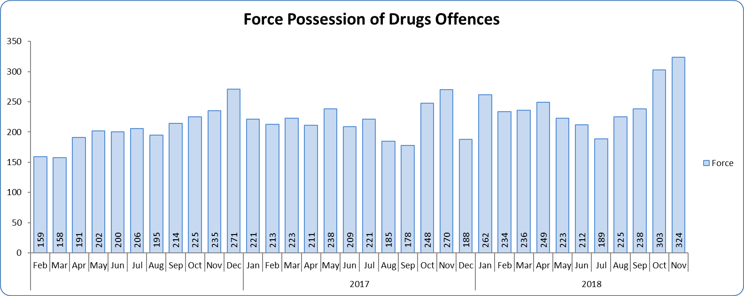
Monthly Performance Overview
Rape Offences
The Force and one district experienced a statistically significant increase in November 2018.
17.7% increase (231 offences) compared to the 12 months to November 2017.
Essex is 4th in its MSG and 14th nationally for crimes per 1,000 of the population. Essex is 7th in its MSG and 29th nationally for crime increase.
Increases seen in 35 out of 42 forces.
The forecast is that Rape offences will decrease over the next three months, none of which are forecasted to be statistical exceptions.
Possession of Drugs Offences
The Force and four districts experienced a statistically significant increase in November 2018.
8.8% increase (236 offences) compared to the 12 months to November 2017.
Essex is 6th in its MSG and 21st nationally for crimes per 1,000 of the population. Essex is 7th in its MSG and 27th nationally for crime increase.
Increases seen in 28 out of 42 forces.
There is no consistent pattern to provide a statistical forecast.
Figure 7 - Offences by month
Figure 8 - Offences by month

Slide 7
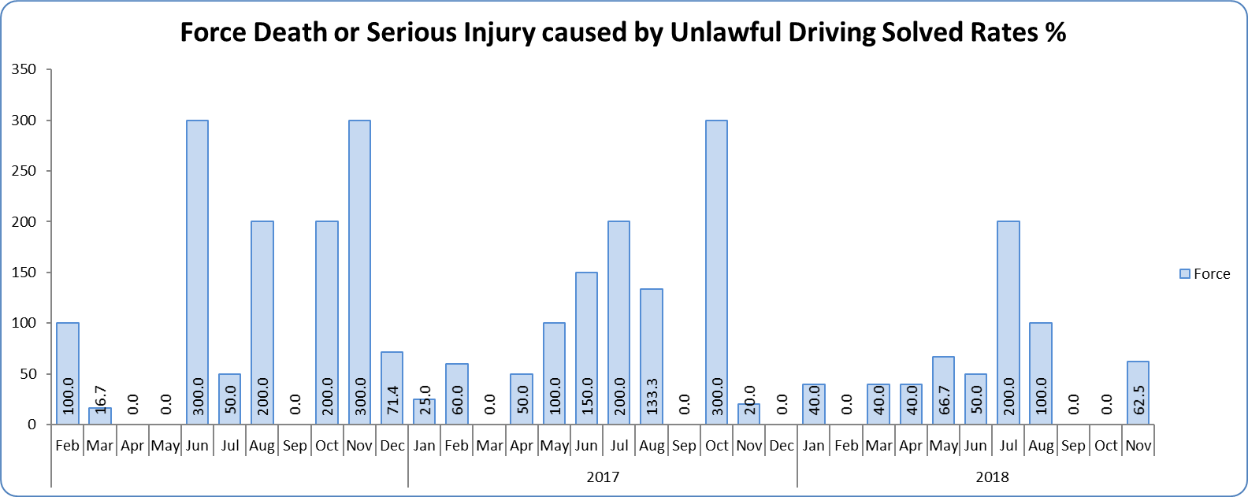
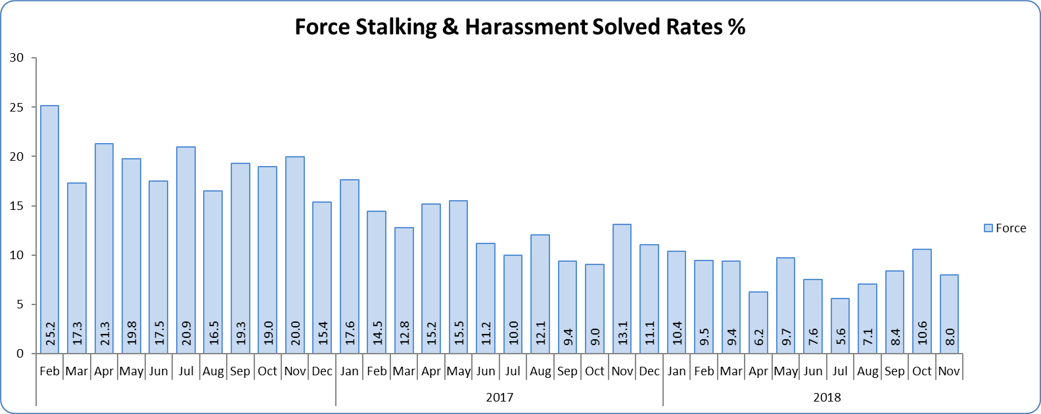
Monthly Performance Overview
Solved Rates by Exception
Death or Serious Injury caused by Unlawful Driving Solved Rate
Solved rate fell over 10% (by 53.2% to 44.4%).
The number of crimes solved decreased: by 51.2% (21 fewer solved outcomes to 20) compared to the 12 months to November 2017.
There are no national or MSG comparisons on iQuanta** for Death or Serious Injury caused by Unlawful Driving Solved Rate.
The Force did not experience a statistically significant change in November 2018.
There is no consistent pattern to provide a statistical forecast.
Stalking and Harassment Solved Rate
Solved rate remains below 10% (at 9.1%).
The number of crimes solved increased: by 30.8% (368 more to 1,564 solved outcomes) compared to the 12 months to November 2017.
There are no national or MSG comparisons on iQuanta** for Stalking and Harassment solved rates.
Neither the Force nor any of the districts experienced a statistically significant change in November 2018.
There is no consistent pattern to provide a statistical forecast.
Figure 9 - Solved rate by month
Figure 10 - Solved rate by month

Slide 8
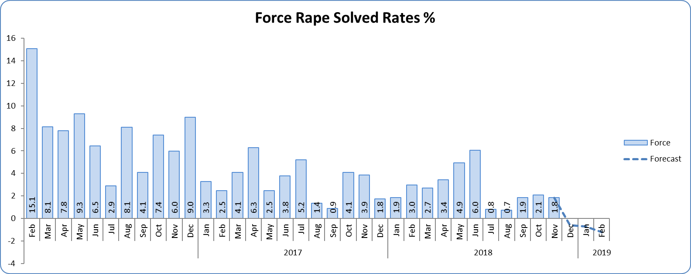
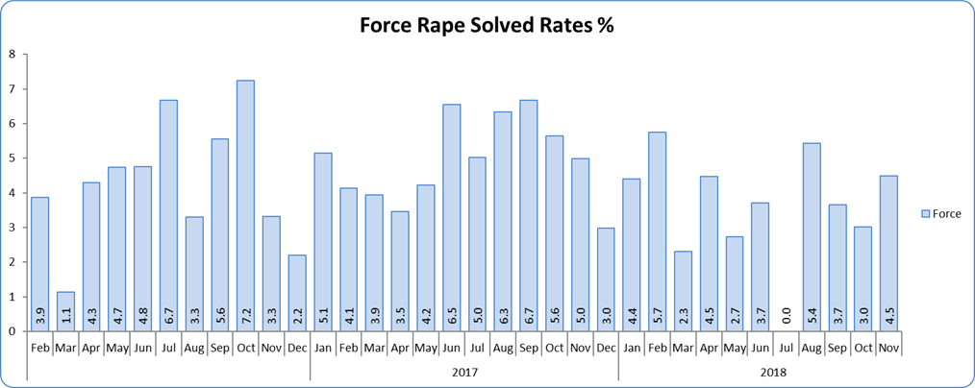
Monthly Performance Overview
Rape Solved Rate
Solved rate remains below 10% (at 2.8%).
The number of crimes solved decreased: by 17.3% (9 fewer solved outcomes to 43) compared to the 12 months to November 2017.
Essex is 7th in its MSG and 38th nationally for solved rate. Essex is 3rd in its MSG and 10th nationally for solved rate % point change.
The Force did not experience a statistically significant change in November 2018.
The forecast is that the solved rate will decrease over the next three months, none of which are forecasted to be statistical exceptions.
Figure 11 - Solved rate by month

Slide 9
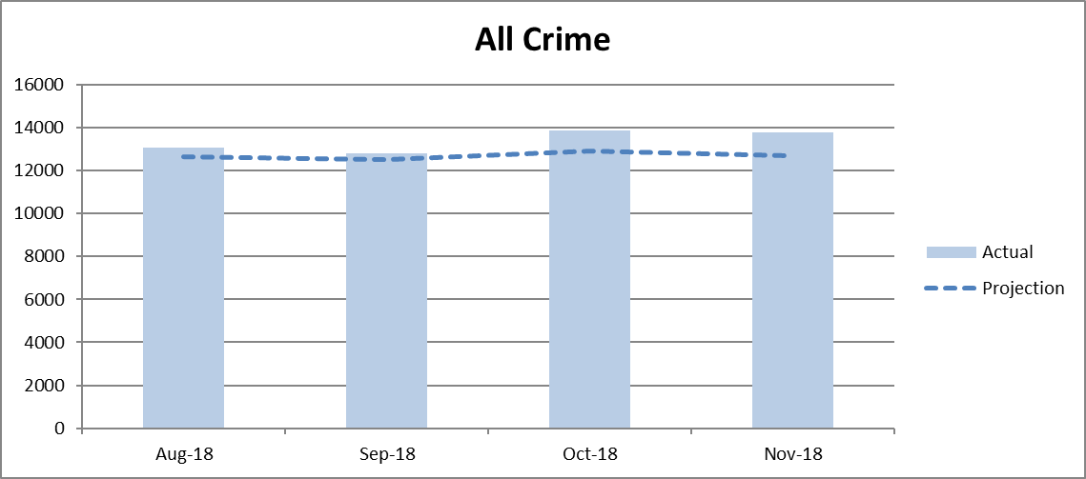
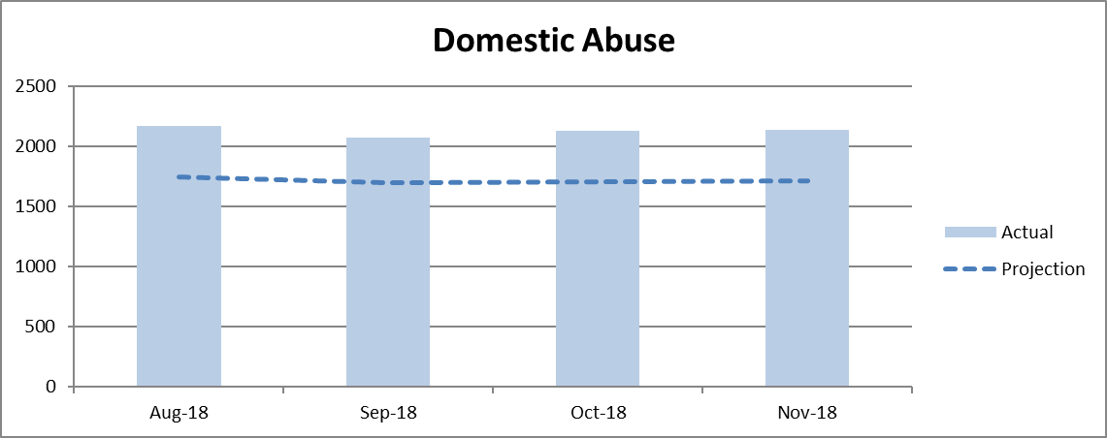
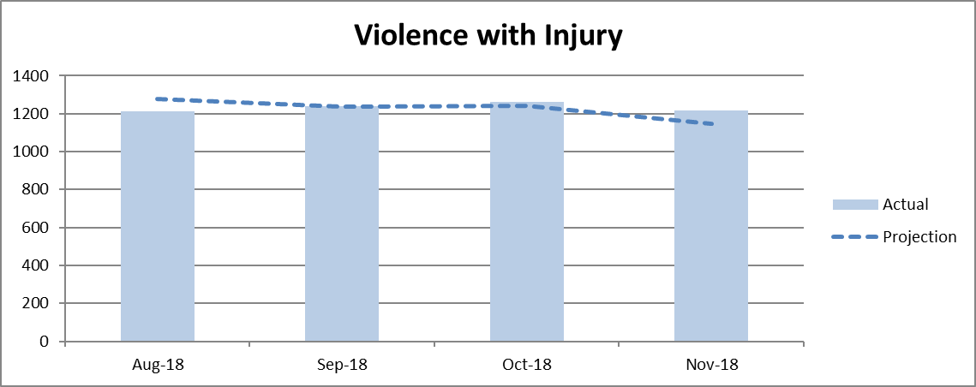
Time Series Forecasting – Testing the Methodology
From September 2018, this report has included a method of statistically forecasting future crime levels. This is called Time Series Forecasting. This method makes use of data from the previous four years (or the greatest amount available) and determines the effect seasonality has on the volumes of offences reported each month. When crime areas have an R² above 0.6 (a relative closeness of fit to the regression line), the levels of offences are more likely to broadly follow the same pattern; future levels can therefore be forecasted.
All Crime, Violence with Injury and Domestic Abuse (DA) are identified as priorities in both Essex Police’s Plan on a Page and the PFCC’s Police and Crime Plan, and are routinely discussed in this report. Since September, all three of these crime areas have had an R² above 0.6. However, having tested the forecast for the previous three months by comparing it to the actual volumes recorded the following month, the difference between the forecast and the actual was within 9% for All Crime and Violence with Injury, but over 22% for DA; this difference in the higher volumes of DA offence levels has been caused by an external factor: the increase in Stalking and Harassment offences following the changes in the recording rules (see p. 5 for further detail). DA forecasts, for now, will not feature in future reports; but All Crime and Violence with Injury forecasts will.

Slide 10
2016-2020 Police and Crime Plan Performance Indicators
Table 1
See Appendix for endnotes.
Below is an explanation as to why certain indicators are considered to be improving or deteriorating:
Priority 1 – Number of all crime offences. Performance is considered to be deteriorating due to the rise in crime. No data are available to indicate how much of this rise is attributable to better crime data integrity. An increase in crime has been experienced in every UK police force .
Priority 3 - Number of incidents of domestic abuse. Performance is considered to be deteriorating due to the rise in incidents. No data are available to indicate whether this rise is attributable to media campaigns or initiatives that encourage reporting.
Priority 5 - Number of arrests in relation to the trafficking of drugs. Drug trafficking arrests are dependent on pro-active policing. This may include pre-planned operations conducted as a result of intelligence reports received, positive search warrants of residences/premises, and positive searches of individuals.
Priority 7 - Number of driving related mobile phone crime on Essex roads. This is considered to be improving as Essex Police’s Operational Policing Command (OPC) have stated there has been a noticeable reduction in the number of drivers stopped whilst using a mobile phone at the wheel.
Priority 7 - Number of driving under the influence of drink and/or drugs on Essex roads. Operational Policing Command (OPC) have stated that a reduction indicates the public are adhering to the strong educational messages being delivered by drink/driving campaigns. Collisions attended by the police involve routine breath-testing of involved parties. An increase could also demonstrate proactive policing.

Slide 11
Appendix
¹ Results are for the period October 2017 to June 2018. Essex Police performed significantly above the results for the local confidence question contained in the PFCC’s Plan for Q1 and Q2. This difference could not be explained and consequently an additional question was added in Q3 with the exact wording used in the CSEW. This is the question now being used.
² The confidence interval is the range +/- between where the survey result may lie. This is mainly influenced by the number of people answering the survey. The more people that answer the survey, the smaller the interval range.
³ Crime Survey for England and Wales (CSEW): 12 months to June 2018 vs. 12 months to June 2017.
⁴ Results are for the period July 2017 to June 2018.
⁵ Activity is now recorded rather than the number of people arrested. If there was a day of action, for example, and five people were arrested, this would formerly have counted as five disruptions, but now will count as one. The change stems from confusion over the previous guidelines, with counties counting disruptions in different ways. The numbers of disruptions now being reported will consequently be substantially lower than previously reported. Data are for November 2018.
⁶ Solved outcomes are crimes that result in: charge or summons, caution, crimes taken into consideration, fixed penalty notice, cannabis warning or community resolution.
⁷ ‘Driving under the influence of drink and/or drugs’. In January 2017, Essex Police introduced a new system that records the number of those who failed to provide (FTP) in relation to drink/drug drive offences, as well as the number of drink/drug drive offences. Prior to this, FTP data was not recorded. The volume of those driving under the influence of drink and/or drugs will therefore appear higher in the past 12 months when compared to the same period the previous year, as FTP data is included.
⁸ ‘Killed or Seriously Injured’ refers to all people killed or seriously injured on Essex’s roads, regardless of whether any criminal offences were committed. ‘Causing Death/Serious Injury by Dangerous/Inconsiderate Driving’, however, refers to the number of crimes of this type.

Slide 12
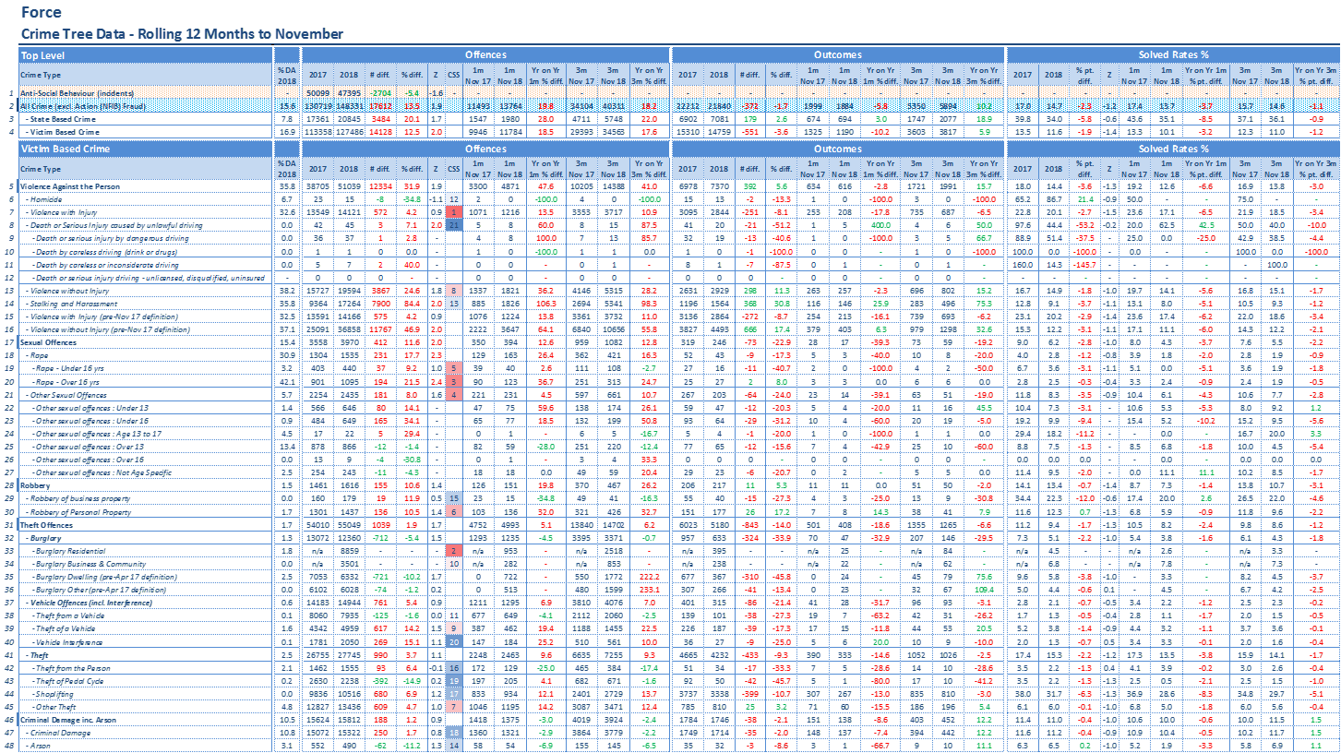
Crime Tree Data – Rolling 12 Months to November
Table 2

Slide 13
Crime Tree Data – Rolling 12 Months to November
Table 3

Slide 14
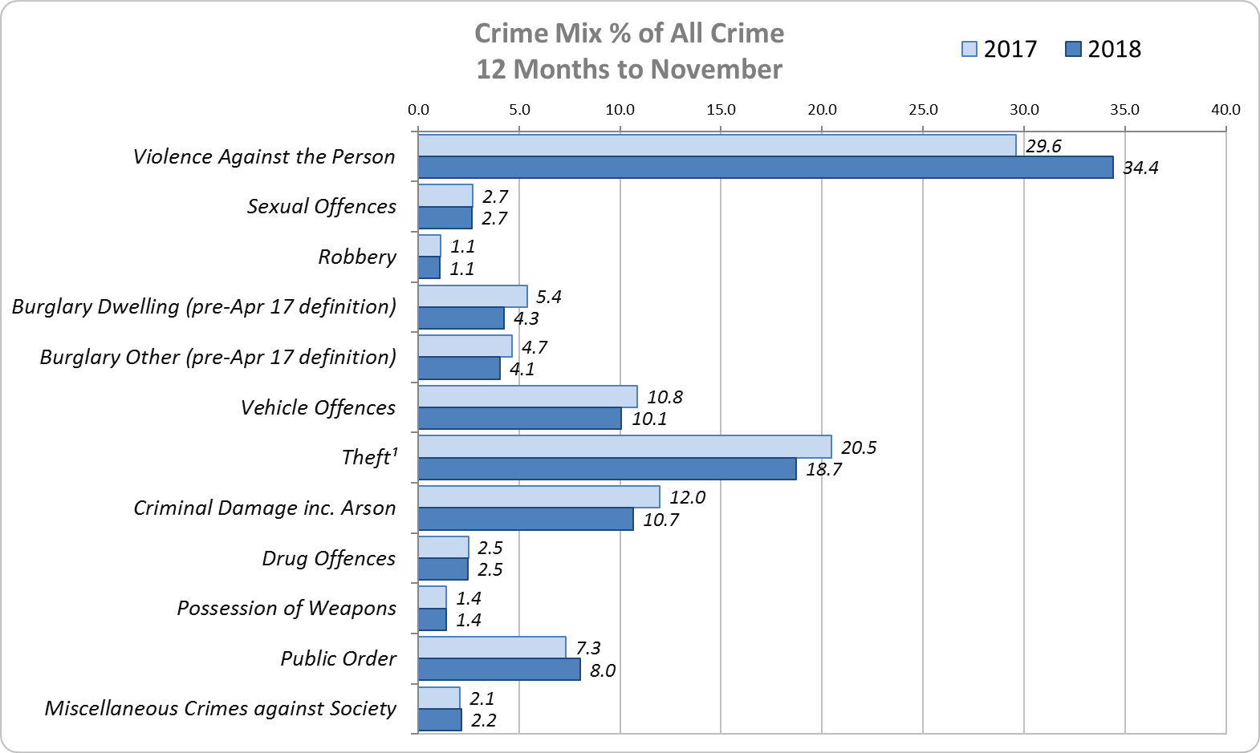
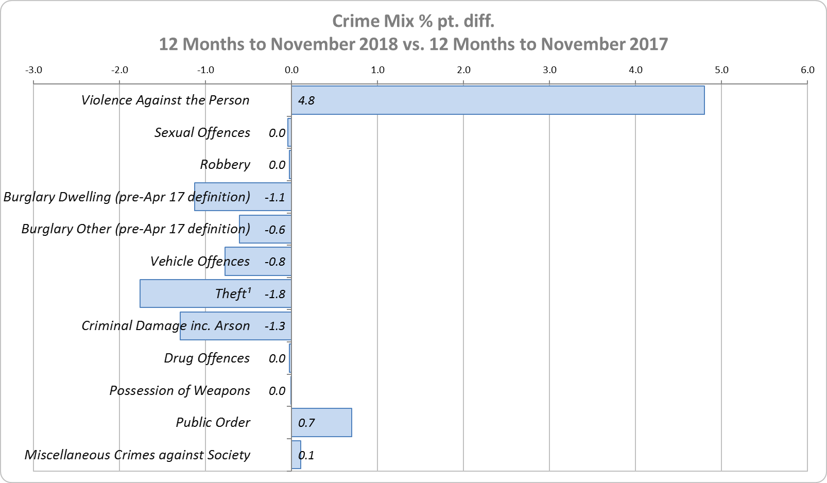
Crime Mix – Rolling 12 Months to November 2017 vs. 2018
Figure 12
Figure 13
Violence Against the Person saw a 4.8% point increase in the proportion of all crime; it also experienced the biggest volume rise (12,334 further offences). Public Order Offences saw a 0.7% point increase in the proportion of all crime, and experienced the second biggest volume rise (2,328 offences).
15.6% of crime is Domestic Abuse-related; this proportion has increased from 15.3% for 12 months to October 2018. Domestic Abuse-related Violence Against the Person increased to 35.8% (from 35.5% 12m October 2018).

