Slide 1
Police and Crime Plan 2016-2020
Monthly Performance Update
December 2018
National and MSG positions are to 30th November 2018 (Essex Police data are to 31st December 2018).
Version 1.3
Produced January 2019
Performance Analysis Unit, Essex Police
Sensitivity: Official

Slide 2
Executive Summary
All Crime has risen by 15.3%. Domestic Abuse (DA) has risen by 46.4%. The increase in both can, in part, be attributed to the increase seen in Stalking and Harassment (which is not an exception this month) following changes to the Home Office Counting Rules (see p.5. for further detail). Other analysis conducted by Essex Police furthermore indicates that better Crime Data Accuracy (CDA), as well as a genuine increase in crime, are also likely to be contributing factors to this rise.
The All Crime solved rate continues to decline due to an increase in the number of crimes, as well as a reduction in the number of crimes considered ‘solved’.
In December 2018 three crime types experienced statistically significant changes:
Violence without Injury: statistical increase. December 2018 was the highest month on record (2,008 offences). This rise has primarily been driven by the change in the means by which Stalking & Harassment has been recorded since April 2018. As now both the most serious offence and the Stalking & Harassment are recorded (rather than purely the most serious), there have been consequent increases in other categories of offences; this includes the Violence without Injury category.
Robbery of Business Property Offences: statistical increase.
Burglary Other Offences: statistical decrease.
There has been a change in the way in which the number of Organised Criminal Group (OCG) disruptions are counted in Essex. This follows guidance issued by the National Crime Agency (NCA) and the Eastern Region Special Operations Unit (ERSOU) to ensure that all forces record disruptions in the same way. Data are consequently only available for November 2018 to December 2018 (see p.10 for further explanation). This measure will change again in January 2019.

Slide 3
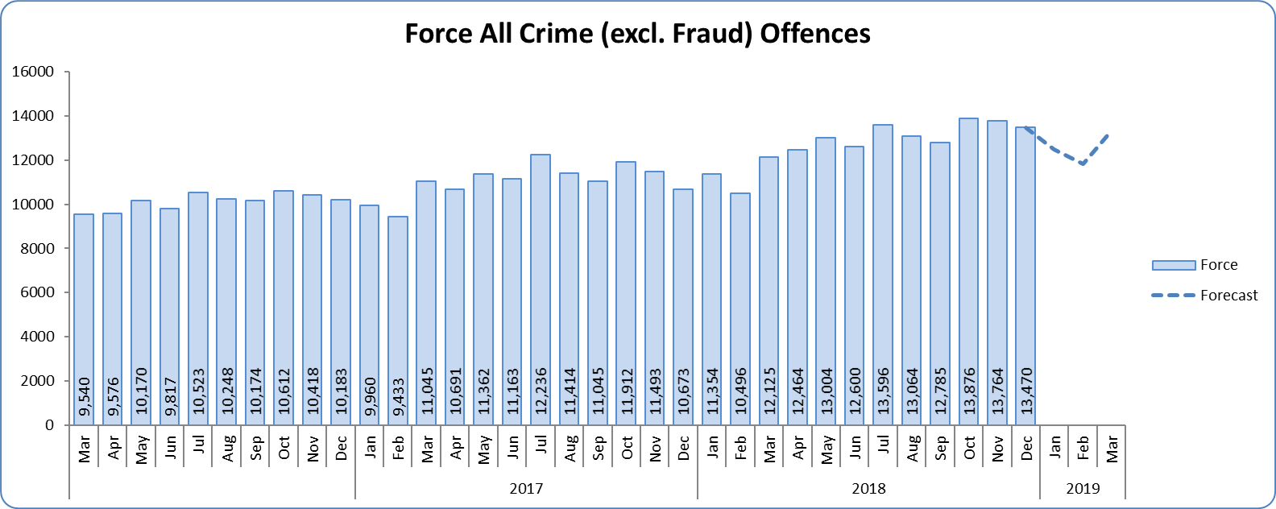
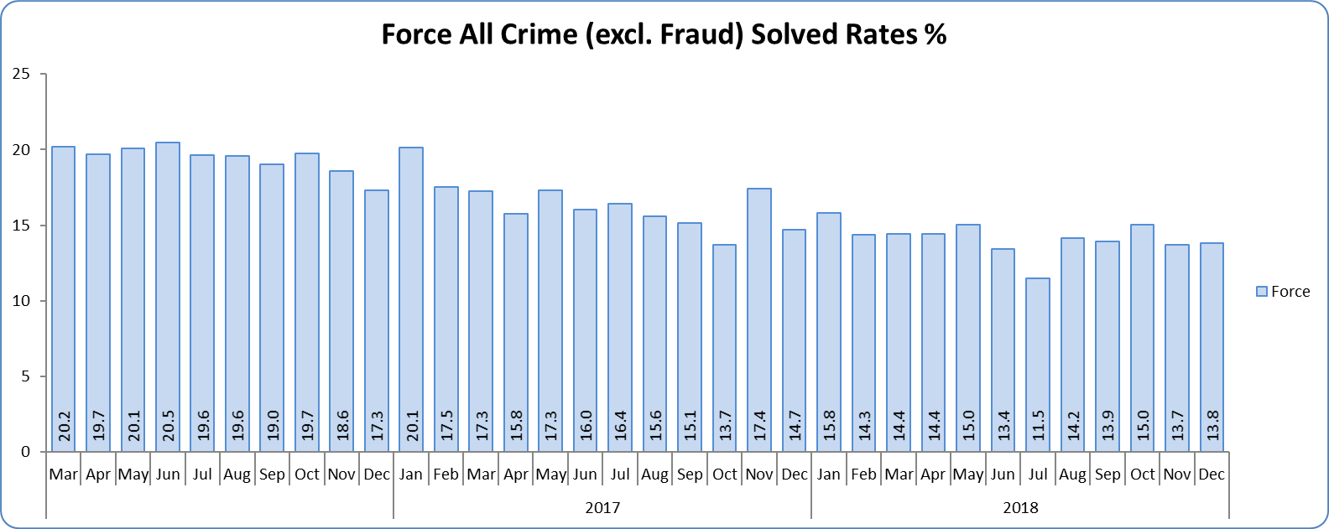
Monthly Performance Overview
Key Areas
All Crime
15.3% increase (20,089 additional offences) compared to the 12 months to December 2017⁺. The national increase~ was 10.3%.
Essex is 8th in its Most Similar Group of forces (MSG) and 25th nationally for crimes per 1,000 of the population. Essex is 8th (out of eight) in its MSG, and is 33rd nationally* for crime increase. Increases seen in 35 out of 42 forces.
Three out of 14 districts experienced statistically significant increases in December 2018. The Force did not.
The forecast^ is that although All Crime will decrease for the next two months before rising again, the level will be higher than that experienced in the same months in previous years. None of the next three months are forecasted to be statistical exceptions.
All Crime Solved Rate
3.0% point decrease (to 14.7%) compared to the 12 months to December 2017 ⁺⁺.
The number of crimes solved also fell: by 4.0% (931 fewer solved outcomes to 22,223) compared to the 12 months to December 2017.
Essex has the 5th highest solved rate in its MSG and is 22nd nationally for its solved rate. Essex is 5th in its MSG and 15th nationally for solved rate % point change.
No district experienced a statistically significant change in December 2018. Neither did the Force.
There is no consistent pattern to provide a statistical forecast.
Figure 1 – Offences by month
Figure 2 – Solved rate by month
⁺ All crime increases/decreases shown are for 12 months to December 2018 compared to the same period to December 2017.
⁺⁺ Solved rate increases/decreases are for 12 months to December 2018 compared to the same period to December 2017. The quoted solved rate is for 12 months to December 2018.
* 1st is considered best performing, and 42nd worst.
~ The national increase (where the category is available) relates to the 12 months to June 2018 vs. 12 months to June 2017 and are the official Home Office figures.
^ Forward projection based on “Time Series Forecasting” method, which takes into account seasonality (when the data follows a statistically consistent pattern).

Slide 4
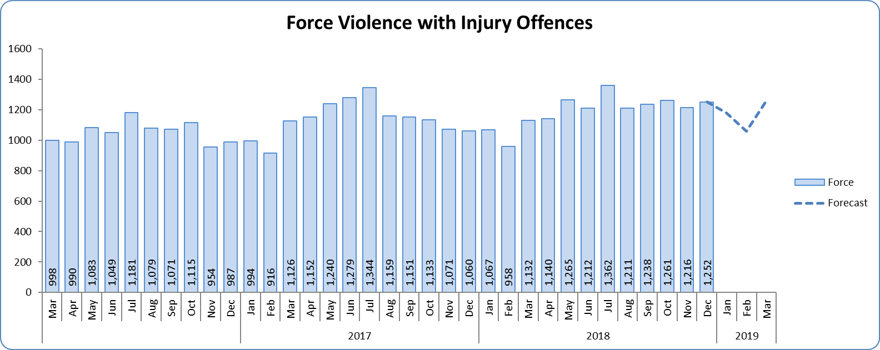
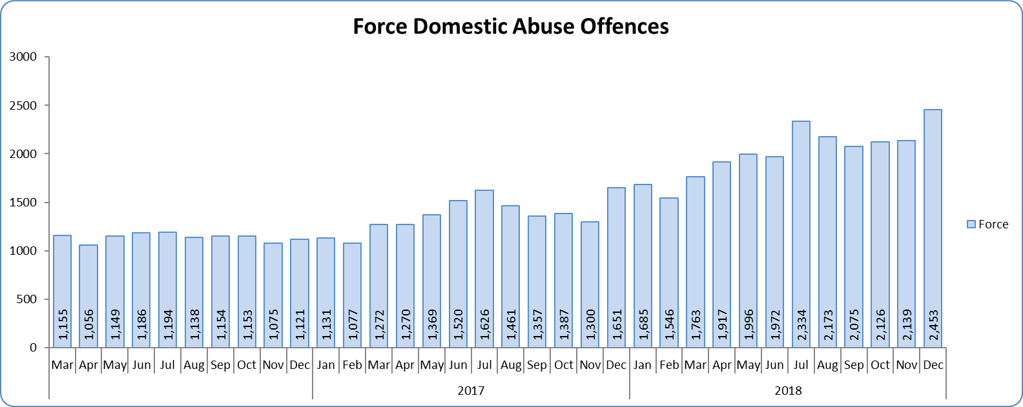
Monthly Performance Overview
Violence with Injury*
5.2% increase (705 additional offences) compared to the 12 months to December 2017. The national increase was 8.5%.
Essex is 4th in its MSG and 15th nationally for crimes per 1,000 of the population. Essex is 5th in its MSG and 16th nationally for crime increase.
Increases seen in 36 out of 42 forces.
83.4% of Violence with Injury is Actual Bodily Harm (ABH). By volume, ABH rose by 5.0% (569 additional offences).
80.7% of the increase in Violence with Injury is due to the rise in ABH.
33.0% of Violence with Injury is Domestic Abuse-related.
No districts experienced a statistically significant increase in December 2018.
Domestic Abuse
46.4% increase (7,594 additional offences) compared to the 12 months to December 2017. This is being driven by the changes in the counting rules relating to Stalking & Harassment (see p.5 for further detail).
There are no national or MSG comparisons on iQuanta** for Domestic Abuse.
The Force and seven districts experienced statistically significant increases in December 2018.
High Risk Domestic Abuse 19.4% increase (386 additional offences).
Medium Risk Domestic Abuse 6.4% increase (283 additional offences).
Standard Risk Domestic Abuse 61.6% increase (5,846 additional offences).
Figure 3 - Offences by month
Figure 4 - Offences by month
* Offences included within the Violence with Injury classification changed in November 2017. Offences involving “Death or Serious Injury – Unlawful Driving” have now been removed and are in a separate category. Please note iQuanta related positions still relate to the former definition.
** A web-based service provided for the use of Police forces, Community Safety Partnerships (CSPs) and Her Majesty’s Inspectorate of Constabulary and Fire & Rescue Service (HMICFRS).

Slide 5
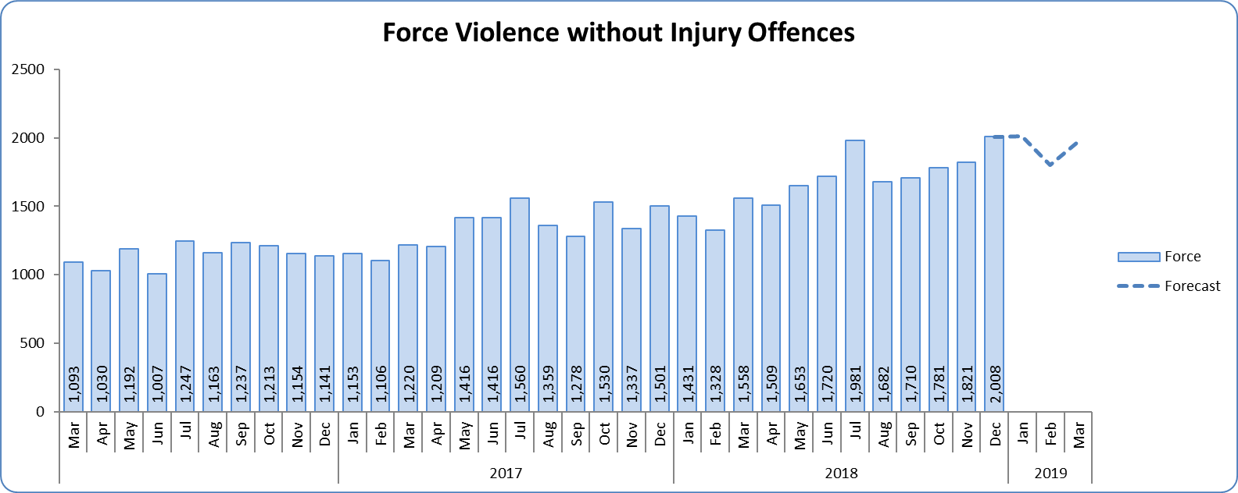
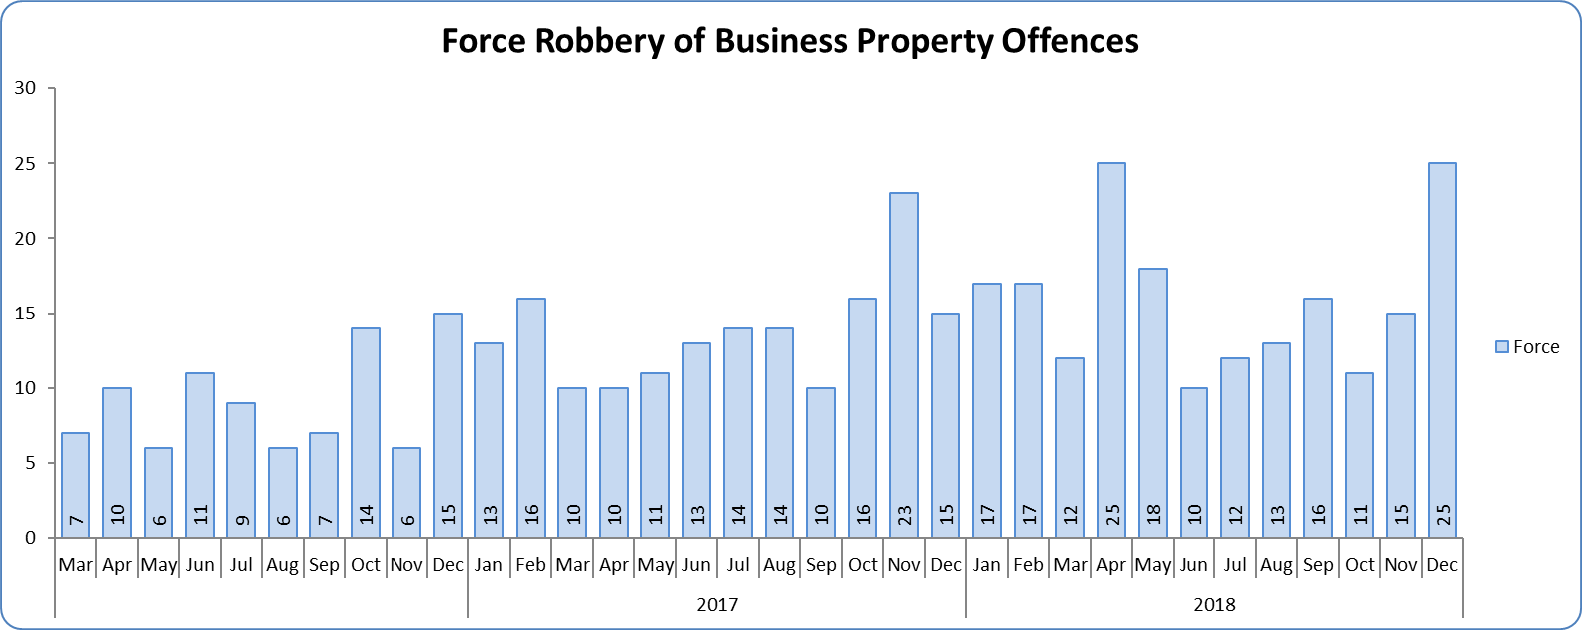
Monthly Performance Overview
Statistical Exceptions – Offences
Violence without Injury Offences
The Force and eight districts experienced a statistically significant increase in December 2018.
25.1% increase (4,026 offences) compared to the 12 months to December 2017.
From April 2018, forces began to record both Stalking & Harassment offences and the most serious additional crime, whereas when someone previously committed a Stalking & Harassment type offence and another offence we recorded just the other offence, not the Stalking & Harassment. This has consequently led to an increase in offences in other categories, such as Violence with Injury. Other analysis previously conducted by Essex Police further indicate that better Crime Data Accuracy (CDA), as well as a genuine increase in crime, are also responsible for the rise.
Essex is 8th in its MSG and 30th nationally for crimes per 1,000 of the population. Essex is 8th in its MSG and 33rd nationally for crime increase.
89.3% of Violence without Injury is Assault without Injury. By volume, Assault without Injury rose by 22.7% (3,323 additional offences).
Increases seen in all 42 forces.
The forecast is offences will increase over the next three months, with January 2019 being forecasted to be a statistical exception.
Figure 5 - Offences by month
Figure 6 - Offences by month
Robbery of Business Property Offences
The Force and three districts experienced a statistically significant increase in December 2018.
18.8% increase (30 offences) compared to the 12 months to December 2017.
Essex is 7th in its MSG and 28th nationally for crimes per 1,000 of the population. Essex is 6th in its MSG and 24th nationally for crime increase.
Increases seen in 30 out of 42 forces.
The forecast is not significant.

Slide 6
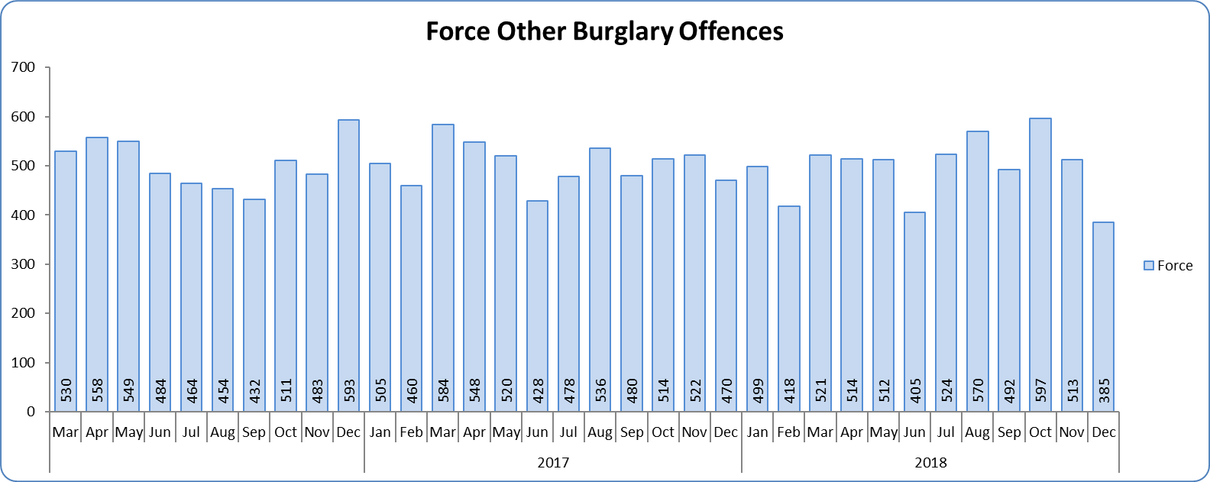
Monthly Performance Overview
Burglary Other Offences
The Force experienced a statistically significant decrease in December 2018.
2.5% decrease (154 offences) compared to the 12 months to December 2017.
There are no national or MSG comparisons on iQuanta for Burglary Other offences.
The forecast is not significant.
Figure 7 - Offences by month

Slide 7
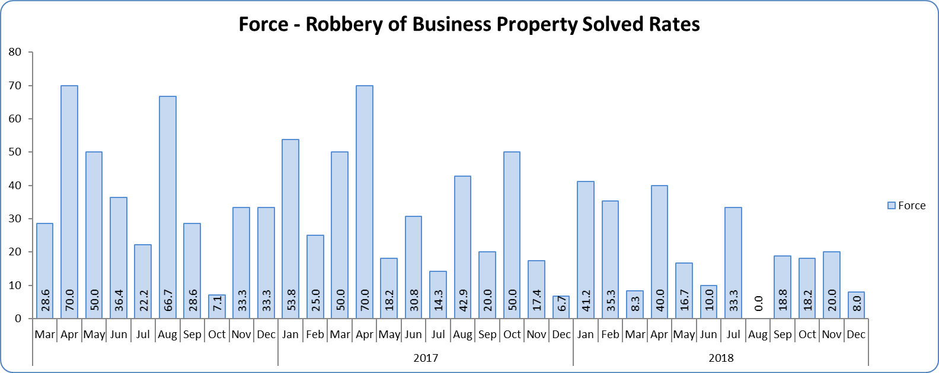
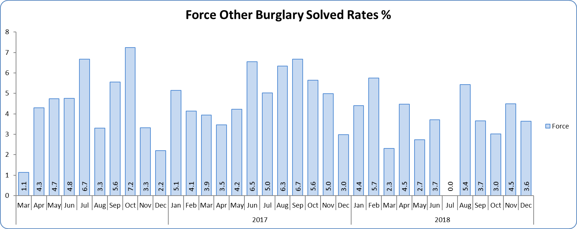
Monthly Performance Overview
Solved Rates by Exception
Robbery of Business Property Solved Rate
Solved rate fell by over 10% compared to the 12 months to December 2017(by 10.3% to 21.6%).
The number of crimes solved also decreased: by 19.6% (10 fewer solved outcomes to 41).
Essex is 6th in its MSG and 29th nationally for solved rate. Essex is 6th in its MSG and 30th nationally for solved rate % point change.
The Force did not experience a statistically significant change in December 2018.
There is no consistent pattern to provide a statistical forecast.
Burglary Other Solved Rate
Solved rate remains below 10% (at 4.8%).
The number of crimes solved decreased: by 7.8% (24 less to 283 solved outcomes) compared to the 12 months to December 2017.
There are no national or MSG comparisons on iQuanta for Burglary Other Solved Rate.
The Force did not experienced a statistically significant change in December 2018.
There is no consistent pattern to provide a statistical forecast.
Figure 8 - Solved rate by month
Figure 9 - Solved rate by month

Slide 8
2016-2020 Police and Crime Plan Performance Indicators
Table 1
See Appendix for endnotes.
Below is an explanation as to why certain indicators are considered to be improving or deteriorating:
Priority 1 – Number of all crime offences. Performance is considered to be deteriorating due to the rise in crime. No data are available to indicate how much of this rise is attributable to better crime data integrity. An increase in crime has been experienced in every UK police force .
Priority 3 - Number of incidents of domestic abuse. Performance is considered to be deteriorating due to the rise in incidents. No data are available to indicate whether this rise is attributable to media campaigns or initiatives that encourage reporting.
Priority 5 - Number of arrests in relation to the trafficking of drugs. Drug trafficking arrests are dependent on pro-active policing. This may include pre-planned operations conducted as a result of intelligence reports received, positive search warrants of residences/premises, and positive searches of individuals.
Priority 7 - Number of driving related mobile phone crime on Essex roads. This is considered to be deteriorating as there has been a noticeable increase in the number of drivers stopped whilst using a mobile phone at the wheel.
Priority 7 - Number of driving under the influence of drink and/or drugs on Essex roads. Operational Policing Command (OPC) have stated that a reduction indicates the public are adhering to the strong educational messages being delivered by drink/driving campaigns. Collisions attended by the police involve routine breath-testing of involved parties. An increase could also demonstrate proactive policing.

Slide 9
Appendix
¹ Results are for the period October 2017 to June 2018. Essex Police performed significantly above the results for the local confidence question contained in the PFCC’s Plan for Q1 and Q2. This difference could not be explained and consequently an additional question was added in Q3 with the exact wording used in the CSEW. This is the question now being used.
² The confidence interval is the range +/- between where the survey result may lie. This is mainly influenced by the number of people answering the survey. The more people that answer the survey, the smaller the interval range.
³ Crime Survey for England and Wales (CSEW): 12 months to June 2018 vs. 12 months to June 2017.
⁴ Results are for the period July 2017 to June 2018.
⁵ Activity is now recorded rather than the number of people arrested. If there was a day of action, for example, and five people were arrested, this would formerly have counted as five disruptions, but now will count as one. The change stems from confusion over the previous guidelines, with counties counting disruptions in different ways. The numbers of disruptions now being reported will consequently be substantially lower than previously reported. Data are for November 2018 to December 2018.
⁶ Solved outcomes are crimes that result in: charge or summons, caution, crimes taken into consideration, fixed penalty notice, cannabis warning or community resolution.
⁷ ‘Killed or Seriously Injured’ refers to all people killed or seriously injured on Essex’s roads, regardless of whether any criminal offences were committed. ‘Causing Death/Serious Injury by Dangerous/Inconsiderate Driving’, however, refers to the number of crimes of this type.

Slide 10
Crime Tree Data – Rolling 12 Months to December
Table 2

Slide 11
Crime Tree Data – Rolling 12 Months to December
Table 3

Slide 12
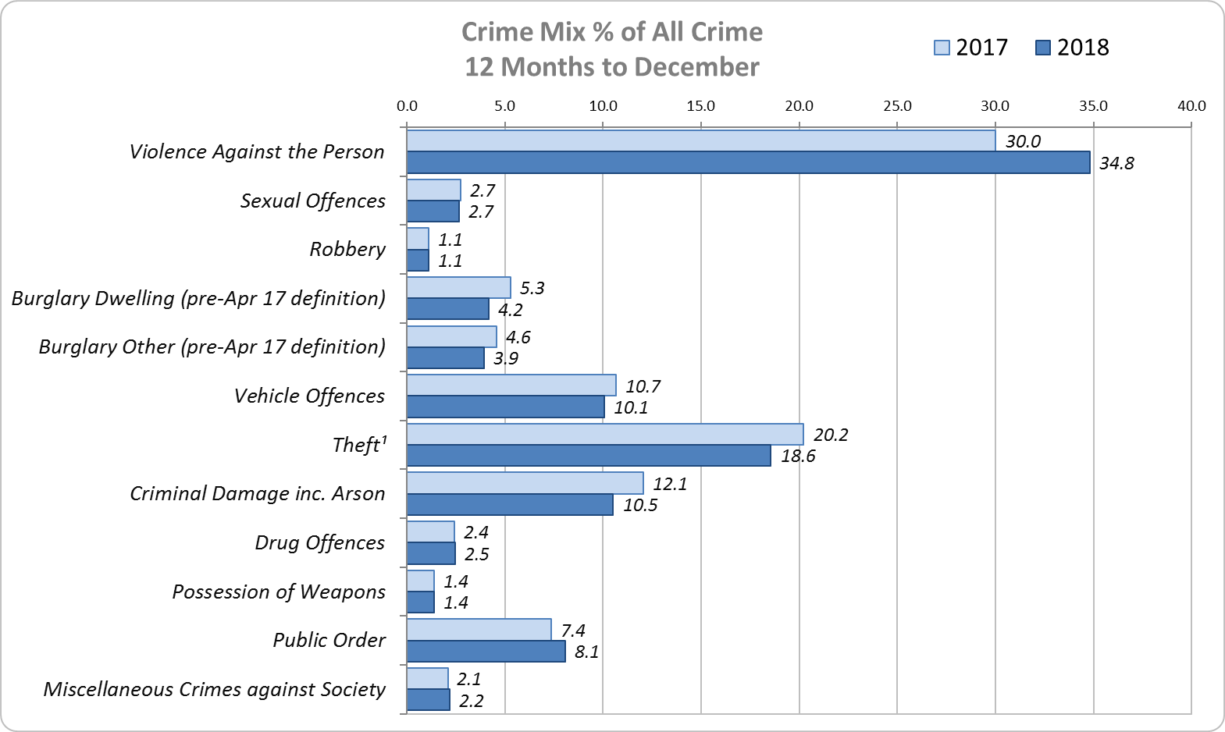
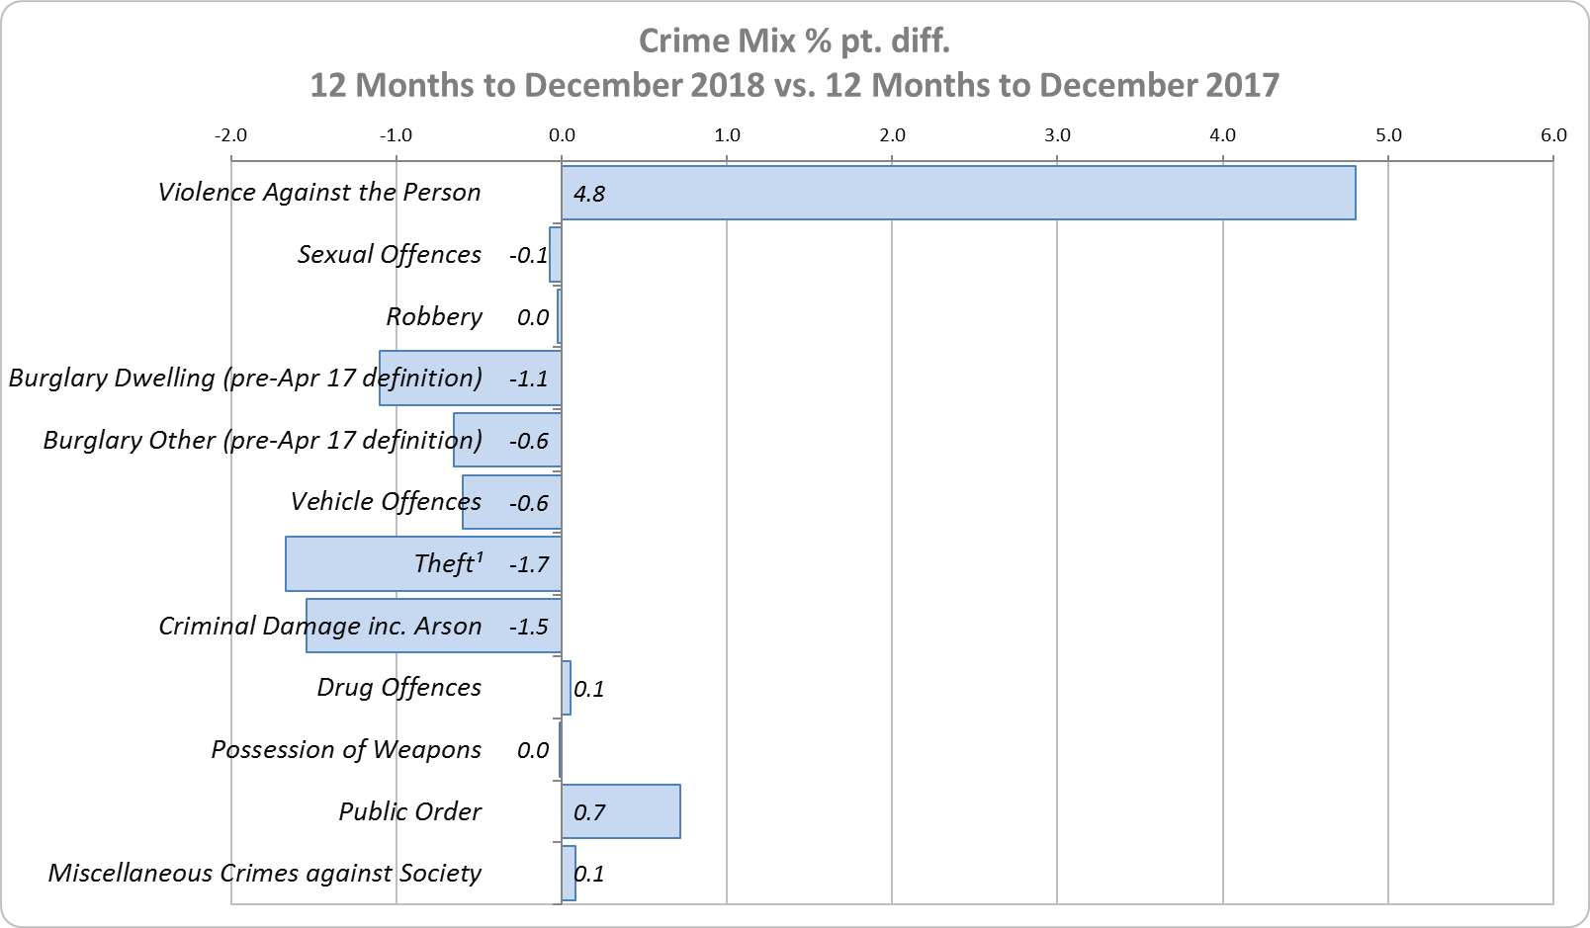
Crime Mix – Rolling 12 Months to December 2017 vs. 2018
Figure 10
Figure 11
Violence Against the Person saw a 4.8% point increase in the proportion of all crime; it also experienced the biggest volume rise (13,297 further offences). Public Order Offences saw a 0.7% point increase in the proportion of all crime, and experienced the second biggest volume rise (2,564 offences).
15.9% of crime is Domestic Abuse-related; this proportion has increased from 15.6% for 12m to November 2018. Domestic Abuse-related Violence Against the Person increased to 35.9% from 35.8% 12m November 2018.

