Slide 1
Police and Crime Plan 2016-2020
Monthly Performance Update
July 2018
National and MSG positions are to 30th June 2018 (Essex Police data are to 31st July 2018).
Version 1.3
Produced August 2018
Performance Information Unit, Essex Police
Sensitivity: Official

Slide 2
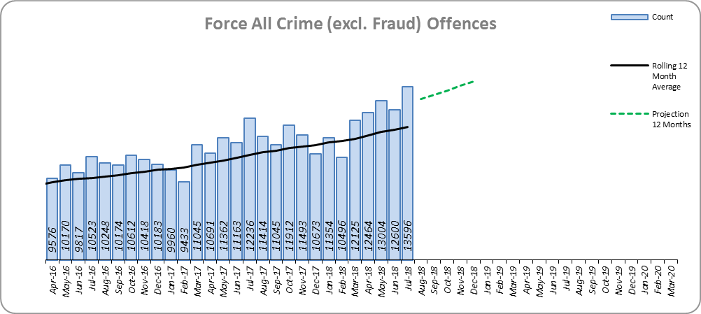
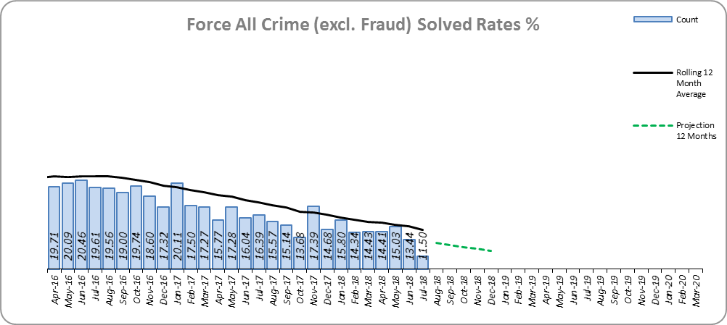
Monthly Performance Overview
Key Areas
All Crime
10.9% increase (13,760 additional offences)⁺. The national increase~ was 12.9%.
Essex is 7th (out of eight) in its Most Similar Group of forces (MSG), and is 28th nationally* for crime increase. Essex is 5th in its MSG and 22nd nationally for crimes per 1,000 of the population.
Increases seen in 40 out of 42 forces.
The Force and seven out of 14 districts experienced statistically significant increases in July 2018.
The forecast^ is that All Crime will increase.
All Crime Solved Rate
3.1% point decrease (to 15.0%) ⁺⁺.
The number of crimes solved also fell: by 8.2% (1,895 fewer solved outcomes to 21,104).
Essex is 6th in its MSG and 20th nationally for solved rate % point change. Essex has the 4th highest solved rate in its MSG and 24th nationally for solved rate.
The Force and three districts experienced a statistically significant decrease in July 2018.
The forecast is that the solved rate will decrease.
Figure 1
Figure 2
⁺ All crime increases/decreases shown are for 12 months to July 2018 compared to the same period to July 2017.
⁺⁺ Solved rate increases/decreases are for 12 months to July 2018 compared to the same period to July 2017. The final solved rate is for 12 months to July 2018.
* 1st is considered best performing, and 42nd worst.
~ The national increase (where the category is available) relates to the 12 months to March 2018 vs. 12 months to March 2017 and are the official Home Office figures.
^ All forecasts are based on the last 12 months.

Slide 3
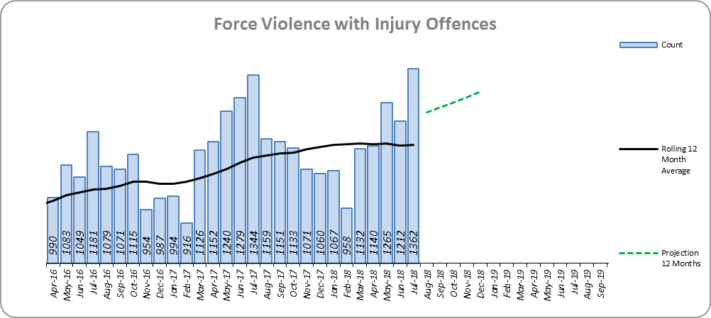
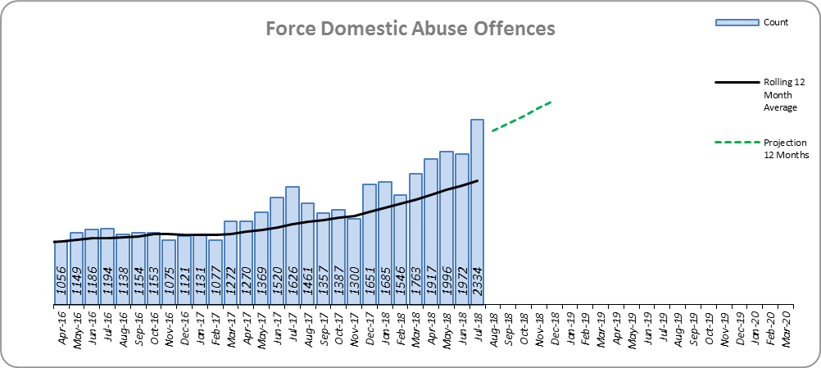
Monthly Performance Overview
Violence with Injury*
3.0% increase (400 additional offences).
Essex is 4th in its MSG and 14th nationally for crime increase. Essex is 4th in its MSG and 13th nationally for crimes per 1,000 of the population.
Increases seen in 37 out of 42 forces. The national increase was 9.9%.
83.3% of Violence with Injury is Actual Bodily Harm (ABH). By volume, ABH rose by 1.9% (209 additional offences).
52.3% of the increase in Violence with Injury is due to the rise in ABH.
32.1% of Violence with Injury is Domestic Abuse-related.
The Force and three districts experienced statistically significant increases in July 2018.
The forecast is that Violence with Injury will increase.
Figure 3
Domestic Abuse
34.3% increase (5,123 additional offences).
There are no national or MSG comparisons on iQuanta** for Domestic Abuse.
The Force and 12 districts experienced statistically significant increases in July 2018.
The forecast is that Domestic Abuse (all risk levels combined) will continue to rise.
High Risk Domestic Abuse 1.1% increase (24 offences).
Medium Risk Domestic Abuse 10.8% decrease (535 offences).
Standard Risk Domestic Abuse 64.1% increase (4,839 offences).
Figure 4
* Offences included within the Violence with Injury classification changed in November 2017. Offences involving “Death or Serious Injury – Unlawful Driving” have now been removed and are in a separate category. Please note iQuanta related positions still relate to the former definition.
** A web-based service provided for the use of Police forces, Community Safety Partnerships (CSPs) and Her Majesty’s Inspectorate of Constabulary and Fire & Rescue Service (HMICFRS).

Slide 4
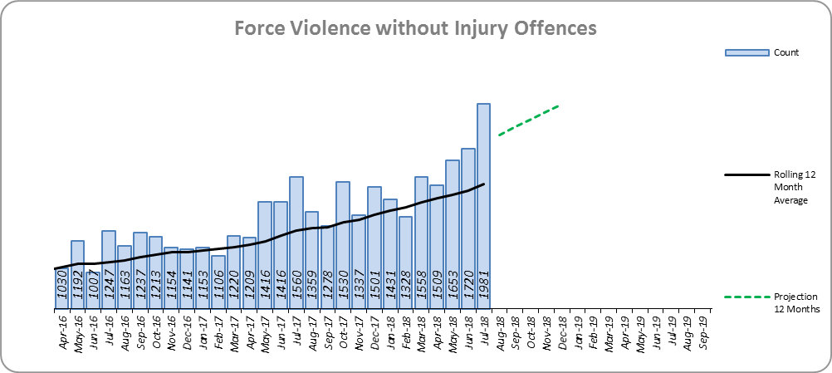
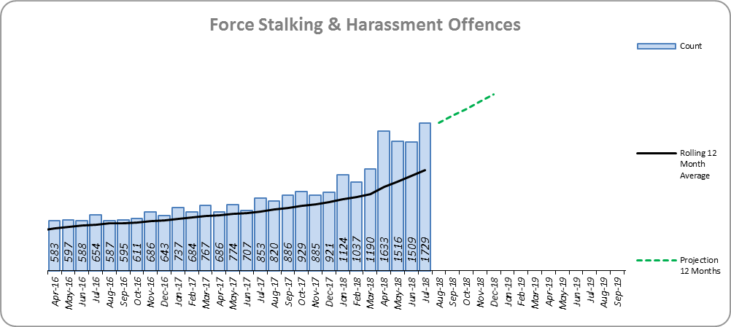
Monthly Performance Overview
Statistical Exceptions – Offences
Violence without Injury*
The Force and 13 districts experienced statistically significant increases in July 2018.
20.3% increase (3,043 offences). The national increase was 23.6%.
Essex is 7th in its MSG and 29th nationally for crime increase. Essex is 7th in its MSG and 28th nationally for crimes per 1,000 of the population.
Increases seen in all 42 forces.
89.0% of Violence without Injury is Common Assault.
82.3% of the increase in Violence without Injury is due to the rise in Common Assault.
The forecast is that Violence without Injury offences will continue to increase.
Figure 5
Stalking and Harassment Offences
The Force and 13 districts experienced statistically significant increases in July 2018.
65.7% increase (5,482 offences). The national increase was 30.1%.
From April 2018, forces began to record both the Harassment and the most serious additional crime, whereas when someone previously committed a Harassment type offence and another offence (such as ABH) we recorded just the other offence, not the Harassment.
We will see further increases to the number of recorded offences due to the above change in the counting rules for Harassment.
There are no full year national or MSG comparisons on iQuanta.
34.3% of offences were Domestic Abuse-related.
The forecast is that Stalking and Harassment offences will continue to increase.
Figure 6
* Offences included within the Violence without Injury classification changed in November 2017. Offences involving “Stalking and Harassment” have now been removed and are within a separate category. Please note iQuanta related positions still relate to the former definition.

Slide 5
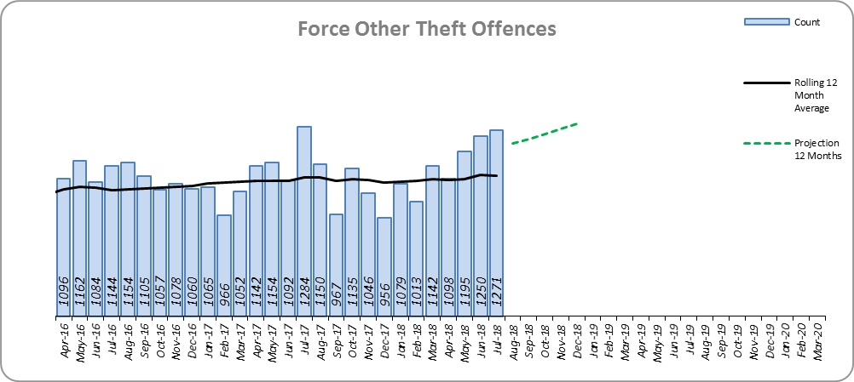
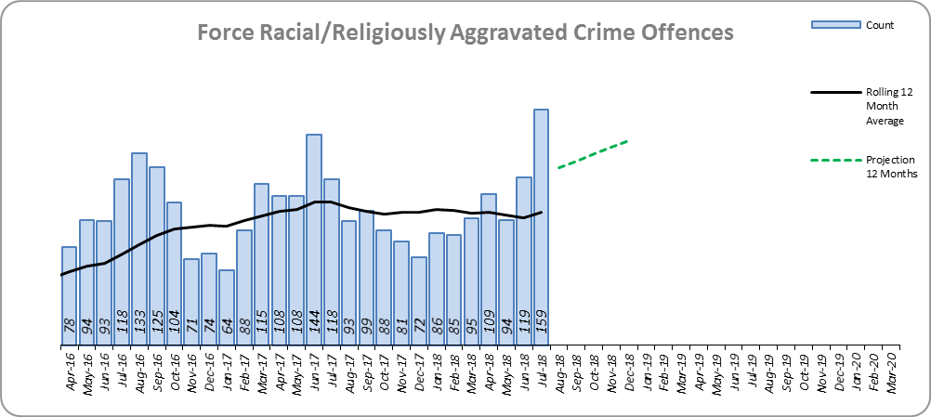
Monthly Performance Overview
Other Theft Offences
The Force and two districts experienced statistically significant increases in July 2018.
0.2% decrease (23 offences).
Essex is 5th in its MSG and 20th nationally for crime increase. Essex is 3rd in its MSG and 15th nationally for crimes per 1,000 of the population.
Increases seen in 28 out of 42 forces.
The forecast is that Other Theft offences will increase.
Figure 7
Racially Aggravated Crime
The Force and three districts experienced statistically significant increases in July 2018.
6.1% decrease (77 offences).
The spike experienced in July 2018 was also seen in June 2017 and August 2016.
Essex is 2nd in its MSG and 4th nationally for crime increase. Essex is 3rd in its MSG and 19th nationally for crimes per 1,000 of the population.
Increases seen in 25 out of 42 forces.
The forecast is that Racially Aggravated offences will increase.
Figure 8

Slide 6
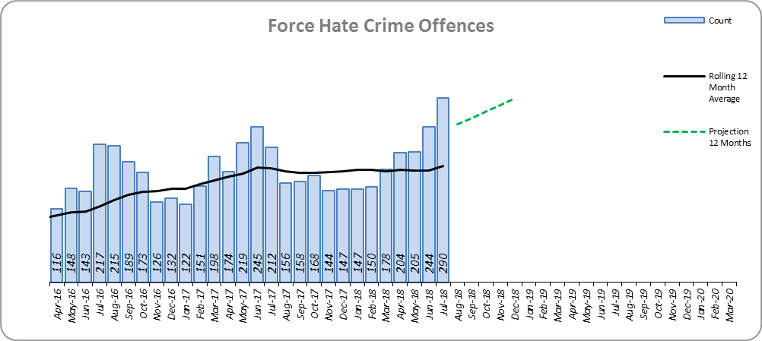
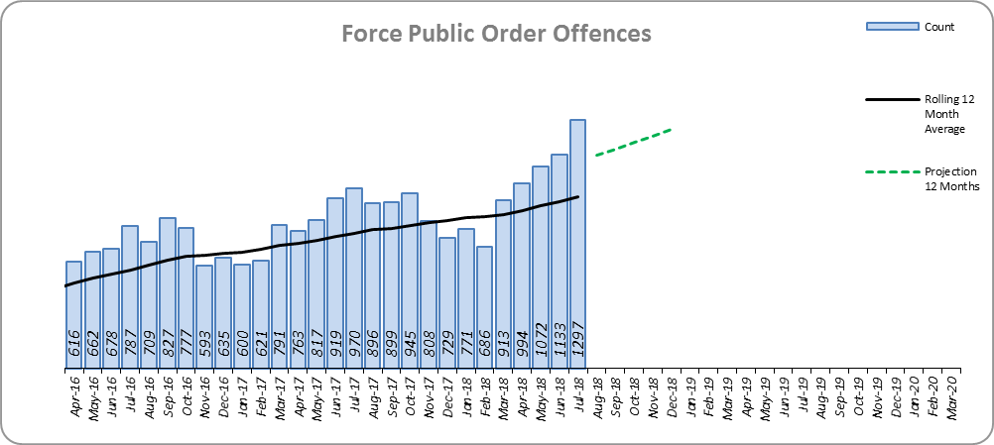
Monthly Performance Overview
Figure 9
Hate Crime
The Force experienced a statistically significant increase in July 2018.
1.9% increase (41 offences).
There are no national or MSG comparisons on iQuanta for Hate Crime.
The forecast is that Hate Crime will increase.
Figure 10
Public Order
The Force and 10 districts experienced statistically significant increases in July 2018.
23.0% increase (2,064 offences). The national increase was 36.1%.
Essex is 6th in its MSG and 21st nationally for crime increase. Essex is 6th in its MSG and 26th nationally for crimes per 1,000 of the population.
Increases seen in 39 out of 42 forces.
The forecast is that Public Order offences will increase.

Slide 7
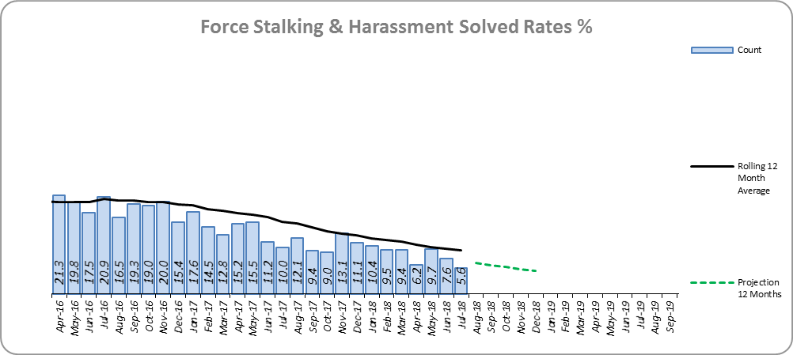
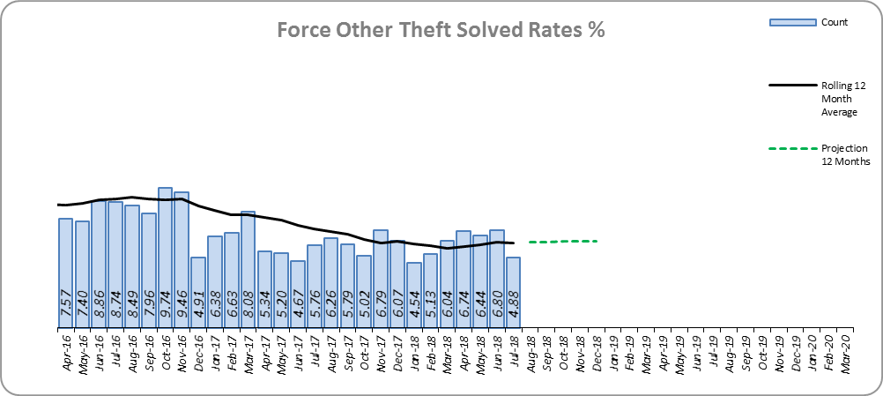
Monthly Performance Overview
Solved Rates by Exception
Stalking and Harassment Solved Rate
Solved rate remains below 10% (at 9.5%).
The number of crimes solved increased: by 2.5% (32 more to 1,310 solved outcomes).
The Force and no districts experienced a statistically significant change in July 2018.
The forecast is that the solved rate will decrease.
Figure 11
Figure 12
Other Theft Solved Rate
Solved rate remains below 10% (at 6.3%).
The number of crimes solved decreased: by 11.4% (104 fewer solved outcomes to 811).
Essex is 6th in its MSG and 24th nationally for solved rate % point change. Essex has the 3rd highest solved rate in its MSG and 11th nationally for solved rate.
The Force and no districts experienced a statistically significant change in July 2018.
The forecast is that the solved rate will increase.

Slide 8
2016-2020 Police and Crime Plan Performance Indicators
Table 1
See Appendix for endnotes.
Below is an explanation as to why certain indicators are considered to be improving or deteriorating:
Priority 1 – Number of all crime offences. Performance is considered to be deteriorating due to the rise in crime. No data are available to indicate how much of this rise is attributable to better crime data integrity. An increase in crime has been experienced in every UK police force .
Priority 3 - Number of incidents of domestic abuse. Performance is considered to be deteriorating due to the rise in incidents. No data are available to indicate whether this rise is attributable to media campaigns or initiatives that encourage reporting.
Priority 5 - Number of arrests in relation to the trafficking of drugs. Drug trafficking arrests are dependent on pro-active policing. This may include pre-planned operations conducted as a result of intelligence reports received, positive search warrants of residences/premises, and positive searches of individuals.
Priority 7 - Number of driving related mobile phone crime on Essex roads. This is considered to be improving as Essex Police’s Operational Policing Command (OPC) have stated there has been a noticeable reduction in the number of drivers stopped whilst using a mobile phone at the wheel.
Priority 7 - Number of driving under the influence of drink and/or drugs on Essex roads. Operational Policing Command (OPC) have stated that a reduction indicates the public are adhering to the strong educational messages being delivered by drink/driving campaigns. Collisions attended by the police involve routine breath-testing of involved parties. An increase could also demonstrate proactive policing.

Slide 9
Appendix
¹ª Results are for the period October 2017 to March 2018. Essex Police performed significantly above the results for the local confidence question contained in the PFCC’s Plan for Q1 and Q2. This difference could not be explained and consequently an additional question was added in Q3 with the exact wording used in the CSEW. This is the question now being used.
¹^{b} Results are for the period April 2017 to March 2018.
² Crime Survey for England and Wales (CSEW): 12 months to March 2018 vs. 12 months to March 2017.
³ The number of Organised Criminal Group disruptions are for the periods May 2018 to July 2018 vs. February 2018 to April 2018.
⁴ Solved outcomes are crimes that result in: charge or summons, caution, crimes taken into consideration, fixed penalty notice, cannabis warning or community resolution.
⁵ ‘Killed or Seriously Injured’ refers to all people killed or seriously injured on Essex’s roads, regardless of whether any criminal offences were committed. ‘Causing Death/Serious Injury by Dangerous/Inconsiderate Driving’, however, refers to the number of crimes of this type.
⁶ The confidence interval is the range +/- between where the survey result may lie. This is mainly influenced by the number of people answering the survey. The more people that answer the survey, the smaller the interval range.
* Standard Scores are used to compare figures from different normal distributions, and determine how spread out they are from the average or ‘mean’. They are calculated in the following way: (the month's figure, minus the average figure per month over the previous three years) divided by the Standard Deviation of the same three year period. In this document, a Standard Score over 1.96 or under -1.96 was used to identify whether the increase or decrease was statistically significant.

Slide 10
Crime Tree Data – Rolling 12 Months to July
Table 2

Slide 11
Crime Tree Data – Rolling 12 Months to July
Table 3

Slide 12
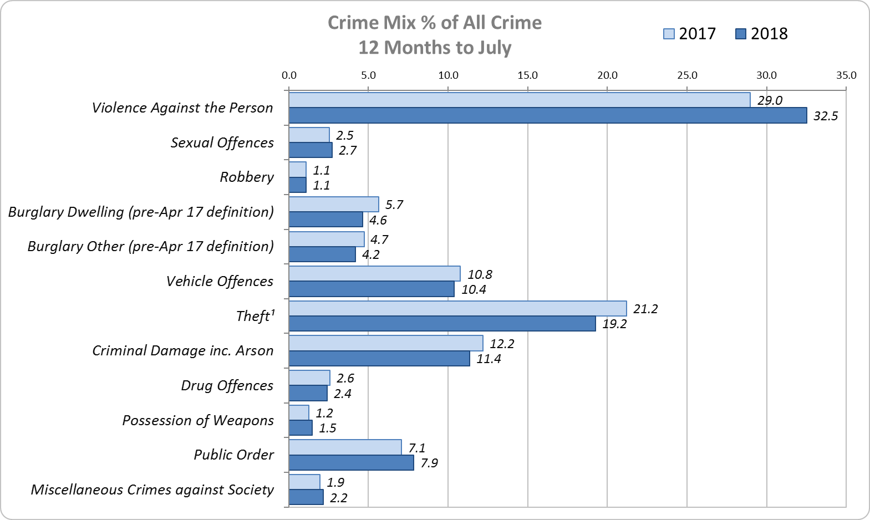
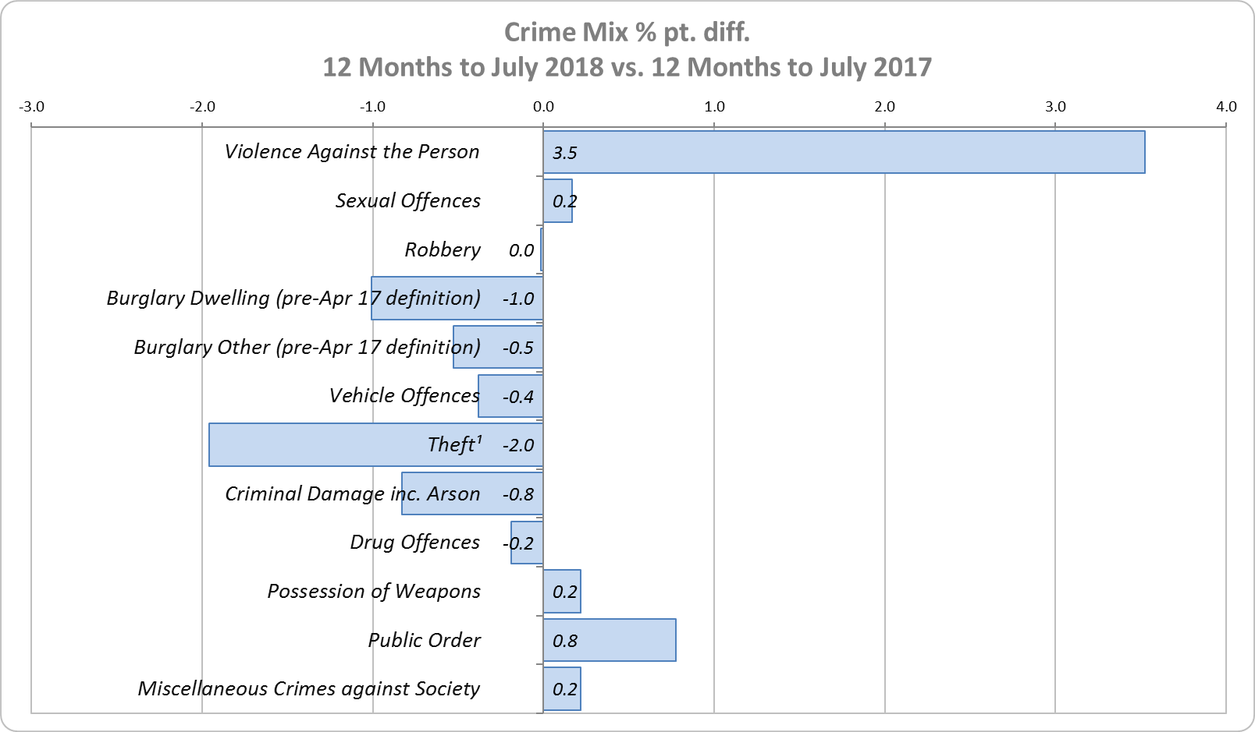
Crime Mix – Rolling 12 Months to July 2017 vs. 2018
Figure 13
Figure 14
Violence Against the Person saw a 3.5% point increase in the proportion of all crime; it also experienced the biggest volume rise (8,933 further offences). Public Order Offences saw a 0.8% point increase in the proportion of all crime, and experienced the second biggest volume rise (2,064 offences).
14.3% of crime is Domestic Abuse-related; this proportion has increased from 13.9% for 12 months to June 2018. Domestic Abuse-related Violence Against the Person increased to 34.7% (from 34.4% for 12 months to June 2018).

