Slide 1
Police and Crime Plan 2016-2020
Monthly Performance Update
February 2018
National and MSG positions are to 31st January 2018 (Essex Police data are to 28th February 2018).
Version 1.0
Produced March 2018
Performance Information Unit, Essex Police

Slide 2
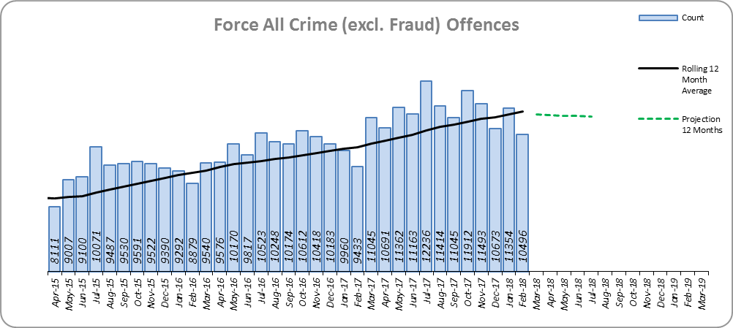
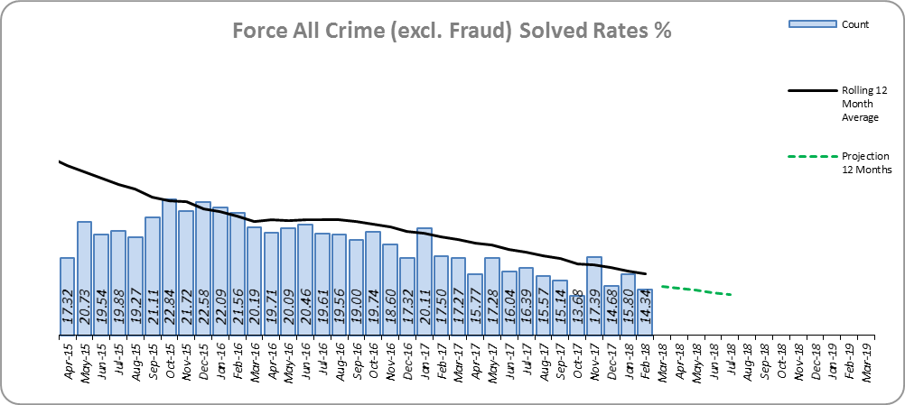
Monthly Performance Overview
Key Areas
All Crime
12.0% increase (14,232 additional offences).⁺
Essex has the 6th lowest increase (out of eight) in its Most Similar Group of forces (MSG), and is 19th nationally* for crime increase. Essex is 4th in its MSG and 19th nationally for crimes per 1,000 of the population.
Increases seen in all 42 forces. The national increase~ was 15.3%.
One district experienced a statistically significant increase in February 2018.
The forecast^ is that All Crime will decrease.
All Crime Solved Rate
3.5% point decrease (to 16.3%).
The number of crimes solved also fell: by 7.7% (1,810 fewer solved outcomes to 21,691).
Essex is 6th in its MSG and 21st nationally for solved rate % point change. Essex has the 4th highest solved rate in its MSG and 22nd nationally for solved rate.
The Force and five districts experienced statistically significant decreases in February 2018.
The forecast is that the solved rate will continue to decrease.
Figure 1
Figure 2
⁺ All crime increases shown are for 12 months to February 2018 compared to the same period to February 2017.
* 1st is considered best performing, and 42nd worst.
~ The national increase (where the category is available) relates to the 12 months to September 2017 vs 12 months to September 2016.
^ All forecasts are based on the last 12 months.

Slide 3
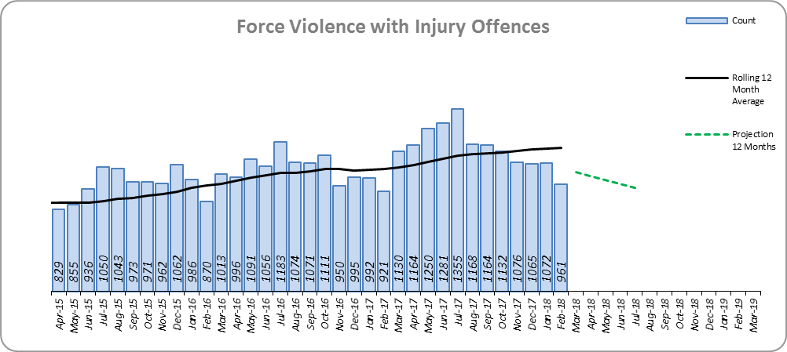
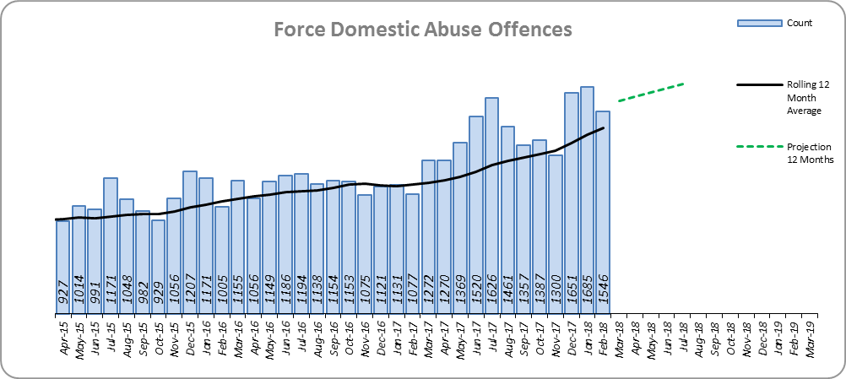
Monthly Performance Overview
Violence with Injury*
10.5% increase (1,306 additional offences).
Essex is 6th in its MSG and 22nd nationally for crime increase. Essex is 5th in its MSG and 17th nationally for crimes per 1,000 of the population.
Increases seen in 41 out of 42 forces. The national increase was 9.4%.
83.4% of Violence with Injury is Actual Bodily Harm (ABH). By volume, ABH rose by 8.5% (894 additional offences).
68.5% of the increase in Violence with Injury is due to the rise in ABH. There was also a 63.3% rise in ‘wounding with intent to do grievous bodily harm or resist apprehension’ (432 additional offences); this was the category with the second highest volume rise (after ABH).
31.3% of Violence with Injury is Domestic Abuse-related.
Four districts experienced a statistically significant decreases in February 2018.
The forecast is that Violence with Injury will decrease.
Figure 3
Domestic Abuse
27.6% increase (3,751 additional offences).
There are no national or MSG comparisons on iQuanta** for Domestic Abuse.
The Force and eight districts experienced statistically significant increases in February 2018.
The forecast is that Domestic Abuse (all risk levels combined) will continue to rise.
High Risk Domestic Abuse 25.5% decrease (691 offences).
Medium Risk Domestic Abuse 28.9% decrease (1,792 offences).
Standard Risk Domestic Abuse 131.8% increase (5,858 offences).
Figure 4
* Offences included within the Violence with Injury classification changed in November 2017. Offences involving “Death or Serious Injury – Unlawful Driving” have now been removed and are in a separate category. Please note iQuanta related positions still relate to the former definition.
** A web-based service provided for the use of Police forces, Community Safety Partnerships (CSPs) and Her Majesty’s Inspectorate of Constabulary and Fire & Rescue Service (HMICFRS).

Slide 4
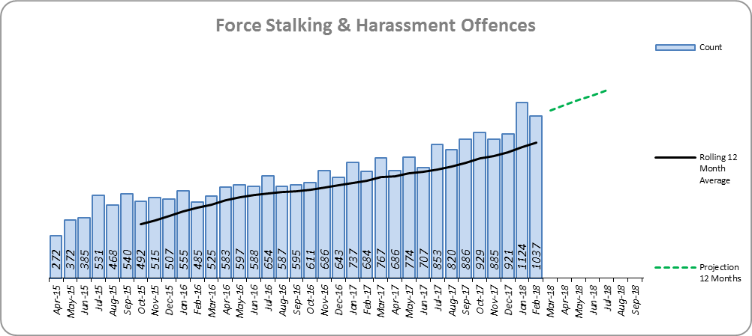
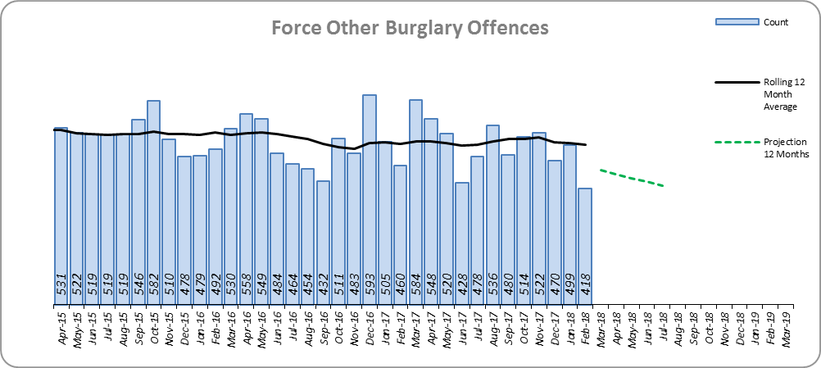
Monthly Performance Overview
Statistical Exceptions – Offences
Stalking and Harassment Offences*
The Force and 10 out of 14 districts experienced statistically significant increases in February 2018.
45.7% increase (3,224 additional offences). 84.4% of this was as a result of an increase in Malicious Communications.
Malicious Communication experienced a 78.3% increase to 6,196 offences (2,720 more), and accounted for 60.3% of Stalking and Harassment.
Harassment saw a 22.8% increase to 3,178 (590 more offences) and accounts for 30.9% of Stalking and Harassment.
There are no full year national or MSG comparisons on iQuanta.
33.2% of offences were Domestic Abuse-related.
The national increase was 35.9%.
The forecast is that Stalking and Harassment offences will continue to increase.
Figure 5
Figure 6
Other Burglary
The Force and two out of 14 districts experienced statistically significant decreases in February 2018. One district saw a statistically significant increase.
0.8% decrease (50 fewer offences).
There are no national or MSG comparisons on iQuanta.
The forecast is that Other Burglary offences will decrease.
* Offences included within the Violence without Injury classification changed in November 2017. Offences involving “Stalking and Harassment” have now been removed and are within a separate category. Please note iQuanta related positions still relate to the former definition.

Slide 5
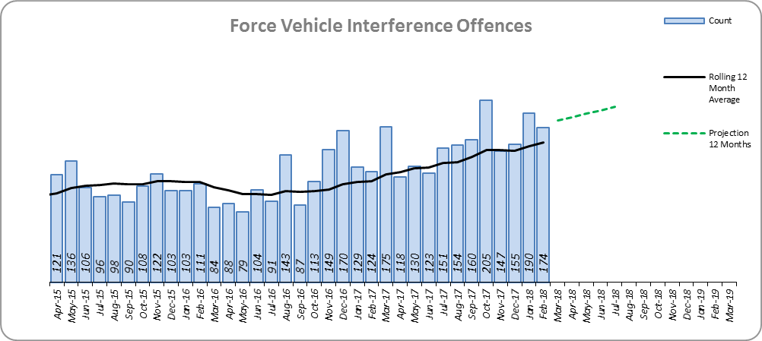
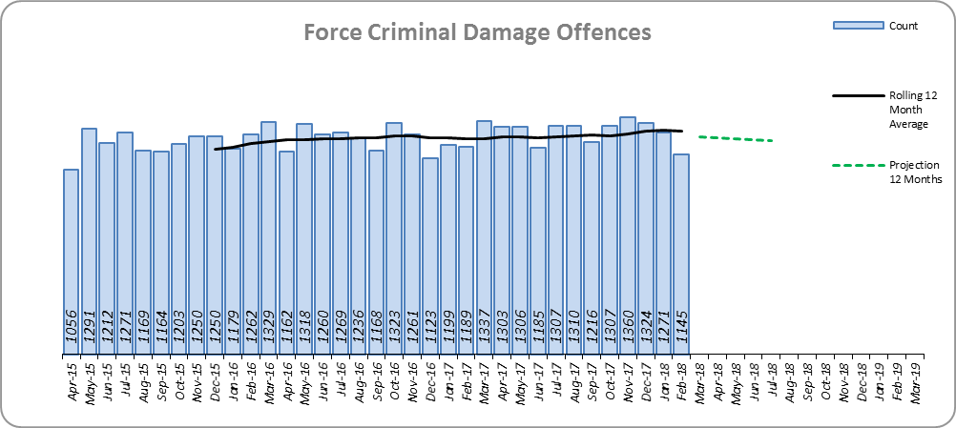
Monthly Performance Overview
Vehicle Interference Offences
The Force and four out of 14 districts experienced statistically significant increases in February 2018. One district saw a statistically significant decrease.
37.5% increase (511 additional offences).
Essex is 4th in its MSG and 24th nationally for crime increase. Essex is 4th in its MSG and 24th nationally for crimes per 1,000 of the population.
Increases seen in 39 out of 42 forces.
The forecast is that Vehicle Interference offences will continue to increase.
Figure 7
Criminal Damage Offences
The Force experienced a statistically significant decrease in February 2018.
3.6% increase (535 additional offences).
Essex is 5th in its MSG and 11th nationally for crime increase. Essex is 4th in its MSG and 16th nationally for crimes per 1,000 of the population.
Increases seen in 38 out of 42 forces. The national increase was 6.4%.
The forecast is that Criminal Damage offences will decrease.
Figure 8

Slide 6
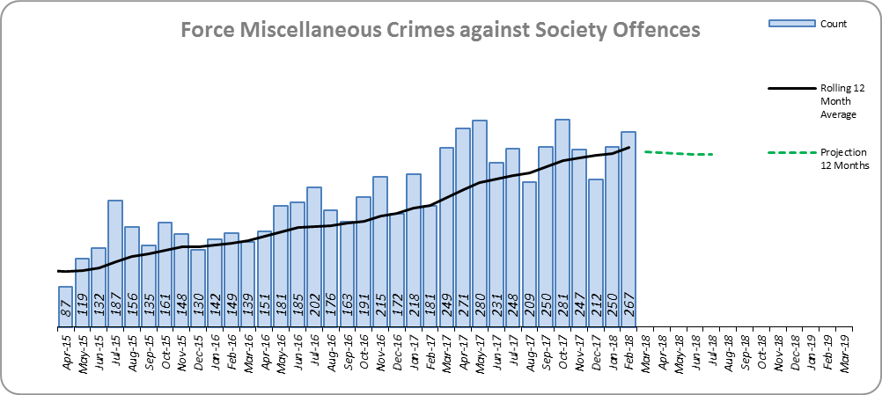
Monthly Performance Overview
Miscellaneous Crimes Against Society Offences*
The Force and four out of 14 districts experienced statistically significant increases in February 2018.
38.6% increase (801 additional offences).
Essex is 8th in its MSG and 29th nationally for crime increase. Essex is 7th in its MSG and 27th nationally for crimes per 1,000 of the population.
Increases seen in 41 out of 42 forces. The national increase was 29.2%.
The forecast is that Miscellaneous Crimes against Society offences will decrease.
Figure 9
*This category includes offences such as threat/possession with intent to cause criminal damage 93.3% increase to 1007, obscene publications 45.8% increase to 793, public health offences 25.4% increase to 222 and perverting the course of justice 5.8% increase to 202.

Slide 7
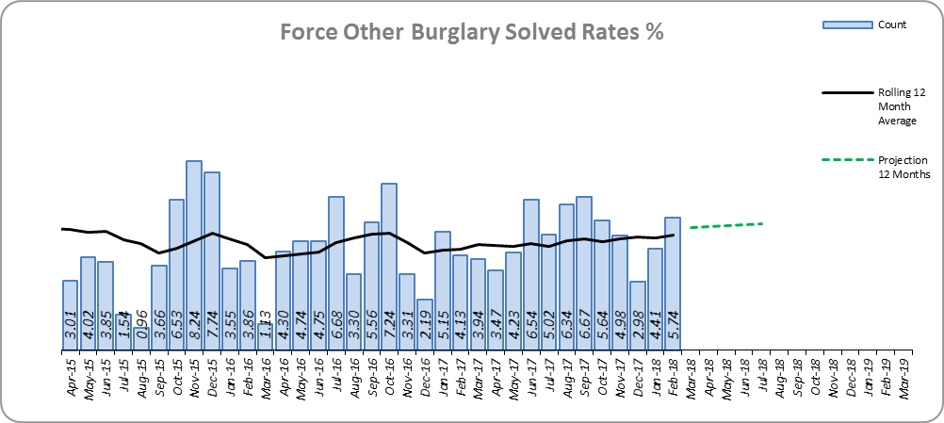
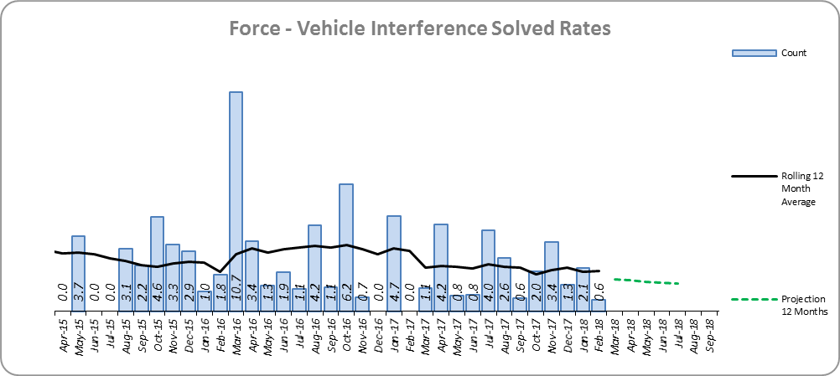
Monthly Performance Overview
Solved Rates by Exception
Burglary Other Solved Rate
Solved rate remains below 10% (at 5.4%).
However, the solved rate increased by 0.9% points, and it was not a statistically significant exception in February 2018.
The number of crimes solved also increased: by 19.6% (53 more solved outcomes to 323).
There are no national or MSG comparisons (the Home Office changed the definition of Burglary Other in April 2017).
The forecast is that the solved rate will increase.
Figure 10
Figure 11
Vehicle Interference Solved Rate
Solved rate remains below 10% (at 2.0%).
The number of crimes solved decreased: by 2.6% (1 fewer to 37 solved outcomes).
Essex is 6th in its MSG and 29th nationally for solved rate % point change. Essex is 6th in its MSG and 34th nationally for solved rate.
The forecast is that the solved rate will decrease.

Slide 8
2016-2020 Police and Crime Plan Performance Indicators
Table 1
See Appendix for endnotes.
Below is an explanation as to why certain indicators are considered to be improving or deteriorating:
Priority 1 – Number of all crime offences. Performance is considered to be deteriorating due to the rise in crime. No data are available to indicate how much of this rise is attributable to better crime data integrity. An increase in crime has been experienced in every UK police force .
Priority 3 - Number of incidents of domestic abuse. Performance is considered to be deteriorating due to the rise in incidents. No data are available to indicate whether this rise is attributable to media campaigns or initiatives that encourage reporting.
Priority 5 - Number of arrests in relation to the trafficking of drugs. Drug trafficking arrests are dependent on pro-active policing. This may include pre-planned operations conducted as a result of intelligence reports received, positive search warrants of residences/premises, and positive searches of individuals.
Priority 7 - Number of driving related mobile phone crime on Essex roads. This is considered to be improving as Essex Police’s Operational Policing Command (OPC) have stated there has been a noticeable reduction in the number of drivers stopped whilst using a mobile phone at the wheel.
Priority 7 - Number of driving under the influence of drink and/or drugs on Essex roads. Operational Policing Command (OPC) have stated that a reduction indicates the public are adhering to the strong educational messages being delivered by drink/driving campaigns. Collisions attended by the police involve routine breath-testing of involved parties. An increase could also demonstrate proactive policing.

Slide 9
Appendix
¹ Results are for the period April 2017 to September 2017.
² Crime Survey for England and Wales (CSEW): 12 months to September 2017 vs. 12 months to September 2016. The confidence interval is the range +/- between which the survey result may lie.
³ The number of repeat incidents of Domestic Abuse is for March 2017 to February 2018. The previous period cannot be produced, until April 2018 data is available, due to a change in how this measure is captured.
⁴ The number of Organised Criminal Group disruptions are for the periods December 2017 to February 2018 vs. September 2017 to November 2017.
⁵ Solved outcomes are crimes that result in: charge or summons, caution, crimes taken into consideration, fixed penalty notice, cannabis warning or community resolution.
⁶ ‘Killed or Seriously Injured’ refers to all people killed or seriously injured on Essex’s roads, regardless of whether any criminal offences were committed. ‘Causing Death/Serious Injury by Dangerous/Inconsiderate Driving’, however, refers to the number of crimes of this type.
* Standard Scores are used to compare figures from different normal distributions, and determine how spread out they are from the average or ‘mean’. They are calculated in the following way: (the month's figure, minus the average figure per month over the previous three years) divided by the Standard Deviation of the same three year period. In this document, a Standard Score over 1.28 or under -1.28 was used to identify whether the increase or decrease was statistically significant.

Slide 10
Crime Tree Data – Rolling 12 Months to February
Table 2

Slide 11
Crime Tree Data – Rolling 12 Months to February
Table 3

Slide 12
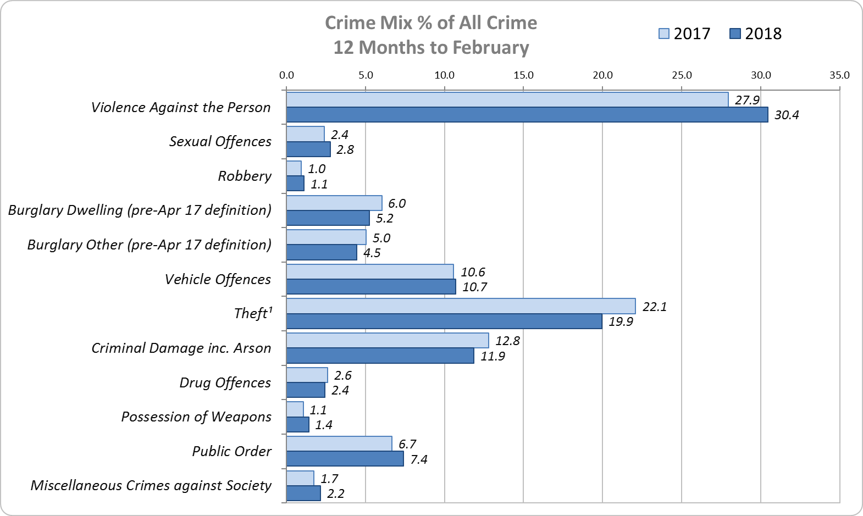
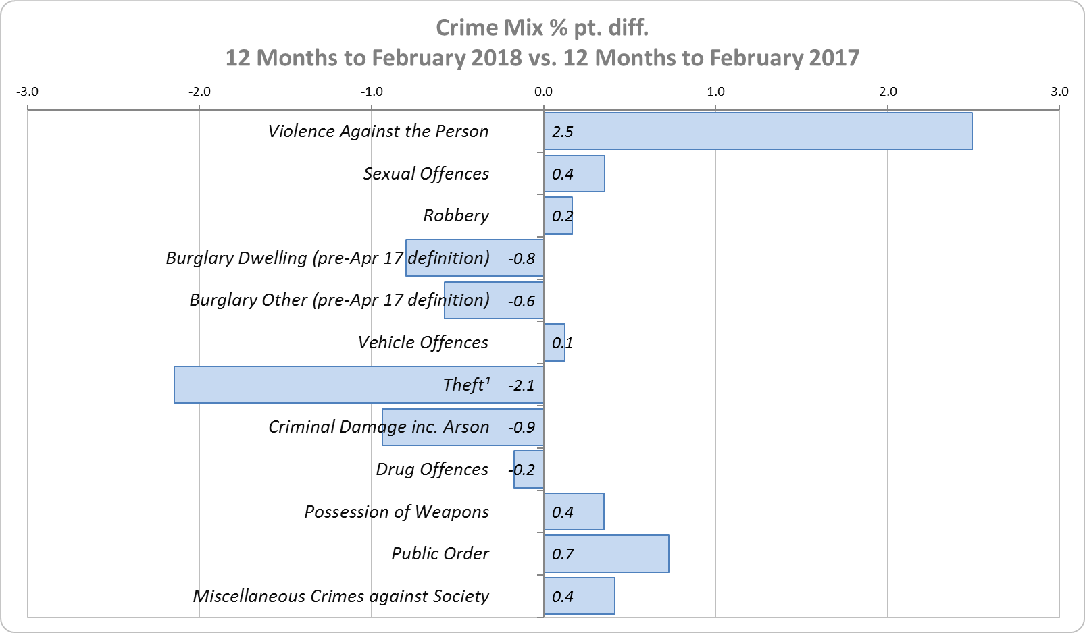
Crime Mix – Rolling 12 Months to February 2017 vs. 2018
Figure 12
Figure 13
Violence Against the Person saw a 2.5% point increase in the proportion of all crime; it also experienced the biggest volume rise (7,298 further offences). Public Order Offences saw a 0.7% point increase in the proportion of all crime, and experienced the second biggest volume rise (1,920 offences).
13.0% of crime is Domestic Abuse-related; this proportion has increased from 12.8% for 12 months to January 2018. Domestic Abuse-related Violence Against the Person also increased to 33.8% (from 33.4% for 12 months to January 2018).

