Slide 1
Police and Crime Plan 2016-2020
Monthly Performance Update
December 2017
National and MSG positions are to 30th November 2017 (Essex Police data are to 31st December 2017).
Version 1.2
Produced January 2018
Performance Information Unit, Essex Police

Slide 2
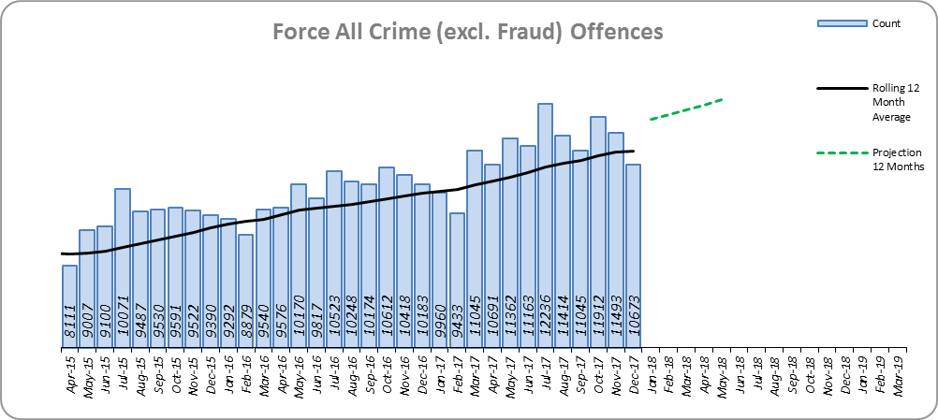
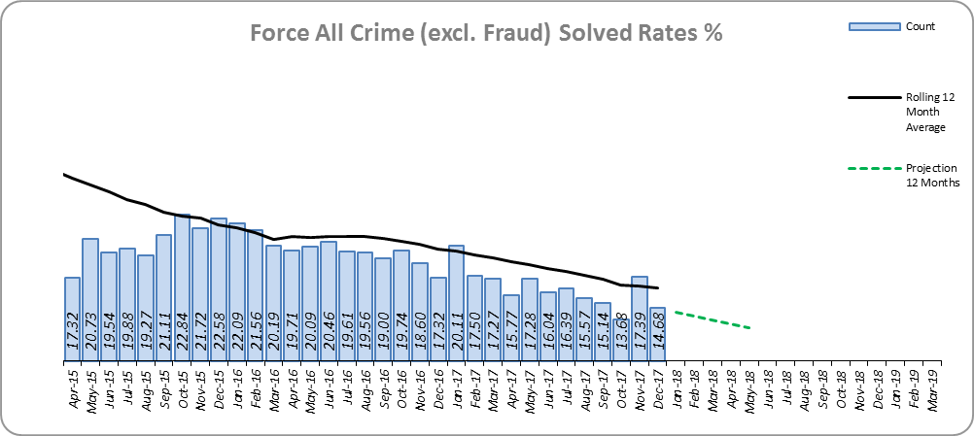
Monthly Performance Overview
Key Areas
All Crime
11.3% increase (13,339 additional offences).⁺
Essex has the 5th lowest increase (out of eight) in its Most Similar Group of forces (MSG), and is 18th nationally* for crime increase. Essex is 4th in its MSG and 19th nationally for crimes per 1,000 of the population.
Increases seen in all 42 forces. The national increase~ was 14.1%.
One district experienced a statistically significant increase in December 2017 and one experienced a statistically significant decrease.
The forecast^ is that crime will continue to increase.
All Crime Solved Rate
3.4% point decrease (to 16.8%).
The number of crimes solved also fell: by 7.5% (1,790 fewer solved outcomes to 22,040).
Essex is 6th in its MSG and 24th nationally for solved rate % point change. Essex has the 4th highest solved rate in its MSG and 23rd nationally for solved rate.
The Force and six districts experienced a statistically significant decrease in December 2017.
The forecast is that the solved rate will continue to decrease.
Figure 1
Figure 2
⁺ All crime increases shown are for 12 months to December 2017 compared to the same period to December 2016.
* 1st is considered best performing, and 42nd worst.
~ The national increase (where the category is available) relates to the 12 months to June 2017 vs 12 months to June 2016.
^ All forecasts are based on the last 12 months.

Slide 3
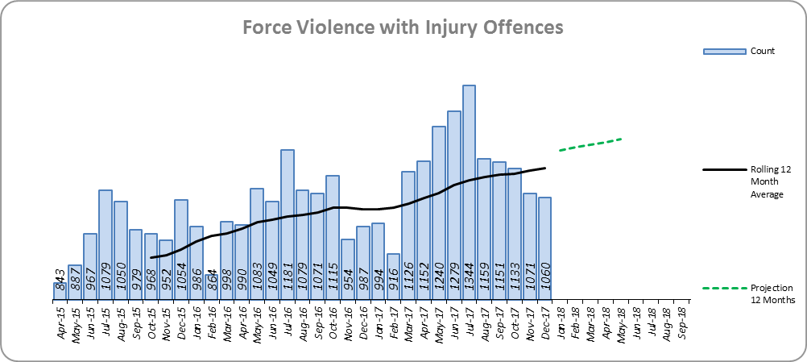
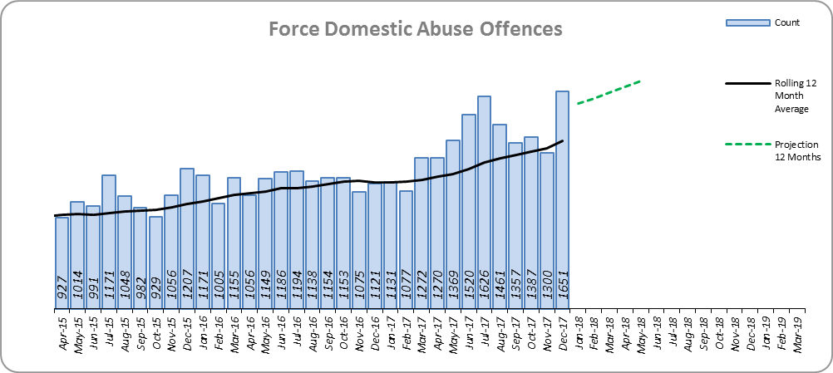
Monthly Performance Overview
Violence with Injury*
10.3% increase (1,267 additional offences).
Essex is 5th in its MSG and 22nd nationally for crime increase. Essex is 5th in its MSG and 16th nationally for crimes per 1,000 of the population.
Increases seen in 39 out of 42 forces.
83.5% of Violence with Injury is Actual Bodily Harm (ABH). By volume, ABH rose by 8.0% (845 additional offences).
66.7% of the increase in Violence with Injury is due to the rise in ABH. There was also a 58.7% rise in ‘wounding with intent to do grievous bodily harm or resist apprehension’ (398 additional offences); this was the category with the second highest volume rise (after ABH).
31.3% of Violence with Injury is Domestic Abuse-related.
There were no statistically significant increases at Force or District level in December 2017.
The forecast is that Violence with Injury will continue to increase.
Figure 3
Domestic Abuse
20.8% increase (2,822 additional offences).
There are no national or MSG comparisons on iQuanta** for Domestic Abuse.
The Force and nine districts experienced statistically significant increases in December 2017.
The forecast is that Domestic Abuse (all risk levels combined) will continue to rise.
High Risk Domestic Abuse 33.6% decrease (1,008 offences).
Medium Risk Domestic Abuse 33.8% decrease (2,248 offences).
Standard Risk Domestic Abuse 156.6% increase (5,793 offences).
Figure 4
* Offences included within the Violence with Injury classification changed in November 2017. Offences involving “Death or Serious Injury – Unlawful Driving” have now been removed and are in a separate category. Please note iQuanta related positions still relate to the former definition.
** A web-based service provided for the use of Police forces, Community Safety Partnerships (CSPs) and Her Majesty’s Inspectorate of Constabulary and Fire & Rescue Service (HMICFRS).

Slide 4
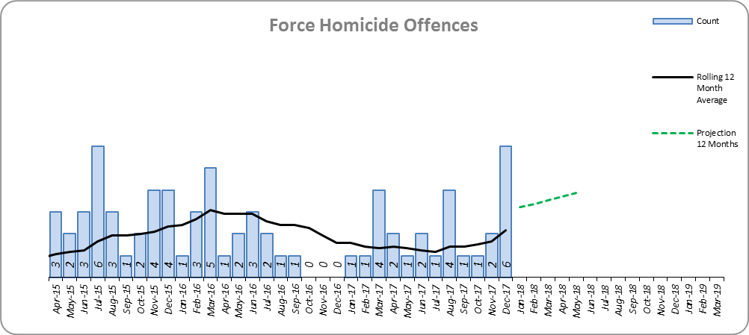
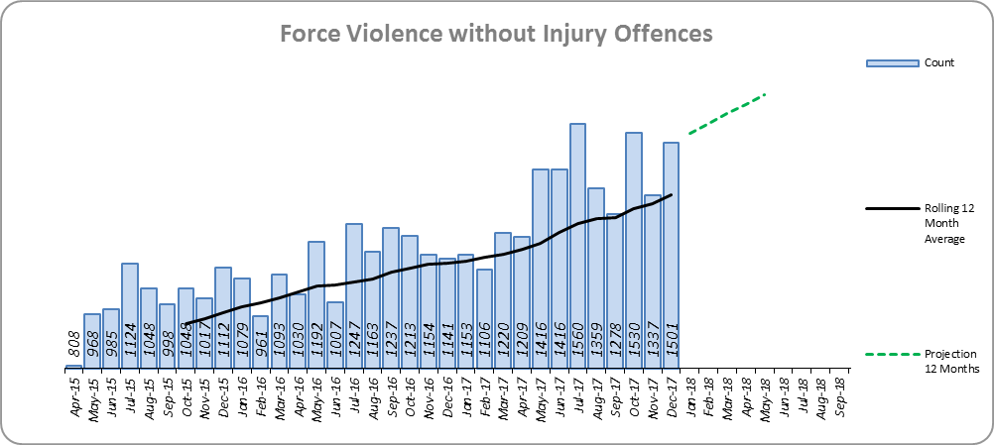
Monthly Performance Overview
Statistical Exceptions – Offences
Homicide Offences
The Force and three out of 14 districts experienced statistically significant increases in December 2017.
81.3% increase (13 additional offences).
Essex is 5th in its MSG and is 21st nationally for crime increase. Essex is 6th in its MSG and 32nd nationally for crimes per 1,000 of the population.
Increases seen in 25 out of 42 forces. The national decrease was 2.2%.
10.3% of Homicide Offences are Domestic Abuse-related.
The forecast is that Homicide offences will continue to increase.
Figure 5
Violence without Injury*
The Force and nine out of 14 districts experienced statistically significant increases in December 2017.
18.7% increase (2,536 offences).
Essex is 6th in its MSG and 20th nationally for crime increase. Essex is 5th in its MSG and 26th nationally for crimes per 1,000 of the population.
90.4% of Violence without Injury is Common Assault.
96.8% of the increase in Violence without Injury is due to the rise in Common Assault.
Increases seen in 41 out of 42 forces.
The forecast is that Violence without Injury offences will continue to increase.
Figure 6
* Offences included within the Violence without Injury classification changed in November 2017. Offences involving “Stalking and Harassment” have now been removed and are within a separate category. Please note iQuanta related positions still relate to the former definition.

Slide 5
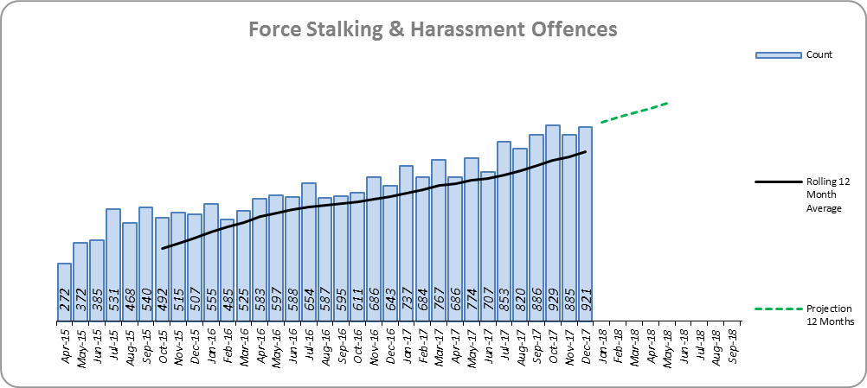
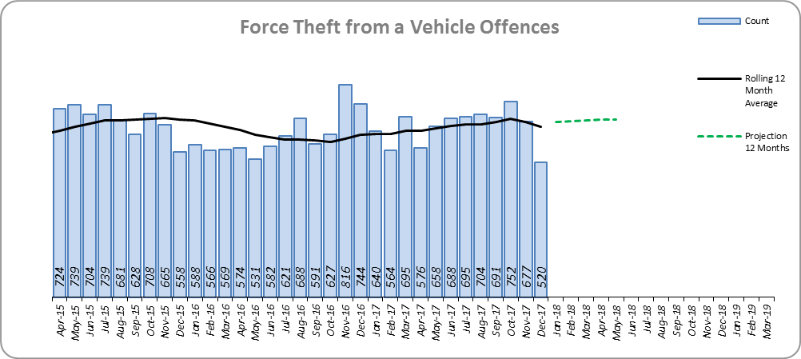
Monthly Performance Overview
Stalking and Harassment Offences*
The Force and 10 out of 14 districts experienced statistically significant increases in December 2017.
43.1% increase (2,897 additional offences). 86.5% of this was as a result of an increase in Malicious Communications.
Malicious Communication experienced a 79.3% increase to 5,670 offences (2,507 more), and accounted for 59.0% of Stalking and Harassment.
Harassment saw a 17.8% increase to 3,029 (457 more offences) and accounts for 31.5% of Stalking and Harassment.
There are no national or MSG comparisons on iQuanta.
31.6% of offences were Domestic Abuse-related (compared to 30.7% 12m November 2017).
The national increase was 36.4%.
The forecast is that Stalking and Harassment offences will continue to increase.
Figure 7
Theft from a Vehicle
The Force and five out of 14 districts experienced statistically significant decreases in December 2017.
4.7% increase (352 additional offences).
Essex is 4th in its MSG and 20th nationally for crime increase. Essex is 6th in its MSG and 26th nationally for crimes per 1,000 of the population.
Increases seen in 38 out of 42 forces.
The forecast is that Theft from a Vehicle offences will continue to increase.
Figure 8
* The offences that form this category were formerly within the Violence without Injury category.

Slide 6
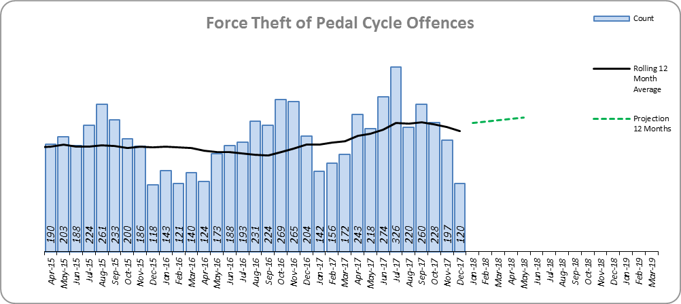
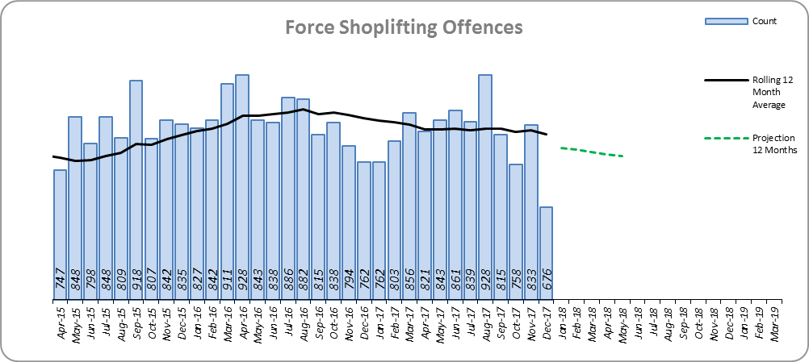
Monthly Performance Overview
Theft of Pedal Cycle Offences
The Force and five out of 14 districts experienced statistically significant decreases in December 2017.
12.3% increase (279 additional offences).
Essex is 5th in its MSG and 30th nationally for crime increase. Essex is 4th in its MSG and 24th nationally for crimes per 1,000 of the population.
Increases seen in 35 out of 42 forces. The national increase was 19.0%.
The forecast is that Theft of Pedal Cycle offences will increase.
Figure 9
Shoplifting Offences
The Force and five out of 14 districts experienced statistically significant decreases in December 2017. One district saw a statistically significant increase.
3.1% decrease (316 fewer offences).
Essex is 1st in its MSG and 2nd nationally for crime increase. Essex is 2nd in its MSG and 7th nationally for crimes per 1,000 of the population.
Increases seen in 39 out of 42 forces. The national increase was 10.7%.
The forecast is that Shoplifting offences will continue to decrease.
Figure 10

Slide 7
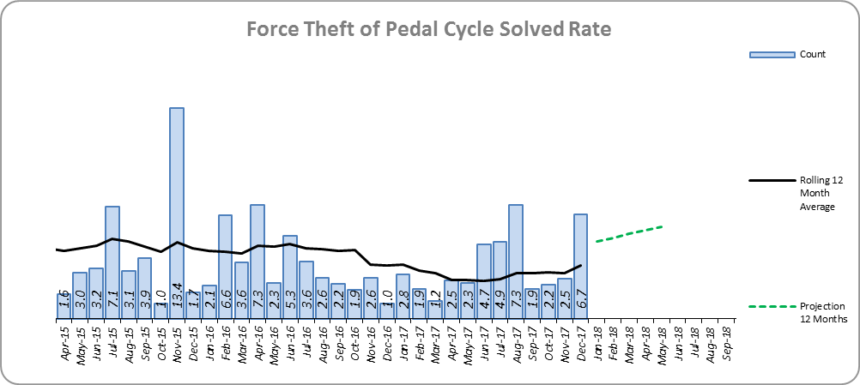
Monthly Performance Overview
Solved Rates by Exception
Theft from a Vehicle Solved Rate*
Solved rate remains below 10% (1.8%).
The number of crimes solved increased: by 3.7% (5 more solved outcomes to 141).
Essex is 6th in its MSG and 23rd nationally for solved rate % point change. Essex is 8th in its MSG and 39th nationally for solved rate.
Theft of Pedal Cycle Solved Rate
Solved rate remains below 10% (4.0%).
The number of crimes solved increased: by 42.3% (30 more solved outcomes to 101).
Essex is 4th in its MSG and 15th nationally for solved rate % point change. Essex is 5th in its MSG and 26th nationally for solved rate.
The forecast is that the solved rate will increase.
Figure 11
* Statistical Process Control (SPC) charts are not available

Slide 8
2016-2020 Police and Crime Plan Performance Indicators
Table 1
See Appendix for endnotes.
Below is an explanation as to why certain indicators are considered to be improving or deteriorating:
Priority 1 – Number of all crime offences. Performance is considered to be deteriorating due to the rise in crime. No data are available to indicate how much of this rise is attributable to better crime data integrity. An increase in crime has been experienced in every UK police force .
Priority 3 - Number of incidents of domestic abuse. Performance is considered to be deteriorating due to the rise in incidents. No data are available to indicate whether this rise is attributable to media campaigns or initiatives that encourage reporting.
Priority 5 - Number of arrests in relation to the trafficking of drugs. Drug trafficking arrests are dependent on pro-active policing. This may include pre-planned operations conducted as a result of intelligence reports received, positive search warrants of residences/premises, and positive searches of individuals.
Priority 7 - Number of driving related mobile phone crime on Essex roads. This is considered to be improving as Essex Police’s Operational Policing Command (OPC) have stated there has been a noticeable reduction in the number of drivers stopped whilst using a mobile phone at the wheel.
Priority 7 - Number of driving under the influence of drink and/or drugs on Essex roads. Operational Policing Command (OPC) have stated that a reduction indicates the public are adhering to the strong educational messages being delivered by drink/driving campaigns. Collisions attended by the police involve routine breath-testing of involved parties.

Slide 9
Appendix
¹ Results are available quarterly from December 2017, for the period April 2017 to September 2017.
² Crime Survey for England and Wales (CSEW): 12 months to June 2017 vs. 12 months to June 2016. The confidence interval is the range +/- between which the survey result may lie.
³ The number of repeat incidents of Domestic Abuse is for January 2017 to December 2017. The previous period cannot be produced due to a change in how this measure is captured.
⁴ The number of Organised Criminal Group disruptions cannot be produced for the previous year due to a change in the definition (January 2017). The data are for the period January 2017 to December 2017.
⁵ Solved outcomes are crimes that result in: charge or summons, caution, crimes taken into consideration, fixed penalty notice, cannabis warning or community resolution.
⁶ ‘Killed or Seriously Injured’ refers to all people killed or seriously injured on Essex’s roads, regardless of whether any criminal offences were committed. ‘Causing Death/Serious Injury by Dangerous/Inconsiderate Driving’, however, refers only to the number of crimes of this type.
* Standard Scores are used to compare figures from different normal distributions, and determine how spread out they are from the average or ‘mean’. They are calculated in the following way: (previous month's figure, minus the average figure per month over the previous three years) divided by the Standard Deviation of the same three year period. In this document, a Standard Score over 1.28 or under -1.28 was used to identify whether the increase or decrease was statistically significant.

Slide 10
HMIC Crime Tree Data – Rolling 12 Months to December
Table 2

Slide 11
HMIC Crime Tree Data – Rolling 12 Months to December
Table 3

Slide 12
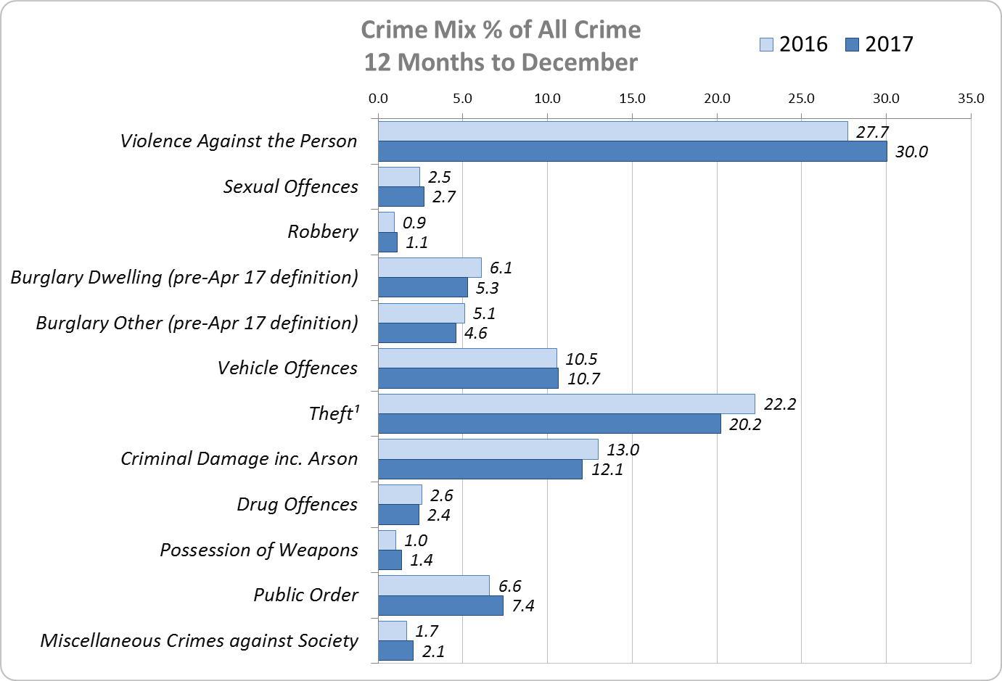
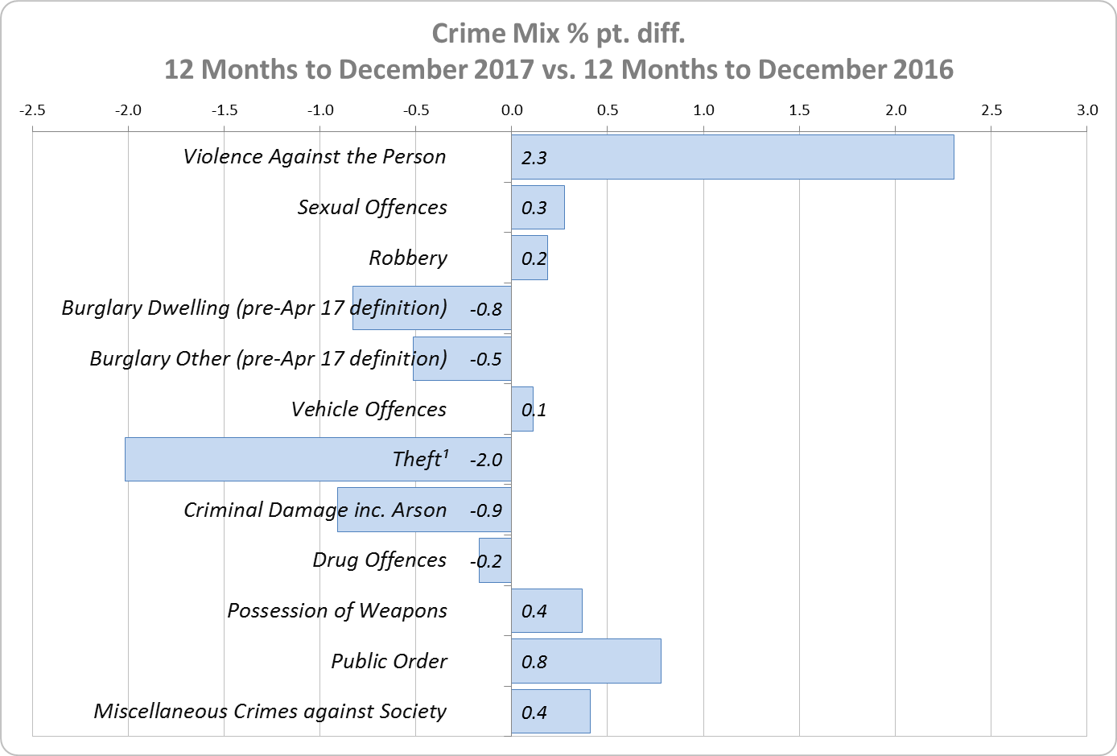
Crime Mix – Rolling 12 Months to December 2016 vs. 2017
Figure 12
Figure 13
Violence Against the Person saw a 2.3% point increase in the proportion of all crime; it also experienced the biggest volume rise (6,722 further offences). Public Order Offences saw a 0.8% point increase in the proportion of all crime, and experienced the second biggest volume rise (1,902 offences). These two crime types accounted for 37.4% of all crime during 12 months to December 2017 (an increase of 3.1% points on the 12 months to December 2016).
12.5% of crime is Domestic Abuse-related; this proportion has increased from 12.1% for 12 months to November 2017. Domestic Abuse-related Violence Against the Person also increased to 32.9% from 32.4% for 12 months to November 2017.

