Slide 1


Police and Crime Plan 2016-2020
Monthly Performance Update
March 2018
National and MSG positions are to 28th February 2018 (Essex Police data are to 31st March 2018).
Version 1.1
Produced April 2018
Performance Information Unit, Essex Police

Slide 2
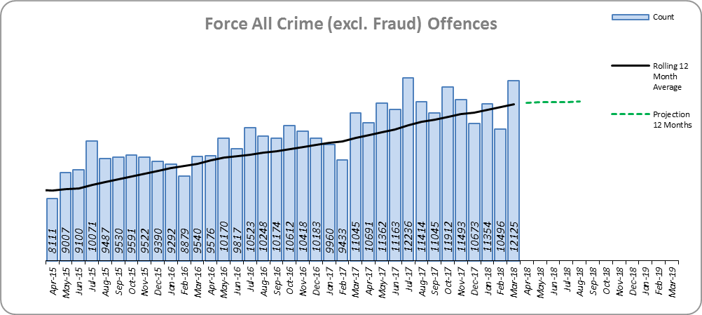
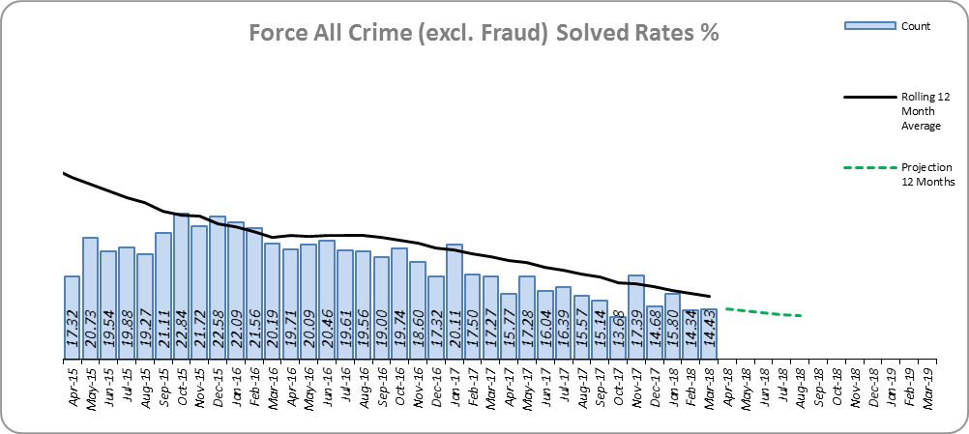
Monthly Performance Overview
Key Areas
All Crime
11.2% increase (13,520 additional offences).⁺
Essex has the 6th lowest increase (out of eight) in its Most Similar Group of forces (MSG), and is 20th nationally* for crime increase. Essex is 4th in its MSG and 19th nationally for crimes per 1,000 of the population.
Increases seen in all 42 forces. The national increase~ was 15.3%.
The force and nine districts experienced statistically significant increases in March 2018.
The forecast^ is that All Crime will increase.
All Crime Solved Rate
3.4% point decrease (to 16.1%).
The number of crimes solved also fell: by 8.3% (1,939 fewer solved outcomes to 21,554).
Essex is 5th in its MSG and 21st nationally for solved rate % point change. Essex has the 4th highest solved rate in its MSG and 22nd nationally for solved rate.
The Force and three districts experienced statistically significant decreases in March 2018.
The forecast is that the solved rate will continue to decrease.
Figure 1
Figure 2
⁺ All crime increases shown are for 12 months to March 2018 compared to the same period to March 2017.
* 1st is considered best performing, and 42nd worst.
~ The national increase (where the category is available) relates to the 12 months to September 2017 vs 12 months to September 2016.
^ All forecasts are based on the last 12 months.

Slide 3
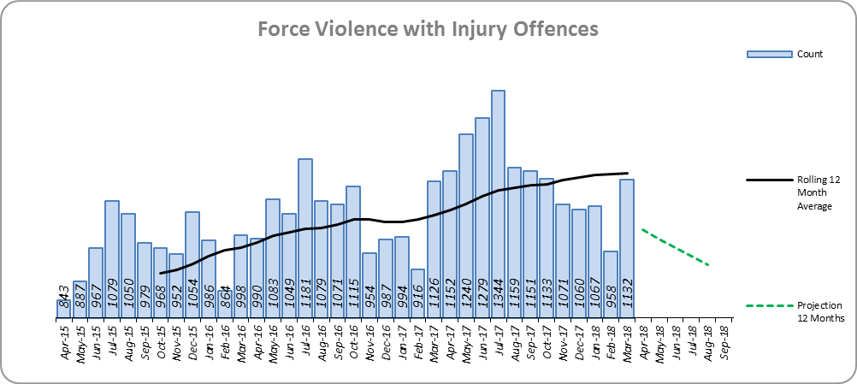
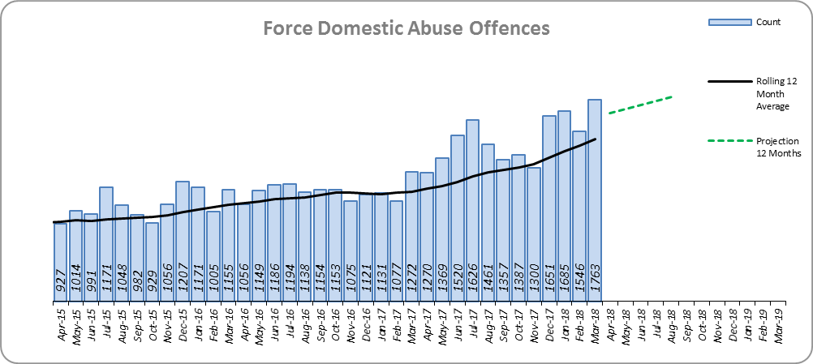
Monthly Performance Overview
Violence with Injury*
9.3% increase (1,162 additional offences).
Essex is 5th in its MSG and 22nd nationally for crime increase. Essex is 4th in its MSG and 15th nationally for crimes per 1,000 of the population.
Increases seen in 41 out of 42 forces. The national increase was 9.4%.
83.2% of Violence with Injury is Actual Bodily Harm (ABH). By volume, ABH rose by 6.8% (730 additional offences).
62.8% of the increase in Violence with Injury is due to the rise in ABH. There was also a 65.5% rise in ‘wounding with intent to do grievous bodily harm or resist apprehension’ (449 additional offences); this was the category with the second highest volume rise (after ABH).
31.4% of Violence with Injury is Domestic Abuse-related.
One district experienced a statistically significant increase in March 2018.
The forecast is that Violence with Injury will decrease.
Figure 3
Domestic Abuse
29.8% increase (4,082 additional offences).
There are no national or MSG comparisons on iQuanta** for Domestic Abuse.
The Force and 10 districts experienced statistically significant increases in March 2018.
The forecast is that Domestic Abuse (all risk levels combined) will continue to rise.
High Risk Domestic Abuse 22.8% decrease (593 offences).
Medium Risk Domestic Abuse 24.7% decrease (1,454 offences).
Standard Risk Domestic Abuse 115.9% increase (5,768 offences).
Figure 4
* Offences included within the Violence with Injury classification changed in November 2017. Offences involving “Death or Serious Injury – Unlawful Driving” have now been removed and are in a separate category. Please note iQuanta related positions still relate to the former definition.
** A web-based service provided for the use of Police forces, Community Safety Partnerships (CSPs) and Her Majesty’s Inspectorate of Constabulary and Fire & Rescue Service (HMICFRS).

Slide 4
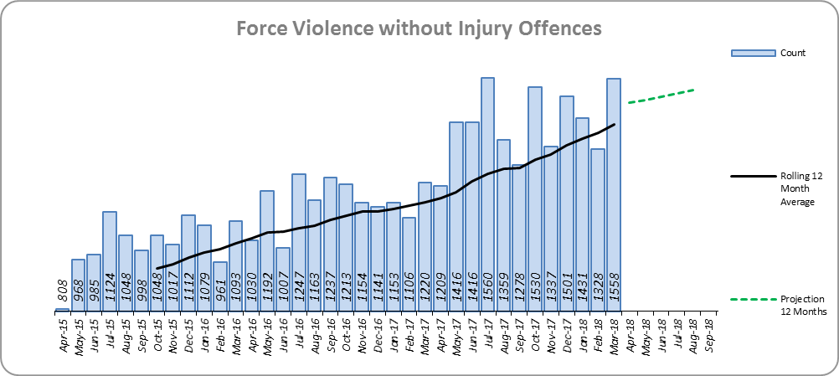
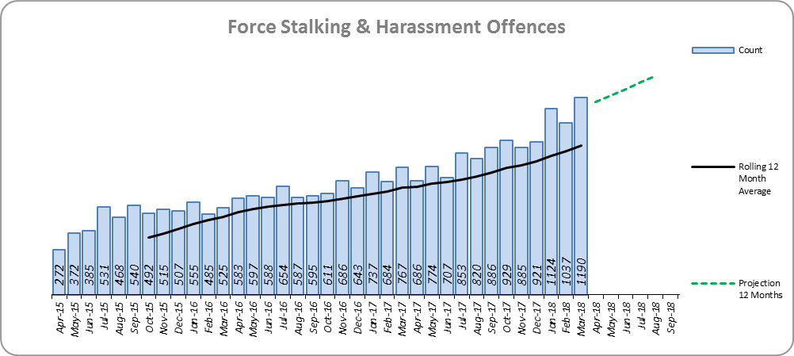
Monthly Performance Overview
Statistical Exceptions – Offences
Violence without Injury*
The Force and eight districts experienced statistically significant increases in March 2018.
21.3% increase (2,953 offences).
Essex is 7th in its MSG and 25th nationally for crime increase. Essex is 5th in its MSG and 25th nationally for crimes per 1,000 of the population.
89.8% of Violence without Injury is Common Assault.
88.5% of the increase in Violence without Injury is due to the rise in Common Assault.
Increases seen in 41 out of 42 forces.
The forecast is that Violence without Injury offences will continue to increase.
Figure 5
Stalking and Harassment Offences
The Force and 14 out of 14 districts experienced statistically significant increases in March 2018.
45.2% increase (3,312 additional offences). 82.5% of this was as a result of an increase in Malicious Communications.
Malicious Communication experienced a 74.3% increase to 6,407 offences (2,732 more), and accounted for 60.2% of Stalking and Harassment.
Harassment saw a 24.9% increase to 3,282 (655 more offences) and accounts for 30.9% of Stalking and Harassment.
There are no full year national or MSG comparisons on iQuanta.
33.6% of offences were Domestic Abuse-related.
The national increase was 35.9%.
The forecast is that Stalking and Harassment offences will continue to increase.
Figure 6
* Offences included within the Violence without Injury classification changed in November 2017. Offences involving “Stalking and Harassment” have now been removed and are within a separate category. Please note iQuanta related positions still relate to the former definition.

Slide 5
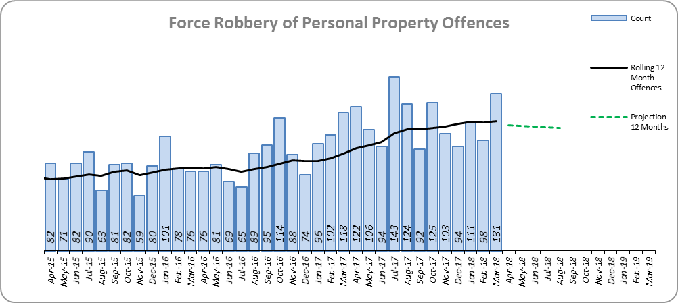
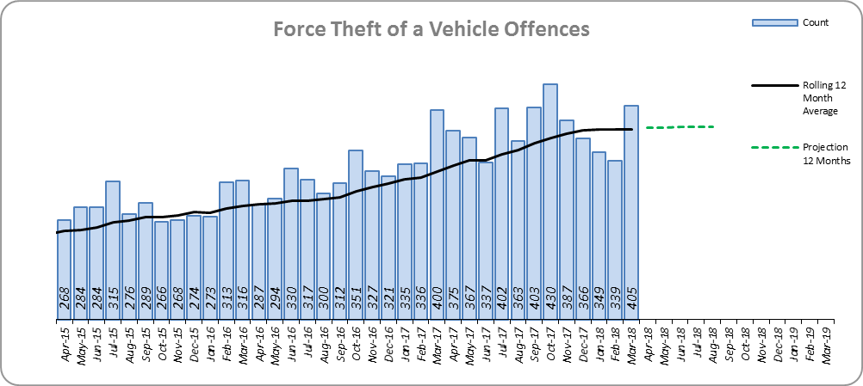
Monthly Performance Overview
Robbery of Personal Property
The Force and six out of 14 districts experienced statistically significant increases in March 2018.
25.5% increase (272 additional offences).
The number of crimes solved increased: by 40.5% (49 more to 170 solved outcomes).
The solved rate increase 1.4% points to 12.7%
Essex is 6th in its MSG and 29th nationally for crime increase. Essex is 8th in its MSG and 30th nationally for crimes per 1,000 of the population.
Increases seen in 38 out of 42 forces.
The forecast is that Robbery of Personal Property will decrease.
Figure 7
Theft of a Vehicle
The Force and three out of 14 districts experienced statistically significant increases in March 2018.
14.3% increase (545 additional offences).
Essex is 4th in its MSG and 22nd nationally for crime increase. Essex is 8th in its MSG and 39th nationally for crimes per 1,000 of the population.
Increases seen in 37 out of 42 forces.
The forecast is that Theft of a Vehicle offences will continue to increase.
Figure 8

Slide 6
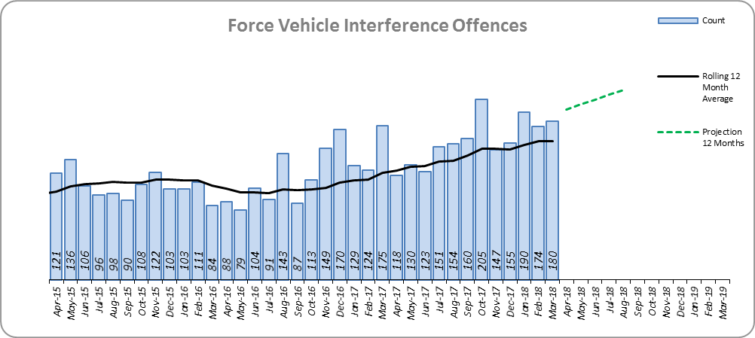
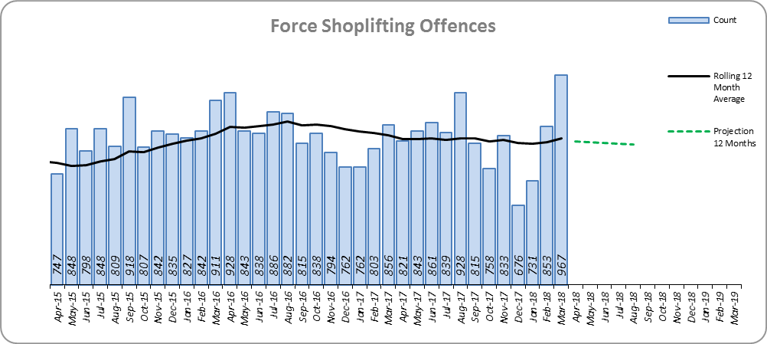
Monthly Performance Overview
Vehicle Interference Offences
The Force and two out of 14 districts experienced statistically significant increases in March 2018.
29.1% increase (423 additional offences).
Essex is 4th in its MSG and 25th nationally for crime increase. Essex is 4th in its MSG and 25th nationally for crimes per 1,000 of the population.
Increases seen in 39 out of 42 forces.
The forecast is that Vehicle Interference offences will continue to increase.
Figure 9
Shoplifting Offences
The Force and six out of 14 districts experienced statistically significant increases in March 2018.
0.7% decrease (66 fewer offences).
Essex is 2nd in its MSG and 6th nationally for crime increase. Essex is 2nd in its MSG and 8th nationally for crimes per 1,000 of the population.
Increases seen in 33 out of 42 forces. The national increase was 9.7%.
The forecast is that Shoplifting offences will decrease.
Figure 10

Slide 7
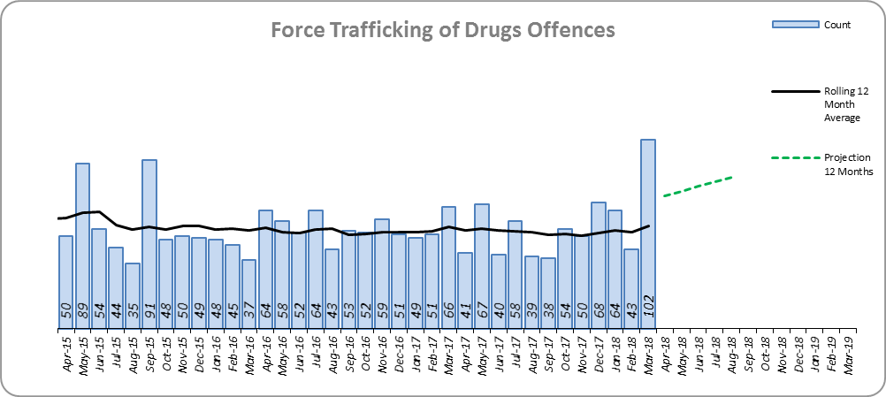
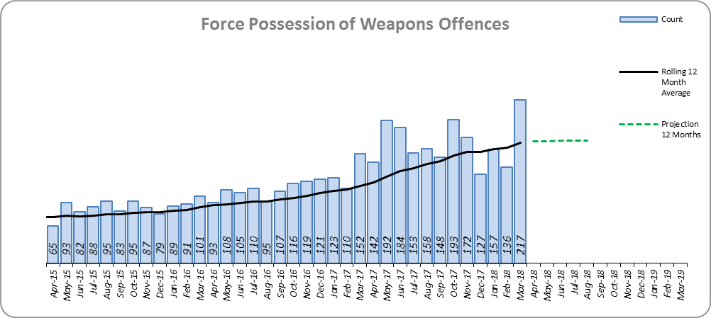
Monthly Performance Overview
Trafficking of Drugs
This measure reflects police activity.
The Force and seven out of 14 districts experienced statistically significant increases in March 2018.
5.4% increase (33 more offences).
Essex is 5th in its MSG and 17th nationally for crime increase. Essex is 2nd in its MSG and 6th nationally for crimes per 1,000 of the population.
Increases seen in 29 out of 42 forces.
The forecast is that Trafficking of Drugs offences will increase.
Figure 11
Possession of Weapons
The Force and 10 out of 14 districts experienced statistically significant increases in March 2018.
48.5% increase (638 offences). However, 60.5% of this increase is due to offences committed at Stansted Airport.
Stansted Airport accounts for 42.8% of total Possession of Weapons This increase is due to more accurate crime recording practices.
Essex is 8th in its MSG and 39th nationally for crime increase. Essex is 8th in its MSG and 42nd nationally for crimes per 1,000 of the population.
Increases seen in 39 out of 42 forces. The national increase was 26.2%.
The forecast is that Possession of Weapons offences will increase.
Figure 12

Slide 8
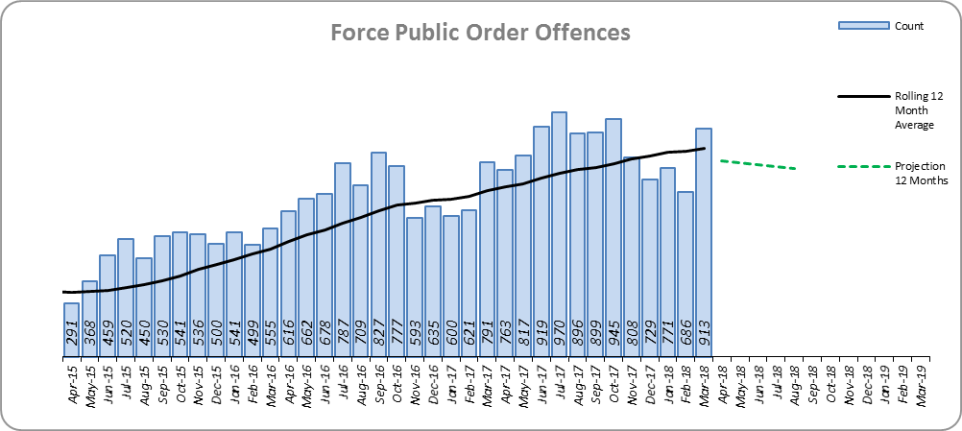
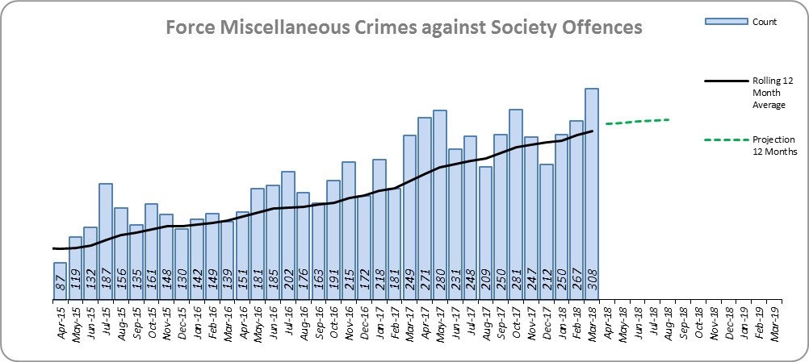
Monthly Performance Overview
Public Order
The Force and seven out of 14 districts experienced statistically significant increases in March 2018.
21.9% increase (1,798 offences).
Essex is 6th in its MSG and 16th nationally for crime increase. Essex is 5th in its MSG and 25th nationally for crimes per 1,000 of the population.
Increases seen in 41 out of 42 forces. The national increase was 43.7%.
The forecast is that Public Order offences will decrease.
Figure 13
Miscellaneous Crimes Against Society Offences*
The Force and six out of 14 districts experienced statistically significant increases in March 2018.
34.5% increase (750 additional offences).
Essex is 8th in its MSG and 32nd nationally for crime increase. Essex is 7th in its MSG and 27th nationally for crimes per 1,000 of the population.
Increases seen in 40 out of 42 forces. The national increase was 29.2%.
The forecast is that Miscellaneous Crimes against Society offences will increase.
Figure 14
*This category includes offences such as threat/possession with intent to cause criminal damage 93.8% increase to 1058, obscene publications 34.7% increase to 796, public health offences 8.8% increase to 210 and perverting the course of justice 3.1% increase to 198.

Slide 9
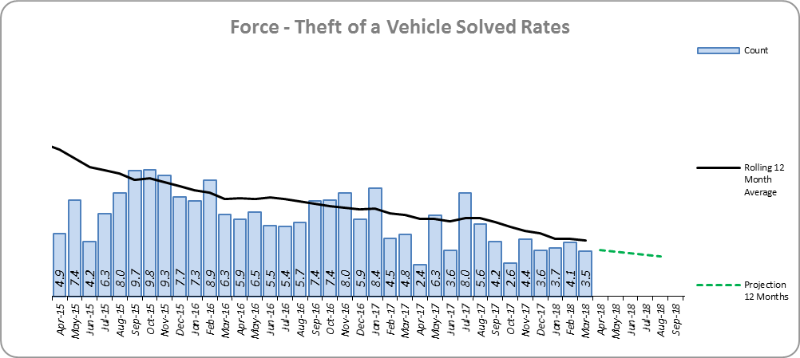
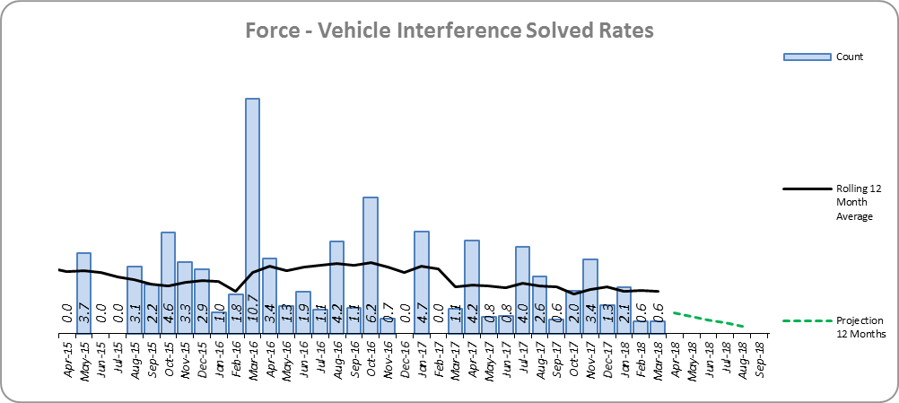
Monthly Performance Overview
Solved Rates by Exception
Theft of a Vehicle Solved Rate
Solved rate remains below 10% (at 4.6%).
The number of crimes solved decreased: by 19.0% (47 fewer to 200 solved outcomes).
Essex is 4th in its MSG and 18th nationally for solved rate % point change. Essex is 8th in its MSG and 39th nationally for solved rate.
The forecast is that the solved rate will decrease.
Figure 15
Figure 16
Vehicle Interference Solved Rate
Solved rate remains below 10% (at 1.9%).
The number of crimes solved increased: by 16.1% (5 more to 36 solved outcomes).
Essex is 6th in its MSG and 29th nationally for solved rate % point change. Essex is 5th in its MSG and 33rd nationally for solved rate.
The forecast is that the solved rate will decrease.

Slide 10
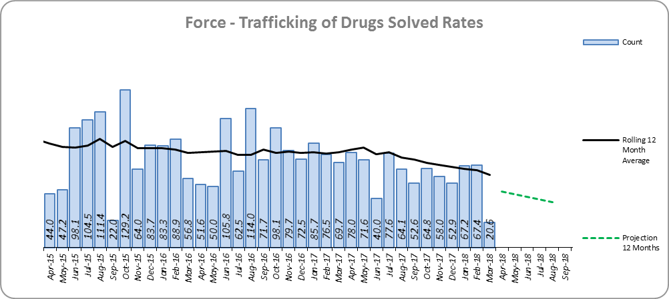
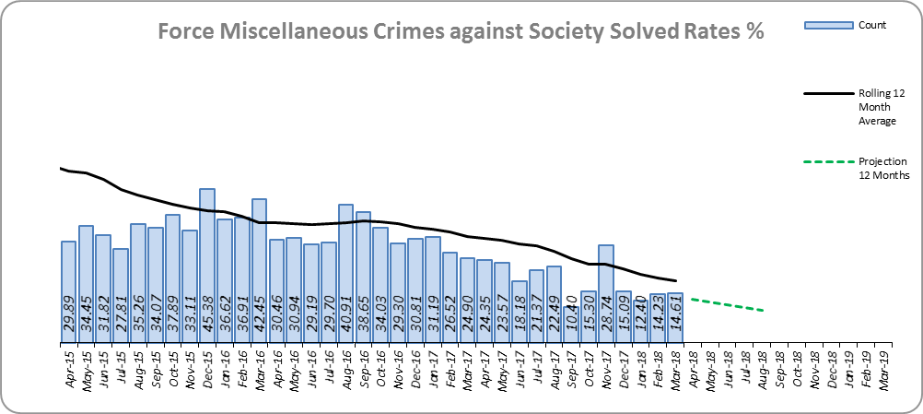
Monthly Performance Overview
Trafficking of Drugs Solved Rate
Solved rate fell 10% points or more (22.5% points less to 61.7%).
The number of crimes solved decreased: by 22.7% (116 fewer to 394 solved outcomes).
Essex is 6th in its MSG and 23rd nationally for solved rate % point change. Essex is 4th in its MSG and 16th nationally for solved rate.
The forecast is that the solved rate will decrease.
Figure 17
Miscellaneous Crimes against Society Solved Rate
Solved rate fell 10% points or more (13.2% points less to 19.9%).
The number of crimes solved decreased: by 19.0% (137 fewer to 583 solved outcomes).
Essex is 8th in its MSG and 37th nationally for solved rate % point change. Essex is 8th in its MSG and 36th nationally for solved rate.
The forecast is that the solved rate will decrease.
Figure 18

Slide 11
2016-2020 Police and Crime Plan Performance Indicators
Table 1
See Appendix for endnotes.
Below is an explanation as to why certain indicators are considered to be improving or deteriorating:
Priority 1 – Number of all crime offences. Performance is considered to be deteriorating due to the rise in crime. No data are available to indicate how much of this rise is attributable to better crime data integrity. An increase in crime has been experienced in every UK police force .
Priority 3 - Number of incidents of domestic abuse. Performance is considered to be deteriorating due to the rise in incidents. No data are available to indicate whether this rise is attributable to media campaigns or initiatives that encourage reporting.
Priority 5 - Number of arrests in relation to the trafficking of drugs. Drug trafficking arrests are dependent on pro-active policing. This may include pre-planned operations conducted as a result of intelligence reports received, positive search warrants of residences/premises, and positive searches of individuals.
Priority 7 - Number of driving related mobile phone crime on Essex roads. This is considered to be improving as Essex Police’s Operational Policing Command (OPC) have stated there has been a noticeable reduction in the number of drivers stopped whilst using a mobile phone at the wheel.
Priority 7 - Number of driving under the influence of drink and/or drugs on Essex roads. Operational Policing Command (OPC) have stated that a reduction indicates the public are adhering to the strong educational messages being delivered by drink/driving campaigns. Collisions attended by the police involve routine breath-testing of involved parties. An increase could also demonstrate proactive policing.

Slide 12
Appendix
¹ Results are for the period April 2017 to September 2017.
² Crime Survey for England and Wales (CSEW): 12 months to September 2017 vs. 12 months to September 2016. The confidence interval is the range +/- between which the survey result may lie.
³ The number of repeat incidents of Domestic Abuse is for April 2017 to March 2018. The previous period cannot be produced, until April 2018 data is available, due to a change in how this measure is captured.
⁴ The number of Organised Criminal Group disruptions are for the periods January 2018 to March 2018 vs. October 2017 to December 2017.
⁵ Solved outcomes are crimes that result in: charge or summons, caution, crimes taken into consideration, fixed penalty notice, cannabis warning or community resolution.
⁶ ‘Killed or Seriously Injured’ refers to all people killed or seriously injured on Essex’s roads, regardless of whether any criminal offences were committed. ‘Causing Death/Serious Injury by Dangerous/Inconsiderate Driving’, however, refers to the number of crimes of this type.
* Standard Scores are used to compare figures from different normal distributions, and determine how spread out they are from the average or ‘mean’. They are calculated in the following way: (the month's figure, minus the average figure per month over the previous three years) divided by the Standard Deviation of the same three year period. In this document, a Standard Score over 1.28 or under -1.28 was used to identify whether the increase or decrease was statistically significant.

Slide 13
Crime Tree Data – Rolling 12 Months to March
Table 2

Slide 14
Crime Tree Data – Rolling 12 Months to March
Table 3

Slide 15
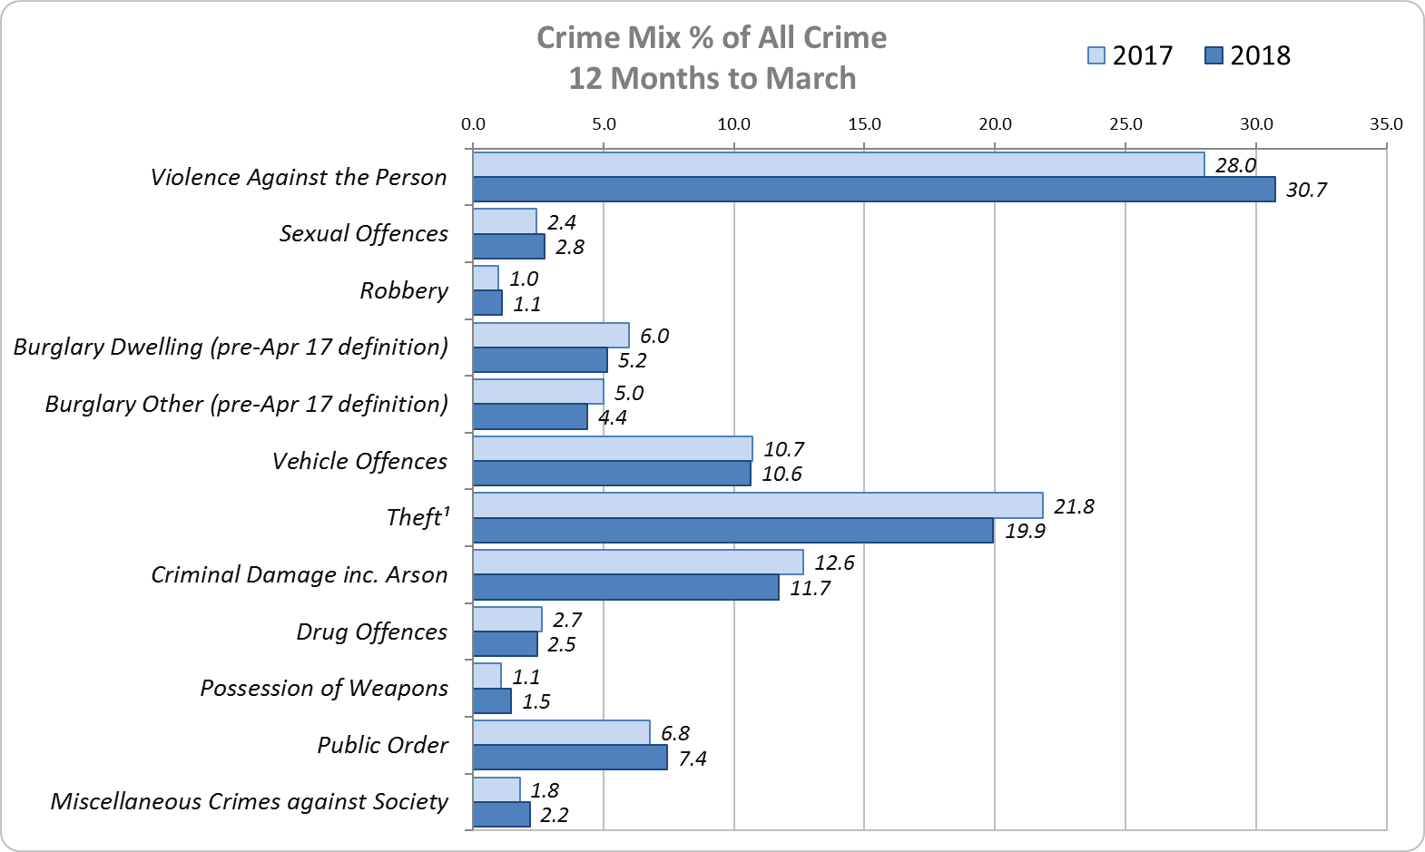
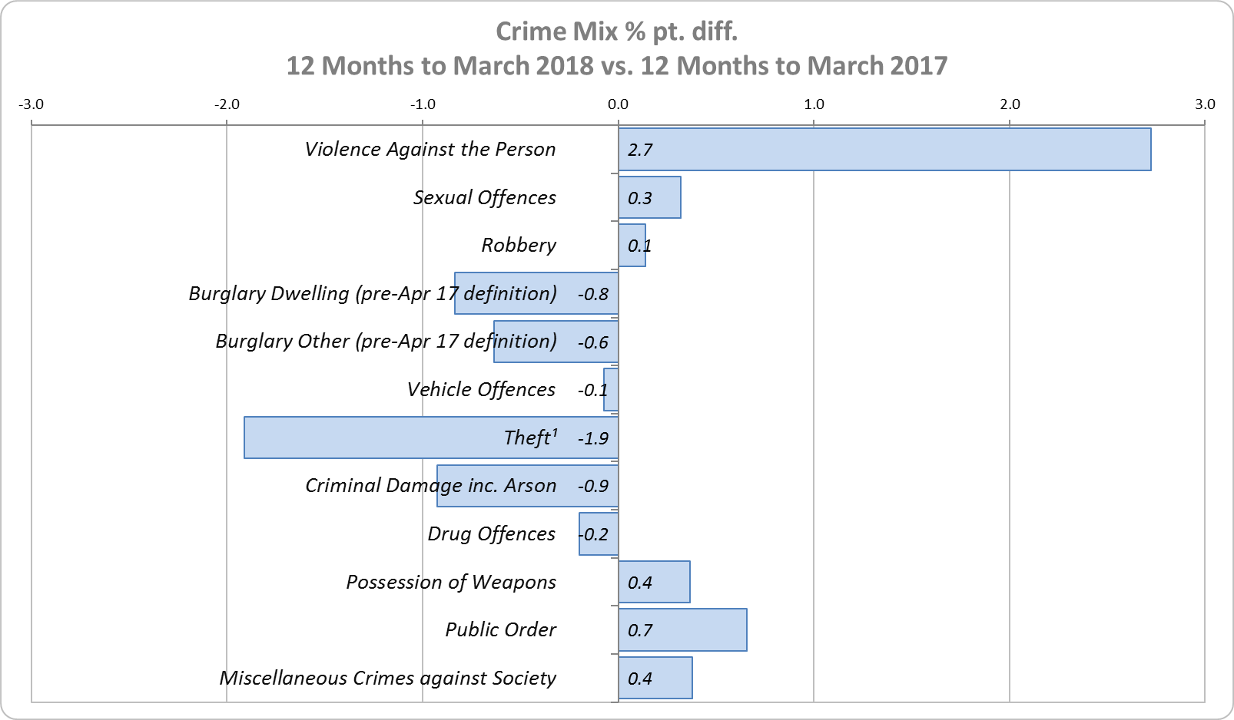
Crime Mix – Rolling 12 Months to March 2017 vs. 2018
Figure 19
Figure 20
Violence Against the Person saw a 2.7% point increase in the proportion of all crime; it also experienced the biggest volume rise (7,440 further offences). Public Order Offences saw a 0.7% point increase in the proportion of all crime, and experienced the second biggest volume rise (1,798 offences).
13.2% of crime is Domestic Abuse-related; this proportion has increased from 13.0% for 12 months to February 2018. Domestic Abuse-related Violence Against the Person also increased to 34.1% (from 33.8% for 12 months to February 2018).

