Slide 1
[Official]
Police and Crime Plan 2016-2020
Quarterly Update – for the OPFCC only (not for publication)
June 2018
Data to May 2018.
Version 1.3
Produced June 2018
Performance Information Unit, Essex Police

Slide 2
Police and Crime Plan 2016-2020 – Quarterly Update June 2018
Contents
Essex Police Balanced Scorecard Final Force Grades 3
Priority 1 – More Local, Visible and Accessible Policing 4-6
Priority 2 – Crack Down on Anti-social Behaviour 7
Priority 3 – Breaking the Cycle of Domestic Abuse 8
Priority 4 – Reverse the Trend in Serious Violence 9-10
Priority 5 – Tackle Gangs and Organised Crime 11-12
Priority 6 – Protecting Children and Vulnerable People 13-15
Priority 7 – Improve Safety on our Roads 16

Slide 3
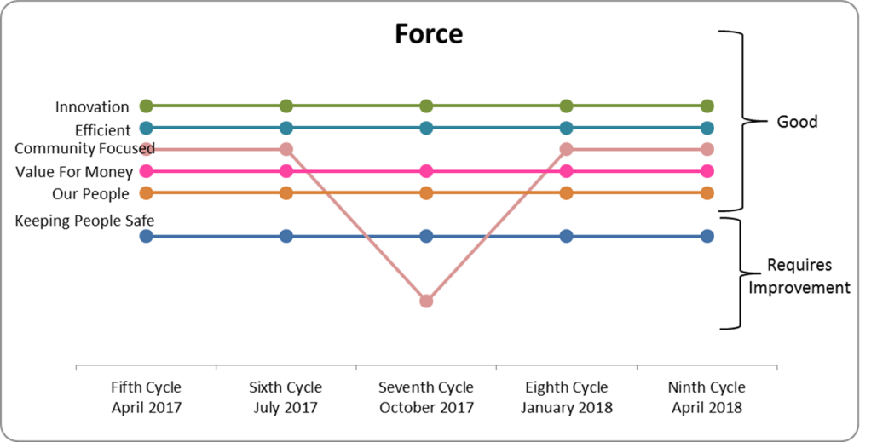
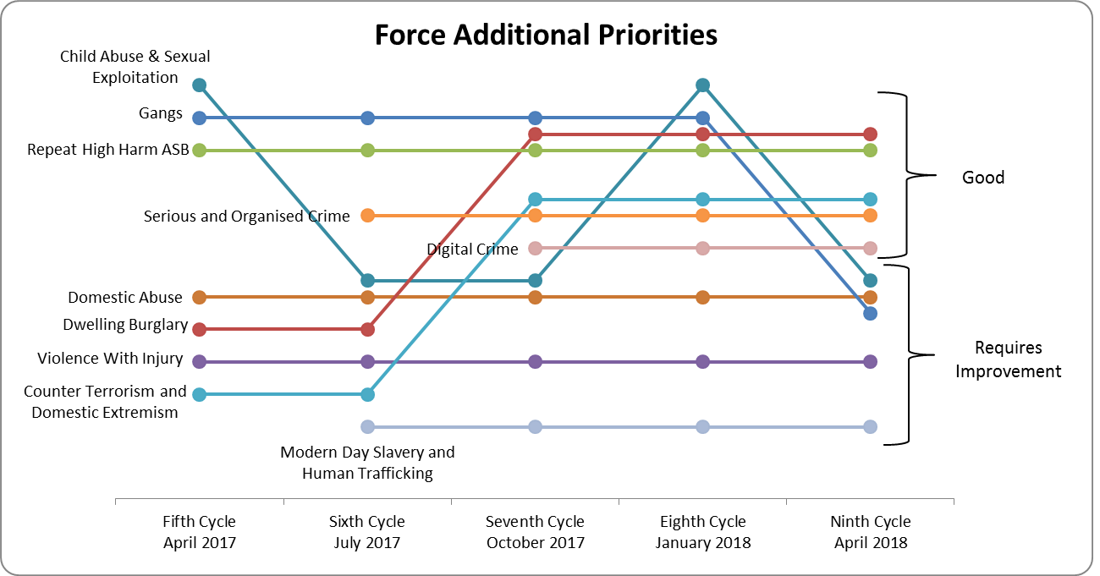
Police and Crime Plan 2016-2020 – Quarterly Update June 2018
Essex Police Balanced Scorecard Final Force Grades – April 2018
Force Priorities
Keeping People Safe remained at “Requires Improvement”. All other Force Priority areas (Innovation, Efficient, Community Focussed, Value for Money and Our People) remained “Good”.
Additional Priorities
Child Abuse & Sexual Exploitation was downgraded from “Good” to “Requires Improvement”.
Gangs was similarly downgraded from “Good” to “Requires Improvement”.
There were no changes to any of the other additional priorities.
Gradings at Force-level are calculated by scoring from 0-3 (0= Inadequate, 1 = Requires Improvement, 2= Good, 3 = Outstanding). The graphs do not identify relative positions within a grade; in April 2018, for example, Innovation does not have a higher grade than Efficient (they are both graded Good).

Slide 4
Police and Crime Plan 2016-2020 – Quarterly Update June 2018
Priority 1 - More Local, Visible and Accessible Policing
We will:
Boost community volunteering, encourage the Active Citizen Programme and grow the police family – doubling the Special Constabulary, with a Special Constable in every community.
There are currently 135 Active Citizens in Essex.
A campaign to increase the number of community volunteers and champion the Active Citizen Programme has been ongoing in the North and West LPAs, resulting in an increase in numbers. Volunteers have been utilised in various different ways around the county, including the introduction of a new and thriving Community Speedwatch group in the Harwich and Dovercourt area.
The Special Constable headcount increased from 361 at the end of May 2017 to 444 at the end of May 2018 (83 additional officers); a further 18 officers are scheduled to start in June 2018. In the last quarter there have been 239 applications to join the Special Constabulary; 116 candidates are currently in pre-employment checks. The #MyOtherLife campaign continues with considerable publicity planned for National Volunteers Week at the start of June.
In the three months to 31st May 2018, Special Constables provided 35,900 hours of service; this is an increase of 6% when compared to the same period in 2017, when Special Constables provided 33,824 hours of service. There was also an 8% increase in the numbers of hours spent on operational duties (those where officers are most likely to be visible to the public) compared to the same period in 2017: 23,630 to 25,462. This is equivalent to an additional 76 full-time officers (£970k salary equivalent over a quarter). Special Constables recorded 14,918 hours of visible policing in the three months to 31st May 2018 (this equates to an average of 162 hours per day).
In the last quarter Specials have provided significant assistance to high harm anti-social behaviour issues in the county. This includes Operation PARACHUTE in Witham where over 300 hours of high visibility policing has been carried out, and Operation TEUTONIC in Brentwood, where 90 hours of patrols focussed on issues in the High Street.
Witham-dedicated Community Special Constables funded by the Parish Council are now in post.
Discussions are ongoing with large businesses in West LPA to assist in the recruitment of specials.

Slide 5
Police and Crime Plan 2016-2020 – Quarterly Update June 2018
Priority 1 - More Local, Visible and Accessible Policing
We will:
Make it easy to contact the police through ‘Do It Online’ and improvements to 101 ensuring that the public get a swift and responsive service from the police.
The average time for a 101 call to be answered by the Switchboard (primary call handling - the first opportunity a member of the public can speak to a member of Essex Police staff) is positive. Year to date (end of March 2018) it was reduced to 5 seconds. Currently, work is ongoing to tackle repeat callers and streamline processes with other agencies who generate high demand to help address the volumes of calls (around 2,000 per day) that are received on our 101 lines.
The abandoned rate for 101 in the command was identified as an Area For Improvement by Her Majesty’s Inspectorate of Constabulary and Fire & Rescue Services (HMICFRS) in an inspection in 2017. 101 calls into the command have increased over the past quarter (around 11% in both FCR and the Crime Bureau) compared to the December 2017- February 2018 period. Abandoned calls to 101 in the FCR have risen slightly since the last reporting period: March 2018 saw 15.41% of 101 calls abandoned; April was 19% and May 19.45%. Abandoned calls to Crime Bureau were at 18% in March 2018, 23.5% in April, and 24.9% in May. Some challenges around backlogs caused by Athena planned and unplanned outages (seven and 21 respectively) in the period between March and May 2018 have added to these factors as the Crime Bureau has to balance National Crime Recording Standard (NCRS) time lines with public call handling.
To improve our efficiencies around 101 call handling, process changes within Contact Management Command have included a shortened calls protocol and additional training to equip staff to deliver more services at first point of contact (direct crime recording, recording intelligence reports). Within the Crime Bureau, a significant factor has been the robust management and introduction of mobile devices and direct input for officers not equipped with these devices. Crime Bureau average call wait times have reduced from 28 minutes in June 2017 to a current figure of 13.47 minutes.
Online reporting remains relatively stable but we continue to use social media and the Switchboard to help publicise it. Between March and May 2018 there were 8,141 reports made online around lost and found/ASB/crime/RTCs and intelligence reports compared to 7,457 between December 2017 and February 2018. These would previously have been reported via 101 or front counter based reports. For the previous 12 months, over 29,255 reports (an average of 6% per month of the total force recorded crime) have been made online to Essex Police.

Slide 6
Police and Crime Plan 2016-2020 – Quarterly Update June 2018
Priority 1 - More Local, Visible and Accessible Policing
We will:
Support increased participation in Neighbourhood Watch, Street Pastors, Active Citizens and Volunteer Police Cadets.
There are currently 320 Voluntary Police Cadets (VPCs), and recruitment is ongoing. New units are planned for Harwich and Brentwood due to overwhelming enquiries in these areas.
Clacton Community Policing Team (CPT) attended the Street Pastors and Neighbourhood Watch Annual General Meetings in April and May to provide them with some visible support and build up closer working relationships.
Volunteer Police cadets are engaging with “Green Matters” in Uttlesford District where older members of the community have work carried out in their garden and properties to improve the look and condition, in order to reduce offending.
Town Centre Action group has been established in Southend. This group is focused on addressing specific issues in the Town Centre identified by local feedback.
Volunteer Police cadets have recently augmented a high visibility presence in the Springfield area of Chelmsford, meeting the community and providing clearance patrols of areas. There have already been positive results including the seizure of drug related items and weapons.
West Local Policing Area (LPA) are engaging with community groups, particularly shifting to an online presence whereby our CPTs are engaged with community forums and groups allowing us to spot trends in anti-social behaviour (ASB) and other offences that may otherwise not be reported.
Active Citizens are about to be trained to give advice to the community regarding Fraud and Scams to support Operation SIGNATURE, and have received training to assist Public Protection with Operation VOICE OF A CHILD.

Slide 7
Police and Crime Plan 2016-2020 – Quarterly Update June 2018
Priority 2 – Crack Down on Anti-social Behaviour
Working with partners we will:
Target repeat and high harm anti-social behaviour to protect individuals and communities from distress and disruption.
In Tendring, the Community Safety and Partnership Hub has worked together in the town centre and Pier Ward of Clacton, particularly around the use of bicycles, and have held days of action, engaging with the youths responsible. They have also removed bikes from offending young people who were causing a danger to road users, and, in facilitating their return, have engaged with parents/guardians to encourage social responsibility.
In Colchester, a joint-patrol protocol has been introduced with the Royal Military Police with regards weekend night-time economy accessibility, crime prevention and public reassurance.
In Southend, Operation REFLEX is focusing on specific operational deployments in the Southend Town centre, including joint patrols with partners.
West Local Policing Area (LPA) have introduced an operation in Thurrock which sees large numbers of officers attending specific areas on a given day, making their visible presence known. This was implemented with the intention of disrupting criminality.
The entire Intu Lakeside Policing Team has been trained in the use of Community Protections Notices & Warnings (CPNs & CPWs), and the use of Criminal Behaviour Orders (CBOs), which has led to three offenders being banned from Lakeside using CPW conditions for drug-dealing and shoplifting.
In May, Castle Point District obtained the first CBOs in Essex for sexual offending in 2 separate cases; a five year CBO obtained on a 37 year old male for breach of a Community Protections Notice (CPN) and a three year CBO in respect of indecent exposure offences.
On the 31st May Tendring District ran an action day which included ASB officers for the first time. They will take an active part in the day, supporting and guiding colleagues and speaking to victims of ASB.

Slide 8
Police and Crime Plan 2016-2020 – Quarterly Update June 2018
Priority 3 – Breaking the Cycle of Domestic Abuse (DA)
Working with and through the Domestic Abuse Strategic Board to deliver an ambitious programme of transformation we will:
Support victims and their families affected by domestic abuse to feel safe, cope and recover through targeted help and jointly commissioned services; and tackle offending behaviour through robust behaviour change programmes to break the cycle of domestic abuse.
During the first week of March 2018 the Southend, Essex and Thurrock Domestic Abuse Board (SETDAB) launched its single point of access aimed at breaking the cycle of Domestic Abuse by helping people reflect on their behaviour and change their ways. The programme relies on perpetrators voluntarily engaging with a variety of programmes to help them change their behaviour. Essex Police have made officers and staff aware of the single point of access so that they can signpost perpetrators appropriately.
Essex Police attended a Perpetrator Workshop organised by the SETDAB Team to explore other perpetrator options that could be considered for commissioning – recommendations will be taken forward with the Perpetrator Delivery Group.
In May 2018 the updated Essex Police Domestic Abuse Action Plan was agreed and published. The action plan brings together the elements work identified through internal and external inspections, investigations and shared best practice and will be monitored through the Public Protection Programme Board.
The Multi-Agency Risk Assessment Conference (MARAC) review for the SETDAB was published in April, and work with partners continues to ensure that MARAC across the county is appropriately resourced and supported.
On-going engagement is in place at the Women’s Refuge in Colchester. Monthly visits by the Children & Young Persons (CYP) officers takes place in order that police can listen to victims’ concerns and experiences. Development of a specific bespoke questionnaire relating to victims of Domestic Violence is underway to help understand and shape the policing service provided and enhance a route-map of all available support, education and diversion avenues to break the cycle of domestic abuse.
In South LPA, there is specific focus on repeat DA perpetrators, looking at opportunities to break the offending cycle and daily prioritisation of DA suspects who have breached bail / court orders – designed to arrest & remove potential for further offending.
West LPA have introduced a new tasking process which allows intelligence teams to put forward recommendations every two weeks on how domestic perpetrators can be targeted to protect those who are most vulnerable.

Slide 9
Police and Crime Plan 2016-2020 – Quarterly Update June 2018
Priority 4 – Reverse the Trend in Serious Violence
Working with partners we will:
Bring violent offenders to justice through targeted police enforcement, working closely with neighbouring forces such as the Metropolitan Police.
With the Eastern Region adopting County Lines as a Control Strategy Priority, Regional Tactical Tasking and Coordination Group commissioned a week of surge activity to be collectively undertaken by the Eastern Forces, Regional Organised Crime Unit (ROCU) and partner organisations such as the National Crime Agency (NCA) and British Transport Police (BTP). The intention of Operation SURVEY was to:
Disrupt the activity of County Lines offenders and prisoners.
Maximise any safeguarding activity against vulnerable persons exploited by London Gangs carrying out this activity.
Increase intelligence submissions.
Publicise the Law Enforcement activity against this threat to increase knowledge and understanding within communities
Test the ability of the Forces and ROCU to coordinate activity into one week against a priority threat area.
Test a model that could be shared with and enhanced by other ROCU partners .
In Tendring last year we saw an increase in the Crime Severity Score and this is partly due to drug-related violent crime, often involving weapons, and linked to gangs. We have carried out a knife sweep operation and increased the use of stop and search in the relevant areas. We have also now nominated two Organised Crime Groups (OCGs), and have plans in place to disrupt and dismantle them, working with other commands and using the ‘4P’ (Pursue, Prevent, Protect, Prepare) principles.
Braintree and Uttlesford share Most Wanted to local forces through working relationships established as part of Cross Border Cambridgeshire Hertfordshire Essex Suffolk tasking meetings; this has lead to several arrests and better information-sharing. The excellent working relationships led to a recent arrest for burglaries committed in Hertfordshire by residents of Uttlesford. Joint enquires continue to exploit the intelligence gained through the investigation.
We continue to meet regularly with our MPS colleagues and have forged new relationships with the borough commanders who border the West LPA. We have held meetings to discuss burglary suspects and how we can best tackle the problem together ensuring that the borders do not impact our ability to target offenders.
We have run several joint operations with British Transport Police (BTP), including BTP Special Constabulary, throughout West Local Policing Area (LPA) to target Robbery and Burglary offenders.

Slide 10
Police and Crime Plan 2016-2020 – Quarterly Update June 2018
Priority 4 – Reverse the Trend in Serious Violence
Working with partners we will:
Ensure victims of rape and sexual violence receive the help and support they need, and work with criminal justice partners to ensure that perpetrators are convicted.
Monthly meetings between the Head of Rape and Serious Sexual offences (RASSO) and Crime & Public Protection Unit (C&PPU) continues to highlight best practice and areas for development. On the back of new Disclosure guidelines a new procedure, which will involve early face-to-face meetings between the lawyer and officer in the case, is waiting to be signed off by CPS. This will give the officer and lawyer clear guidelines on what will be required for charges to be brought.
The role of a DS within RASSO has been in place for year and the benefit of this role is evidenced by the following figures. Essex RASSO a year ago had a guilty plea rate of 28% for rape; it currently holds a guilty plea rate of 52%, which is above the national average of 40.4%.
The rate of reporting continues to increase in Rape under 16, with an 18.6 % increase, whilst Rape over 16 has increased by 24.8%. The solved rate for May was 5.1% with a yearly solved rate currently 4.3%.
The quarterly Sexual Assaults Services Pathway (SASP) Board membership has been updated. New partners have been invited, including organisations that work with victims/survivors; a new terms of reference has also been agreed. The new membership and direction is as a result of decisions made following the Police, Fire and Crime Commissioner Sexual Violence roundtable event.
Female Genital Mutilation (FGM) training for officers is being rolled out w/c 11th June 2018. This includes a presentation to increase opportunities to work and connect with the African Community regarding DA, Sexual Abuse and FGM.
Essex Police are working with the University of Essex to look at crime trends of Rape, including victim and suspects profiles and hot spot areas under Operation CATALYST. This specifically looks at protecting our most vulnerable in Essex.
A Continued Professional Development (CPD) theme within Crime and Public Protection Command for 2018 is “thinking outside the box”, with one of the key areas including dealing with Child Sexual Exploitation (CSE). There was a Kent Leadership event with key speakers from Rotherham and plans to create a similar event within Essex to support this learning theme.

Slide 11
Police and Crime Plan 2016-2020 – Quarterly Update June 2018
Priority 5 – Tackle Gangs and Organised Crime
Working with partners we will:
Disrupt and prevent organised drug distribution through improved intelligence shared between the police, partners and local communities to limit the harm drugs cause.
Number of Organised Crime Group Disruptions in Essex as of 21st May 2018:
Work is underway at a Strategic Level with Essex County Council, focusing on a “Pan Essex” approach to Gangs. Work is being undertaken with key partners on a diversionary/education programme, aimed at delivering an effective educational message in primary and secondary schools. Diversionary activity for those already involved is also included.
The structure/strategy of Operation RAPTOR (drugs and gangs) is under review, and is focused on developing partnership engagement.
Tendring has seen an increase in the volume of intelligence submitted by officers. May 2018 experienced the highest number (480) since the monthly figures have been captured from December 2017. By way of illustration, March saw 364.
Halstead Community Policing Team (CPT) are working with East Of England Co-Op following concerns raised by local head teachers of drug-dealing near to schools. There has been a series of workshops and engagement events with pupils to empower them not to become involved in drugs or gang activity. This programme of work is supported through Braintree District Community Hub.
In Chelmsford, significant disruption of Organised Crime Groups (OCGs) was carried out including: wide ranging enforcement, including use of community protection notices; and high number of drugs warrants. Planning is on-going. Next phase: Operation OVERWATCH, which will be a week of action from July 16th, and includes partnership education sessions on gangs, enforcement and public reassurance activities.
The West Local Policing Areas (LPA) Operation RAPTOR (drugs and gangs) team is proactively targeting drugs use and distribution in the LPA. During this period we have had a number of successful disruptions against the most prolific and harmful drugs lines which have resulted in drugs and large quantities of cash and weapons being removed from our streets.

Slide 12
Police and Crime Plan 2016-2020 – Quarterly Update June 2018
Priority 5 – Tackle Gangs and Organised Crime
Working with partners we will:
Support victims of human trafficking and modern slavery including sexual exploitation working closely with UK Border Agency (UKBA), National Crime Agency (NCA) and national and regional partners to bring perpetrators to justice
Operation AIDANT, which seeks to extend and develop the information held on various communities (including those not previously recognised by police and partners), has been on-going. The last one was completed 15th May 2018. In conjunction with officers from HM Revenue & Customs (HMRC) and Planning enforcement, Colchester CPT visited 7 car washes in the Colchester District. As a result we engaged with 45-50 workers and managers for each site regarding working pay/conditions/welfare. Intelligence submissions for each site were completed, and we have vastly increased the local knowledge base and intel picture with regards to each location and those working locally. On-going activities are producing further action around workers living in House’s of multiple occupancy and conditions re housing. HMRC have numerous enquiries to follow up at each site with regards to registered workers and pay and VAT issues; Planning enforcement also have actions with regards advertising and building regulations. This work is proactively contributing to the disruption of and prevention of organised Human Trafficking (Organised Crime/Cannabis factories etc.)
A representative from Devon and Cornwall Police (part of the Modern Slavery Transformation Programme) , and a Modern Slavery Regional Coordinator were invited to conduct a case file audit for five randomly selected Essex Police Modern Slavery / Human Trafficking investigations as recorded on Athena. The aim was to identify good practice and areas for development to ensure Essex Police is at the forefront of best practice in relation to MDS investigations. As a result of this report and the recommendations made, the Essex Cold Case review team have been commissioned to review all modern slavery human trafficking offences back to the 1st January 2017. The purpose is to examine the quality of the investigation, highlight good practice, re-open any cases that require further investigation, ensure adequate safeguarding was implemented and ensure compliance with National Crime Recording standards.
The Force Intelligence Bureau has recently entered into an information sharing agreement with the Sham Marriage Investigation Team for Border Force. This follows a national trend of an increase in trafficked women coming to the UK as sex workers and then being involved in forced/sham marriages to enable citizenship. This has already resulted in a referral of intelligence to Essex Police that hitherto would have not been shared.

Slide 13
Police and Crime Plan 2016-2020 – Quarterly Update June 2018
Priority 6 – Protecting Children and Vulnerable People
Working with safeguarding partners and the Southend, Thurrock and Essex Safeguarding Boards we will:
Bring more perpetrators of rape and sexual abuse to justice.
In March 2018, a Joint targeted area inspection (JTAI) in Southend-on-Sea was conducted by the joint inspectorate group of Ofsted, the Care Quality Commission (CQC), Her Majesty’s Inspectorate of Constabulary and Fire & Rescue services (HMICFRS) and Her Majesty’s Inspectorate of Probation (HMIP) regarding the multi-agency response to child sexual exploitation along with other matters. A multi-agency response will be returned in response to the JTAI findings, including a proposed action plan in order to address any areas for improvement. The inspection identified partner agencies have strong working relationships, along with a shared commitment to tackling risk and continuous improvement, with staff across agencies demonstrating efforts to make a positive difference. A number of key strengths referencing Essex Police specifically included: the Force’s commitment to protecting children through well-focused intelligence work and strong leadership, supporting successful engagement with partner agencies and securing of sufficient resources to identify and enhance safety. Inspectors highlighted the Force’s ‘plan on a page’ sets out clear priorities and drive, along with its open approach to improving responses and training with a strong emphasis on the sexual exploitation of children.

Slide 14
Police and Crime Plan 2016-2020 – Quarterly Update June 2018
Priority 6 – Protecting Children and Vulnerable People
Working with safeguarding partners and the Southend, Thurrock and Essex Safeguarding Boards we will:
Improve reporting of hate incidents through improved community engagement and greater use of Hate Incident Reporting Centres.
An increase in volunteers involved with Hate Incident Reporting Centres (HIRCs) has enabled more HIRCs to open. The number of HIRCS countywide has grown to 43 by April 2018. The new HIRCs are connecting with communities previously in marginal contact with Essex police, with all protected characteristics now represented within the HIRC network. Early signs are encouraging with volumes of reported hate crime on the increase.
Following the decision that all standard and medium risk hate crime investigations would be dealt with by the Community Policing Teams (CPT) to enable a more problem-solving, partnership-focussed approach to support victims and communities and tackle hate crime in a more holistic way, a slide pack has been designed and disseminated to every CPT Inspector for locally delivery to CPT officers. The content is designed to increase CPT officers awareness and understanding of the importance of the following key points: taking Victim Personal Statements; providing an enhanced level of care under the VCOP; providing victims with a HC-2 support leaflet; the importance of a summary before closing an investigation around all support offered to the victim and rationale for the final outcome.
In Tendring, social media has been used to encourage the reporting of hate incidents in the district. The new HIRC is due to be opening later this year which again will provide an improved method through which victims of hate incidents can reports these to us.
Tendring have re-established a new Independent Advisory Group (IAG) with statutory partners and key stakeholders across the district. A new Chair of the IAG has been identified and the group will look at innovative new ways of supportively holding the local police to account and becoming an effective ‘critical friend’. This will include, but not be limited to, providing the group with a greater understanding of the processes and policies adopted by Essex Police to establish gaps in our learning and understanding where these processes and policies can be developed further.
Colchester currently has four HIRCs, where free training is being offered for Hate Crime Ambassadors. This caters for organisations that want staff to be trained or that want to host a HIRC, as well as community members with an interest in tackling hate crime. Colchester CPT currently has two Hate Crime Ambassadors and the team has primacy for investigating all Hate Crimes reported in Colchester. Proactive intervention is yielding positive results increasing confidence of reporting and in the police response. The IAG is the forum where regular community engagements are measured and feedback actively sought around any community tensions as well as identifying hard to reach groups.

Slide 15
Police and Crime Plan 2016-2020 – Quarterly Update June 2018
Priority 6 – Protecting Children and Vulnerable People
Working with safeguarding partners and the Southend, Thurrock and Essex Safeguarding Boards we will:
Improve reporting of hate incidents through improved community engagement and greater use of Hate Incident Reporting Centres.
A hate crime task and finish group has convened, chaired by a Detective Superintendent, in order to improve overall management from the point of reporting through the criminal justice process. The inaugural meeting was held 8th March 2018. The group will seek to improve the overall solved rate for hate crime. Action centres around the delivery of quality investigations and victim care and satisfaction.
Following the decision that all standard and medium risk hate crime investigations would be dealt with by the Community Policing Teams (CPT) to enable a more problem solving, partnership-focussed approach to support victims and communities and tackle hate crime in a more holistic way, a slide pack has been designed and disseminated to every CPT Inspector for locally delivery to CPT officers. The content is designed to increase CPT officers awareness and understanding of the importance of the following key points: taking Victim Personal Statements; providing an enhanced level of care under the VCOP; providing victims with a HC-2 support leaflet; the importance of a summary before closing an investigation around all support offered to the victim and rationale for the final outcome.

Slide 16
Police and Crime Plan 2016-2020 – Quarterly Update June 2018
Priority 7 – Improve Safety on our Roads
Working with Safer Essex Roads Partnership we will:
Reduce the numbers of people killed or seriously injured on our roads through the work of the multi-agency Safer Essex Roads Partnership on enforcement, engagement and education.
In the last quarter there has been a reduction in the number of KSI casualties: 223 serious casualties 2017/18 v. 257 serious casualties 2016/17.
Southend, Clacton, Colchester, Chelmsford & Braintree have been identified as areas with the highest concentrations of KSI collisions over the reporting period alongside M11 J8, M11 Loughton, M25 (A282) route to A1089 via A13, A127 & A13 Basildon.
A total of 89 Community Speed Watch Groups are now active with the following groups trained over the last quarter – Buckhurst Hill, Harwich, Little Waltham, Colchester Garrison, Copford & Ardleigh. These additional communities bring the total number of Community Speed Watch volunteers to 648. PCSO staff across Tendring have now received a TRUCAM speed enforcement device plus applicable training and are actively enforcing speed limits across the Tendring area, many of which are in support of local Community Speed Watch groups.
A programme of educational and engagement activity has been developed by the Safer Essex Roads Partnership and delivered by Essex Fire & Rescue & Essex Police focused Motorcycle safety (P2W). Practical skills courses such as Bikesafe, Better Biking & Safe Pass focus on vulnerable road users such as horses and cyclists. Firebike Advanced Machine skills courses have taken place during the last quarter alongside a publicity campaign entitled “Are you looking out for me”.

