Slide 1
Police and Crime Plan 2016-2020
Monthly Performance Update
April 2018
National and MSG positions are to 31st March 2018 (Essex Police data are to 30th April 2018).
Version 1.3
Produced May 2018
Performance Information Unit, Essex Police

Slide 2
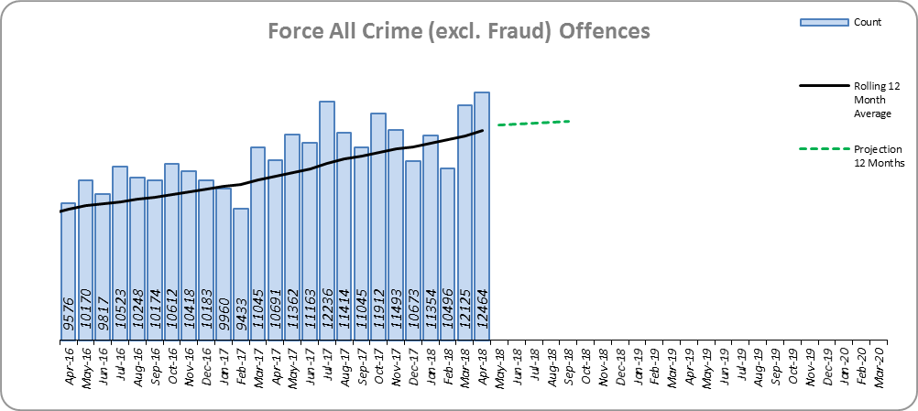
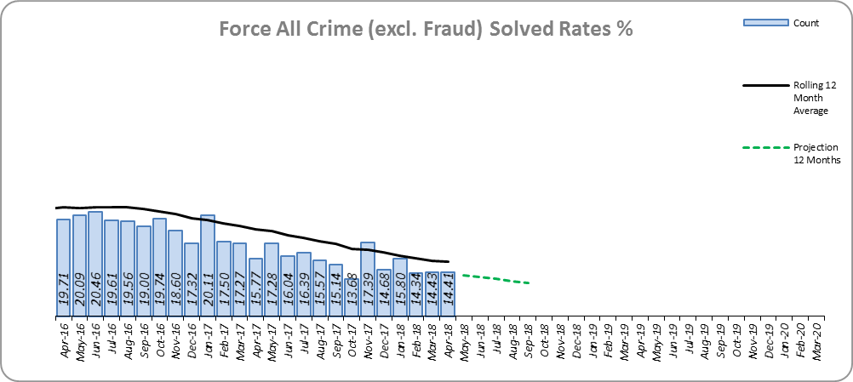
Monthly Performance Overview
Key Areas
All Crime
11.4% increase (13,953 additional offences).⁺
Essex has the 6th lowest increase (out of eight) in its Most Similar Group of forces (MSG), and is 20th nationally* for crime increase. Essex is 4th in its MSG and 18th nationally for crimes per 1,000 of the population.
Increases seen in all 42 forces. The national increase~ was 15.3%.
The force and 11 districts experienced statistically significant increases in April 2018.
The forecast^ is that All Crime will increase.
All Crime Solved Rate
3.1% point decrease (to 16.0%).
The number of crimes solved also fell: by 6.9% (1,604 fewer solved outcomes to 21,691).
Essex is 5th in its MSG and 17th nationally for solved rate % point change. Essex has the 4th highest solved rate in its MSG and 21st nationally for solved rate.
The Force and five districts experienced statistically significant decreases in April 2018.
The forecast is that the solved rate will decrease.
Figure 1
Figure 2
⁺ All crime increases shown are for 12 months to April 2018 compared to the same period to April 2017.
* 1st is considered best performing, and 42nd worst.
~ The national increase (where the category is available) relates to the 12 months to December 2017 vs 12 months to December 2016.
^ All forecasts are based on the last 12 months.

Slide 3
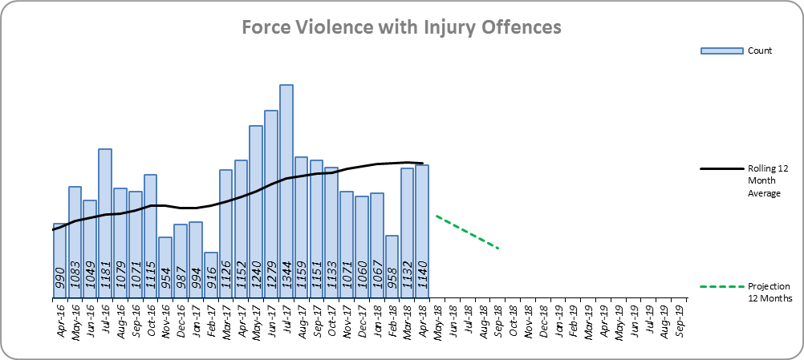
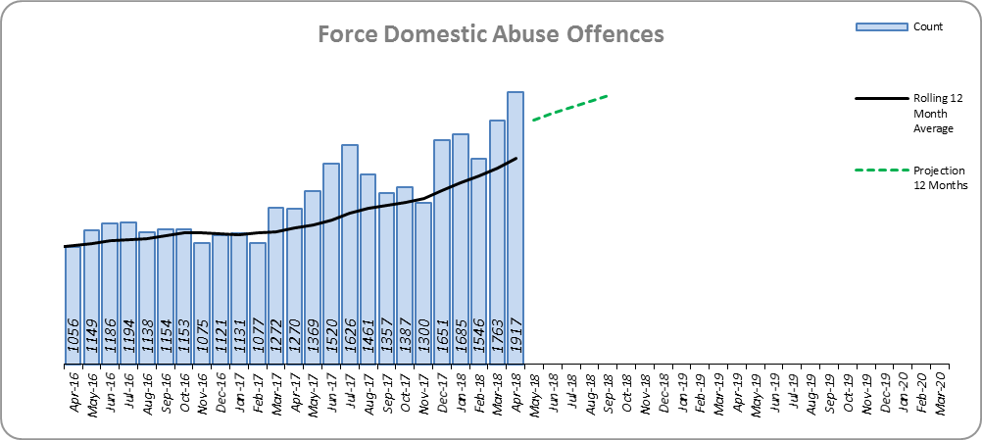
Monthly Performance Overview
Violence with Injury*
7.7% increase (975 additional offences).
Essex is 5th in its MSG and 23rd nationally for crime increase. Essex is 4th in its MSG and 14th nationally for crimes per 1,000 of the population.
Increases seen in 40 out of 42 forces. The national increase was 10.6%.
83.3% of Violence with Injury is Actual Bodily Harm (ABH). By volume, ABH rose by 5.9% (638 additional offences).
65.4% of the increase in Violence with Injury is due to the rise in ABH. There was also a 54.2% rise in ‘wounding with intent to do grievous bodily harm or resist apprehension’ (403 additional offences); this was the category with the second highest volume rise (after ABH).
31.6% of Violence with Injury is Domestic Abuse-related.
Two districts experienced a statistically significant increase in April 2018.
The forecast is that Violence with Injury will decrease.
Figure 3
Domestic Abuse
32.2% increase (4,472 additional offences).
There are no national or MSG comparisons on iQuanta** for Domestic Abuse.
The Force and 14 districts experienced statistically significant increases in April 2018.
The forecast is that Domestic Abuse (all risk levels combined) will continue to rise.
High Risk Domestic Abuse 17.3% decrease (432 offences).
Medium Risk Domestic Abuse 21.2% decrease (1,197 offences).
Standard Risk Domestic Abuse 102.3% increase (5,623 offences).
Figure 4
* Offences included within the Violence with Injury classification changed in November 2017. Offences involving “Death or Serious Injury – Unlawful Driving” have now been removed and are in a separate category. Please note iQuanta related positions still relate to the former definition.
** A web-based service provided for the use of Police forces, Community Safety Partnerships (CSPs) and Her Majesty’s Inspectorate of Constabulary and Fire & Rescue Service (HMICFRS).

Slide 4
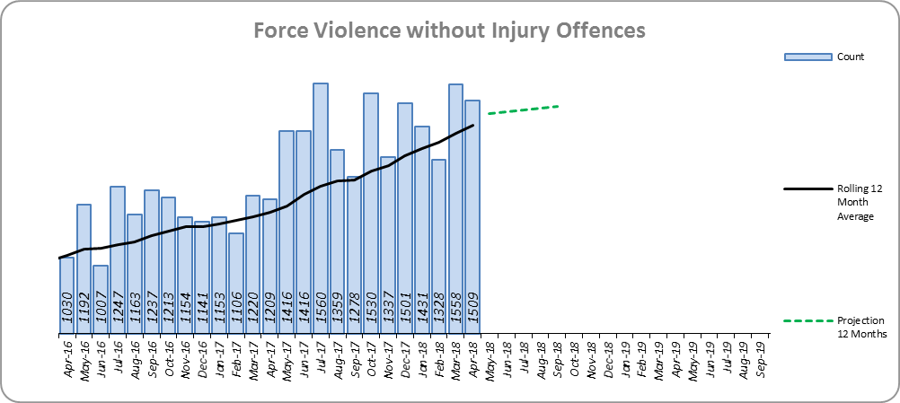
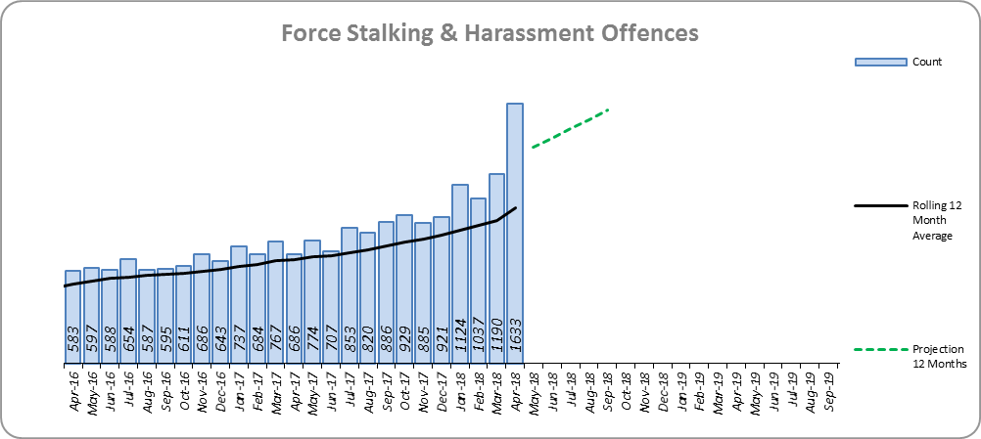
Monthly Performance Overview
Statistical Exceptions – Offences
Violence without Injury*
The Force and six districts experienced statistically significant increases in April 2018.
21.6% increase (3,045 offences).
Essex is 7th in its MSG and 28th nationally for crime increase. Essex is 5th in its MSG and 27th nationally for crimes per 1,000 of the population.
89.5% of Violence without Injury is Common Assault.
86.1% of the increase in Violence without Injury is due to the rise in Common Assault.
Increases seen in 41 out of 42 forces. The national increase was 24.8%.
The forecast is that Violence without Injury offences will continue to increase.
Figure 5
Stalking and Harassment Offences
The Force and 14 out of 14 districts experienced statistically significant increases in April 2018.
54.1% increase (4,047 additional offences). The national increase was 33.2%.
We will see further increases to the number of recorded offences due to the change in the counting rules for Harassment.
Previously when someone committed a Harassment type offence and another offence (such as ABH, Criminal Damage) we always recorded just the other offence, not the harassment. From April 2018 onwards, we record both the harassment and the most serious additional crime.
There are no full year national or MSG comparisons on iQuanta.
34.1% of offences were Domestic Abuse-related.
The forecast is that Stalking and Harassment offences will continue to increase.
Figure 6
* Offences included within the Violence without Injury classification changed in November 2017. Offences involving “Stalking and Harassment” have now been removed and are within a separate category. Please note iQuanta related positions still relate to the former definition.

Slide 5
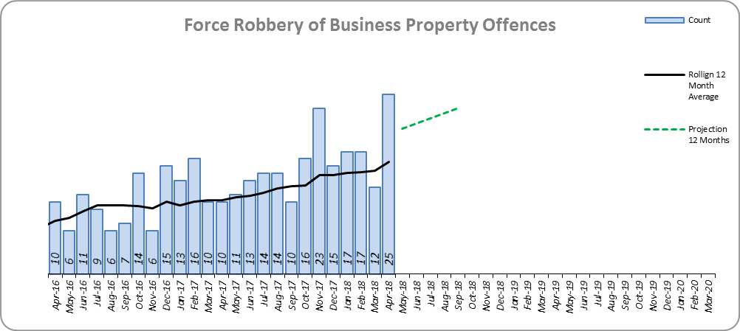
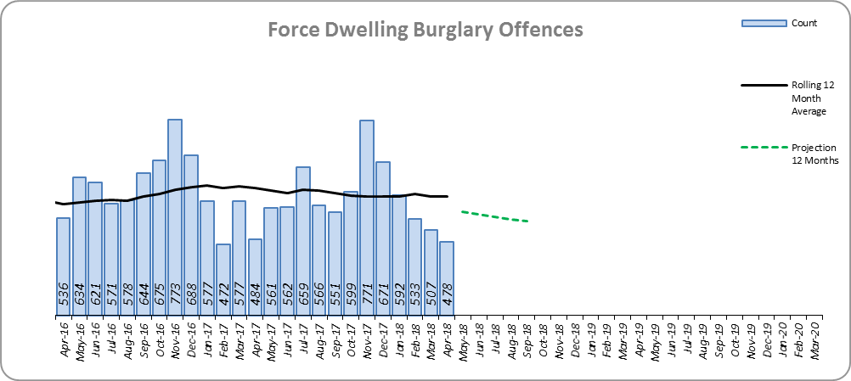
Monthly Performance Overview
Robbery of Business Property
The Force and four out of 14 districts experienced statistically significant increases in April 2018.
51.7% increase (62 additional offences).
Essex is 5th in its MSG and 28th nationally for crime increase. Essex is 6th in its MSG and 28th nationally for crimes per 1,000 of the population.
Increases seen in 31 out of 42 forces.
The forecast is that Robbery of Business Property will increase.
Figure 7
Dwelling Burglary Offences
The Force and one out of 14 districts experienced a statistically significant decrease in April 2018.
1.6% decrease (111 fewer offences).
The number of crimes solved increased: by 16.9% (86 more to 595 solved outcomes).
The solved rate increased by 1.3% points to 8.5%
The forecast is that Dwelling Burglary Offences will decrease.
Figure 8

Slide 6
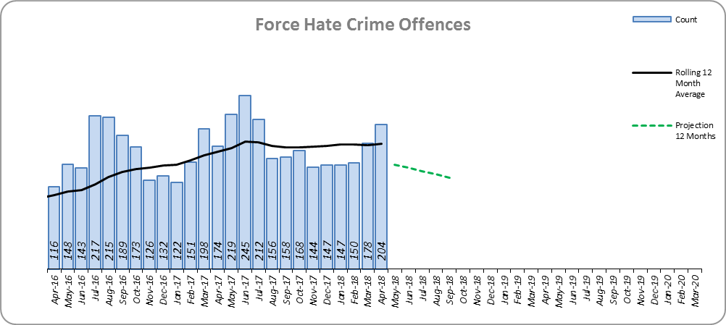
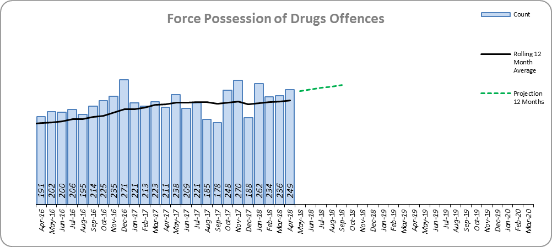
Monthly Performance Overview
Hate Crime (As defined by the Home Office)
The Force experienced a statistically significant increase in April 2018.
6.7% increase (134 additional offences).
Racially/Religiously Aggravated offences, which are a sub set of Hate Crime decreased by 1.7% (21 less offences).
Age, Disability, Homophobic and Transgender offences, as subsets of Hate Crime have all increased, the largest increase in volume being Disability with 74 more offences this year (42.8% increase).
There are no full year national or MSG comparisons on iQuanta.
The forecast is that Hate Crime offences will decrease.
Figure 9
Possession of Drugs
The Force and six out of 14 districts experienced statistically significant increases in April 2018.
3.3% increase (86 more offences).
Essex is 6th in its MSG and 28th nationally for crime increase. Essex is 5th in its MSG and 21st nationally for crimes per 1,000 of the population.
Increases seen in 19 out of 42 forces.
The forecast is that Possession of Drugs offences will increase.
Figure 10

Slide 7
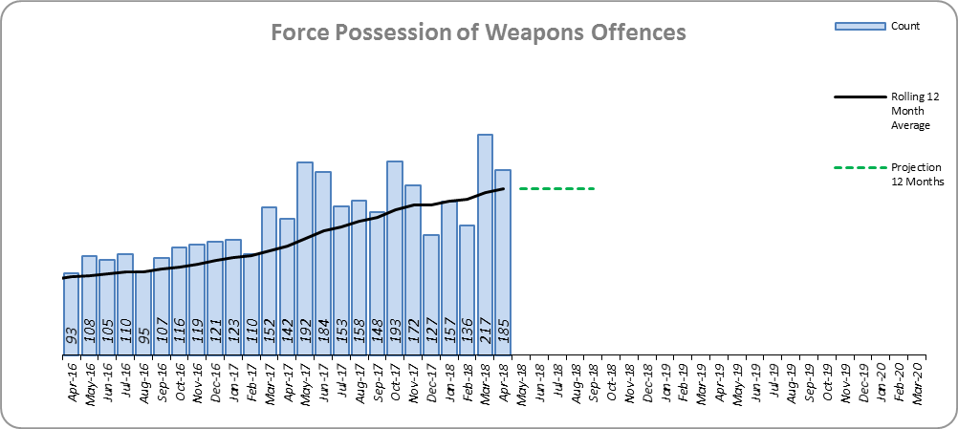
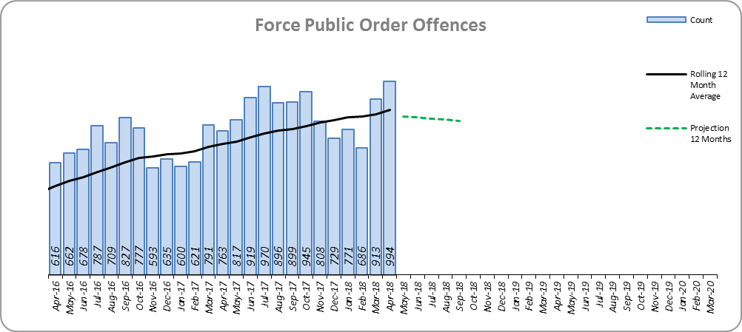
Monthly Performance Overview
Possession of Weapons
The Force and two out of 14 districts experienced statistically significant increases in April 2018.
46.0% increase (630 offences). However, 56.7% of this increase is due to offences committed at Stansted Airport.
Stansted Airport accounts for 42.3% of total Possession of Weapons This increase is due to more accurate crime recording practices.
Essex is 8th in its MSG and 39th nationally for crime increase. Essex is 8th in its MSG and 42nd nationally for crimes per 1,000 of the population.
Increases seen in 39 out of 42 forces. The national increase was 25.2%.
The forecast is that Possession of Weapons offences will increase.
Figure 11
Public Order
The Force and six out of 14 districts experienced statistically significant increases in April 2018.
22.1% increase (1,852 offences).
Essex is 7th in its MSG and 20th nationally for crime increase. Essex is 5th in its MSG and 27th nationally for crimes per 1,000 of the population.
Increases seen in 41 out of 42 forces. The national increase was 41.8%.
The forecast is that Public Order offences will decrease.
Figure 12

Slide 8
2016-2020 Police and Crime Plan Performance Indicators
Table 1
See Appendix for endnotes.
Below is an explanation as to why certain indicators are considered to be improving or deteriorating:
Priority 1 – Number of all crime offences. Performance is considered to be deteriorating due to the rise in crime. No data are available to indicate how much of this rise is attributable to better crime data integrity. An increase in crime has been experienced in every UK police force .
Priority 3 - Number of incidents of domestic abuse. Performance is considered to be deteriorating due to the rise in incidents. No data are available to indicate whether this rise is attributable to media campaigns or initiatives that encourage reporting.
Priority 5 - Number of arrests in relation to the trafficking of drugs. Drug trafficking arrests are dependent on pro-active policing. This may include pre-planned operations conducted as a result of intelligence reports received, positive search warrants of residences/premises, and positive searches of individuals.
Priority 7 - Number of driving related mobile phone crime on Essex roads. This is considered to be improving as Essex Police’s Operational Policing Command (OPC) have stated there has been a noticeable reduction in the number of drivers stopped whilst using a mobile phone at the wheel.
Priority 7 - Number of driving under the influence of drink and/or drugs on Essex roads. Operational Policing Command (OPC) have stated that a reduction indicates the public are adhering to the strong educational messages being delivered by drink/driving campaigns. Collisions attended by the police involve routine breath-testing of involved parties. An increase could also demonstrate proactive policing.

Slide 9
Appendix
¹ª Results are for the period September 2017 to December 2017. Essex Police performed significantly above the results for the local confidence question contained in the PFCC’s Plan for Q1 and Q2. This difference could not be explained and consequently an additional question was added in Q3 with the exact wording used in the CSEW. This is the question now being used.
¹^{b} Results are for the period April 2017 to December 2017.
² Crime Survey for England and Wales (CSEW): 12 months to December 2017 vs. 12 months to December 2016. The confidence interval is the range +/- between which the survey result may lie.
³ The number of Organised Criminal Group disruptions are for the periods February 2018 to April 2018 vs. November 2017 to January 2018.
⁴ Solved outcomes are crimes that result in: charge or summons, caution, crimes taken into consideration, fixed penalty notice, cannabis warning or community resolution.
⁵ ‘Killed or Seriously Injured’ refers to all people killed or seriously injured on Essex’s roads, regardless of whether any criminal offences were committed. ‘Causing Death/Serious Injury by Dangerous/Inconsiderate Driving’, however, refers to the number of crimes of this type.
* Standard Scores are used to compare figures from different normal distributions, and determine how spread out they are from the average or ‘mean’. They are calculated in the following way: (the month's figure, minus the average figure per month over the previous three years) divided by the Standard Deviation of the same three year period. In this document, a Standard Score over 1.28 or under -1.28 was used to identify whether the increase or decrease was statistically significant.

Slide 10
Crime Tree Data – Rolling 12 Months to April
Table 2

Slide 11
Crime Tree Data – Rolling 12 Months to April
Table 3

Slide 12
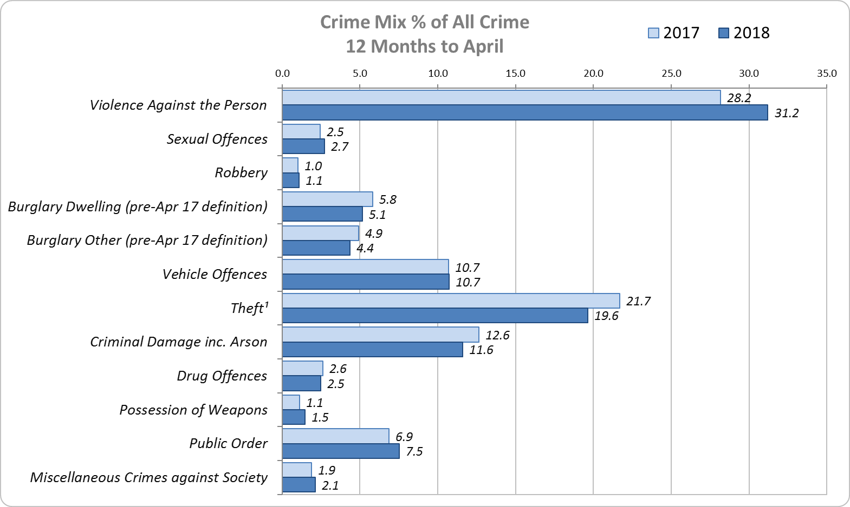
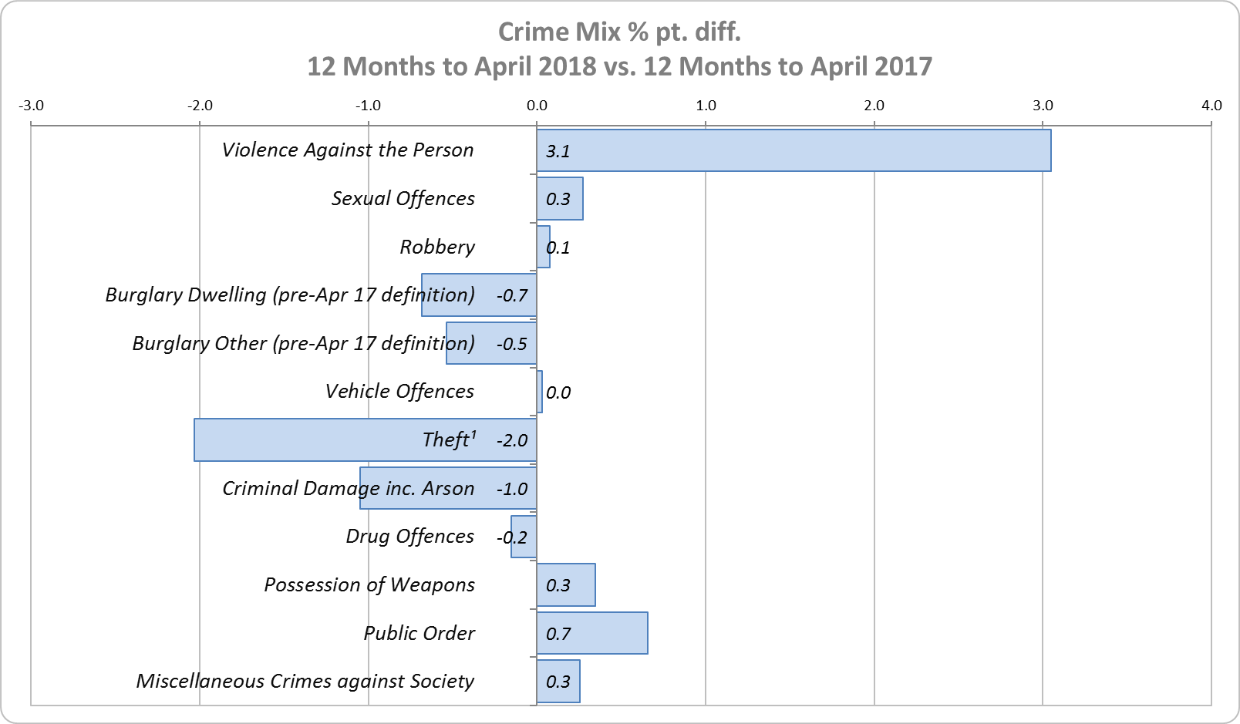
Crime Mix – Rolling 12 Months to April 2017 vs. 2018
Figure 13
Figure 14
Violence Against the Person saw a 3.1% point increase in the proportion of all crime; it also experienced the biggest volume rise (8,074 further offences). Public Order Offences saw a 0.7% point increase in the proportion of all crime, and experienced the second biggest volume rise (1,852 offences).
13.5% of crime is Domestic Abuse-related; this proportion has increased from 13.2% for 12 months to March 2018. Domestic Abuse-related Violence Against the Person also increased to 34.3% (from 34.1% for 12 months to March 2018).

