Slide 2
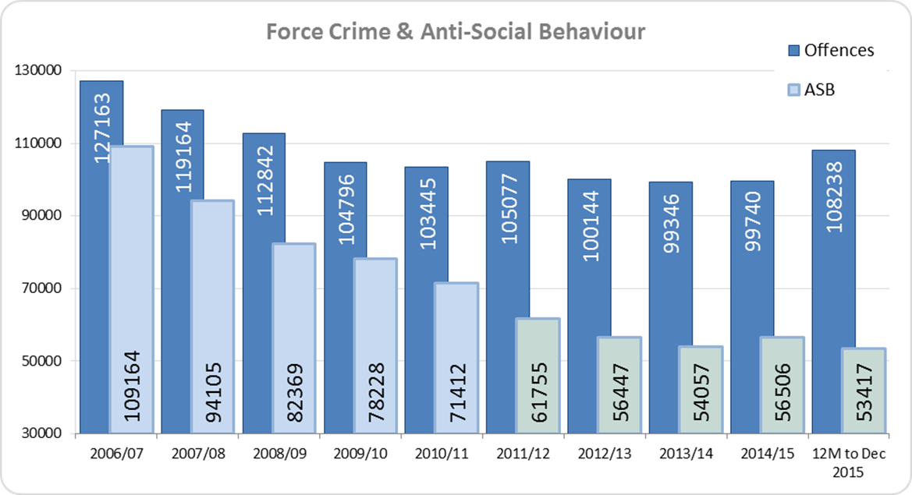
Reducing Crime and Anti-Social Behaviour

Slide 3
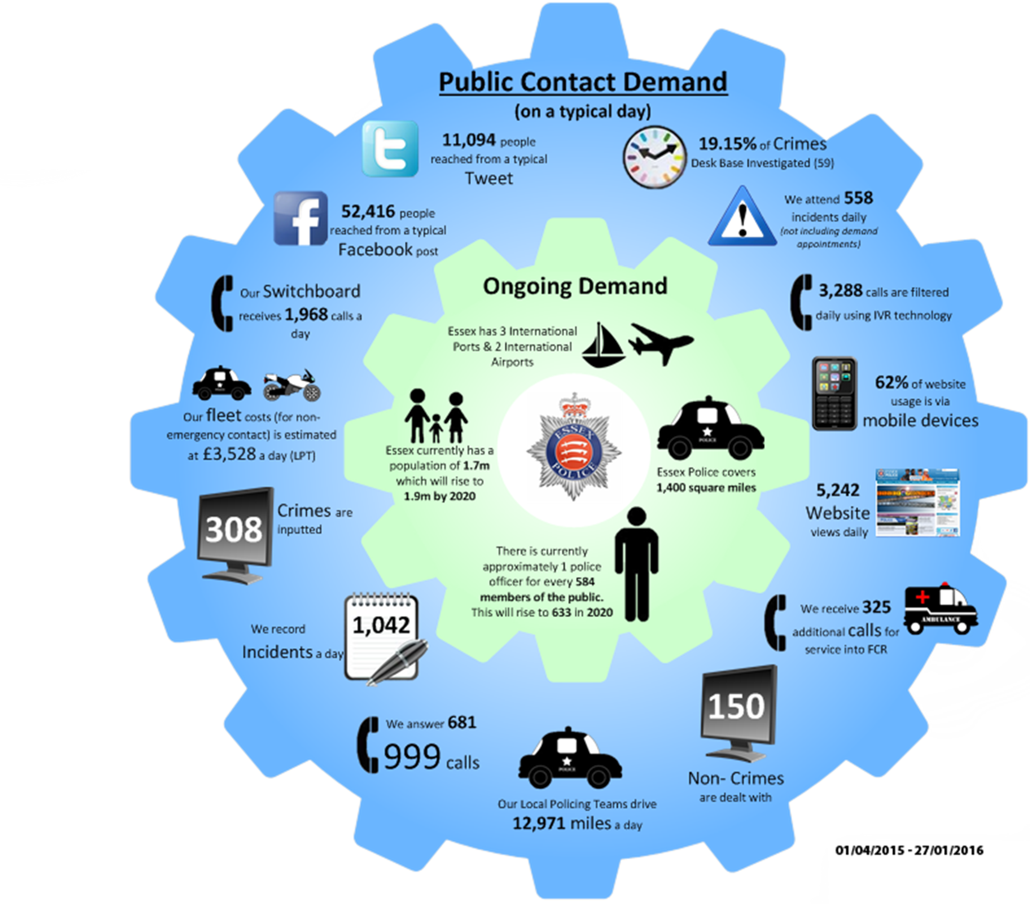
On a typical Day,
Essex police:

Slide 4
Challenges
Solving Crime and promoting satisfaction and public confidence
Increasing Trends
Violence Against the Person up 24.0%
Sexual Crime up 26.2%
Encouraging Under Reported Crime
Domestic Abuse – reported offences up 11.8%
Hate Crime
Emerging Crime Types
Cyber (including grooming, fraud, etc.)
Gang related crime

Slide 5
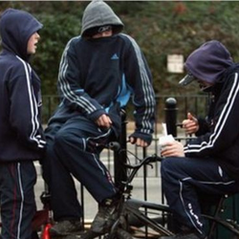
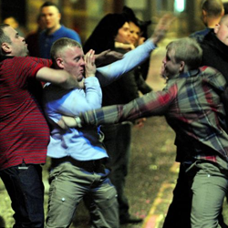
Community Policing Team and Partnership Hubs
Ten Community Policing Teams across the county
Problem solving focus:
High risk / repeat victims
Emerging crime series / hotspots
Supporting the most vulnerable
Managing the night-time economy
Engaging with local communities
Working with local partners – ‘Partnership Hubs’

Slide 6
Counter Terrorism in Essex

Slide 7
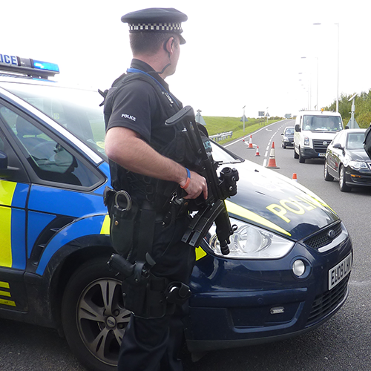
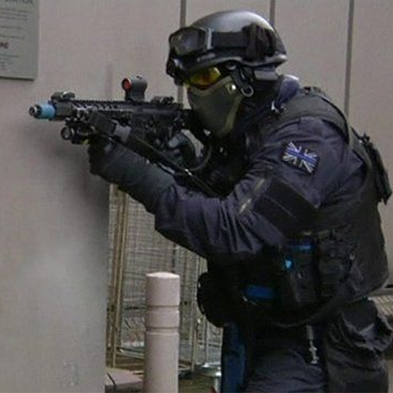
How is Essex Police
Prepared?
Planning
New Revised Plans
Regional Approach
No notice attack / Rise in the threat level
Exercising
Military
Internal
Multi Agency
Training
Command level briefings
Armed Response Officer Tactics
Specially Trained Commanders

Slide 8
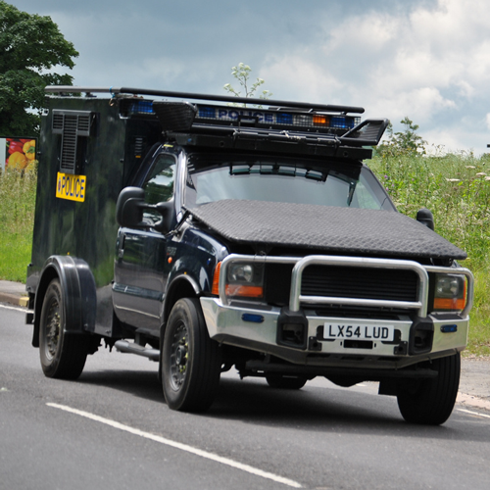
How is Essex Police
Prepared?
Command
Specialist Commanders
Nationally Trained
Available 24 hours a day
Capability
Review of equipment
Enhanced Weaponry to neutralise threat
Review of initial Firearms response
Capacity
Review of Armed response capability
Uplift in capability during times of highest threat
Only one level of training which is above minimum National Standard

Slide 9
Domestic Abuse and Vulnerable Victims

Slide 10
HMIC Vulnerability Inspection conducted July 2015
The key areas of focus were:
How well does the force identify those who are vulnerable and assess their level of risk and need
How well does the force respond to vulnerable victims
How well does the subsequent police action and work with partners keep victims safe
How well does the force respond to and safeguard specific vulnerable groups:
Missing and absent children
Victims of Domestic Abuse
Preparedness to tackle Child Sexual Exploitation

Slide 11
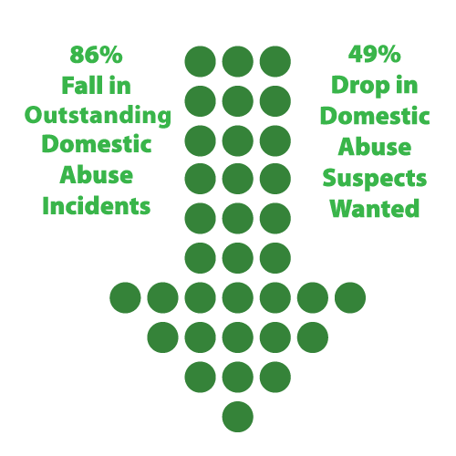
Improvements relating
to Domestic Abuse
Essex Police now provide bespoke safety plans for all victims of Domestic Abuse, irrespective of their risk assessment grading
The number of outstanding unallocated Domestic Abuse incidents has fallen by 86% over the last six months and the number of Domestic Abuse suspects wanted in connection with offences has dropped by 49%

Slide 12
Improvements relating
to Domestic Abuse
Multi-agency hubs are set up to deliver more effective safety planning
Operation Shield targets prolific high risk offenders and offers enhanced service to acute victims
The Force is working with partners to progress 2 perpetrator programmes in an effort to reduce offending

Slide 13
Context around CSE
and Missing Children
Each year more than 250,000 people go missing.
140,000 of these are children
91% of people are found within 48hrs and 99% within a year
Police spend 15% of their time looking for missing people

Slide 14
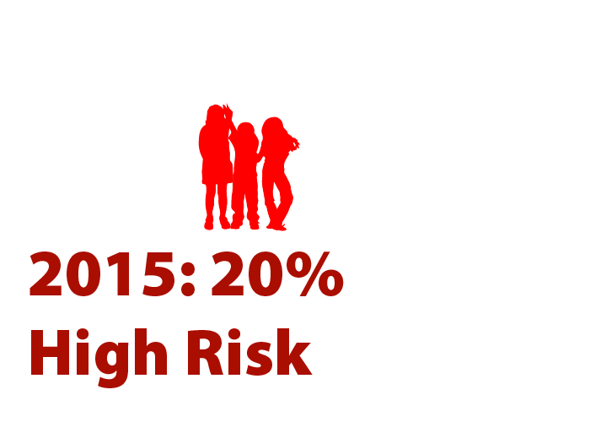
Context around CSE
and Missing Children
In 2015, Essex Police received more than 4700 missing person reports.
2700 involved children.
Approximately 20% of missing children cases are classified as high risk
The Child Sexual Exploitation Triage Team evaluates an average of 90 pieces of information
Relating to more than 140 children each month

Slide 15
Improvements around CSE
and Missing Children
The Force has developed a child protection referral form to notify Children’s Social Care where children are at risk
The Force has invested in 10 Missing Person Liaison Officers to concentrate on those children most at risk
Multi-agency Child Exploitation meetings have been developed in order to put measures in place to protect children most at risk

Slide 16
Improvements around CSE
and Missing Children
Significant investment in police officers and staff in training and raising awareness through conferences seminars.
Three-day Public Protection course being delivered to all front line officers.

