Slide 1
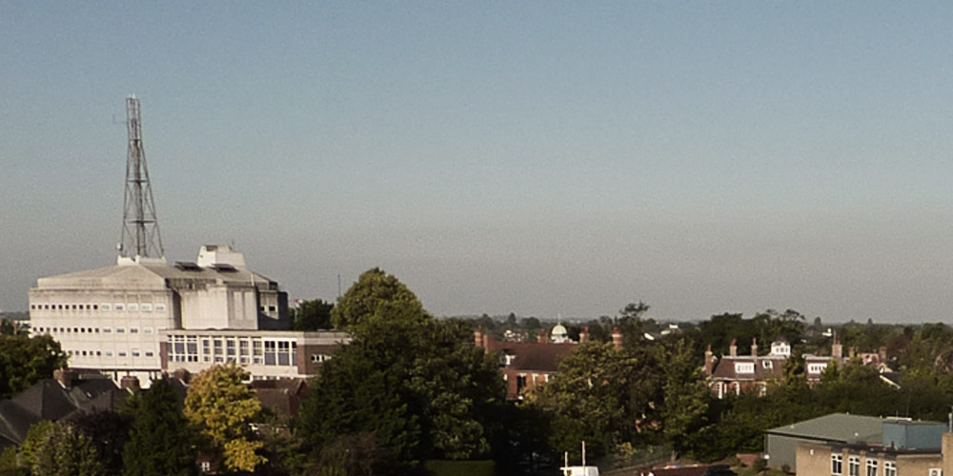


Slide 2
Stephen Kavanagh
Chief Constable of Essex Police
Nick Alston
Police and Crime Commissioner for Essex

Slide 3
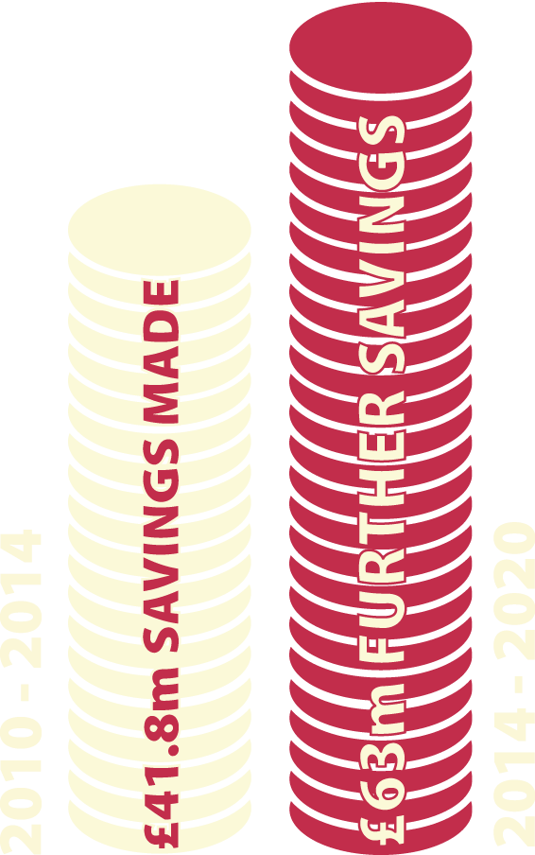
The financial context
83% of the £262m budget is spent on salaries of
police officers, PCSOs and police staff
Every £1 million pays for 20 police constables for a year
We have just under 3,000 officers, 600 fewer
than in 2010
We are in the middle of a decade that will see
policing budgets in Essex cut by a third.
Essex Police has made
£41.8 million of
savings between
2010 and 2014.
The force is
now facing further
cuts of £63 million to be made by 2019/20.

Slide 4





On an average
day Essex Police…
records 1200 incidents and receives 600 emergency 999 calls
records 272 crimes and arrests 99 people
responds to 25 incidents where people are experiencing mental health issues
attends 11 road traffic collisions where there are casualties, and conducts 39 breath tests
responds to around 9 reports of a missing person: 6 will be classed as medium or high risk. The person might be found in hours or it may take weeks and months of work.

Slide 5


The local policing context
The nature of crime in the county is changing… and the technology available to Essex Police is changing too
Some of the most serious crime now happens not on our streets but behind closed doors and online
Essex Police has to be leaner but also smarter, taking even more account of risk and the vulnerability of victims
Local policing will change but Community Policing Teams will continue to serve all communities
It is police officers that keep people safe and solve crimes, not buildings
1 in 10 report a
crime or incident.
Only around 1 in 10
visits to police stations
are to report a crime or
other incident.
Every day 5,797 people
contact Essex Police via
the non-emergency 101
number. A further 593
people call Essex Police
via 999 to report an
emergency.

Slide 6
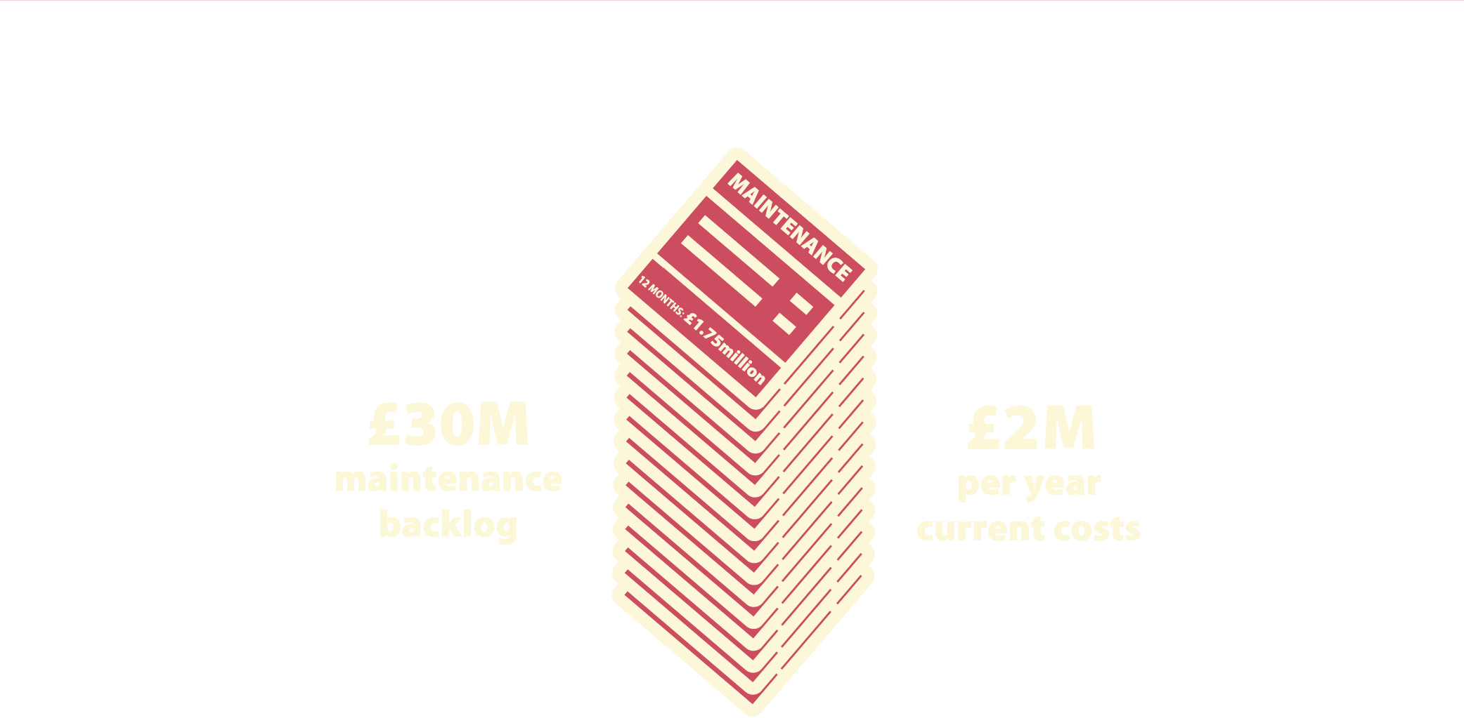
The Police Estate
80 buildings costing £10m a year to run,
£2m a year to maintain with maintenance
backlog £30m and growing…
Essex Police needs modern fit for purpose
accommodation in the right locations to meet
the challenges of policing for the next 20 years.
Essex Police’s 80 buildings require £30 million
maintenance work to bring up to standard and
expenditure of £2 million a year to maintain the
current condition.

Slide 7


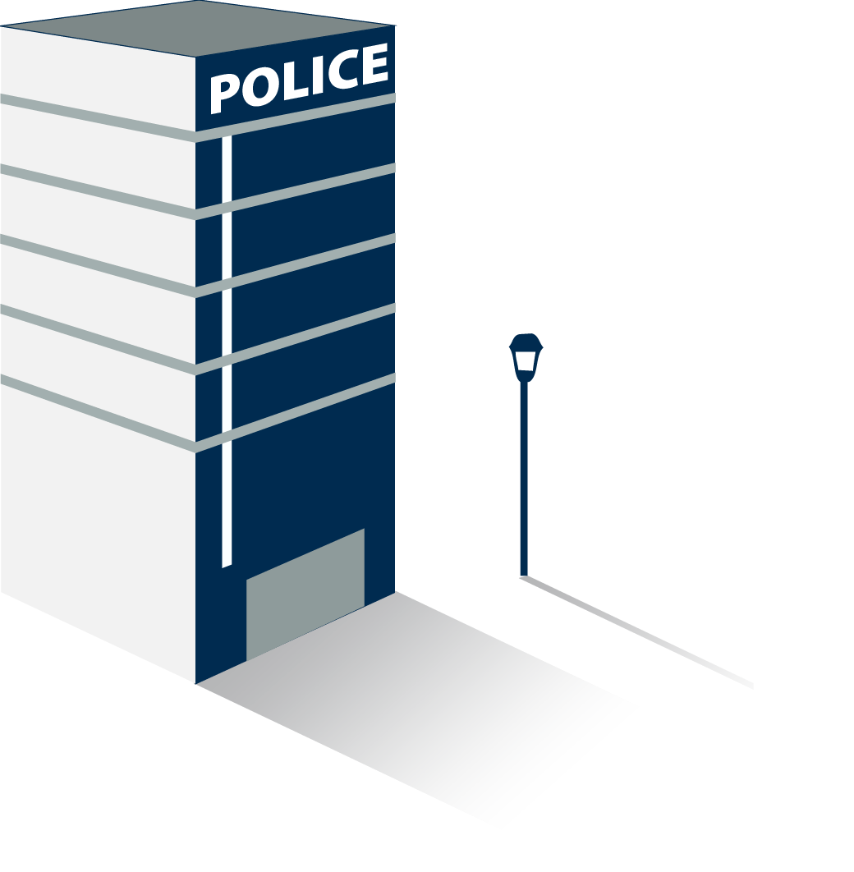
Police Estate proposals
10 central stations
1 headquarters
80 police buildings and
stations, reduced down to 30
fit for purpose buildings.
10 central police stations that will continue
to provide front counter services to the public.
Plans are also underway for the future sharing
of space with other public sector partners.
A modern police headquarters
that will house 2,000 staff which is
efficient and purpose-built.

Slide 8
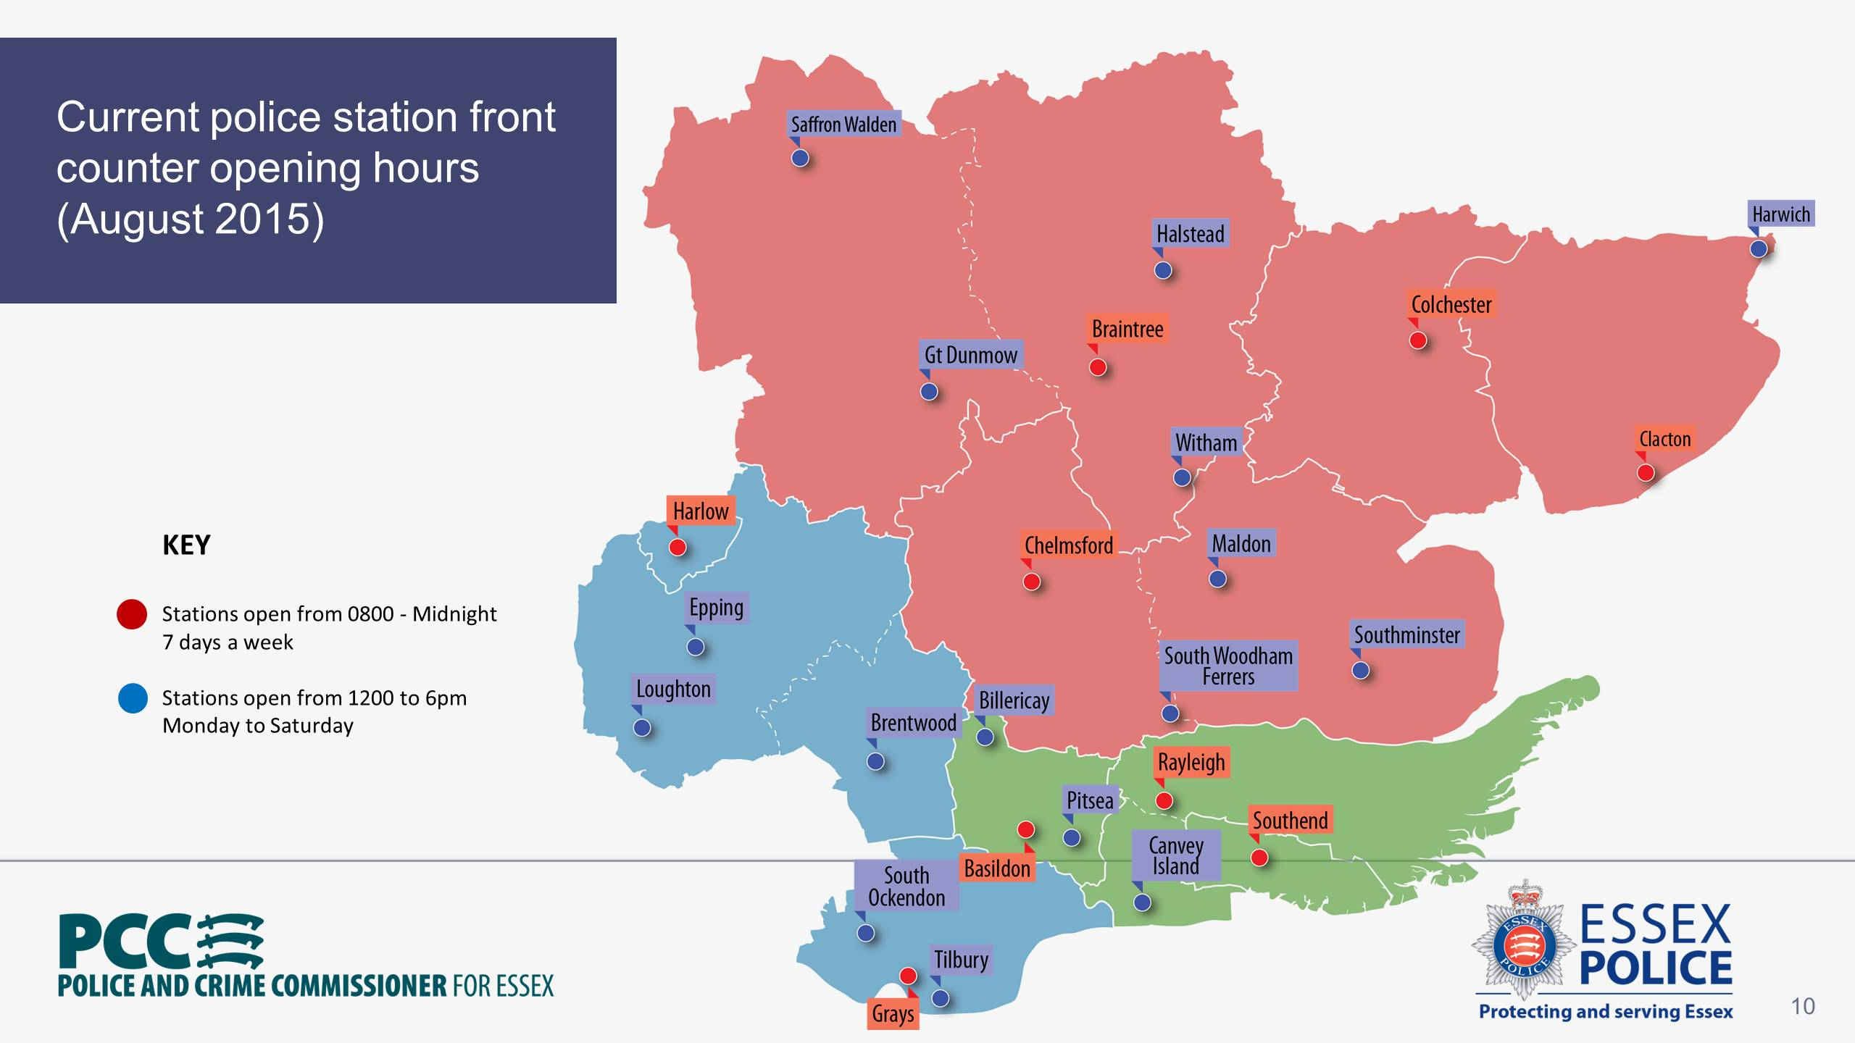
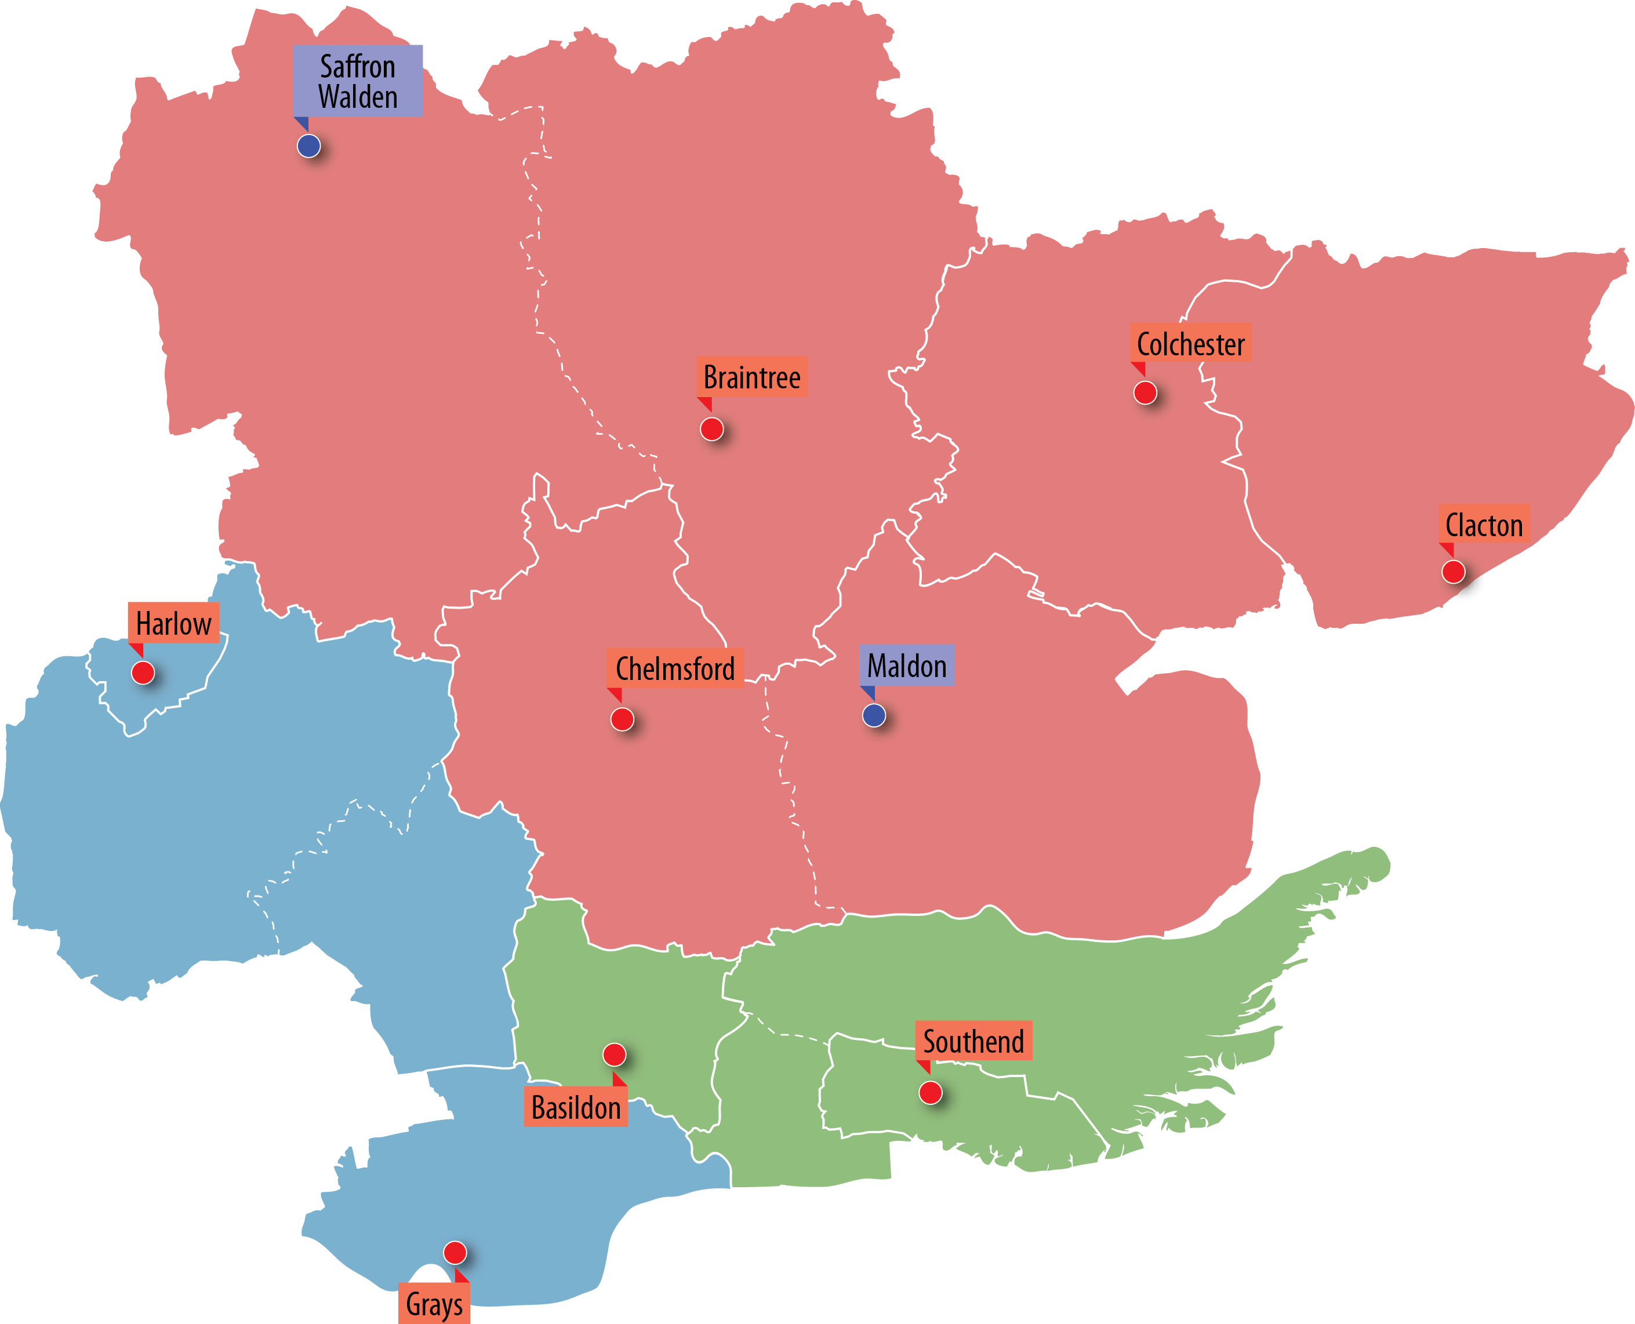
Proposed police station
front counter opening
hours from April 2016
KEY
Stations open from 9am to 5pm
Monday – Friday
Stations open from 9am to 5pm
Monday to Friday

Slide 9
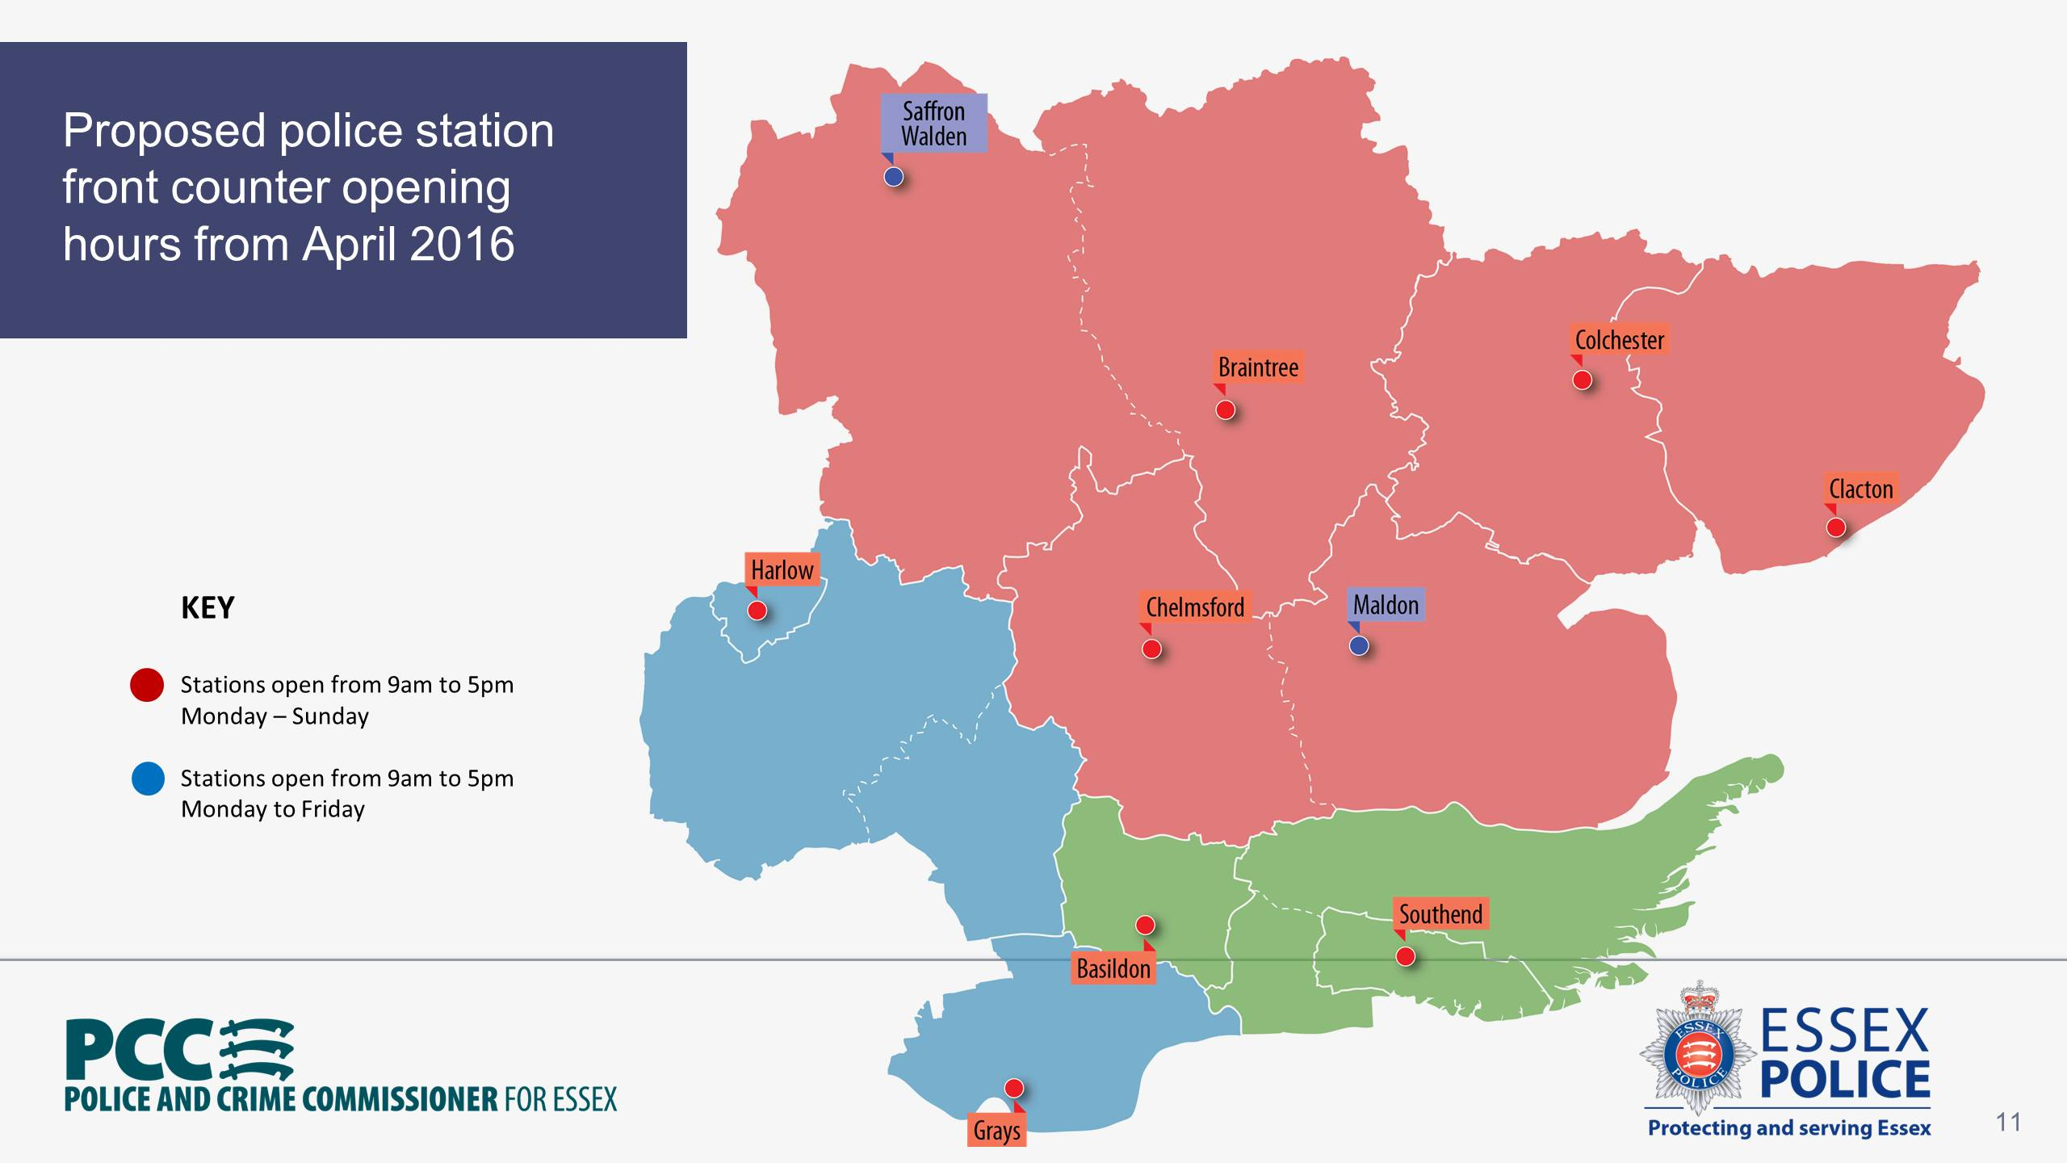
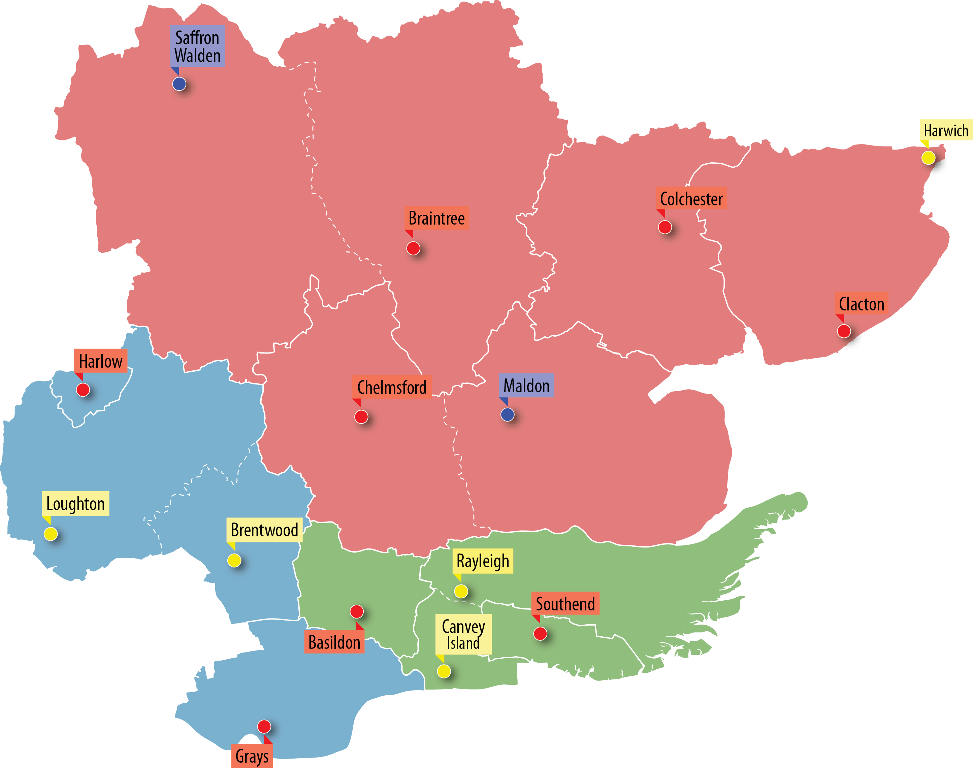
Proposed police station
front counter opening
hours from April 2016 plus
remaining operational bases
KEY
Stations open from 9am to 5pm
Monday – Friday
Stations open from 9am to 5pm
Monday to Friday
Remaining operational bases
(no front counters)

Slide 10
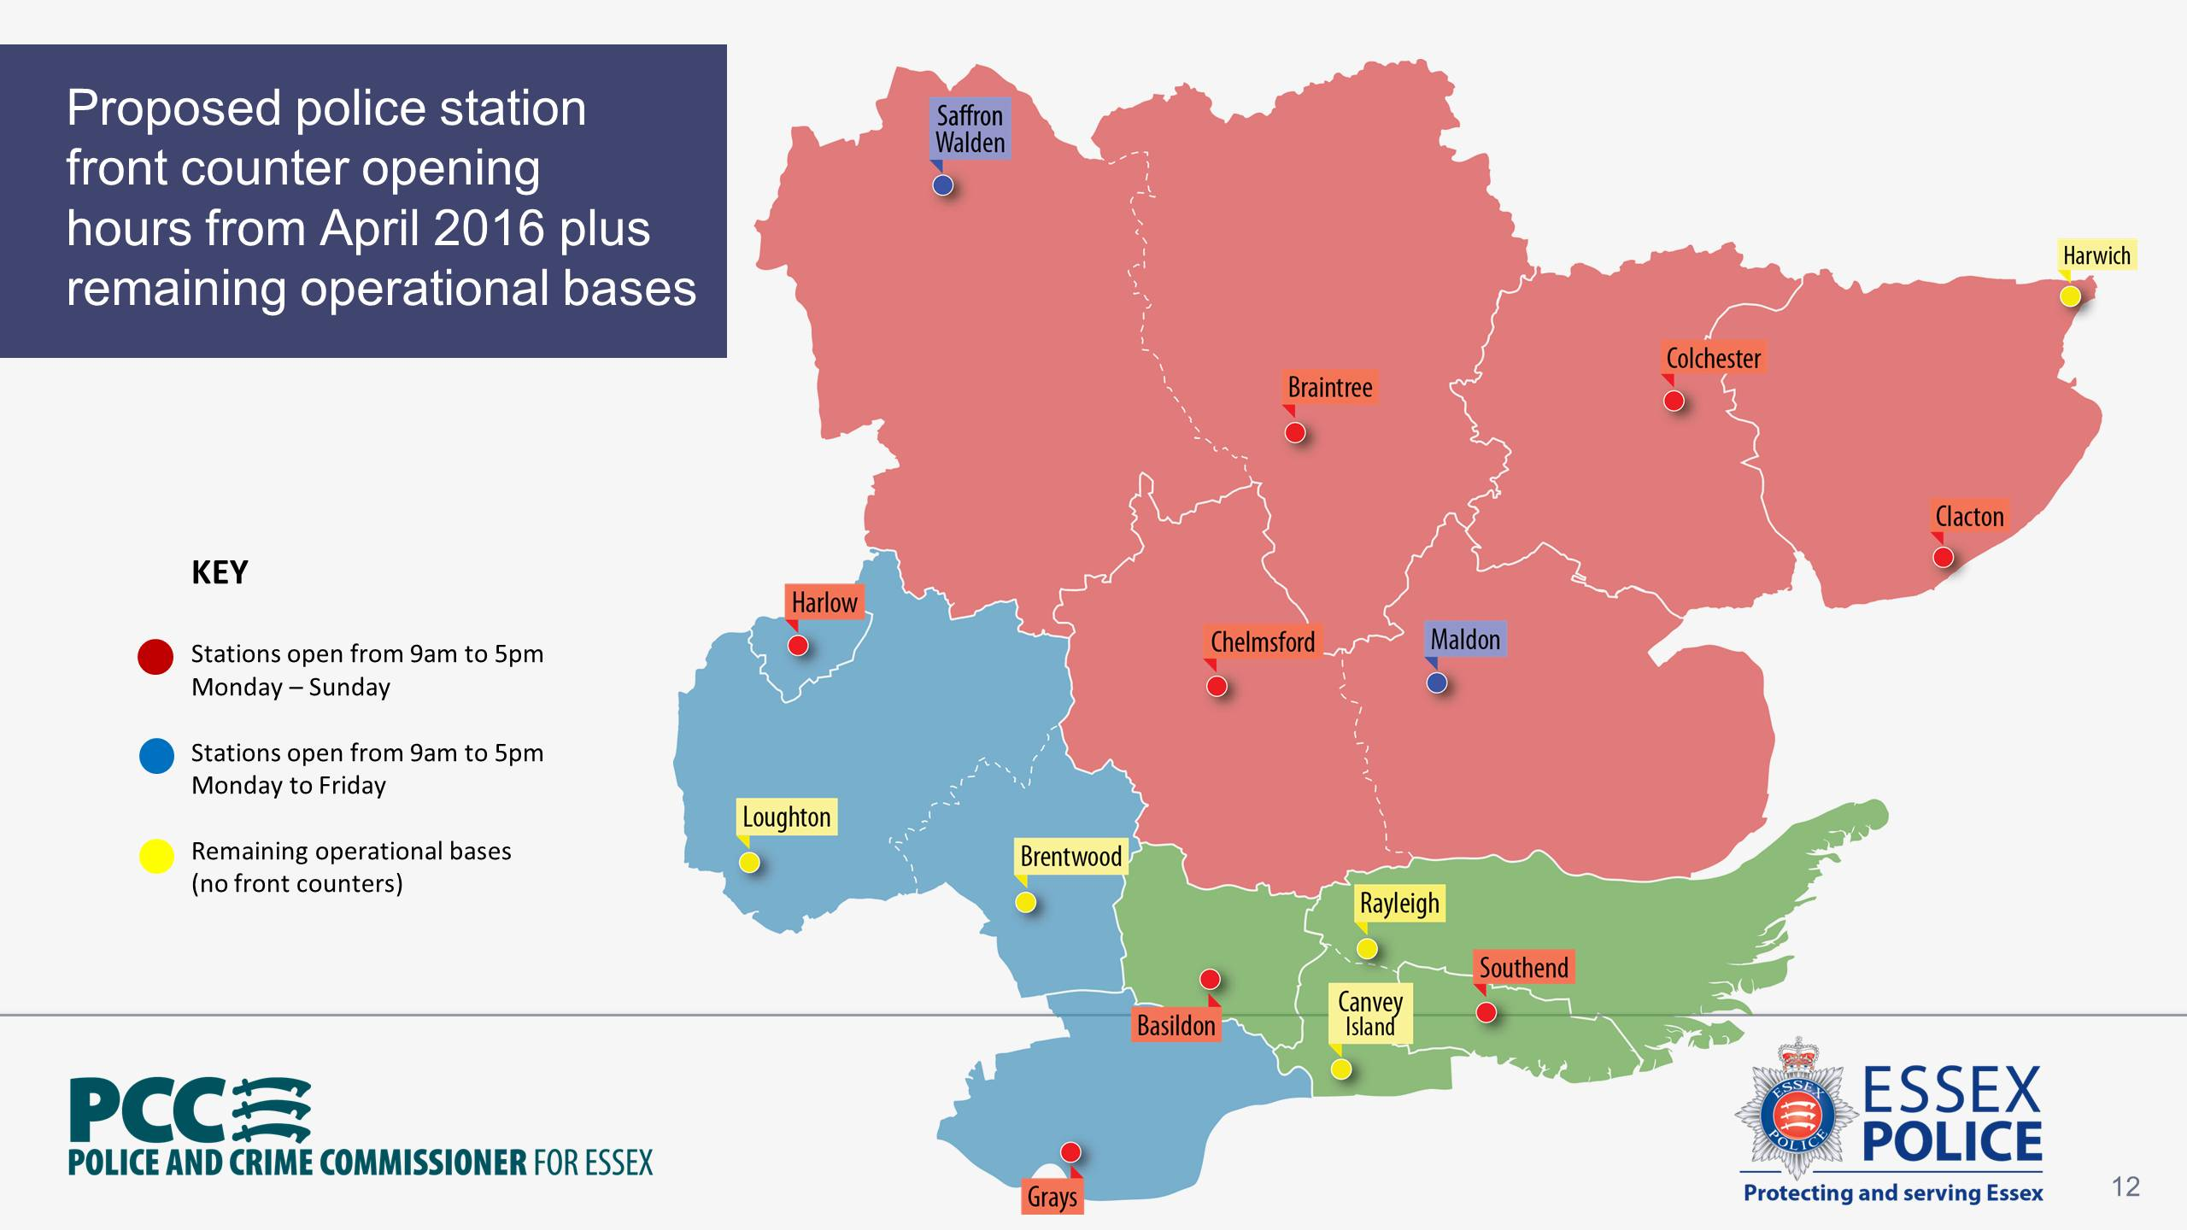

Slide 11

Local policing proposals
10
policing districts managed
by a district commander
New policing teams in each district that are
locally based,
locally accountable and
prioritise issues causing the greatest
harm to the local community.

Slide 12






Local policing proposals
Nearly 3000 officers, including
900 working 24/7 shifts responding
to emergencies and investigating crimes,
220 detectives on CID teams investigating
serious Offences
and 150 officers and staff dedicated to
dealing with domestic abuse.

Slide 13

Local policing proposals
Essex Police will put your officers where the
most harm is being caused in our communities.
That is on the frontline dealing with
domestic abuse,
violent crime,
sexual offences and
child abuse.

Slide 14
Local policing proposals
Essex Police currently has 250 PCSOs.
It is proposed that there will be 60 PCSOs,
flexibly deployed across each of the
10 Community Policing Teams across Essex
Essex Police currently has 98 posts for
front counter staff. It is proposed that there
will be 36 posts for staff working on the
10 remaining front counters

Slide 15
The bottom line
DOING NOTHING IS NOT AN OPTION
Essex Police is not leaving you.
However, we need to change so
that we can continue to provide
you with a modern, viable and
effective police service.

Slide 16
Reducing Crime and
Anti-Social Behaviour

Slide 17
Challenges
Solving Crime and promoting satisfaction and public confidence
Increasing Trends
Violence Against the Person up 18.5%
Sexual Crime up 35.0%
Encouraging Under Reported Crime
Domestic Abuse
Hate Crime

