Slide 1
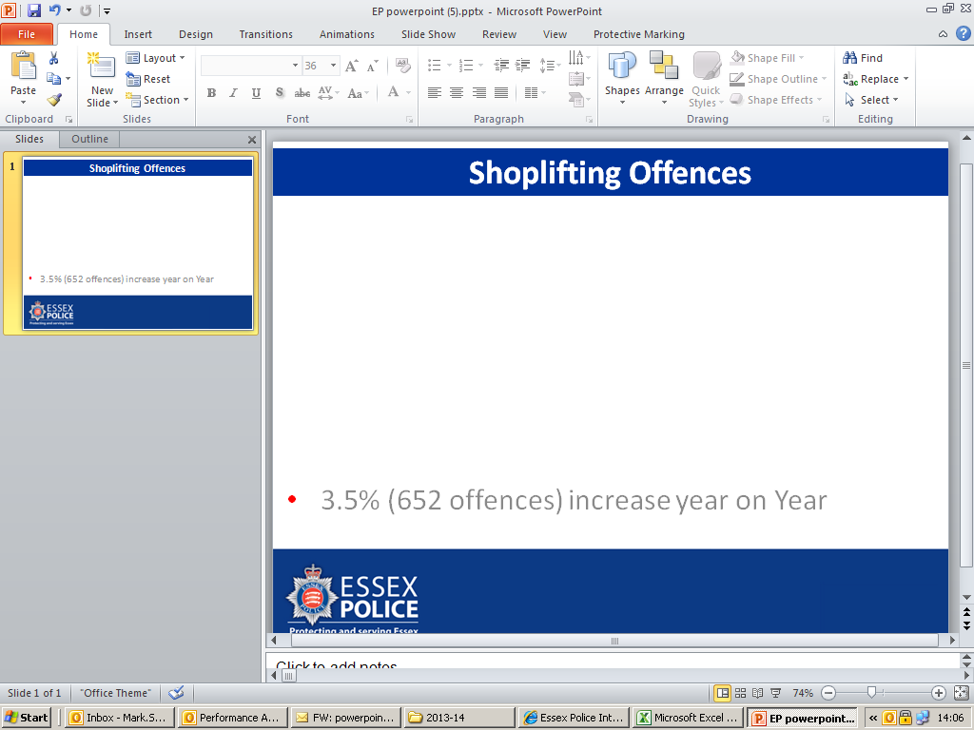
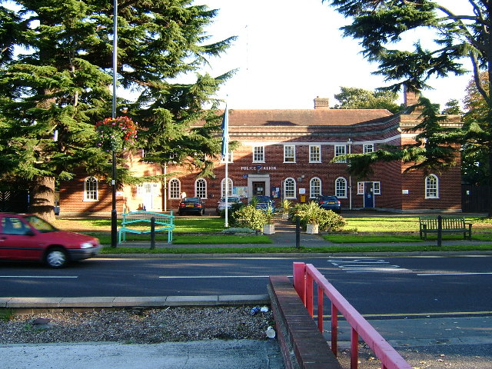
Essex Police Challenge Meeting
12th March 2015

Slide 2

Austerity
Policing on a smaller budget will become the new normal

Slide 3

Since 2010 – saved £42million
We estimate additional cost savings of
£50million to 60million by 2020
We will have no choice but to deliver them

Slide 4
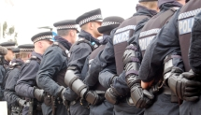
Next year, a 4.7% cut in the Home Office grant funding means Essex will get £8.5million less to police the county.
This follows 5 years of similar cuts.
Emerging Challenges:
Child Abuse demand
Domestic Abuse
Digital/Cyber Crime
Terrorist threat

Slide 5




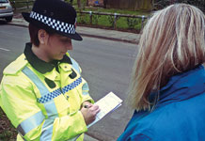


Reducing Crime and Anti-Social Behaviour

Slide 6
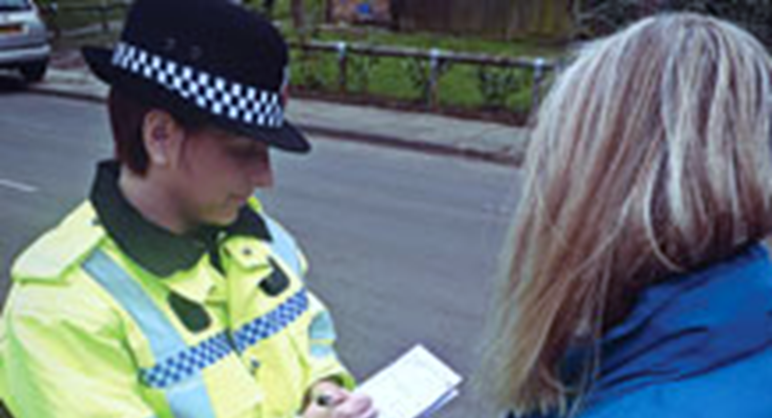
Significant Reductions
Vehicle Crime 18.4% (1674 offences)
Dwelling Burglary 10.2% (770 offences)
Robbery 14.3% (158 offences)

Slide 7

Increasing Trends and Challenges
Increasing Trends
  Serious Violent Crime up 9.0%
  Serious Sexual Crime up 26.2%
Encouraging Under Reported Crime
Domestic Abuse
Hate Crime

Slide 8
Solving Crime and Bringing Offenders To Justice
Essex is 25th out of 43 forces
Serious Violent Crime Outcomes up 9.0%
Serious Sexual Crime detections up 29.3%

Slide 9
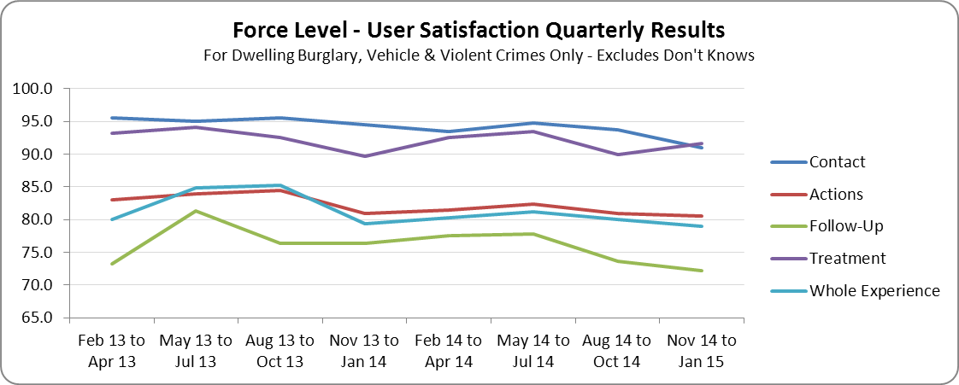

Promoting Satisfaction and Public Confidence
  User Satisfaction Survey
  Crime Survey for England and Wales
% Agree ‘Dealing with local concerns’ – 58.26%
% Agree ‘Confidence in the local police’ – 57.80%

Slide 10
Essex Police Challenge Meeting
12th March 2015

Slide 11





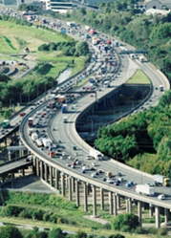
TRANSFORMING
THE ESSEX THE ESSEX POLICE ESTATE
March 2015LICE ESTATE
TRANSFORMING
THE ESSEX POLICE ESTATE
March 2015

Slide 12

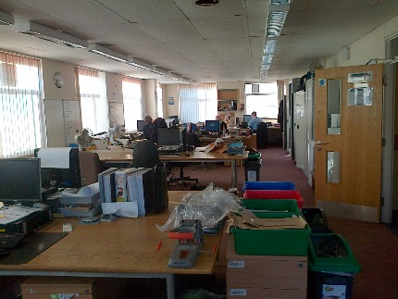
The Estate Challenge for Essex
In addition to being unaffordable, the size, age, nature and distribution of the Essex Police estate is not best able to support modern policing and the Force’s transformation programme
Over-sized – too big for current and future staffing
Under utilised - low levels generally
Poor quality - by modern accommodation standards
Fragmented – too many small, dispersed assets
Inefficient – highly cellular and inflexible
Unaffordable – significant future R&M liabilities
Logistics issues – storage, parking,
Compliance – access, custody, building performance
Resilience – single points of failure
The Force recognise a significant intervention is needed to overcome the existing estate constraints and unlock its potential

Slide 13
Key Themes
The Force is undergoing significant change influencing future estate needs – public contact, custody, forensics, transport, training and support services form integral work streams of the Strategic Change Programme
Key Influences
Operational Need – demand; operational structure
Agile Working – greater use of technology
Collaboration – multi-agency assets, shared services
Public Access – multi-channel, CRM system
Rationalisation – fewer more effective strategic locations
Improvement – better quality, flexible accommodation
Affordability - sustainable energy efficient buildings
Flexibility – assets that can readily change and adapt to the Force need

Slide 14
Existing Estate Configuration
The existing estate is highly diverse in nature representing over one hundred years of piecemeal evolution. Inefficient by almost every measure, very few assets would be buildings of choice today
Estate Metrics
Over 80 properties
Over 1,000,000 sq/ft
85% freehold
Dated, cellular accommodation
HQ makes up 25% of the estate
Police stations comprise more than 55%
Over £10m annual running costs
Significant lifecycle investment needed
£5.5m backlog maintenance
Net to gross of 70% (inefficient)
Extra £1.75 million per annum required to “stand still”
The estate is highly fragmented with sixty of the eighty buildings making up less than 20% of the estate (20 buildings comprise 80%).

Slide 15
Financial Considerations
Portfolio change must be affordable in both capital and revenue terms. The Force is seeking to finance the necessary investment from capital receipts, ideally with a positive balance. Mortgaging the investment is not a preferred option (PFI)
Doing nothing is not an option
Over £5m backlog maintenance
C.£10m existing annual operating cost
Plus £30m just to ‘stand still’ in medium / long term
Estate Value
Portfolio valued at £55m - £70m
Half of portfolio value in only 2 assets
Further 14 assets valued at £4m - £6m
Concerns
Selling the ‘family silver’
Significant future R&M liabilities need to be avoided. Retaining an interest in the redevelopment of the surplus estate also presents opportunities to generate long term revenue income

Slide 16
Summary
Delivers a 21st Century policing service that provides access and reassurance to our communities and addresses victims needs
Key Decisions.- 2015
Location of HQ
Size of HQ
Location of Hubs
Size of Hubs
Location of Local Contact Centres
Custody Strategy
Specialist Centre locations
Targets
40% reduction in estate gross area
£2.5m annual property savings on £9m baseline
Avoidance of £multi R&M costs
Viable long term estate
Leaner, higher quality, flexible and ‘future-proofed’
Enhanced collaboration - force and other agencies
Good quality core assets with granular local flexibility
More effective policing outcomes
Supports and facilitates regeneration

Slide 17
Essex Police Challenge Meeting
12th March 2015

